Slide 1
Internet Domain And
Domain Name System
Presented by :Rupak Poudyal

Slide 2
Internet Domain
Identification string that defines a realm of administrative autonomy, authority, or control on the Internet
Formed by the rules and procedures of the Domain Name System (DNS).
Represents an Internet Protocol (IP) resource

Slide 3
Levels of Domain Name
Organized in subordinate levels (subdomains) of the DNS root domain
Top-Level Domain
Second-Level Domain
Third-Level Domain

Slide 4
Top-Level Domain
Domains at the highest level in the hierarchical Domain Name System
Installed in the root zone of the name space
Last part of the domain name
Types:
Country code top-level domains (ccTLD)
Generic top-level domain (gTLD)

Slide 5
Country code top-level domains
(ccTLD)
Reserved for a country, sovereign state, or dependent territory identified with a country code.
Extension based on the ISO 3166-1 alpha-2 country codes

Slide 6
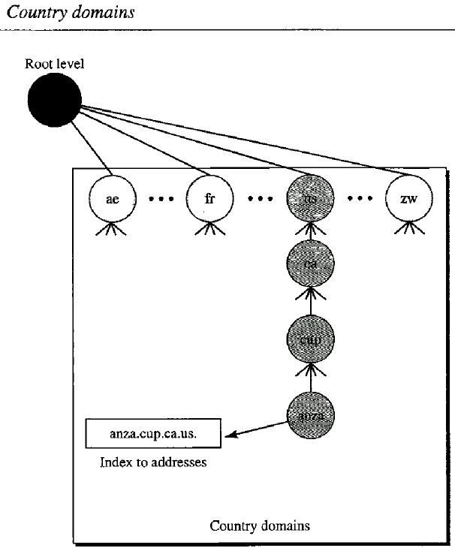

Slide 7
Generic top-level domains
(gTLD)
Identifies TLD generically as associated with some domain class
Define registered hosts according to their generic behavior.

Slide 8
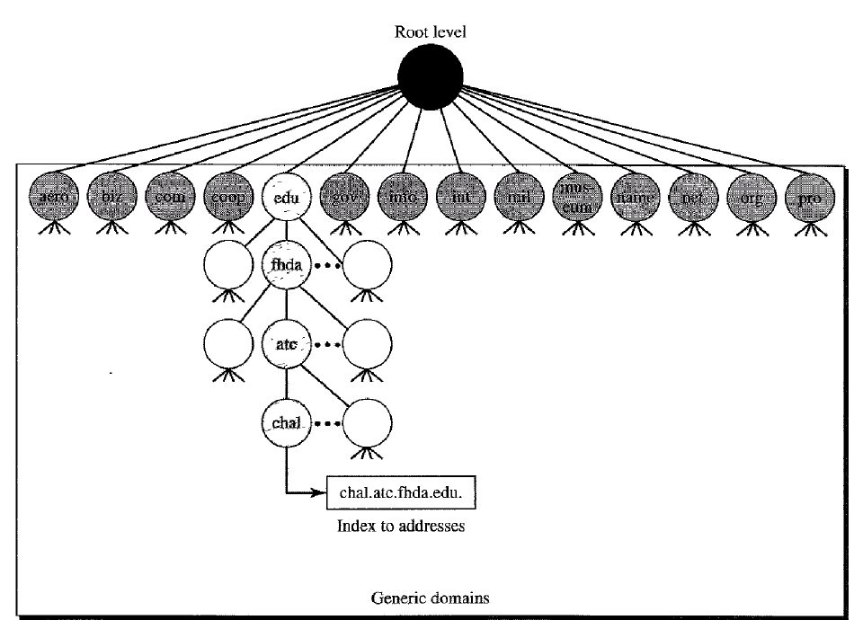

Slide 9
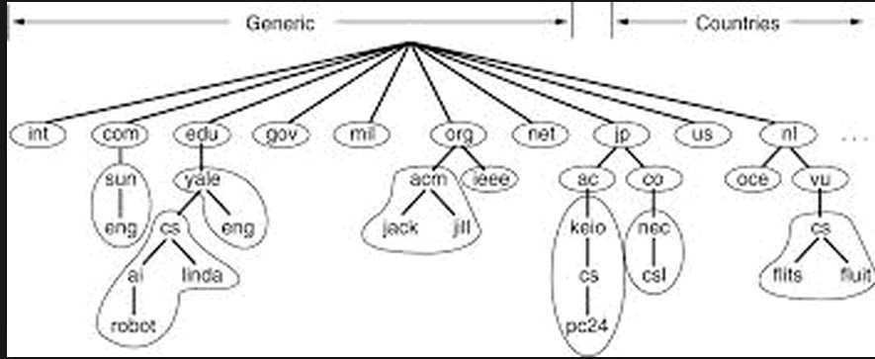

Slide 10
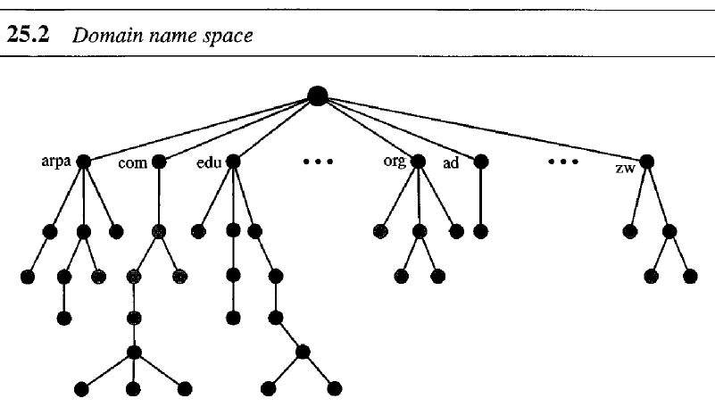
Domain Name Space
When we have hierarchical name space, a domain name space to be designed.
In that tree names are defined in an inverted-tree with one root at the top.
The tree can have only 128 levels. Level 0(root) to level127
•
•
•
•

Slide 11
Label
Each node in the tree has a label, maximum of 63 characters.
•
which is a string with a
•
The root label is a null string(empty).

Slide 12
Domain Name System
Follow the client/server paradigm.
A hierarchical, domain-based naming scheme and a distributed database system for implementing this naming scheme
Resolves queries for these names into IP addresses
Each domain has unique IP addresses

Slide 13
Forward Lookup
Using an Internet domain name to find an ip address
More common lookup

Slide 14
Reverse Lookup
Determine the domain name associated with an IP address
Uses PTR records
Involves searching domain name registry and registrar tables

Slide 15
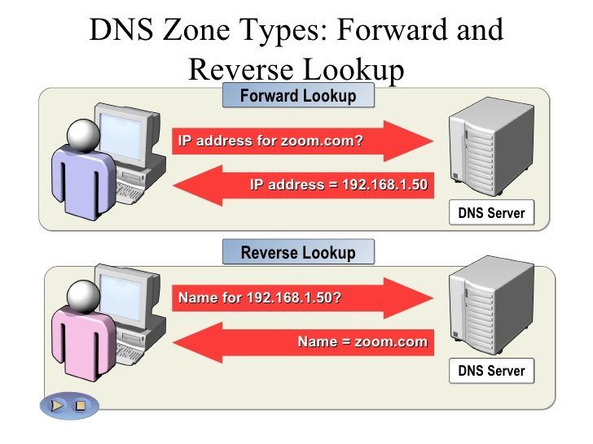

Slide 16
Thank You

