Slide 1

Centralized CIP Physical Inventory System Web
24A Bright Project – BP2
Toshiba Information Equipment (Phils.), Inc.
09.30.2024
Scope of Disclosure | within TIP only
Information Owner | ISD

Slide 2
TIP FY2024 CTQ
TIP Vision
“To be the No. 1 Total Storage Company in the World”
Key Policy
TRANSFORM TIP in the NEXT 5 YEARS
TIP’s CTQ
Flexible Factory Utilization & Organization
Strengthen Technological Capability
Transform
TIP Culture
FY24
Strategies
Factory Utilization
Acquire Core Technology Capability
Uplifting TIP Culture
(Pro-learning mindset,
Innovation thru BRIGHT, TPM, TPIE)
Agile Operation
& Management
(Man, Machine, Process, Facility)
Flexible & Low-Cost Operation
(Cost Reductions, Capacity Achievement & IT-Driven Improvements)
Expand Quality & Engineering Capability
(Job Enhancement & Enrichment)
(New Model EVT/DVT & Launch)
Invigorating, Healthy & Safe Work Environment
(Productivity, Engagement, Retention)
Adaptable Supply Chain Management
(Supply, Inventory)
Speedy New Model Development & Transition to Masspro
Expand Human Development
(Competency Building & Specialization)
Nurture TIP
Next Generation Leaders & Employees
Organization
Strategic Functional Organization
Effective Utilization
of Resources
Pursue
TIP Autonomy
Enhanced
People Program
(Employee Experience & Motivation)
(Work Style Innovation)

Slide 3
Team Profile
Project Leader: Gerald Jan Balverde
Team Members:
Jonathan Gaygon (IS3 – Portal Team)
Raymart Salvador (IS3 – Portal Team)
Gil De Villa (IS3 – PRAS Team)
James Paul Antonio (IS3 – PRAS Team)
Therese Eleonor Villapando (PPD3)
Catherine Publico (PPD3)

Slide 4
OUTLINE
01
Project Background
02
PLAN Phase
03
DO Phase
04
CHECK Phase
05
ACT Phase

Slide 5
Project Background
During EHD physical inventory, uploading of data is consuming several hours by using 6 applications resulting of serious discrepancies during validation after data consolidation. However, for the past 4 semesters, it is observed that EHD PI takes about an average of 22 hours inventory time. This affects the efficiency & operation time of conducting PI and affects the resumption of production output.
6
5
5
4
4
4
4
4

Slide 6
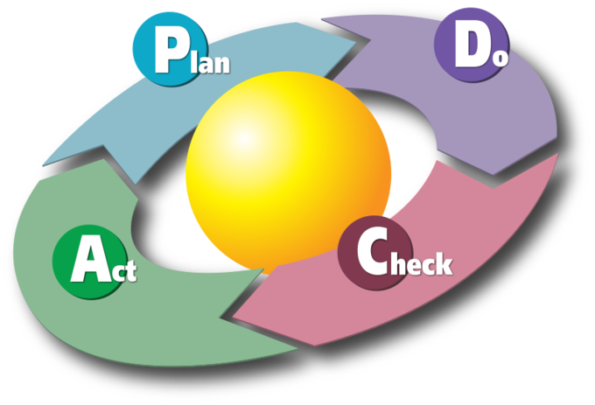
PLAN PHASE
PROBLEM STATEMENT
Since 2017, PPD is using 6 .NET applications for printing of tags and uploading of eHDD physical inventory data per modules from MySQL up to Oracle database for data processing and consolidation. Using these applications needs pre-requisite applications and configurations in able to run completely and conserves CPU utilization to Person-In-Charge PC upon uploading due to how big is the data being uploaded and sometimes the uploading will result to failure and cause significant discrepancies.
GOAL STATEMENT
To improve Physical Inventory hours from (22 hrs. - 19% higher) → (18 hrs. - target) in 24B.
METRIC GOAL
System Support in Physical Inventory (hrs.): FY 23: 4hrs. → FY 24B: 1 hr. or less.
TARGET SAVINGS
Annual Soft Savings: $ 0.242K / Year

Slide 7



PLAN PHASE
PLAN / FOCUS : To shorten the Physical Inventory hours from an average of 22 hrs. to 18 hrs.

Slide 8
PLAN PHASE
PROBLEMS IDENTIFIED:
Person-In-Charge PC is not configured completely to run the .NET application uploaders.
If configured, some Person-In-Charge experience of long waiting time for the uploading to be completed (application crash – high CPU utilization) resulting for discrepancies (data not all uploaded).
Wrong usage of .NET application uploader version.
Different version of .NET application uploader was used in the Person-in-Charge PC’s.

Slide 9
PLAN PHASE
PLAN/ANALYZE
Important Factors are the following:
1 : Checking of Person-In-Charge PC
Confirm if the Person-In-Charge PC is configured completely and ready to use the .NET application uploaders.
2 : Validation of .NET application version
Ask and check if the latest .NET application uploader version is currently installed on the Person-In-Charge PC.

Slide 10



DO PHASE
Current Process Flow
Person-In-Charge is currently using 6 different .NET Application for Tags Printing & Uploading EHD Physical Inventory Data on which still needed to install pre-requisite applications and configurations
to run it completely that sometimes resulting to data discrepancy, error occurrence or the Person-In-Charge PC fail / crash due to high CPU Utilization usage during data uploading processing.
6 different .NET applications for EHD Physical Inventory Uploading and Tags Printing.
Uploaded in Oracle Database for data processing
Data Processing and Count Consolidation

Slide 11

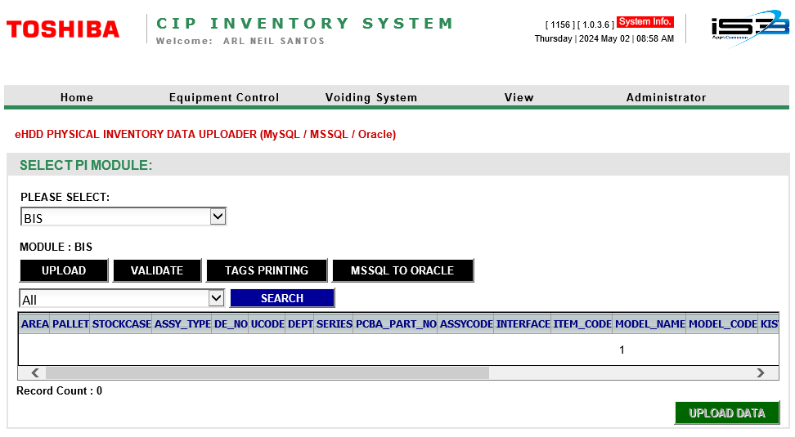
DO PHASE
Improved Process Flow
Person-In-Charge may use the new enhanced Centralized CIP Inventory Application Web System for the Tags Printing and Data Uploading. To where the current 6 .NET Applications features are being integrated and consolidated into one Webpage, also this is to prevent the occurrence of high CPU usage during tags printing, data uploading, eliminate data discrepancy and avoid wrong version usage of the uploader application.
Integrated the 6 .NET Application Uploaders in the Centralized CIP Inventory System Web
Uploaded in Oracle Database for data processing
Data Processing and Count Consolidation

Slide 12
CHECK PHASE
CIP Inventory System Web
FUNCTIONS | IMPACT
Can be used by a any user/s registered in the Web Application by the Administrator/Owner. | Fast and easy registration access and usage unlike in the 6 .NET Application Uploaders.
Use the designated CPU of Application Server to eliminate the high CPU Utilization usage on the Person-In-Charge PC during Tags Printing and Data Uploading. | Avoidance of application failure / crash in Person-In-Charge PC and avoid data discrepancy during Tags Printing and Data Uploading.
Eliminate the frequent installation of pre-requisite applications and configurations for Person-In-Charge PC. | One time setup for the migration of the enhanced CIP Inventory System Web.
Application version will be easily controlled and ensure to be the latest. | Eliminate the usage of wrong / old version of applications.

Slide 13
ACT PHASE
Activity Plan
24A Activities | Jun-24 | Jul-24 | Aug-24 | Sep-24 | Oct-24 | Nov-24
Planning and Design | ⬧
Development and Testing |  | ⬧ | ⬧
Debugging & Evaluation |  |  | ⬧ | ⬧
Partial Implementation |  |  |  | ⬧
Monitoring & Improvement |  |  |  |  | ⬧ | ⬧
Full Implementation |  |  |  |  |  | ⬧

Slide 14
CONCLUSION
Summary
TIP ISD was able to improve an easy and maintainable application from 6 .NET Uploader Applications into 1 Web System that does not need any pre-requisite application installation and configuration. Eliminating the need to troubleshoot many applications thus reducing the system support needed.
Key Innovation
Implemented a Web System that can be maintain by the current resource members.
Easy to be use and access by any authorized users.
Future Plan
Study on how to apply same improvement approach into other site Physical Inventory System (Mobile and Annex) for a maintenance free application deployment & usage.
Notes:
- Add in Future Plan that currently, only HDC can register PCBA parts, and in the future, we plan to add other departments.

