Slide 1
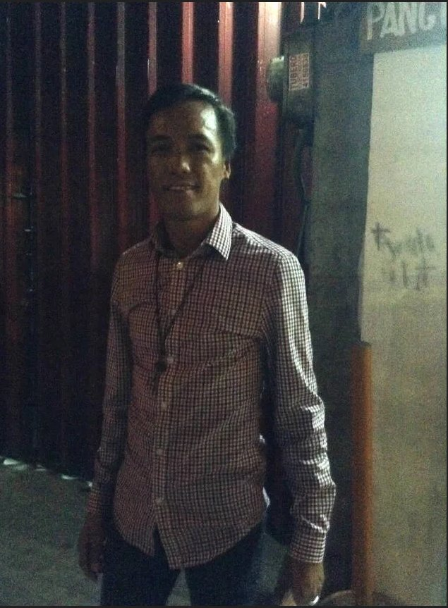

Slide 2
Junnie Mallari

Slide 3
Junnie Mallari
He was on a ledge just in front of the DJ’s booth dancing along with his friends, unaware of the tragedy that was about to happen.
Shortly before midnight, there was a spark at the booth. Then a fire broke and spread through the ceiling.
While some people thought it was part of the disco’s “special effects”, Mallari already knew something was wrong.
Someone shouted there was a fire. Then there was commotion.
He jumped and rushed towards the door, which was already full of people trying to get out of the room.
The fire engulfed the whole room really fast, he said. And as people tried pushing their way through the door, the harder it was to get out because the door could only be opened inwards.
“Nakikipagsiksikan ako. Hanggang sa hindi ko na kaya, huminto na kami kasi hindi na… trapped na kami,” he said. (I pushed myself through the thick crowd until I couldn’t anymore. We stopped because we were already trapped.)
After several tries, he reached the door, but was already too weak. Around him were his co-dancers, lying on the floor, not breathing. He remembered closing his eyes and giving up.
“Lord, kayo na pong bahala,” he prayed. (Lord, everything’s up to you.)
Then just like a miracle, he said, he felt something cold in his arms. “Pagchill nito [mga balikat ko], biglang parang nahampas ko yung handle ng pintuan,” (When I felt something cold in my ams, it felt like I hit the door handle.)
He was able to get out of the room.
He survived, his body suffering from third-degree burns. He lost an ear and 16 friends.

Slide 4
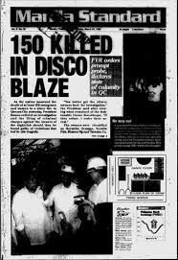
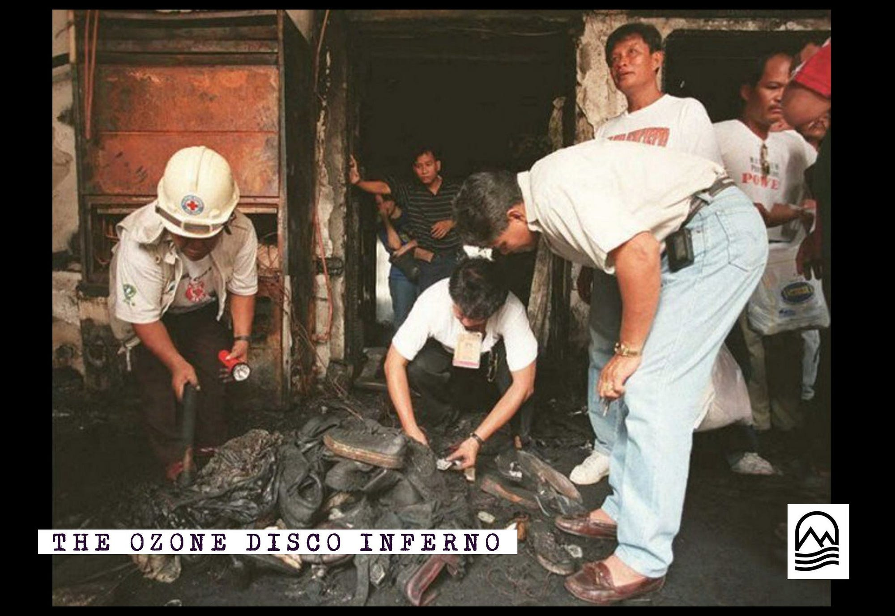

Slide 5
