Slide 1
Descripton de la donnée | Type | Longeur | Exrmple | Nom de la colonne | Contrainte/règle de calcul
Id ecole | Int | 100 | 1 | eco_id | Obligatoire automatique
Nom Encole | Varchar | 100 | lestang | eco_nom | obligatoire
Id classe | Int | 100 | 1 | cla_id | Obligatoire automatique
Nom Classe | Varchar | 25 | ce1 | cla_nom | obligatoire
Id commande | Int | 100 | 1 | com_id | Obligatoire automatique
Date | Date | 10 | 31/12/2022 | com_date | Automatique Obligatoire
Repas normaux | Int | 3 | 35 | com_repa
Repas sans gluten | Int | 3 | 35 | com_glu
Repas sans porc | Int | 3 | 35 | com_porc
Repas végétariens | Int | 3 | 35 | com_vege
Repas sans laitages | Int | 3 | 35 | com_lait

Slide 2
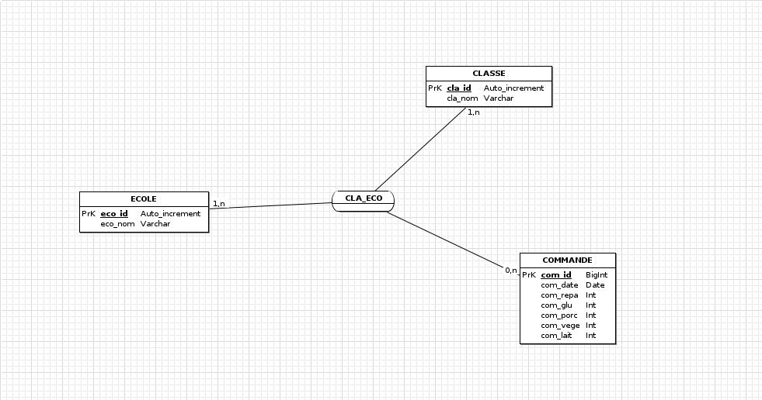

Slide 3
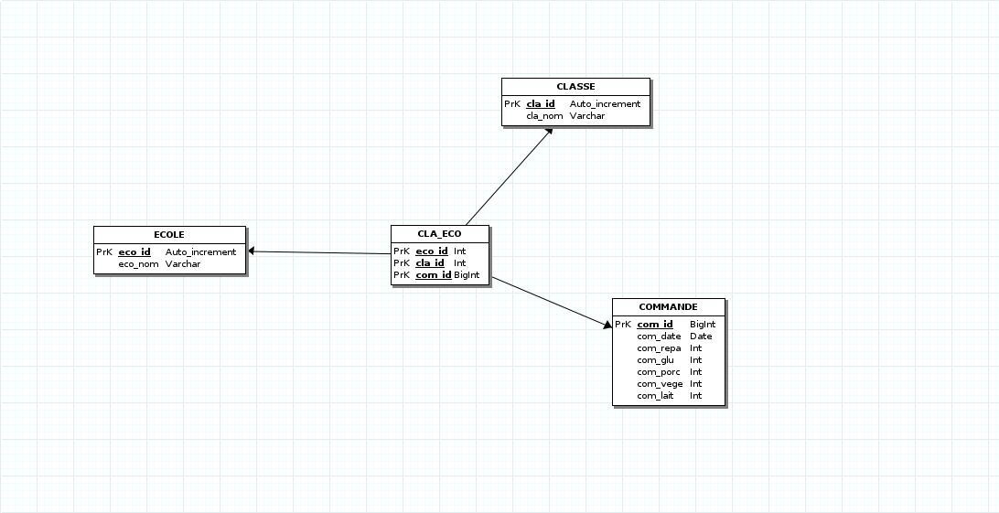

Slide 4
------------------------------------------------------------
-- Script Postgre
------------------------------------------------------------
------------------------------------------------------------
-- Table: ECOLE
------------------------------------------------------------
CREATE TABLE public.ECOLE(
eco_id SERIAL NOT NULL ,
eco_nom VARCHAR (25) NOT NULL ,
CONSTRAINT prk_constraint_ECOLE PRIMARY KEY (eco_id)
)WITHOUT OIDS;
------------------------------------------------------------
-- Table: CLASSE
------------------------------------------------------------
CREATE TABLE public.CLASSE(
cla_id SERIAL NOT NULL ,
cla_nom VARCHAR (25) NOT NULL ,
CONSTRAINT prk_constraint_CLASSE PRIMARY KEY (cla_id)
)WITHOUT OIDS;
------------------------------------------------------------
-- Table: COMMANDE
------------------------------------------------------------
CREATE TABLE public.COMMANDE(
com_id ,
com_date DATE NOT NULL ,
com_repa INT NOT NULL ,
com_glu INT ,
com_porc INT ,
com_vege INT ,
com_lait INT ,
CONSTRAINT prk_constraint_COMMANDE PRIMARY KEY (com_id)
)WITHOUT OIDS;
------------------------------------------------------------
-- Table: CLA_ECO
------------------------------------------------------------
CREATE TABLE public.CLA_ECO(
eco_id INT NOT NULL ,
cla_id INT NOT NULL ,
com_id ,
CONSTRAINT prk_constraint_CLA_ECO PRIMARY KEY (eco_id,cla_id,com_id)
)WITHOUT OIDS;
ALTER TABLE public.CLA_ECO ADD CONSTRAINT FK_CLA_ECO_eco_id FOREIGN KEY (eco_id) REFERENCES public.ECOLE(eco_id);
ALTER TABLE public.CLA_ECO ADD CONSTRAINT FK_CLA_ECO_cla_id FOREIGN KEY (cla_id) REFERENCES public.CLASSE(cla_id);
ALTER TABLE public.CLA_ECO ADD CONSTRAINT FK_CLA_ECO_com_id FOREIGN KEY (com_id) REFERENCES public.COMMANDE(com_id);

