Slide 1
High Performance Matrix Multiplication
Ardavan Pedram
perdavan@stanford.edu
Notes:
This is Ardavan Pedram presenting the first version of the linear algebra processor simulator.
This project was part of my PhD project in UT Austin and the Flame group.
My Supervisors were Professors Robert van de Geijn and Andreas Gerstlauer.

Slide 2
References
BLIS: A Framework for Rapid Instantiation of BLAS Functionality, Van Zee et. al.
Anatomy of High Performance Matrix Multiplication, Goto et. al.
An Experimental Comparison of Cache-oblivious and Cache-conscious Programs, Yoto et. Al.
Automated Empirical Optimization of software and the ATLAS Project, Whaley et. Al.
Codesign Tradeoffs for High-Performance, Low-Power Linear Algebra Architectures, Pedram et. al.

Slide 3
Memory Hierarchy

Slide 4
Memory Hierarchy
Most programs have a high degree of locality in their accesses
spatial locality: accessing things nearby previous accesses
temporal locality: reusing an item that was previously accessed
Memory hierarchy tries to exploit locality
processor
control
Second level cache (SRAM)
Main memory
(DRAM)
Secondary storage (Disk)
Tertiary storage
(Disk/Tape)
datapath
registers
on-chip cache
Speed | 1ns | 10ns | 100ns | 10ms | 10sec
Size | B | KB | MB | GB | TB
Source: www.cs.berkeley.edu/~yelick/cs267_spr07

Slide 5
Insight
Why does block matrix multiply reduce the number of memory references?
The performance of any algorithm is limited by q
q = # flops / # memory refs = “Computational Intensity”
In matrix multiply, we increase q by changing computation order
Reuse data in cache (increased temporal locality)
Source: www.cs.berkeley.edu/~yelick/cs267_spr07

Slide 6
Naïve Matrix Multiply on RS/6000
Page miss every iteration
TLB miss every
iteration
Cache miss every
16 iterations
Page miss every 512 iterations
Slide source: Larry Carter, UCSD

Slide 7
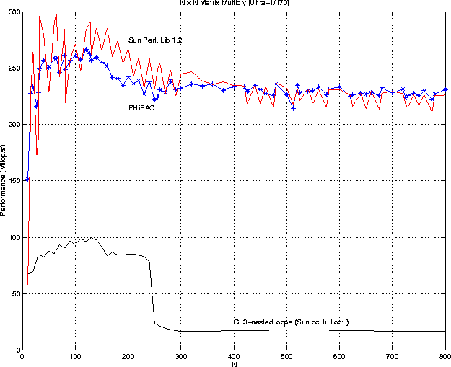
GEMM Naïve versus blocked
Speed of n-by-n matrix multiply on Sun Ultra-1/170, peak = 330 MFlops

Slide 8
Cache Oblivious Matrix Multiplication
Halve the largest of the three dimensions and recurs according to one of the three cases:
A(n×m) × B(m×p) = C(n×p)
m>= max{n,p}:
n>= max{m,p}:
p>= max{m,n}:
Source: www.cs.berkeley.edu/~yelick/cs267_spr07

Slide 9
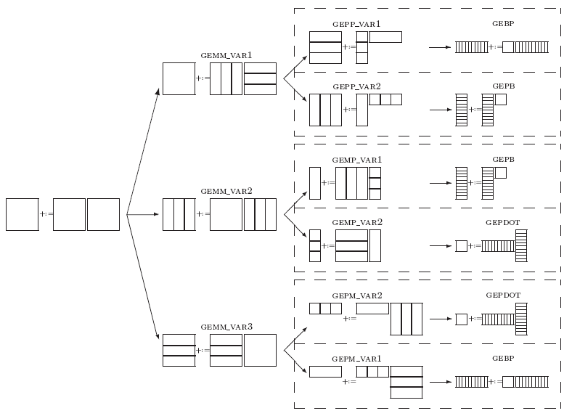
General Matrix-Matrix Multiplication (GEMM)
Blocked algorithm variants
Fastest general-purpose implementation [GotoBLAS]
C
+:=
A
×
B
C
Notes:
GEMM requires blocking that can be done in various ways
The best is the top branch implemented in GotoBlas and BLIS.
The choice is the same as what I independently arrived at.at.

Slide 10
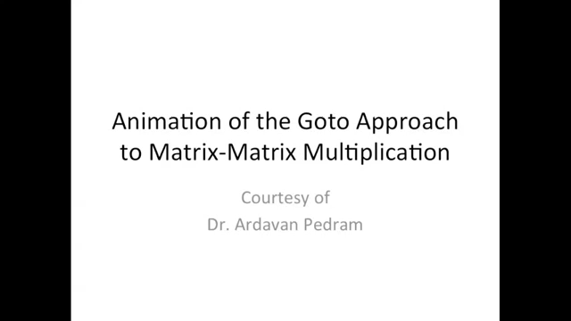
GEMM and Memory Hierarchy

Slide 11
The GEMM algorithm
+=

Slide 12
The GEMM algorithm
NC
NC
+=

Slide 13
The GEMM algorithm
+=

Slide 14
The GEMM algorithm
KC
KC
+=

Slide 15
The GEMM algorithm
+=

Slide 16
The GEMM algorithm
+=
Pack row panel of B

Slide 17
The GEMM algorithm
+=
Pack row panel of B
NR

Slide 18
The GEMM algorithm
+=

Slide 19
The GEMM algorithm
MC
+=

Slide 20
The GEMM algorithm
+=

Slide 21
The GEMM algorithm
+=
Pack block of A

Slide 22
The GEMM algorithm
+=
Pack block of A
MR

Slide 23
The GEMM algorithm
+=

Slide 24
Where the micro-kernel fits in
for ( 0 to NC-1 )
for ( 0 to MC-1 )
for ( 0 to KC-1 )
// outer product
endfor
endfor
endfor
+=

Slide 25
Where the micro-kernel fits in
for ( 0 to NC-1: NR )
for ( 0 to MC-1 )
for ( 0 to KC-1 )
// outer product
endfor
endfor
endfor
NR
+=
NR

Slide 26
Where the micro-kernel fits in
for ( 0 to NC-1: NR )
for ( 0 to MC-1 )
for ( 0 to KC-1 )
// outer product
endfor
endfor
endfor
+=

Slide 27
Where the micro-kernel fits in
for ( 0 to NC-1: NR )
for ( 0 to MC-1: MR )
for ( 0 to KC-1 )
// outer product
endfor
endfor
endfor
MR
+=
MR

Slide 28
Where the micro-kernel fits in
for ( 0 to NC-1: NR )
for ( 0 to MC-1: MR )
for ( 0 to KC-1 )
// outer product
endfor
endfor
endfor
+=

Slide 29
The gemm micro-kernel
NR
KC
NR
for ( 0 to NC-1: NR )
for ( 0 to MC-1: MR )
for ( 0 to KC-1 )
// outer product
endfor
endfor
endfor
MR
C
+=
A
B

Slide 30
The gemm micro-kernel
NR
KC
NR
for ( 0 to NC-1: NR )
for ( 0 to MC-1: MR )
for ( 0 to KC-1: 1 )
// outer product
endfor
endfor
endfor
MR
C
+=
A
B
β₀
β₁
β₂
β₃
Typical micro-kernel loop iteration
Load column of packed A
Load row of packed B
Compute outer product
Update C (kept in registers)
γ₀₀
γ₀₁
γ₀₂
γ₀₃
α₀
γ₁₀
γ₁₁
γ₁₂
γ₁₃
α₁
+=
γ₂₀
γ₂₁
γ₂₂
γ₂₃
α₂
γ₃₀
γ₃₁
γ₃₂
γ₃₃
α₃

Slide 31
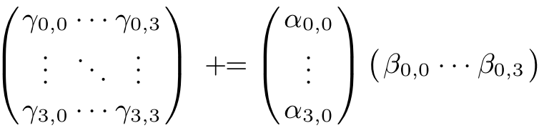
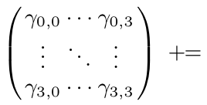
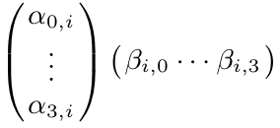
GEMM Kernel
Rank-1 update
Update matrix by adding outer product of two vectors to it
Matrix multiplication as a series of rank-1 updates
B
Let C, A, and B be 4x4, 4xk_{c}, and k_{c}x4 matrices.
C+=AB can be computed as:
for i=0 to k_{c}-1
end for
C
A
Notes:
At the bottom of the food chain
Inherently matmul can be composed of series of the Rank-1 updates.
Rank-1 Update is outer product of two vectors.
In particular a loop of rank-1 update both parallelizes computations and reduces memory traffic.
Because columns A and rows of B are streamed in and there is full locality for elements of C.
31

