Slide 1
Technical Reading Report Virtual Power: Coordinated Power Management in Virtualized Enterprise Environment
Paper by: Ripal Nathuji & Karsten Schwan from CERCS Research Center
Read by: Liang Hao

Slide 2
Motivations:
To make full use of ‘Soft’ scaling, TO CONSOLIDATE
Limited processor frequency states
But virtualization offers new opportunities for scaling the allocation of physical resources
Integrated power saving policy, TO COORDINATE
Building a tiered power management framework to integrate multiple power management mechanisms and policies
But still, ISOLATED
Without negating the nature of virtualization: isolation
Providing FLEXIBILITY
accept a variety of power management policies

Slide 3
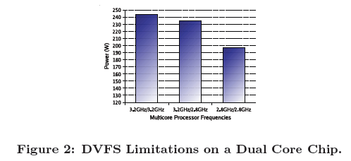
Challenges
Power management throws threatens on the independence and performance isolation properties of virtualization technologies.
ondemand, real-time.
Limitation of Hardware Management
hypervisor scheduling time granularity
multiple cores

Slide 4
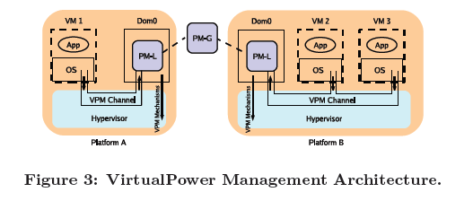
Solution: VirtualPower
Architecture:

Slide 5
VPM Architecture(1): VPM States
Exported to VMs as ‘soft’ states
Can be updated by VM’s own power management policy
Be transported by VPM Channels to VPM rules
VPM states are unified in multiple platforms so there is no need to alter VM’s power management policy if the VM is migrated to other platforms.
This quality maintains the isolation of VMs and does not lack consistency between the VM and hypervisor layer.

Slide 6
VPM Architecture(2): VPM Channels
Implemented using hypercalls and Xen event channels
VPM channels mainly take charge of delivering the message between VMs and Dom0
Here, Hypervisor would ignore the privileged requests by VM-level power policy, but Virtual Power will intercepts them through VPM channels as ‘hints’ provided to VPM rules and mechanisms to help make the final decision.
The benefit is, one request from a single VM would not directly influence the hardware environment and therefore keeps fault isolation.

Slide 7
VPM Architecture(3): VPM Mechanisms
Provide for information of underlying platforms to VPM rules
Deal with the diversity
Information includes the platform management options including hardware scaling, soft scaling, and consolidation.

Slide 8
Evaluation Methodology
Experimental Setup
Processors based upon the Intel Netburst microarchitecture, 3GB of memory, gigabit network cards, and 80GB hard drives. In terms of manageability, they support two physical operating modes for their processor cores: 3.2GHz and 2.8GHz.
Power data is obtained using an Extech 380801 power analyzer, which allows for out of band measurements via a laptop, thereby avoiding undesirable measurement effects on the system under test.

Slide 9
Guest Applications and Policies
Transactional Workloads
1. event queuing time often outweigh actual event processing time
2. arrival rates vary significantly over the course of a day
Tiered Web Service Workloads (RUBiS)
CPU utilization relates to current request behaviors and request arriving rates.

Slide 10
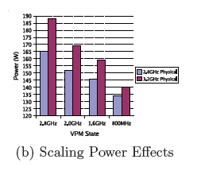
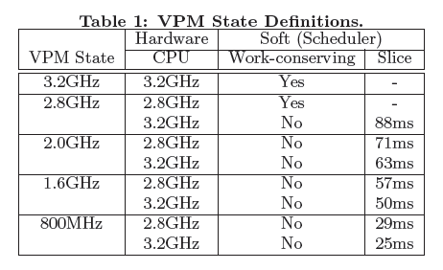
Viability of soft scaling
Combination of hardware and software scaling

Slide 11
Policy Based Coordination
PM-L Policies: Platform Management
PM-G Policies: Global Coordination

Slide 12

PM-L Policies: Platform management
PM-$L_{min}$
PM-$L_{throttle}$
PM-$L_{plan}$

Slide 13
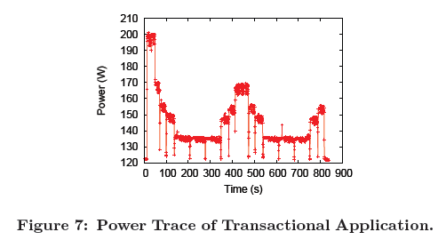
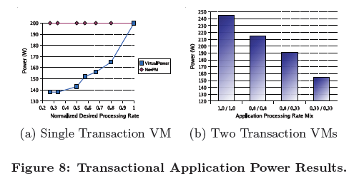

PM-$L_{min}(1)$

Slide 14
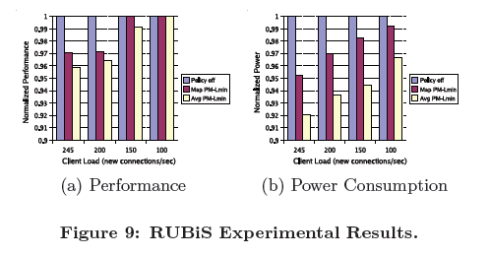

PM-$L_{min}(2)$

Slide 15
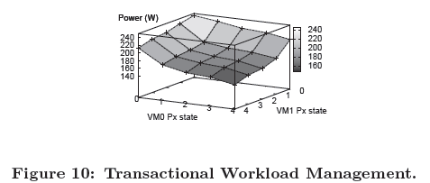
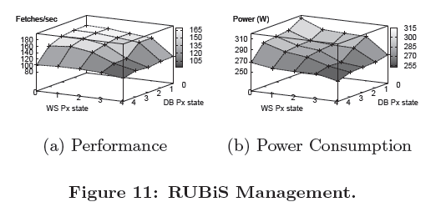

PM-$L_{throttle}$

Slide 16
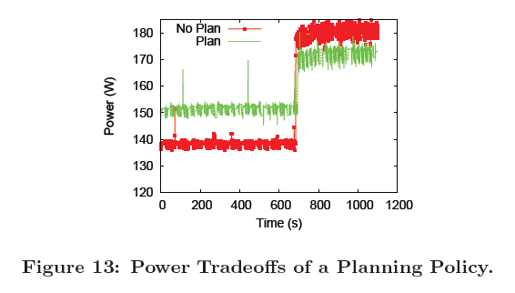

PM-$L_{plan}$

Slide 17
Conclusion
To present guest virtual machines with what appears to be a rich set of ‘soft’ power states accessible to their application-specific policies, termed VPM states, and then
To use the state changes requested by VMs as inputs to virtualization-level management policies.

Slide 18
What’s insight
State-guidance methodology
Choose typical samples for evaluation
Get down to lower layers, the lower, the stronger.

