Slide 1
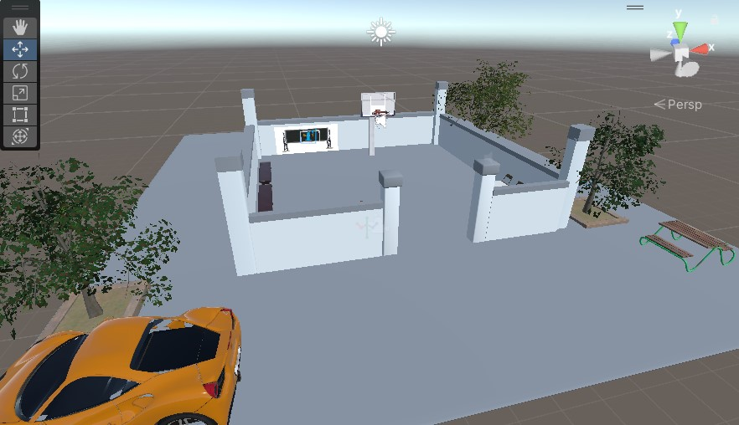
BasketVR Toss
A Casual VR Experience for Relaxation and Fun
Created By: Pouria Abtahi
Role: Game Designer and Developer

Slide 2
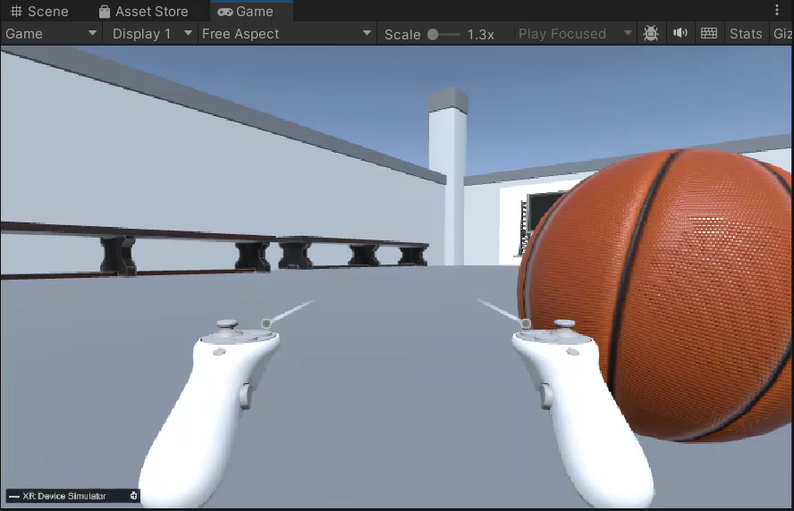
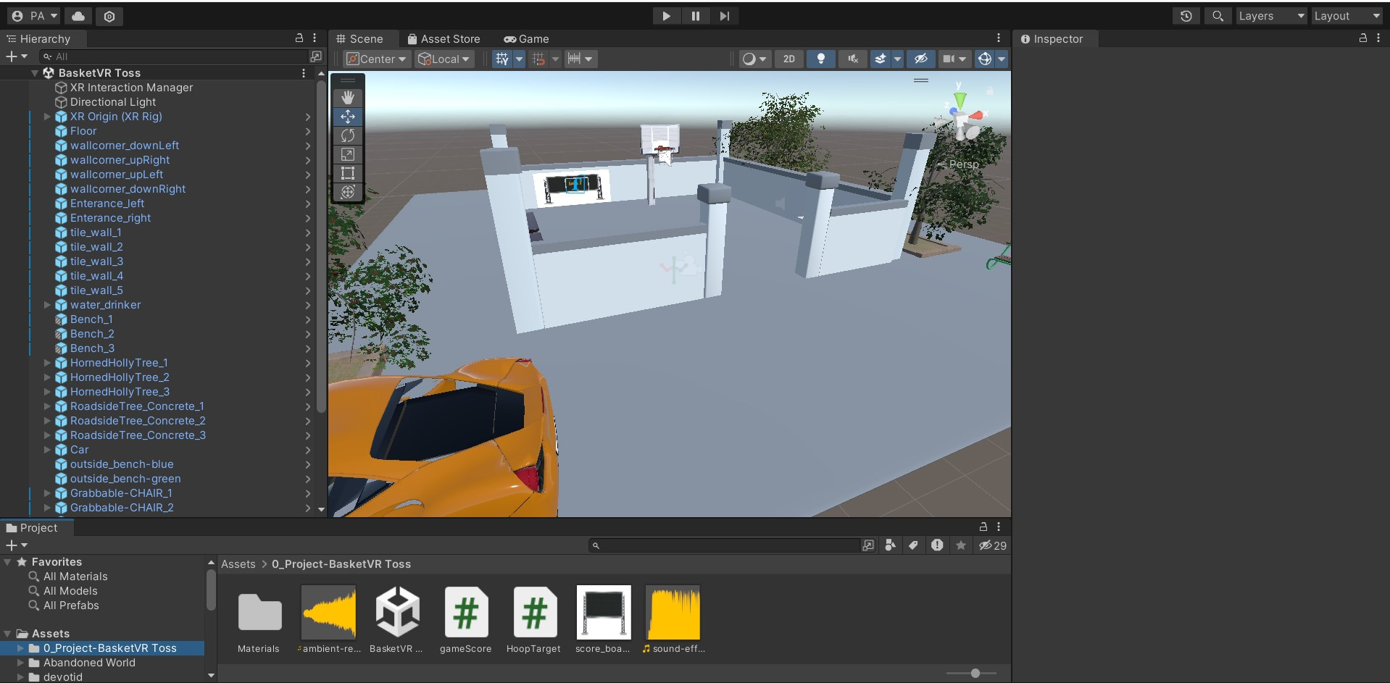

Introduction
Game Concept:
Objective:
BasketVR Toss is a VR game where players grab and throw basketballs into a hoop in a relaxing, stress-free environment.
To create a casual and immersive VR experience that emphasizes simplicity and fun.

Slide 3
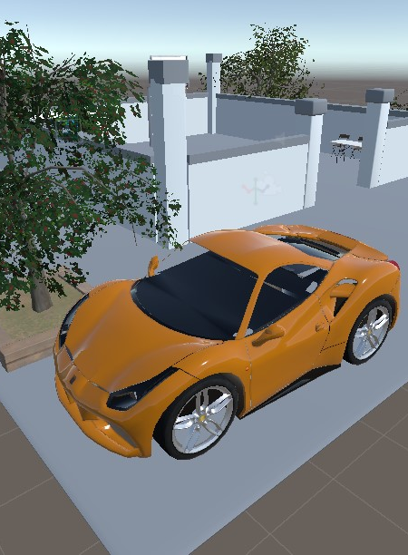
Game Design Process
Game Concept:
Interaction: Grabbable basketballs with realistic throwing physics.
Feedback: Positive audio and visual cues for scoring baskets.
Environment: A minimalistic and relaxing basketball court.
Grab a basketball, aim for the hoop and toss it.
Positive feedback encourages continued play.
Core Loop:

Slide 4
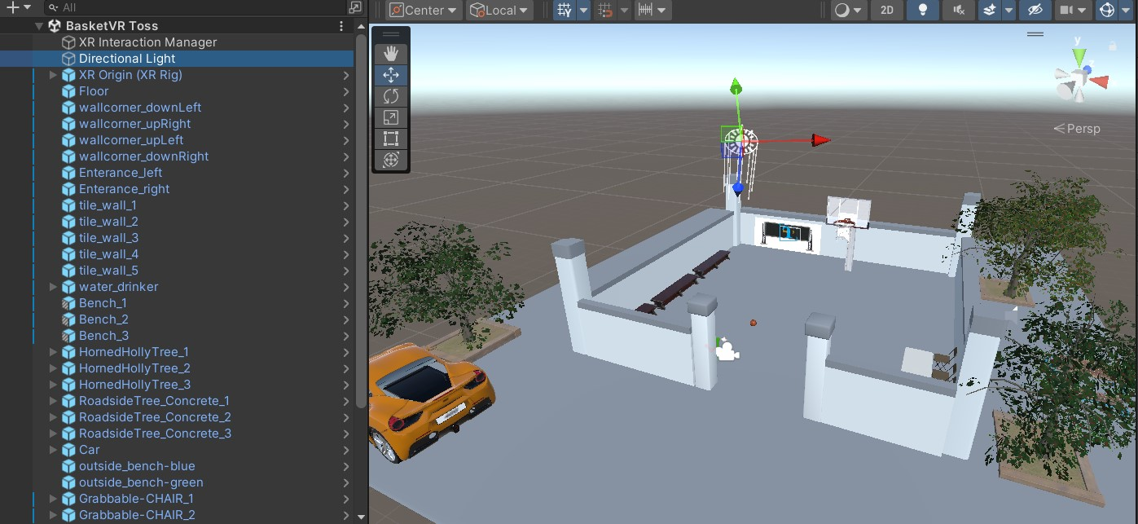
Development:
Environment Design
Environment Goals:
Create a relaxing basketball court with interactive elements
Key Features:
Solid floor and props like chairs and tables, trees, benches and a car.
Minimal distractions to maintain focus on gameplay.
Soft lighting for a calming aesthetic.

Slide 5
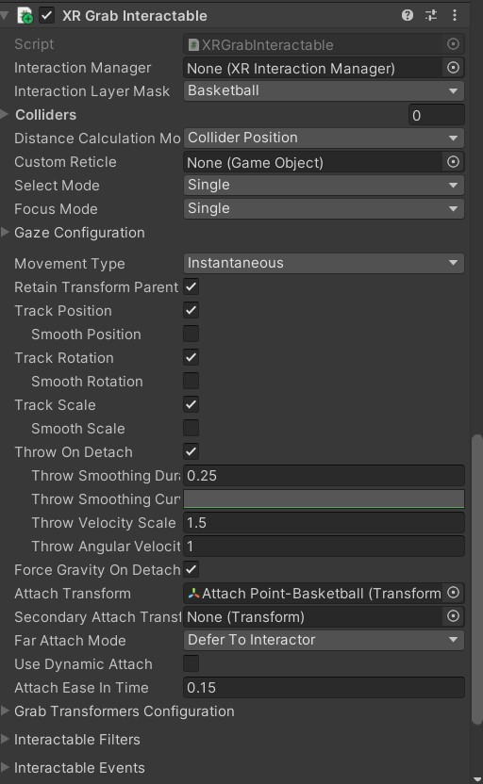
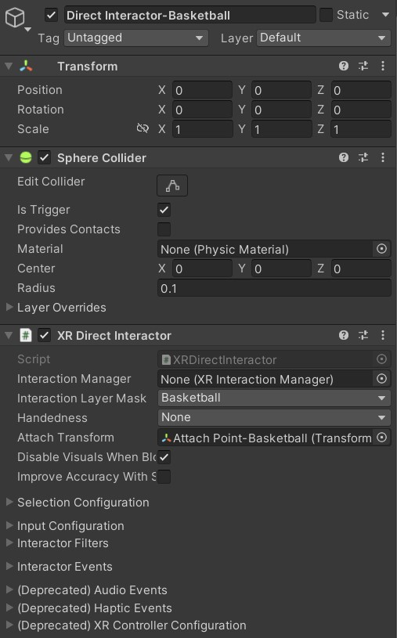
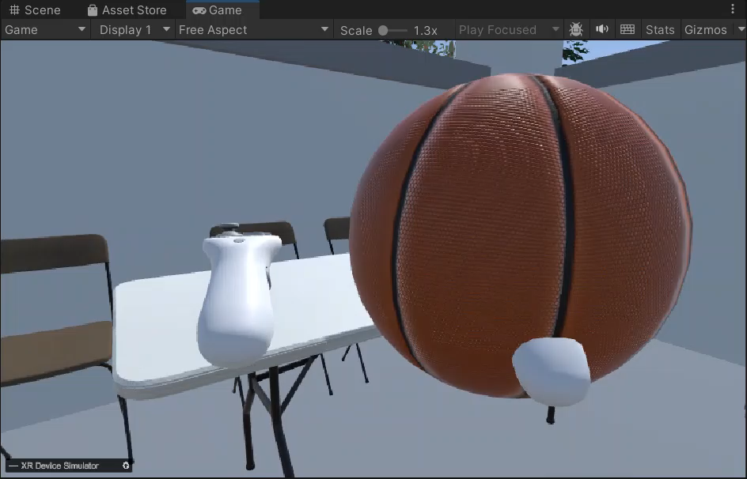
Development:
Mechanics Implementation
Key Mechanics:
Grabbable Basketball and chairs: Players can pick up basketball and chairs using VR
Item Placement:
Players can place basketball on a table or in a box for organizing within the playground.
Sockets enable smooth and intuitive placement of basketballs on the table or in the box, adding interactivity and personalization to the environment.
Realistic Throwing Physics: Physics-based interactions for natural throws.
Scoring System: Triggers detect when the basketball passes through the hoop, updating the score.

Slide 6
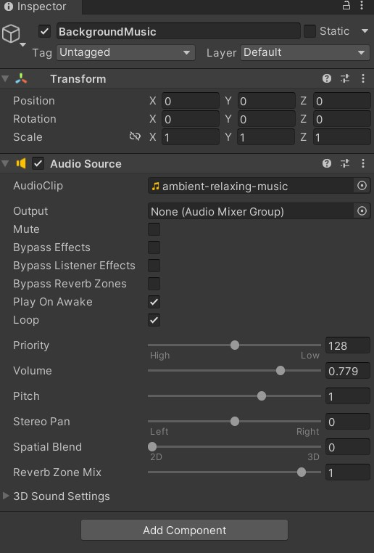
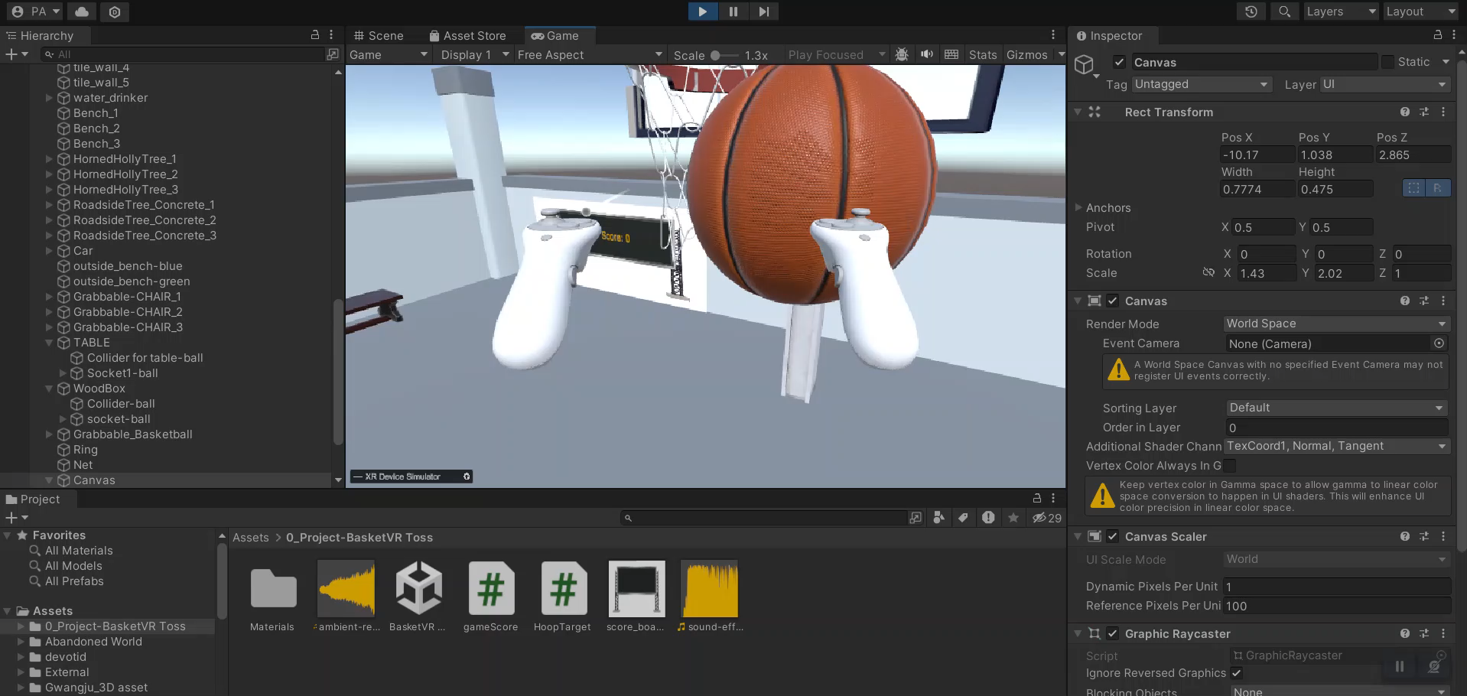
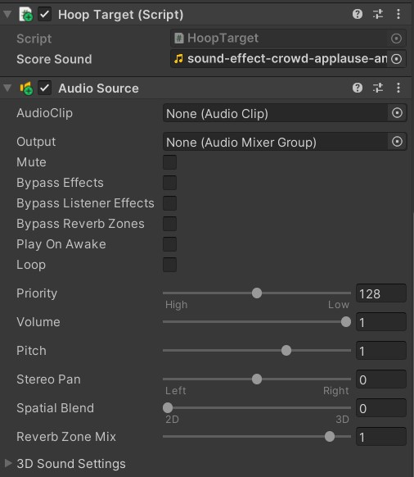
Audio and Feedback Design
Audio:
Ambient background music creates a calming atmosphere.
Cheerful sound effects play when a basket is scored.
Visual Feedback:
A world-space UI updates the score dynamically.

Slide 7
Challenges Encountered
Major Challenges:
Fine-tuning physics for consistent throwing mechanics.
Ensuring the trigger collider on the hoop reliably detected fast throws.
Integrating a responsive UI for score tracking.
Solutions:
Adjusted Rigidbody properties and refined trigger zones for accuracy.
Tested multiple UI placements to ensure visibility without distraction.

Slide 8
Notable Achievements
Accomplishments:
Created a relaxing and interactive VR environment.
Implemented intuitive grab-and-throw mechanics.
Added chair interactivity for enhanced immersion.
Integrated scoring feedback for a rewarding experience.

Slide 9
Conclusion
Summary: BasketVR Toss delivers a relaxing, immersive VR experience that focuses on fun and simplicity.
Key Takeaways: This project allowed me to refine my skills in VR development, physics-based interactions, and player-centric design.

Slide 10
Thanks!

