Slide 1
Data engineering
Implementation of LinkedIn Job Postings (2023 - 2024)
Professors: José Ramón Rios Viqueira
Anália Maria Garcia Lourenço
Guillermo de Bernardo Roca
Collector: Pouria Alvarzandi

Slide 2

About Dataset
Every day, thousands of companies and individuals use LinkedIn to find talent. This dataset includes over 124,000 job postings from 2023 and 2024, detailing along with company information.

Slide 3
Project Goals
For users find the best jobs suited to their conditions
For companies find ways to advance their goals
For assist researchers and journalists in using the data for articles

Slide 4
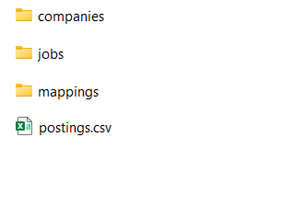
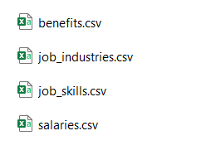
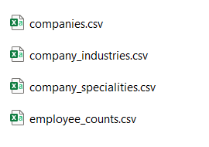
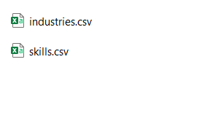
Data Sources
postings.csv
benefits.csv
job_industries.csv
job_skills.csv
salaries.csv
industries.csv
skills.csv
companies.csv
company_industries.csv
company_specialities.csv
employee_counts.csv

Slide 5
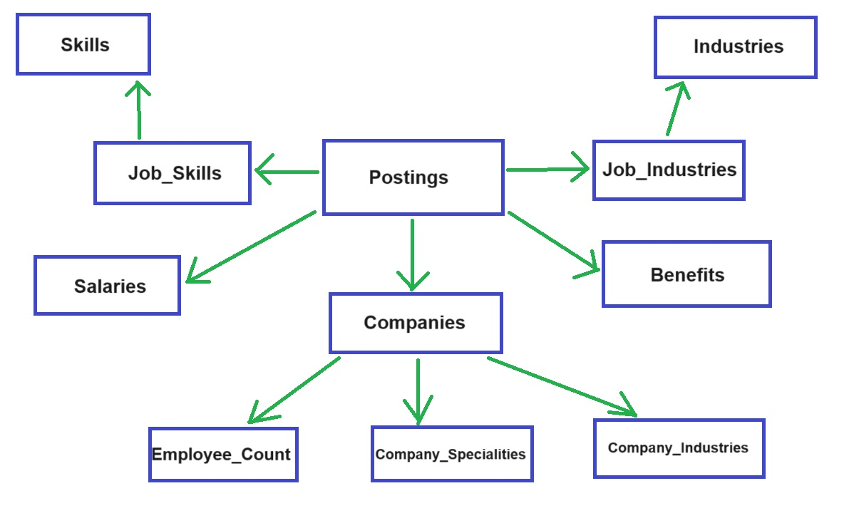
The relationships of Data sources

Slide 6
Materials and Methods
- Which jobs are remote?
- What benefits do the jobs offer?
- What is the payment structure for the jobs?
- What skills are required for the jobs?
- What type of work needs to be done for each job?
- What is the specialization of each company?
- Where are the companies located in terms of city, state, and country?

Slide 7
Materials and Methods
Postings
Companies
Benefits
Experience_Level
Pay_Period
Skills
Work_Type
Company_Details
Specialties
City
State
Country
Industries
Specialities
Company_Details

Slide 8
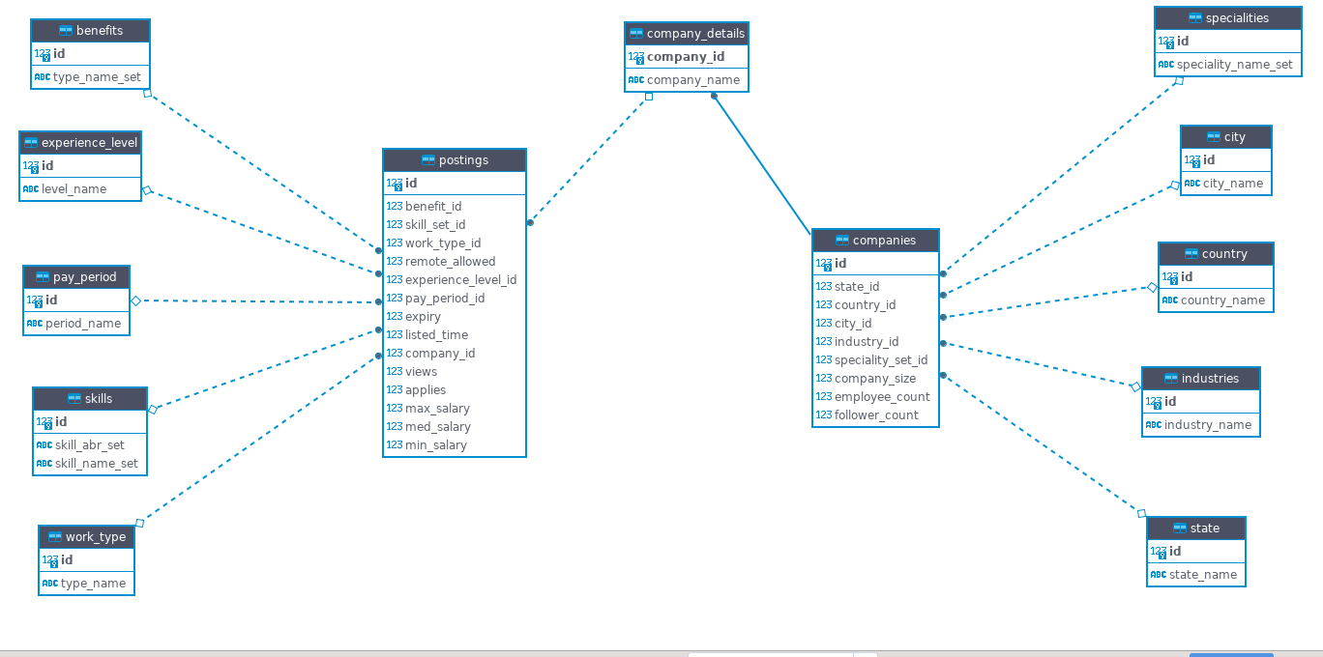
The overall schema design of the data warehouse tables

Slide 9
Workflow
First: Implementation of Dimensions
Second: Implementation of Companies
Third: Implementation of Company_Details
Forth: Implementation of Postings

Slide 10
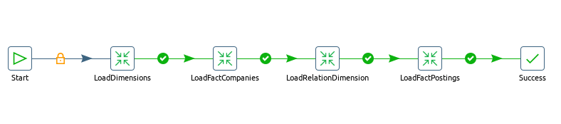
overall workflow
overall workflow of this project, which is implemented as a job

Slide 11
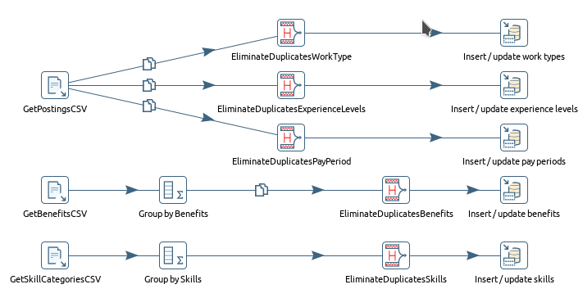
LoadDimensions Implementation
all the dimension tables related Postings are implemented

Slide 12
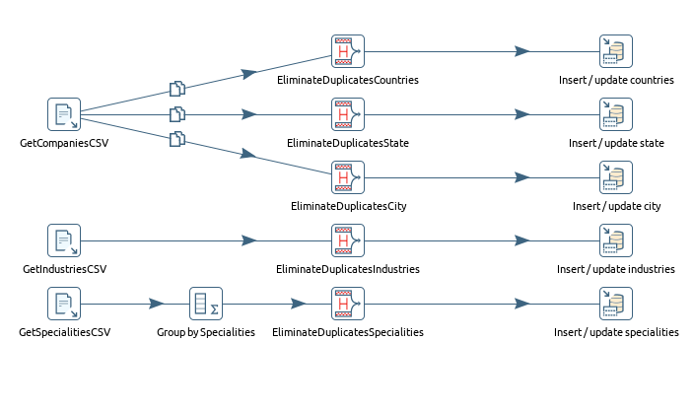
LoadDimensions Implementation
all the dimension tables related Companies are implemented

Slide 13
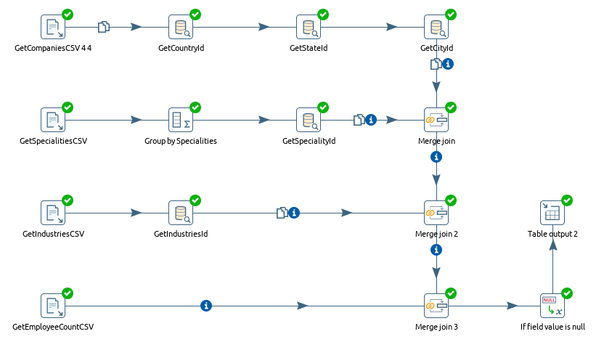
LoadFactCompanies Implementation
Companies fact table

Slide 14

LoadRelationDimension Implementation
Companies_Details - intermediate table between companies and postings

Slide 15
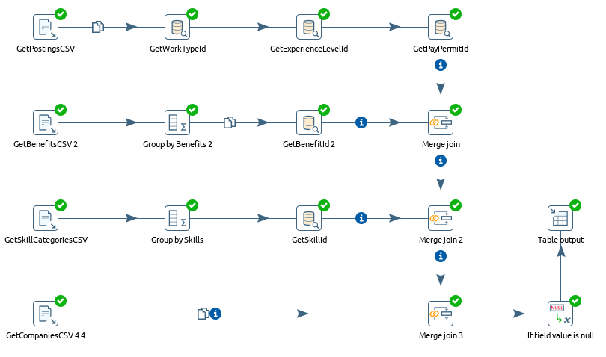
LoadFactPostings Implementation
Postings fact table

Slide 16
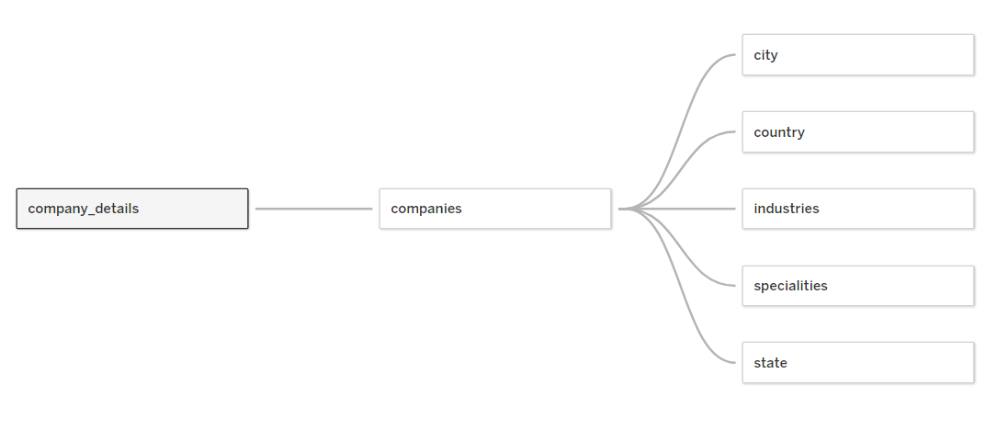
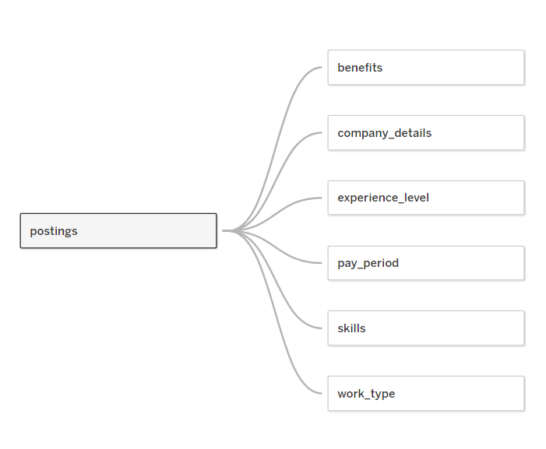
Analytical Queries and Results

Slide 17
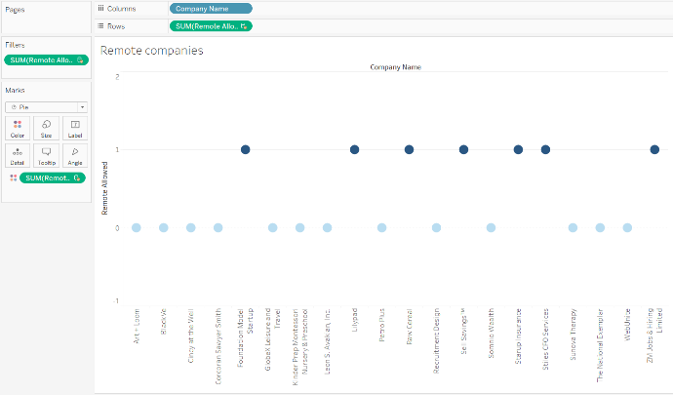
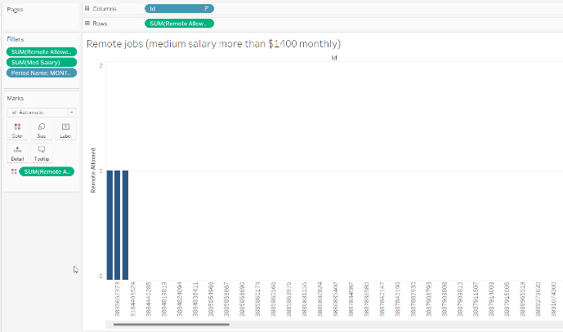
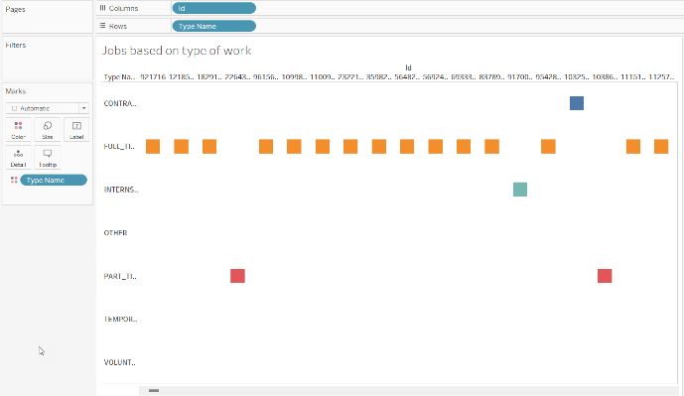
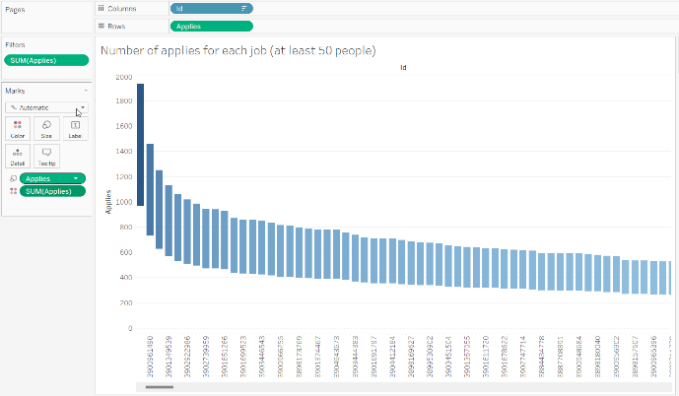
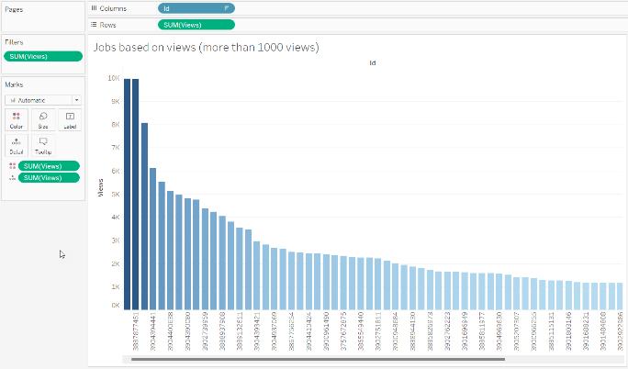
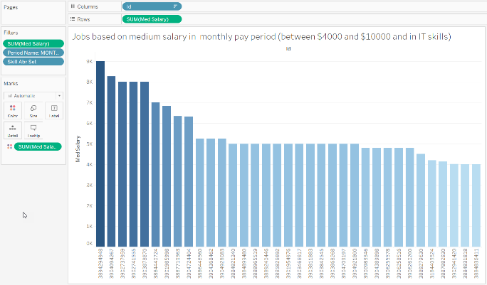
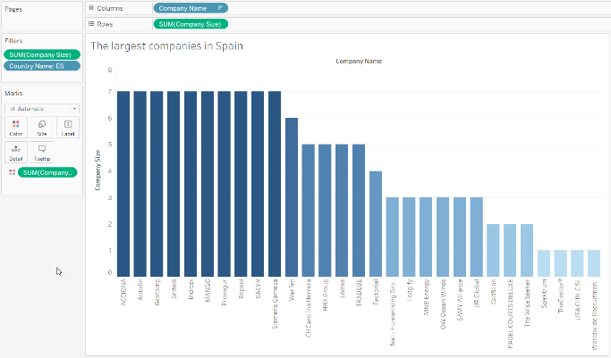
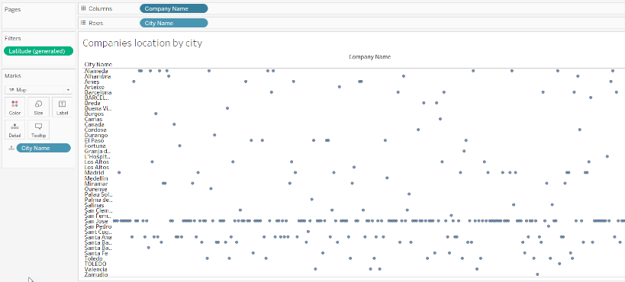
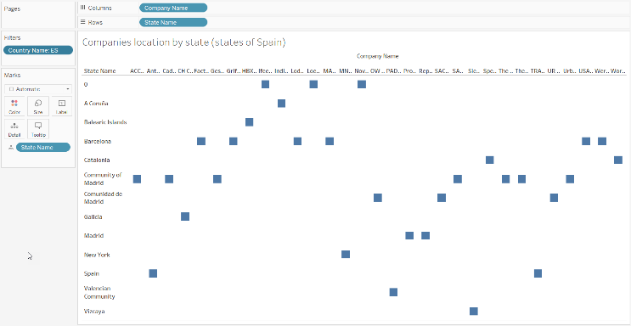
examples of reports

Slide 18
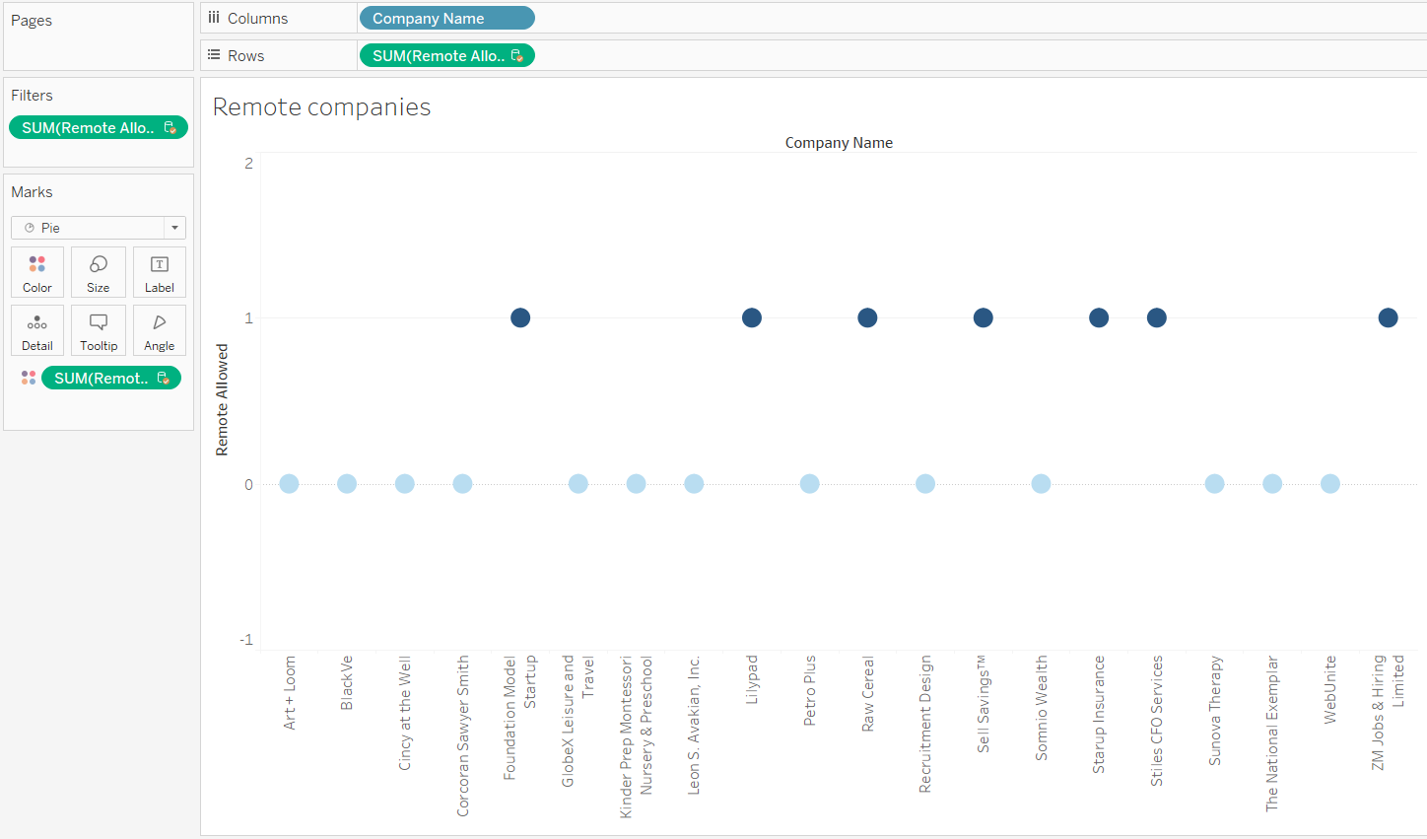
examples of reports
Which companies offer remote work services?

Slide 19

examples of reports
Which jobs are remote and have a monthly income of over $1400?

Slide 20
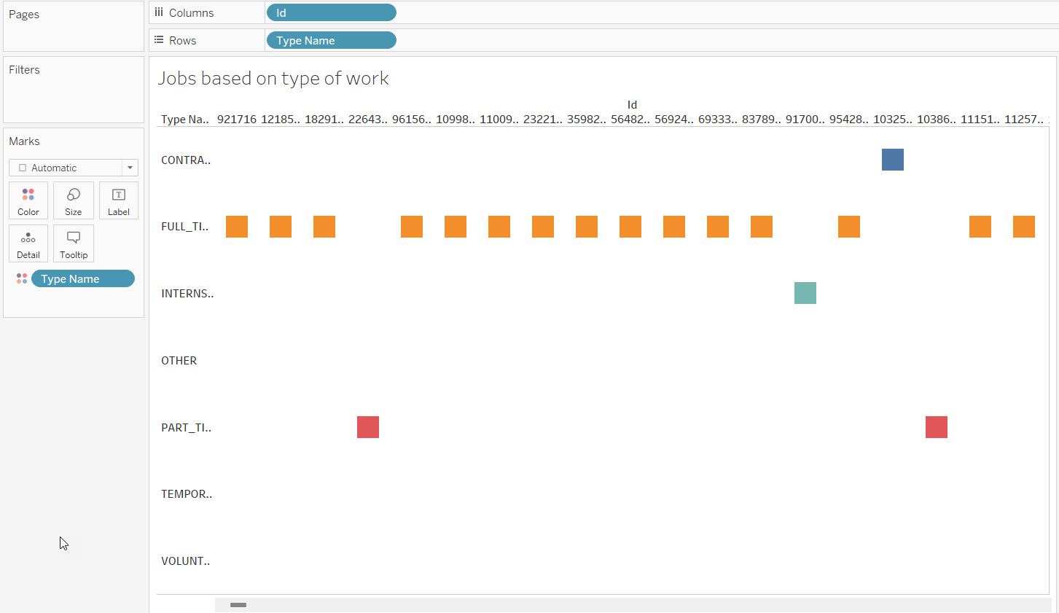
examples of reports
How do registered jobs contract with their employees?

Slide 21

examples of reports
Which jobs have had more than 50 applicants?

Slide 22

examples of reports
Which jobs have been viewed more than 1000 times?

Slide 23

examples of reports
Which jobs have a monthly income between $4000 and $10000?

Slide 24

examples of reports
Which are the largest companies in Spain?

Slide 25

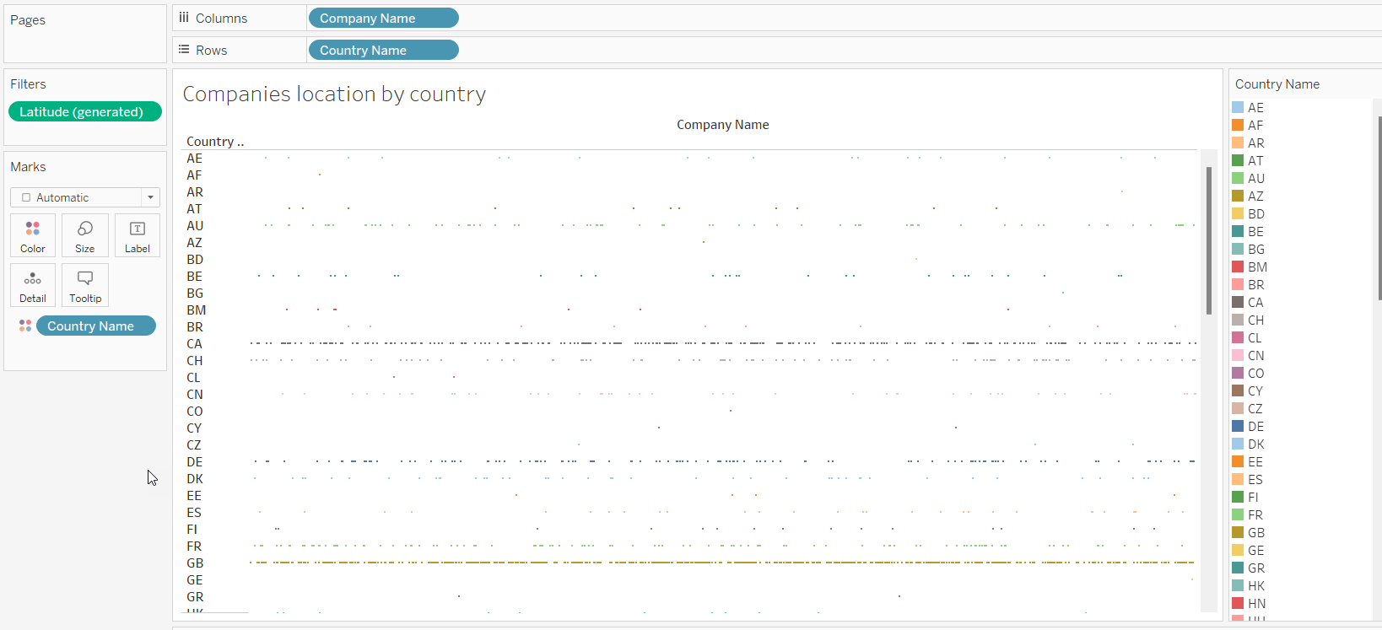
examples of reports
How do companies vary based on city or country?

Slide 26
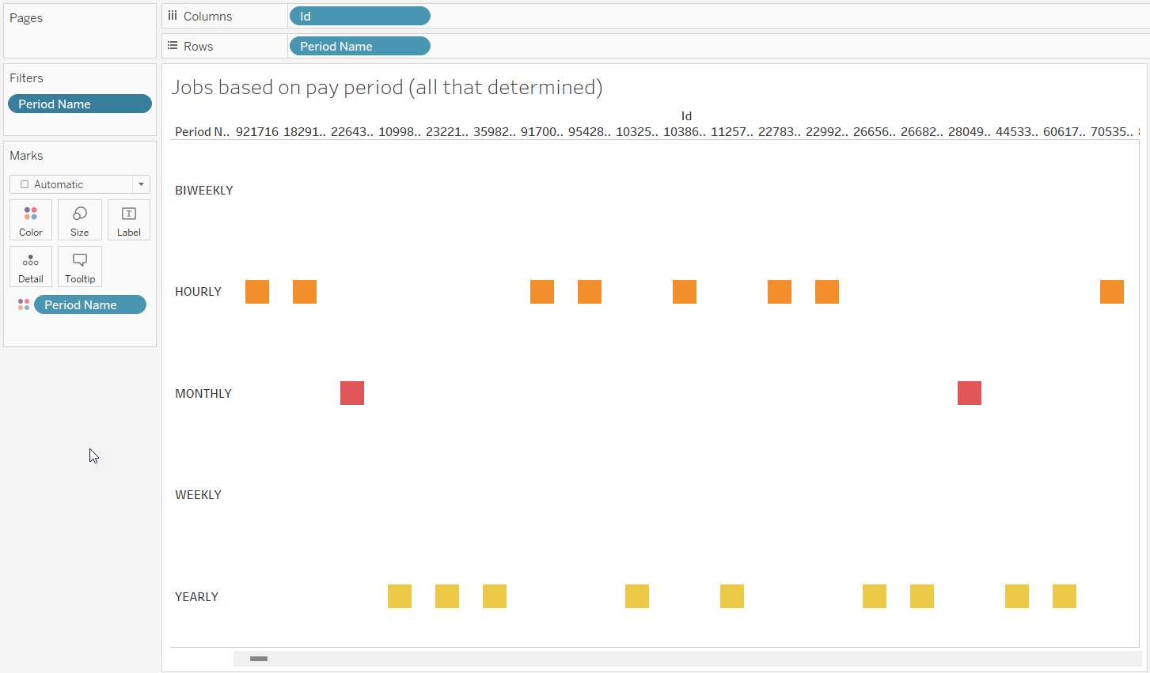
examples of reports
How are jobs based on the method of salary payment?

Slide 27
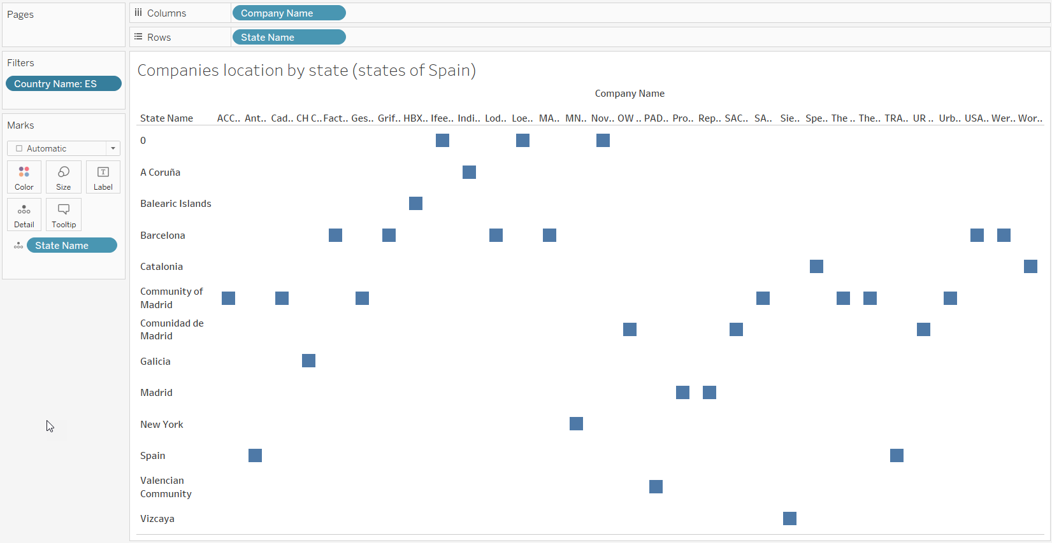
examples of reports
Which companies are in Spain?

Slide 28
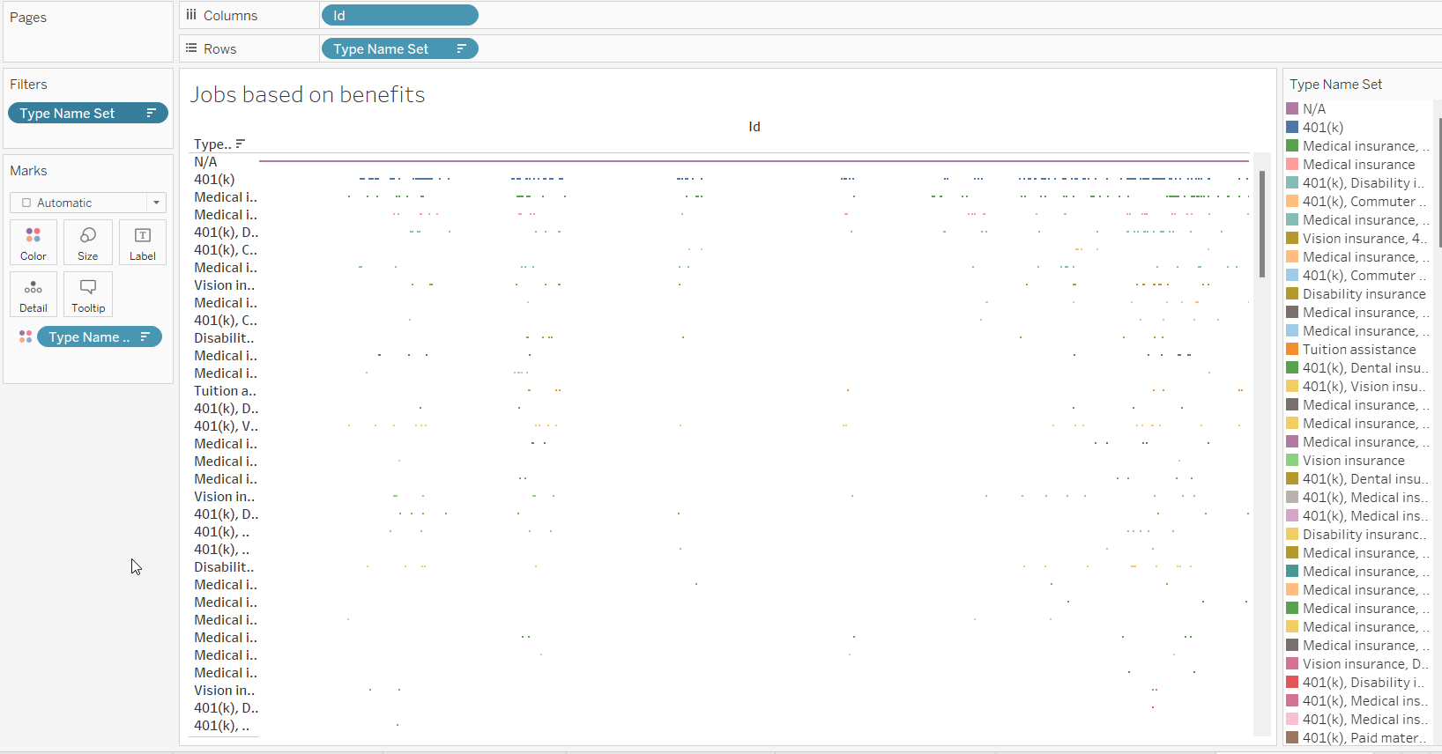
examples of reports
What benefits does each job offer?

Slide 29
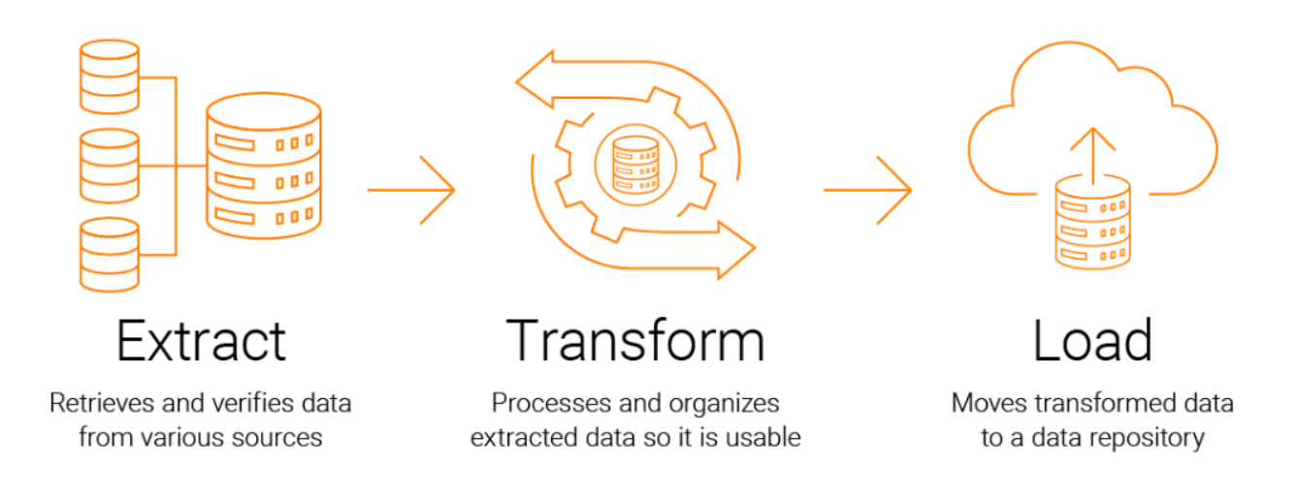
Discussion

Slide 30
Conclusion
The project successfully demonstrates the implementation of an ETL process and the establishment of a data warehouse for LinkedIn post analysis. The project provides a valuable framework for organizations seeking to leverage LinkedIn data for strategic advantage.

Slide 31
Thank you for your time

