Slide 1



Secure V2V Communication Using Identity-Based Cryptography and License Plate Recognition.
Jaypee University of Information Technology
Department of Computer Science and Engineering and Information Technology
Major Project - I (18B19CI791) | AY 2025-26
Mid-Term Evaluation | Sept 29 – Oct 03, 2025.
Group No.: 37
Team Member (s)
Pourush Pandey (221030172)
Akankshita Puri (221030052)
Adarsh Mishra (221030386)
Avinav Jay (221030062)
Supervisor
Name: Dr. Nishant Sharma
Designation: Assistant Professor Department of CSE & IT

Slide 2
Outline
Introduction
Problem Statement
Objectives
Literature Review
Project Design
Tools, Technologies and Languages
Dataset
Implementation (if any)
Results (if any)
Key Learnings
Work Plan till End-Term Evaluation
Project Plan
Work Contribution and Attendance
Supervisor Interactions
References

Slide 3
Introduction
Vehicular Ad-hoc Networks (VANETs) have become an essential component of intelligent transport systems, which facilitate real-time Vehicle-to-Vehicle (V2V) communication. This facilitates vehicles to exchange safety alerts, traffic information, and crash warnings to enhance road efficiency and lower risk.
But security is one of the largest challenges in such networks. Impersonation attacks, message tampering, and unauthorized access can compromise both vehicles and passengers. Public Key Infrastructure (PKI) has been largely applied, but it brings in heavy certificate management complexity and communication latency.
To bypass these constraints, Identity-Based Cryptography (IBC) comes as a solace in utilizing vehicle identities (e.g., license plates) as cryptographic keys. Combined with License Plate Recognition (LPR) based on deep learning, vehicles may be identified and authenticated uniquely, making a safer and more scalable V2V system a possibility.

Slide 4
Problem Statement
With the rapid rise of connected cars, ensuring secure communication has become a major concern as current V2V systems remain vulnerable to cyber threats such as spoofing, Sybil attacks, replay attacks, and false data injection, all of which compromise both reliability and road safety. While PKI-based approaches offer strong security, they suffer from scalability issues and heavy certificate management overhead in highly dynamic vehicular networks. Moreover, there is a lack of integration between vehicle identification technologies and cryptographic frameworks, creating the need for a unified system that links a vehicle’s physical identity, like its license plate, with secure cryptographic mechanisms to establish trust in communication.

Slide 5
Objectives
The project seeks to mitigate these issues through the following goals:
First, designing and deploying a certificate-free V2V communication protocol using Identity-Based Cryptography (IBC) to secure vehicle communication.
Second, to implement a License Plate Recognition (LPR) system based on computer vision and deep learning algorithms capable of extracting vehicle identities in real time.
Third, to make it possible for the recognition module to be integrated into the cryptographic system such that vehicles can communicate securely using their license plate-derived identities.
Moreover, the project aims at creating a mobile application for drivers and a web-based platform for traffic authorities to monitor, register, and authenticate cars in the network.
Finally, the system will be tested for strength of security, latency, and scalability, and its performance will be compared with conventional PKI-based solutions.

Slide 6
Literature Review
S. No. | Author & Paper Title [Citation] | Journal/ Conference (Year) | Tools/ Techniques/ Dataset | Key Findings/ Results | Limitations/ Gaps Identified
1. | Ahmed Abdelmoamen Ahmed and Sheikh Ahmed & “A Real-Time Car Towing Management System Using ML-Powered Automatic Number Plate Recognition.” | Published in the journal Algorithms in 2021. | Image processing, contour detection, KNN classifier, Android app. | Proposed ML-powered ANPR for towing management; achieved high recognition accuracy, automated illegal car detection, and reduced manual errors. | Performance drops in poor lighting, occlusion, or low-resolution images; system scope limited to towing scenarios.
2. | Rajkumar Singh Rathore ,Chaminda Hewage ,Omprakash Kaiwartya and Jaime Lloret & “In-Vehicle Communication Cyber Security: Challenges and Solutions.” | Published in Sensors in 2022. | Survey of CAN, LIN, FlexRay, Ethernet; covers cryptography, IDS, secure gateways | Identifies key cyber threats in vehicular networks and analyzes PKI, IDS, and blockchain as security measures. | Solutions are mostly theoretical, lack real-world scalability validation, and ignore hardware/latency issues.
3. | Shyang-Lih Chang, Li-Shien Chen, Yun-Chung Chung, and Sei-Wan Chen, Senior Member, IEEE & “Automatic License Plate Recognition.” | Published in IEEE Transactions on Intelligent Transportation Systems (TITS) in 2004. | Fuzzy logic for plate locating, neural networks (SOM) for character recognition. Dataset: 1088 images. | Using fuzzy logic for detection and neural SOM for recognition, the system achieved ~94% overall license plate recognition accuracy. | Limited dataset, weak under skew, motion blur, and lighting variations; fails on some complex cases.

Slide 7
Literature Review (cont…)
S. No. | Author & Paper Title [Citation] | Journal/ Conference (Year) | Tools/ Techniques/ Dataset | Key Findings/ Results | Limitations/ Gaps Identified
4. | P. Patchigulla, D. Sairam, L. Kariggi, G. Kuramana, and J. Mallireddi, & “License Plate Detection and Recognition System Using YOLOv8 and LPRNet,” | International Journal of Creative Research Thoughts (IJCRT), 2025. | YOLOv8 for detection, LPRNet for recognition Dataset: Experimental dataset | Achieved fast, accurate license plate detection and recognition on Indian datasets with YOLOv8 with LPRNet. | Struggles with night images, occlusions, and cross-country datasets; not fully generalized.
5. | T. Khan, J. S. Yadav, and D. Agarwal, “A Broad Survey on Performance Analysis of Number Plate Recognition from Stationary Images and Video Sequences,” | Published 2018 (ResearchGate). | Survey; reviews stationary and video-based NPLR methods | Broadly compares classical and ML methods for NPLR across images and videos, showing progress in accuracy. | Purely review-based, lacks experiments, and does not cover latest deep learning trends
6. | A. Shamir, “Identity-Based Cryptosystems and Signature Schemes” | International Cryptology Conference (CRYPTO), 1984 (published 1985). | Theoretical cryptographic scheme; identity as public key. | Introduced the concept of identity-based cryptography (IBC). Showed that public keys can be derived from user identities. Reduced reliance on certificate authorities | Relies heavily on a trusted Private Key Generator (PKG). Key escrow problem: PKG knows all private keys.

Slide 8
Literature Review (cont…)
S. No. | Author & Paper Title [Citation] | Journal/ Conference (Year) | Tools/ Techniques/ Dataset | Key Findings/ Results | Limitations/ Gaps Identified
7. | Sultan, S., Ullah, A., & Baig, A. “Towards Automatic License Plate Recognition in Challenging Conditions.” | Applied Sciences (MDPI), 2023. | Deep learning (CNN, YOLO-based models), Dataset: Multiple benchmark datasets. | A fine-tuned Faster R-CNN provides robust LPR in low light, noise, occlusion; improved OCR accuracy. | Limited real world testing. No LPR integration. Scalability under large vehicular networks not fully addressed.
8. | Q. Li, “A V2V Identity Authentication and Key Agreement Scheme Based on Identity-Based Cryptography,” | Future Internet (MDPI), 2023. | Identity-based cryptography, elliptic curve bilinear pairing simulation-based validation. | Proposed an IBC-based scheme for secure V2V communication. Achieved mutual authentication.Improved efficiency compared to PKI-based methods. | Plate format dependency. High computation cost. Not directly integrated with cryptographic security mechanisms.
9. | A. Demba and D. P. F. Moller, “Vehicle-to-Vehicle Communication Technology” | IEEE International Conference on Electro/Information Technology (EIT) (2018) | Dedicated Short Range Communication (DSRC) - Asymmetric Public Key Infrastructure (PKI) - Global Positioning System (GPS) - Vehicular Ad Hoc Networks (VANET) | V2V communication has a 1000m range, doesn't rely on third-party networks, and improves road safety. | Challenges include security with interference, lack of standards, and limited real-world deployment

Slide 9
Literature Review (cont…)
S. No. | Author & Paper Title [Citation] | Journal/ Conference (Year) | Tools/ Techniques/ Dataset | Key Findings/ Results | Limitations/ Gaps Identified
10. | Abdullah MFA, Yogarayan S, Abdul Razak SF, Azman A, Muhammad Amir Ani, Salleh M, “Edge Computing for Vehicle to Everything: a short review” | F1000Research (2023) | Mobile Edge Computing (MEC) - Cloudlet technology - Fog Computing - Software-Defined Networking (SDN) - Blockchain technology integration - Simulation tools for EC positioning - V2X communication protocols | Edge Computing (EC) addresses low latency and hardware challenges in V2X communication. A hierarchical approach with EC improves resource distribution and security. | Edge Computing (EC) addresses low latency and hardware challenges in V2X communication. A hierarchical approach with EC improves resource distribution and security.
11.. | J. Zhang et al., “Efficient and Robust Collaborative Perception via Cross-Vehicle Spatio-Temporal Feature Selecting” | IEEE Transactions on Intelligent Transportation Systems (2025) | CERCP (Communication Efficient and Robust Collaborative Perception) framework - Cross-vehicle spatio-temporal feature selection module - Global-aware feature fusion module | The CERCP framework minimizes communication by only transmitting essential sensor data and effectively mitigates data delays | It is limited to specific sensors (LiDAR and camera) and lacks real-world deployment validation for larger networks.
12.. | Daddanala, R.; Mannava, V.; Tawlbeh, L.; Al-Ramahi, M. & “Vehicle to Vehicle (V2V) Communication Protocol: Components, Benefits, Challenges, Safety and Machine Learning Applications.” | Preprint on arXiv, 2021 | Survey & analysis of V2V architectures, ML applications in vehicular networks. | Outlines V2V architecture, safety benefits, and machine learning applications like predictive collision avoidance. | Conceptual work only; no experimental validation, and issues like trust, latency, and privacy are underexplored.

Slide 10
Project Design
High-Level Architecture
License Plate Recognition (LPR) Layer
Captures vehicle plate images, preprocesses them, performs OCR.
Cryptographic Layer (IBC-Based)
Derives public key from license plate identity.
PKG Portal (Web App) generates/distributes private keys.
Provides encryption/decryption of V2V messages.

Slide 11
Project Design
High-Level Architecture
Communication Layer
Handles secure V2V messaging protocols.
Broadcasts alerts (collision, traffic).
Application Layer
Mobile App (Drivers): Encrypt/decrypt messages, show alerts.
Web App (Authorities): Acts as PKG portal; key management, auditing, monitoring.

Slide 12
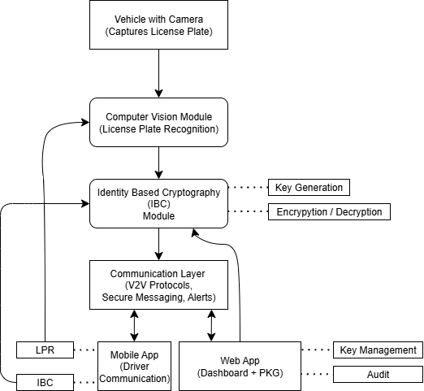
Project Design
Data Flow
Figure 1.1 : High-Level System Architecture of Secure V2V Communication Framework integrating License Plate Recognition (LPR), Identity-Based Cryptography (IBC) and multi-platform applications.

Slide 13
Project Design
Key Design Decisions
Identity-Based Cryptography (IBC): License plate as identity, no PKI overhead, scalable for V2V.
PKG Portal (Web App): Trusted key issuer/revoker; enables monitoring & auditing.
LPR + IBC Integration: Links physical plates to cryptographic identities for real-time verification.
Mobile App (Drivers): Real-time alerts; lightweight crypto; MVVM for scalability.
Web App (Authorities): Vehicle registration, key management, audits & anomaly detection.
Layered Design: LPR → Cryptography → Communication → Application ensures modularity & maintainability.

Slide 14
Tools, Technologies and Languages
Programming Languages:
Kotlin v2.2.20, Jetpack Compose 2.8.1 (Mobile App)
Python (LPR + Cryptographic modules) v3.13.7
JavaScript (ES2025), TypeScript v5.9.2, React v19.1.1 (Web frontend)
Node.js v24.8.0 (Web backend + PKG portal)
Frameworks & Libraries:
TensorFlow v2.17.0 / PyTorch v2.0 → LPR & OCR
OpenCV v4.12.0→ Image preprocessing
Room / SQLite → Local storage in mobile app
REST APIs → Communication between mobile and web (Socket.io v4.7.5)

Slide 15
Dataset
OpenALPR Benchmark Dataset (public dataset of license plate images). Source: https://cdn.openalpr.com/benchmarks.html
AOLP (Academia Sinica Open License Plate Dataset) – includes varied lighting, angles, and vehicle types. Source: https://opendatalab.com/OpenDataLab/AOLP
Synthetic augmentation: Blurring, rotation, and noise injection to simulate real road conditions.

Slide 16
Key Learnings
Understood the role of Identity-Based Cryptography (IBC) in secure V2V communication.
Learned the importance of a PKG portal for key management, issuance, and revocation.
Gained insights into License Plate Recognition (LPR) challenges under real-world conditions.
Explored integration of computer vision with cryptographic frameworks.
Strengthened knowledge of MVVM mobile app design for real-time secure communication.
Understood gaps in existing research (PKI overhead, scalability, and lack of LPR integration).

Slide 17
Work Plan till End-Term Evaluation
Sept–Oct: Complete literature survey; finalize requirements & architecture design.
Nov: Develop LPR module (Python + CV); implement initial IBC algorithms.
Dec: Integrate cryptographic functions and LPR with mobile app.
Jan: Implement PKG portal on web app; connect with mobile app for key issuance.
Feb: Integrate V2V communication flow (mobile ↔ web ↔ vehicles).
Mar: Conduct testing (accuracy of LPR, encryption latency, communication reliability).
Apr: Optimize system performance, complete documentation, and prepare for end-term evaluation.

Slide 18
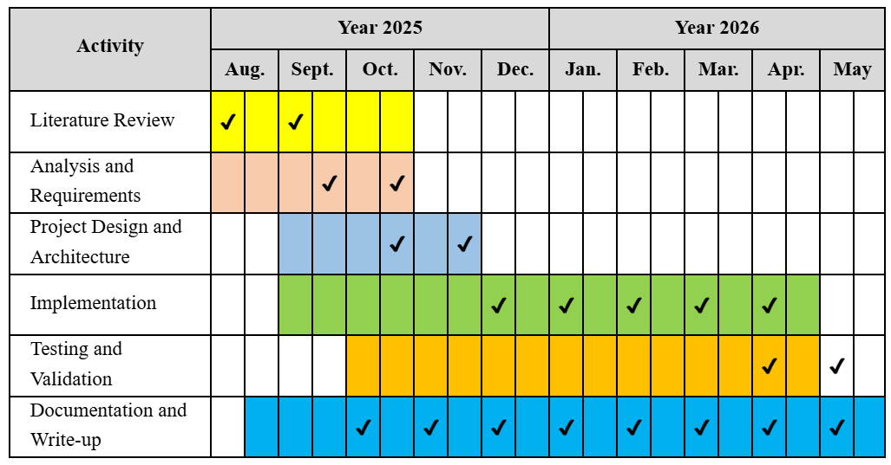
Project Plan
.

Slide 19
Work Contribution and Attendance
GitHub Repository URL: https://github.com/pourush5/SecureV2VCommunication
Team Member | Roll No. | Work Done (provide complete details) | Work Contribution (%) | Lines of Code (if any) | Lab Attendance (%)
1. | 221030172 | Constructed project architecture, focused on IBC implementation and secure communication design and mapped mobile app implementation to MVVM design pattern. Research on cryptographic applications. | 25% |  | 100%
2. | 221030052 | Conducted literature survey, finalized problem statement, handled License Plate Recognition (LPR) integration. Presented the project introduction and objectives | 25% |  | 100%
3. | 221030386 | Detailed overview of planned tasks till end-term. Provided key insights into cryptography, deep learning, and V2V security and worked on report writing. | 25% |  | 100%
4. | 221030062 | Worked on collecting research materials and arranging references. Contributed in report writing and project planning with help of gantt chart. | 25% |  | 100%

Slide 20
Supervisor Interactions (as mentioned in weekly log)
No. of Meetings with Supervisor:
Week No. | Duration | Remarks (as mentioned in the weekly log) | Incorporated (Yes/No)
1. | 18/08/2025 to 25/08/2025 | Studied a wider range of recent research papers to strengthen understanding of existing approaches. Explore multiple project ideas before finalizing to ensure feasibility The idea is promising, but team ensured clearly defining the scope and measurable outcomes early on. | Yes
2. | 26/08/2025 to 13/09/2025 | Project title and objectives are well-defined at this stage. Team has understood the problem statement clearly. Initial planning and task division. | Yes
3. | 15/09/2025 to 20/09/2025 | Team has started the survey and basic work well. Members are collecting study material actively. | Yes

Slide 21
References
[1] A. A. Ahmed and S. Ahmed, “A Real-Time Car Towing Management System Using ML-Powered Automatic Number Plate Recognition,” Future Internet, vol. 15, no. 5, p. 170, May 2021.
Available: https://www.mdpi.com/1337300
[2] R. S. Rathore, C. Hewage, O. Kaiwartya, and J. Lloret, “In-vehicle communication cyber security: Challenges and solutions,” Sensors, vol. 22, no. 17, p. 6679, 2022. Available: https://www.mdpi.com/1812018
[3] S.-L. Chang, L.-S. Chen, Y.-C. Chung, and S.-W. Chen, “Automatic license plate recognition,” IEEE Transactions on Intelligent Transportation Systems, vol. 5, no. 1, pp. 42–53, Mar. 2004..
Available: https://www.academia.edu/download/3459486/Automatic_License_Plate_Recognition.pdf
[4] R. Daddanala and V. Mannava, “Vehicle to vehicle (V2V) communication protocol: Components, benefits, challenges, safety and machine learning applications,” arXiv preprint arXiv:2102.07306, 2021.
Available: https://arxiv.org/pdf/2102.07306
[5] P. Patchigulla, K. D. Sairam, K. Lavanya, K. GovindaRaju, and M. JayaPrakash, “License plate detection and recognition system using YOLOv8 and LPRNet,” International Journal of Creative Research Thoughts (IJCRT), vol. 13, no. 2, pp. 1234–1242, 2025. [Online]. Available: https://www.ijcrt.org/papers/IJCRT25A4448.pdf
[6] T. Khan, J. S. Yadav, and D. Agarwal, “A broad survey on performance analysis of number plate recognition from stationary images and video sequences,” ResearchGate Preprint, 2018.
Available:https://www.researchgate.net/publication/326707084_A_Broad_Survey_on_Performance_Analysis_of_Number_Plate_Recognition_from_Stationary_Images_and_Video_Sequences

Slide 22
References (cont…)
[7] A. Shamir, “Identity based cryptosystems and signature schemes,” in Advances in Cryptology — CRYPTO 1984, Lecture Notes in Computer Science, vol. 196, G. R. Blakley and D. Chaum, Eds. Berlin, Heidelberg: Springer, 1985, pp. 47–53. doi: 10.1007/3-540-39568-7_5.
Available: https://link.springer.com/chapter/10.1007/3-540-39568-7_5
[8] Q. Li, “A V2V identity authentication and key agreement scheme based on identity-based cryptography,” Future Internet, vol. 15, no. 1, p. 25, 2023. doi: 10.3390/fi15010025.
Available: https://www.mdpi.com/1999-5903/15/1/25?utm_source=chatgpt.com
[9] S. Sultan, A. Ullah, and A. Baig, “Towards automatic license plate recognition in challenging conditions,” Applied Sciences, vol. 13, no. 6, p. 3956, 2023. doi: 10.3390/app13063956.
Available: https://www.mdpi.com/2076-3417/13/6/3956?utm_source=chatgpt.com
[10] A. Demba and D. P. F. Möller, “Vehicle-to-vehicle communication technology,” in Proc. 2018 IEEE Int. Conf. Electro/Information Technol. (EIT), Rochester, MI, USA, 2018, pp. 459–464. doi: 10.1109/EIT.2018.8500189.
Available: https://ieeexplore.ieee.org/stamp/stamp.jsp?tp=&arnumber=8500189&isnumber=8500077
[11] M. F. A. Abdullah, S. Yogarayan, S. F. Abdul Razak, A. Azman, A. H. Muhamad Amin, and M. Salleh, “Edge computing for vehicle to everything: A short review,” F1000Research, vol. 10, p. 1104, Nov. 2023. doi: 10.12688/f1000research.73269.4. PMID: 38595984; PMCID: PMC11002521.
[12] J. Zhang et al., “Efficient and robust collaborative perception via cross-vehicle spatio-temporal feature selecting,” IEEE Transactions on Intelligent Transportation Systems, early access, 2025. doi: 10.1109/TITS.2025.3611530.
Available: https://ieeexplore.ieee.org/stamp/stamp.jsp?tp=&arnumber=11180840&isnumber=4358928

Slide 23

Thanks.

