Slide 1
From Algorithm to Routine Care
A practical roadmap for deploying in-house computational pathology AI
AIMViewer · AI Processing Pipeline · Azure Clinical Deployment
Guided by: Meeuwsen et al. — A practical roadmap to implementation of
in-house developed computational pathology algorithms (Radboudumc, 2026)
High-level overview — not an implementation spec

Slide 2
The gap the paper addresses
• AI research in pathology is abundant — routine clinical use is still rare
• Most work stops at model accuracy; few cover workflow, regulation, and adoption
• Success needs more than a good algorithm: IT fit, validation, quality, training, monitoring
• In-house (lab-developed) tools put accountability on the laboratory — not the vendor
Technical
performance
Workflow &
operations
Governance &
safety
Necessary
but not enough
Where adoption
succeeds or fails
Validation, risk,
and ongoing oversight
AIM Lab · Clinical AI Implementation Roadmap · High-level overview
2 / 12

Slide 3
Paper roadmap — eight pillars
Meeuwsen et al. frame implementation as a full lifecycle, not a single go-live event.
Clinical need
& use case
Technical
integration
Security &
privacy
Analytical
validation
1
2
3
4
Clinical
validation
Quality &
risk (QMS)
Training &
user adoption
Post-market
surveillance
5
6
7
8
AIM Lab · Clinical AI Implementation Roadmap · High-level overview
3 / 12

Slide 4
How we map the roadmap to our platform
Clinical need
AI-assisted reading for IHC quantification, subtype support, and triage
Ingest & privacy
Scan → client QC → de-identify on site → Transfer upload to OMERO
View & decide
Pathologist works in Aimviewer with overlays and concise AI summaries
Compute
In-house models via our AI processing service (scalable workers on Azure)
Governance
Validation → risk review → training → continuous monitoring
AIM Lab · Clinical AI Implementation Roadmap · High-level overview
4 / 12

Slide 5
End-to-end clinical workflow (high level)
1
2
3
4
5
6
Scan
→
QC
→
Anonymize
→
Upload
→
AI assist
→
Read
WSI from
the lab
Quality
check
Client-side
de-ID
Transfer
to OMERO
Models
run
Pathologist
sign-out
Privacy gate (before cloud)
• QC can be self-serve checklist and/or light automated checks on the client machine
• Patient identifiers stay local — only de-identified slides and study IDs reach Azure / OMERO
• Human remains responsible for the final diagnostic decision
AIM Lab · Clinical AI Implementation Roadmap · High-level overview
5 / 12

Slide 6
Azure deployment picture (conceptual)
Clinic / client
Azure platform
AI workers
Scan · QC · Anonymize
Transfer upload
→
OMERO · Aimviewer
Shared slide storage
→
Scalable GPU pool
Queued inference
Designed for many concurrent cases
• Uploads and viewing scale independently from GPU inference
• AI work is queued so peak demand adds workers without blocking the reader UI
• Shared storage keeps large slides in one place — viewers and models read the same files
• Security boundary: hospital network / private Azure — no unnecessary PHI exposure
AIM Lab · Clinical AI Implementation Roadmap · High-level overview
6 / 12

Slide 7
Validation — two complementary gates
Analytical validation
Clinical validation
• Is the algorithm technically reliable?
• Reproducibility across scanners / stains / days
• Sensitivity & specificity under controlled conditions
• Foundation before any clinical go-live
• Does AI help readers in real practice?
• Multi-reader study: with vs without AI
• Diagnostic performance, time, and workflow impact
• Confirms readiness for routine use
AIM Lab · Clinical AI Implementation Roadmap · High-level overview
7 / 12

Slide 8
How results help the diagnostic reader
Same principle as the paper: AI supports focus and efficiency — it does not replace sign-out.
Highlight
Quantify
Triage
Consistency
Flag regions of interest
and attention overlays
Cell counts, positivity %,
subtype probabilities
Prioritize positive / urgent
cases in the worklist
Reduce inter-reader
variability on hard calls
Example use cases on our stack
• IHC scoring assist · Endometrial subtype support · PDAC subtype support · Nucleus / tissue context
• Reader sees: visual overlay + short summary scores → accept, adjust, or override → finalize report
AIM Lab · Clinical AI Implementation Roadmap · High-level overview
8 / 12

Slide 9
Quality, risk, and trust
Quality system
Risk analysis
Document intended use, SOPs, and change control — aligned with lab accreditation practice
Map failure modes across scan → AI → reader (e.g. HFMEA-style review as in the paper)
Privacy
Human oversight
De-identify before upload; process within controlled Azure / institutional boundaries
AI is decision support; pathologist owns the diagnostic conclusion
Traceability
Ongoing watch
Record which model/version assisted which case for audit and review
Post-market surveillance: errors, drift, user feedback, periodic re-check
AIM Lab · Clinical AI Implementation Roadmap · High-level overview
9 / 12

Slide 10
People make implementation succeed
The paper stresses multidisciplinary design and early user involvement — we follow the same principle.
Pathologists
Lab staff
IT / platform
AI / science
Quality
Define need, validate clinically, use daily
QC, staining, upload, IHC follow-up
OMERO, Aimviewer, Azure, security
Models, performance, monitoring
Risk, SOPs, accreditation readiness
• Clear UI cues (status, overlays) without clutter — like the paper’s focus on viewer usability
• Short role-based training and a known escalation path when something looks wrong
• Usability / acceptance feedback before and after go-live
AIM Lab · Clinical AI Implementation Roadmap · High-level overview
10 / 12

Slide 11
Phased path to routine use
Phase 1
Phase 2
Phase 3
Phase 4
Pilot
Harden
Scale
Sustain
One use case · one site
Manual QC + de-ID
On-demand AI in viewer
Formal validation
Risk & SOP pack
Enforced privacy gate
Azure capacity for
many uploads & jobs
Worklist triage
Post-market monitoring
Retrain / revalidate
Expand assays
AIM Lab · Clinical AI Implementation Roadmap · High-level overview
11 / 12

Slide 12
Takeaways
1
Implementation is a roadmap — accuracy alone does not equal clinical deployment
2
Privacy-first ingest: QC and anonymization before slides leave the client site
3
Our platform already covers the core loop: Transfer → OMERO → Aimviewer → AI assist
4
Azure scaling separates viewing from GPU work so the service can grow with demand
5
Readers gain highlights, numbers, and triage — they keep the final diagnostic call
6
Sustain with validation, risk management, training, and post-market surveillance
AIM Lab · Clinical AI Implementation Roadmap · High-level overview
12 / 12

Slide 13
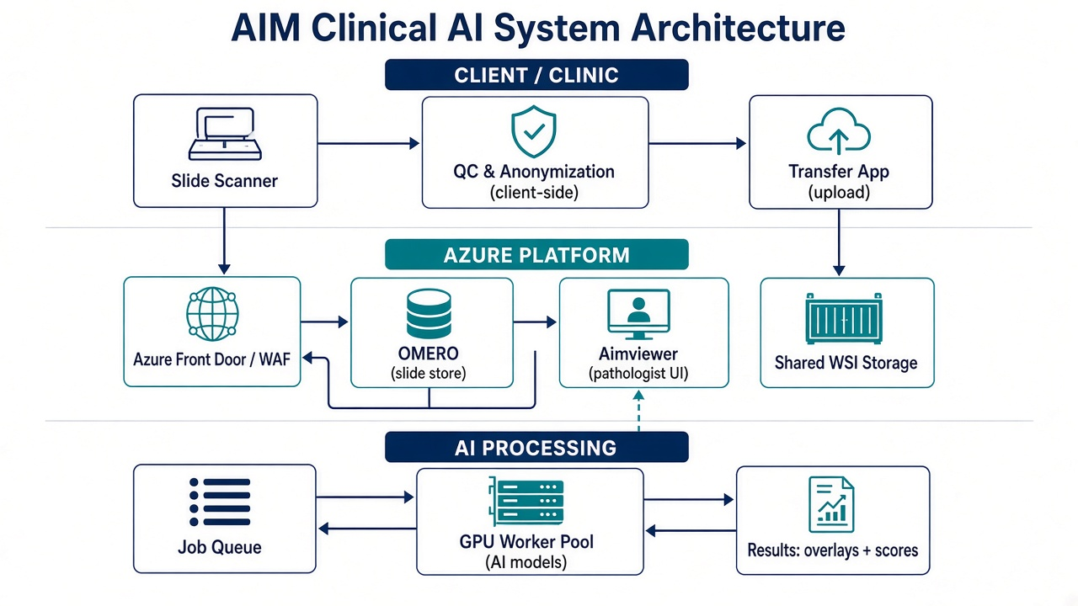
System architecture
Client QC/de-ID → Transfer → Azure OMERO / Aimviewer → queued AI workers → overlays & scores

Slide 14
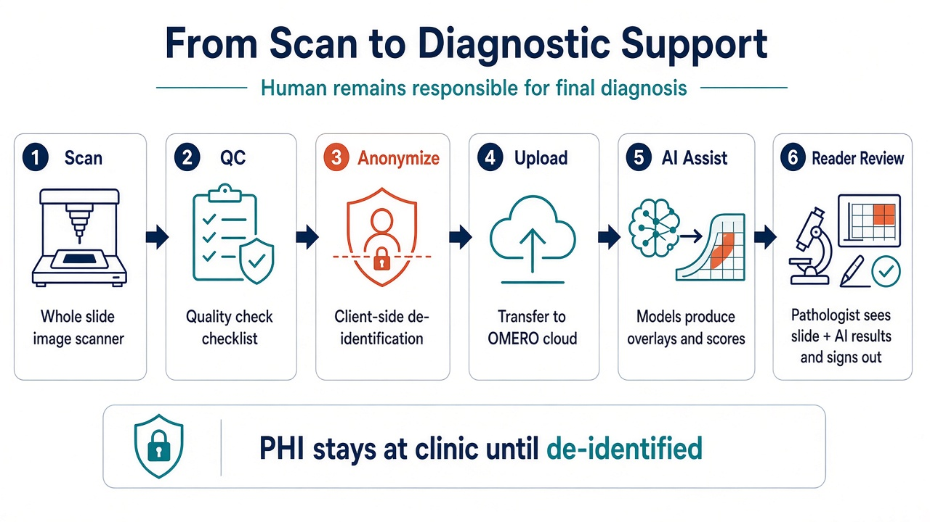
Workflow: scan to results
End-to-end path from scanning to pathologist review — AI is decision support, not autonomous diagnosis

