Slide 1
Customer Segmentation
Pouya Ebrahimi

Slide 2
Table of Contents
DSM Method
Data Source
Problem Identification Statement
Data Wrangling
Exploratory Data Analysis
Feature Engineering
Modeling
Data Storytelling

Slide 3
DSM Method

Slide 4
Identifying Correct Problem to Solve
Exploratory Data Analysis and testing Hypothesis
Finding best machine learning model with optimal values
Problem Statement
Data Wrangling
EDA
Feature Engineering
Modeling
Cleaning the data by filling Null values and changing data types
Add new attributes and make data ready for modeling

Slide 5
2) Data Source

Slide 6
Data Source
For this project, I have used a dataset from Kaggle.com website.
Here is a link to the dataset on Kaggle.com :
https://www.kaggle.com/code/farzadnekouei/customer-segmentation-recommendation-system

Slide 7
3) Problem Identification

Slide 8
DSM Step 1: Problem Identification
To expand business, an online retailing company wants to have a comprehensive analysis of the customers and products. Therefore, the company wants to segment customers based on shopping behavior and then recommend them most related products.
The online retail company’s marketing team, executive sales manager, and the IT Development team are stakeholders for this project.

Slide 9
4) Data Wrangling

Slide 10
DSM Step 2: Data Wrangling
The received dataset has so many Null values. Most of these Null values are ‘Unit Price’ of an item which is recorder as 0. As the first step of Data Wrangling, I will be removing or imputing values for those rows with Null values.
Data Type is another problem of this dataset. ‘Date’ column is of string type, which needs to be converted to datetime type.
There are some outliers as well, but most of them come from wrong inputs. Simply, I will be removing the outliers.

Slide 11
5) EDA - Exploratory Data Analysis

Slide 12
DSM Step 3: EDA - Exploratory Data Analysis
I start EDA by drawing bar charts, scatterplots, heatmaps, and line plots.
Then a Null Hypothesis and Alternative Hypothesis will be tested.
Discovering correlation between attributes will be considered as well.

Slide 13
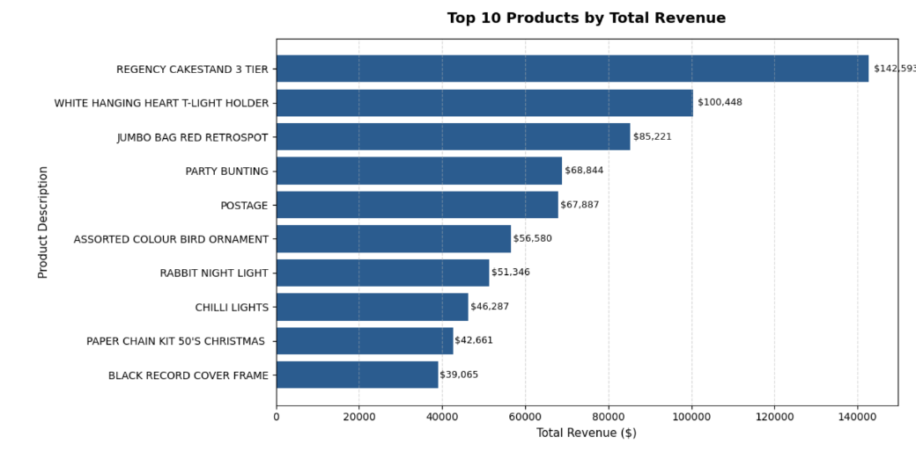
A Bar Chart showing top 10 best selling products

Slide 14
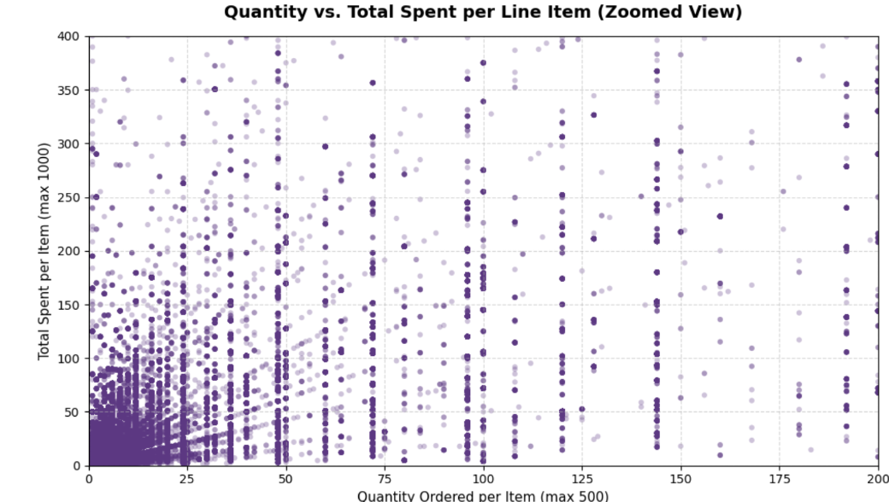
A Scatterplot shows Quantity vs Total Spent per Line Item

Slide 15
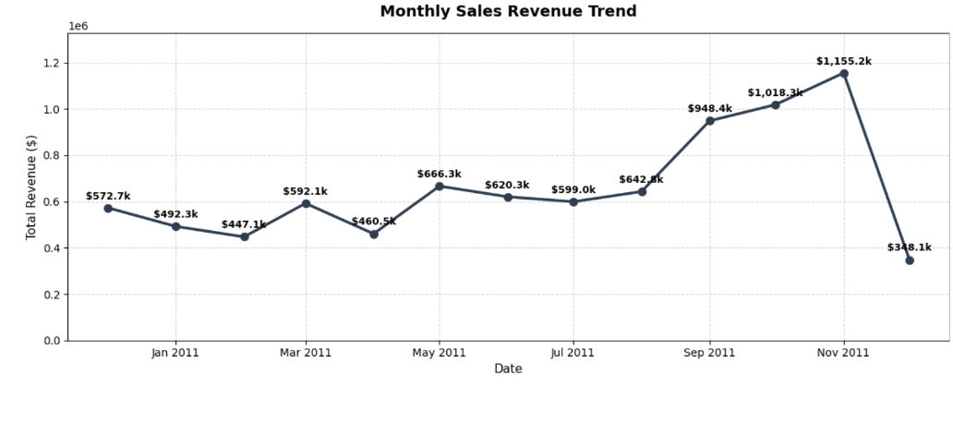
A Line-Plot shows monthly sales revenue trend for the online store

Slide 16
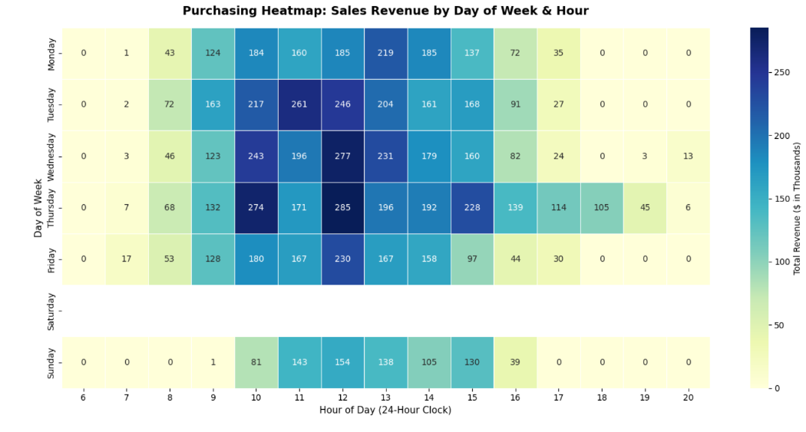
A Heatmap which shows Sales Revenue by Day of Week & Hour

Slide 17
6) Feature Engineering

Slide 18
DSM Step 4: Feature Engineering
In this step, we preprocess our dataframe and try to add new attributes, and remove those attributes which are unnecessary for a machine learning model to learn. For example, I removed ‘Country’ column since all transactions happened in United Kingdom.
I have added three columns to my dataframe. Those columns are Recency, Frequency, and Monetary which are very important for this type of analysis.

Slide 19
7) Machine Learning Modeling

Slide 20
DSM Step 5: Machine Learning Modeling
Customer Segmentation is an Unsupervised Machine Learning problem.
I have worked on 2 different unsupervised machine learning models:
K-Means Clustering
Gaussian Mixture Model

Slide 21
K-Means Clustering:
I have found Silhouette score as 7 which means there are 7 clusters for this online retail store customers.
An Excel sheet is exported and provided at my GitHub repo with all customers assigned to associated clusters.
GMM - Gaussian Mixture Model:
This model has soft clustering. In other words, it assigns a set of probabilities to each customer. For example, a customer can belong to Electronics segment by 70% and Household segment by 30%.

Slide 22
8) Data Storytelling

Slide 23
DSM Step 6: Data Storytelling
We have two results for this project. One is from K-Means Clustering and the other is from GMM.
An Excel sheet is exported and saved at my GitHub repo which shows each customer and associated cluster.
Also, as the result of GMM, a set of probabilities is provided for each customer which can be found in my GitHub repo as well.

