Slide 1
Solving CSAW'25 ESC Challenges
Meowginal Leaks
Pouya Narimani, Kseniia Rogova, Ali Abbasi​ | November 2025

Slide 2
Set 1
GateKeeper 1 & 2
Sorters Song 1 & 2
Critical Calculation

Slide 3
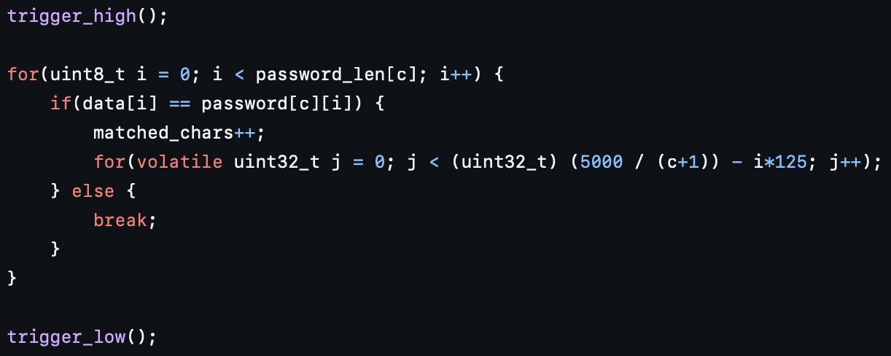
GateKeeper 1 & 2
Challenge:
Two passwords (8 and 12 characters) to be recovered
The password verification loop has input-dependent execution time
Adaptive delay based on the index of the character
Timing from the OS wasn’t accurate

Slide 4
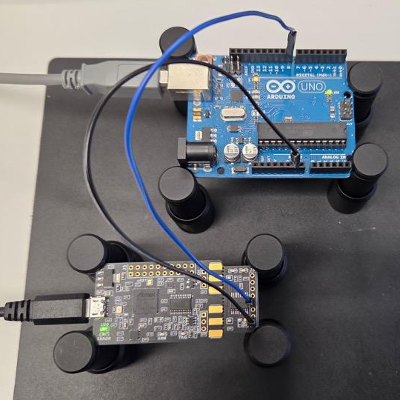
GateKeeper 1 & 2
Test setup:
We use an Arduino Uno to capture the trigger window (trigger_high to trigger_low from GPIO4)
Approach:
Compute adaptive timing thresholds for each character position
Test possible characters and measure execution time
If timing exceeds the threshold → mark the character as correct
Repeat the process until the full password is recovered
gk1{l0g1npwn} → 511 queries (< 45 s)
gk2{7rU3ncrYkIND} → 671 queries (< 37 s)

Slide 5
Set 1
GateKeeper 1 & 2
Sorters Song 1 & 2
Critical Calculation

Slide 6
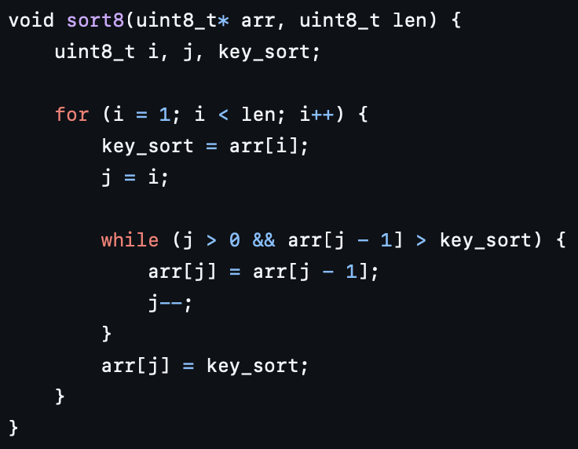
Sorters Song 1 & 2
Challenge:
Two secret 15-byte arrays (with 8-bit and 16-bit values) to be recovered
Secret arrays are stored and sorted by the target
The sorting function leaks power patterns per element comparison
The attacker can control copied elements (get_pt) and trigger sort calls

Slide 7
Sorters Song 1 & 2
Approach:
Capture a reference trace by inserting the smallest value (0x00)
  This shows the “no shift” case.
For each key element, run a binary search over possible values.
For every guess:
  Capture the trace and compute Euclidean distance to the reference
Use the distance to decide whether to move the lower or upper bound
Repeat until the element’s value is found

Slide 8
Sorters Song 1 & 2
Complexity:
For n-bit values → ≈ 2×⌈log⁡2(2ⁿ)⌉+2 queries per byte
Results:
ss1{y0u_g0t_it_br0!} → 241 queries (8-bit array)
ss2{!AEGILOPS_chimps → 497 queries (16-bit array)

Slide 9
Set 1
GateKeeper 1 & 2
Sorters Song 1 & 2
Critical Calculation

Slide 10
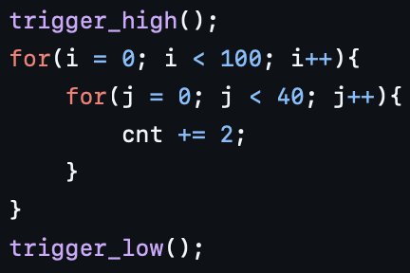
Critical Calculation
Challenge:
Simple counter implemented with two nested for-loops
Boot continues only if the counter reaches the expected final value
If the counter value differs, the system halts and returns a secret flag
Task: force a mismatch in the counter to trigger the flag

Slide 11
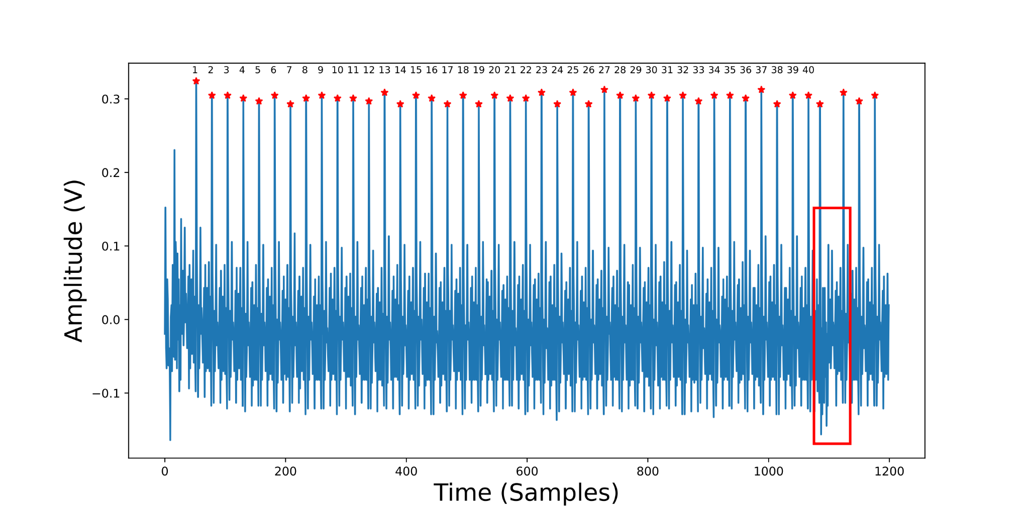
Critical Calculation
Approach:
Analyze the power trace to locate loop branch instructions
Inject a voltage glitch at the branch to skip an inner-loop iteration
Tune glitch parameters (width/repeat) with an oscilloscope and CWNANO:
  scope.glitch.repeat = 3
  Example location for fault injection: 207
Results:
cc1{C0RRUPT3D C4LCUL4T10N}

Slide 12
Set 2
Dark GateKeeper
Hyperspace Jump Drive
Ghost Blood

Slide 13
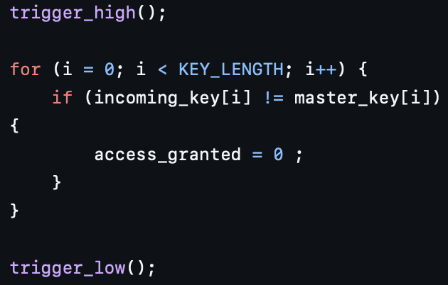
Dark GateKeeper
Challenge:
Recover a 12-character master key
The password verification loop is almost constant-time
We employ power analysis to recover the key
When the if condition is false, the execution pattern is slightly different

Slide 14
Dark GateKeeper
Approach:
Capture a reference trace by inserting the smallest value (0x00)
For each key byte, brute force the possible values
For every guess:
  Capture the trace and compute the Euclidean distance to the reference
Use the distance to decide whether the input was correct or not
Repeat until the correct key is recovered
Results:
ESC{J0lt_Th3_G473} → 83 queries

Slide 15
Set 2
Dark GateKeeper
Hyperspace Jump Drive
Ghost Blood

Slide 16
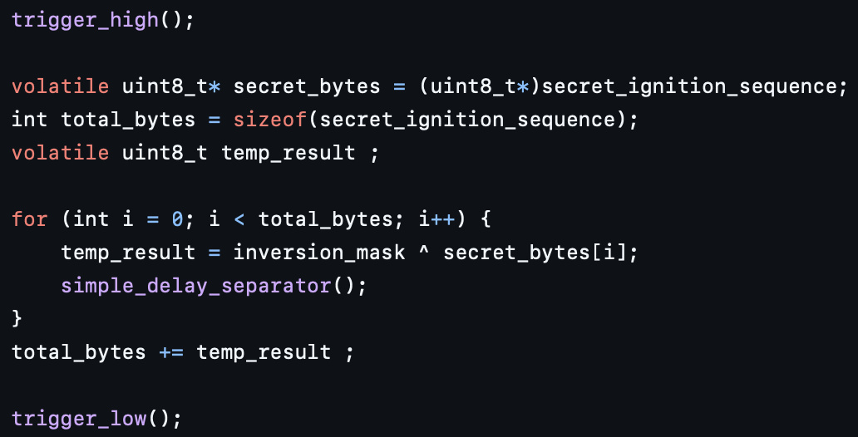
Hyperspace Jump Drive
Challenge:
Recover a 12-byte secret and provide it to capture the flag
The invert_polarity() function calculates the XOR of the input with the secret
The Correlation Power Analysis (CPA) can recover the key

Slide 17
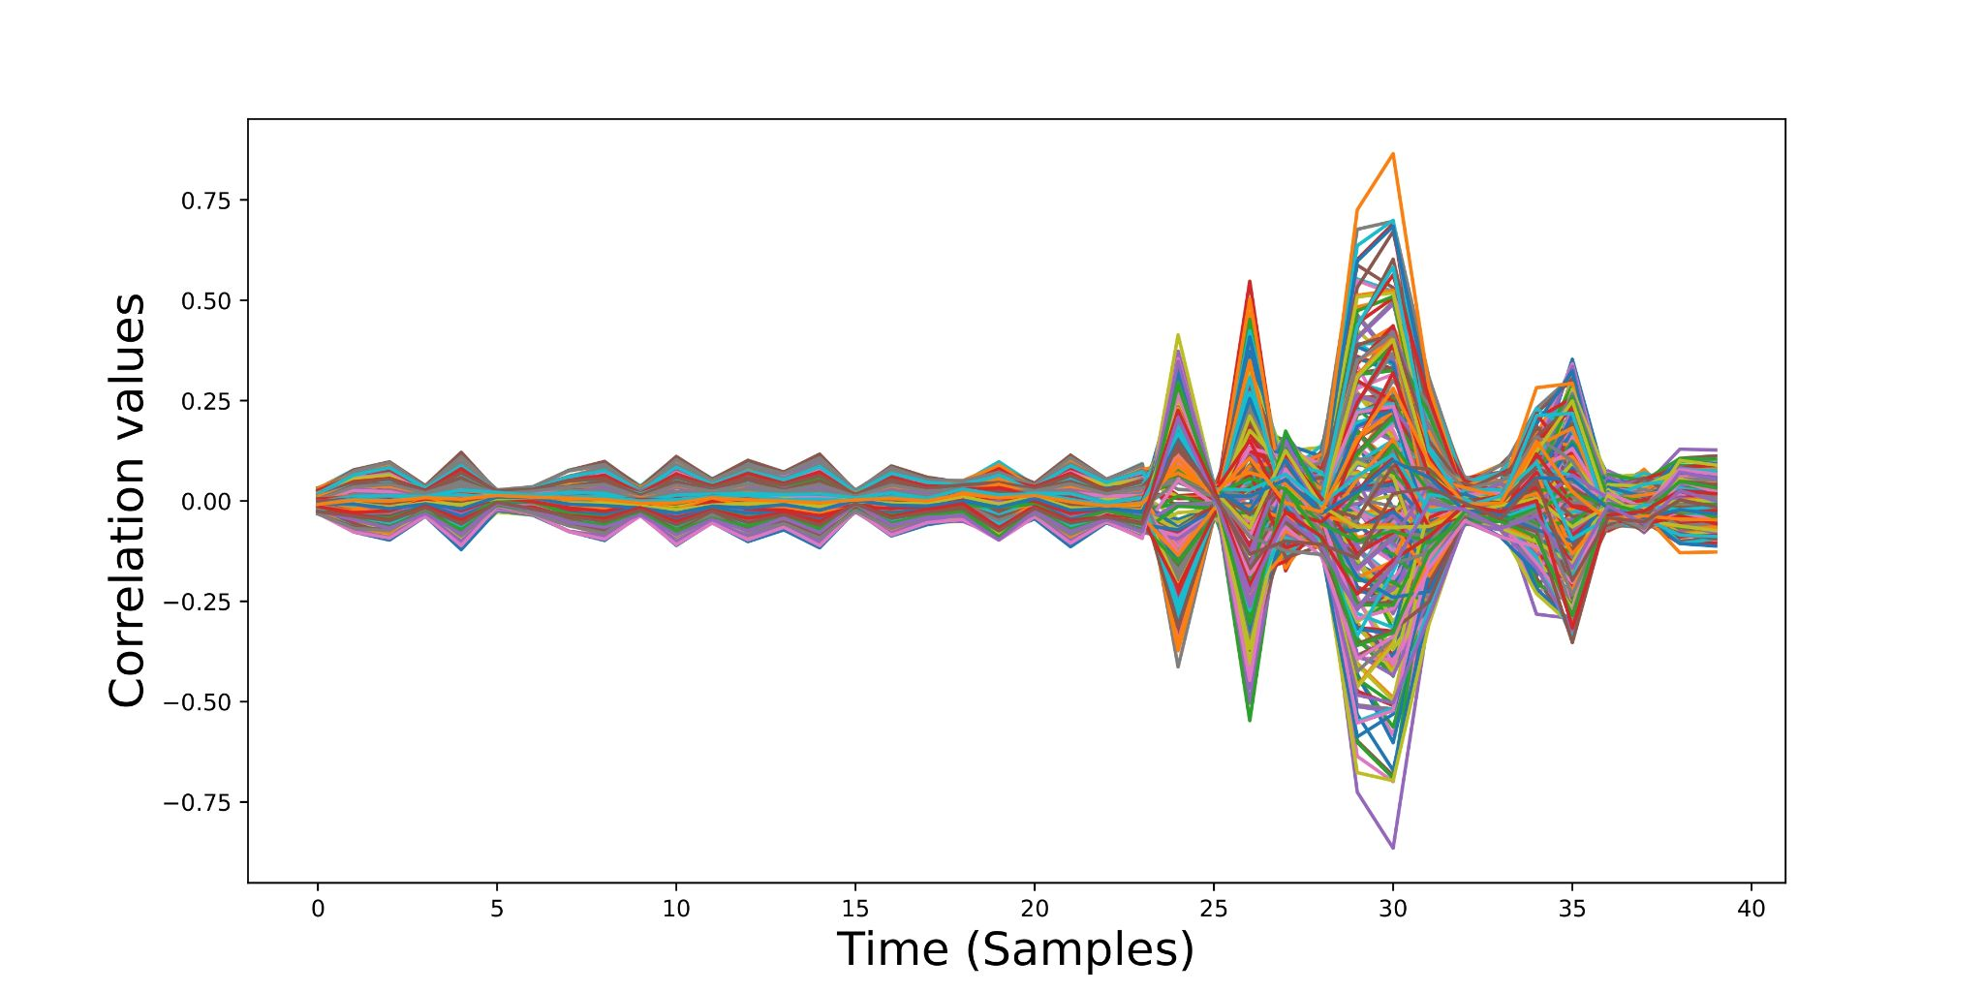
Hyperspace Jump Drive
We gather 25600 power traces (100 per input)
Results:
[0x3, 0x7D, 0x39, 0x5D, 0xB4, 0xCF, 0x56, 0x66, 0x6F, 0x27, 0xBF, 0x5B]
b64{c3RhcmR1c3Q=}

Slide 18
Set 3
Alchemist Infuser
Echoes of Chaos

Slide 19
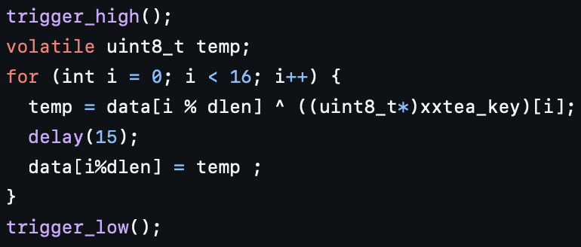
Alchemist Infuser
Challenge:
Recover a 16-byte secret and decrypt the message to capture the flag
The encrypt() function calculates the XOR of the input with the secret
The Correlation Power Analysis (CPA) can recover the key
The leakage model should change for the second 8 bytes
  For the first 8 bytes: plaintext ⊕ key guess
  For the second 8 bytes: (plaintext ⊕ recovered key) ⊕ key guess

Slide 20
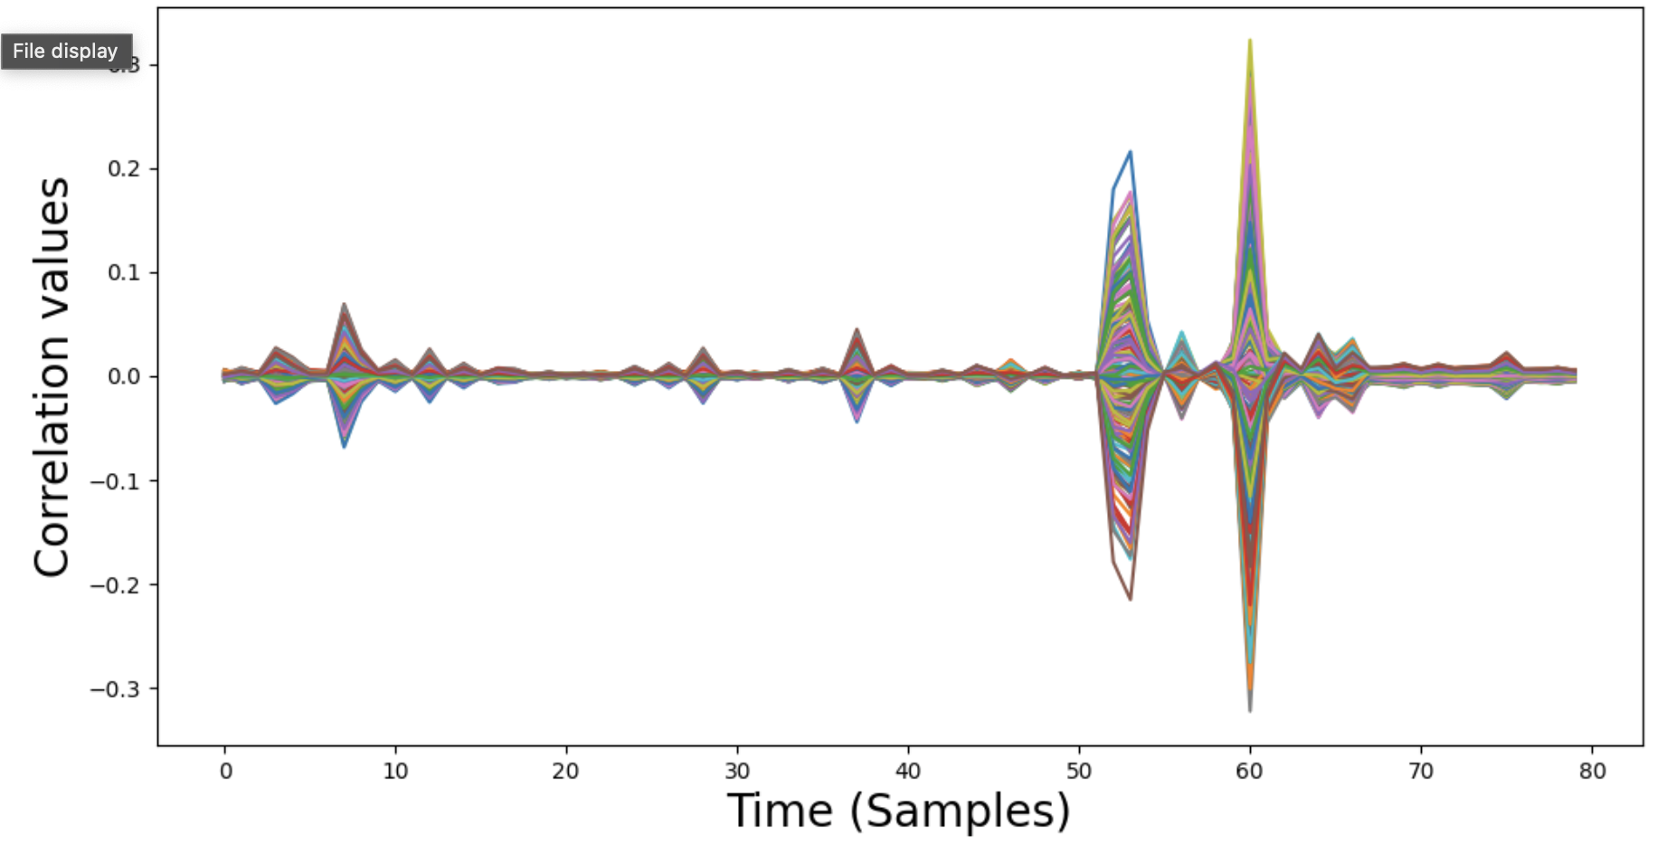
Alchemist Infuser
We gather 102400 power traces (400 per input)
Results:
[0x4e, 0x61, 0x4a, 0x2d, 0x55, 0x67, 0x52, 0x64, 0x32, 0x70, 0x58, 0x6b, 0x38, 0x76, 0x35, 0x73]
a1c{Wh1teDragonT}

Slide 21
Set 3
Alchemist Infuser
Echoes of Chaos

Slide 22
Echoes of Chaos
Challenge:
Similar to the Sorters Song challenge
Approach:
For each guessed value, capture a new sorting trace for the first left comparison
Compare it to the reference trace using the Euclidean distance
Based on the distance, we decide whether to adjust the lower or upper bound of the search range
Repeat this process for all 15 key values
Each comparison involves a reset() (no new query) and get_pt() call

Slide 23
Echoes of Chaos
Complexity: (15 * (16 + 1)) + 1 = 256
Results:
[0x2B9, 0x1988, 0x2384, 0x369F, 0x4CA1, 0x6582, 0x6D3C, 0x73A0, 0x8CF0, 0xA56D, 0xB3EC, 0xBFF4, 0xE594, 0xFCEC, 0xFDDA]
eoc{th3yreC00ked}

Slide 24
Thank you ☺
Code for our artifacts can be found here:
github.com/pouya13/csaw2025_ESC_solutions

