Slide 1
MACHINE LEARNING
Machine Learning with Python
From Raw Data to Predictions — Regression, Classification & Model Evaluation
Term 2 Course Summary • Python, pandas, scikit-learn
Machine Learning with Python • Term 2
1

Slide 2
AGENDA
What We Will Cover
01
Data Foundations
02
Types of Machine Learning
Data types, Python libraries, DataFrames, iloc
Supervised, Unsupervised, Semi-Supervised, Reinforcement
03
Data Preprocessing
04
Regression Models
Encoders, Scalers, Train/Test Split, Correlation & Heatmaps
Linear Regression, MAE & MSE
05
Classification Models
06
Wrap-Up
Logistic Regression, Decision Tree, Random Forest, KNN, SVM
Model comparison and the complete ML workflow
Machine Learning with Python • Term 2
2

Slide 3
DATA FOUNDATIONS
What Is Data?
Definition
Any information a system uses to learn, analyze, or make decisions.
Numeric data
Car prices, height & weight, temperature — used directly in calculations.
Text data
News articles, comments, medical reports.
Image data
Medical scans, traffic images, face recognition.
Video & audio data
Sports-movement analysis, behavior/theft detection, voice recognition.
Key rule
A computer only understands numbers directly — every other data type must be converted into numbers before a model can use it.
Machine Learning with Python • Term 2
3

Slide 4
DATA FOUNDATIONS
Python Libraries for Machine Learning
A library (module) is a ready-made collection of code, so we don't write everything from scratch. We import a library with the 'import' command.
# Install the core libraries
pip install numpy
pip install pandas
pip install matplotlib
pip install seaborn
pip install scikit-learn
# Import them into our script
import numpy as np # arrays & numerical operations
import pandas as pd # tabular data (DataFrames)
import matplotlib.pyplot as plt # chart drawing
import seaborn as sns # statistical charts (e.g. heatmap)
from sklearn import linear_model, tree, ensemble, neighbors, svm, metrics
numpy → numbers & arrays | pandas → tables | matplotlib/seaborn → plotting | scikit-learn → ML models
Machine Learning with Python • Term 2
4

Slide 5
DATA FOUNDATIONS
DataFrame & Reading Data
DataFrame = Data + Frame: pandas organizes data into a labeled table of rows and columns.
height_list = [145,150,155,160,165,170,175,180,185,190]
weight_list = [42, 45, 50, 55, 60, 65, 70, 76, 82, 87]
height_and_weight = {"height": height_list, "weight": weight_list}
data = pd.DataFrame(height_and_weight) # build a table from a dictionary
data["Name"] = ["Emma","Rose","John", ...] # add a new column
data["age"] = [10,15,14,15,None,13,...] # missing values: None / NaN / null
data.to_csv("height and weight.csv", index=False) # save to file
data = pd.read_csv("Salary Data.csv") # read from file
Missing cells happen because information is unavailable or was lost — pandas represents them as None / NaN / null.
Machine Learning with Python • Term 2
5

Slide 6
DATA FOUNDATIONS
Visualizing Data with Matplotlib
Function | Chart Type | Typical Use
plt.scatter() | Scatter (points) | Relationship between two numeric columns, e.g. height vs weight
plt.plot() | Line chart | Trend of a value across an ordered axis
plt.bar() / barh() | Bar chart (vertical/horizontal) | Comparing categories, e.g. experience vs salary
plt.hist() | Histogram | Grouping values into bins and counting how many fall in each
plt.pie() | Pie chart | Share of each category out of a whole, e.g. phone brand market share
Example: plt.scatter(data['Experience Years'], data['Salary']); plt.xlabel('experience'); plt.ylabel('salary'); plt.grid(); plt.show()
Machine Learning with Python • Term 2
6

Slide 7
DATA FOUNDATIONS
Exploring a Dataset
Command | What It Shows
data.head(5) | The first 5 rows of the dataset
data.tail(5) | The last 5 rows of the dataset
data.shape | Number of rows and columns (rows, columns)
data.info() | Column names, data types, and non-null counts
data.describe() | Statistics for numeric columns: min, max, mean, std, 25%/50%/75%
data.isnull().sum() | Count of missing (empty) values per column
data.duplicated().sum() | Count of duplicated rows in the dataset
describe(): std = standard deviation (spread around the mean); 25/50/75% = the value below which that % of the data falls.
Machine Learning with Python • Term 2
7

Slide 8
DATA FOUNDATIONS
Handling Missing Values
Empty cells (None / NaN / null) must be filled or removed before training a model.
data["Embarked"].mode()[0] # most frequent value
data["Embarked"] = data["Embarked"].fillna(data["Embarked"].mode()[0])
data = data.drop("Cabin", axis=1) # too many missing values -> drop column
data = data.dropna(subset=["Age"]) # drop rows still missing "Age"
data = data.drop_duplicates() # remove duplicated rows
fillna() strategies: mode (most frequent), mean (average), min, max, or a custom constant value.
Machine Learning with Python • Term 2
8

Slide 9
DATA FOUNDATIONS
iloc — Integer-Location Indexing
iloc selects rows and columns of a DataFrame by their integer position (0-based index), regardless of labels.
data.iloc[5] # the row at position 5 (6th row)
x_train.iloc[0] # the first row of the training features
# General pattern:
# df.iloc[row_position, column_position]
# df.iloc[0:5, 0:3] -> first 5 rows, first 3 columns
Use iloc when you need a row/column by numeric position rather than by its column name or index label — handy for inspecting a single training example.
Machine Learning with Python • Term 2
9

Slide 10
PART 1
Types of Machine Learning
Four broad ways a model can learn from data
Machine Learning with Python • Term 2
10

Slide 11
TYPES OF MACHINE LEARNING
Supervised Learning
Definition
Both the input (x) and the correct output (y) are given to the model, and it learns the relationship between them.
Example
Teaching a model to recognize animals by showing it photos already labeled with the animal's name.
Two main problem types
Regression (predicting a continuous number) and Classification (predicting a category).
Used throughout this course
Linear Regression, Logistic Regression, Decision Tree, Random Forest, KNN, and SVM are all supervised models.
Machine Learning with Python • Term 2
11

Slide 12
TYPES OF MACHINE LEARNING
Unsupervised Learning
Definition
Only the input is given — no correct output/label. The model discovers patterns or groupings on its own.
Example
Automatically sorting shapes into squares, triangles, and circles without being told which is which.
Typical use
Clustering similar customers, grouping similar documents, detecting structure in raw data.
Machine Learning with Python • Term 2
12

Slide 13
TYPES OF MACHINE LEARNING
Semi-Supervised Learning
Definition
The model is given the input together with labels for only some of the examples.
Example
Learning the alphabet: a few letters are explicitly named, and the pattern is generalized to the rest.
Why it matters
Useful when labeling every example is expensive, but a small labeled subset can guide learning on a much larger unlabeled set.
Machine Learning with Python • Term 2
13

Slide 14
TYPES OF MACHINE LEARNING
Reinforcement Learning
Definition
The model receives rewards or penalties based on its actions, and learns the behavior that maximizes reward.
Example
A baby learning to walk: falling down hurts (penalty), reaching the goal is rewarding — behavior improves through trial and error.
Typical use
Game-playing agents, robotics, and any setting where an agent interacts with an environment over time.
Machine Learning with Python • Term 2
14

Slide 15
TYPES OF MACHINE LEARNING
Supervised Tasks: Regression vs Classification
 | Regression | Classification
Predicts | A continuous numeric value | A category / class label
Examples | Car price, salary, weight, exam score | Loan approval, dorm assignment, flower type
Evaluation metric | MAE / MSE (mean absolute / squared error) | accuracy_score
Models covered | Linear Regression | Logistic Regression, Decision Tree, KNN, SVM
Number type | Continuous (e.g. 12.0, 13.5 — infinitely divisible) | Discrete (e.g. 12, 13 — distinct categories/integers)
Discrete numbers: whole values with no value possible in between (12, 13). Continuous numbers: decimal values where another value can always fit in between (12.0, 12.5, 13.0).
Machine Learning with Python • Term 2
15

Slide 16
PART 2
Data Preprocessing
Preparing raw data so a model can learn from it
Machine Learning with Python • Term 2
16

Slide 17
DATA PREPROCESSING
Defining Features (x) and Target (y)
x = the input features the model examines. y = the answer the model must predict. Model input (x) must always be 2-dimensional.
# Option 1: select the columns we want directly
x = data[["IQ", "Prev_Sem_Result", "CGPA", "Academic_Performance"]]
# Option 2: drop the column we don't want (the target)
x = data.drop("Placement", axis=1)
y = data["Placement"]
model.fit(x_train, y_train) # fit = train the model
y_predict = model.predict(x_test) # predict = ask the model for answers
axis=1 -> operate across columns (drop a column). axis=0 -> operate across rows (drop a row).
Machine Learning with Python • Term 2
17

Slide 18
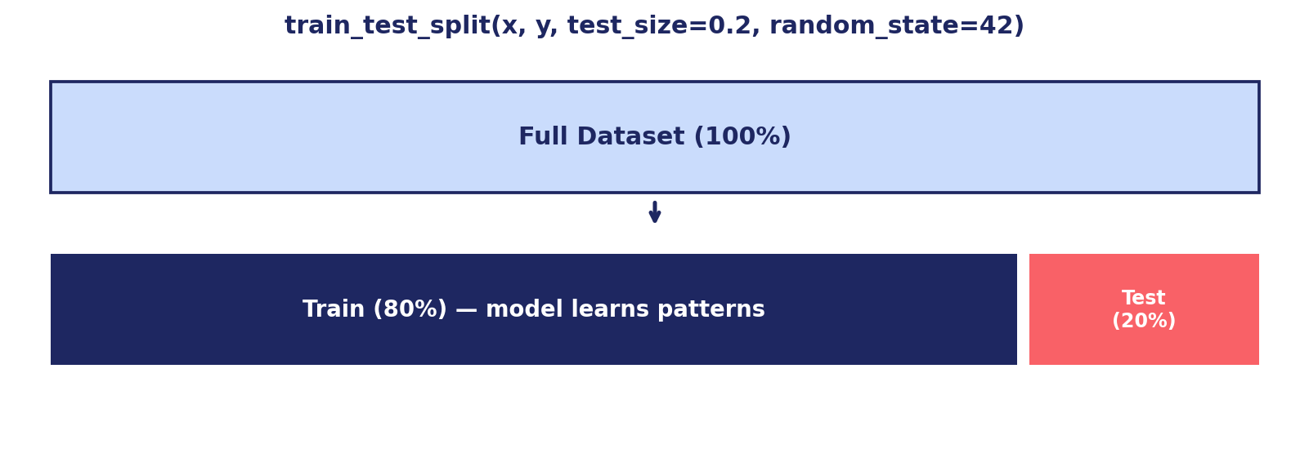
DATA PREPROCESSING
Train / Test Split
The dataset is split so the model is tested on data it never saw during training.
Machine Learning with Python • Term 2
18

Slide 19
DATA PREPROCESSING
Converting Text Columns to Numbers — Manually
Machine learning models only understand numbers, so non-numeric (categorical) columns must be converted, e.g. into 0s and 1s.
data["Placement"] = data["Placement"].replace("No", 0)
data["Placement"] = data["Placement"].replace("Yes", 1)
data["Internship_Experience"] = data["Internship_Experience"].replace("No", 0)
data["Internship_Experience"] = data["Internship_Experience"].replace("Yes", 1)
data["Internship_Experience"] = data["Internship_Experience"].astype(int)
data["Placement"] = data["Placement"].astype(int)
astype(int) ensures values like '1'/'0', 1.0/0.0, or True/False all become standard integers for the model.
Machine Learning with Python • Term 2
19

Slide 20
DATA PREPROCESSING
Encoders: Automatic Text-to-Number Conversion
Why we need encoders
Manual replace() doesn't scale to columns with many categories — encoders do this automatically and consistently.
Label Encoder
Assigns an arbitrary integer to each category — used when the categories have NO natural order/priority.
Ordinal Encoder
Assigns integers that respect a chosen order — used when categories DO have a meaningful priority (e.g. low < med < high).
One-Hot Encoder
Creates a separate 0/1 column for every category, avoiding any implied ordering between them.
All live in
from sklearn import preprocessing
Machine Learning with Python • Term 2
20

Slide 21
DATA PREPROCESSING
Label Encoder
Turns each unique text category into a distinct integer (0, 1, 2, ...). Best when order doesn't matter, e.g. Sex or Embarked port.
from sklearn import preprocessing
encoder = preprocessing.LabelEncoder()
data["Sex"] = encoder.fit_transform(data["Sex"])
data["Embarked"] = encoder.fit_transform(data["Embarked"])
# Applied generically to every text column of a dataset:
for col in data.columns:
if data[col].dtype == "object":
data[col] = encoder.fit_transform(data[col])
Used in the Titanic (section 5) and Loan Approval (section 6) notebooks to encode Sex, Embarked, Gender, Married, Education, etc.
Machine Learning with Python • Term 2
21

Slide 22
DATA PREPROCESSING
Ordinal Encoder
Lets us define the exact category order, so the resulting numbers preserve real-world priority (e.g. low < med < high < vhigh).
cat = [
["low","med","high","vhigh"], # Purchase price
["low","med","high","vhigh"], # Maintenance cost
["2","3","4","5more"], # Doors
["2","4","more"], # Capacity
["small","med","big"], # Luggage
["low","med","high"], # Safety
["unacc","acc","good","vgood"] # Class (target)
]
encoder = preprocessing.OrdinalEncoder(categories=cat)
data2 = encoder.fit_transform(data)
Used on the Car Evaluation dataset (section 4), where 'vhigh' price should encode as a higher number than 'low'.
Machine Learning with Python • Term 2
22

Slide 23
DATA PREPROCESSING
One-Hot Encoder
How it works
Each category becomes its own binary (0/1) column instead of a single integer column.
Example
A 'Color' column with Red/Green/Blue becomes three columns: Color_Red, Color_Green, Color_Blue, each 0 or 1.
Why use it
Label/Ordinal encoding can accidentally imply an order or numeric distance between categories that doesn't exist; One-Hot avoids that.
Trade-off
Creates more columns — best for categorical features with a small number of unlabeled (non-ordered) categories.
Rule of thumb
No priority + few categories -> One-Hot Encoder. No priority + many categories -> Label Encoder. Has priority -> Ordinal Encoder.
Machine Learning with Python • Term 2
23

Slide 24
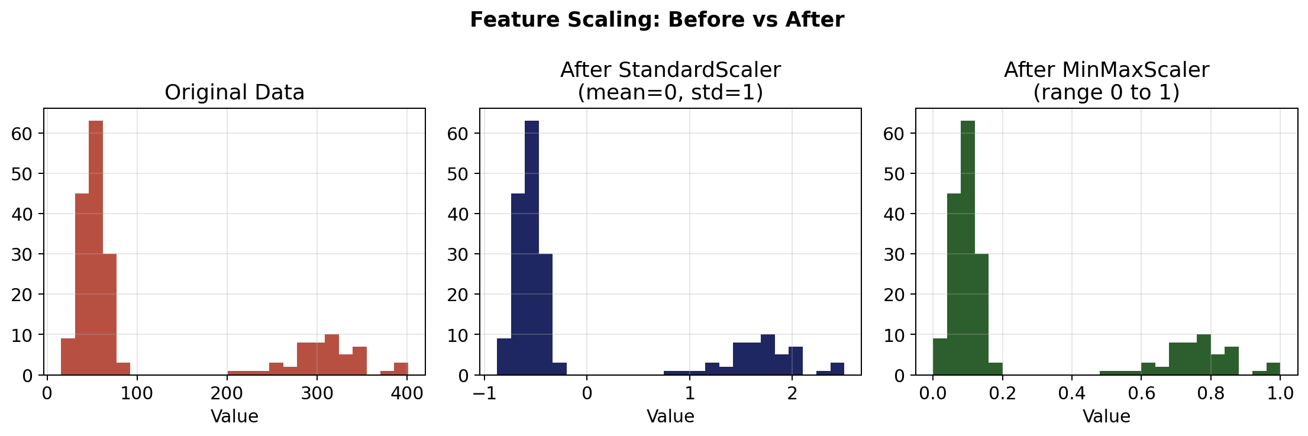
DATA PREPROCESSING
Feature Scaling: Why Scale Data?
Same data before scaling, after StandardScaler, and after MinMaxScaler.
Machine Learning with Python • Term 2
24

Slide 25
DATA PREPROCESSING
StandardScaler
Rescales each feature to have mean = 0 and standard deviation = 1 — useful when features are on very different numeric ranges.
from sklearn import preprocessing
scaler = preprocessing.StandardScaler()
x_cols = x_train.columns
x_train = pd.DataFrame(scaler.fit_transform(x_train), columns=x_cols)
x_test = scaler.transform(x_test) # use the SAME scaler, fitted only on training data
Distance-based models (KNN, SVM) are strongly affected by feature range, so StandardScaler is applied before training them (see Titanic notebook, section 5).
Machine Learning with Python • Term 2
25

Slide 26
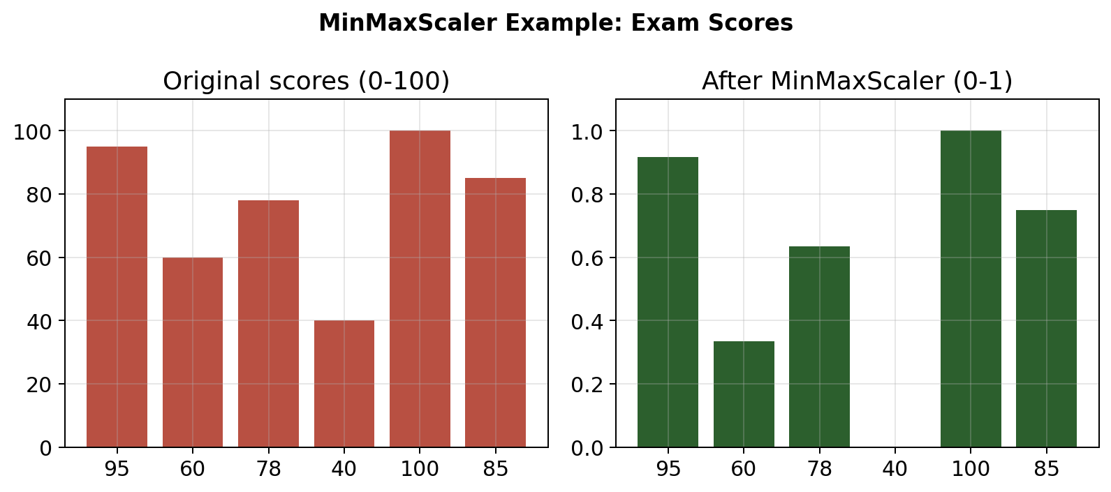
DATA PREPROCESSING
MinMaxScaler
What it does
Squeezes every value of a feature into a fixed range, typically 0 to 1.
Everyday analogy
A class score out of 100 becomes 95 -> 9.5 out of 10 -> 0.95 out of 1: the same relative position, a different scale.
Code
scaler = preprocessing.MinMaxScaler((0,1))
x_train = pd.DataFrame(scaler.fit_transform(x_train), columns=x_cols)
x_test = pd.DataFrame(scaler.transform(x_test), columns=x_cols)
Used in
The Loan Approval SVM notebook (section 6), before training SVC models.
Exam scores rescaled from 0–100 into the 0–1 range.
Machine Learning with Python • Term 2
26

Slide 27
DATA PREPROCESSING
Correlation Between Columns
Definition & range
Correlation measures how strongly two columns move together; values range from -1 to +1.
corr > 0 — Direct relationship
As one feature increases, the other tends to increase too (e.g. car brand rating and car safety).
corr < 0 — Inverse relationship
As one feature increases, the other tends to decrease (e.g. car wear/depreciation up, safety down).
corr = 0 — No relationship
Changing one feature has no effect on the other (e.g. fuel tank being full vs. car safety).
Why it matters
Helps identify which features are actually useful for predicting the target, and which can be dropped.
Machine Learning with Python • Term 2
27

Slide 28
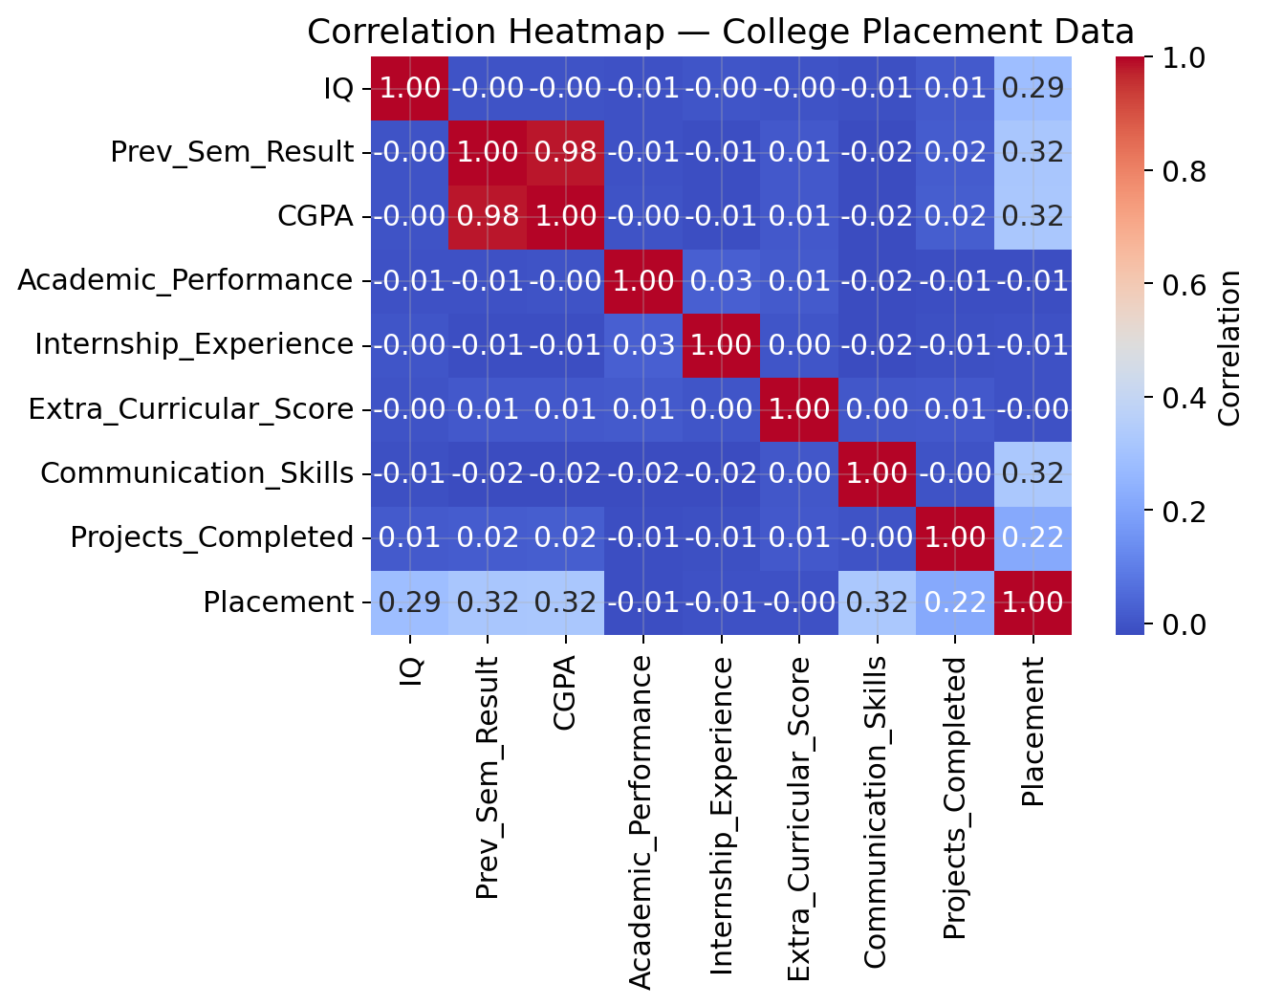
DATA PREPROCESSING
Heatmap: Visualizing Correlation
What a heatmap is
A grid of colored cells where color intensity represents correlation strength between every pair of columns.
How to read it
Darker/warmer colors = stronger correlation; the diagonal is always 1.00 (a column with itself).
Code
plt.figure(figsize=(10,5))
sns.heatmap(data.corr(), annot=True)
plt.show()
Practical use
In the Loan dataset (section 6), columns with |correlation| < 0.02 to Loan_Status were dropped before training.
Correlation heatmap of the College Placement dataset (annot=True shows exact values).
Machine Learning with Python • Term 2
28

Slide 29
PART 3
Regression Models
Predicting a continuous numeric value
Machine Learning with Python • Term 2
29

Slide 30
REGRESSION MODELS
Linear Regression — Concept
y = b0 + b1·x1 + b2·x2 + ... + bn·xn
Definition
A machine learning method that finds the straight line best describing the relationship between one or more inputs and one output.
Goal
Fit a line (or hyperplane) through the data points that minimizes the overall prediction error.
Typical use
Predicting salary from years of experience, or a final exam score from study hours, attendance, and previous grades.
Machine Learning with Python • Term 2
30

Slide 31
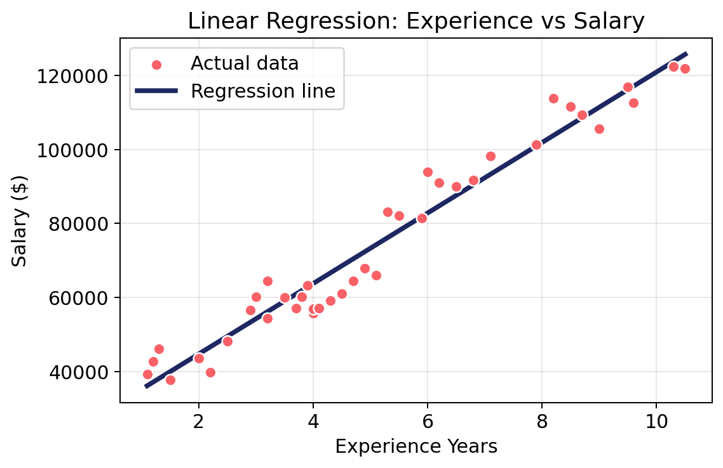
REGRESSION MODELS
Linear Regression in scikit-learn
from sklearn import linear_model, metrics
x = data[["Experience Years"]]
y = data["Salary"]
model = linear_model.LinearRegression()
model.fit(x, y) # learn the pattern
# Double brackets -> 2D input shape (n_samples, n_features)
salary = model.predict([[5]])
print(float(salary[0]))
y_predict = model.predict(x)
metrics.mean_absolute_error(y, y_predict)
Scatter plot of real data with the fitted regression line.
Machine Learning with Python • Term 2
31

Slide 32
REGRESSION MODELS
MAE & MSE — Evaluating Regression
MAE = mean(|y - y_pred|) MSE = mean((y - y_pred)^2)
Mean Absolute Error (MAE)
Average of the absolute (direction-ignoring) differences between actual and predicted values — same unit as the target.
Mean Squared Error (MSE)
Average of the squared differences — squaring removes sign and heavily penalizes larger errors.
When to use which
MAE is easier to interpret and robust to outliers; MSE is more sensitive to large errors, useful when big mistakes are especially costly.
Machine Learning with Python • Term 2
32

Slide 33
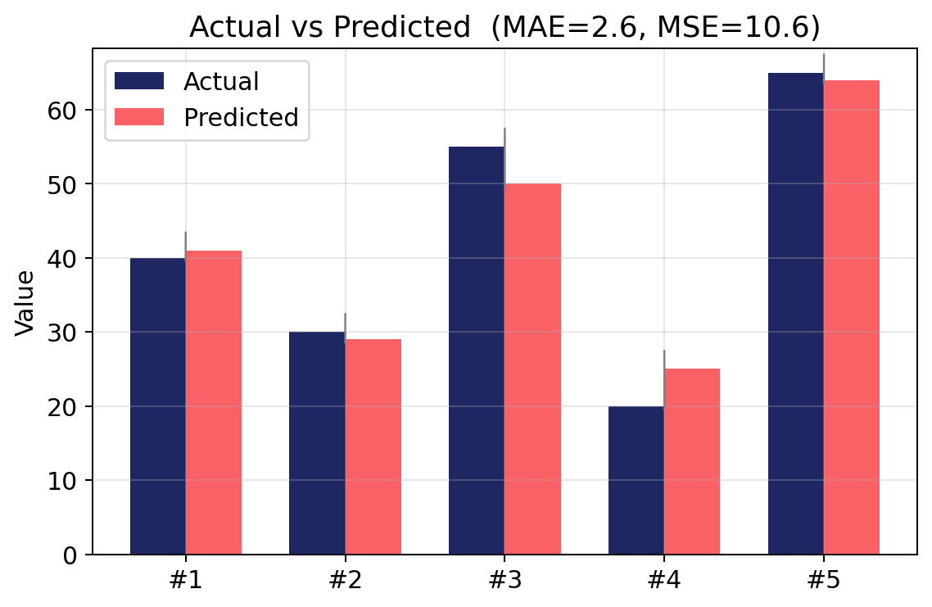
REGRESSION MODELS
MAE & MSE — Worked Example
Actual values (y)
40, 30
Predicted values
41, 29
MAE calculation
(|40-41| + |30-29|) / 2 = (1 + 1) / 2 = 1
MSE calculation
((40-41)^2 + (30-29)^2) / 2 = (1 + 1) / 2 = 1
Note
Actual vs predicted bars for 5 samples, with resulting MAE and MSE.
Simply averaging signed errors, (-1 + 1)/2 = 0, would hide the fact that mistakes were made — this is why MAE/MSE use absolute value or squaring.
Machine Learning with Python • Term 2
33

Slide 34
PART 4
Classification Models
Predicting a category or class label
Machine Learning with Python • Term 2
34

Slide 35
CLASSIFICATION MODELS
Logistic Regression — Concept
Definition
A supervised classification model that estimates the probability an input belongs to a given class, using the sigmoid (S-shaped) function.
How it works
It computes a linear combination of the inputs, then squashes that value into a 0–1 probability using the sigmoid function.
Decision rule
If the probability is above a threshold (commonly 0.5), the model predicts class 1; otherwise class 0.
Typical use
Predicting loan approval, admission/placement decisions — 'yes/no' style outcomes.
Machine Learning with Python • Term 2
35

Slide 36
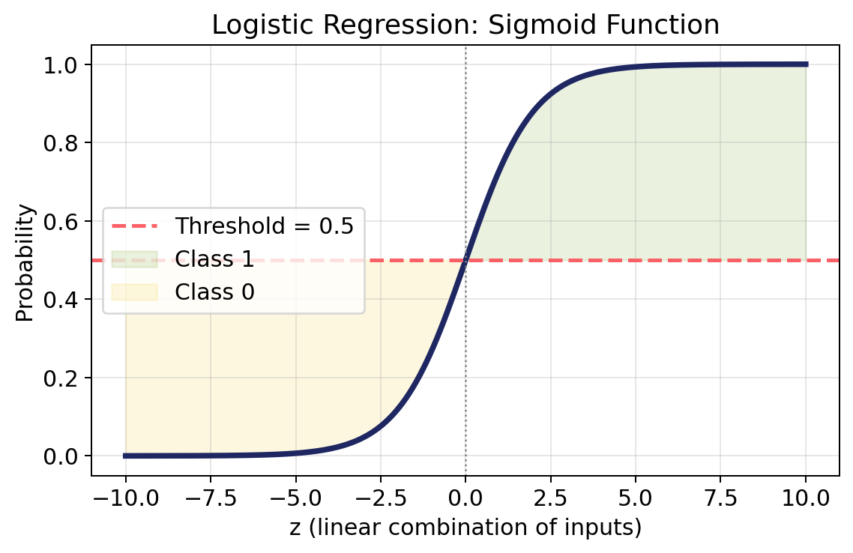
CLASSIFICATION MODELS
Logistic Regression in scikit-learn
from sklearn import linear_model, metrics
from sklearn.model_selection import train_test_split
x = data.drop("Placement", axis=1)
y = data["Placement"]
x_train, x_test, y_train, y_test = train_test_split(
x, y, random_state=42, test_size=0.2)
model = linear_model.LogisticRegression()
model.fit(x_train, y_train)
y_predict = model.predict(x_test)
metrics.accuracy_score(y_test, y_predict) * 100
The sigmoid curve maps any input to a 0–1 probability; 0.5 is the decision threshold.
Machine Learning with Python • Term 2
36

Slide 37
CLASSIFICATION MODELS
Decision Tree — Concept
Definition
A model that repeatedly splits the data on the feature that most reduces 'impurity' (mixing of classes) at each step.
Gini impurity
A score measuring how mixed a group is. A group with 10 girls / 0 boys has impurity 0 (pure); 5 girls / 5 boys has impurity 0.5 (maximally mixed).
How splits are chosen
The feature/threshold that produces the purest child groups (lowest Gini) is selected at each node.
Works for both
Decision Trees (and Random Forests) can be used for both classification and regression problems.
Machine Learning with Python • Term 2
37

Slide 38
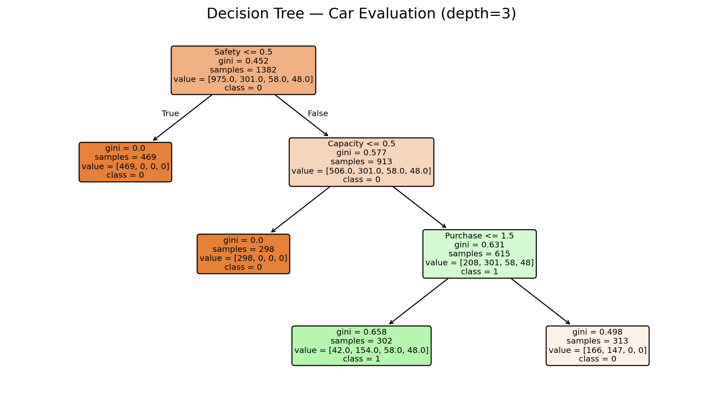
CLASSIFICATION MODELS
Decision Tree in scikit-learn
from sklearn import tree, metrics
model_tree = tree.DecisionTreeClassifier()
model_tree.fit(x_train, y_train)
y_predict = model_tree.predict(x_test)
metrics.accuracy_score(y_test, y_predict) * 100
# Visualize the tree
tree.plot_tree(model_tree, max_depth=3)
plt.show()
Decision tree trained on the Car Evaluation dataset (first 3 levels shown).
Machine Learning with Python • Term 2
38

Slide 39
CLASSIFICATION MODELS
Random Forest — Concept
Definition
An ensemble of many decision trees, where each tree trains on a different portion of the data.
How the final answer is chosen
Every tree makes its own prediction, then the forest takes a majority vote among all trees to decide the final output.
Why it helps
Combining many imperfect trees reduces overfitting and typically improves accuracy compared with a single tree.
Works for both
Just like Decision Trees, Random Forests handle both classification and regression tasks.
Machine Learning with Python • Term 2
39

Slide 40
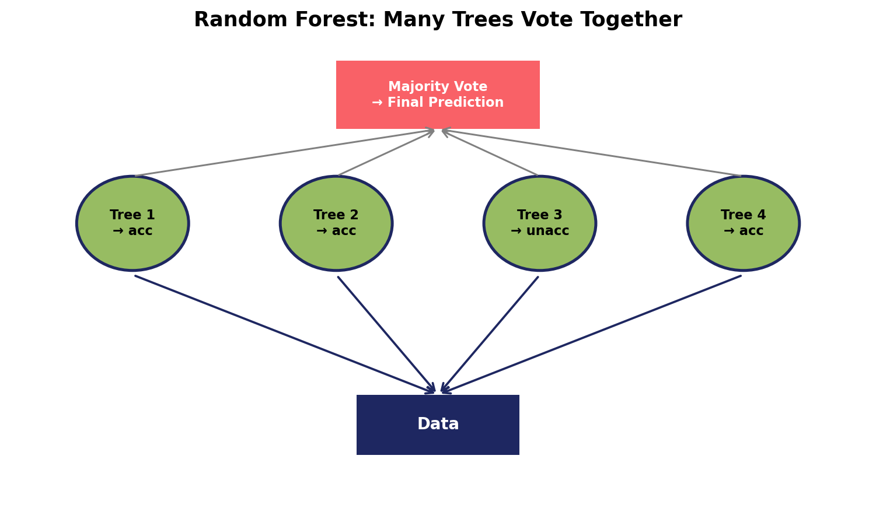
CLASSIFICATION MODELS
Random Forest in scikit-learn
from sklearn import ensemble, metrics
model_forest = ensemble.RandomForestClassifier(random_state=42)
model_forest.fit(x_train, y_train)
y_predict = model_forest.predict(x_test)
metrics.accuracy_score(y_test, y_predict) * 100
Multiple trees each vote; the majority decision becomes the forest's final prediction.
Machine Learning with Python • Term 2
40

Slide 41
CLASSIFICATION MODELS
K-Nearest Neighbors (KNN) — Concept
Definition
Finds the K closest data points (neighbors) to a new sample, then assigns the majority class among those neighbors.
Effect of K
K too large -> the model becomes biased toward whichever class has more samples overall.
Effect of K (continued)
K too small -> the model's accuracy and stability drop, since a single noisy neighbor can flip the prediction.
Sensitive to scale
Because KNN relies on distance between points, features must be scaled (e.g. with StandardScaler) before training.
Machine Learning with Python • Term 2
41

Slide 42
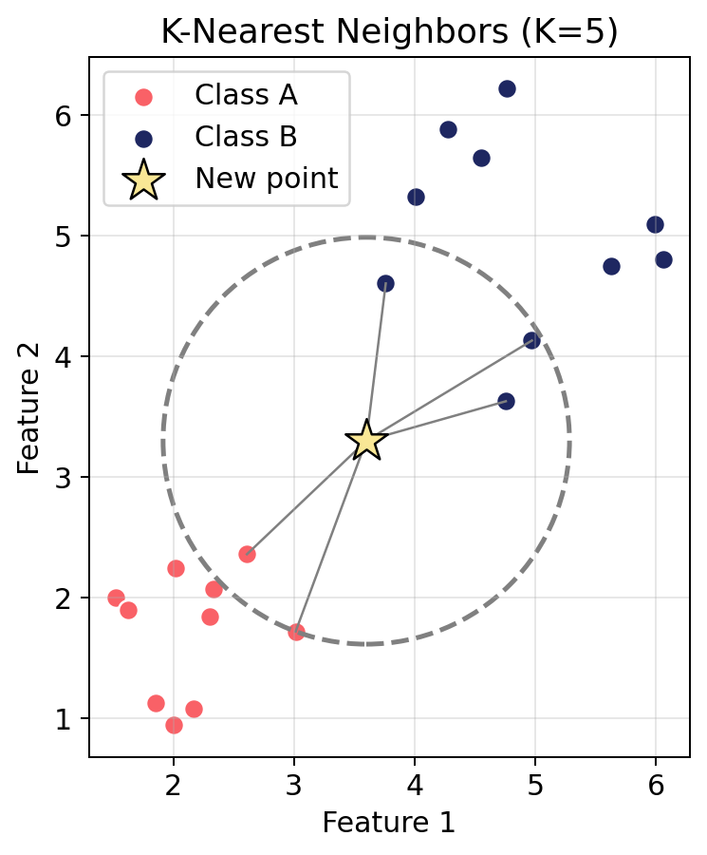
CLASSIFICATION MODELS
How KNN Classifies a New Point
The new point (star) is classified by the majority vote of its K=5 nearest neighbors.
Machine Learning with Python • Term 2
42

Slide 43
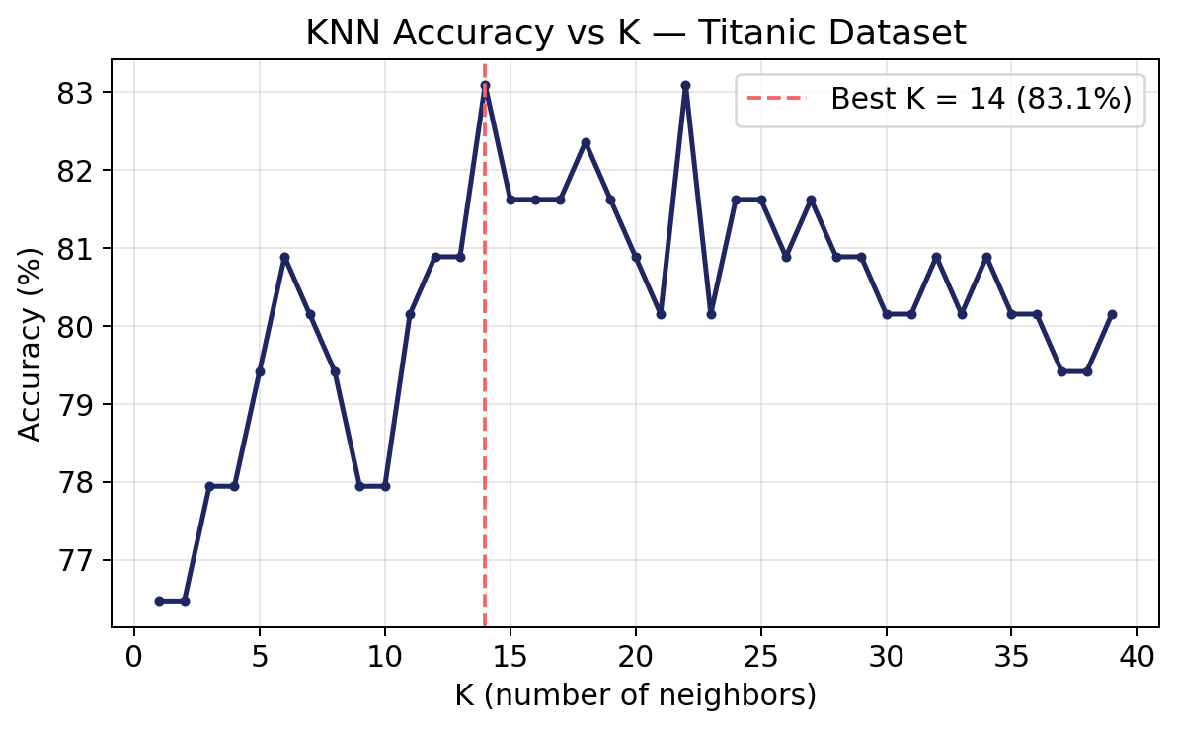
CLASSIFICATION MODELS
Finding the Best K — KNN in scikit-learn
from sklearn import neighbors, metrics
list_accuracy = []
for k in range(1, x_train.shape[0]):
model_knn = neighbors.KNeighborsClassifier(k)
model_knn.fit(x_train, y_train)
y_pred = model_knn.predict(x_test)
acc = metrics.accuracy_score(y_test, y_pred) * 100
list_accuracy.append(acc)
best_k = list_accuracy.index(max(list_accuracy)) + 1
model_knn = neighbors.KNeighborsClassifier(best_k)
model_knn.fit(x_train, y_train)
Accuracy vs K on the Titanic dataset — best K found automatically.
Machine Learning with Python • Term 2
43

Slide 44
CLASSIFICATION MODELS
Support Vector Machine (SVM) — Concept
Definition
Finds the boundary (hyperplane) that separates classes while staying as far as possible from the nearest samples of each class.
Margin & support vectors
Margin = the safe distance between the boundary and the closest points. Support vectors = those closest, boundary-defining points.
Kernels
SVM can use different kernels (linear, poly, rbf, sigmoid) to project data into different dimensions and separate it in ways a straight line can't.
SVC vs SVR
SVC (Support Vector Classifier) solves classification problems; SVR (Support Vector Regressor) solves regression problems.
Machine Learning with Python • Term 2
44

Slide 45
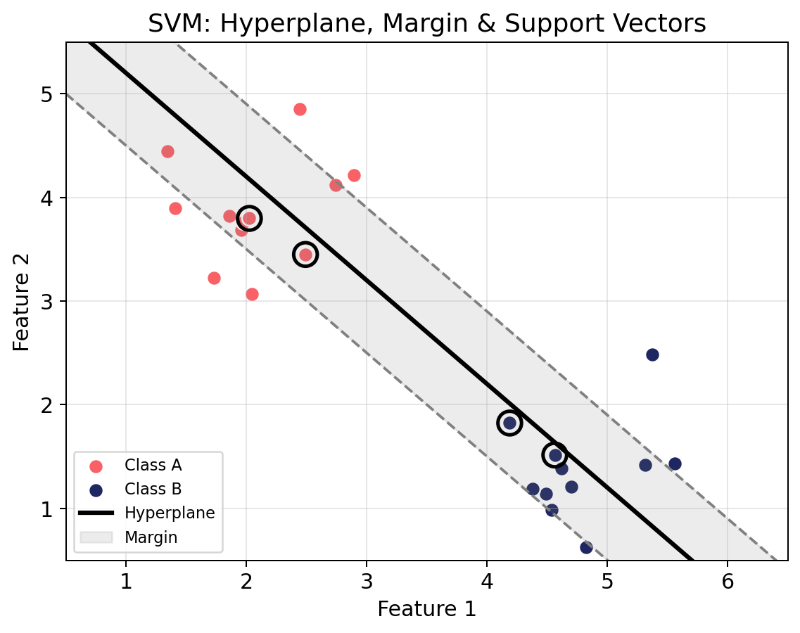
CLASSIFICATION MODELS
SVM: Hyperplane, Margin & Support Vectors
The circled points are the support vectors that define the margin around the separating hyperplane.
Machine Learning with Python • Term 2
45

Slide 46
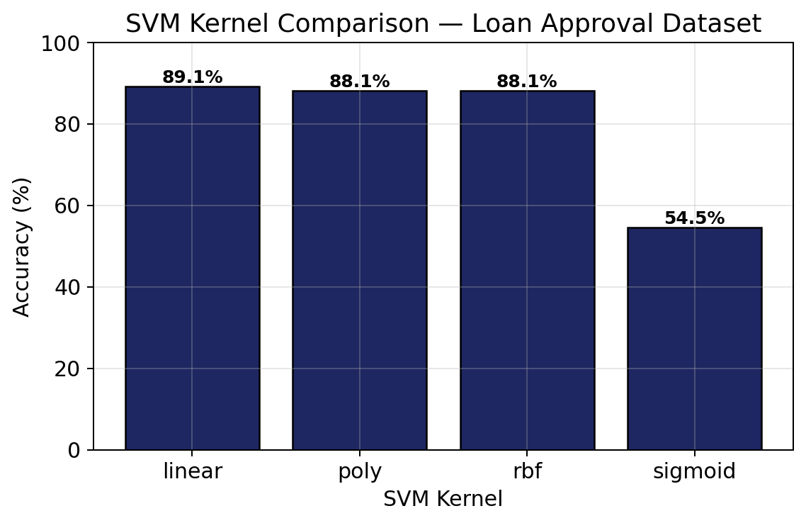
CLASSIFICATION MODELS
Comparing SVM Kernels
from sklearn import svm, metrics
for k in ["linear", "poly", "rbf", "sigmoid"]:
model_svm = svm.SVC(kernel=k)
model_svm.fit(x_train, y_train)
y_pred = model_svm.predict(x_test)
acc = metrics.accuracy_score(y_test, y_pred) * 100
print(k, acc)
# Best model can be saved for later use
import pickle
with open("model_loan.pkl","wb") as file:
pickle.dump(model_svm1, file)
Kernel comparison on the Loan Approval dataset (MinMaxScaler applied first).
Machine Learning with Python • Term 2
46

Slide 47
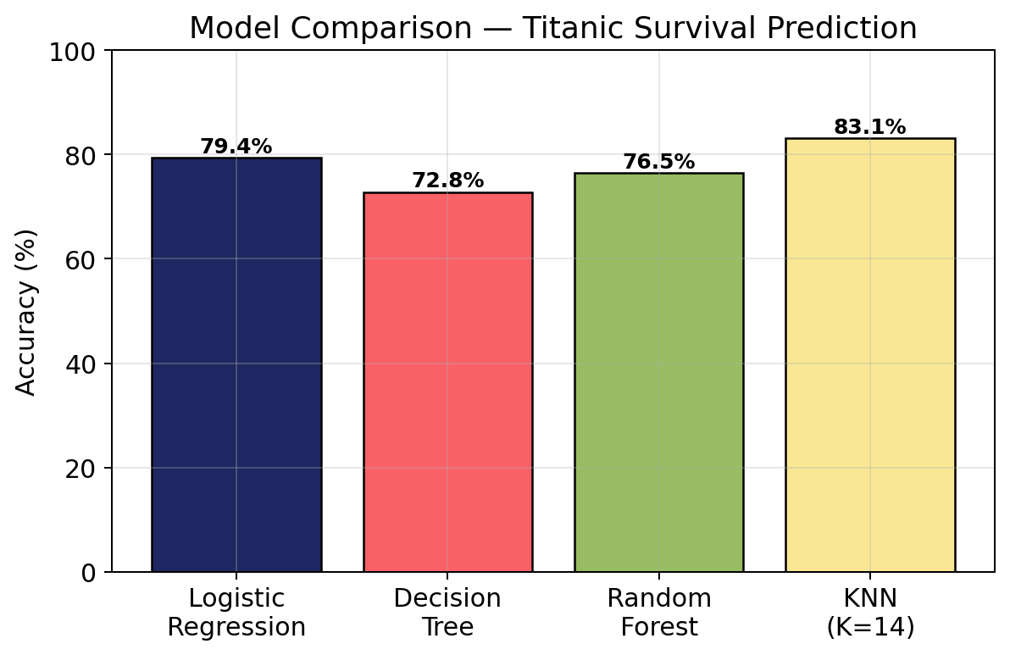
WRAP-UP
Model Comparison — Titanic Survival Prediction
Same train/test split and scaled features; accuracy varies by model and hyperparameters (e.g. K).
Machine Learning with Python • Term 2
47

Slide 48
WRAP-UP
The Complete Machine Learning Workflow
1. Load data
pd.read_csv() to bring the dataset into a DataFrame.
2. Explore & clean
head/tail/info/describe/isnull/duplicated, then fillna/dropna/drop_duplicates.
3. Encode categories
replace(), LabelEncoder, OrdinalEncoder, or OneHotEncoder to turn text into numbers.
4. Analyze relationships
data.corr() and sns.heatmap() to see which features relate to the target.
5. Split & scale
train_test_split(), then StandardScaler / MinMaxScaler (fit on train, transform on test).
6. Train & evaluate
model.fit(x_train, y_train), model.predict(x_test), then MAE/MSE (regression) or accuracy_score (classification).
Machine Learning with Python • Term 2
48

Slide 49
WRAP-UP
Key Takeaways
Data must become numbers
Every non-numeric feature needs an encoder before it can reach a model.
Regression predicts numbers, classification predicts categories
Choose the matching model and metric (MAE/MSE vs accuracy_score).
Scaling matters for distance-based models
KNN and SVM need StandardScaler/MinMaxScaler; tree-based models generally do not.
Always test on unseen data
train_test_split protects against overestimating how well a model will generalize.
No single best model
Linear/Logistic Regression, Decision Tree, Random Forest, KNN, and SVM each fit different data shapes — compare and choose.
Machine Learning with Python • Term 2
49

Slide 50
Thank You
Questions & Discussion
Machine Learning with Python — Term 2 Course Summary
Machine Learning with Python • Term 2
50

