Slide 1
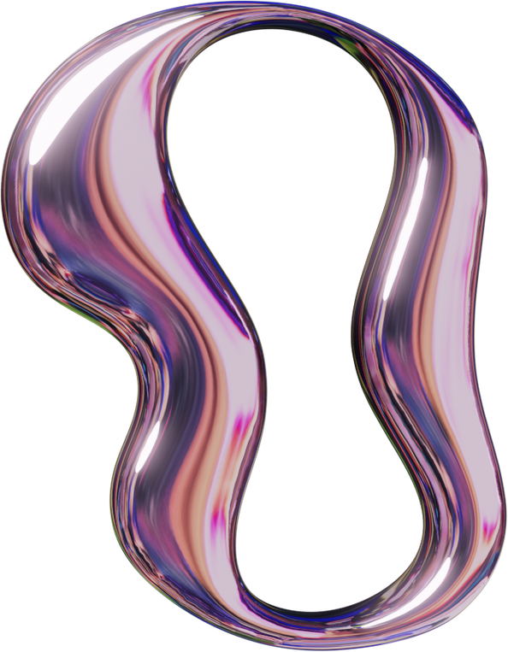


PNEUMONIA DETECTION FROM CHEST X-RAYS
page 01
BY: SALMAN KHAN
(22I-1285)
2025

Slide 2


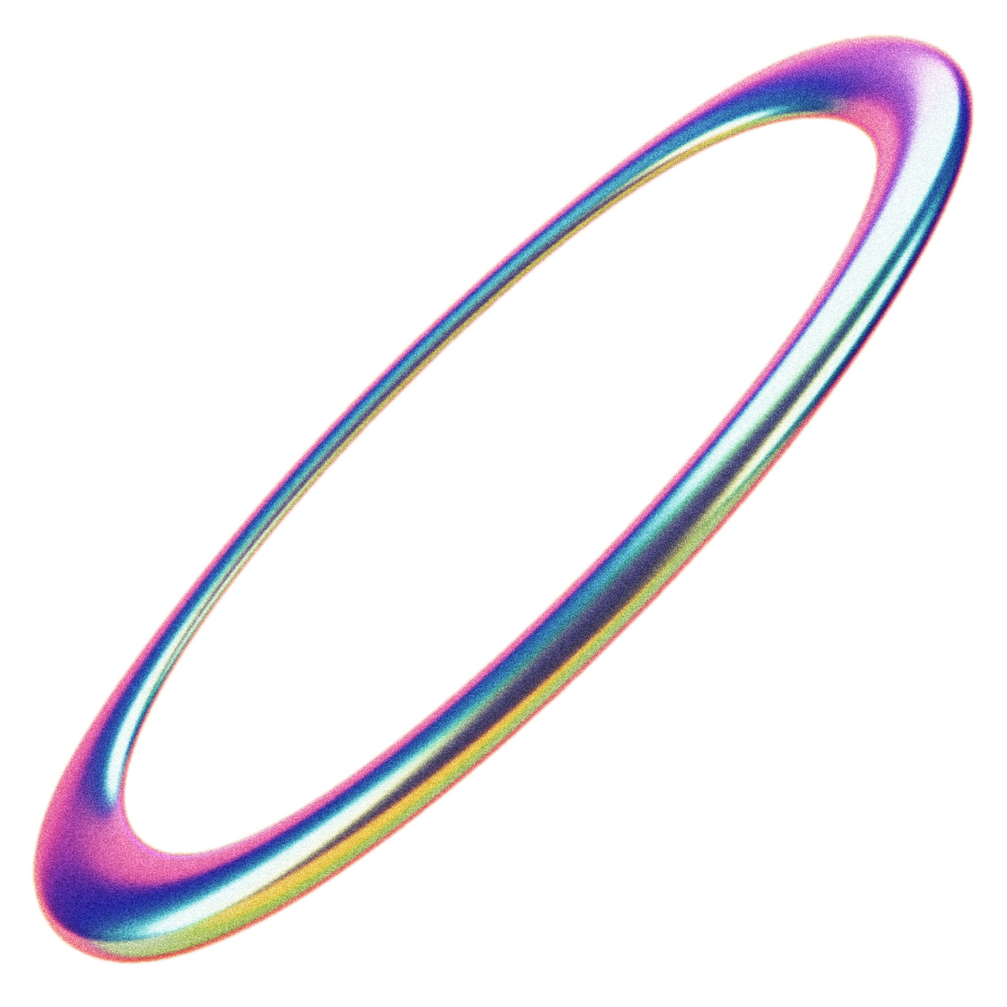
Problem
Objective: Detect pneumonia from chest X-ray images using deep learning.
Dataset: Kaggle chest X-ray dataset (5856 images: NORMAL, PNEUMONIA).
Train: ~4694 (NORMAL: ~1207, PNEUMONIA: ~3487, 90% split).
Validation: ~522 (NORMAL: ~134, PNEUMONIA: ~387, 10% split).
Test: 624 (NORMAL: 234, PNEUMONIA: 390).
Challenge: Manual X-ray analysis is error-prone due to human variability and image quality issues (e.g., rotation, contrast loss).
Approach: Use LSTM and MobileNet models to automate and improve accuracy.
Goal: Achieve high accuracy (>95%) for reliable pneumonia detection.
page 02

Slide 3
Model Architecture
LSTM Model (RNN Model):
Input: 150x150x3 images reshaped to (150, 450).
Layers: 3 LSTM (250, 120, 64 units, dropout=0.05, recurrent_dropout=0.20).
Dense: 250, 120, 64, 28 (ReLU), 2 neurons (softmax).
Optimizer: Adam, Loss: Categorical cross-entropy.
MobileNet Model (transfer learning):
Pre-trained MobileNet (ImageNet, frozen), input: 150x150x3.
Layers: GlobalAveragePooling2D, Dense(128, ReLU), Dense(2, softmax).
Optimizer: Adam, Loss: Categorical cross-entropy.
Training: 10 epochs, batch size=32, class weights for imbalance (NORMAL: ~2.89, PNEUMONIA: ~0.35).
page 03

Slide 4

Results, Evaluation, Challenges & Lessons
Results:
LSTM: ~79.2% test accuracy.
MobileNet: ~96.98% test accuracy.
Metrics: Precision, Recall, F1-score; Confusion matrices show strong PNEUMONIA detection.
Grad-CAM: MobileNet focuses on lung opacities (visualized on test PNEUMONIA image).
page 04

Slide 5
Evaluation
Training/validation accuracy and loss curves show convergence.
MobileNet outperforms LSTM in efficiency, with better accuracy.
page 05

Slide 6
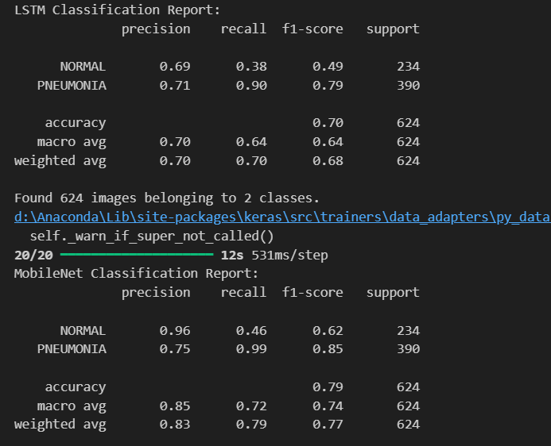
Evaluation
page 04

Slide 7
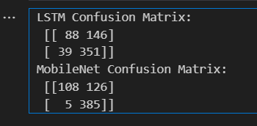
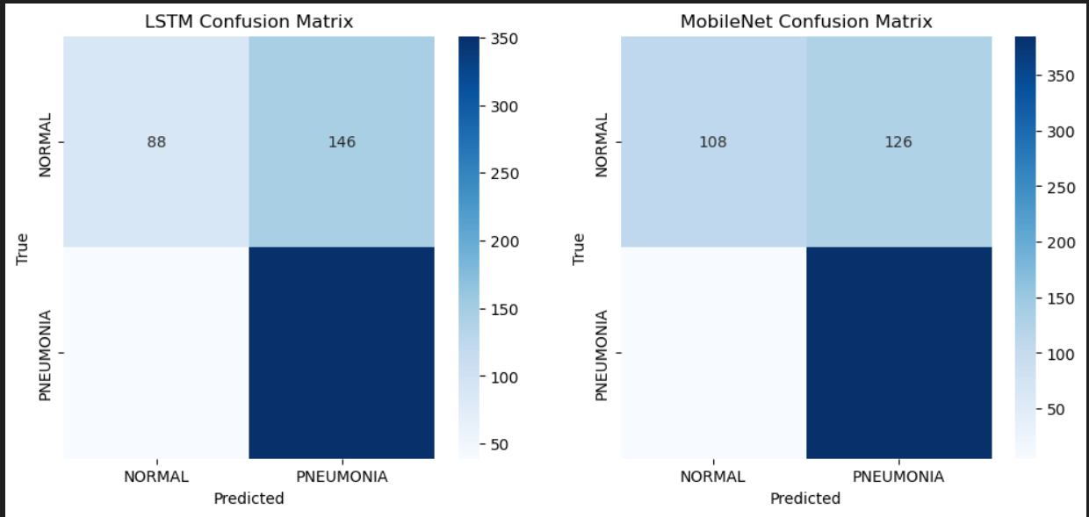
Evaluation
page 04

Slide 8
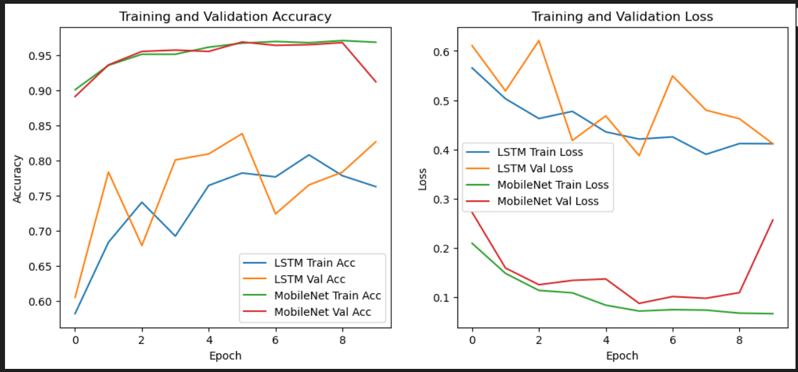
Evaluation
page 04

Slide 9
Challenges
Class imbalance (PNEUMONIA > NORMAL) addressed with class weights.
LSTM preprocessing (reshaping) computationally intensive. (Took like 30 mins for just 10 epochs)
Small validation set (~522 images) risks unreliable metrics.
Grad Cam is tough to get working :(
Alternatively, Main function is provided for testing
Also, tried to achieve accuracy mentioned in the refereced paper (which was better than MobileNet ) but fell short
Alternatively, implemented robust MobileNet version to compensate for time and accuracy
page 05

Slide 10
Lessons Learnt
Transfer learning (MobileNet) is faster and effective for small datasets.
LSTM suits sequential data but less intuitive for image features.
Grad-CAM enhances trust by showing model focus on lungs.
CNN Algos work best for image analysis rather than sequential ones which need robust hyper paramerters adjustment
page 05

Slide 11
Extra
Reference paper for learning and experimented method:
S. Hossain, Rafeed Rahman, Pneumonia Detection by Analyzing Xray Images Using MobileNET ResNET Architecture and Long Short Term Memory(2020).
Github link for code, slides and video recording:
https://github.com/povsalman/Pneumonia-Detection-from-Chest-X-Rays.git
page 06

Slide 12
THANK YOU!
page 15

