Slide 1
Mathematical Foundations
MFDS & MFML Team

Slide 2
Mathematical Foundations
Webinar#2

Slide 3
Agenda
Problems on
Orthogonal Matrices
Gram-Schmidt orthogonalization
Characteristic polynomial
Eigen values and Eigen vectors
Spectral theorem
Singular Value Decomposition

Slide 4
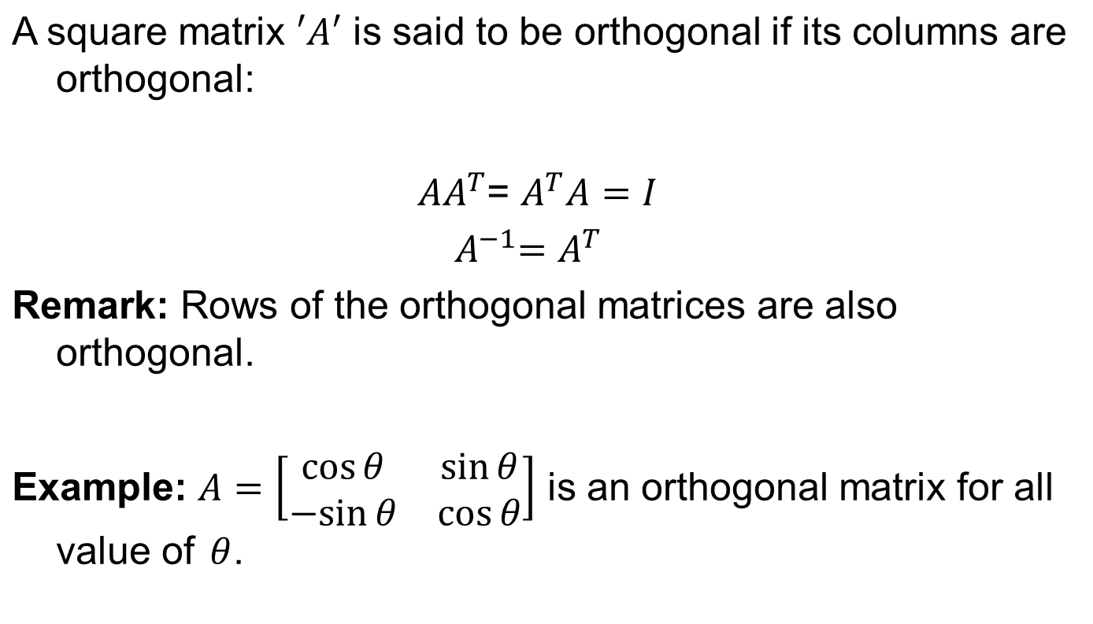
Some Important Definitions
orthonormal
(Orthonormal columns means dot product of any two columns is zero and each column is of length 1)
Equivalently, we can say
orthonormal

Slide 5
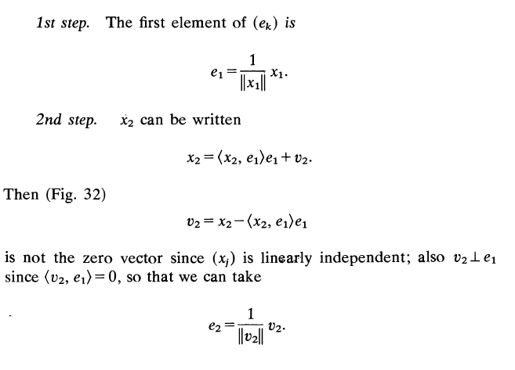
Gram-Schmidt Orthonormalization Method
Given a linearly independent set {x₁, x₂, …. x_{n}} we have to find an orthonormal set {e₁, e₂, … e_{n}} such that span {x₁, x₂, …. x_{n}} = span {e₁, e₂, … e_{n}} .

Slide 6
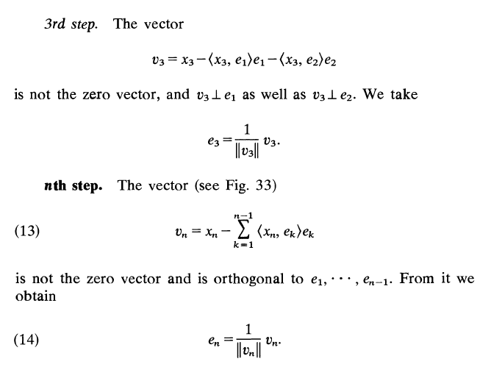
Gram-Schmidt Orthonormalization Method

Slide 7
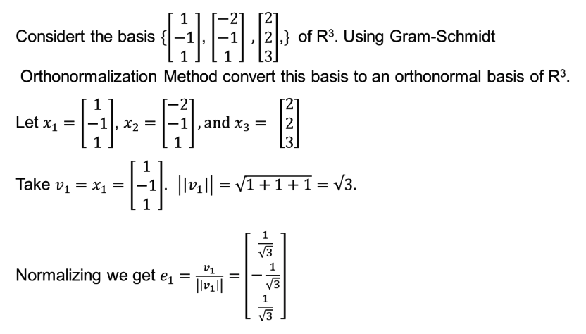
Example

Slide 8
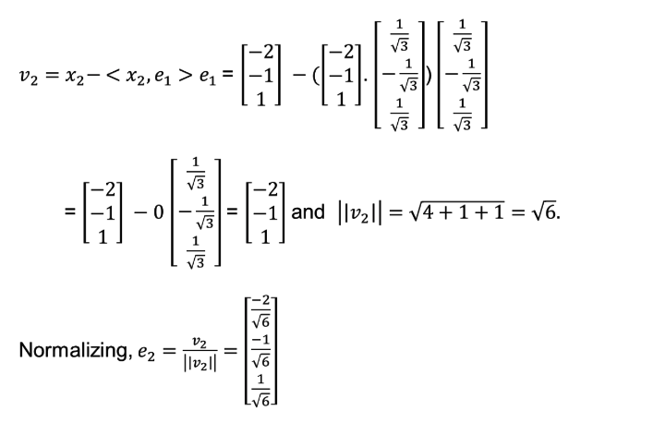
Example

Slide 9
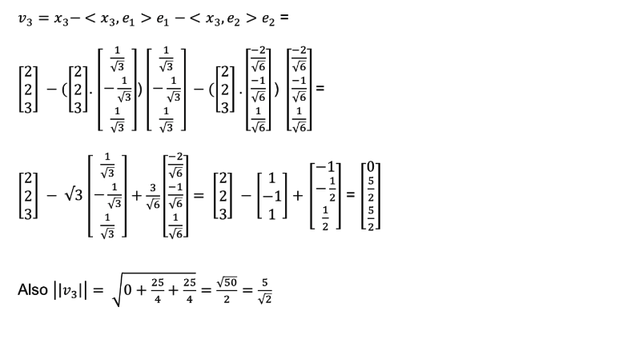
Example

Slide 10
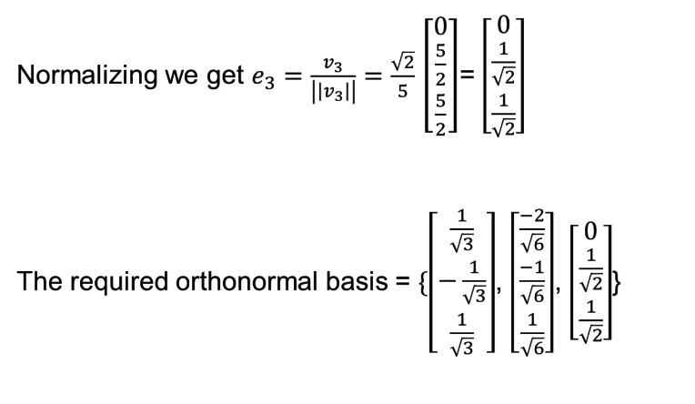
Example

Slide 11
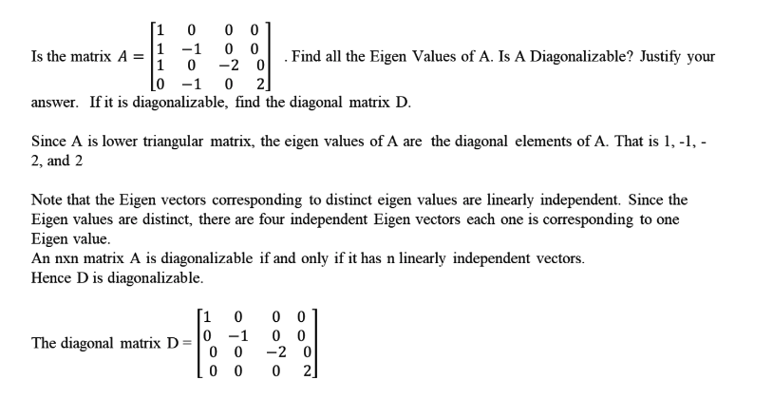
Problem on Diagonalization

Slide 12
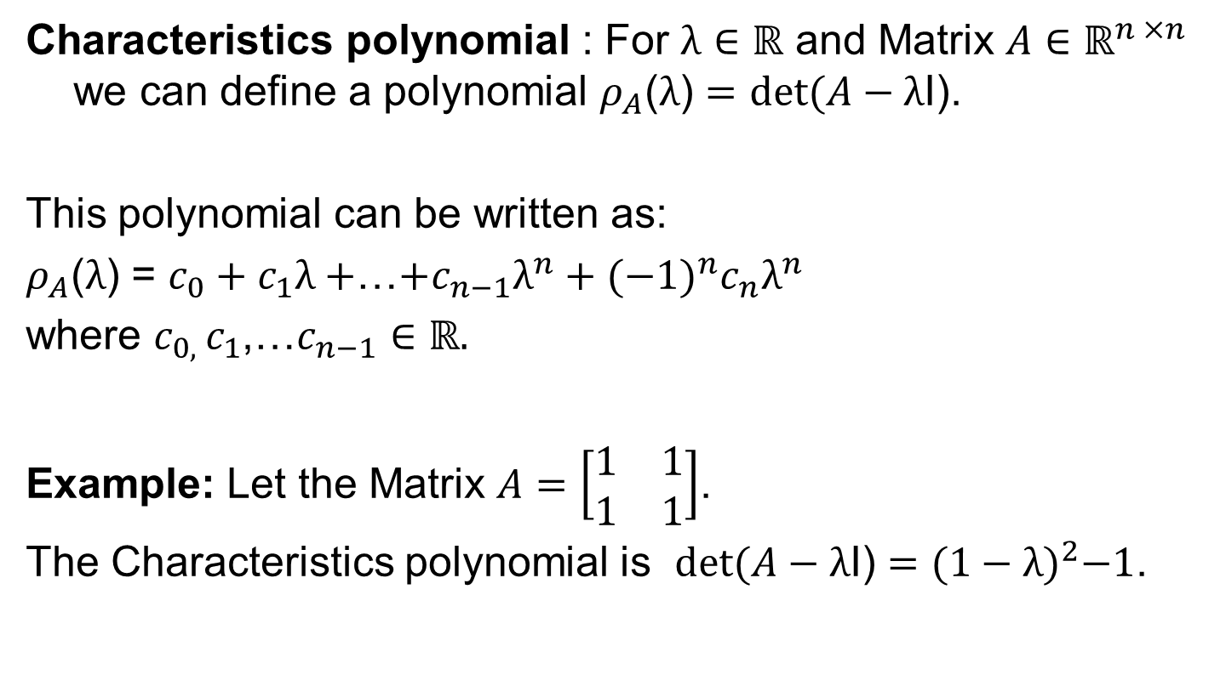
Characteristics Polynomial
-1

Slide 13
Eigenvalues and eigenvectors
Let A be n×n square matrix.
λ ∈ R is called eigenvalue of A and x ∈ R^{n} \ {0} is the corresponding eigenvector of λ if
Ax = λx
This equation is called the eigenvalue equation.

Slide 14
Spectral Theorem
Theorem: If A is n x n symmetric matrix then there exists an orthonormal basis of the corresponding vector space V consisting of the eigenvectors of A, and each eigenvalue is real.

Slide 15
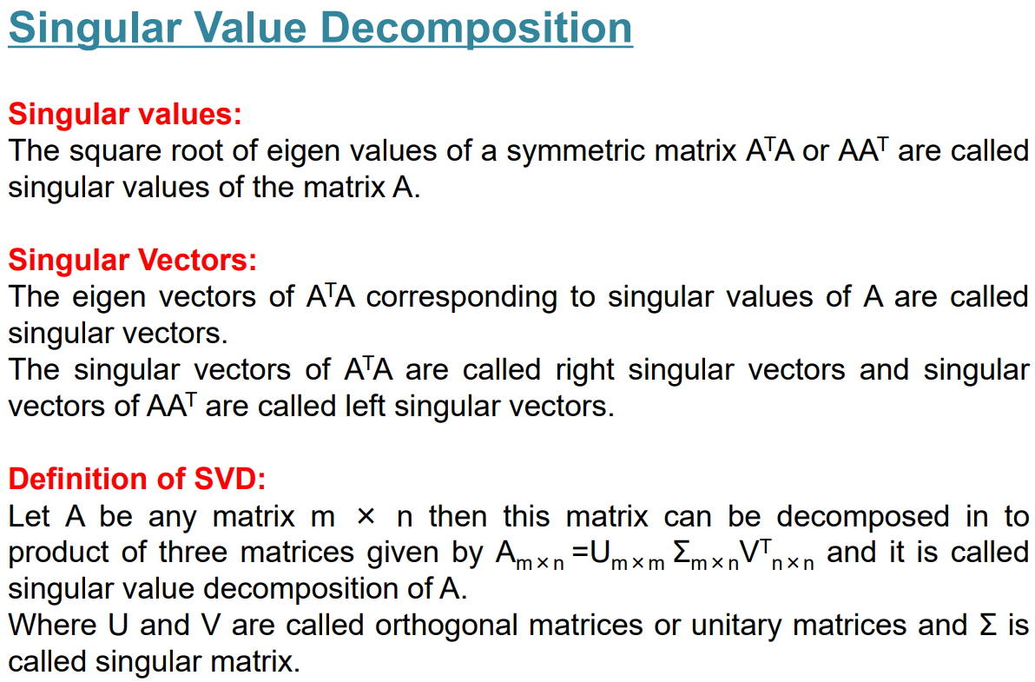

Slide 16
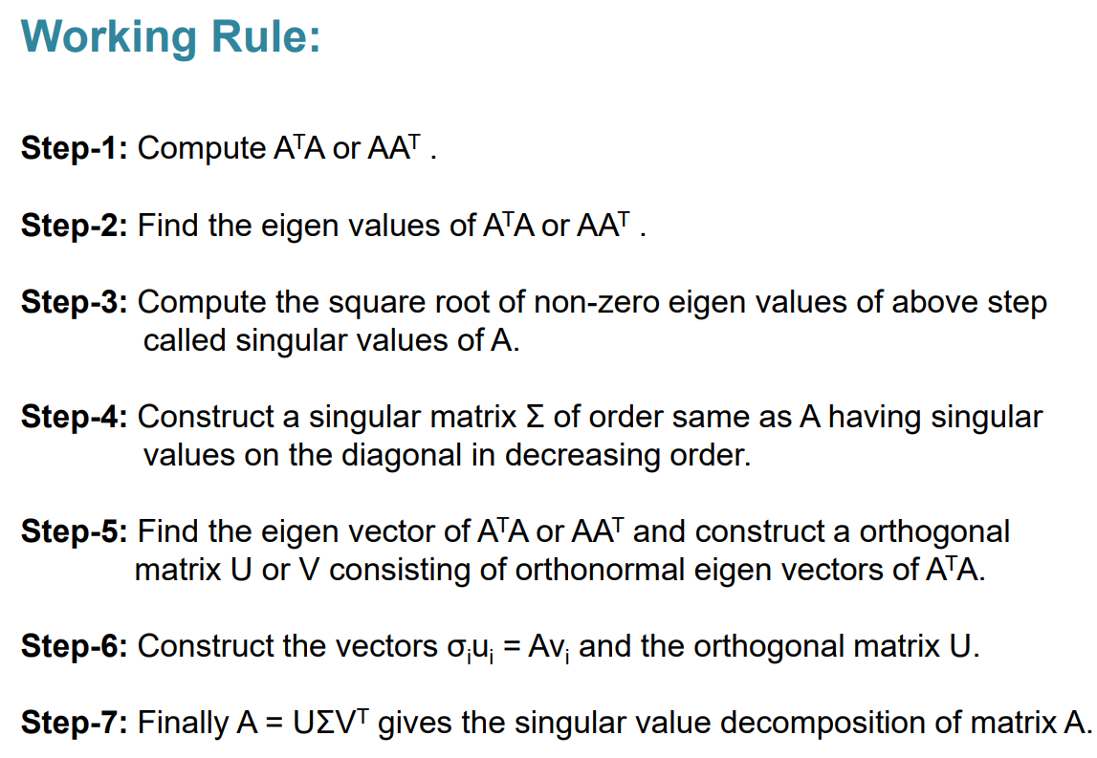

Slide 17
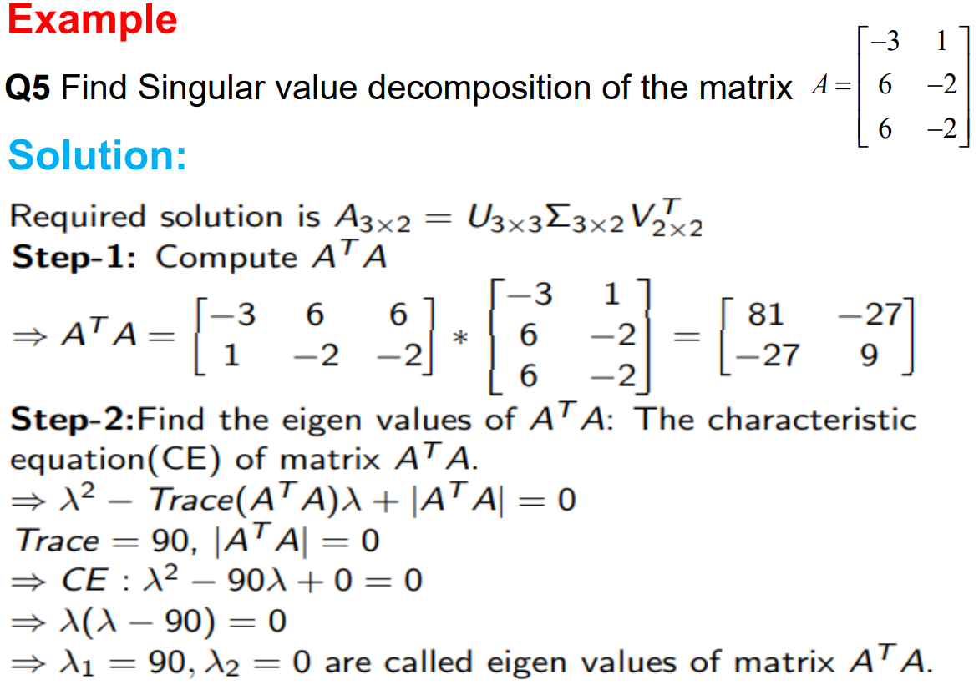
Note: You can also form the characteristic equation: det(A – λI) = 0.

Slide 18
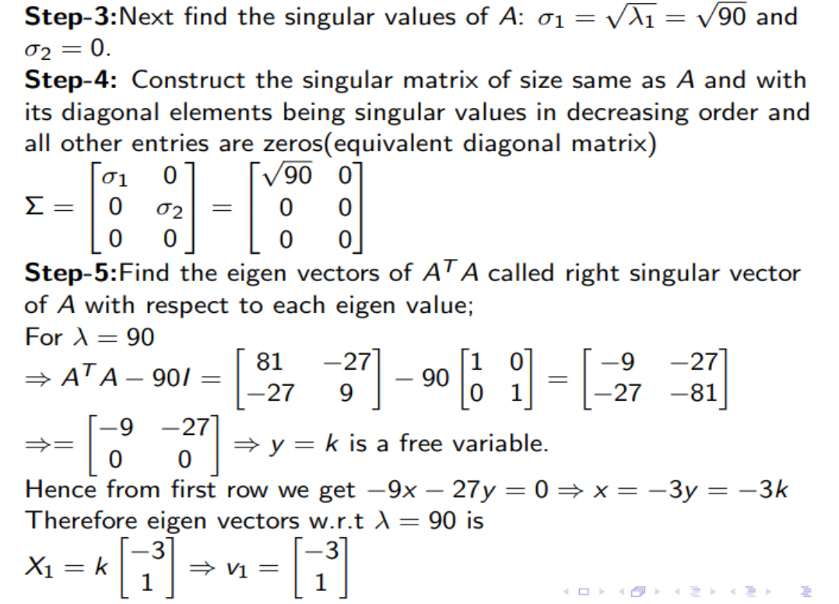

Slide 19
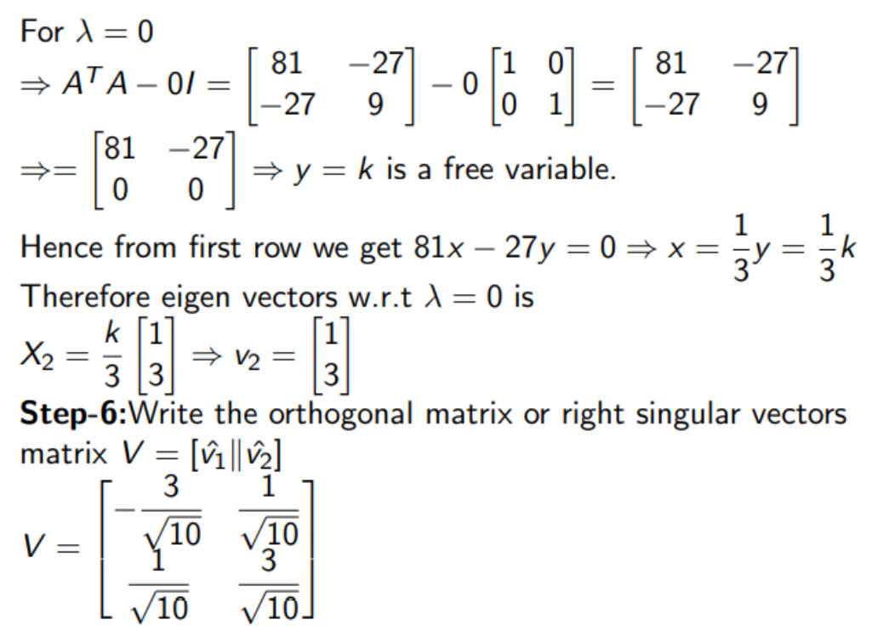

Slide 20
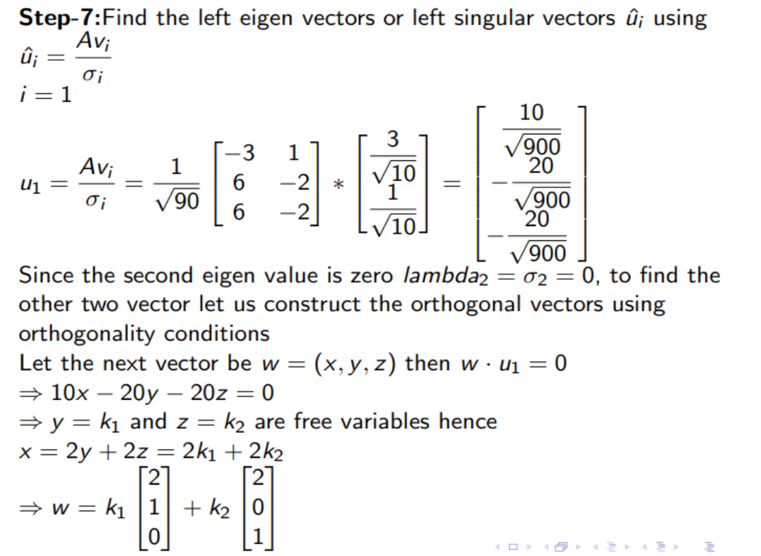

Slide 21
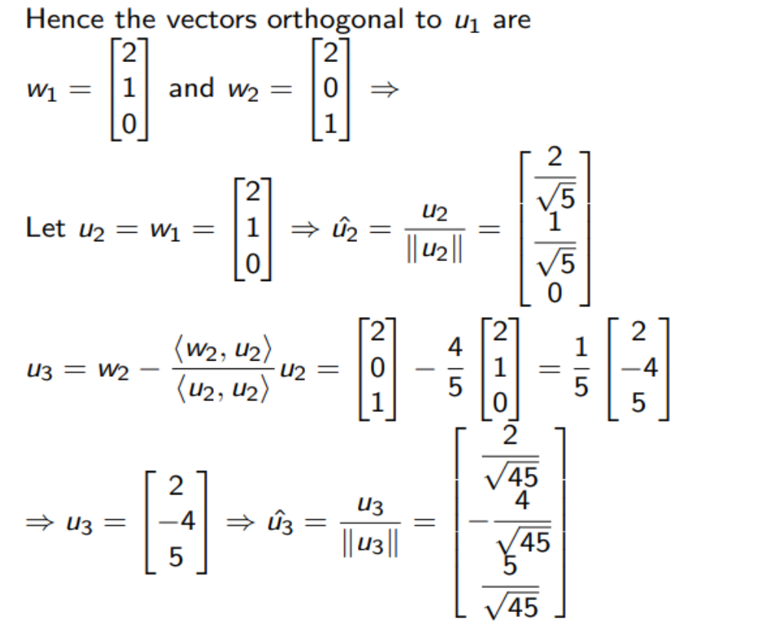

Slide 22
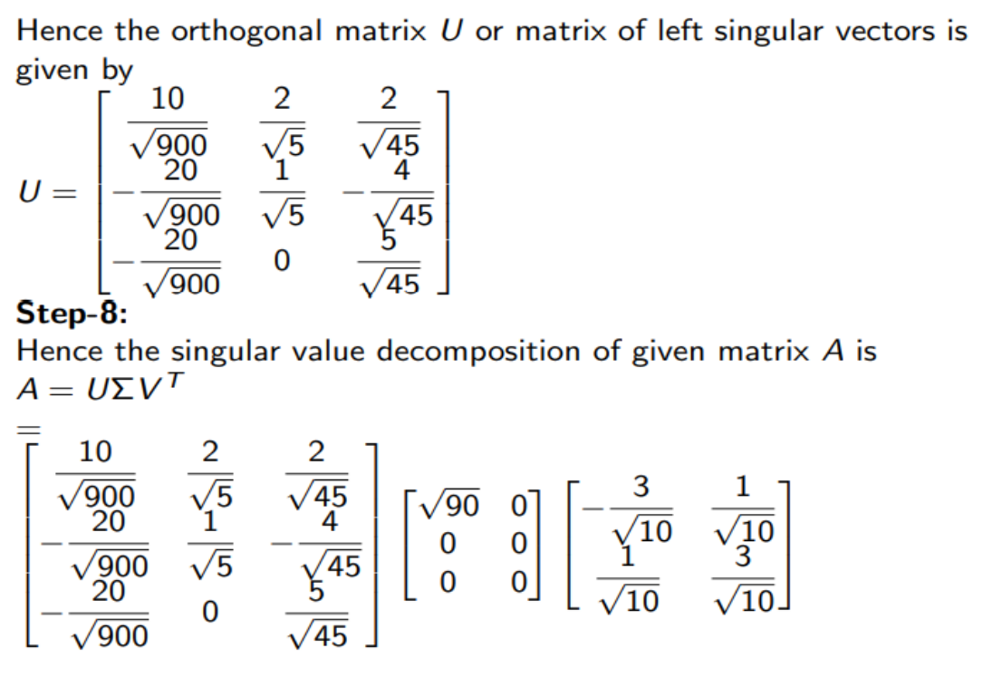

Slide 23
Problem 1

Slide 24
Solution

Slide 25
Solution

Slide 26
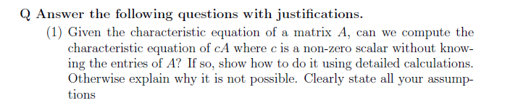
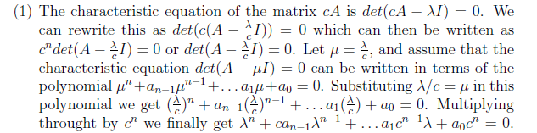
Problem 2
Solution:

Slide 27
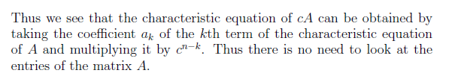

Slide 28
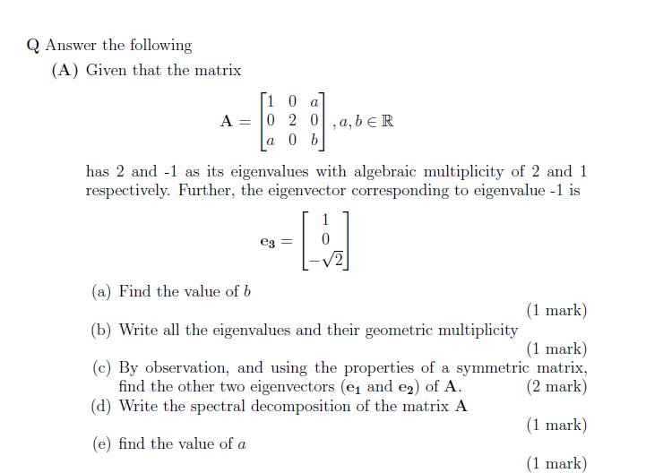
Problem 3

Slide 29
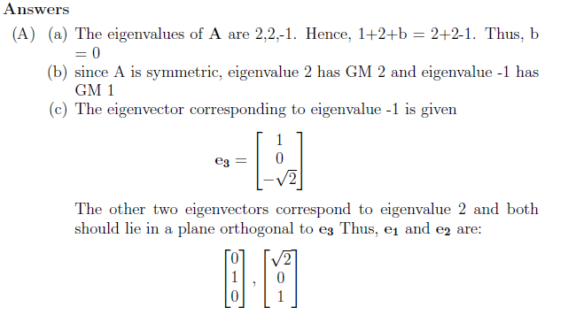
Problem 3 – Solution

Slide 30
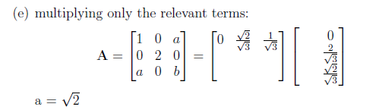
Problem 3 - Solution

Slide 31
Problem 3 B

Slide 32
Problem 3 B solution

Slide 33
Problem 4

Slide 34
Problem 4 solution

Slide 35
solution

Slide 36
THANK YOU

