Slide 1
Chapter 1: Introduction

Slide 2
Why this course
Computer System: Data + Process
Many process related courses
Less data related courses
Data generation, transmission, storage, security, sharing, access, ….
Different data types: unstructured, semistructured, structured
Different volumes
Different data access requirements: write intensive, read intensive, strict transaction, analysis

Slide 3
Part One: Relational Database System Concepts

Slide 4
A data management scenario
Data related problems for a course selection system
  Where to store the data
  How to organize the data
  How to access the data
  How to access data efficiently
  How to ensure the safety of data
  How to ensure the consistency of data
  How to serve the increasing number of users (concurrent access)
User Interface
Data access functions
Data

Slide 5
Drawbacks of using file systems to store data
  Data redundancy and inconsistency
    Multiple file formats, duplication of information in different files
  Difficulty in accessing data
    Need to write a new program to carry out each new task
  Integrity problems
    Integrity constraints (e.g., account balance > 0) become “buried” in program code rather than being stated explicitly
    Hard to add new constraints or change existing ones

Slide 6
Drawbacks of using file systems to store data (Cont.)
  Atomicity of updates
    Failures may leave database in an inconsistent state with partial updates carried out
    Example: Transfer of funds from one account to another should either complete or not happen at all
  Concurrent access by multiple users
    Concurrent access needed for performance
    Uncontrolled concurrent accesses can lead to inconsistencies
      Example: Two people reading a balance (say 100) and updating it by withdrawing money (say 50 each) at the same time
  Security problems
    Hard to provide user access to some, but not all, data
Database systems offer solutions to all the above problems

Slide 7
Database Management System (DBMS)
DBMS contains information about a particular enterprise
  Collection of interrelated data
  Set of programs to access the data
  An environment that is both convenient and efficient to use
Database Applications:
  Banking: transactions
  Airlines: reservations, schedules
  Universities: registration, grades, online education
  Sales: customers, products, purchases
  Online retailers: order tracking, customized recommendations
  Manufacturing: production, inventory, orders, supply chain
  Human resources: employee records, salaries, tax deductions
Databases can be very large.
Databases touch all aspects of our lives

Slide 8
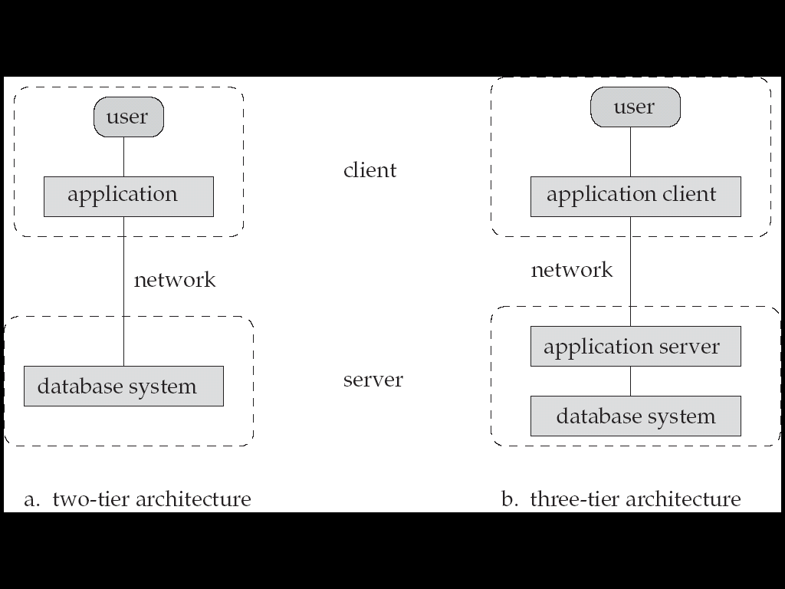
Where is database system

Slide 9
How does it work
App_2
App_n
App_1
Commands; Data
Server
Database
Management
System
Interrelated Data

Slide 10
Data – Different Levels
Physical level: describes how a record (e.g., customer) is stored.
Logical level: describes data stored in database, and the relationships among the data.
  type instructor = record
  ID : string;
  name : string;
  dept_name : string;
  salary : integer;
        end;
View level: application programs hide details of data types. Views can also hide information (such as an employee’s salary) for security purposes.

Slide 11

Data – Different Levels (Cont.)
An architecture of data in a database system

Slide 12
Data Models
A collection of tools for describing
  Data
  Data relationships
  Data semantics
  Data constraints
Relational model, example: department( dept_name, building, budget )
Entity-Relationship data model (mainly for database design)
Object-based data models (Object-oriented and Object-relational)
Semistructured data model (XML)
Other older models:
  Network model
  Hierarchical model

Slide 13
Instances and Schemas
Similar to types and variables in programming languages
Schema – the logical structure of the database
  Example: The database consists of information about a set of customers and accounts and the relationship between them
  Analogous to type information of a variable in a program
  Physical schema: database design at the physical level
  Logical schema: database design at the logical level
Instance – the actual content of the database at a particular point of time
  Analogous to the value of a variable
Physical Data Independence – the ability to modify the physical schema without changing the logical schema
  Applications depend on the logical schema
  In general, the interfaces between the various levels and components should be well defined so that changes in some parts do not seriously influence others.

Slide 14

Relational Model
Relational model (Chapter 2)
Relational algebra
Example of tabular data in the relational model
Columns
Rows

Slide 15
A Sample Relational Database
& Sample Queries
σ _{dept_name=“Physics”}(instructor)
  ∏_{ID,building} (σ_{Instructor.dept_name=“Physics”} (
  σ instructor.dept_name=department.dept_name(instructor x department)))

Slide 16
Data Definition Language (DDL)
Specification notation for defining the database schema
  Example: create table instructor (
  ID char(5),
  name varchar(20),
  dept_name varchar(20),
  salary numeric(8,2))
DDL compiler generates a set of table templates stored in a data dictionary
Data dictionary contains metadata (i.e., data about data)
  Database schema
  Integrity constraints
    Primary key (ID uniquely identifies instructors)
    Referential integrity (references constraint in SQL)
      e.g. dept_name value in any instructor tuple must appear in department relation
  Authorization

Slide 17
Data Manipulation Language (DML)
Language for accessing and manipulating the data organized by the appropriate data model
  DML also known as query language
Two classes of languages
  Procedural – user specifies what data is required and how to get those data. Relational algebra is procedural
  Declarative (nonprocedural) – user specifies what data is required without specifying how to get those data
SQL is the most widely used query language

Slide 18
SQL
SQL: widely used non-procedural language
  Example: Find the name of the instructor with ID 22222
  select name
  from instructor
  where instructor.ID = ‘22222’
  Example: Find the ID and building of instructors in the Physics dept.
  select instructor.ID, department.building
  from instructor, department
  where instructor.dept_name = department.dept_name and
  department.dept_name = ‘Physics’
SQL are not as powerful as a universal Turing machine
Application programs generally access databases through one of
  Language extensions to allow embedded SQL
  Application program interface (e.g., ODBC/JDBC) which allow SQL queries to be sent to a database
Chapters 3, 4 and 5

Slide 19
Database Design
The process of designing the general structure of the database:
Logical Design – Deciding on the database schema. Database design requires that we find a “good” collection of relation schemas.
  Business decision – What relation schemas and attributes should we record in the database?
  Computer Science decision – How to optimize the schema and how should the attributes be distributed among the various relation schemas?
Physical Design – Deciding on the physical layout of the database

Slide 20

Database Design?
Is there any problem with this design?

Slide 21
Design Approaches
Entity Relationship Model (Chapter 6)
  Models an enterprise as a collection of entities and relationships
    Entity: a “thing” or “object” in the enterprise that is distinguishable from other objects
      Described by a set of attributes
    Relationship: an association among several entities
  Represented diagrammatically by an entity-relationship diagram:
Normalization Theory (Chapter 7)
  Formalize what designs are bad, and test for them
  Basic theory: functional dependency. Example: student_id ->student_name

Slide 22

The Entity-Relationship Model
Models an enterprise as a collection of entities and relationships
  Entity: a “thing” or “object” in the enterprise that is distinguishable from other objects
    Described by a set of attributes
  Relationship: an association among several entities
Represented diagrammatically by an entity-relationship diagram:
Does a instructor have a dept_name?

Slide 23
Part Two: Relational Database System Design

Slide 24

Database System Internals

Slide 25
Storage Management
(Chapter 12,13,14)
Storage manager is a program module that provides the interface between the low-level data stored in the database and the query processor of DBMS.
The storage manager is responsible to the following tasks:
  Interaction with the file manager
  Efficient storing, retrieving and updating of data
Issues:
  Storage access (file, buffer); File organization; Indexing and hashing
  Transaction;
  Failure recovery
The storage manager components include:
  Authorization and integrity manager
  Transaction manager
  File manager
  Buffer manager

Slide 26


Storage Management (Cont.)
File organization example:
Index example:

Slide 27
Query Processing
(Charpter 15,16)
The query processor components include:
  DDL interpreter -- interprets DDL statements and records the definitions in the data dictionary.
  DML compiler -- translates DML statements in a query language into an evaluation plan consisting of low-level instructions that the query evaluation engine understands.
    The DML compiler performs query optimization; that is, it picks the lowest cost evaluation plan from among the various alternatives.
  Query evaluation engine -- executes low-level instructions generated by the DML compiler.

Slide 28

Query Processing(Cont.)
1. Parsing and translation
2. Optimization
3. Evaluation

Slide 29

Query Processing (Cont.)
Alternative ways of evaluating a given query
  Equivalent expressions
  Different algorithms for each operation

Slide 30
Query Processing (Cont.)
Different algorithms for each operation. Cost difference between a good and a bad way of evaluating a query can be enormous
  Sequence search: Num of Blocks * t_{T} + t_{S}
  Index based search: (h_{i} + 1) * (t_{T} + t_{S})
Need to estimate the cost of operations
  Depends critically on statistical information about relations which the database must maintain
  Need to estimate size of intermediate results to compute cost of complex expressions. Example, estimate number of records to find course information from takes for a specific student: n_{takes}/ V(student_id,takes) , where takes is the relation that stores information of students and the courses they take.

Slide 31
Transaction Management
Chapter 17,18,19
What is a transaction: A transaction is a collection of operations that performs a single logical function in a database application
What if the system fails?
What if more than one user is concurrently updating the same data?
Transaction-management component ensures that the database remains in a consistent (correct) state despite system failures (e.g., power failures and operating system crashes) and transaction failures.
Concurrency-control manager controls the interaction among the concurrent transactions, to ensure the consistency of the database.

Slide 32

Transaction Management:
Lock Based Concurrent Control

Slide 33

Transaction Management:
Log Based Recovery

Slide 34

Database Users and Administrators
Database

Slide 35
History of Database Systems
1950s and early 1960s:
  Data processing using magnetic tapes for storage
    Tapes provided only sequential access
  Punched cards for input
Late 1960s and 1970s:
  Hard disks allowed direct access to data
  Network and hierarchical data models in widespread use
  Ted Codd defines the relational data model
    Would win the ACM Turing Award for this work
    IBM Research begins System R prototype
    UC Berkeley begins Ingres prototype
    Oracle releases first commercial relational database
  High-performance (for the era) transaction processing (OLTP)

Slide 36
History (cont.)
1980s:
  Research relational prototypes evolve into commercial systems
    SQL becomes industrial standard
  Parallel and distributed database systems
  Object-oriented database systems
1990s:
  Large decision support and data-mining applications (OLAP)
  Large multi-terabyte data warehouses
  Emergence of Web commerce
2000s:
  NoSQL: MongoDB, Redis, HBase
  Cloud DB: Google Spanner, Amazon Aurora, Aliyun PolarDB
Now: AI based database or AI supporting database; Blockchain database
It’s not later products replace the earlier ones. Different products can satisfy different application requirements

Slide 37
End of Chapter 1
Exercise 7, 8，9，15

Slide 38

Figure 1.02

Slide 39
Figure 1.04

Slide 40

Figure 1.06

