Slide 1
Restaurant Location Analysis
By Powell Menezes

Slide 2
Presentation Plan
01 02 03 04
Introduction
Importance of Location for Restaurants
Factors of Good Business Location
Buy, Lease or Build
05 06 07
Data Scraping
Analysis on Scraped Data
Conclusion

Slide 3
Introduction
There are variety of possible locations for restaurants including a freestanding unit, located in shopping mall outlet, food court etc..
There is no substitute for a good location. Good food, space, promotion, fast service and competitive pricing are extremely important, but these factors may lose its importance due to poor location

Slide 4
Importance of location for restaurants
1. To get more clients
3. Permits and Licenses
* Depending on the zone and
the area
2. Operation size
* area of production defines the
restaurant capacity
* warehousing area define
amount of stocks the
restaurant can keep
* dining area defines the
capacity of restoring to
generate sales
4. Affects cost of operation
* cost of rent
* cost of marketing
* labor cost
* supply cost
* utilities cost

Slide 5
Factors of Good Business Location
Area demographic and market Research
Visibility
Accessibility
View and environment
Parking
Side of the street / Main road

Slide 6
Buying, Leasing or building
Alternative | Advantages | Disadvantages
Buying | Ownership, operating flexibility, quick occupancy, accessibility to traffic asset appreciation | Long term commitment, initial capital outlay, adaptability, initial facility condition, maintenance costs
Leasing | Quick occupancy, relatively low initial cost reduced commitment | Operating flexibility, changing lease terms, initial facility condition, adaptability, lease nonrenewal
Building | Ownership, operating flexibility, facility condition, assert appreciation, location flexibility | long term commitment, initial capital outlay construction time, maintenance cost

Slide 7
Scraping
Converting unstructured document into structural information
Software technique to extract information from website is call web scraping
Why web scraping
Web scraping can help you extract any kind of data that you want and enables to retrieve, analyze and use the data the way you want.
How?
Scraping can be done using scripts with or without API key (Python, R)
Using Software's are build for scraping (G extractor, JustDial extractor)

Slide 8
Challenges Faced
Anti- Scraping Technologies: Some websites will use anti-scraping technologies, which may block the IP Address Example LinkedIn
More Data, More Time: This one is obvious. The larger a website is, the more data it contains. And the more data it contains, the longer it takes to scrape that site.
Scraping Software's are not freeware
Necessary skills and Coding Knowledge required if the data is scraped using scripts
Some websites will keep daily threshold where required amount of data cannot be scraped at a time

Slide 9
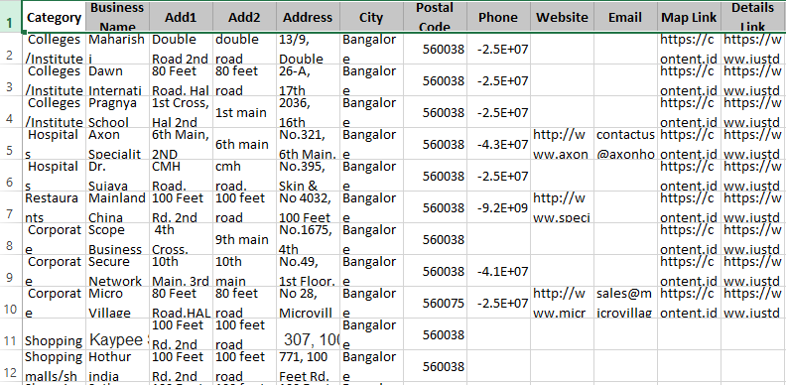
Restaurant data was Scraped from Zomato using zomatopy library, where number of orders and revenue details were not available
Scraping data from google API failed due to daily threshold limit
Demographic data was extracted from Yello leads extractor using JustDial website, which was a demo version and only 30 record were fetched for each field like college, hospital, Business park etc..

Slide 10
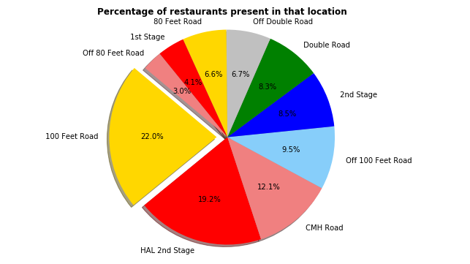
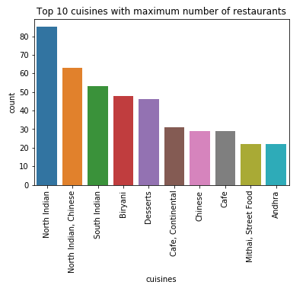
Analysis of Restaurant's located in Indiranagar (data source –Zomato)

Slide 11
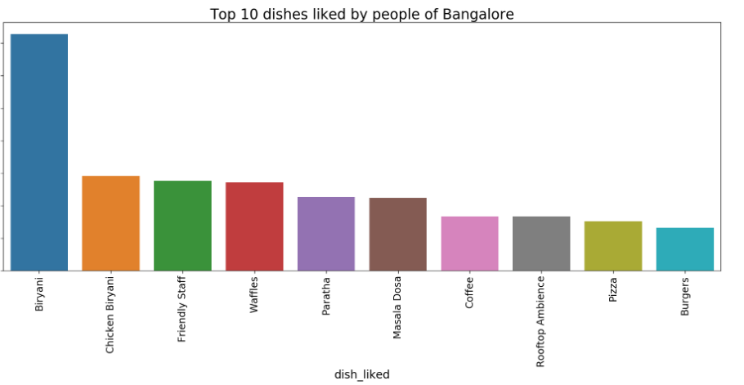

Slide 12
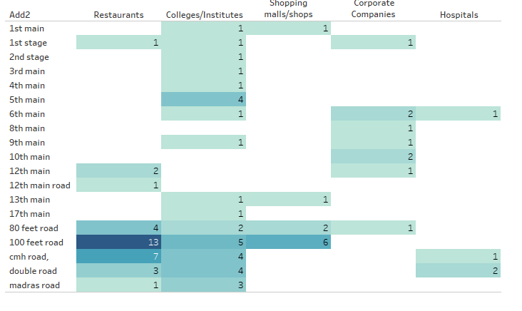
87 Unique records were fetched for Indiranagar location, following is the analysis report of count of each fields for different location.

Slide 13
Conclusion
(d) Highway/Main Road
Fast food, quick service restaurant’s
Fast food, Lounge bar/restaurant
Fine dine, take away, Lounge bar/fine dine
Multi cuisine Restaurant's
(c) Residential Areas
(b) college, University
(a)
Bus stops, Railway/Metro station
Hospital offices
If a client approaches us to suggest location to open a Multi cuisine Restaurant's in Indiranagar we can suggest them to establish a new restaurant in either 100ft road, 80ft road or CHM Road
We can suggest 5th main, 100ft road, CHM road, or Double road location for lounge bar/restaurant

