Slide 1


Web Sockets
Tech Talk

Slide 2
Origin & purpose
Originally defined in 2011 by RFC 6455
Created to provide better bidirectional communication between client and server

Slide 3
Purpose & Advantages

Slide 5
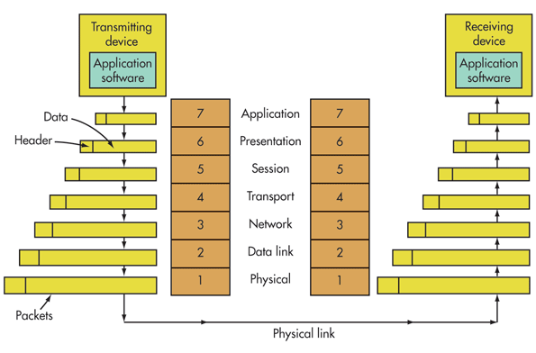

Slide 6
Citations
https://tools.ietf.org/html/rfc6455
https://en.wikipedia.org/wiki/WebSocket
https://www.electronicdesign.com

