Slide 1


Web Sockets
Tech Talk

Slide 2
Origin
Originally defined in 2011 by RFC 6455

Slide 3
Purpose & Advantages
Created to solve bidirectional communication issues with server
Issues before:
Server is forced to use TCP connection for sending to client and a new one for each incoming client request
High unnecessary overhead of HTTP header on each message
Client forced to map outgoing connections to the incoming connection when tracking replies

Slide 4
Design Philosophy
Designed on the principle that there should be minimal framing
the only framing that exists is to make the protocol frame-based instead of stream-based and to support a distinction between Unicode text and binary frames
Any desired metadata would be layered on top of WebSocket by the application

Slide 5
Relation to Network Stack
The WebSocket Protocol is an independent TCP-based protocol. Its only relationship to HTTP is that its handshake is interpreted by HTTP servers as an Upgrade request
Also sits at the Application Layer of the network stack

Slide 6
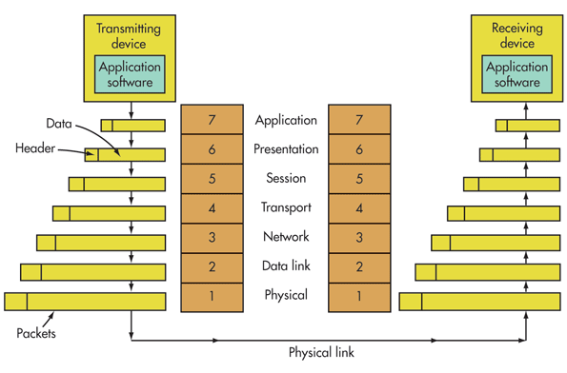

Slide 7
Using Websockets
In .NET using Websockets is a breeze
Start in Javascript as a WebSocket
URI is either "ws" for port 80 and "wss" is port 443
Client side can bind events
Server side can send and receive async, reading bytes into a buffer

Slide 8
Citations
https://tools.ietf.org/html/rfc6455
https://en.wikipedia.org/wiki/WebSocket
https://www.electronicdesign.com

