Slide 1
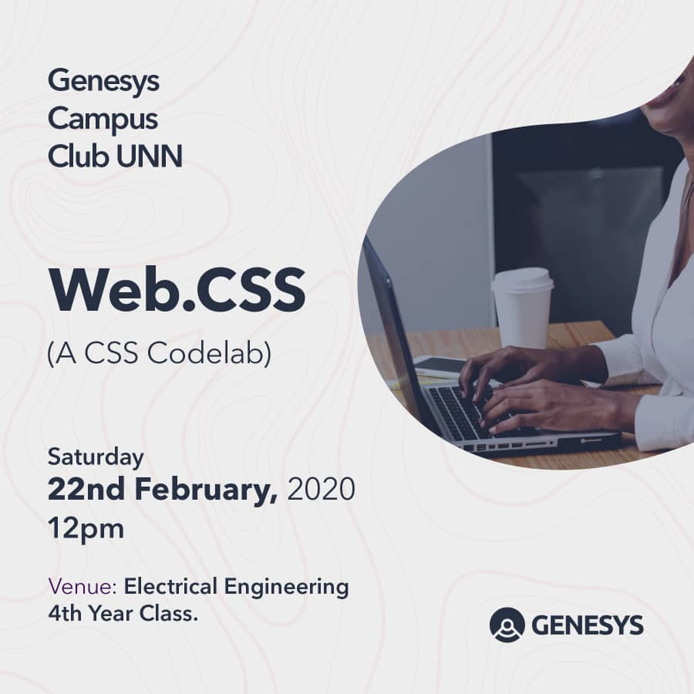

Slide 2
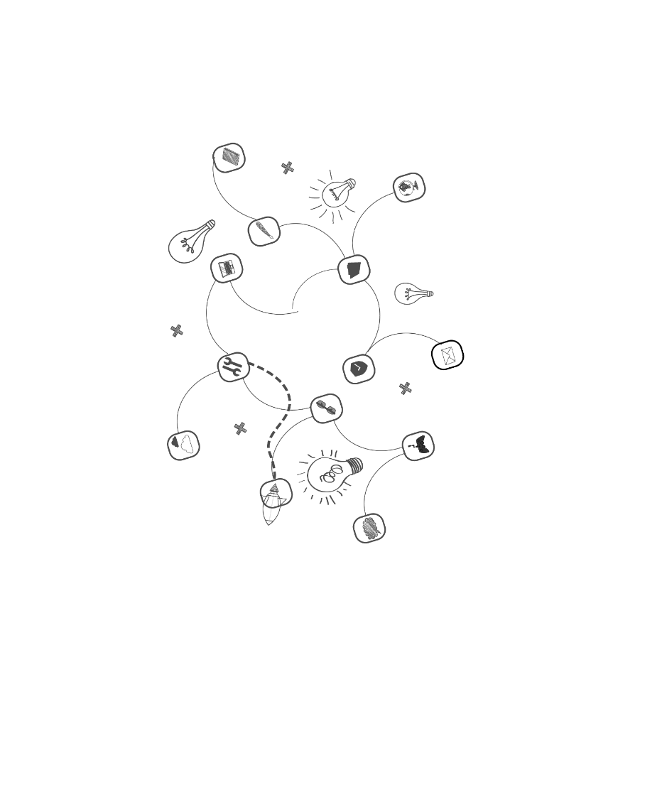


Web.CSS: A CSS Codelab Saturday, February 22, 2020

Slide 3

Twitter: @genesystechhub
First things first:
- Introduction -
Let’s introduce ourselves to the community
Protocol: Name, Department and Level

Slide 4
Twitter: @genesysclubunn
Course prerequisites:
A laptop (PC)
Basic knowledge of HTML
Basic computer operation skill
Average typing speed of 15WPM (optional)
Patience, perseverance and the will to go on

Slide 5
Twitter: #weAreGenesys
Alright. Before we begin proper, I want you all to know (or be reminded) that, in terms of knowledge and information, after…

Slide 6

…in this world is…☺

Slide 7
Whenever you get stuck, remember that you can always Google your way out!

Slide 8
Twitter: @genesystechhub
A Little Recap from the Last Study Jam!

Slide 9
Twitter: @genesysclubunn
Recap - HTML
HTML stands for HyperText Markup Language. Unlike a scripting or programming language that uses scripts to perform functions, a markup language uses tags to identify content.
Some common HTML tags discussed last time are:
- <head> - <title> - <body> - <div> - <span> - <p>
- <ul> - <ol> - <li> - <a> - <br /> - <h1>
- <h6> - <img /> - <table> - <form> - <input /> - <audio>
- <video> - <strong> - <i> - <button> - <link /> - <style>
- <script> - <meta> - <nav> - <header> - <aside> - <section>

Slide 10
Twitter: @genesysclubunn
Lab Content:
Basics (of CSS)
Properties (of CSS)
Position and Layout

Slide 11
Twitter: @genesystechhub
Basics

Slide 12
Twitter: @genesysclubunn
What is CSS?

Slide 13
Twitter: @genesysclubunn
Welcome to CSS!
CSS stands for Cascading Style Sheets. - Cascading refers to the way CSS applies one style on top of another. - Style Sheets control the look and feel of web documents. CSS and HTML work hand in hand: - HTML sorts out the page structure. - CSS defines how HTML elements are displayed.
To understand CSS, you should already have a basic knowledge of HTML.

Slide 14
Twitter: @genesysclubunn
Why Use CSS?
CSS allows you to apply specific styles to specific HTML elements. The main benefit of CSS is that it allows you to separate style from content. Using just HTML, all the styles and formatting are in the same place, which becomes rather difficult to maintain as the page grows.
Sidebar: All formatting can (and should) be removed from the HTML document and stored in a separate CSS file.

Slide 15
Twitter: @genesysclubunn
Inline, Embedded, External CSS

Slide 16
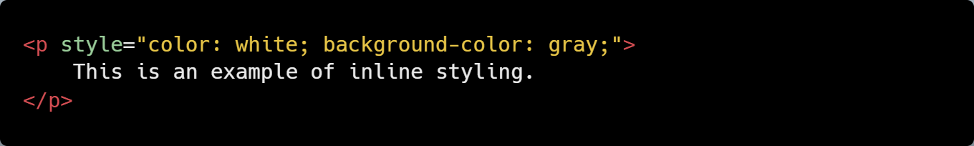
Twitter: @genesysclubunn
Inline CSS
Using an inline style is one of the ways to insert a style sheet. With an inline style, a unique style is applied to a single element. In order to use an inline style, add the style attribute to the relevant tag. The example below shows how to create a paragraph with a gray background and white text:
Sidebar: The style attribute can contain any CSS property.

Slide 17
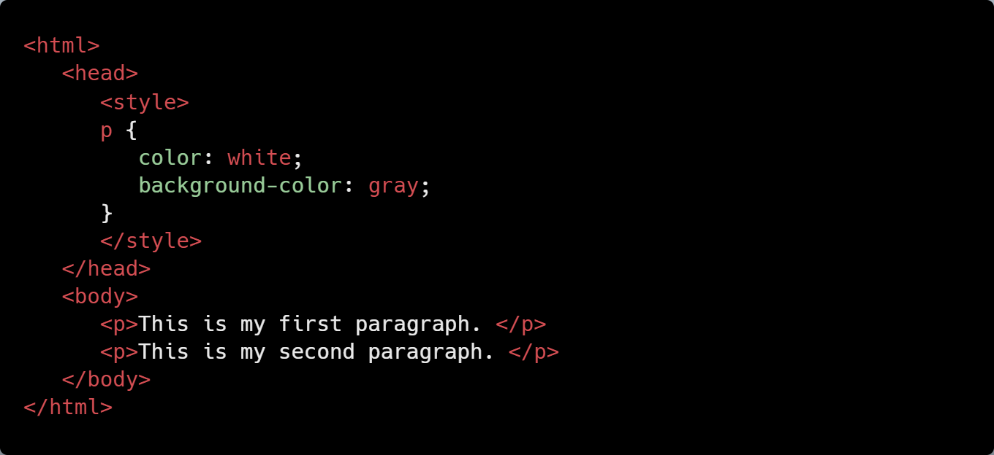
Twitter: @genesysclubunn
Embedded/Internal CSS
Internal styles are defined within the <style> element, inside the head section of an HTML page.
For example, the following code styles all paragraphs:
All paragraphs will have a white font and a gray background.
Sidebar: An internal style sheet may be used if one single page has a unique style.

Slide 18
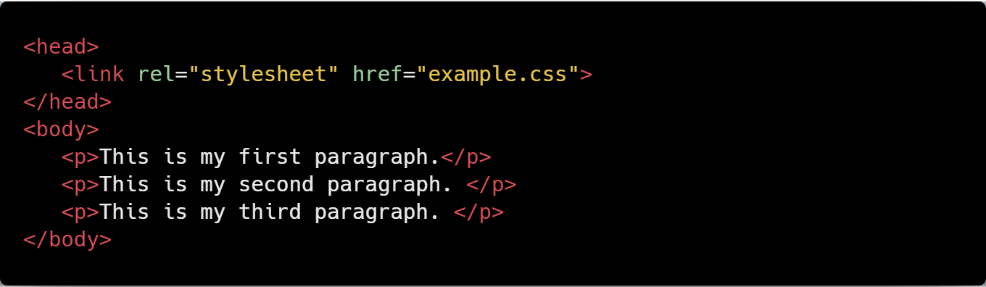
Twitter: @genesysclubunn
External CSS
With this method, all styling rules are contained in a single text file, which is saved with the .css extension.
This CSS file is then referenced in the HTML using the <link> tag. The <link> element goes inside the head section.
Here is an example: The HTML:

Slide 19
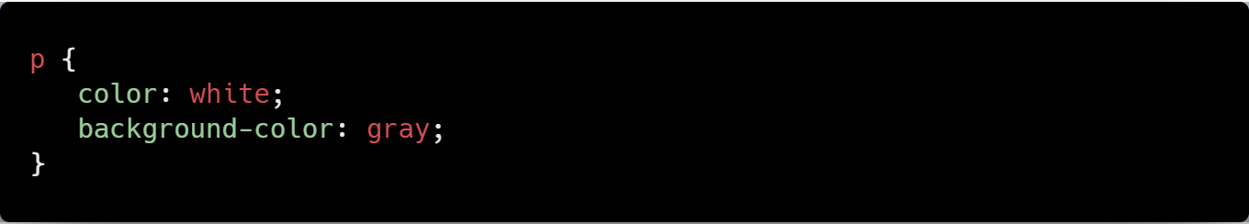
Twitter: @genesysclubunn
The CSS:
Sidebar: Both relative and absolute paths can be used to define the href for the CSS file. In our example, the path is relative, as the CSS file is in the same directory as the HTML file.

Slide 20
Twitter: @genesysclubunn
CSS Rules and Selectors

Slide 21

Twitter: @genesysclubunn
CSS Syntax
CSS is composed of style rules that the browser interprets and then applies to the corresponding elements in your document. A style rule has three parts: selector, property, and value.
For example, the headline color can be defined as:
Where:
The selector points to the HTML element you want to style.
Sidebar: The declaration block contains one or more declarations, separated by semicolons. Each declaration includes a property name and a value, separated by a colon.

Slide 22
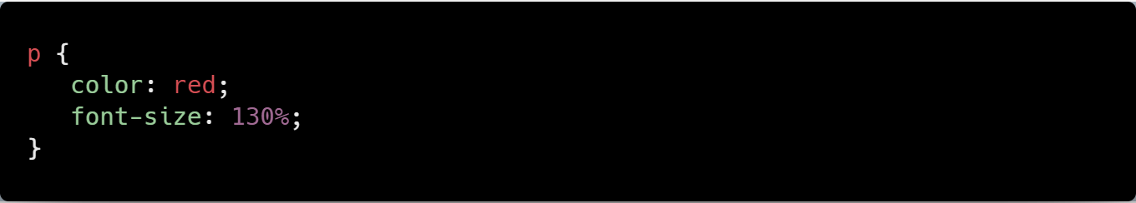
Twitter: @genesysclubunn
Type Selectors
The most common and easy to understand selectors are type selectors. This selector targets element types on the page. For example, to target all the paragraphs on the page:
Sidebar: A CSS declaration always ends with a semicolon, and declaration groups are surrounded by curly braces.

Slide 23
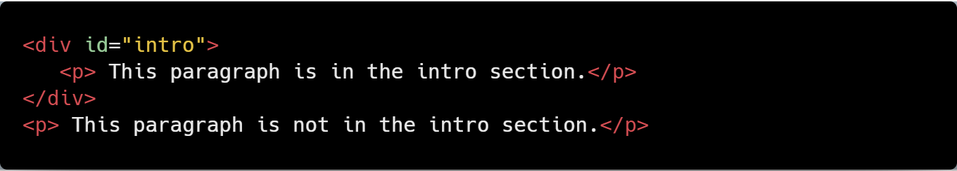
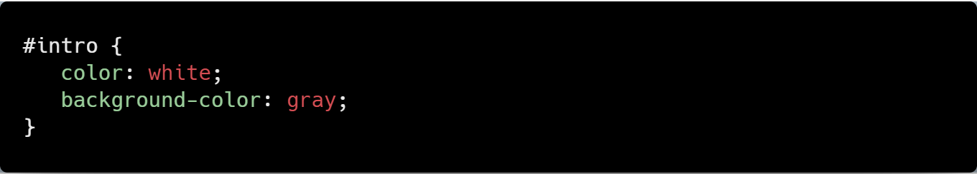
Twitter: @genesysclubunn
id and class Selectors
id selectors allow you to style an HTML element that has an id attribute, regardless of their position in the document tree. Here is an example of an id selector:
The HTML:
The CSS:
Sidebar: To select an element with a specific id, use a hash [#] character, and then follow it with the id of the element.

Slide 24
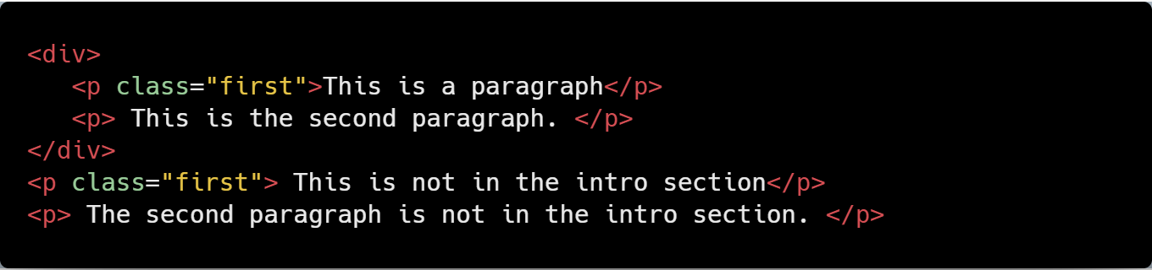
Twitter: @genesysclubunn
Class selectors work in a similar way. The major difference is that IDs can only be applied once per page, while classes can be used as many times on a page as needed.
In the example below, both paragraphs having the class "first" will be affected by the CSS:
The HTML:
The CSS:
Note: To select elements with a specific class, use a period character, followed by the name of the class. Do NOT start a class or id name with a number!

Slide 25
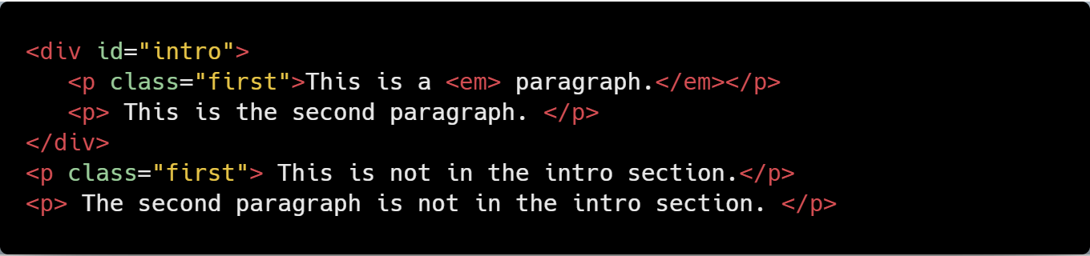
Twitter: @genesysclubunn
Descendant Selectors
These selectors are used to select elements that are descendants of another element. When selecting levels, you can select as many levels deep as you need to. For example, to target only <em> elements in the first paragraph of the "intro" section: The HTML:

Slide 26
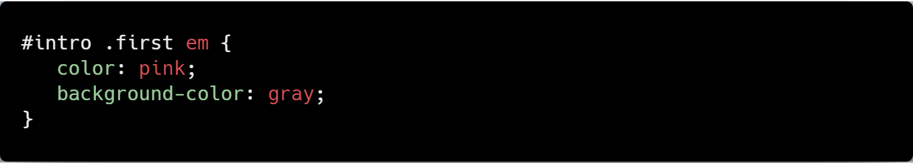
Twitter: @genesysclubunn
The CSS:
As a result, only the elements selected will be affected.
Sidebar: The descendant selector matches all elements that are descendants of a specified element.

Slide 27
Facebook: #genesystechhub
CSS Comments

Slide 28
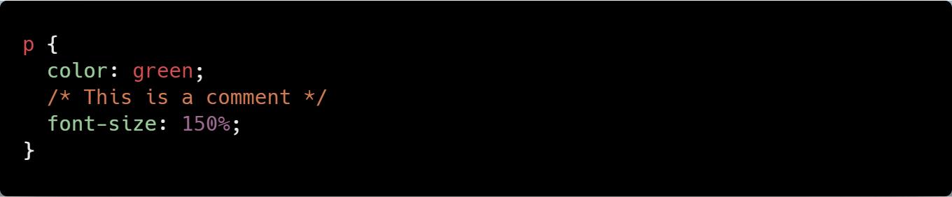
Facebook: #genesystechhub
Comments
Comments are used to explain your code, and may help you when you edit the source code later. Comments are ignored by browsers.
A CSS comment looks like this:
Example:
The comment does not appear in the browser.
Sidebar: Comments can also span multiple lines.

Slide 29
Facebook: #genesystechhub
Style Cascade and Inheritance

Slide 30
Twitter: #weAreGenesys
Cascade
The final appearance of a web page is a result of different styling rules. The three main sources of style information that form a cascade are: - The stylesheet created by the author of the page - The browser's default styles - Styles specified by the user
Sidebar: CSS is an acronym for Cascading Style Sheets.

Slide 31
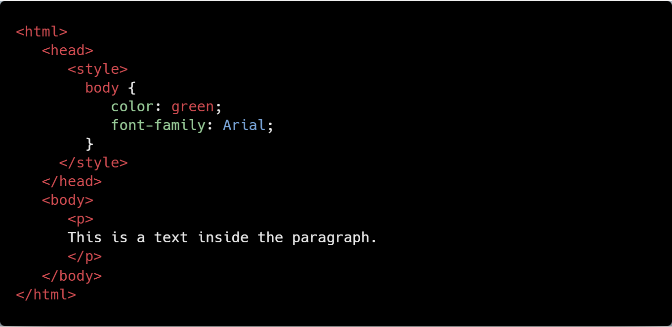
Twitter: #weAreGenesys
Inheritance
Inheritance refers to the way properties flow through the page. A child element will usually take on the characteristics of the parent element unless otherwise defined.
For example:
Since the paragraph tag (child element) is inside the body tag (parent element), it takes on any styles assigned to the body tag.

Slide 32
Twitter: @genesysclubunn
Properties

Slide 33
Twitter: @genesysclubunn
Introducing the Box Model

Slide 34
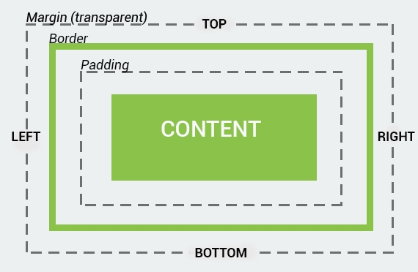
Twitter: #weAreGenesys
The CSS Box Model
All HTML elements can be considered as boxes. The CSS box model represents the design and layout of the site. It consists of margins, borders, paddings, and the actual content.
The properties work in the same order: top, right, bottom, and left.
The image below illustrates the box model:
Sidebar: The term "box model" is used when talking about design and layout.

Slide 35
Twitter: @genesysclubunn
Understanding the Box Model

Slide 36
Twitter: #weAreGenesys
More on Box Models
Every element of the webpage is a box. CSS uses the box model to determine how big the boxes are and how to place them.
Sidebar: The box model is also used to calculate the actual width and height of the HTML elements.

Slide 37
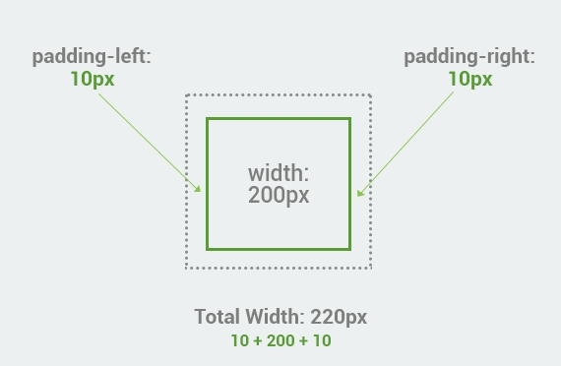
Twitter: #weAreGenesys
Total Width of an Element
When working with boxes, it is important to understand how the total width of an element is calculated. For example, the total width of the box with paddings will be the sum of width plus padding left and padding right.

Slide 38
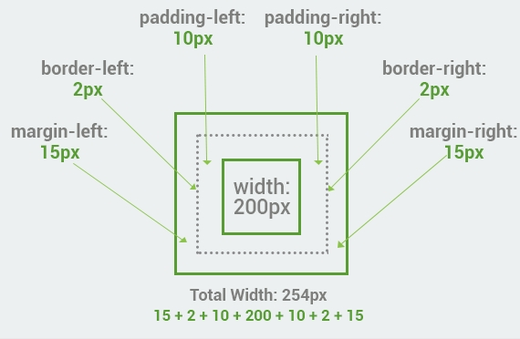
Twitter: #weAreGenesys
Here is another box with margins, border, and paddings. The total width is the sum of left and right margins, left and right borders, left and right paddings, and the actual width of the content.
Note: When you set the width and height properties of an element with CSS, you set the width and height of the content area. When setting a background-color to a box, it covers the content area, as well as the padding.

Slide 39
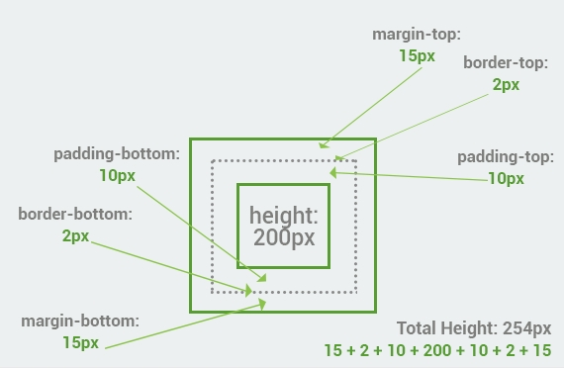
Twitter: #weAreGenesys
Total Height of an Element
The total height of an element is calculated the same way as the width. The example below is the same box from the previous lesson with padding, border and margin.
Summary: Total element height = height + top padding + bottom padding + top border + bottom border + top margin + bottom margin

Slide 40
Twitter: @genesysclubunn
Borders

Slide 41
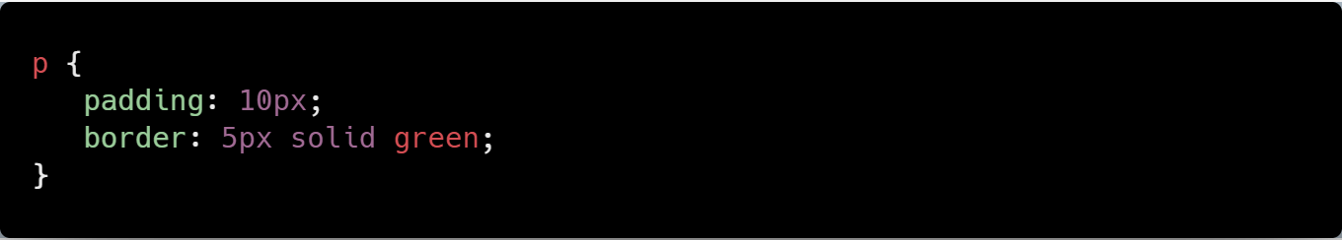
Twitter: #weAreGenesys
The border Property
The CSS border property allows you to customize the borders of HTML elements. In order to add a border to the element, you need to specify the size, style, and color of the border. The example below shows how to add a solid green border to the paragraph.
The HTML:
The CSS:

Slide 42
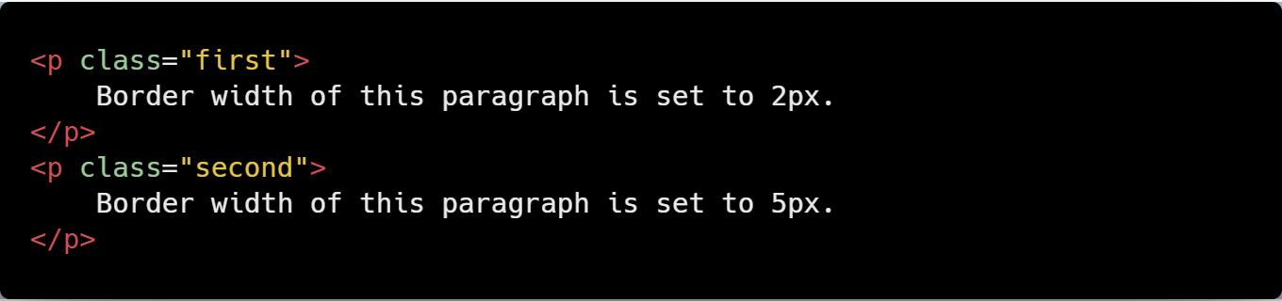
Twitter: #weAreGenesys
Border Width
The properties for the border can be set separately. The border-width property specifies the width of the border.
The HTML:
…

Slide 43
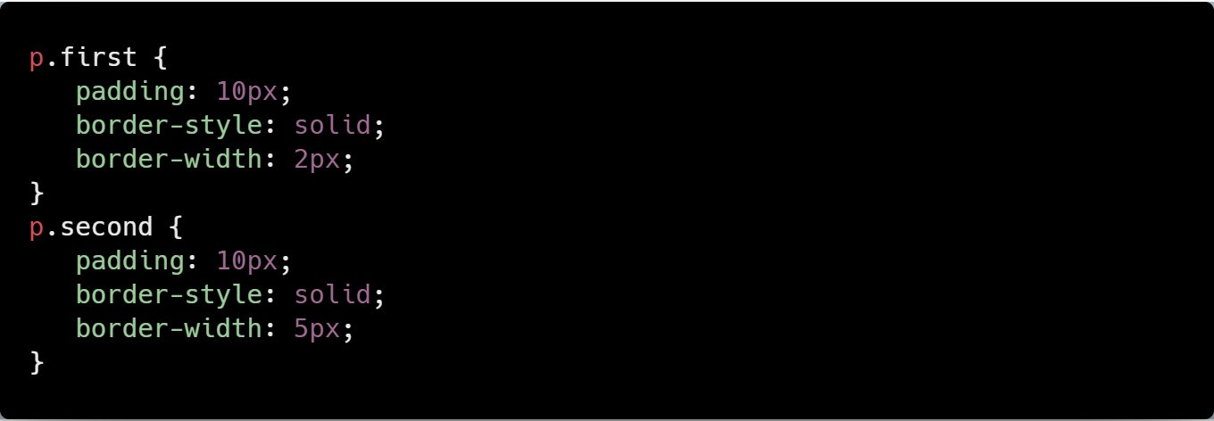
Twitter: #weAreGenesys
The CSS:

Slide 44
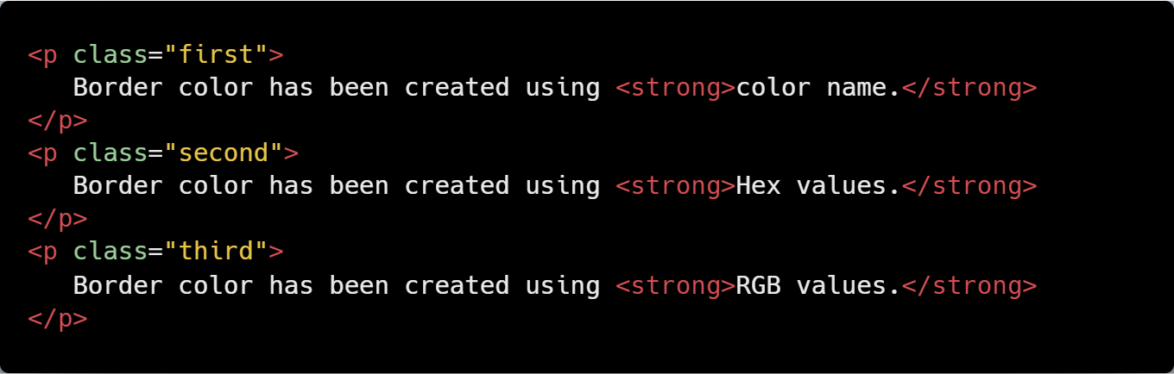
Twitter: #weAreGenesys
Border Color
The border color of the element can be defined using a color name, RGB, or Hex values.
The HTML:

Slide 45
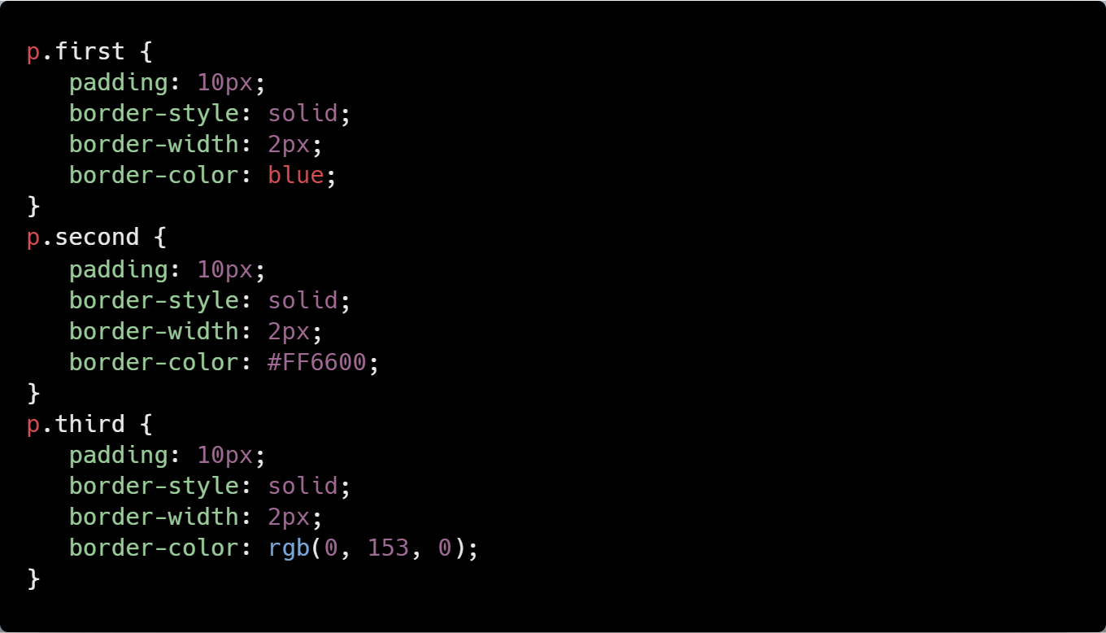
Twitter: #weAreGenesys
The CSS:
Note: None of the border properties will have any effect unless the border-style property is set.

Slide 46
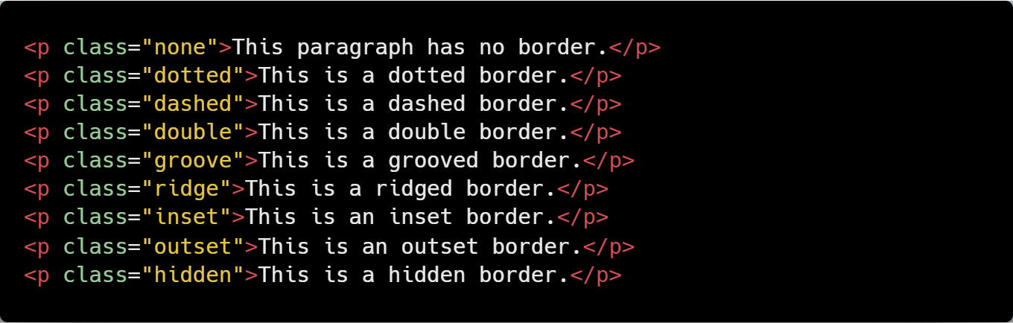
Twitter: #weAreGenesys
The border-style Property
The default value of border-style is none, which defines no border. There are various styles supported for the border-style property: dotted, dashed, double, etc. The example below illustrates the differences between them. The HTML:

Slide 47
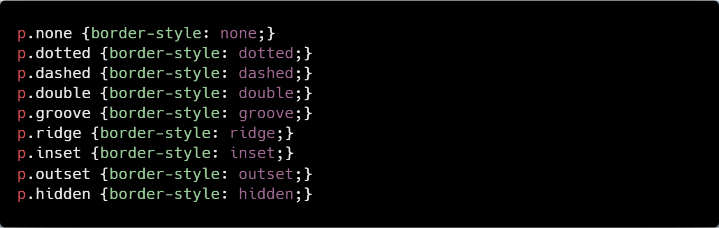
Twitter: #weAreGenesys
The CSS:
Sidebar: In CSS, it is possible to specify different borders for different sides, using the following properties: border-top-style, border-right-style, border-bottom-style, and border-left-style for the corresponding sides.

Slide 48
Twitter: @genesysclubunn
Width and Height

Slide 49
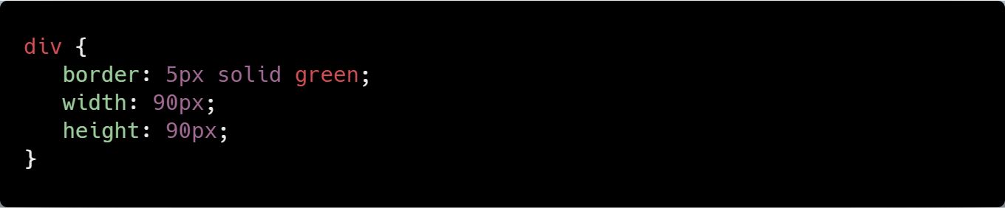
Facebook: #genesystechhub
CSS Width and Height
To style a <div> element to have a total width and height of 100px: The HTML:
The CSS:
Sidebar: The total width and height of the box will be the 90px+5px (border)+5px(border) = 100px;

Slide 50
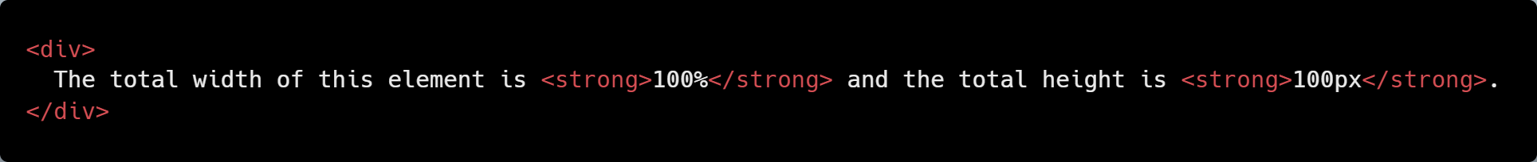
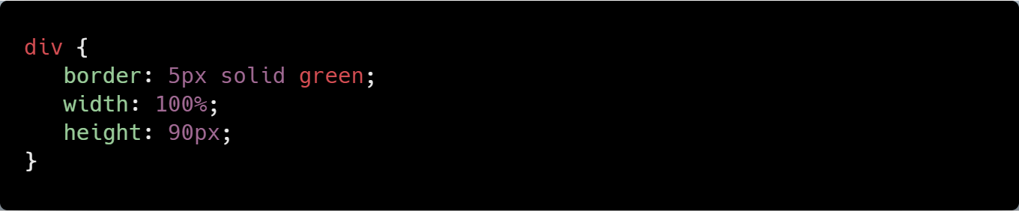
Facebook: #genesystechhub
Width and Height Measurement
The width and height of an element can be also assigned using percents. In the example below the width of an element is assigned in percentages, the height is in pixels. The HTML:
The CSS:

Slide 51
Facebook: #genesystechhub
The Minimum and Maximum Sizes
To set the minimum and maximum height and width of an element, you can use the following properties:
min-width - the minimum width of an element min-height - the minimum height of an element max-width - the maximum width of an element max-height - the maximum height of an element
In the example below, we set the minimum height and maximum width of different paragraphs to 100px. The HTML:

Slide 52
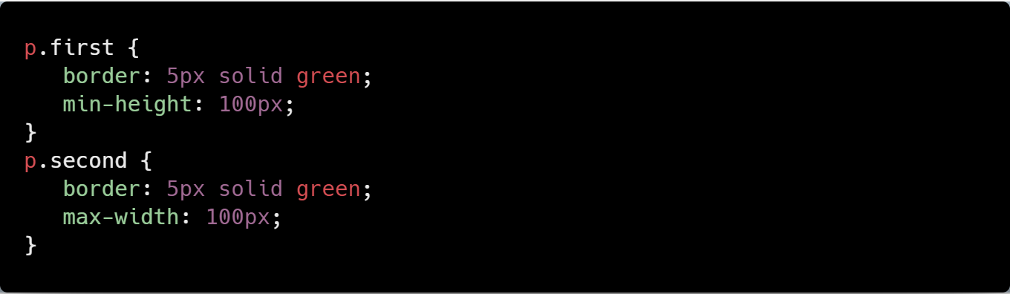
Facebook: #genesystechhub
The CSS:

Slide 53
Twitter: @genesysclubunn
background-color

Slide 54
Facebook: #genesystechhub
The background-color Property
The background-color property is used to specify the background color of an element. The HTML:
The CSS:
<p>The background color of this page is set to LightSkyBlue.</p>
body {
background-color: #87CEFA;
}

Slide 55
Facebook: #genesystechhub
The Background Color Values
The background-color property is used to specify the background color of an element. The HTML:
The CSS:
...
<h1>This is a heading</h1> <p>This is a paragraph</p>

Slide 56
Facebook: #genesystechhub
body {
background-color: #C0C0C0;
}
h1 {
background-color: rgb(135,206,235);
}
p {
background-color: LightGreen;
}

Slide 57
Twitter: @genesysclubunn
background-image

Slide 58
Facebook: #genesystechhub
The background-image Property
The background-image property sets one or several background images in an element. Let's set a background-image for the <body> element. The CSS:
The url specifies the path to the image file. Both relative and absolute paths are supported.
body {
background-image: url("css_logo.png");
background-color: #e9e9e9;
}
By default, a background-image is placed at the top-left corner of an element, and is repeated both vertically and horizontally to cover the entire element.

Slide 59
Facebook: #genesystechhub
Background-image can be set not only for the whole page, but for individual elements, as well. Below we set a background image for the <p> element.
The HTML:
The CSS:
<p>This paragraph has a background image.</p>
p {
padding: 30px;
background-image: url("green_photo.jpg");
color: white;
}
To specify more than one image, just separate the URLs with commas.

Slide 60
Twitter: @genesysclubunn
background-repeat

Slide 61
Facebook: #genesystechhub
The background-repeat Property
The background repeat property specifies how background images are repeated. A background image can be repeated along the horizontal axis, the vertical axis, both axes, or not repeated at all. The repeat-x will repeat a background image only horizontally.
The CSS:
The repeat-y will repeat a background-image only vertically. The CSS:
...
body {
background-image: url("css_logo.png");
background-repeat: repeat-x;
}

Slide 62
Facebook: #genesystechhub
The CSS:
body {
background-image: url("css_logo.png");
background-repeat: repeat-y;
}
If you want the image to be shown only once, use the no-repeat value.

Slide 63
Facebook: #genesystechhub
Setting the Value to Inherit
When you set the background-repeat property to inherit, it will take the same specified value as the property for the element's parent. For example, we set the body background repeat only horizontally. If we set some paragraph background-repeat values to be inherited, they will take the same property value as the body element. The CSS:
body {
background-image: url("css_logo.png");
background-repeat: repeat-x;
}
p {
background-image: url("css_logo.png");
background-repeat: inherit;
margin-top: 100px;
padding: 40px;
}

Slide 64
Twitter: @genesysclubunn
background-attachment

Slide 65
Facebook: #genesystechhub
The background-attachment Property
The background-attachment property sets whether a background image is fixed or scrolls with the rest of the page. Even if an element has a scrolling mechanism, a "fixed" background doesn't move with the element. The CSS:
body {
background-image: url("css_logo.png");
background-repeat: no-repeat;
background-attachment: fixed;
}

Slide 66
Facebook: #genesystechhub
The background-attachment Values
You can also set the background-attachment to inherit or scroll. When you set the background-attachment to inherit, it will inherit the value from its parent element. When you set the background-attachment to scroll, the background image will scroll with the rest of the content. The CSS:
body {
background-image: url("css_logo.png");
background-repeat: no-repeat;
background-attachment: scroll;
}

Slide 67
Twitter: @genesysclubunn
Ok. So much stuff, right?
A Short Break: In case you feel overwhelmed, watch these two videos for some (success) motivation… ☺

Slide 68

Twitter: #weAreGenesys
#feedYourMindWithSuccess

Slide 69
Twitter: @genesysclubunn
…Feed your mind with success.
This is the time to invest in yourself, your personality.
Read the more; learn the more; code the more; practice the more; ask (Google) the more.
“Invest in yourself!” Your future self is begging you! It’ll be worth it at the end!
#feedYourMindWithSuccess

Slide 70
Twitter: #weAreGenesys
#neverQuit

Slide 71
Twitter: @genesysclubunn
Styling the Lists

Slide 72
Facebook: #genesystechhub
The list-style-type Property
The CSS list properties allow us to set different list item markers. In HTML, there are two types of lists: unordered lists (<ul>) - the list items are marked with bullets ordered lists (<ol>) - the list items are marked with numbers or letters With CSS, lists can be styled further, and images can be used as the list item marker. One of the ways is to use the list-style-type property, which can be set to circle, square, decimal, disc, lower-alpha, etc. The HTML:
...

Slide 73
Facebook: #genesystechhub
<ol class="lower-alpha">
<li>Red</li>
<li>Green</li>
<li>Blue</li>
</ol>
<ul class="circle">
<li>Red</li>
<li>Green</li>
<li>Blue</li>
</ul>
<ul class="square">
<li>Red</li>
<li>Green</li>
<li>Blue</li>
</ul>

Slide 74
Facebook: #genesystechhub
The CSS:
ol.lower-alpha {
list-style-type: lower-alpha;
}
ul.circle {
list-style-type: circle;
}
ul.square {
list-style-type: square;
}
Some of the values are for unordered lists, and some for ordered lists.

Slide 75
Facebook: #genesystechhub
The List Image and Position
There are also other list properties, such as: list-style-image - specifies an image to be used as the list item marker. list-style-position - specifies the position of the marker box (inside, outside). In the example below, we use an image as the list item marker, and specify the position to be inside of the content flow. The HTML:
...
<p>The following list has list-style-position: <strong>inside</strong>.</p>
<ul>
<li>Red</li>
<li>Green</li>
<li>Blue</li>
</ul>

Slide 76
Facebook: #genesystechhub
The CSS:
ul {
list-style-image: url("logo.jpg");
list-style-position: inside;
}
"list-style-position: outside" is the default value.

Slide 77
Facebook: #genesystechhub
The list-style Property
The list-style property is a shorthand property for setting list-style-type, list-style-image and list-style-position. It is used to set all of the list properties in one declaration:
This would be the same as the longhand version.
ul {
list-style: square outside none;
}
ul {
list-style: square outside none;
}
If one of the property values are missing, the default value for the missing property will be inserted, if any.

Slide 78
Twitter: @genesysclubunn
Styling the Tables

Slide 79
Facebook: #genesystechhub
The Table Properties
The look of an HTML table can be greatly improved with CSS. The border-collapse property specifies whether the table borders are collapsed into a single border or separated as default. If the borders are separate, the border-spacing property can be used to change the spacing. The HTML:
<table border="1">
<tr>
<td>Red</td>
<td>Green</td>
</tr>
<tr>
<td>Blue</td>
<td>Yellow</td>
</tr>
</table>

Slide 80
Facebook: #genesystechhub
The CSS:
table {
border-collapse: separate;
border-spacing: 20px 40px;
}

Slide 81
Facebook: #genesystechhub
The caption-side Property
The caption-side property specifies the position of a table caption. The values can be set as top or bottom. In the example below, we specify the placement of a table caption to top. The HTML:
<table border="1">
<caption>Some of Our Courses</caption>
<tr>
<th>Course name</th>
<th>Lessons</th>
<th>Quizzes</th>
</tr>
<tr>
<td>C++</td>
<td>81</td>
<td>363</td>
</tr>

Slide 82
Facebook: #genesystechhub
<tr>
<td>JavaScript</td>
<td>48</td>
<td>144</td>
</tr>
<tr>
<td>HTML</td>
<td>38</td>
<td>119</td>
</tr>
<tr>
<td>CSS</td>
<td>70</td>
<td>174</td>
</tr>
</table>

Slide 83
Facebook: #genesystechhub
The CSS:
caption {
caption-side: top;
}

Slide 84
Facebook: #genesystechhub
The empty-cells Property
The empty-cells property specifies whether or not to display borders and background on empty cells in a table. Possible values are: show: the borders of an empty cell are rendered hide: the borders of an empty cell are not drawn Here is the empty-cells property that is used to hide borders of empty cells in the <table> element. The HTML:
...

Slide 85
Facebook: #genesystechhub
<table border="1">
<tr>
<td>HTML</td>
<td>CSS</td>
</tr>
<tr>
<td>JavaScript</td>
<td></td>
</tr>
</table>
The CSS:
table {
border-collapse: separate;
empty-cells: hide;
}

Slide 86
Facebook: #genesystechhub
The table-layout Property
The table-layout specifies how the width of table columns is calculated. The possible values are: auto - when column or cell width are not explicitly set, the column width will be in proportion to the amount of content in the cells that make up the column fixed - when column or cell width are not explicitly set, the column width will not be affected by the amount of content in the cells that make up the column. The table layout is set to auto by default. The example below shows the difference between auto and fixed.

Slide 87
Facebook: #genesystechhub
The HTML:
<p>Table-layout is set to <strong>auto</strong></p>
<table class="auto">
<tr>
<td width=“10%">500.000.000.000.000</td>
<td width="90%">20.000</td>
</tr>
</table>
<p>Table-layout is set to <strong>fixed</strong></p>
<table class="fixed">
<tr>
<td width="10%">500.000.000.000.000</td>
<td width="90%">20.000</td>
</tr>
</table>

Slide 88
Facebook: #genesystechhub
The CSS:
table {
border-collapse: separate;
width: 100%;
border: 1px solid gray;
}
td {
border: 1px solid gray;
}
table.auto {
table-layout: auto;
}
table.fixed {
table-layout: fixed;
}

Slide 89
Twitter: @genesysclubunn
Styling the Links

Slide 90
Facebook: #genesystechhub
Setting Styles to Links
Links can be styled with any CSS property (e.g., color, font-family, background, etc.). In addition, links can be styled differently, depending on what state they are in. The following pseudo selectors are available: a:link - defines the style for normal unvisited links a:visited - defines the style for visited links a:active - a link becomes active once you click on it a:hover - a link is hovered when the mouse is over it The example below creates a link that will change the style when the mouse is moved over it. The HTML:
<p>
<a href="http://www.genesystechhub.com" target="_blank">This link is hovered when we mouse over it</a>
</p>

Slide 91
Facebook: #genesystechhub
The CSS:
The link from the above example would have a blue colour (and underlined), but when we mouse over it, it becomes red, as we defined in our stylesheet.
a:hover {
color: red;
}
When setting the style for several link states, there are some order rules: - a:hover MUST come after a:link and a:visited - a:active MUST come after a:hover

Slide 92
Facebook: #genesystechhub
Links' Text Decoration
By default, text links are underlined by the browser. One of the most common uses of CSS with links is to remove the underline. In the example below, the text-decoration property is used to remove the underline. The HTML:
The CSS:
<p>
<a href="http://www.genesystechhub.com" target="_blank">This link has no underline.</a>
</p>
a:link {
text-decoration: none;
}

Slide 93
Twitter: @genesysclubunn
Customizing the Mouse Cursor

Slide 94
Facebook: #genesystechhub
Setting the Mouse Cursor Style
CSS allows you to set your desired cursor style when you mouse over an element. For example, you can change your cursor into a hand icon, help icon, and much more, rather than using the default pointer. In the example below, the mouse pointer is set to a help icon when we mouse over the span element:
<span style="cursor: help;">
Do you need help?
</span>

Slide 95
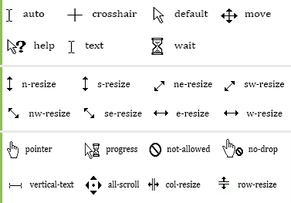
Facebook: #genesystechhub
The cursor Property Values
There are numerous other possible values for the cursor property, such as: default - default cursor crosshair - cursor displays as crosshair pointer - cursor displays hand icon The list of possible values is quite long. The image below demonstrates the various available styles:
CSS allows you to set your desired cursor style when you mouse over an element.

Slide 96
Facebook: #genesystechhub
The default Value
Usually, the appearance of the mouse cursor is altered to provide a more interesting experience for website visitors. However, choosing the wrong cursor style can be misleading, as well. For example, if the cursor value is set to default, users may not "see" the links.
Choose your mouse cursor styles carefully.

Slide 97
Twitter: @genesysclubunn
Tweets time:
#web_css
@genesystechhub @genesysclubunn @genesysclubfuto
@genesysclubunizik
@_powerofgod
@ukejerry #weAreGenesys

Slide 98
Twitter: @genesysclubunn
Positioning and Layout

Slide 99
Twitter: @genesysclubunn
The display Property

Slide 100
Facebook: #genesystechhub
display: block
Every element on a web page is a rectangular box.The display property determines how that rectangular box behaves. A block element is an element that takes up the fullest width available, with line breaks before and after. The style rules in the following example display the inline <span> elements as block-level elements: The HTML:
...
<span>First paragraph.</span>
<span>Second paragraph.</span>
<span>Third paragraph.</span>
<span>Fourth paragraph.</span>
<span>Fifth paragraph.</span>

Slide 101
Facebook: #genesystechhub
The CSS:
span {
display: block;
}

Slide 102
Facebook: #genesystechhub
display: inline
An inline element only takes up as much width as necessary, and does not force line breaks. The CSS:
The code above will make the paragraph tags stack next to each other―a text-like behaviour.
p {
display: inline;
}
Setting the display property of an element only changes how the element is displayed, not what kind of element it is. So, an inline element with display: block is not allowed to have other block elements inside it.

Slide 103
Facebook: #genesystechhub
display: none
display: none hides an element, so it does not take up any space. The element will be hidden, and the page will be displayed as if the element is not there. The HTML:
The CSS:
<h1>This text will not display, as we set the value to none.</h1> <p>Headline of this paragraph is not displayed, as we set the value to none.</p>
h1 {
display: none;
}
There are plenty of other display values, such as list-item, table, table-cell, table-column, grid, flex etc. Just play with values to see the difference.

Slide 104
Twitter: @genesysclubunn
The visibility Property

Slide 105
Facebook: #genesystechhub
The visibility Property
The visibility property specifies whether an element is visible or hidden. The most common values are visible and hidden.
Hiding an element can be done by setting the display property to "none" or the visibility property to "hidden". However, notice that these two methods produce different results: visibility: hidden hides an element, but it will still take up the same space as before. The element will be hidden, but it will still affect the layout: Here is an example: The HTML:
<h1>This is a heading</h1>
<div class="hidden">
This text will not display in browser.
</div>
<p>
The space above this paragraph is empty because
the visibility of the div element is set to hidden.
</p>

Slide 106
Facebook: #genesystechhub
The CSS:
display: none hides an element, without holding a place for that element. Changing visibility: hidden; to display: none; will produce the following result:
div.hidden {
visibility: hidden;
}
div.hidden {
display: none;
}

Slide 107
Twitter: @genesysclubunn
Positioning

Slide 108
Facebook: #genesystechhub
Positioning Elements
The CSS positioning properties allow you to position an element. It can also place an element behind another, and specify what should happen when an element's content is too big. Elements can be positioned using the top, bottom, left, and right properties. However, these properties will not work unless the position property is set first. They also work differently depending on the positioning method. Static Positioning
HTML elements are positioned static by default. A static positioned element is always positioned according to the normal flow of the page. The HTML:
...

Slide 109
Facebook: #genesystechhub
<p>Paragraph with no position.</p>
<p>Paragraph with no position.</p>
<p>Paragraph with no position.</p>
<p>Paragraph with no position.</p>
<p>Paragraph with no position.</p>
<p class="position_static">This paragraph has a static position.</p>
The CSS:
p.position_static {
position: static;
top: 30px;
right: 5px;
color: red;
}
Static positioned elements are not affected by the top, bottom, left, and right properties.

Slide 110
Facebook: #genesystechhub
Fixed Positioning
An element with a fixed position is positioned relative to the browser window, and will not move even if the window is scrolled. The position can be specified using one or more of the properties top, right, bottom, and left. In the example below, the paragraph is fixed to 30px from the top and 5px from the right. The CSS:
p.position_fixed {
position: fixed;
top: 30px;
right: 5px;
color: red;
}
Fixed positioned elements are removed from the normal flow. The document and other elements behave like the fixed positioned element does not exist. Fixed positioned elements can overlap other elements.

Slide 111
Facebook: #genesystechhub
Relative Positioning
A relative positioned element is positioned relative to its normal position. The properties top, right, bottom, and left can be used to specify how the rendered box will be shifted. The CSS:
p {
width: 350px;
border: 1px black solid;
position: fixed;
}
span {
background: green;
color: white;
position: relative;
top: 150px;
left: 50px;
}

Slide 112
Facebook: #genesystechhub
The content of relatively positioned elements can be moved and overlap other elements, but the reserved space for the element is still preserved in the normal flow.
This value cannot be used for table cells, columns, column groups, rows, row groups, or captions.

Slide 113
Facebook: #genesystechhub
Absolute Positioning
An absolute position element is positioned relative to the first parent element that has a position other than static. If no such element is found, the containing block is <html>. Absolutely positioned elements are removed from the normal flow. The document and other elements behave like the absolutely positioned element does not exist.
Absolutely positioned elements can overlap other elements.

Slide 114
Twitter: @genesysclubunn
Floating

Slide 115
Facebook: #genesystechhub
Floating
With CSS float, an element can be pushed to the left or right, allowing other elements to wrap around it. Float is often used with images, but it is also useful when working with layouts. The values for the float property are left, right, and none. Left and right float elements in those directions, respectively. none (the default) ensures that the element will not float. Below is an example of an image that is floated to the right. The HTML:
<p><img src="css_logo.png" /> This paragraph has an image that is floated to the <strong>right.</strong> It is highly recommended to add a margin to images so that the text does not get too close to the image. If you want your text to be easily read, you should always add a few pixels between words and borders, images, and other content. </p>

Slide 116
Facebook: #genesystechhub
The CSS:
img {
float: right;
}
Elements are floated horizontally, meaning that an element can only be floated left or right, not up or down.

Slide 117
Facebook: #genesystechhub
Elements Next to Each Other
If you place several floating elements one after the other, they will float next to each other if there is enough room. As an example, in a print layout, images may be set into the page such that text wraps around them as needed. The CSS:
img {
float: left;
width: 120px;
margin-right: 10px;
}
p {
width: 120px;
float: left;
}

Slide 118
Twitter: @genesysclubunn
The clear Property

Slide 119
Facebook: #genesystechhub
Clearing the Float
Elements that come after the floating element will flow around it. To avoid this, use the clear property. The clear property specifies the sides of an element where other floating elements are not allowed to be. In the example below, if we set the float property to the div, only the paragraph that comes after the div will be wrapped around the image.
The HTML:
...

Slide 120
Facebook: #genesystechhub
This paragraph is above the div element and is not affected by the float right property. <br /><br /> <div class="floating"> <img src="css_logo.png" /> </div> This paragraph comes after the div element and is affected by the float right property. <br /><br /> This paragraph also comes after the div element and is affected by the float right property. <br /> <br />
The CSS:
.floating {
float: right;
}

Slide 121
Facebook: #genesystechhub
Using clear
Use the values right, left, and both to specify the sides of an element where other floating elements are not allowed to be.
The default value is none, which allows floating elements on both sides.

Slide 122
Facebook: #genesystechhub
Clearing Floats
both is used to clear floats coming from either direction. The HTML:
This paragraph is above the div element and is not affected by the float right property. <br/><br/> <div class="floating"> <img src="css_logo.png" /> </div> This paragraph comes after the div element and is affected by the float right property. <br/><br class="clearing"/> This paragraph is out of the floating group and is not affected by the float right property. <br/> <br/>

Slide 123
Facebook: #genesystechhub
The CSS:
.floating {
float: right;
}
.clearing {
clear: both;
}

Slide 124
Twitter: @genesysclubunn
The clear Property

Slide 125
Facebook: #genesystechhub
The overflow Property
As discussed earlier, every element on the page is a box. If the height of the box is not set, the height of that box will grow as large as necessary to accommodate the content. The HTML:
The CSS:
...
<div>
This text is inside the div element, which has a blue
background color and is floated to the left. We set a specific
height and width for the div element, and as you can see,
the content cannot fit.
</div>

Slide 126
Facebook: #genesystechhub
As discussed earlier, every element on the page is a box. If the height of the box is not set, the height of that box will grow as large as necessary to accommodate the content. The HTML:
The CSS:
...
div {
width: 150px;
height: 150px;
background-color: LightBlue;
float: left;
}
The CSS overflow property specifies the behavior that occurs when an element's content overflows the element's box.

Slide 127
Facebook: #genesystechhub
The overflow Property Values
There are four values for the overflow property: visible (the default value), scroll, hidden, and auto. The value scroll results in clipped overflow, but a scrollbar is added, so the rest of the content may be seen. The CSS:
The code above will produce both horizontal and vertical scrollbars.
div {
width: 150px;
height: 150px;
background-color: LightBlue;
float: left;
overflow: scroll;
}

Slide 128
Facebook: #genesystechhub
auto and hidden
auto - If overflow is clipped, a scroll-bar should be added to make it possible to see the rest of the content. hidden - The overflow is clipped, and the rest of the content will be invisible. The CSS:
div {
width: 150px;
height: 150px;
background-color: LightBlue;
float: left;
overflow: hidden;
}
The default value for the overflow property is visible.

Slide 129
Twitter: @genesysclubunn
The z-index Property

Slide 130
Facebook: #genesystechhub
The z-index Property
When elements are positioned outside the normal flow, they can overlap other elements. The z-index property specifies the stack order of an element (which element should be placed in front of, or behind, the others). The CSS:
.blue {
background-color: #8EC4D0;
margin-bottom: 15px;
width: 120px;
height: 120px;
color: #FFF;
}
...

Slide 131
Facebook: #genesystechhub
.red {
background-color: #FF4D4D;
position: relative;
width: 120px;
height: 120px;
color: #FFF;
margin-top: -50px;
margin-left: 50px;
}
The red box overlaps the blue box, because it was placed later in the HTML markup. The z-index property can change this order.

Slide 132
Facebook: #genesystechhub
Assigning the z-index Property
Assigning a higher z-index value to the blue div and a lower z-index value to the red div will result in the following: The CSS:
.blue {
z-index: 3;
position: relative;
}
.red {
z-index: 2;
position: relative;
}
The z-index works only on positioned elements (position: absolute, position: relative, or position: fixed).

Slide 133
Twitter: @genesysclubunn
Practice Time…

Slide 134
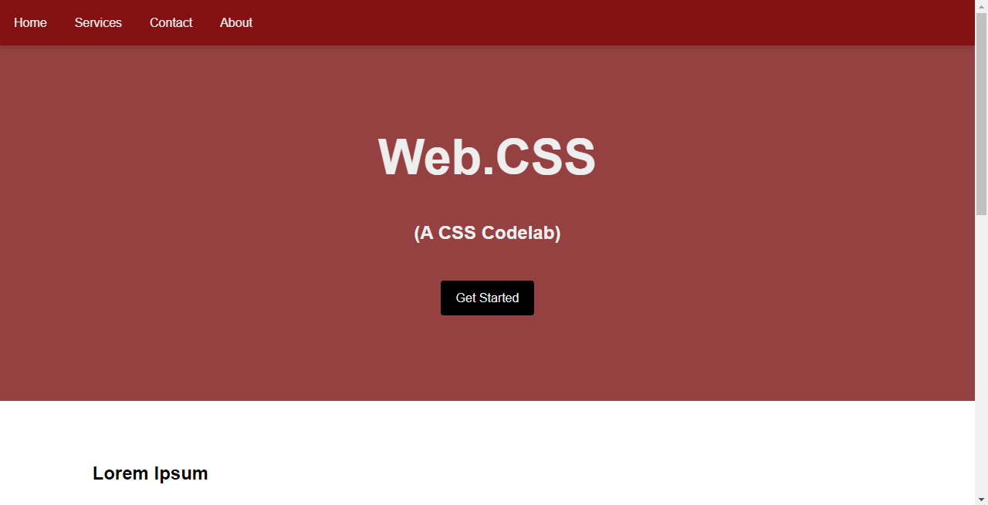
Facebook: #genesystechhub
Task: Create a basic web page like in the image

Slide 135
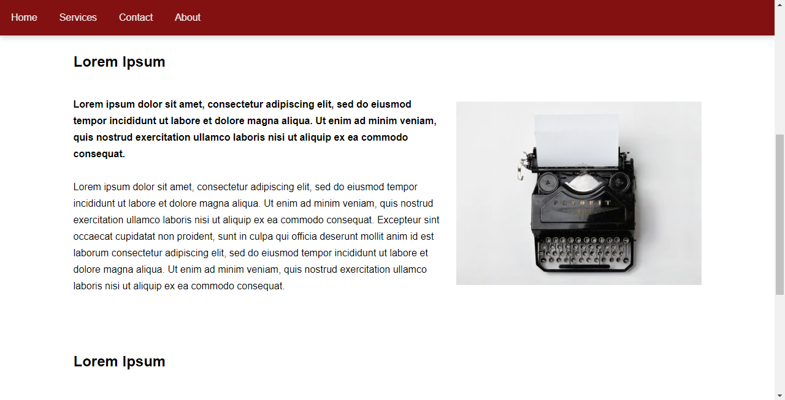
Facebook: #genesystechhub
Task: Create a basic web page like in the image

Slide 136
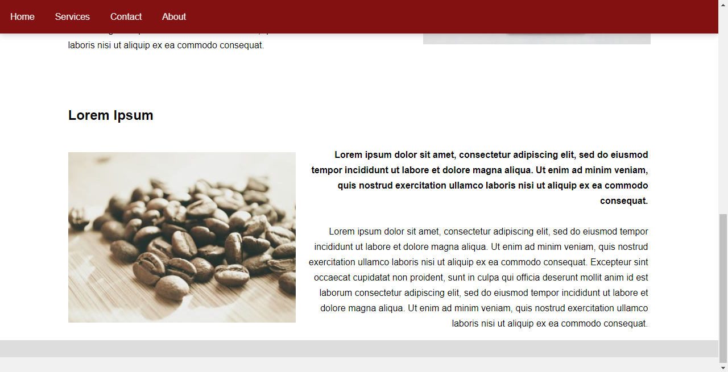
Facebook: #genesystechhub
Task: Create a basic web page like in the image

Slide 137
Twitter: @genesysclubunn
See the link below for a demo of the web page:
https://power-f-god.github.io/genesyscampusclub-unn/

Slide 138
Twitter: @genesysclubunn
What are the Benefits of Being a Web Developer? Sit back and watch the next video…

Slide 139
Twitter: #weAreGenesys
#benefitsOfBeingAWebDeveloper

Slide 140
Twitter: @genesysclubunn
So, with that, we call it a day.
Thanks for coming!
See you next time! ☺

Slide 141
Twitter: @genesystechhub

Slide 142
Twitter: #weAreGenesys
A
a

