Slide 1
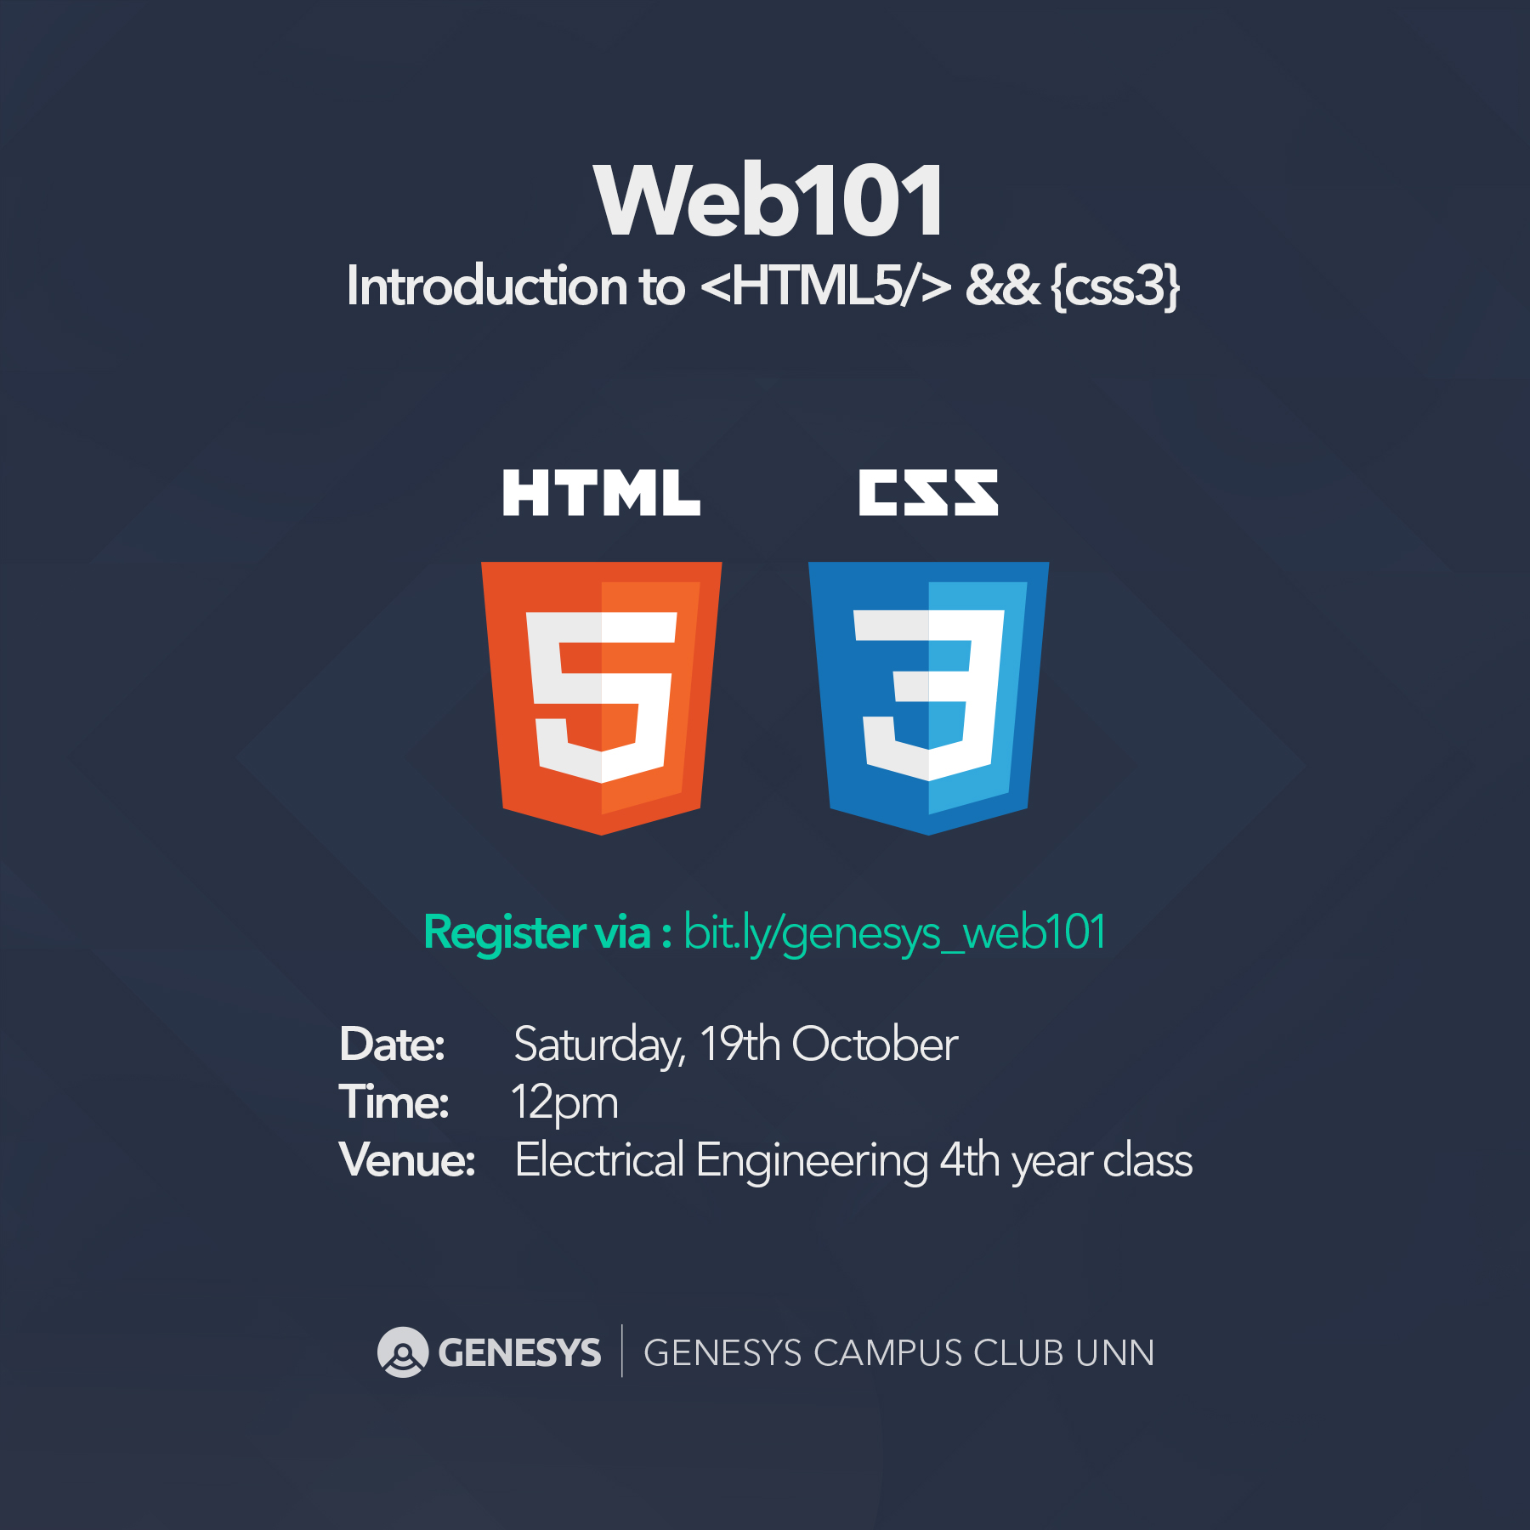

Slide 2




Web101: Introduction to <HTML5 /> && {CSS3} Saturday, October 19, 2019

Slide 3

Twitter: @genesystechhub
First things first:
- Introduction -
Let’s introduce ourselves to the community
Protocol: Name, Department and Level

Slide 4
Twitter: @genesysclubunn
Course prerequisites:
A laptop (PC)
Little to no prior coding experience or knowledge
Basic computer operation skill
Average typing speed of 15WPM (optional)
Patience, perseverance and the will to go on

Slide 5
Twitter: #weAreGenesys
Alright. Before we begin proper, I want you all to know (or be reminded) that, in terms of knowledge and information, after…

Slide 6

…after
…in this world is…you know what I’m about to say already… ☺

Slide 7
…is
Whenever you get stuck, remember that you can always Google your way out!

Slide 8
Twitter: @genesystechhub
A Little Recap from the Last Study Jam!

Slide 9
Twitter: @genesysclubunn
Last time on HTML Basics…
HTML stands for HyperText Markup Language.
Unlike a scripting or programming language that uses scripts to perform functions, a markup language uses tags to identify content.
A web browser will parse the HTML (tags) and use it (along with CSS and JavaScript) to render a (web) page.
Some HTML tags:
<html>...</html> <head>...</head> <body>...</body> <title>...</title>
<p>...</p> <i>...</i> <br /> <sup>...</sup>
<sub>...</sub> <h1>...</h1> <h6>...</h6> <a href=‘’>...</a>
<img src=‘’ /> <hr /> <ul>...</ul> <ol>...</ol>

Slide 10
Twitter: @genesystechhub
We didn’t do this last time…

Slide 11
Twitter: @genesysclubunn
Project: My First Website
Create a basic website similar to the one in the image in the next slide, which has three different pages: Home, About Us and Contact Us. Include any image of your choice from your PC. All your links must be active and not dead or broken.
Your Home, Contact Us and About Us links, when clicked, should link to the Home page, Contact Us page and About Us page of your website respectively.
Hint: Create three HTML files; name them home.html, contact.html and about.html; add links to these files/pages in each file created.
Sidebar: The Genesys and Google links should open in a new tab when clicked. Take not of the text formatting. And don’t forget to add title to your page in the head tag.

Slide 12
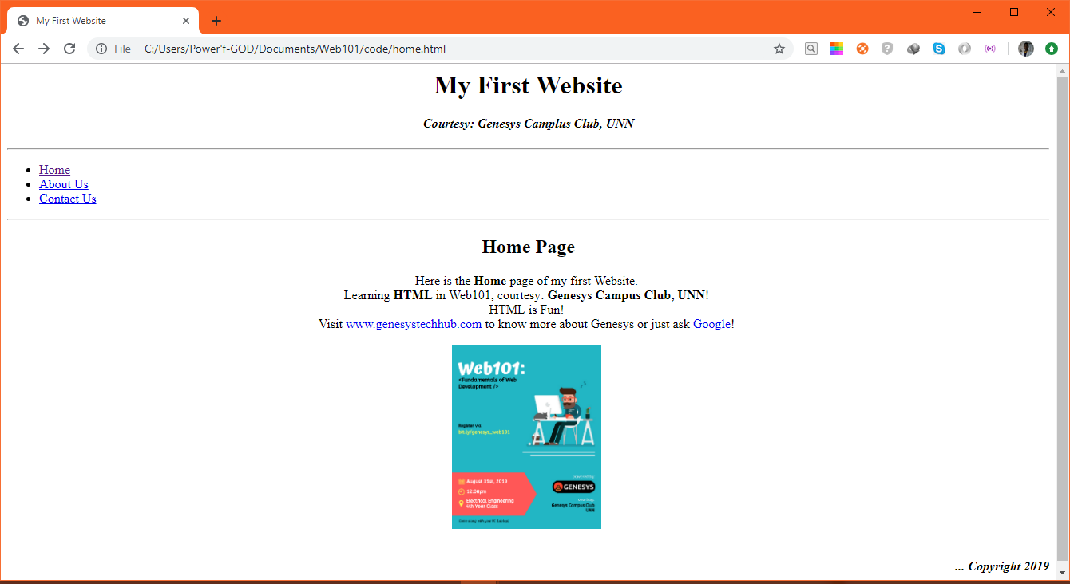
Twitter: @genesystechhub

Slide 13
Twitter: @genesystechhub
Today on HTML Basics…

Slide 14
Twitter: #weAreGenesys
Tables

Slide 15

Twitter: #weAreGenesys
Creating a Table
Tables are defined by using the <table> tag. Tables are divided into table rows with the <tr> tag. Table rows are divided into table columns (table data) with the <td> tag.
Here is an example of a table with one row and three columns:
Sidebar: Table data tags <td> act as data containers within the table. They can contain all sorts of HTML elements, such as text, images, lists, other tables, and so on.

Slide 16
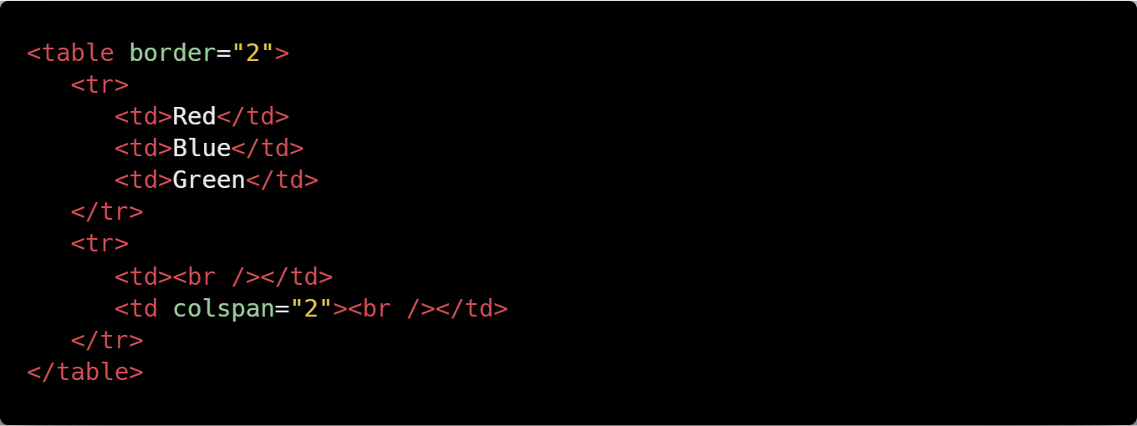
Twitter: #weAreGenesys
The border and colspan Attributes
A border can be added using the border attribute:
A table cell can span two or more columns:
Sidebar: The border attribute is not supported in HTML5.

Slide 17
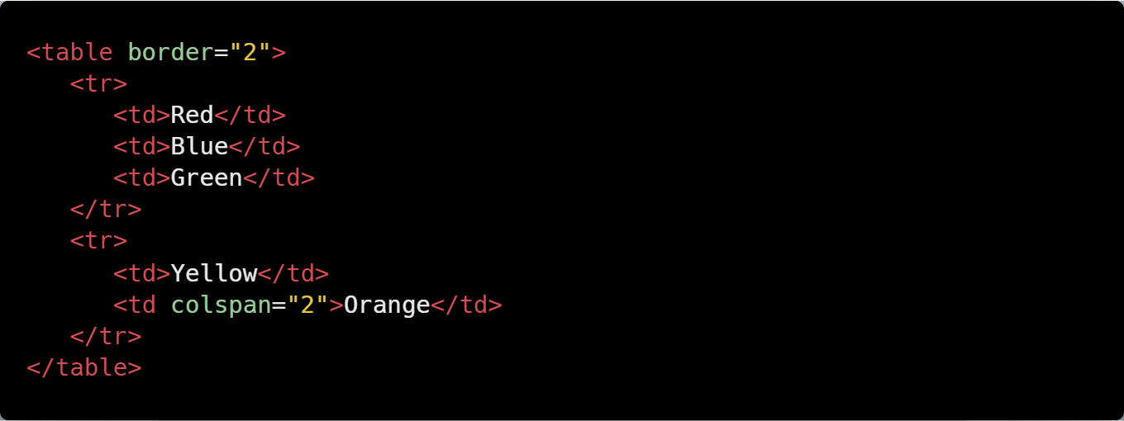
Twitter: #weAreGenesys
Colspan
The example below demonstrates the colspan attribute in action:
A table cell can span two or more columns:
You can see that the cell containing "Orange" spans two cells.
Sidebar: To make a cell span more than one row, use the rowspan attribute.

Slide 18
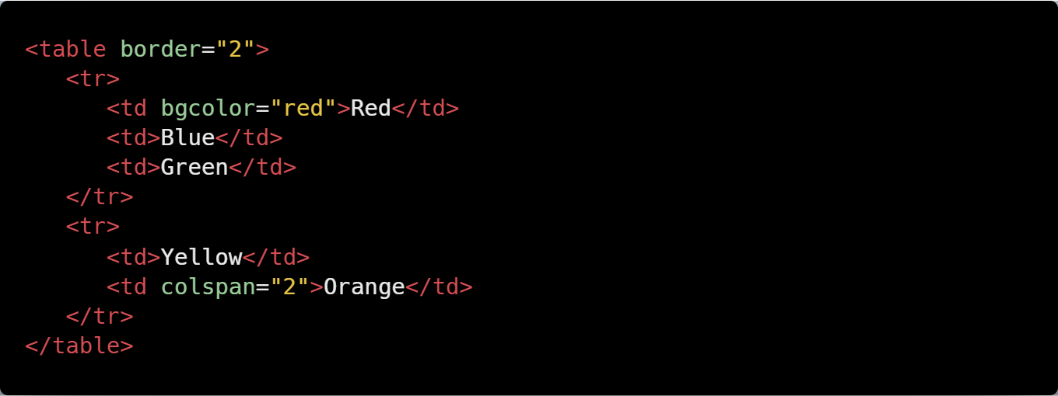
Twitter: #weAreGenesys
The align and bgcolor Attributes
To change your table's position, use the align attribute inside your table tag:
Now let's specify a background color of red for a table cell. To do that, just use the bgcolor attribute.
Sidebar: In the case of styling elements, CSS is more effective than HTML. Try our free "Learn CSS" course to learn more about CSS and styles.

Slide 19
Twitter: @genesystechhub
Tables Practice…

Slide 20

Twitter: @genesysclubunn
Task: Create a Table
Create a web page that displays a table just like in the image below.
Hint: Use the <h1>, <table>, <th>, <tr>, <td> tags, and the colspan and rowspan attributes. Colours used are grey, lightgrey, lime, pink, orange, yellow and skyblue. Don’t forget to align your table to the center.

Slide 21
Twitter: #weAreGenesys
Inline and Block Elements

Slide 22
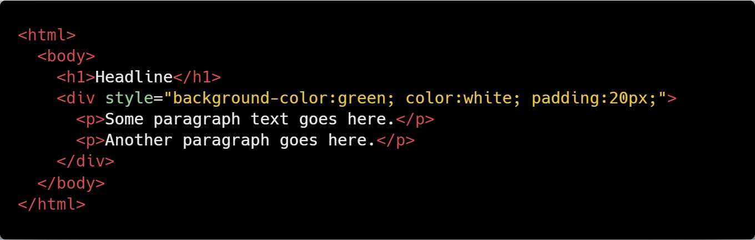
Twitter: @genesysclubunn
Types of Elements
In HTML, most elements are defined as block level or inline elements. Block level elements start from a new line. For example: <h1>, <form>, <li>, <ol>, <ul>, <p>, <pre>, <table>, <div>, etc.
Inline elements are normally displayed without line breaks. For example: <b>, <a>, <strong>, <img>, <input>, <em>, <span>, etc.
The <div> element is a block-level element that is often used as a container for other HTML elements. When used together with some CSS styling, the <div> element can be used to style blocks of content:

Slide 23

Twitter: @genesysclubunn
Similarly, the <span> element is an inline element that is often used as a container for some text. When used together with CSS, the <span> element can be used to style parts of the text:
Summary: The <div> element defines a block-level section in a document. The <span> element defines an inline section in a document.

Slide 24
Twitter: @genesysclubunn
Other elements can be used either as block level elements or inline elements. This includes the following elements: APPLET - embedded Java applet IFRAME - Inline frame INS - inserted text MAP - image map OBJECT - embedded object SCRIPT - script within an HTML document
You can insert inline elements inside block elements. For example, you can have multiple <span> elements inside a <div> element.
Note: Inline elements cannot contain any block level elements.

Slide 25
Facebook: Genesys Tech Hub
Forms

Slide 26

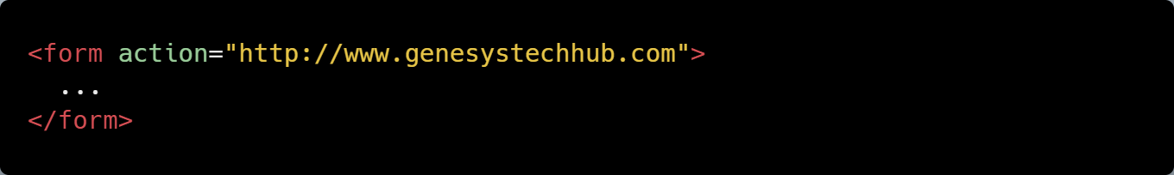
Facebook: #genesystechhub
The <form> Element
HTML forms are used to collect information from the user. Forms are defined using the <form> element, with its opening and closing tags:
Use the action attribute to point to a webpage that will load after the user submits the form.
Sidebar: Usually the form is submitted to a web page on a web server.

Slide 27
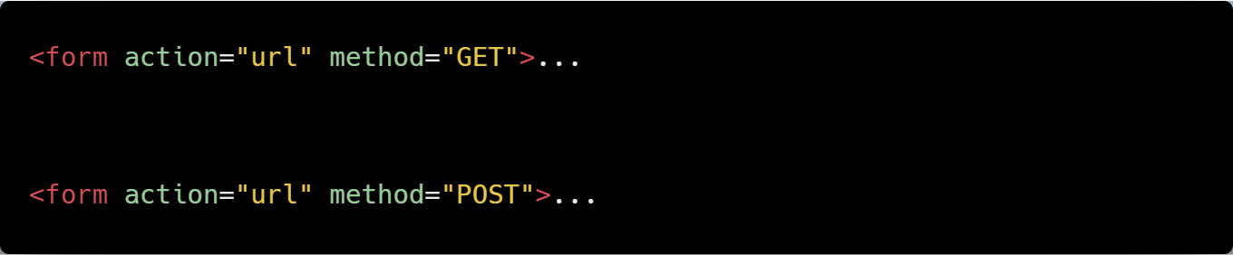
Facebook: #genesystechhub
The method and name Attributes
The method attribute specifies the HTTP method (GET or POST) to be used when forms are submitted (see below for description):
Note: When you use GET, the form data will be visible in the page address. Use POST if the form is updating data, or includes sensitive information (passwords). POST offers better security because the submitted data is not visible in the page address.
To take in user input, you need the corresponding form elements, such as text fields. The <input> element has many variations, depending on the type attribute. It can be a text, password, radio, URL, submit, etc.

Slide 28
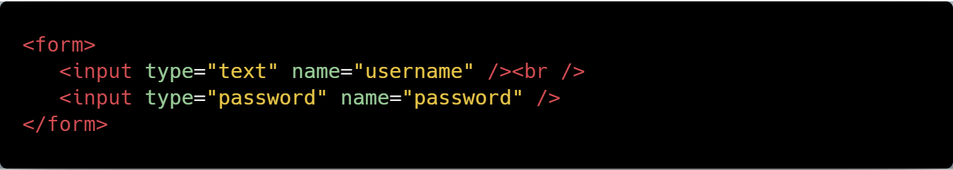
Facebook: #genesystechhub
The example below shows a form requesting a username and password:
Sidebar: The name attribute specifies a name for a form.

Slide 29
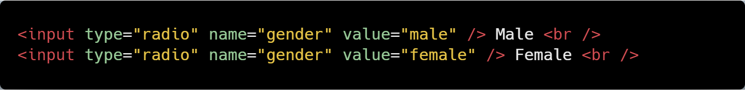
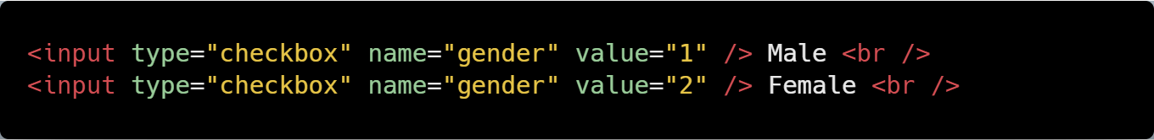
Facebook: #genesystechhub
Form Elements
If we change the input type to radio, it allows the user select only one of a number of choices:
The type "checkbox" allows the user to select more than one option:
Sidebar: The <input /> tag has no end [closing] tag.

Slide 30
Facebook: #genesystechhub
The submit button submits a form to its action attribute:
Sidebar: After the form is submitted, the data should be processed on the server using a programming language, such as PHP.

Slide 31
Facebook: Genesys Tech Hub
Forms practice…

Slide 32
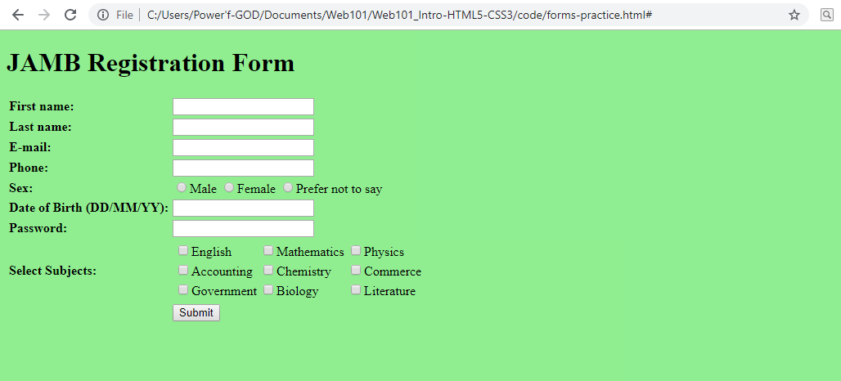
Facebook: #genesystechhub
Task: Create a JAMB Registration Form
Create a web page that has a web form embedded just as in the image below.
Hint: Use the <h1>, <table> (for alignment/positioning), and <form> tags. The background color used is lightgreen. Don’t forget to use type=‘radio’ and type=‘checkbox’ where applicable. Set the form action attribute to ‘#’ and method to ‘POST’.

Slide 33
Facebook: #genesystechhub
HTML Colors

Slide 34
Facebook: #genesystechhub
HTML Colors!
HTML colors are expressed as hexadecimal values.
0, 1, 2, 3, 4, 5, 6, 7, 8, 9, A, B, C, D, E, F
As you can see, there are 16 values there, 0 through F. Zero represents the lowest value, and F represents the highest.

Slide 35
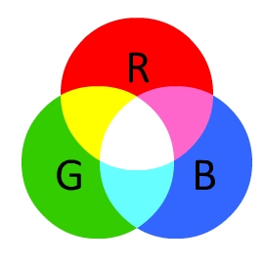
Facebook: #genesystechhub
HTML Color Model
Colors are displayed in combinations of red, green, and blue light (RGB). Hex values are written using the hashtag symbol (#), followed by either three or six hex characters. As shown in the picture below, the circles overlap, forming new colors:
Sidebar: RGB color values are supported in all browsers.

Slide 36
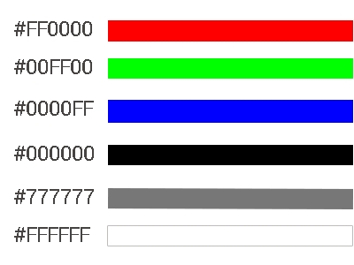

Facebook: #genesystechhub
Color Values
All of the possible red, green, and blue combinations potentially number over 16 million. Here are only a few of them:
We can mix the colors to form additional colors: Orange and red mix:
Sidebar: Hexadecimal color values are supported in all browsers.

Slide 37
Twitter: @genesysclubunn
A Short Break: Watch these two videos for some motivation… ☺

Slide 38

Twitter: #weAreGenesys
#feedYourMindWithSuccess

Slide 39
Twitter: @genesysclubunn
…Feed your mind with success.
This is the time to invest in yourself, your personality.
Read the more; learn the more; code the more; practice the more; ask (Google) the more.
“Invest in yourself!” Your future self is begging you! It’ll be worth it at the end!
#feedYourMindWithSuccess

Slide 40
Twitter: #weAreGenesys
#neverQuit

Slide 41
Twitter: @genesystechhub

Slide 42
Twitter: @genesysclubunn
Introduction to HTML5

Slide 43
Twitter: #weAreGenesys
HTML5
When writing HTML5 documents, one of the first new features that you'll notice is the doc type declaration:
<!DOCTYPE HTML>
The character encoding (charset) declaration is also simplified:
<meta charset="UTF-8">
New Elements in HTML5 <article>, <aside>, <audio>, <canvas>, <datalist>, <details>, <embed>, <footer>, <header>, <nav>, <output>, <progress>, <section>, <video>, and even more!
Sidebar: The default character encoding in HTML5 is UTF-8.

Slide 44
Twitter: #weAreGenesys
New in HTML5
Forms - The Web Forms 2.0 specification allows for creation of more powerful forms and more compelling user experiences. - Date pickers, color pickers, and numeric stepper controls have been added. - Input field types now include email, search, and URL. - PUT and DELETE form methods are now supported.
Integrated API (Application Programming Interfaces) - Drag and Drop - Audio and Video - Offline Web Applications - History - Local Storage - Geolocation - Web Messaging

Slide 45
Twitter: @genesysclubunn
More on HTML5 will be discussed in the next Study Jam. ☺

Slide 46
Twitter: @genesystechhub
Introduction to CSS

Slide 47
Twitter: @genesysclubunn
What is CSS?

Slide 48
Twitter: @genesysclubunn
Welcome to CSS!
CSS stands for Cascading Style Sheets. - Cascading refers to the way CSS applies one style on top of another. - Style Sheets control the look and feel of web documents. CSS and HTML work hand in hand: - HTML sorts out the page structure. - CSS defines how HTML elements are displayed.
Sidebar: To understand CSS, you should already have a basic knowledge of HTML.

Slide 49
Twitter: @genesysclubunn
Why Use CSS?
CSS allows you to apply specific styles to specific HTML elements. The main benefit of CSS is that it allows you to separate style from content. Using just HTML, all the styles and formatting are in the same place, which becomes rather difficult to maintain as the page grows.
Sidebar: All formatting can (and should) be removed from the HTML document and stored in a separate CSS file.

Slide 50
Twitter: @genesysclubunn
Inline, Embedded, External CSS

Slide 51
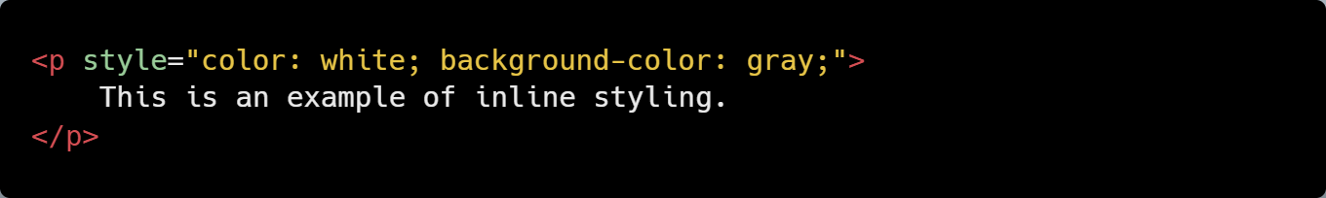
Twitter: @genesysclubunn
Inline CSS
Using an inline style is one of the ways to insert a style sheet. With an inline style, a unique style is applied to a single element. In order to use an inline style, add the style attribute to the relevant tag. The example below shows how to create a paragraph with a gray background and white text:
Sidebar: The style attribute can contain any CSS property.

Slide 52
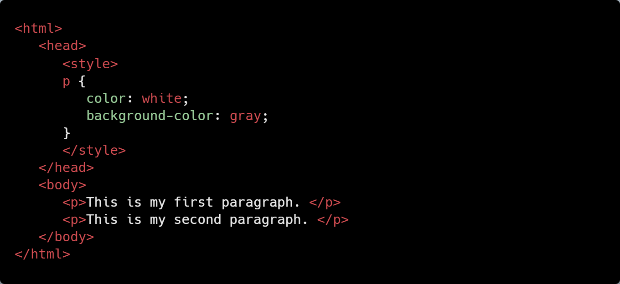
Twitter: @genesysclubunn
Embedded/Internal CSS
Internal styles are defined within the <style> element, inside the head section of an HTML page.
For example, the following code styles all paragraphs:
All paragraphs will have a white font and a gray background.
Sidebar: An internal style sheet may be used if one single page has a unique style.

Slide 53
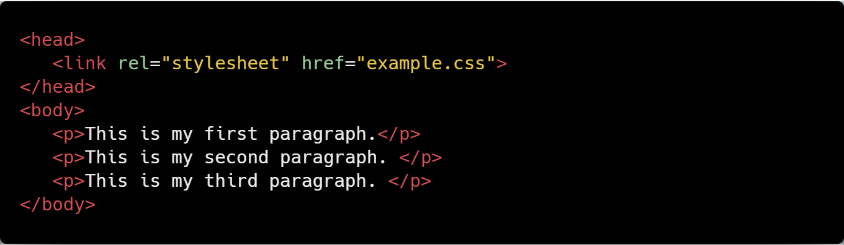
Twitter: @genesysclubunn
External CSS
With this method, all styling rules are contained in a single text file, which is saved with the .css extension.
This CSS file is then referenced in the HTML using the <link> tag. The <link> element goes inside the head section.
Here is an example: The HTML:

Slide 54
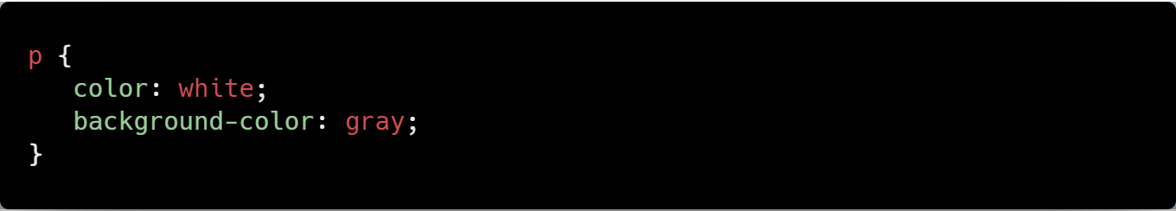
Twitter: @genesysclubunn
The CSS:
Sidebar: Both relative and absolute paths can be used to define the href for the CSS file. In our example, the path is relative, as the CSS file is in the same directory as the HTML file.

Slide 55
Twitter: @genesysclubunn
CSS Rules and Selectors

Slide 56

Twitter: @genesysclubunn
CSS Syntax
CSS is composed of style rules that the browser interprets and then applies to the corresponding elements in your document. A style rule has three parts: selector, property, and value.
For example, the headline color can be defined as:
Where:
The selector points to the HTML element you want to style.
Sidebar: The declaration block contains one or more declarations, separated by semicolons. Each declaration includes a property name and a value, separated by a colon.

Slide 57
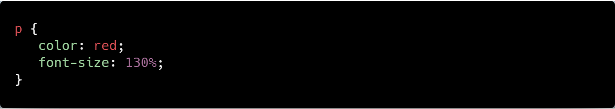
Twitter: @genesysclubunn
Type Selectors
The most common and easy to understand selectors are type selectors. This selector targets element types on the page. For example, to target all the paragraphs on the page:
Sidebar: A CSS declaration always ends with a semicolon, and declaration groups are surrounded by curly braces.

Slide 58
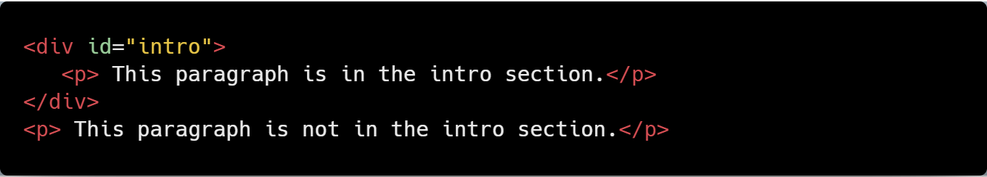
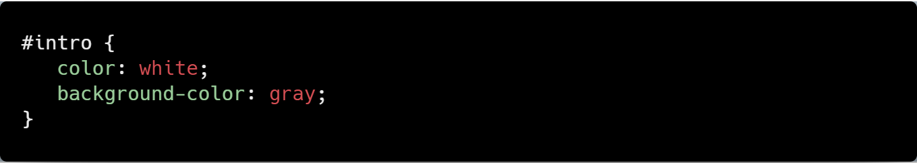
Twitter: @genesysclubunn
id and class Selectors
id selectors allow you to style an HTML element that has an id attribute, regardless of their position in the document tree. Here is an example of an id selector:
The HTML:
The CSS:
Sidebar: To select an element with a specific id, use a hash [#] character, and then follow it with the id of the element.

Slide 59
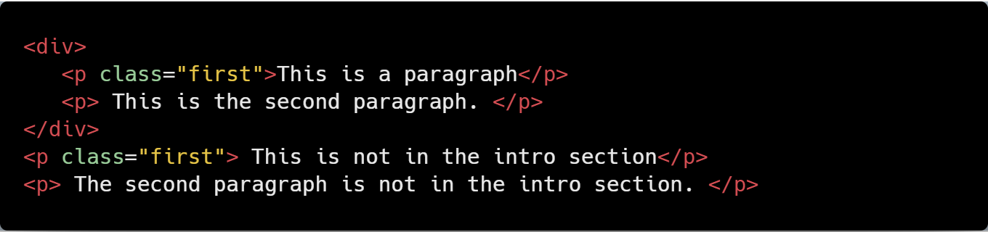
Twitter: @genesysclubunn
Class selectors work in a similar way. The major difference is that IDs can only be applied once per page, while classes can be used as many times on a page as needed.
In the example below, both paragraphs having the class "first" will be affected by the CSS:
The HTML:
The CSS:
Note: To select elements with a specific class, use a period character, followed by the name of the class. Do NOT start a class or id name with a number!

Slide 60
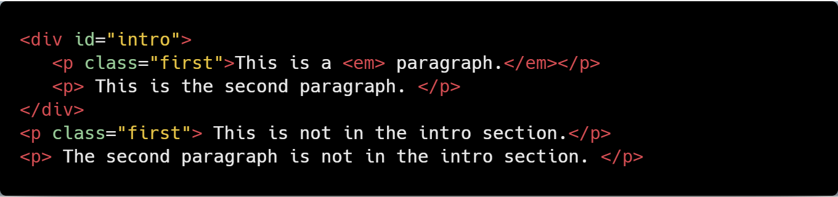
Twitter: @genesysclubunn
Descendant Selectors
These selectors are used to select elements that are descendants of another element. When selecting levels, you can select as many levels deep as you need to. For example, to target only <em> elements in the first paragraph of the "intro" section: The HTML:

Slide 61
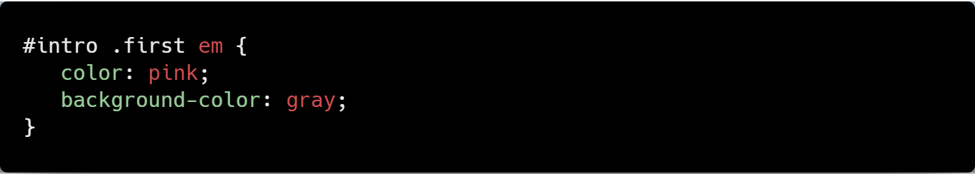
Twitter: @genesysclubunn
The CSS:
As a result, only the elements selected will be affected.
Sidebar: The descendant selector matches all elements that are descendants of a specified element.

Slide 62
Facebook: #genesystechhub
CSS Comments

Slide 63
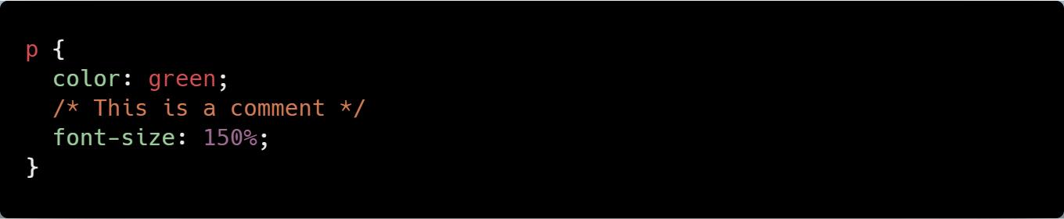
Facebook: #genesystechhub
Comments
Comments are used to explain your code, and may help you when you edit the source code later. Comments are ignored by browsers.
A CSS comment looks like this:
Example:
The comment does not appear in the browser.
Sidebar: Comments can also span multiple lines.

Slide 64
Facebook: #genesystechhub
Style Cascade and Inheritance

Slide 65
Twitter: #weAreGenesys
Cascade
The final appearance of a web page is a result of different styling rules. The three main sources of style information that form a cascade are: - The stylesheet created by the author of the page - The browser's default styles - Styles specified by the user
Sidebar: CSS is an acronym for Cascading Style Sheets.

Slide 66
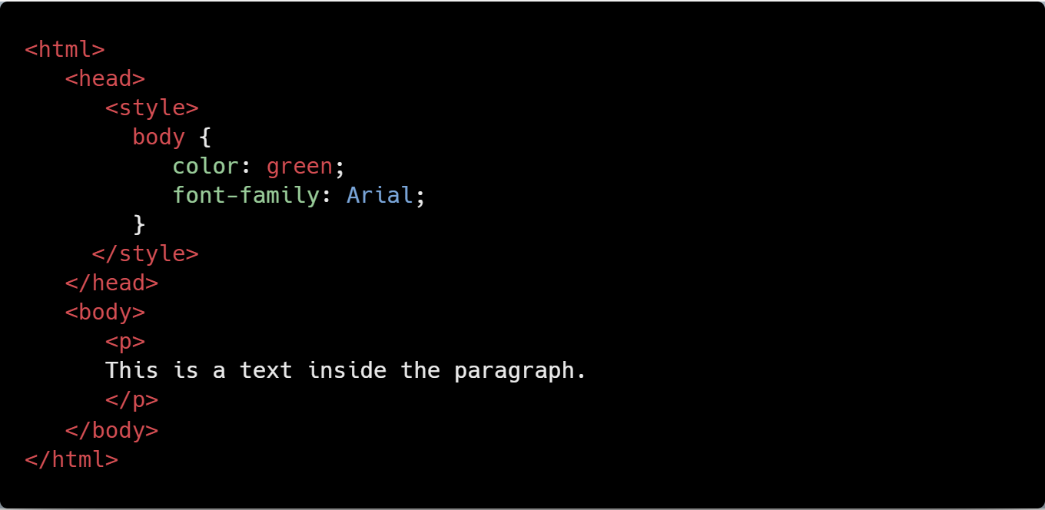
Twitter: #weAreGenesys
Inheritance
Inheritance refers to the way properties flow through the page. A child element will usually take on the characteristics of the parent element unless otherwise defined.
For example:
Since the paragraph tag (child element) is inside the body tag (parent element), it takes on any styles assigned to the body tag.

Slide 67
Twitter: @genesysclubunn
Properties

Slide 68
Twitter: @genesysclubunn
Introducing the Box Model

Slide 69
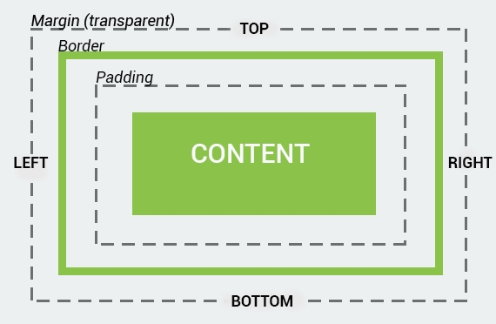
Twitter: #weAreGenesys
The CSS Box Model
All HTML elements can be considered as boxes. The CSS box model represents the design and layout of the site. It consists of margins, borders, paddings, and the actual content.
The properties work in the same order: top, right, bottom, and left.
The image below illustrates the box model:
Sidebar: The term "box model" is used when talking about design and layout.

Slide 70
Twitter: @genesysclubunn
Understanding the Box Model

Slide 71
Twitter: #weAreGenesys
More on Box Models
Every element of the webpage is a box. CSS uses the box model to determine how big the boxes are and how to place them.
Sidebar: The box model is also used to calculate the actual width and height of the HTML elements.

Slide 72
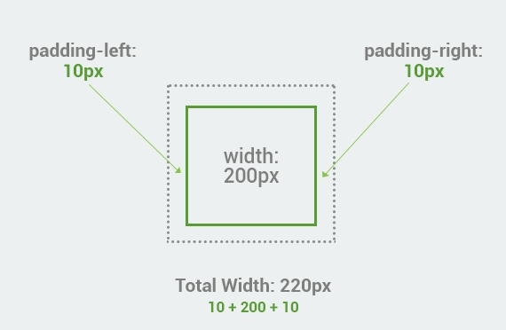
Twitter: #weAreGenesys
Total Width of an Element
When working with boxes, it is important to understand how the total width of an element is calculated. For example, the total width of the box with paddings will be the sum of width plus padding left and padding right.

Slide 73
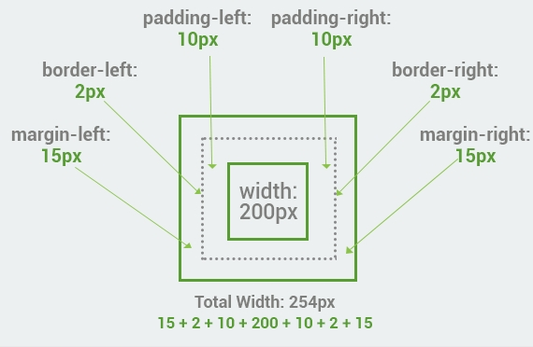
Twitter: #weAreGenesys
Here is another box with margins, border, and paddings. The total width is the sum of left and right margins, left and right borders, left and right paddings, and the actual width of the content.
Note: When you set the width and height properties of an element with CSS, you set the width and height of the content area. When setting a background-color to a box, it covers the content area, as well as the padding.

Slide 74
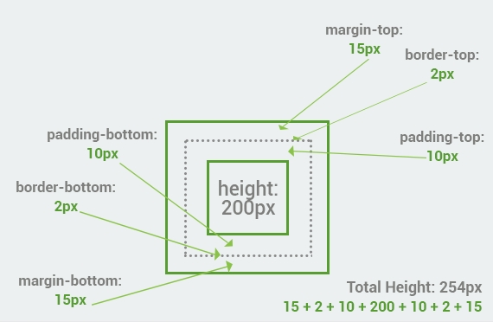
Twitter: #weAreGenesys
Total Height of an Element
The total height of an element is calculated the same way as the width. The example below is the same box from the previous lesson with padding, border and margin.
Summary: Total element height = height + top padding + bottom padding + top border + bottom border + top margin + bottom margin

Slide 75
Twitter: @genesysclubunn
Borders

Slide 76
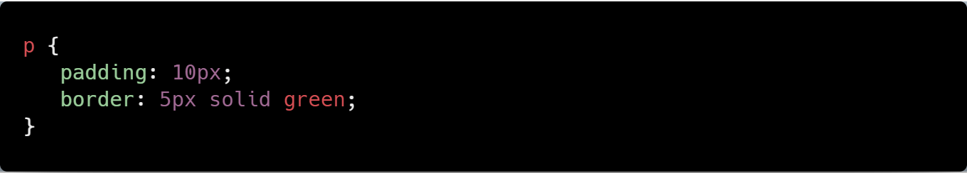
Twitter: #weAreGenesys
The border Property
The CSS border property allows you to customize the borders of HTML elements. In order to add a border to the element, you need to specify the size, style, and color of the border. The example below shows how to add a solid green border to the paragraph.
The HTML:
The CSS:

Slide 77
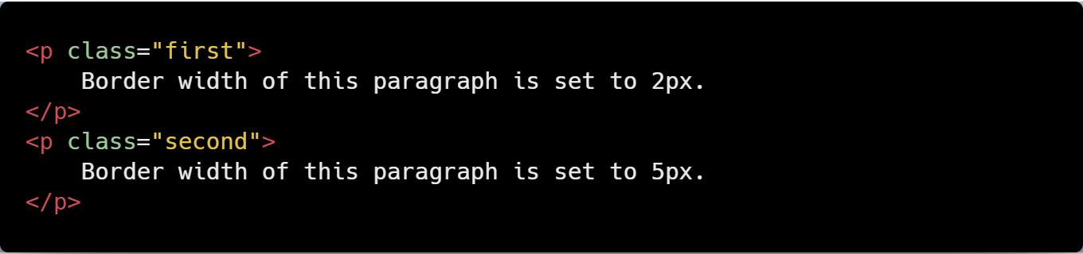
Twitter: #weAreGenesys
Border Width
The properties for the border can be set separately. The border-width property specifies the width of the border.
The HTML:
…

Slide 78
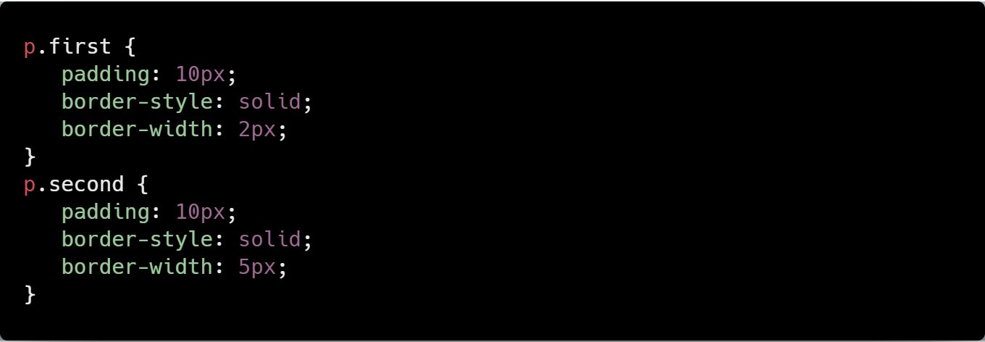
Twitter: #weAreGenesys
The CSS:

Slide 79
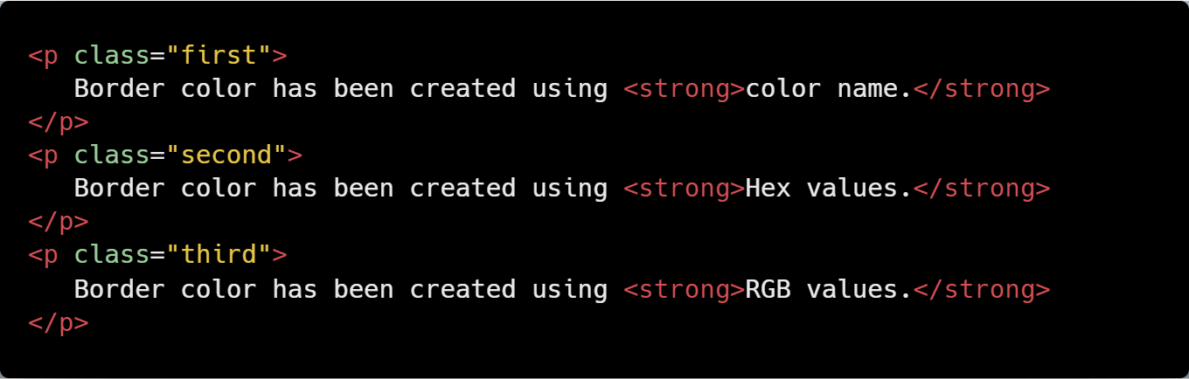
Twitter: #weAreGenesys
Border Color
The border color of the element can be defined using a color name, RGB, or Hex values.
The HTML:

Slide 80
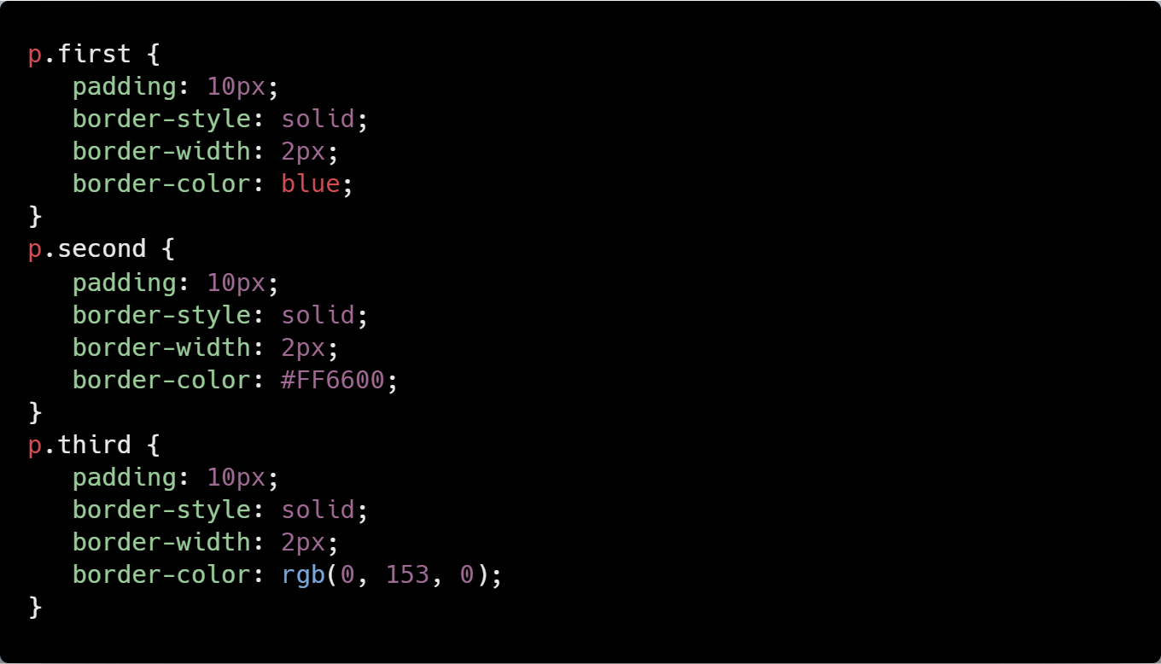
Twitter: #weAreGenesys
The CSS:
Note: None of the border properties will have any effect unless the border-style property is set.

Slide 81
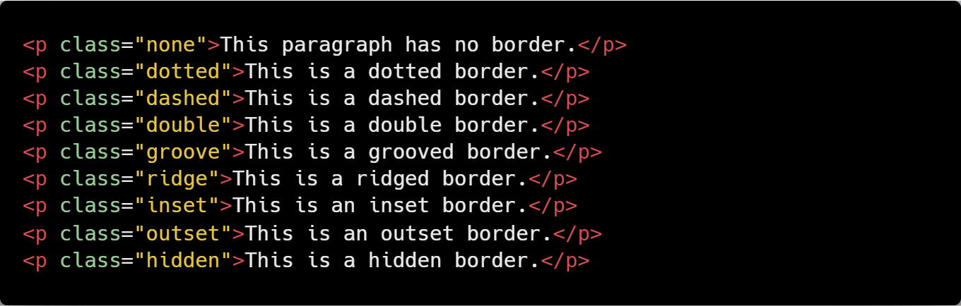
Twitter: #weAreGenesys
The border-style Property
The default value of border-style is none, which defines no border. There are various styles supported for the border-style property: dotted, dashed, double, etc. The example below illustrates the differences between them. The HTML:

Slide 82
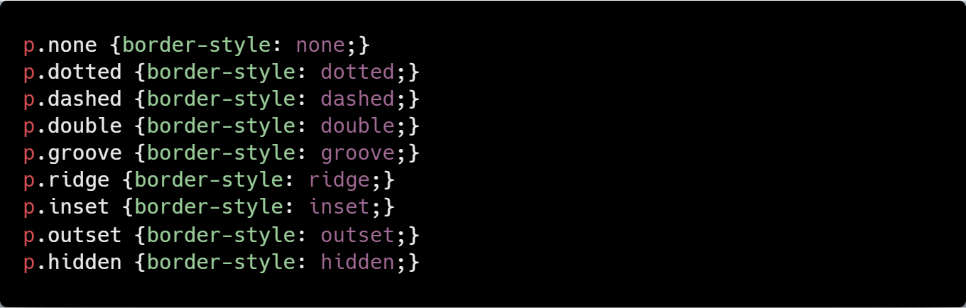
Twitter: #weAreGenesys
The CSS:
Sidebar: In CSS, it is possible to specify different borders for different sides, using the following properties: border-top-style, border-right-style, border-bottom-style, and border-left-style for the corresponding sides.

Slide 83
Twitter: @genesysclubunn
Width and Height

Slide 84
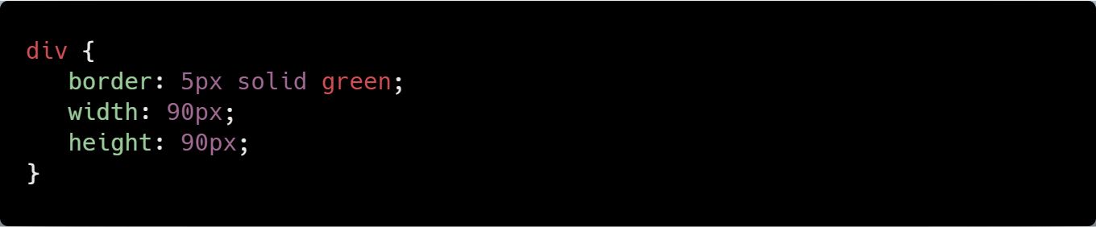
Facebook: #genesystechhub
CSS Width and Height
To style a <div> element to have a total width and height of 100px: The HTML:
The CSS:
Sidebar: The total width and height of the box will be the 90px+5px (border)+5px(border) = 100px;

Slide 85
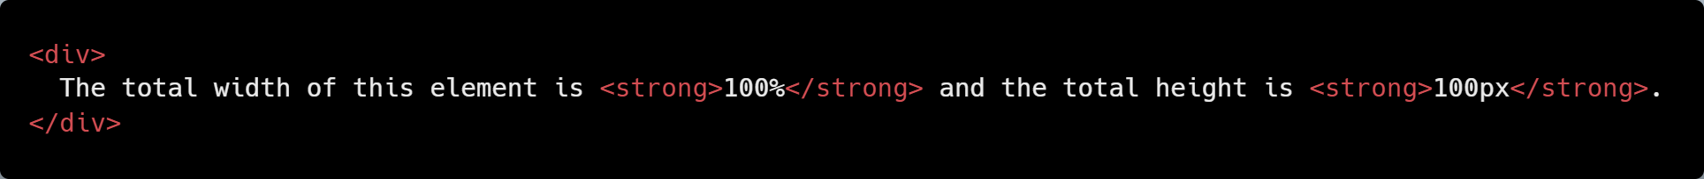
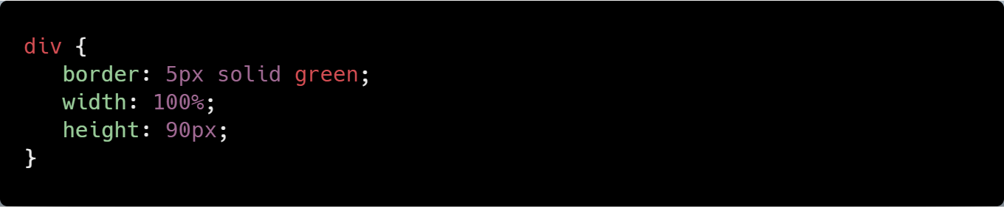
Facebook: #genesystechhub
Width and Height Measurement
The width and height of an element can be also assigned using percents. In the example below the width of an element is assigned in percentages, the height is in pixels. The HTML:
The CSS:

Slide 86
Facebook: #genesystechhub
The Minimum and Maximum Sizes
To set the minimum and maximum height and width of an element, you can use the following properties:
min-width - the minimum width of an element min-height - the minimum height of an element max-width - the maximum width of an element max-height - the maximum height of an element
In the example below, we set the minimum height and maximum width of different paragraphs to 100px. The HTML:

Slide 87
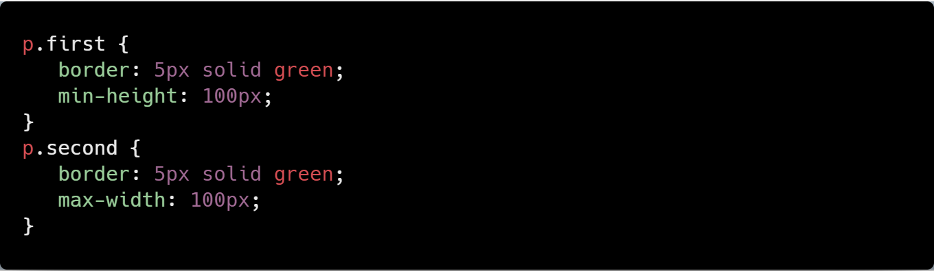
Facebook: #genesystechhub
The CSS:

Slide 88
Twitter: @genesysclubunn
More on CSS will be discussed in our next Study Jam. ☺

Slide 89
Twitter: @genesysclubunn
CSS Practice…

Slide 90
Twitter: #weAreGenesys
Task: Tables revisited
Use your current/so-far knowledge of CSS to modify and style the table you created earlier. Style the table to your taste but maintain its alignment.
Hint: Delete or remove every appearance of the bgcolor, border, and align attributes in your HTML and embed a style sheets in the file to style the table. Use class selectors and id selectors where applicable. Note, the equivalent of bgcolor in CSS is background-color; use text-align and margin: auto to align your text and table to the center.

Slide 91
Twitter: @genesysclubunn
What are the Benefits of Being a Web Developer? Sit back and watch the next video…

Slide 92
Twitter: #weAreGenesys
#benefitsOfBeingAWebDeveloper

Slide 93
Twitter: @genesysclubunn
So, with that, we call it a day.
Thanks for coming!
See you next time! ☺

Slide 94
Twitter: @genesystechhub

Slide 95
Twitter: #weAreGenesys
A
a

