Slide 1
First things first:
- Introduction -
Let’s introduce ourselves to the community
Protocol: Name, Department and Level

Slide 2
So…*thinking-face*…why are YOU here and why do YOU want to learn Web Development or how to code?

Slide 3
Next:
A video illustrating why “Not Everyone Should Code”
Hmm…*thinking-face*

Slide 4

#notEveryoneShouldCode

Slide 5
Course prerequisites:
A laptop (PC)
No prior coding experience or knowledge
Basic computer operation skill
Average typing speed of 15WPM (optional)
Patience, perseverance and the will to go on

Slide 6
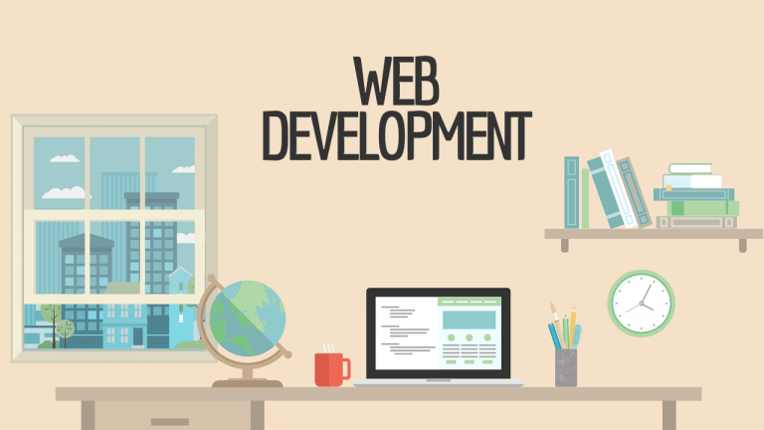
Article by: John Sonmez
(https://www.simpleprogrammer.com)

Slide 7

Introduction:
Web development compared to developing desktop or mobile apps is…well…trickier.
Like it or not, as a software developer you have to know about it—at least the basics.
In fact, most software developers today are web developers.
It’s true; web development has taken over the world. It’s the King Kong of development platforms.
Desktop and mobile developers used to be the norm, but more and more applications have moved to the web and continue to do so.
Even with the rapid growth of mobile development, web development is still critical because, as cell phones and tablets get more powerful, creating cross-platform apps will become easier by making web apps which run in the browser.
That means, whether or not you are planning on becoming a web developer, you need to at least be familiar with web development, how the web works, and the major technologies involved.

Slide 8
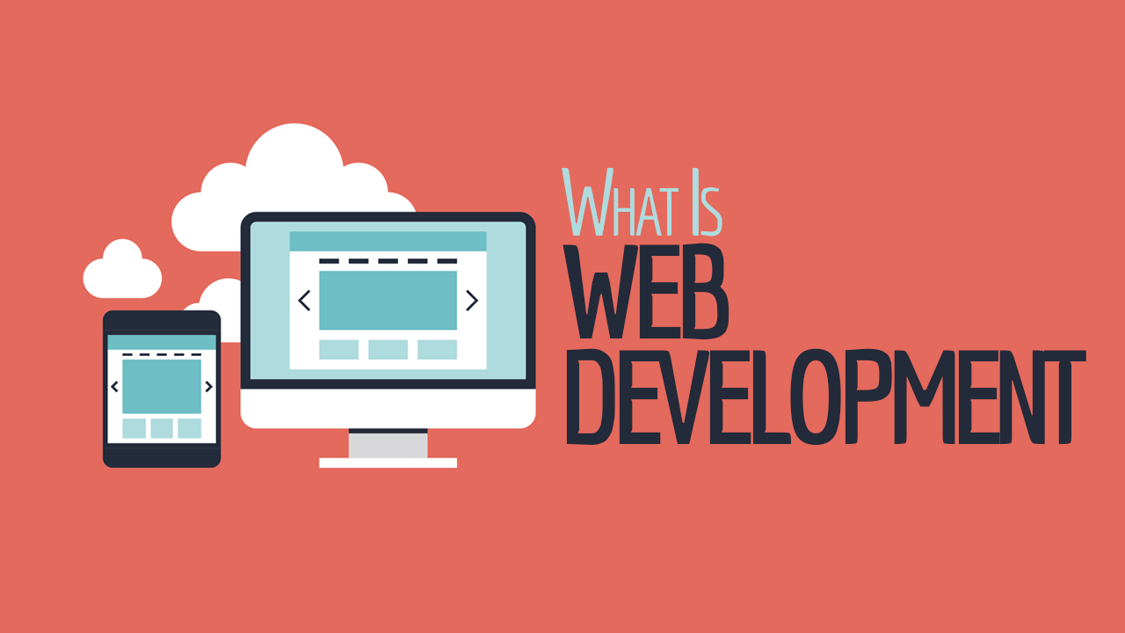

Slide 9

Always remember and never forget that Google is your friend anytime, anyday, anywhere! ☺
And then comes…

Slide 10
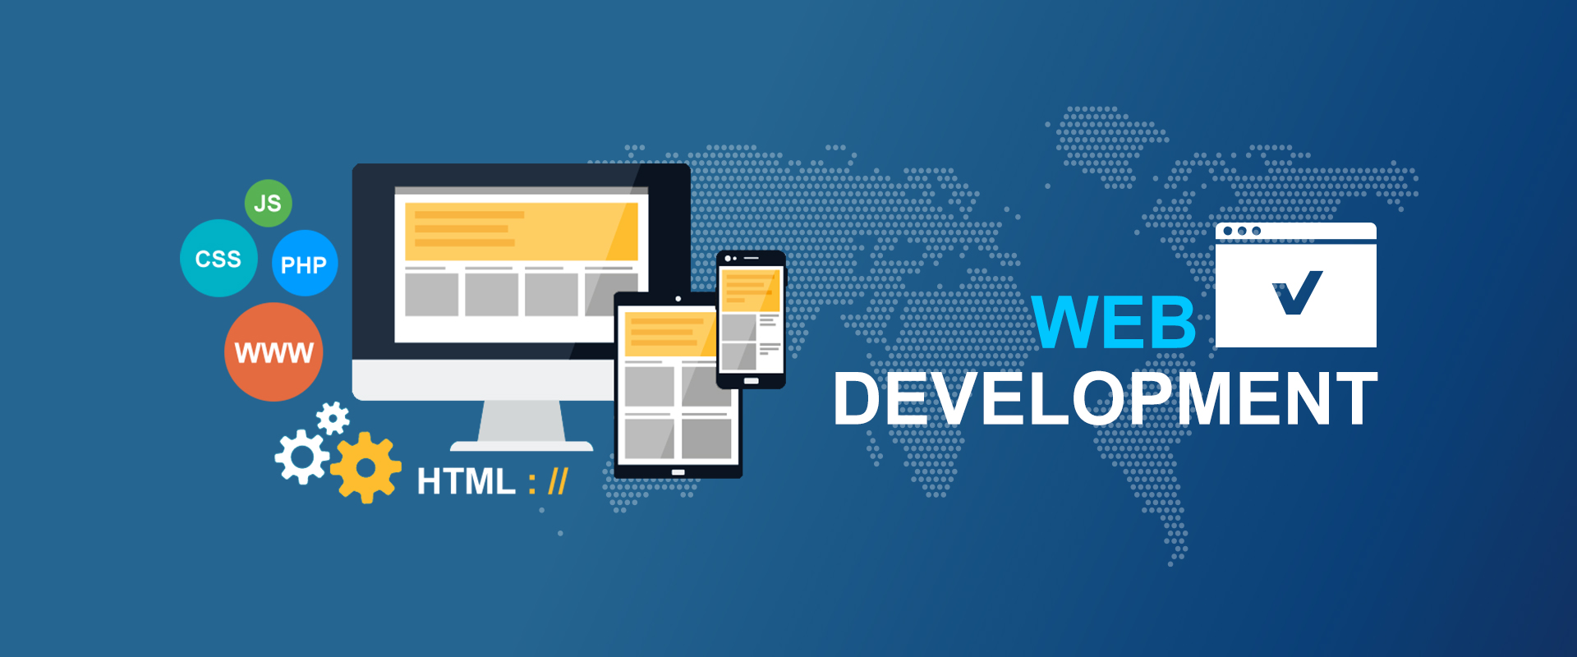
What Is Web Development?
Web development itself and how it is done has changed greatly over the years, but one thing has remained the same: web development is about creating applications which run in a web browser.
Some of those applications have most of their logic living on a web server which renders HTML, CSS, and JavaScript to create an application.
Other applications only utilize the server to create their initial state, download the logic to run the application, and then use the server only to retrieve and store data.
Regardless, though, of how web development is done, the basic technologies are the same: HTML, CSS, JavaScript—and a large amount of patience.

Slide 11
Web developers today utilize about every major programming language to create web applications. To name a few of the most popular web development languages in no particular order:
- Python - Java - ASP.NET - C++
- C - Scala - Ruby etc.
This is possible because the user interface of a web application is essentially HTML, CSS, and JavaScript which can be generated by any programming language capable of generating text.
JavaScript is used to manipulate what is known as the DOM (Document Object Model), which is a representation of a webpage in the browser, to directly change the user interface displayed in the browser without directly creating new HTML or CSS code.

Slide 12

A Brief History of the Web:
Let's talk about the history of web development. It will give us a good reference point for talking about “what is web development” today.
Web development started in a very different place than where it is now.
Early web development consisted mostly of creating static HTML pages, and navigation was done exclusively by hyperlinks.
An early web developer didn’t really create an “app.” They created a set of static web pages which were used to convey information and perhaps a few pictures, all linked together with hyperlinks.
In order for web development to be useful, there needed to be a way to make web pages more interactive and to conditionally render some content (or other content), as well as to track some kind of state.

Slide 13
Early web developers utilized a technology called CGI to create the earliest web applications which were able to conditionally generate HTML depending on data, like query strings, which were sent from the browser to the server.
Then came along actual web development frameworks which were designed to make CGI and dynamic generation of HTML easier.
You may have heard of technologies like ColdFusion or ASP. These were some of the early web frameworks which made web development much easier.
Now a web developer could create HTML mixed with special tags and markup to make the generation of that HTML conditional and could also execute certain logic to determine what kind of HTML to produce for a given web page.
This kind of technology worked like a templating language and allowed a huge number of developers to create web applications for the first time.

Slide 14
Eventually with browser technology evolving and computers getting faster—as well as a growing demand for more complex applications—JavaScript started being used to expand the capabilities of many web applications.
CSS also came along around this time to make it easier to style and change the style of web applications by giving HTML the role of defining content and CSS the role of defining the layout and style of that content.
Developers kept on trying to find ways to make the web more and more dynamic.
Rendering everything on the server was too slow and didn’t feel responsive, so technologies like AJAX (Asynchronous JavaScript and XML) were invented to allow web pages to update dynamically without refreshing the page.
Eventually entire web applications were built dynamically without any page refreshes at all. These types of web applications are known as SPAs, or Single Page Applications.

Slide 15
Ever been on a website, filled in some information on a form, pressed refresh, and the webpage didn't reload? That's likely AJAX submitting the request. It makes it possible to dynamically change a webpage without having to refresh it.
The web continues to move forward as it evolves to be more and more like desktop applications of the past, with the browser really starting to act like an operating system.
In fact, this has become so true that Google created a web-based OS called Chrome OS in which the OS is basically the Chrome web browser. One day everything will be hosted on the web because browsers will be powerful enough to run everything. It's already moving in that direction as we see more and more Cloud-Based technologies popping up.

Slide 16
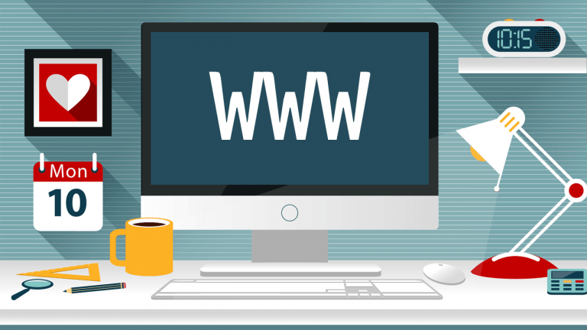

Slide 17

How the Web Works:
It’s difficult to understand what web development is if you don’t have at least a general idea of how the web works.
Some things have changed over the years, but the basic functionality of the web and its underlying technologies have mostly remained the same.
Consider this brief primer a very condensed and basic explanation of how the web works.
First of all, we have the web browser.
The web browser is able to parse and render HTML and CSS into a visible format which we call a web page.
A web browser is also capable of executing JavaScript to do various things including modifying the underlying structure of a web page.

Slide 18
The web browser has to send a request to a web server in order to get a web page to render.
This is done through a protocol known as HTTP, or Hypertext Transfer Protocol.
When a request for a particular resource or URI (Uniform Resource Identifier) is sent to a web server, that web server finds the requested content—if it exists—and send back a response to the browser.
The browser then parses and renders that response, which is what the end user sees in the web browser.
Now, obviously there is much more going on under the covers, but the basic idea is that the web browser makes a request and the web server responds by returning back from HTML, CSS, and JavaScript.
Why is this important to understand if you want to do web development?

Slide 19
Because, as you can imagine, a web application has to be thought about a bit differently than a normal desktop application, since web applications have to continually make requests from the server for every action that happens in the application. (I’m generalizing here, but this is mostly true.)
In a desktop application, you might be able to hold various bits of state in memory and be able to access that state data when you switch to a different page or section of the application.
For web applications, you have to work around the fact that the underlying HTTP protocol is stateless.
You have to have some way to manage states between requests and keep track of the individual users that are using the web application simultaneously.
Now, obviously, there are frameworks and patterns that make this easier to do, but it’s critical to understand that web development is much different than other kinds of development due to the statelessness of HTTP and the constant client server interactions.

Slide 20
Next:
An animated video describing how the web/internet works.
#warriorsOfTheNet

Slide 21
#warriorsOfTheNet

Slide 22


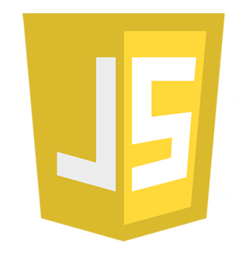
Primary Web Development Technologies:
All right, now that you have the basics of how the web works and understand a little bit about how the web evolved over time, let’s talk about a few of the most common web development technologies you are likely to encounter.

Slide 23
HTML (HyperText Markup Language):
This is the keystone of web development. All web development must contain some HTML, because HTML is the basic building block of the web.
You can build an entire web application using just HTML—although it won’t really do that much (and I’d probably call it a web page).
HTML is used to specify the format and the layout of a web page.
HTML consists of a series of tags that define the parts and components of a web page.
For example, you might use the <img> tag to embed an image on a page.
A web browser will parse the HTML and use it along with CSS and JavaScript to render a page.

Slide 24
CSS (Cascading Style Sheets):
Before CSS existed, HTML was used to both specify the format of a web page as well as to dictate how it should be displayed and styled.
This was a problem because it meant that in order to change the styling of a web application— for example, to make all the buttons a different color—the HTML would have to be changed in many places in the application.
CSS was invented to solve this problem by cleanly separating the content of a web page from the styling of it (although the two do overlap from time to time).
CSS can be linked to in a web page in order to define the styling for that web page.
An entire web application can link to a set of CSS pages which set the style for the entire web application.
Then, if you want to change the color of a button, you can just modify one CSS file, and all the buttons for the entire web application will change.

Slide 25
JavaScript:
When JavaScript first came out, it was a bit of a novelty that was used to do some very basic things on web pages, but JavaScript has evolved to take a much more central role in web development.
At its heart, JavaScript is a fully-functional dynamic language which can be executed directly in the web browser.
JavaScript makes web pages more interactive and allows for programmatic manipulation of web pages and their content.
JavaScript can directly interact with the DOM of a web page, which is its underlying structure.
By using JavaScript to manipulate the DOM, the entire structure and style of a web page can be changed programmatically.
In web applications, this all happens inside of the browser (unless you are using a technology like Node.js, which runs JavaScript on the server to actually parse requests and send back responses).

Slide 26

Rendering:
Before we can wrap up our very basic overview of web development, we do need to talk about the differences between server-side rendering and client-side rendering, because they can be quite confusing.
Let’s start with server-side rendering.

Slide 27
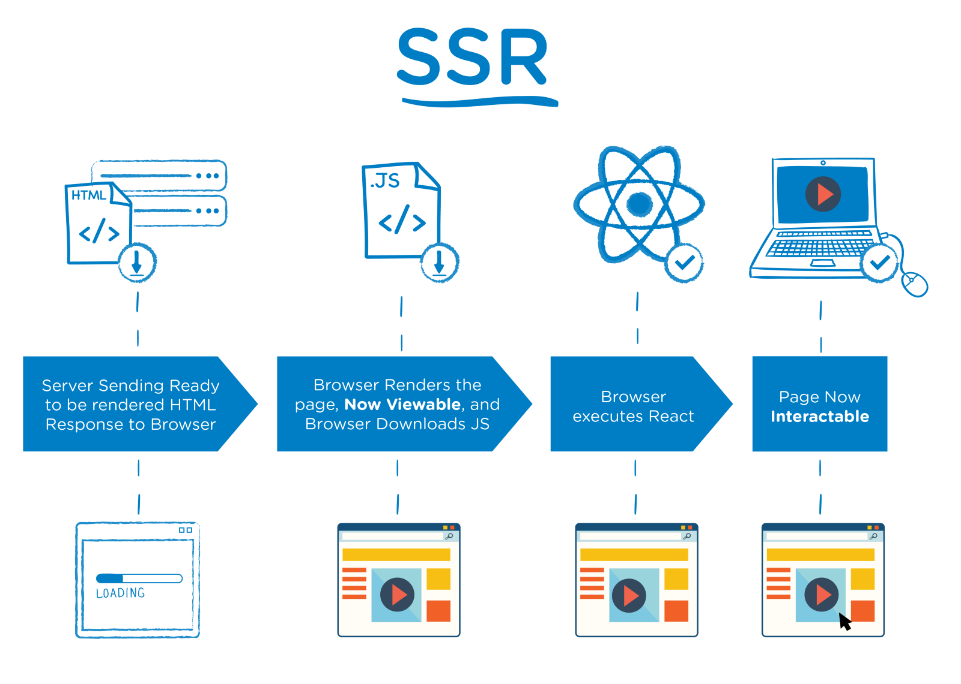
Server-Side Rendering:
In the most simple model of web development, all web pages are rendered on the server and the HTML, CSS, and JavaScript of that page is sent to the web browser, where it is parsed and displayed to the user.
Server-side rendering simply means that the pages are fully constructed by the logic on the server.
So, with server-side rendering, the logic for the application lives almost entirely on the server.
As we talked about in the history of the web, this was the original way most web applications worked.
Today, technologies like ASP.NET or PHP still mainly utilize this model, although with the use of various JavaScript frameworks, even a server-side rendering technology can be used for client-side rendering.

Slide 29
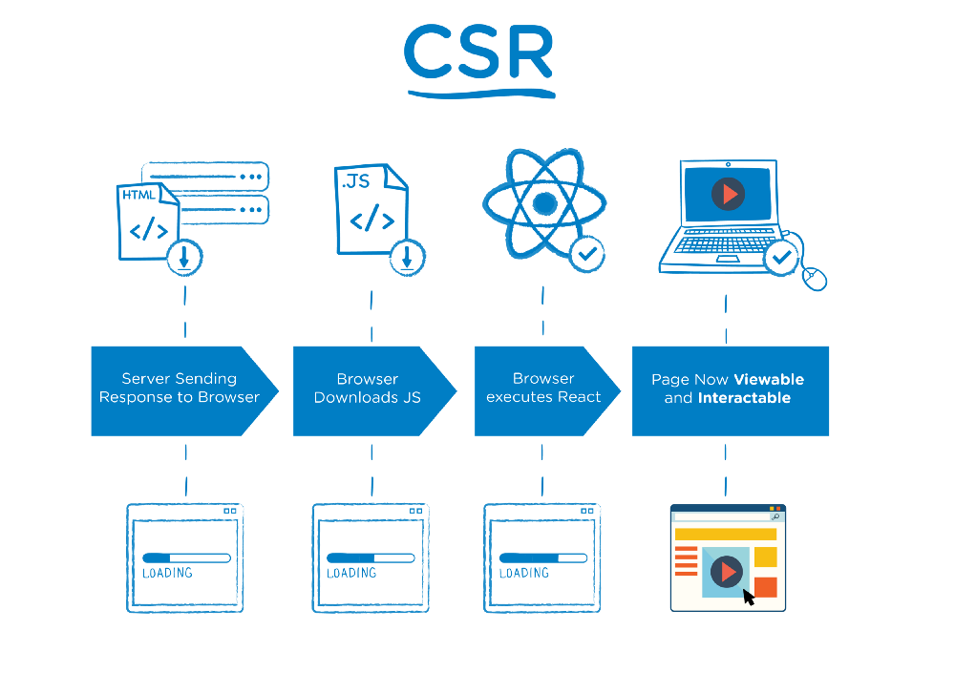
Client-Side Rendering:
With the increasing capabilities of browsers and JavaScript engines in browsers, there has been a strong movement towards what is known as client-side rendering.
Client-side rendering simply means that the content of the web page is constructed in the browser—via JavaScript—instead of on the server.
With client-side rendering, you can almost think of the web server delivering an “app” to the browser, and the browser executes that app internally to render the pages, create the navigations, and request any additional data from the server.
Behind the scenes, JavaScript is being used to create and manipulate DOM elements and even produce HTML or CSS that is part of the web page, or in this case, the web app.

Slide 30
As you can imagine, client-side rendering appears more seamless to the end-user because there isn’t a need to make requests back to the server to have new pages rendered, only requests for additional data, which is then “plugged into” the web page dynamically.
This is why some client-side rendered apps are called SPAs.
There is usually only one page and the contents of that page are dynamically updated.
Both techniques can even be combined in a single web application, where some parts of the user interface are rendered client-side and other parts and pages are rendered server-side.

Slide 32
THE END!

Slide 33
Ok. So, some motivation before we proceed to the main… ☺

Slide 34
#neverQuit

Slide 35
HTML
(HyperText Markup Language)

Slide 36
Overview:

Slide 37
What is HTML?

Slide 38
Definition
HTML stands for HyperText Markup Language. Unlike a scripting or programming language that uses scripts to perform functions, a markup language uses tags to identify content. Here is an example of an HTML tag:

Slide 39
The Web Structure
The ability to code using HTML is essential for any web professional. Acquiring this skill should be the starting point for anyone who is learning how to create content for the web. Modern Web Design
HTML: Structure CSS: Presentation JavaScript: Behavior PHP or similar: Backend CMS: Content Management

Slide 40
Basic HTML Document Structure

Slide 41
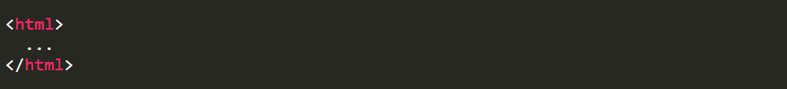
The <html> Tag
Although various versions have been released over the years, HTML basics remain the same. The structure of an HTML document has been compared with that of a sandwich. As a sandwich has two slices of bread, the HTML document has opening and closing HTML tags. These tags, like the bread in a sandwich, surround everything else:
Sidebar: Everything in an HTML document is surrounded by the <html> tag.

Slide 42
The <head> Tag
Immediately following the opening HTML tag, you'll find the head of the document, which is identified by opening and closing head tags. The head of an HTML file contains all of the non-visual elements that help make the page work.

Slide 43
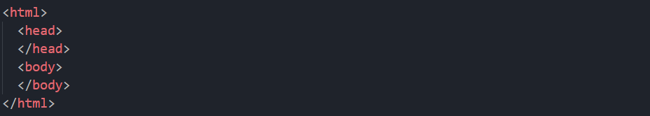
The <body> Tag
The body tag follows the head tag. All visual-structural elements are contained within the body tag. Headings, paragraphs, lists, quotes, images, and links are just a few of the elements that can be contained within the body tag. Basic HTML Structure:
Sidebar: The <body> tag defines the main content of the HTML document.

Slide 44
Creating Your First HTML Page

Slide 45
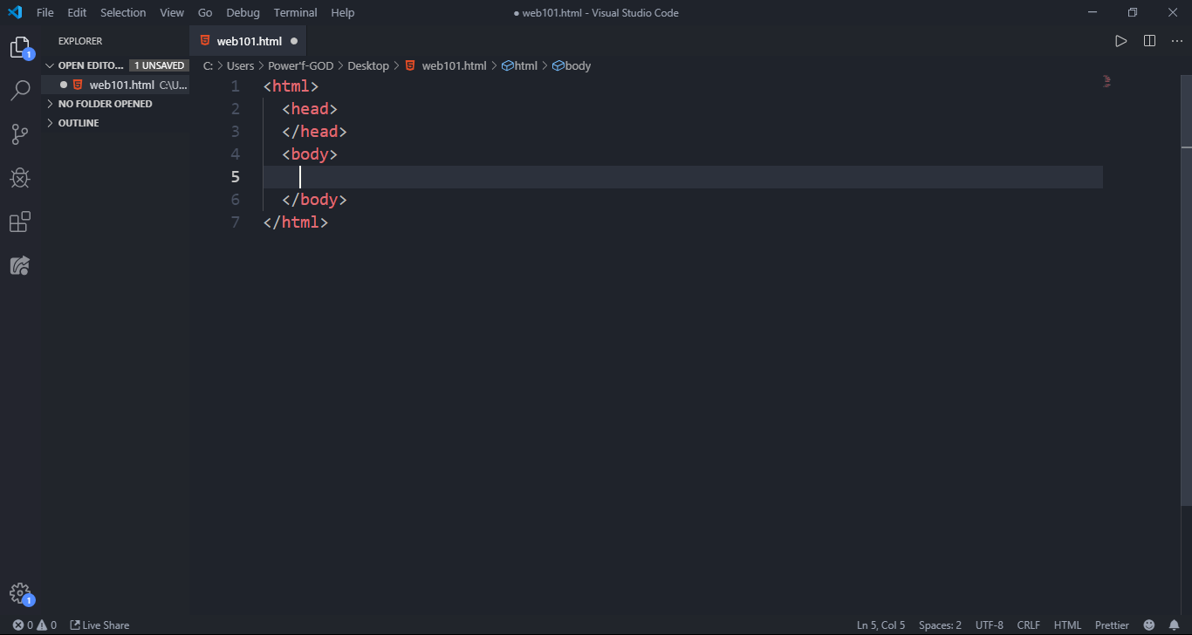
The HTML File
HTML files are text files, so you can use any text editor to create your first webpage. There are some very nice HTML editors available; you can choose the one that works for you.
But for this course, we’ll be using Microsoft’s Visual Studio Code.

Slide 46
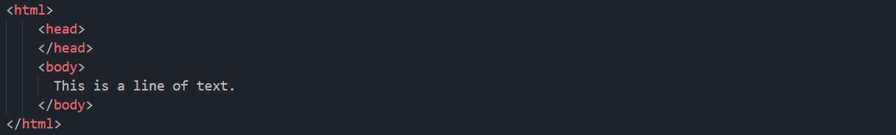
Add the basic HTML structure to the text editor with "This is a line of text" in the body section.
Save the file as “web101” and open in or with Chrome.
Sidebar: HTML file names should end with the ’.html’ extension.

Slide 47
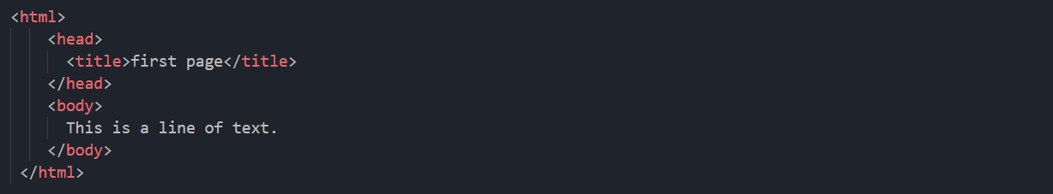
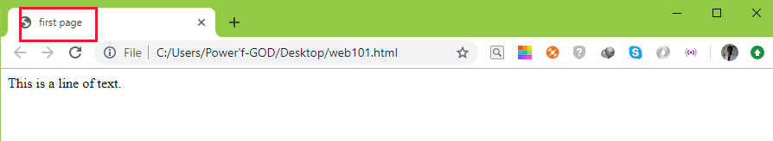
The <title> Tag
To place a title on the tab describing the web page, add a <title> element to your head section:
This will produce the following result:
Sidebar: The title element is important because it describes the page and is used by search engines.

Slide 48
HTML Basics

Slide 49
Paragraphs

Slide 50
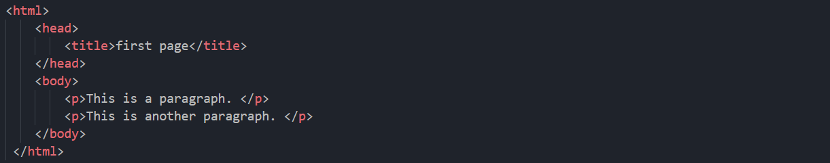
The <p> Element
To create a paragraph, simply type in the <p> element with its opening and closing tags:
Sidebar: Browsers automatically add an empty line before and after a paragraph.

Slide 51
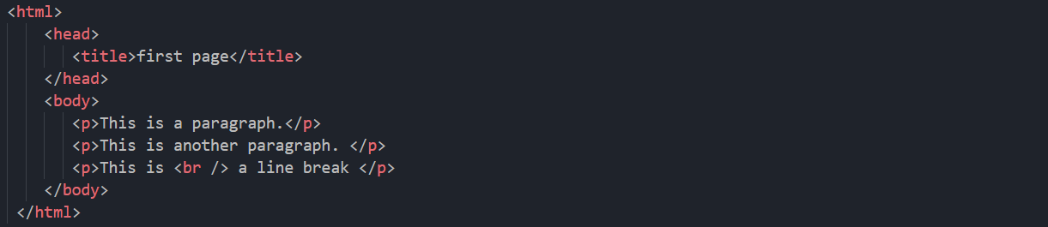
The <br /> Element (Single Line Break)
Use the <br /> tag to add a single line of text without starting a new paragraph:
Sidebar: The <br /> element is an empty HTML element. It has no end tag.

Slide 52
Text Formatting

Slide 53
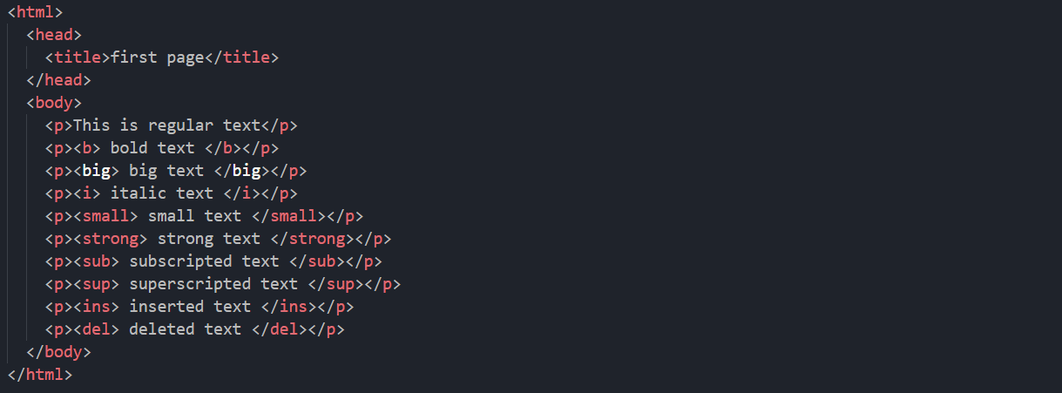
Formatting Elements
Each paragraph in the example is formatted differently to demonstrate what each tag does:
Sidebar: Browsers display <strong> as <b>, and <em> as <i>. However, the meanings of these tags differ: <b> and <i> define bold and italic text, respectively, while <strong> and <em> indicate that the text is "important".

Slide 54
Headings, Lines, Comments

Slide 55
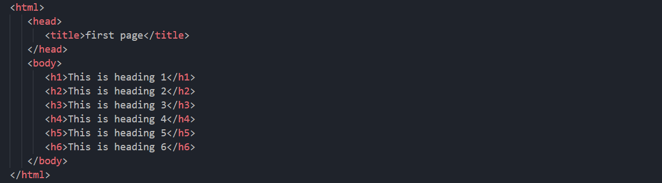
HTML Headings
HTML includes six levels of headings, which are ranked according to importance. These are <h1>, <h2>, <h3>, <h4>, <h5>, and <h6>. The following code defines all of the headings:
Sidebar: It is not recommended that you use headings just to make the text big or bold, because search engines use headings to index the web page structure and content.

Slide 56
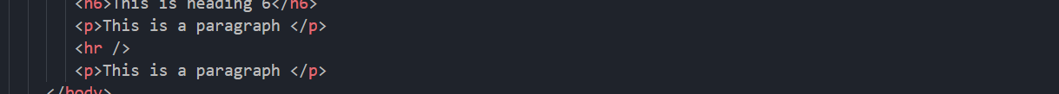
Horizontal Lines
To create a horizontal line, use the <hr /> tag.
Sidebar: In HTML5, the <hr> tag defines a thematic break

Slide 57
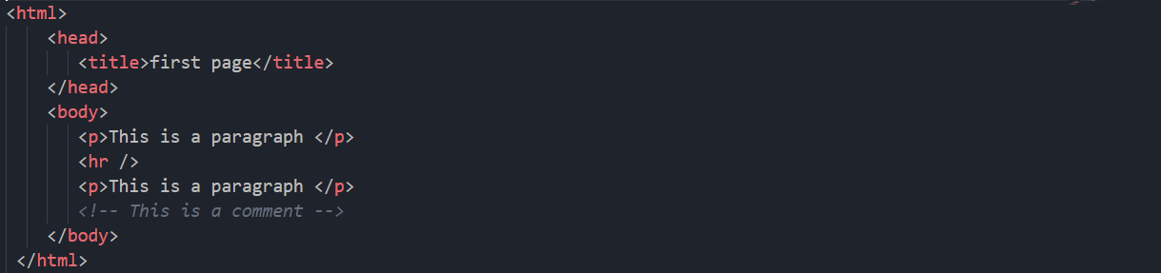
Comments
The browser does not display comments, but they help document the HTML and add descriptions, reminders, and other notes.
Example:
Sidebar: There is an exclamation point (!) in the opening tag, but not in the closing tag.

Slide 58
Attributes

Slide 59
HTML Attributes
Attributes provide additional information about an element or a tag, while also modifying them. Most attributes have a value; the value modifies the attribute.
In this example, the value of "center" indicates that the content within the p element should be aligned to the center.
Sidebar: Attributes are always specified in the start tag, and they appear in name="value" pairs.

Slide 60
Attribute Measurements
As an example, we can modify the horizontal line so it has a width of 50 pixels. This can be done by using the width attribute:
An element's width can also be defined using percentages:
Sidebar: An element's width can be defined using pixels or percentages.

Slide 61
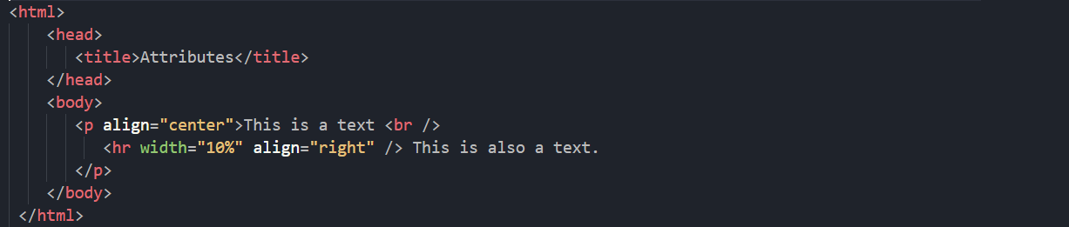
The Align Attribute
The align attribute is used to specify how the text is aligned. In the example below, we have a paragraph that is aligned to the center, and a line that is aligned to the right.
Sidebar: The align attribute of <p> is not supported in HTML5.

Slide 62
Images

Slide 63
The <img> Tag
The <img> tag is used to insert an image. It contains only attributes, and does not have a closing tag. The image's URL (address) can be defined using the src attribute. The HTML image syntax looks like this:
Sidebar: The alt attribute specifies an alternate text for an image.

Slide 64
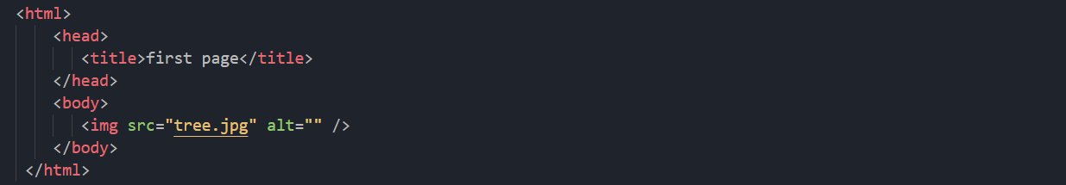
Image Location
You need to put in the image location for the src attribute that is between the quotation marks. For example, if you have a photo named "tree.jpg" in the same folder as the HTML file, your code should look like this:
Sidebar: In case the image cannot be displayed, the alt attribute specifies an alternate text that describes the image in words. The alt attribute is required.

Slide 65
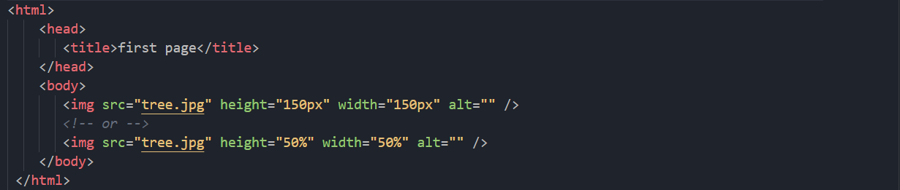
Image Resizing
To define the image size, use the width and height attributes. The value can be specified in pixels or as a percentage:
Sidebar: Loading images takes time. Using large images can slow down your page, so use them with care.

Slide 66
Links

Slide 67
The <a> Tag
Links are also an integral part of every web page. You can add links to text or images that will enable the user to click on them in order to be directed to another file or webpage. In HTML, links are defined using the <a> tag. Use the href attribute to define the link's destination address:
Sidebar: To link an image to another document, simply nest the <img> tag inside <a> tags.

Slide 68
Creating Your First Link
In the example below, a link to Genesys’s website is defined:
Once the code has been saved, “Genesys Tech Hub" will display as a link.
Clicking on “Genesys Tech Hub" redirects you to www.genesystechhub.com.
Sidebar: Links can be either absolute or relative.

Slide 69
The target Attribute
The target attribute specifies where to open the linked document. Giving a _blank value to your attribute will have the link open in a new window or new tab:
Sidebar: A visited link is underlined and purple.

Slide 70
Lists

Slide 71
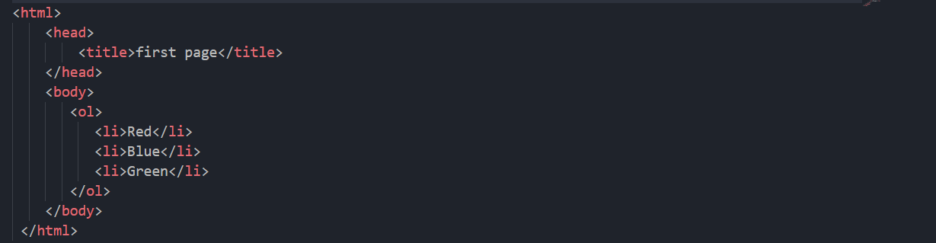
HTML Ordered Lists
An ordered list starts with the <ol> tag, and each list item is defined by the <li> tag. Here is an example of an ordered list:
Sidebar: The list items will be automatically marked with numbers.

Slide 72
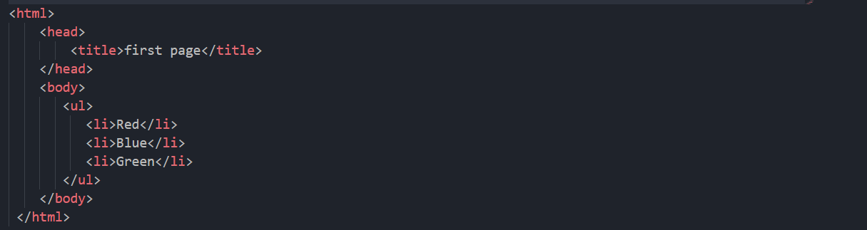
HTML Unordered List
An unordered list starts with the <ul> tag.
Sidebar: The list items will be marked with bullets.

Slide 73
Project Time == Practice Time; ☺

Slide 74
Project: My First Website
Create a basic website similar to the one in the image in the next slide, which has three different pages: Home, About Us and Contact Us. Include any image of your choice from your PC. All your links must be active and not dead.
Contact Us link, when clicked, should link to the Contact Us page of your website.
Sidebar: The Genesys and Google links should open in a new tab when clicked. Take not of the text formatting. And don’t forget to add title to your page in the head tag.

Slide 75
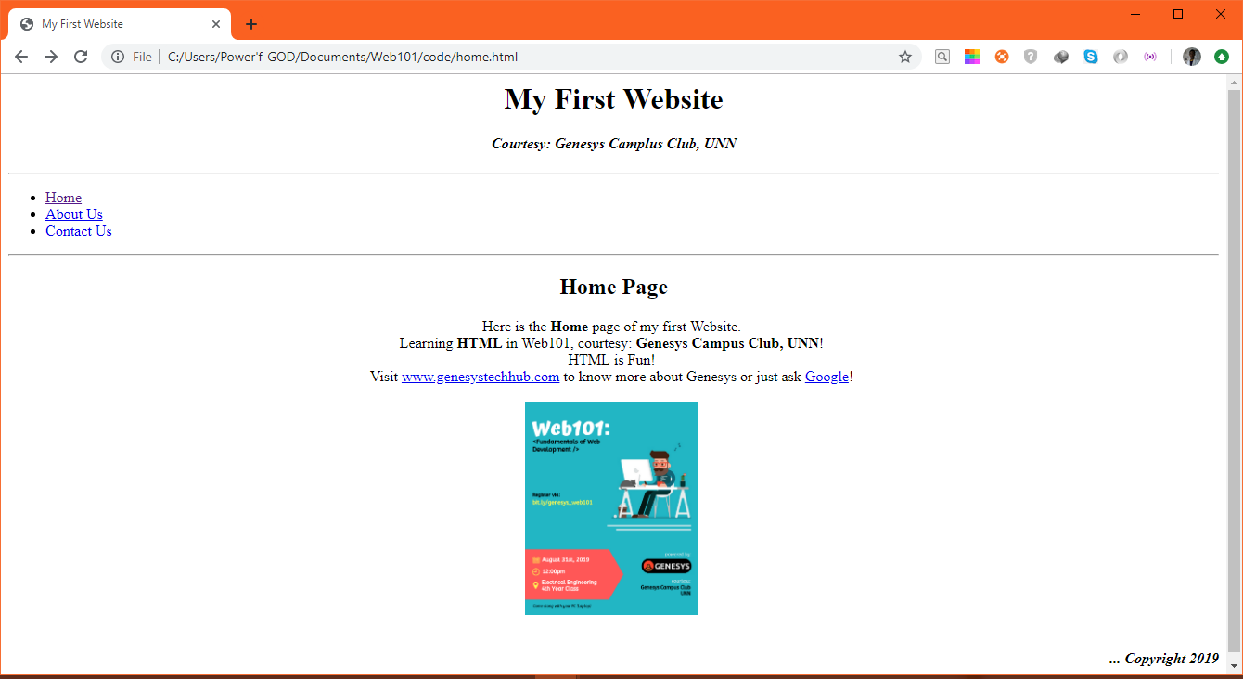
Project: My First Website

Slide 76
Finally, coming up next:
What are the benefits of being a Web Developer?
(video)

Slide 77
#benefitsOfBeingAWebDeveloper

Slide 78
Web101:
To be continued…

Slide 79
Thanks for coming! Let’s do this again next time! ☺

Slide 80


