Slide 1

Journial
David Cox - 2101758

Slide 2
Overview of the App
Journial is a diary app which contains functionality for:
Diary Entries
Diary Managing
Google Maps Capabilities

Slide 3
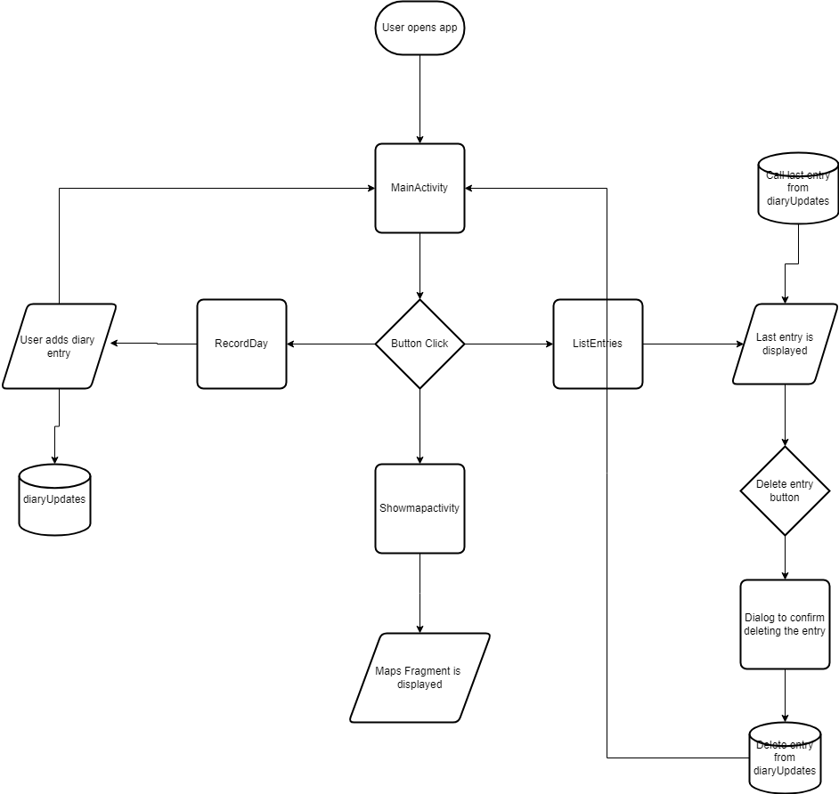
Flow Chart

Slide 4
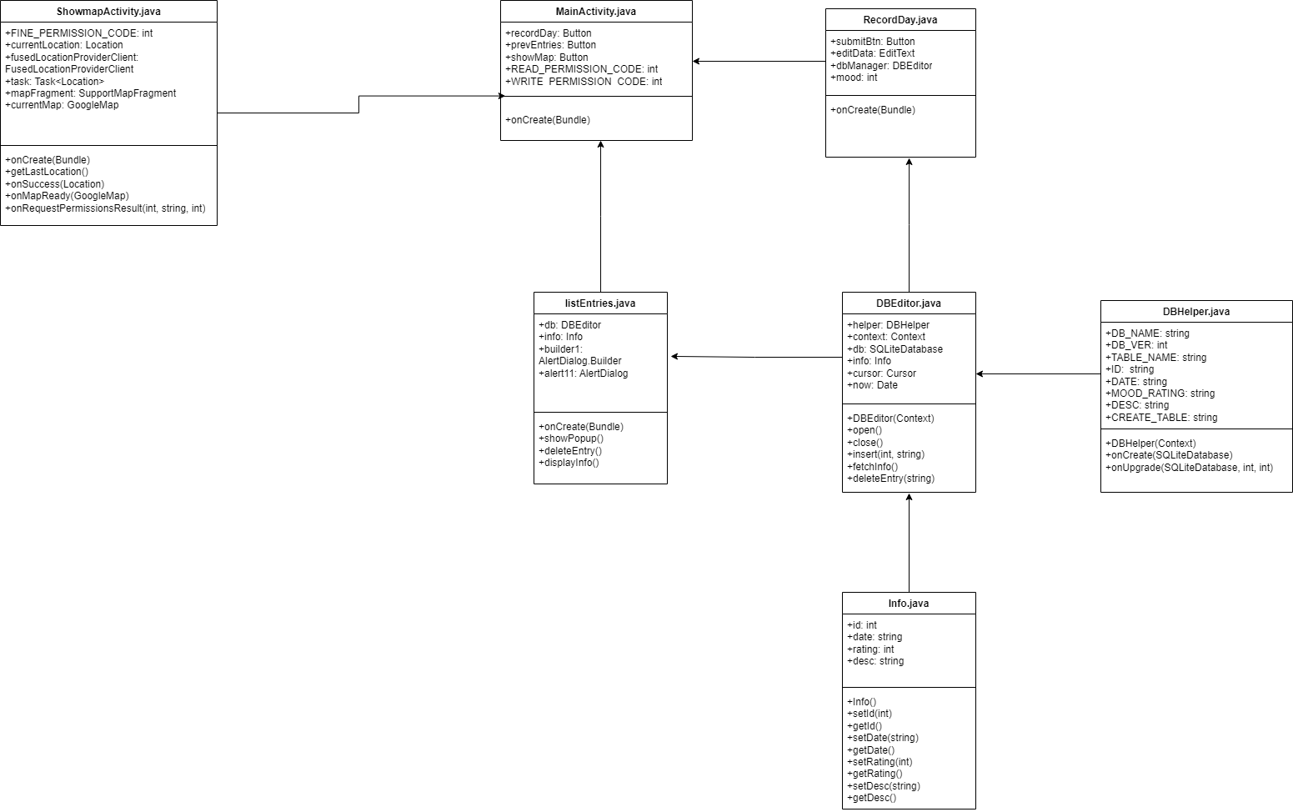
UML Diagram

Slide 5
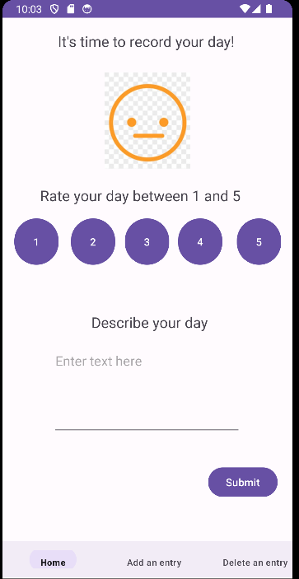
Diary Entries

Slide 6
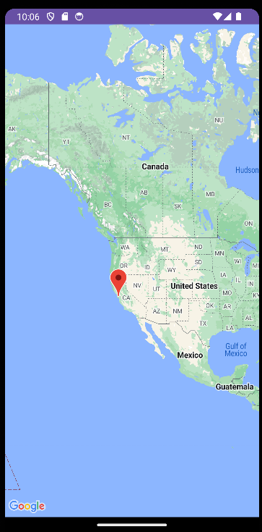
Google Maps

Slide 7
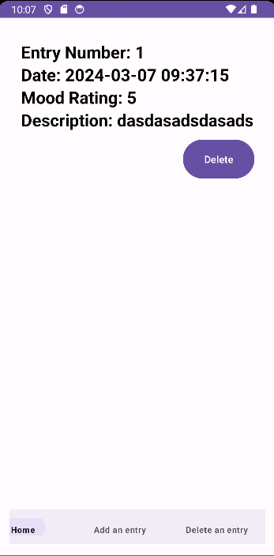
Diary Management

Slide 8
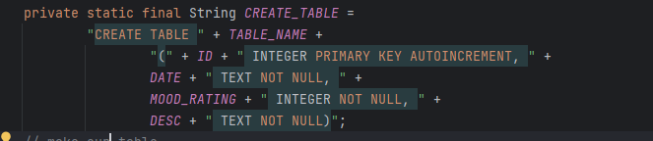
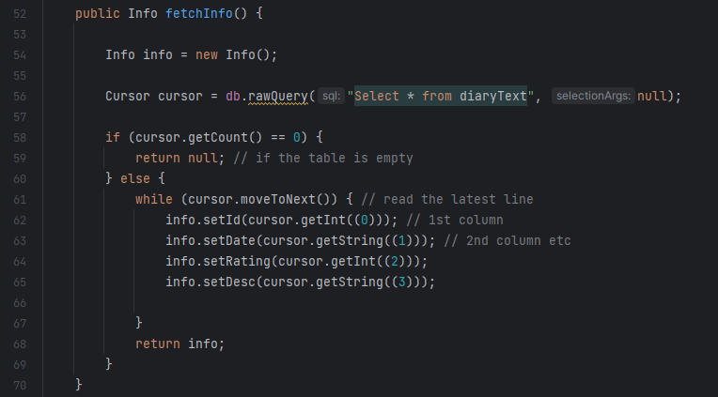
SQLite Database

Slide 9

Navigation Bar

Slide 10
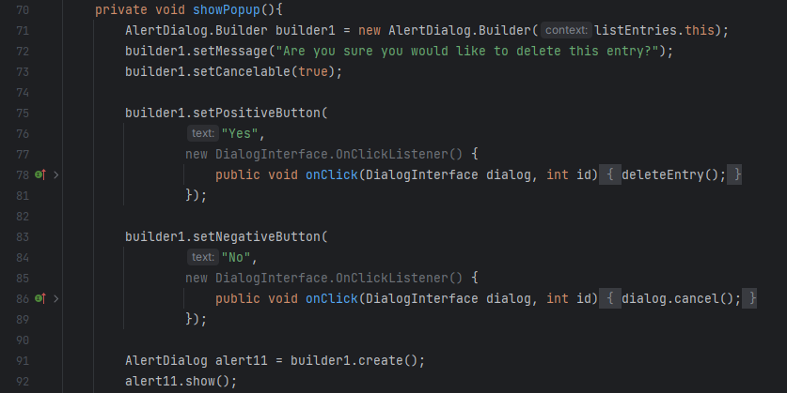
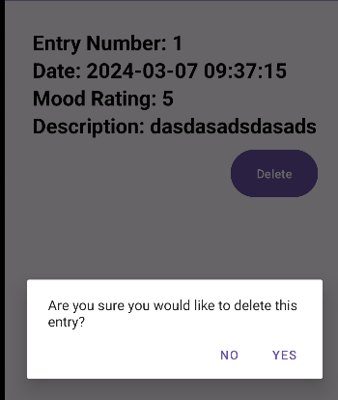
Alert Dialog

Slide 11
Critical Analysis

Slide 12
What Went Well?

Slide 13
What Could Be Improved?

Slide 14
References
Ahmad, H. (2023) Step by step google maps implementation in Android App, CodingZest. Available at: https://codingzest.com/google-maps-implementation-in-android-app/ (Accessed: 21 March 2024).
Android Developers (2022) NavigationBarView.onitemselectedlistener : android developers, Android Developers. Available at: https://developer.android.com/reference/com/google/android/material/navigation/NavigationBarView.OnItemSelectedListener (Accessed: 05 May 2024).
Android Developers (2024) Save data using sqlite : android developers, Android Developers. Available at: https://developer.android.com/training/data-storage/sqlite (Accessed: 04 March 2024).
CodePath Contributors (2021) Bottom Navigation ViewsEdit PagePage history, Bottom Navigation Views | CodePath Android Cliffnotes. Available at: https://guides.codepath.com/android/Bottom-Navigation-Views (Accessed: 01 April 2024).
CodingTutorials (2022) Recyclerview with sqlite database | populate Recyclerview with sqlite database , YouTube. Available at: https://www.youtube.com/watch?v=6enCz2cY18c (Accessed: 13 March 2024).
CodingTutorials (2023) How to create fragments in Android Studio (2023) | fragment activity, YouTube. Available at: https://www.youtube.com/watch?v=m-PefJ2CcR8 (Accessed: 13 March 2024).
Cristian (1956) Android split string, Stack Overflow. Available at: https://stackoverflow.com/questions/3732790/android-split-string (Accessed: 18 March 2024).

Slide 15
References cont.
EmilyEmily Navigation Bug with BottomNavigationView, Stack Overflow. Available at: https://stackoverflow.com/questions/71531576/navigation-bug-with-bottomnavigationview (Accessed: 01 April 2024).
Murali krishna KonduruMurali krishna Konduru Display image after button click in Android, Stack Overflow. Available at: https://stackoverflow.com/questions/26294781/display-image-after-button-click-in-android (Accessed: 11 March 2024).
Ram Kiran Pachigolla (1958) How to save form data in database when submit button is clicked?, Stack Overflow. Available at: https://stackoverflow.com/questions/13580723/how-to-save-form-data-in-database-when-submit-button-is-clicked (Accessed: 04 March 2024).
RNK (1960) How to change the value of a variable on Button Press (Android Studio), Stack Overflow. Available at: https://stackoverflow.com/questions/28113719/how-to-change-the-value-of-a-variable-on-button-press-android-studio (Accessed: 10 March 2024).

