Slide 1


Sound
How to play
in Power Apps
https://powerapps4kids.com/

Slide 2
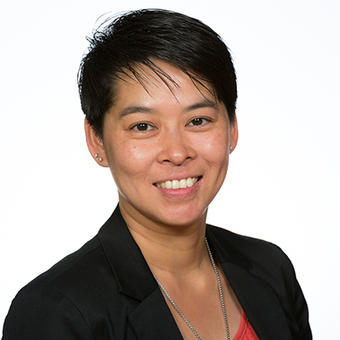
How to play sound?
Introduction
Michelle Wong
Microsoft 365 Consultant
Focus on Microsoft Teams, Power Apps & Power Automate
User adoptions / Trainer / speaker on events
LinkedIn.com/In/MichelleWongNL (LinkedIn)
@MichelleWongNL (Twitter)

Slide 3
How to play sound?
Steps to play sound-effect
Insert a sound file
Defina a Set function by onSelect: set a variable to True or False (True = play sound, False = stop sound)
On sound file: Set the variable to ‘Start’ property
Set the variable to False to ‘onEnd’ property

Slide 4
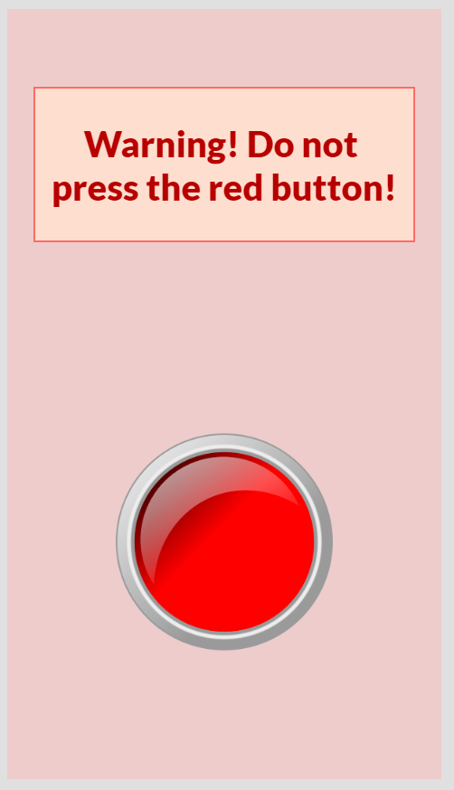
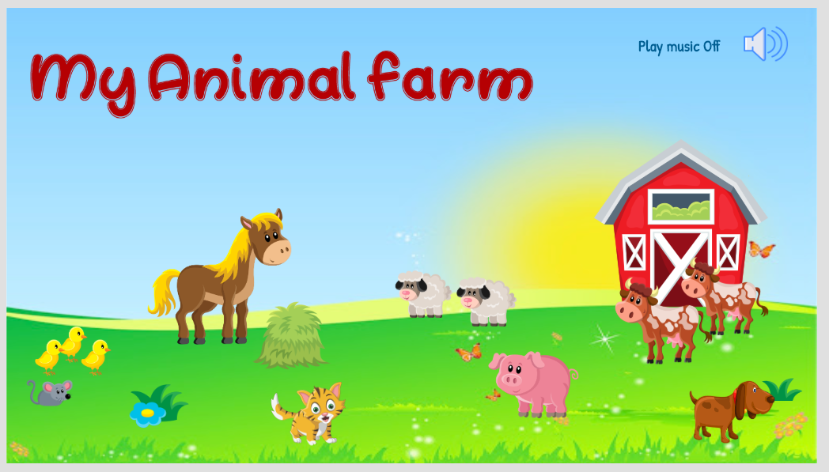
How to play sound?
DEMO
Homework – Create your own animal farm
Download resources: https://github.com/powerapps4kids/Media

Slide 5
How to play sound?
Some free resources:
https://www.101soundboards.com/
https://freesound.org/
https://freesfx.co.uk/
https://www.hiclipart.com/
https://freesvg.org/

