Slide 1
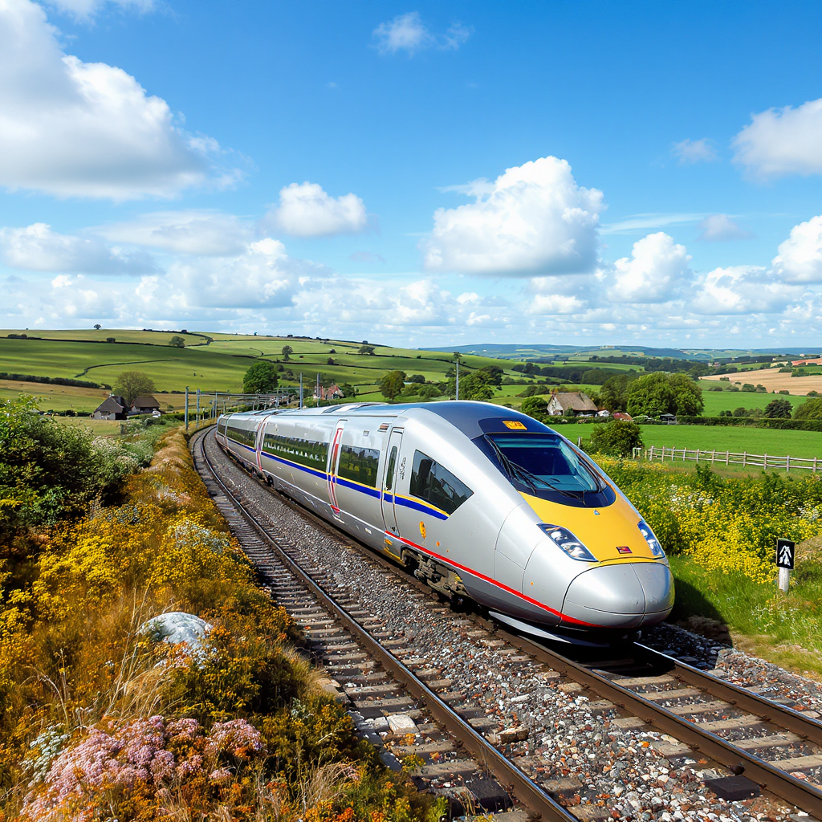
UK Rail Journey Analytics & Power BI Reporting
Turning Rail Journey Data Into Actionable Insights for Performance, Customer Experience & Operational Reliability

Slide 2





Project Team
Mina Mishail
Ahmed Wahed
Tamer Abdo
Mina Ayoub
Karim AbdelSalam

Slide 3
Project Objectives
Analyze journey patterns and seasonality.
Identify causes behind delays & cancellations.
Evaluate customer booking and payment behavior.
Build a complete Power BI reporting suite.
Deliver actionable operational and commercial insights.

Slide 4
Scope of Work
Raw data cleanup and structuring.
Fact–dimension star-schema development.
Creation of 6 analytical Power BI pages.
KPI automation with advanced DAX.
Forecasting & What‑If scenario modeling.

Slide 5
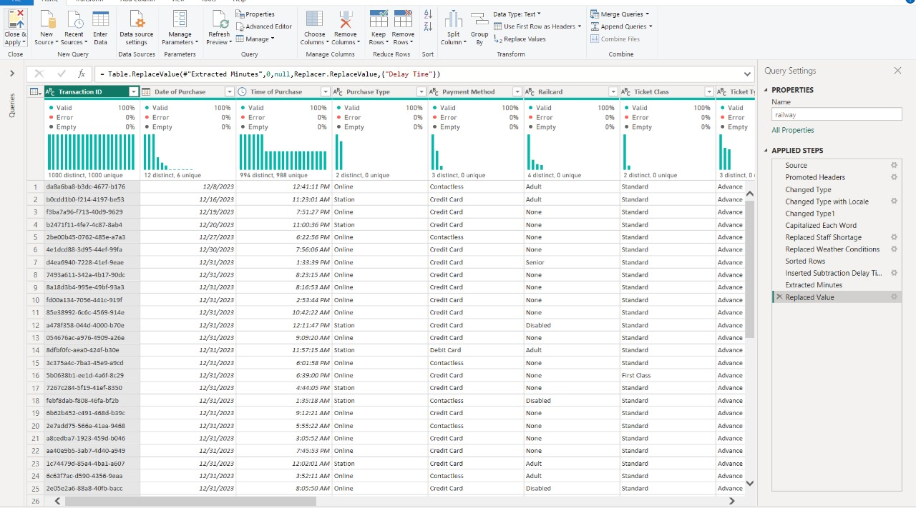
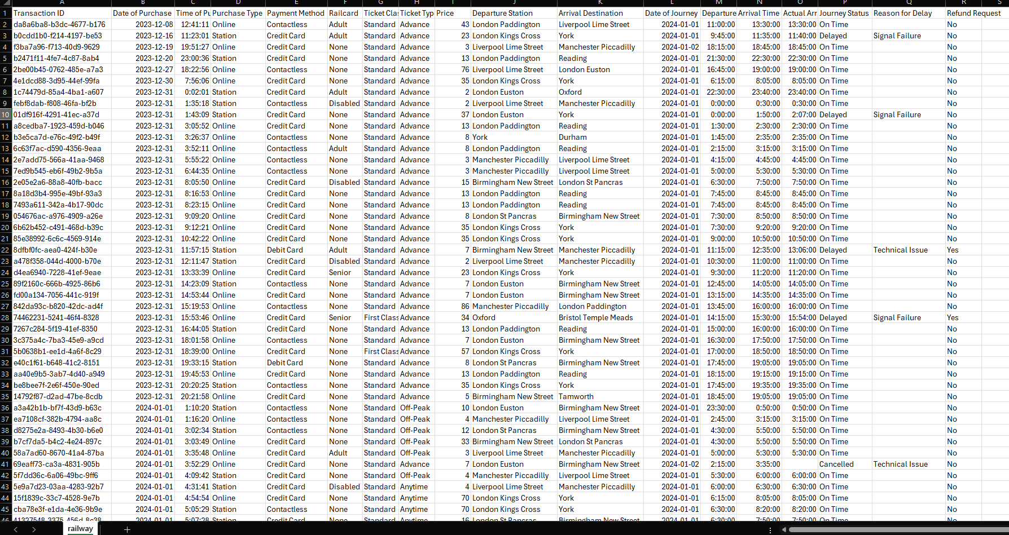
Data Cleaning
Standardized formats including date/time adjustments and categorical encoding for route and station names.
Fact tables: Journeys, Refunds, Delay Reasons
Dimensions: Calendar, Ticket Type, Railcard, Payment, Station
KPI Layer: OTP %, Delay Rate, Refund %, Lead Time
Dynamic KPIs using field parameters
Forecasting using built‑in analytics models

Slide 6
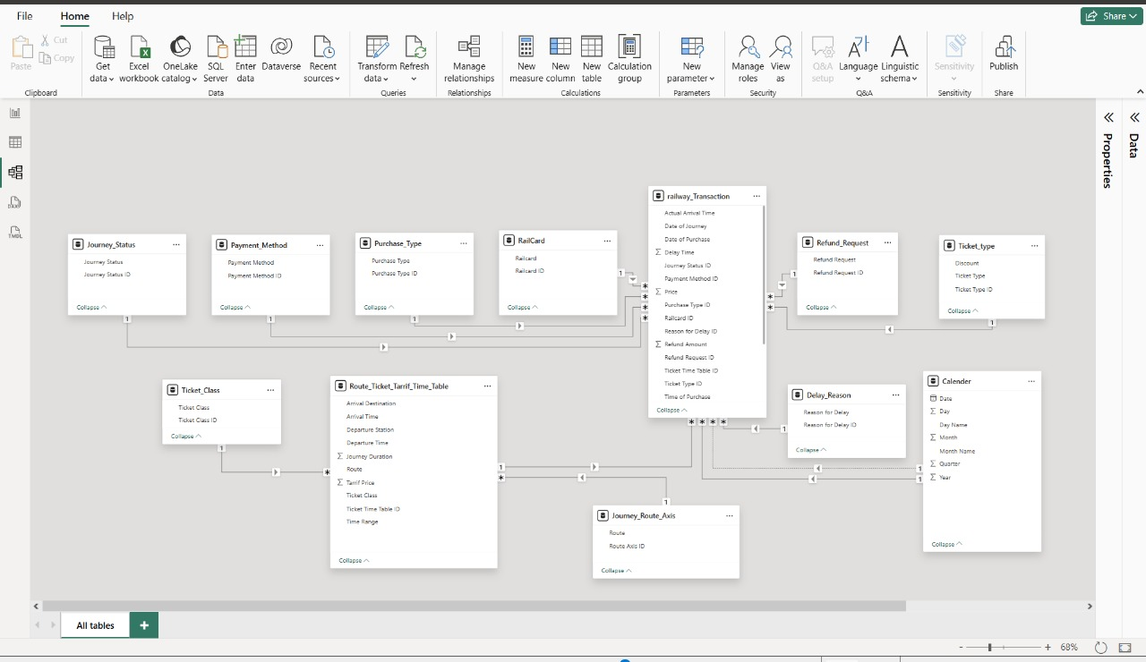
Data Model
Modeling Approach
Implemented a star schema with fact tables for journeys and revenue, and dimension tables for stations, routes, and dates to optimize query performance and reporting.

Slide 7


Slide 8
Recommendations
Operational:
Prioritize addressing technical & staffing delays.
Strengthen teams during peak demand slots.
Commercial:
Expand Railcard‑based promotions.
Introduce dynamic ticket pricing for early bookings.
Customer Experience:
Automate refund handling workflows.
Increase transparency of service disruptions.

Slide 9
Strategic Recommendations
Target High-Risk Operational Areas.
• Enhance Route-Level Performance
• Improve Forecasting & Automation.
• Build a Customer-Centric Performance Culture.
• Strengthen Customer Experience & Refund Governance.

Slide 10
Thank you

