Slide 1
PowerShell Performance
When every ms count
Staffan Gustafsson / PowerCode

Slide 2
Agenda
What is performance?
PowerShell
Object allocation
Working with collections
Filesystem
Parameter binding & the cost of a pipeline
.NET
Tips and tricks
Notes:
Effective (adj.): Adequate to accomplish a purpose; producing the intended or expected result.
Efficient (adj.) Performing or functioning in the best possible manner with the least waste of time and effort.

Slide 3
What is performance
Getting the job done in the least amount of time?
Includes writing the code
Using the minimum resources when running?
Is the environment shared?
Shortest execution time?
If something is repeated a lot, it may be worth optimizing it

Slide 4
Object allocations
Multiple ways of creating objects in PowerShell
Hashtable
PSCustomObject
Class
.NET class
Performance of these are _not_ equal

Slide 5
Demo
Object allocations dotnet powershell class hashtable pscustomobject
Notes:
ObjectCreation.ps1
ObjectCreation.psm1
Src/cs/DotnetPerson.cs

Slide 6
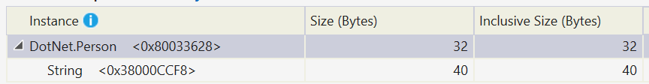
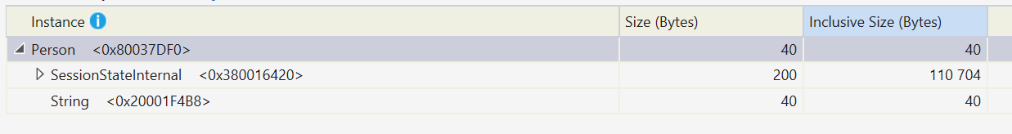
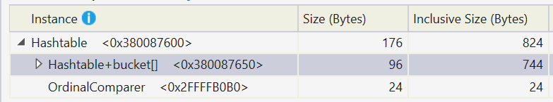
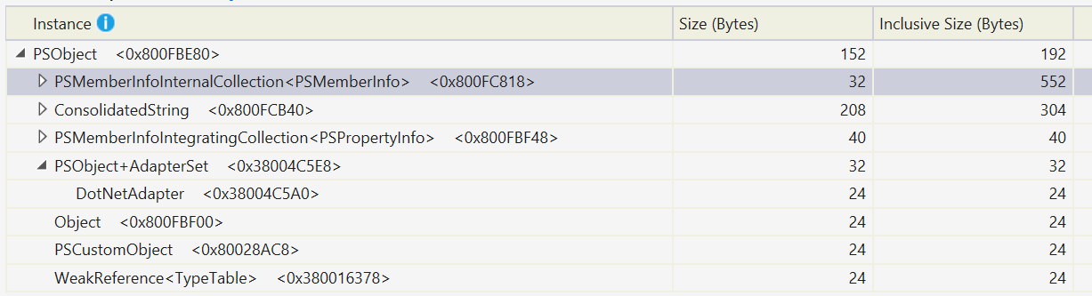
Object in PowerShell

Slide 7
Looping
Processing sets of data is usually what takes time
Options at hand
Foreach-Object, cmdlet
Our interactive work horse
foreach (language construct)
Not as pipeline friendly
.Foreach{}
„Magic“ method, trades memory for speed
for loop with incremented loop variable
With or w/o pipeline

Slide 8
enum LoopKind { ForeachObject; ForeachLang ; MagicForeach; For }
function Get-Sum {
param(
[Parameter(ValueFromPipeline)]
[int[]] $Number,
[LoopKind] $Kind)
begin {
[long]$sum = 0
}
process {
switch($Kind) {
([LoopKind]::ForeachObject) { $Number | ForEach-Object { $sum += $_ } ; break }
([LoopKind]::ForeachLang) { foreach($n in $Number) { $sum += $n } ; break }
([LoopKind]::MagicForeach) { $Number.Foreach{$sum += $_ } ; break }
([LoopKind]::For) { for($i = 0; $i -lt $Number.Length; $i++) {
$sum += $Number[$i] } ; break }
}
}
end {
$sum
}
}
[Enum]::GetValues([LoopKind]).Foreach{
$sw = [Diagnostics.Stopwatch]::StartNew()
$sum = Get-Sum -Number (1..1000000) -Kind $_
$e = $sw.Elapsed
[pscustomobject] @{ Kind = $_ ; Sum = $sum; Time = $e; TimeMs = $e.TotalMilliseconds }
}

Slide 9
Demo
Looping

Slide 10
IO / Filesystem
Enumerating files
Get-ChildItem
[IO.Directory]::EnumerateFiles
Native-interop

Slide 11
Demo
File system iteration

Slide 12
Writing to the pipeline
Compare performance of
Write-Output cmdlet
PSCmdlet.WriteObject
Non-captured objects
Each in two variants, enumerated and non-enumerated

Slide 13
Demo
Pipeline

Slide 14
Member access
Compare performance of
CodeMethod
ScriptMethod
.Net method
PowerShell function

Slide 15
Demo
Collections, Partitioning and download

Slide 16
Summary
Make sure your functions/cmdlets provides array input
Avoid the pipeline where performance is important
Pass arguments as arrays instead
Prefer looping / magic methods
Drop down to .NET when you have to
Create List/StringBuilder with capacity

Slide 17
Next Steps...
Now: 15 min break
Grab a coffee
Stay here to enjoy next presentation
Change track and switch to another room
Ask me questions or meet me in a breakout session room afterwards

Slide 18
Questions?

Slide 19
About_Author
Software Engineer with a passion for PowerShell
At DICE making computer games. Coding mostly C++, but automating processes with PowerShell
Evenings spent contributing to PowerShell
https://gist.github.com/powercode https://github.com/powercode @StaffanGSon

Slide 20
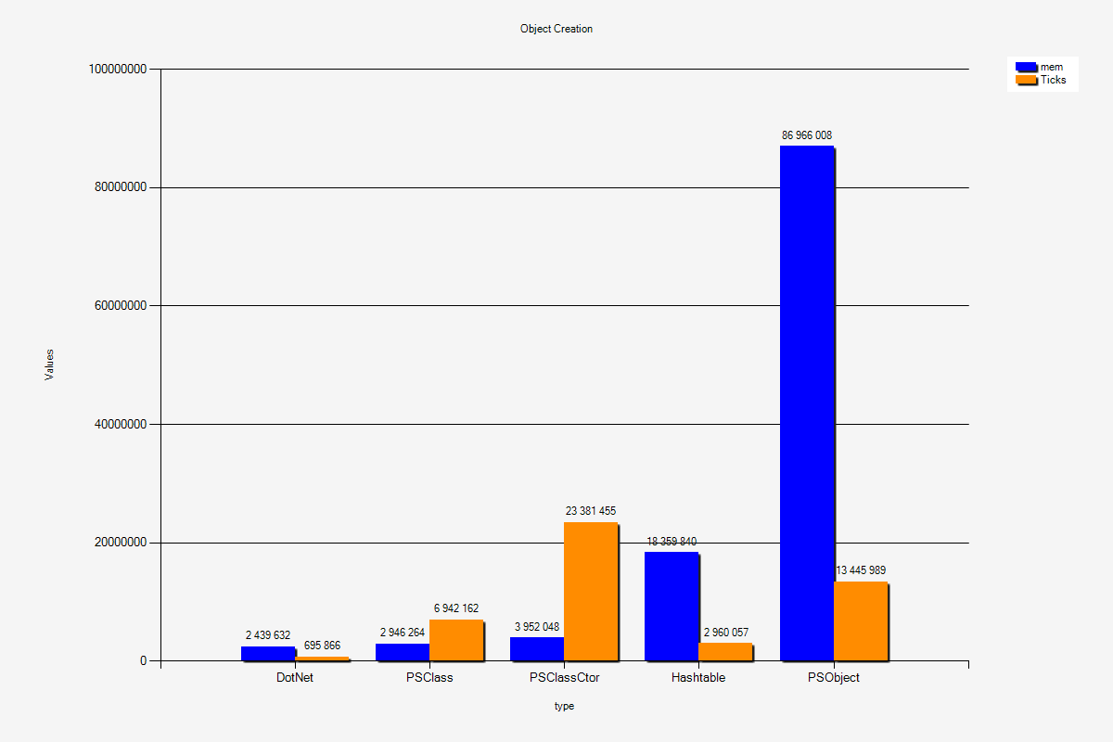
Object allocation

Slide 21
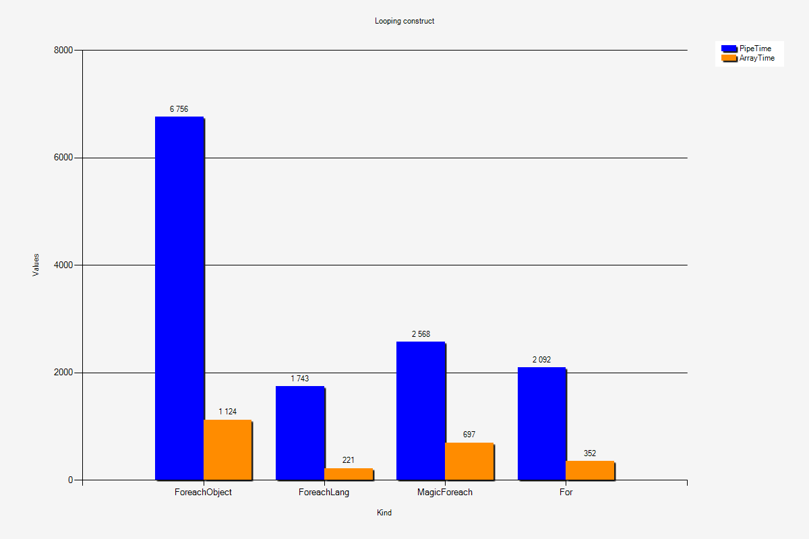
Iterating collections

Slide 22
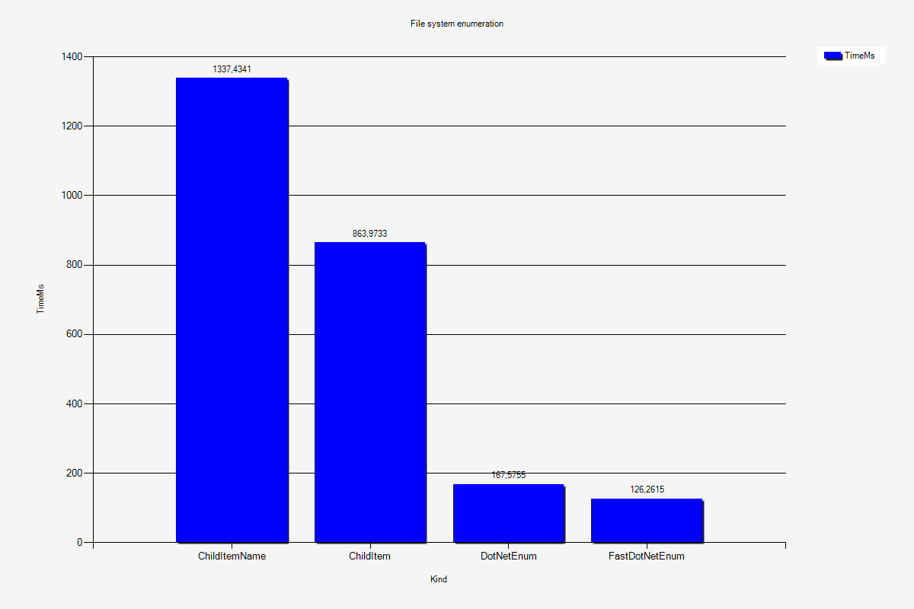
Enumating filesystem

Slide 23
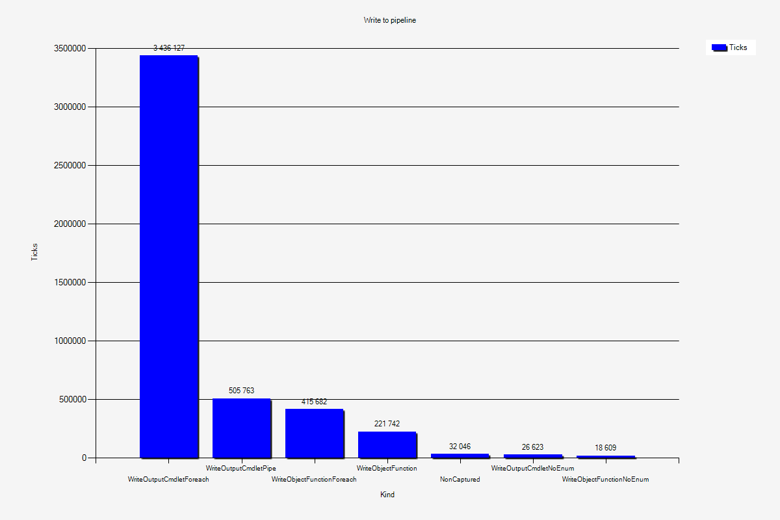
Writing to the pipeline

Slide 24
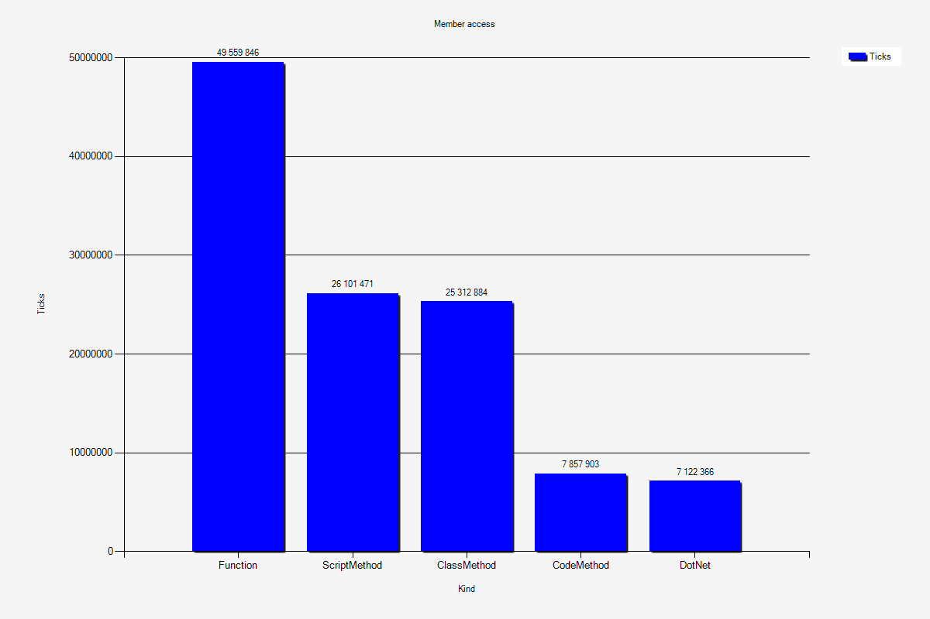
Function call times

Slide 25
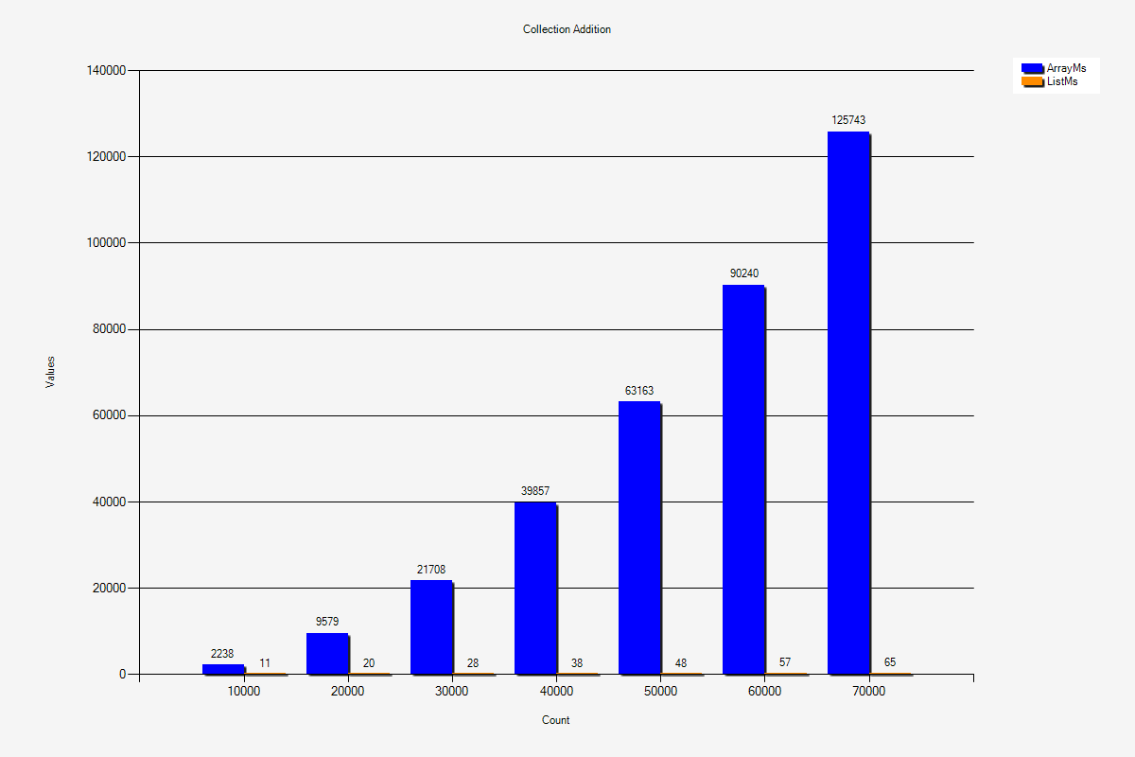
Time adding to array vs List

