Slide 1

5x5 squares w/weird position

Slide 2


Slide 3
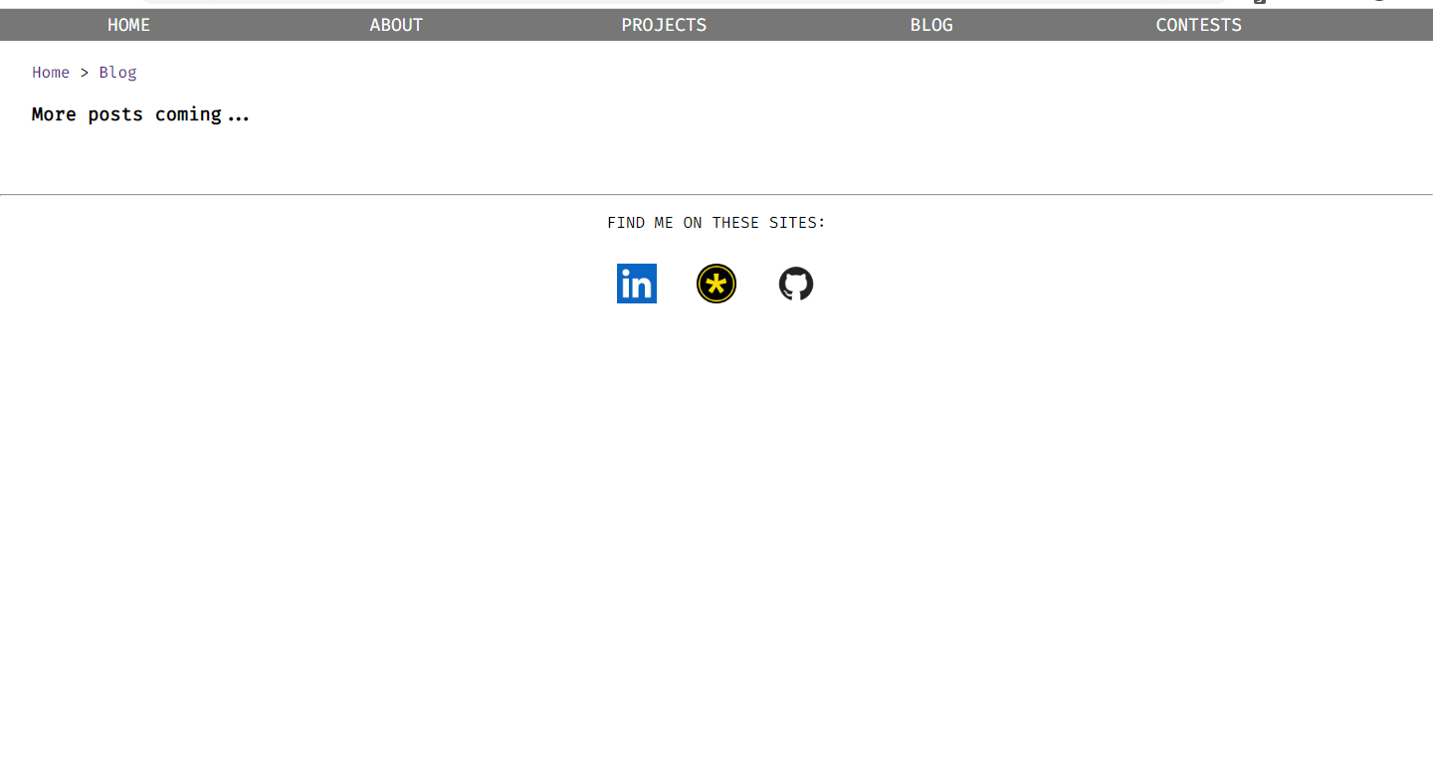

BLOG (RENDITION 1.0)
(I like this blog preview layout right here, might even use Titillium Web instead).
LATEST POSTS:
There’s no sidebar here for now (it is filler, and will later serve as a filter system and sort system for blog posts like the filters for Dell computers).
Rect boxes display messages on hover (title=“”)
What series/theme the post has (NOTE: life blogs or recalling camp experiences or study tips will have the “default website theme”)
Date
How long it takes to read (based on word count)
How advanced material is (prereqs for reading)
CCC 2019 S3 & Linear Algebra
Jul. 6, 2021
Intermediate (HS Math, Data Structs)
30 min
There was a minor DMOJ controversy over CCC 2019 S3- but is it true? I investigate the existence of a linear algebra solution to the problem.
Tags:
CCC
DMOJ
+3 more…
Computer Science
320
tags will be clickable once I get my database up (only return posts of a certain tag and add to the filter). For now, they are decorative. In fact, I might not even put them.
Tablet layout: sidebar is removed and shifts to the top (it is collapsible). <- actually could make that laptop layout.
phone layout (need to make sure text is readable): get rid of image+view count so that the main text can take up everything
Colored in red: features that will be added later. They’re too advanced for now (PHP).
hit counter will only activate if someone clicks on the link!

Slide 4
In the future, I can uato generate the blog list from a database in the feature (auto generated pagination, like dmoj.ca does with its problems), and I can sue the website itself to write down blog posts without using HTML using a private .php file. The problem is access.
Overview
The Controversy
Typical Sol
Notes + Fineprint
Other section
CCC 2019 S3 and Linear Algebra
Jul. 6, 2021
30 min
Prerequisites: Intermediate
This post requires an understanding of high school math. Linear algebra will be given an overview of but is not necessary. It also requires knowledge of basic computer science concepts but competitive programming experience is not necessary to understand this. (in a small font)
wordy so it is a dropdown.
sidebar will have table of contents (like ryan10145) which represent the headings. You can click on them to jump to them.
Overview
So the Canadian Computing Competition (CCC) is a contest, bla, bla, bla
Courier New is the closest thing I can find to the monospaced font here.
JS (or what language this is in)
COPY
This is a code section.
something something something
At the bottom, there will be “All blog posts on this site were written by”, followed by my AVC logo. (cube)
No comments section. Later there might be a share on Facebook/Twitter/etc. button after May

