Slide 1


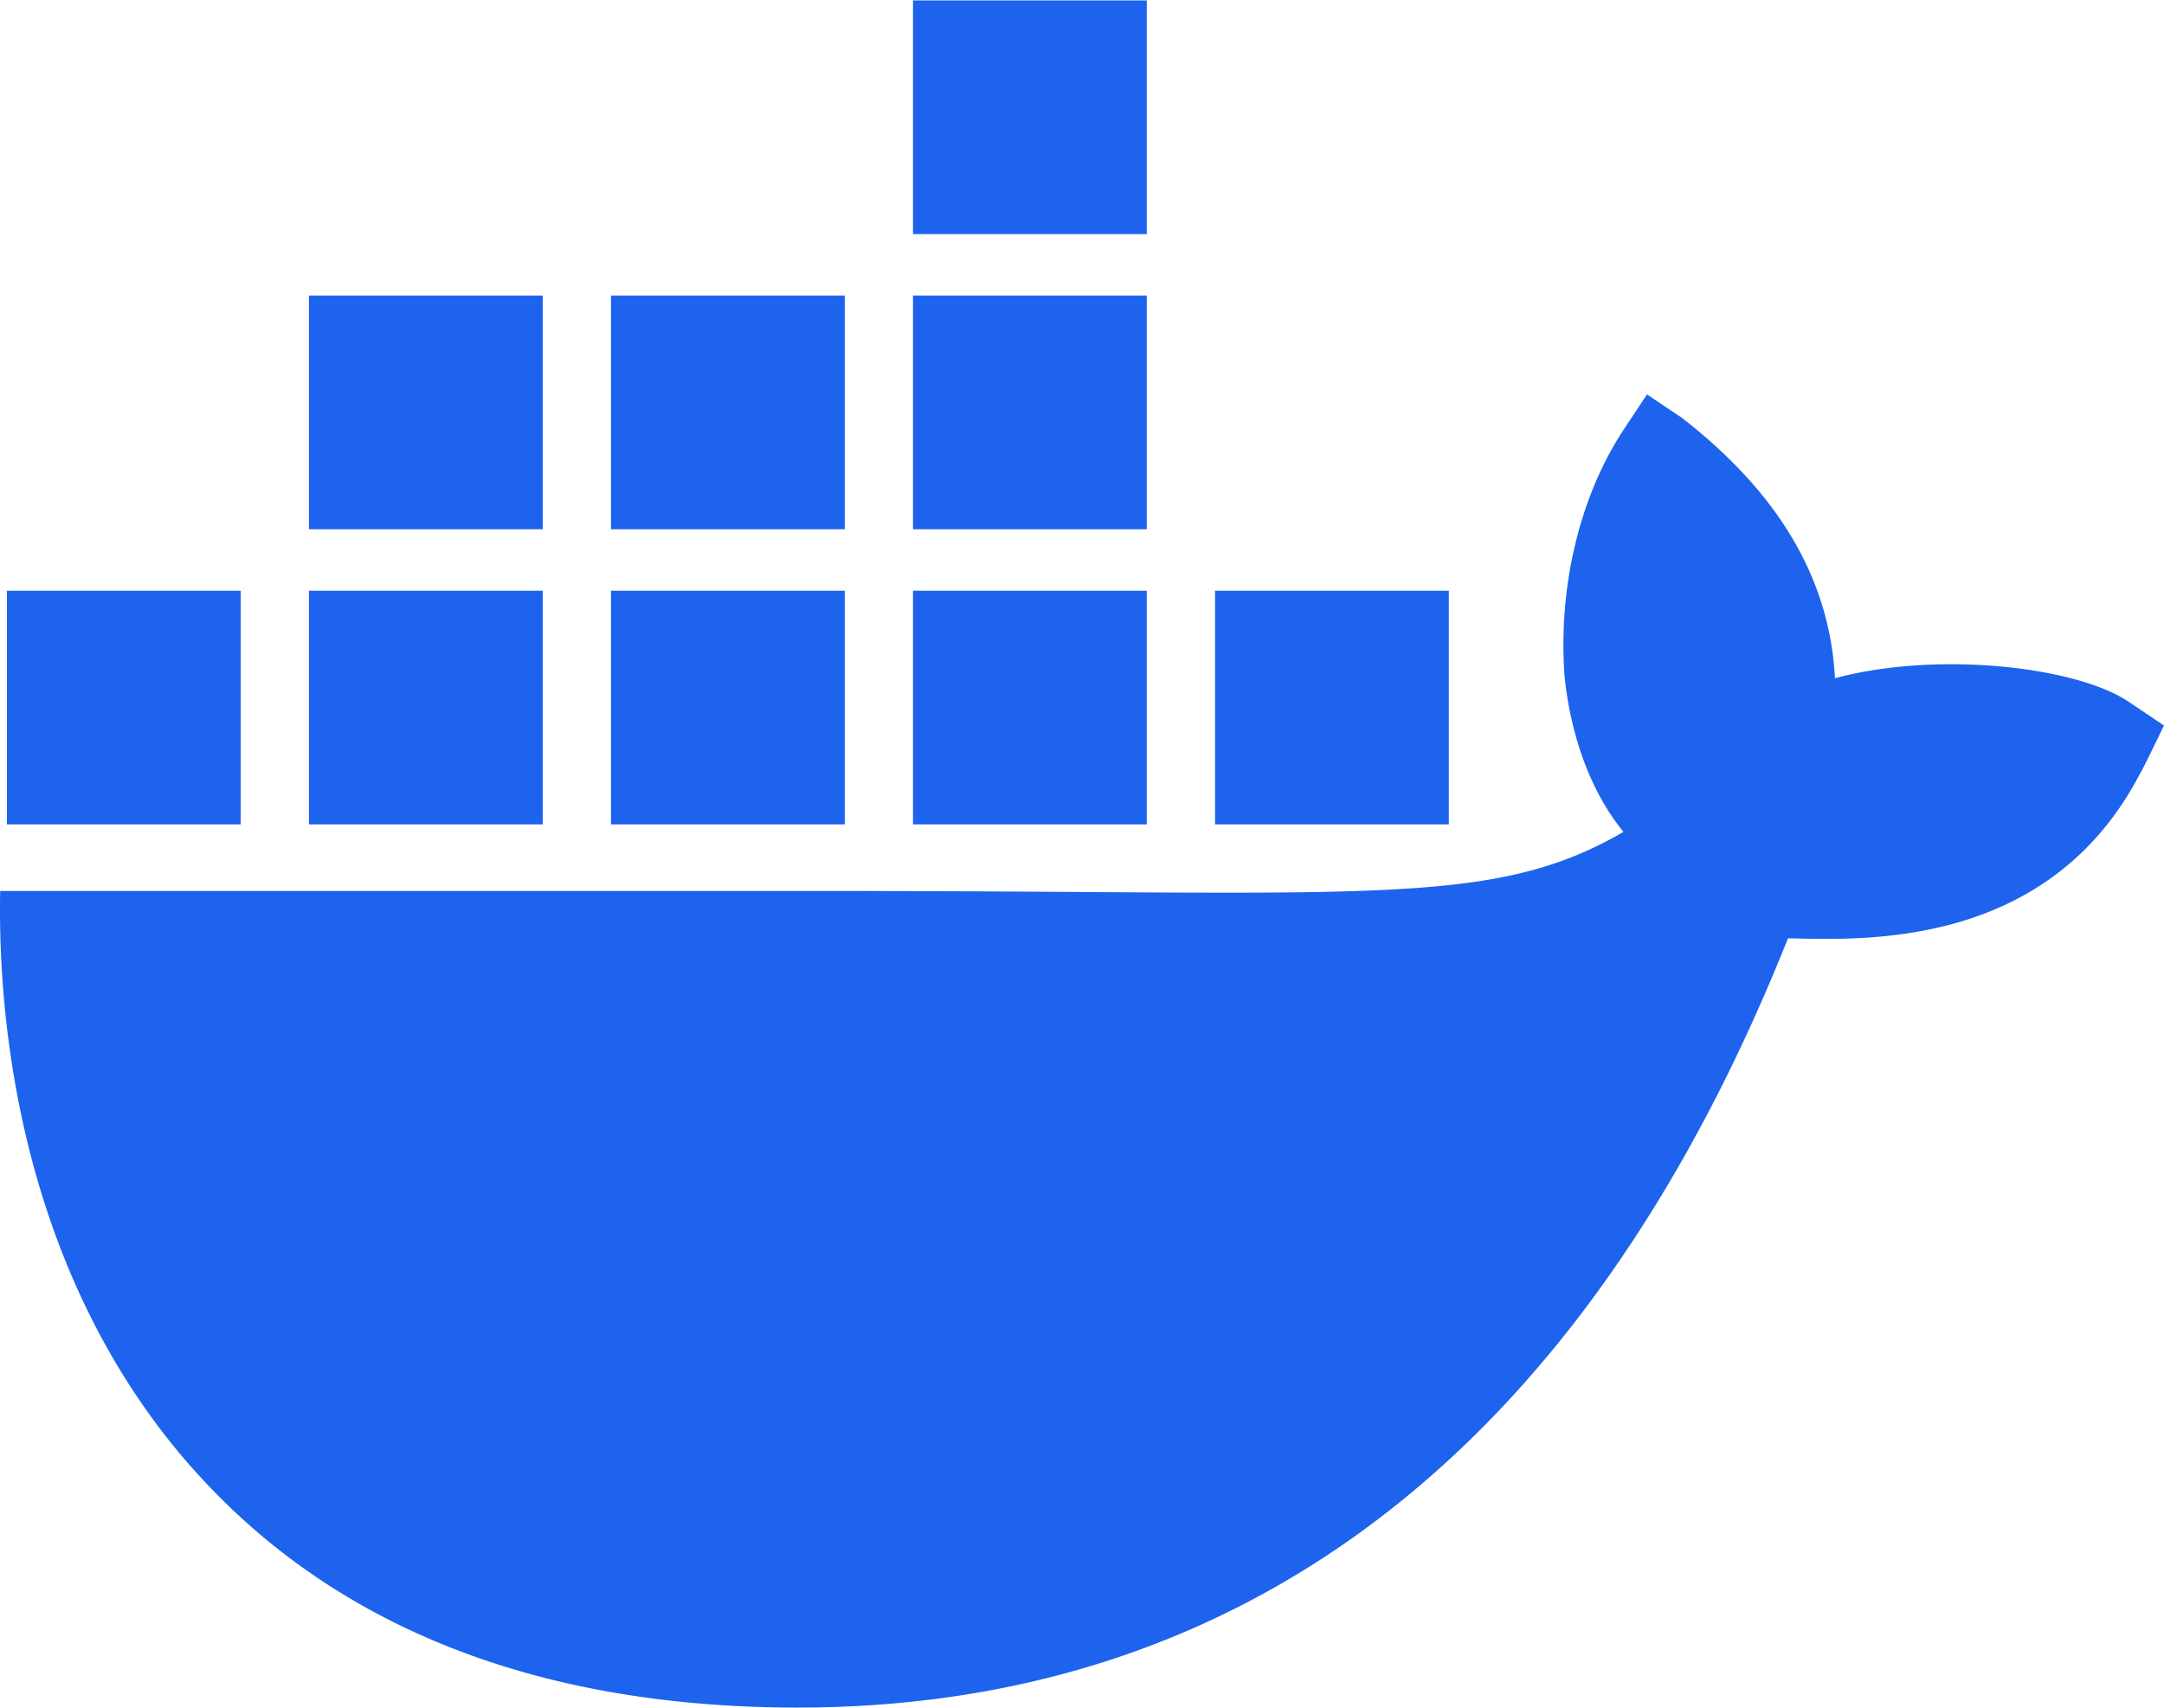
Resource Group
Container Apps Environment
Containers App
MCP Server Docker Container

