Slide 1


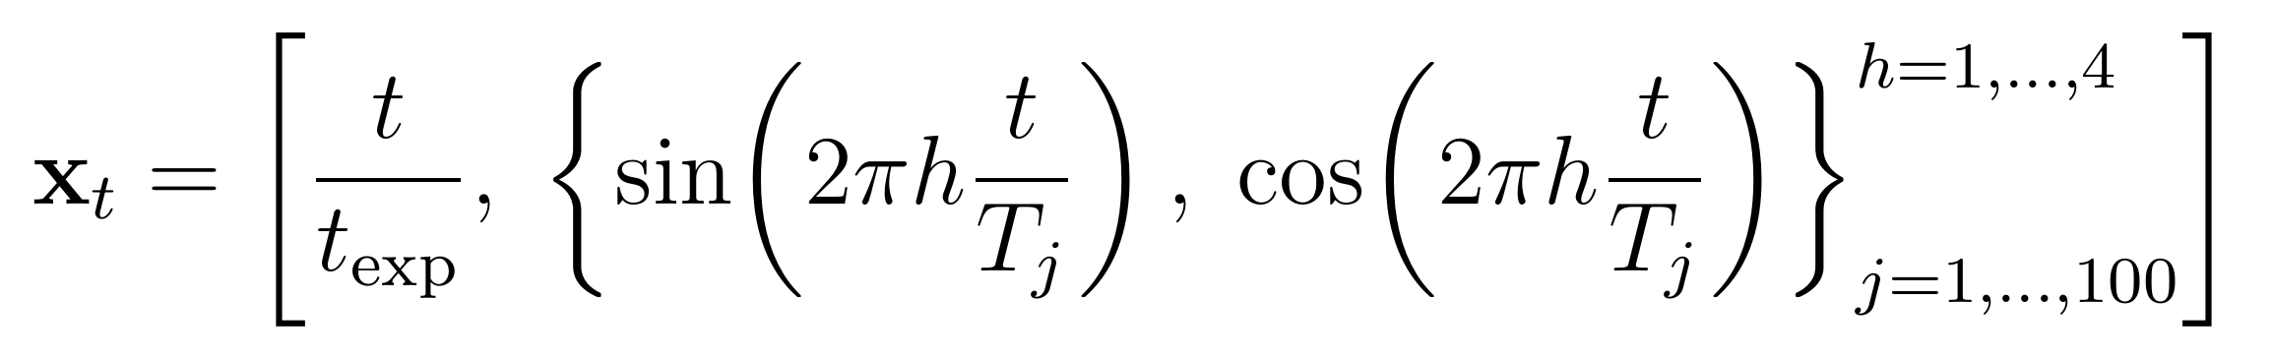
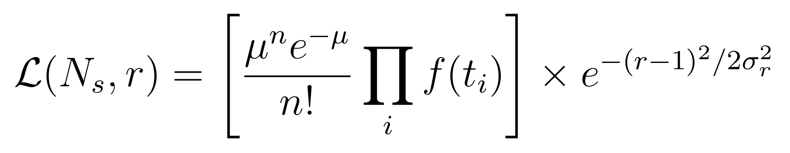
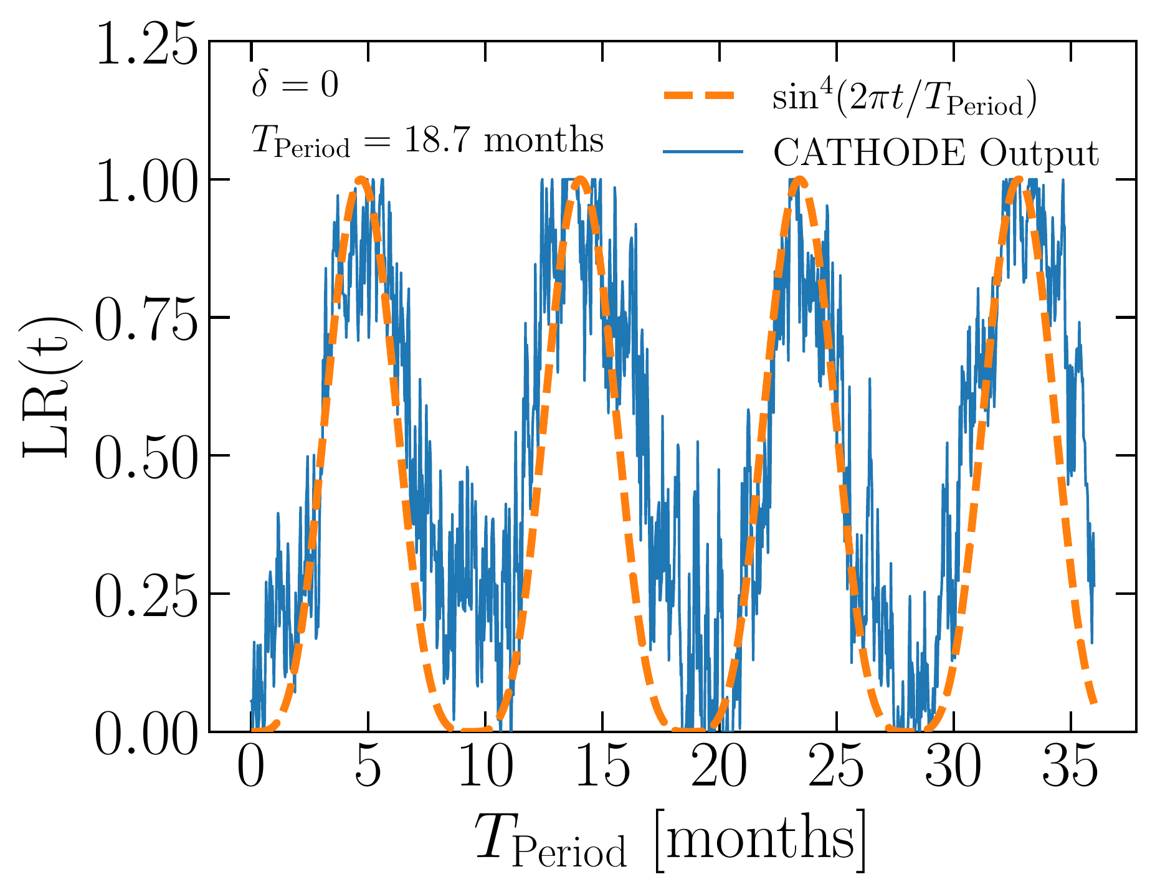
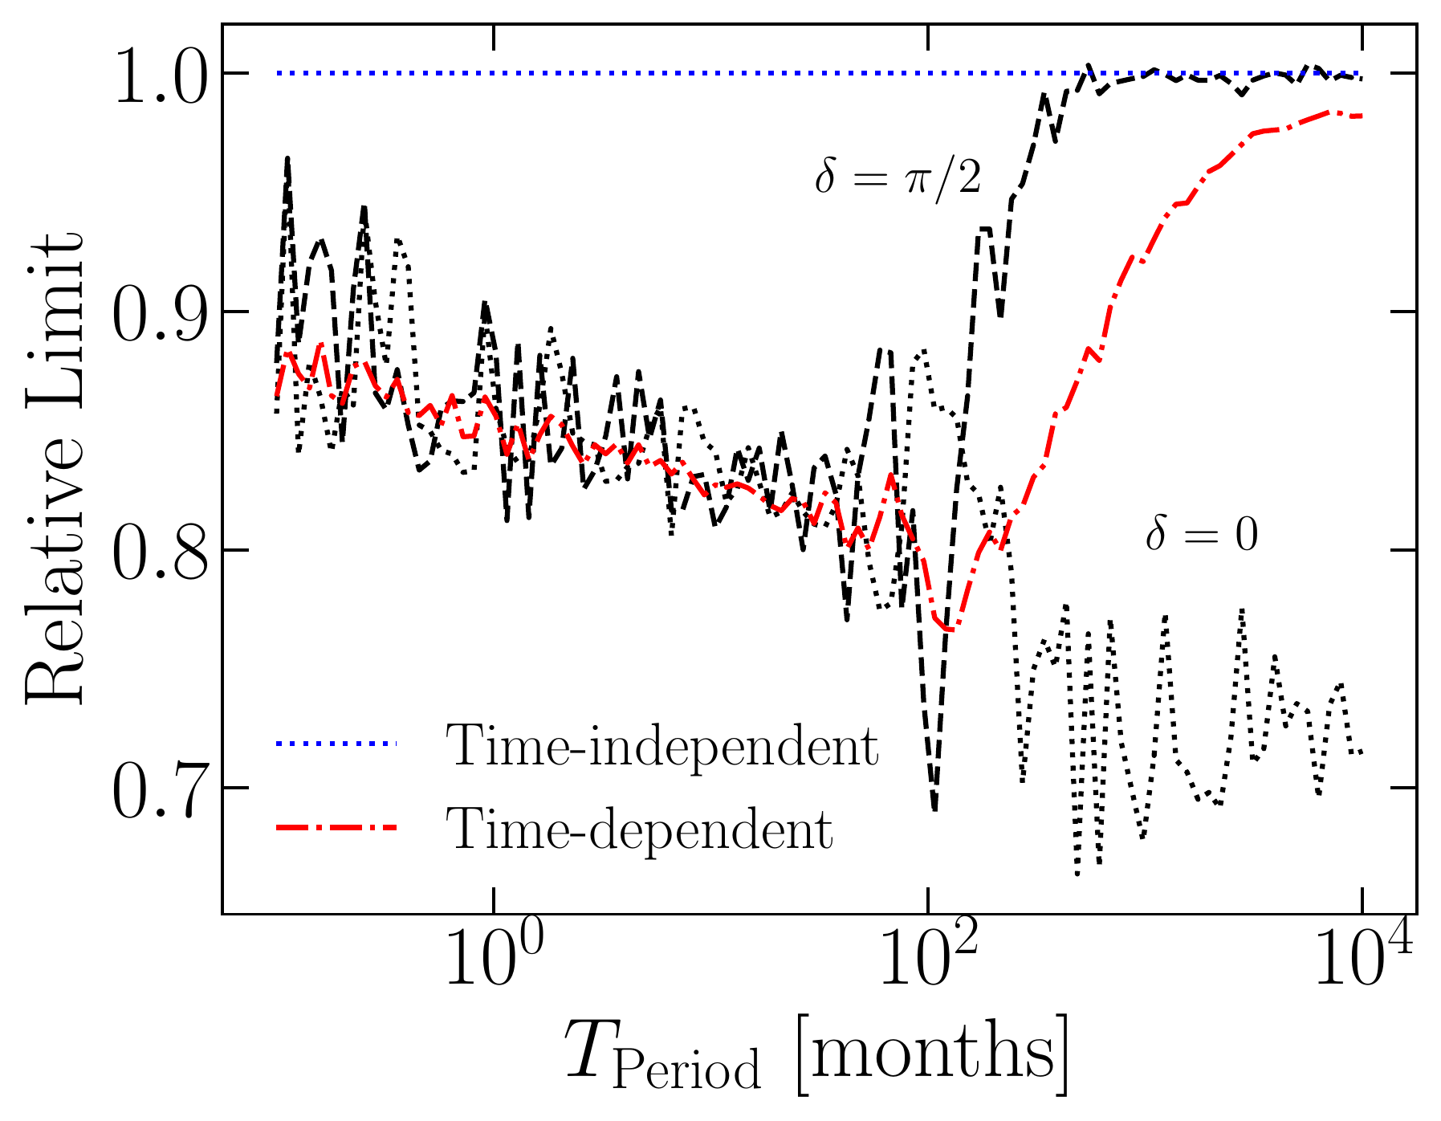
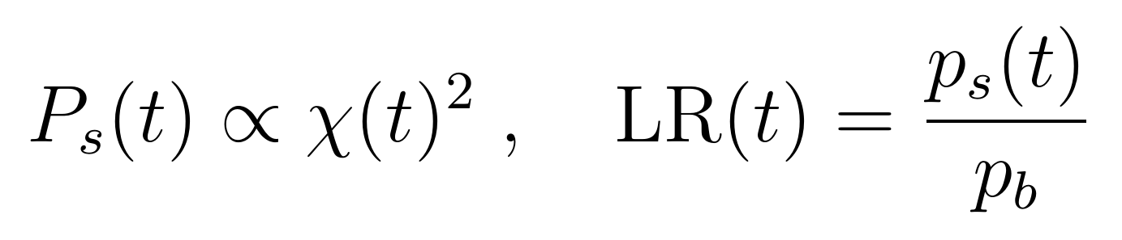
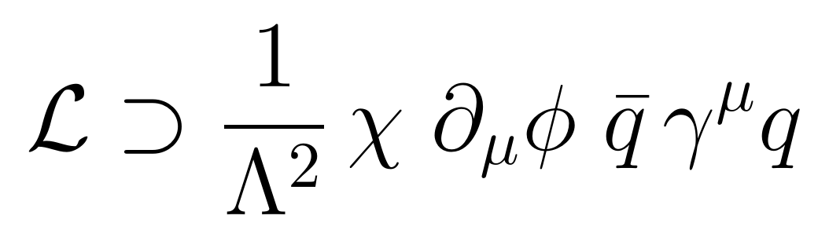
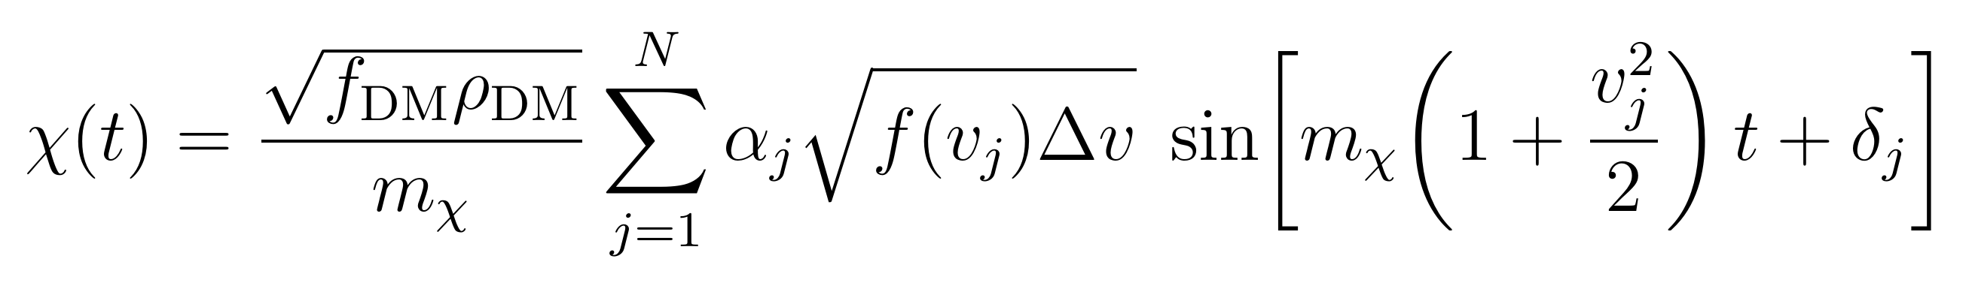
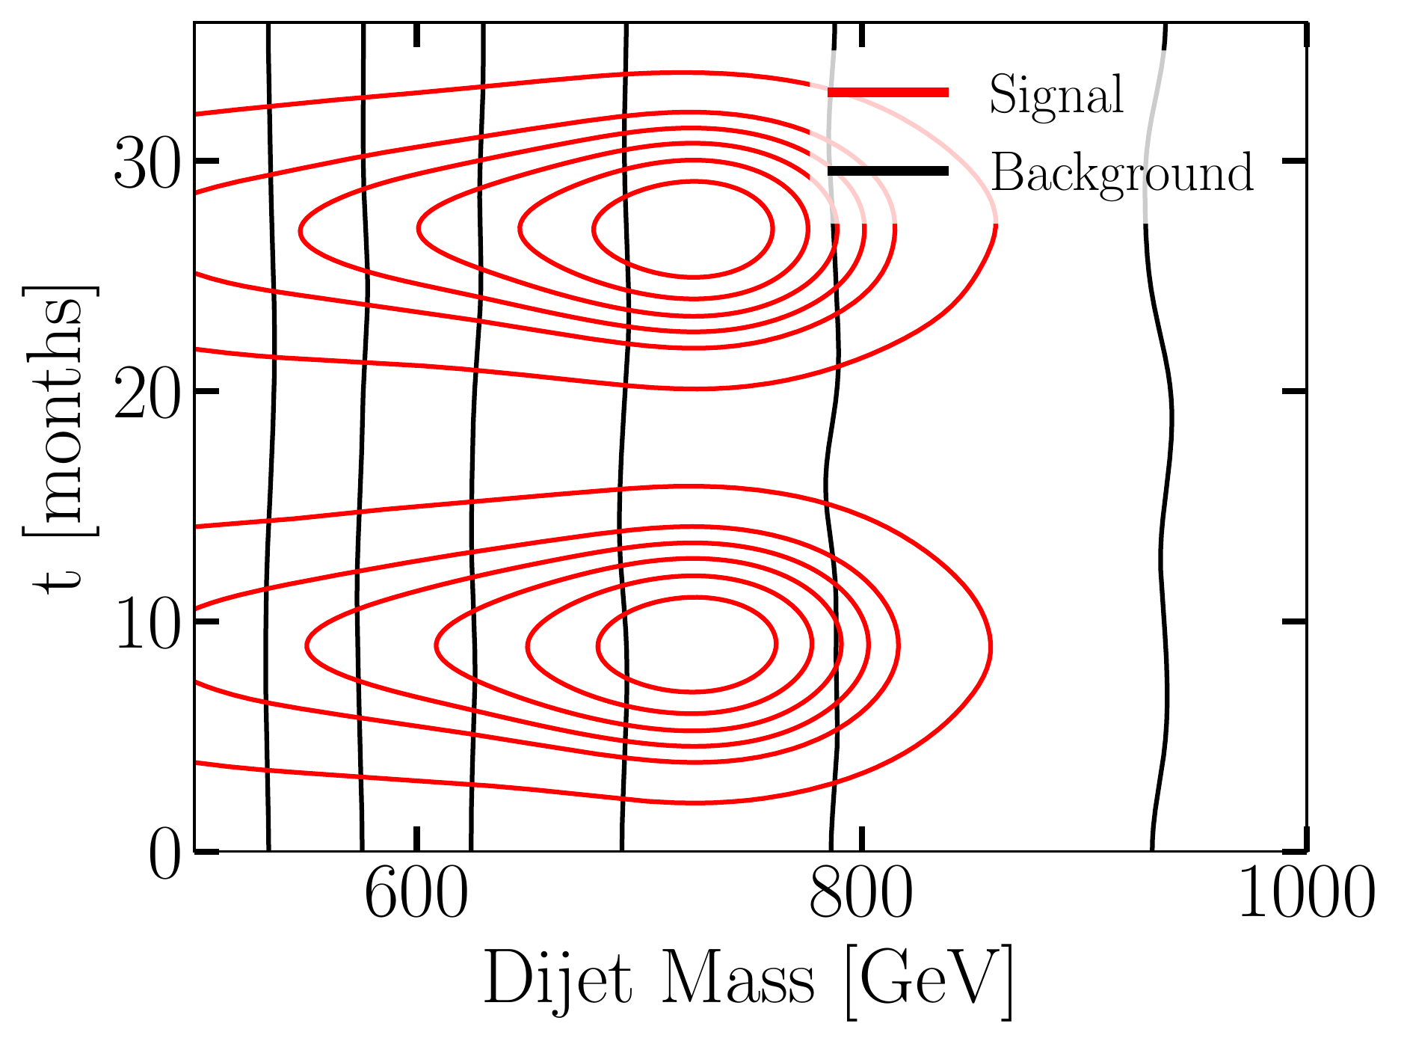
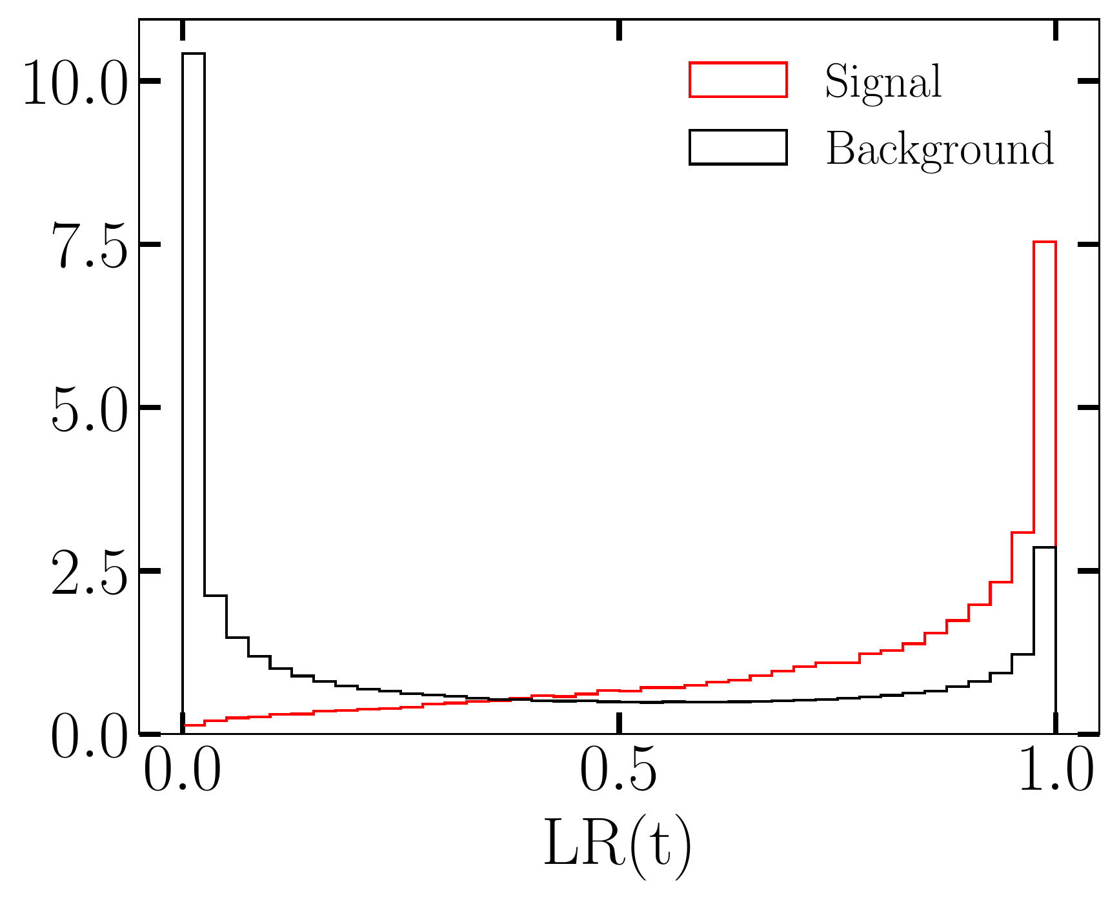
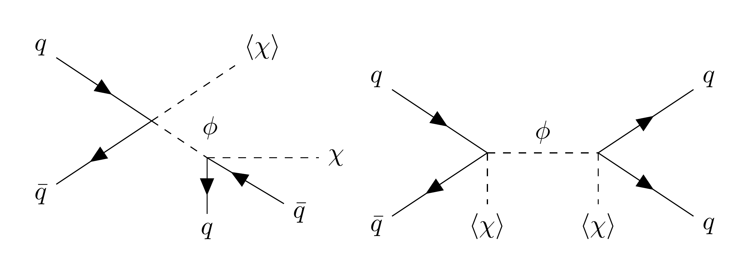
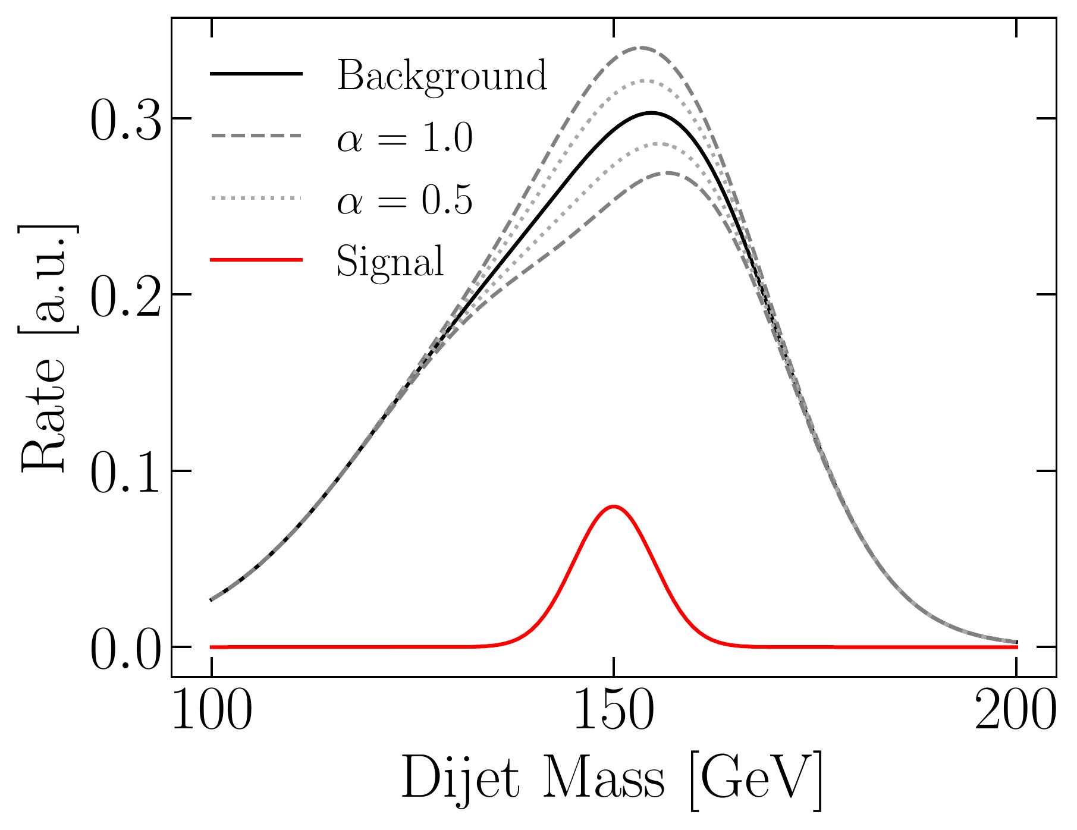
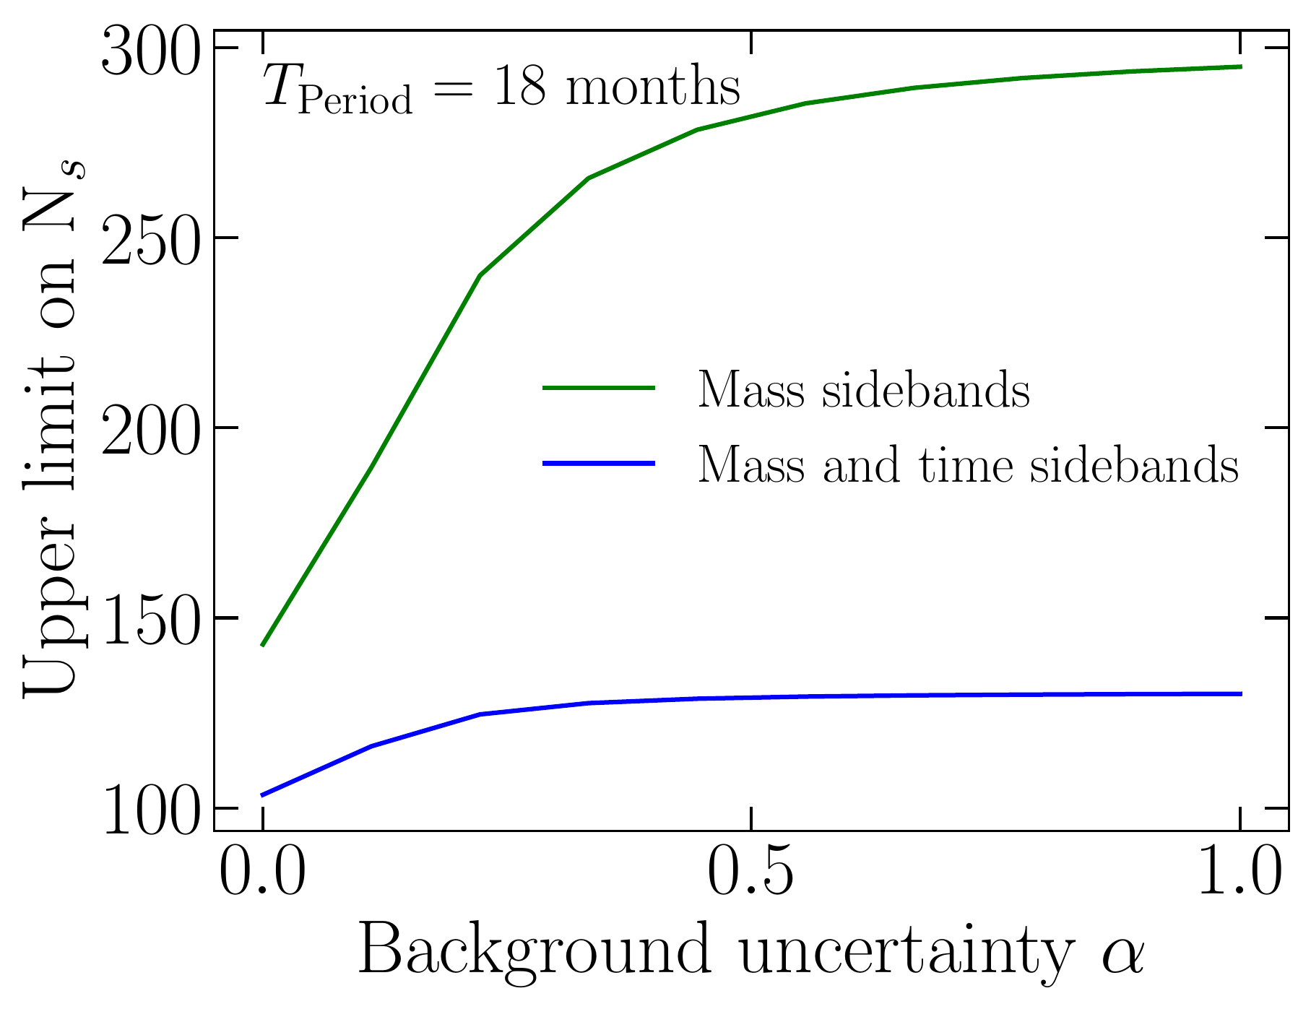
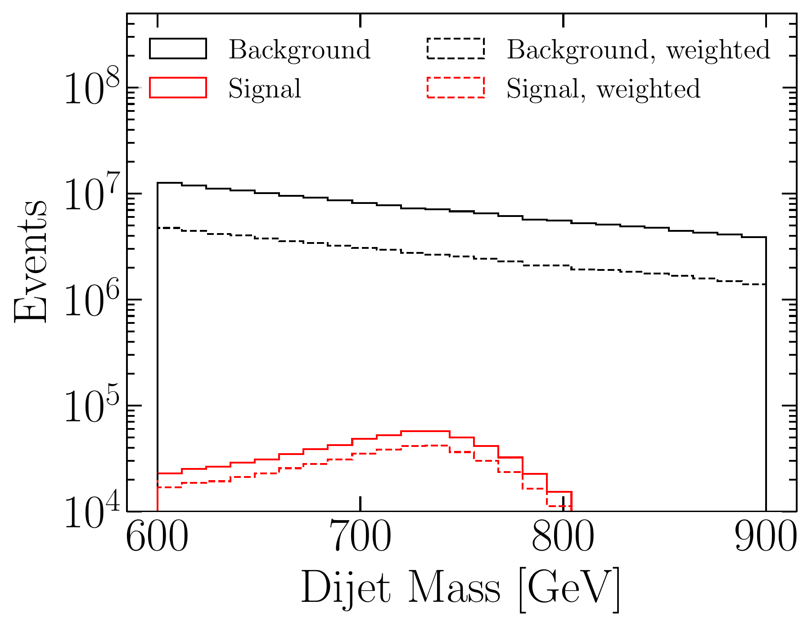
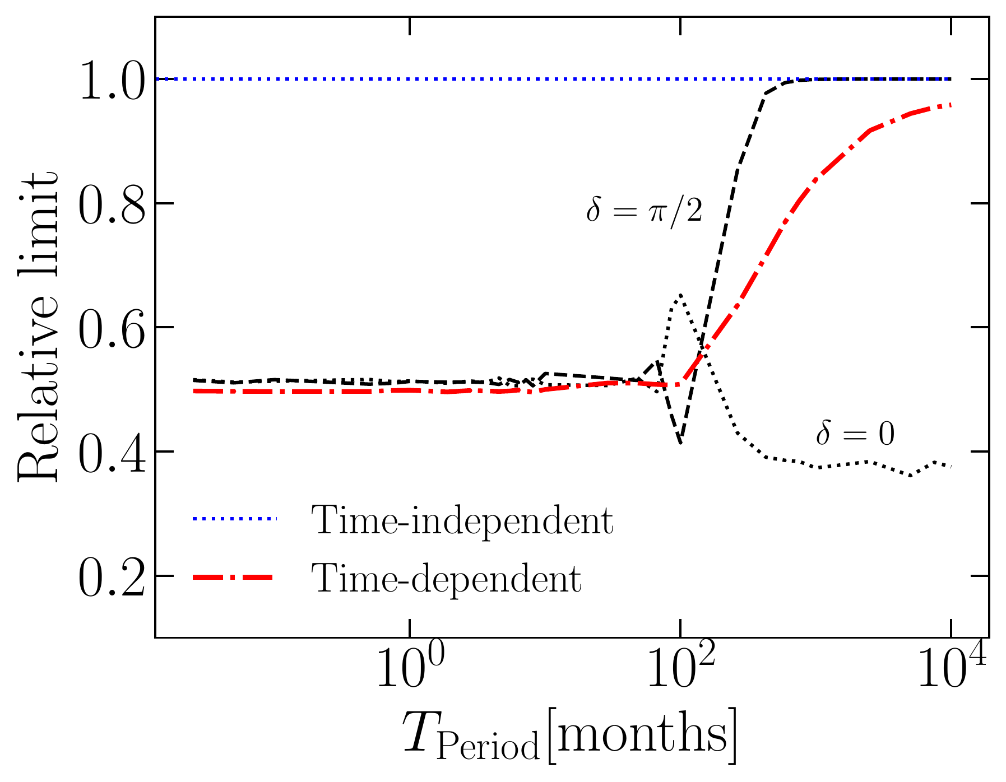
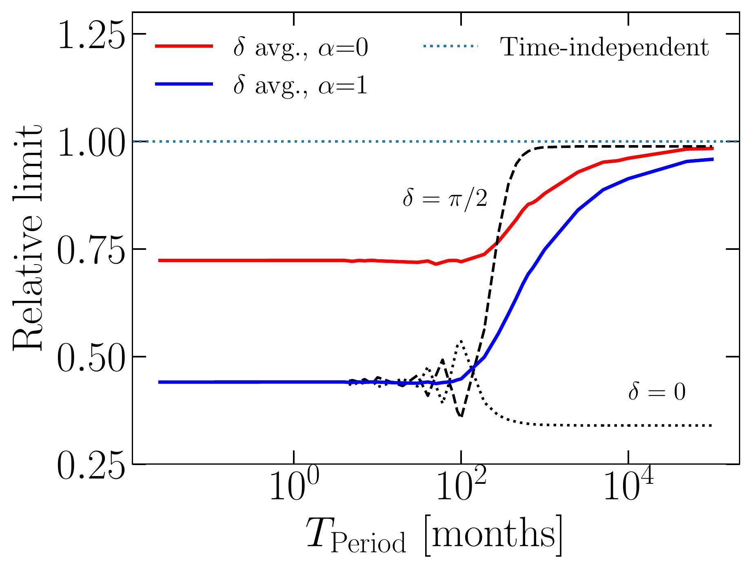
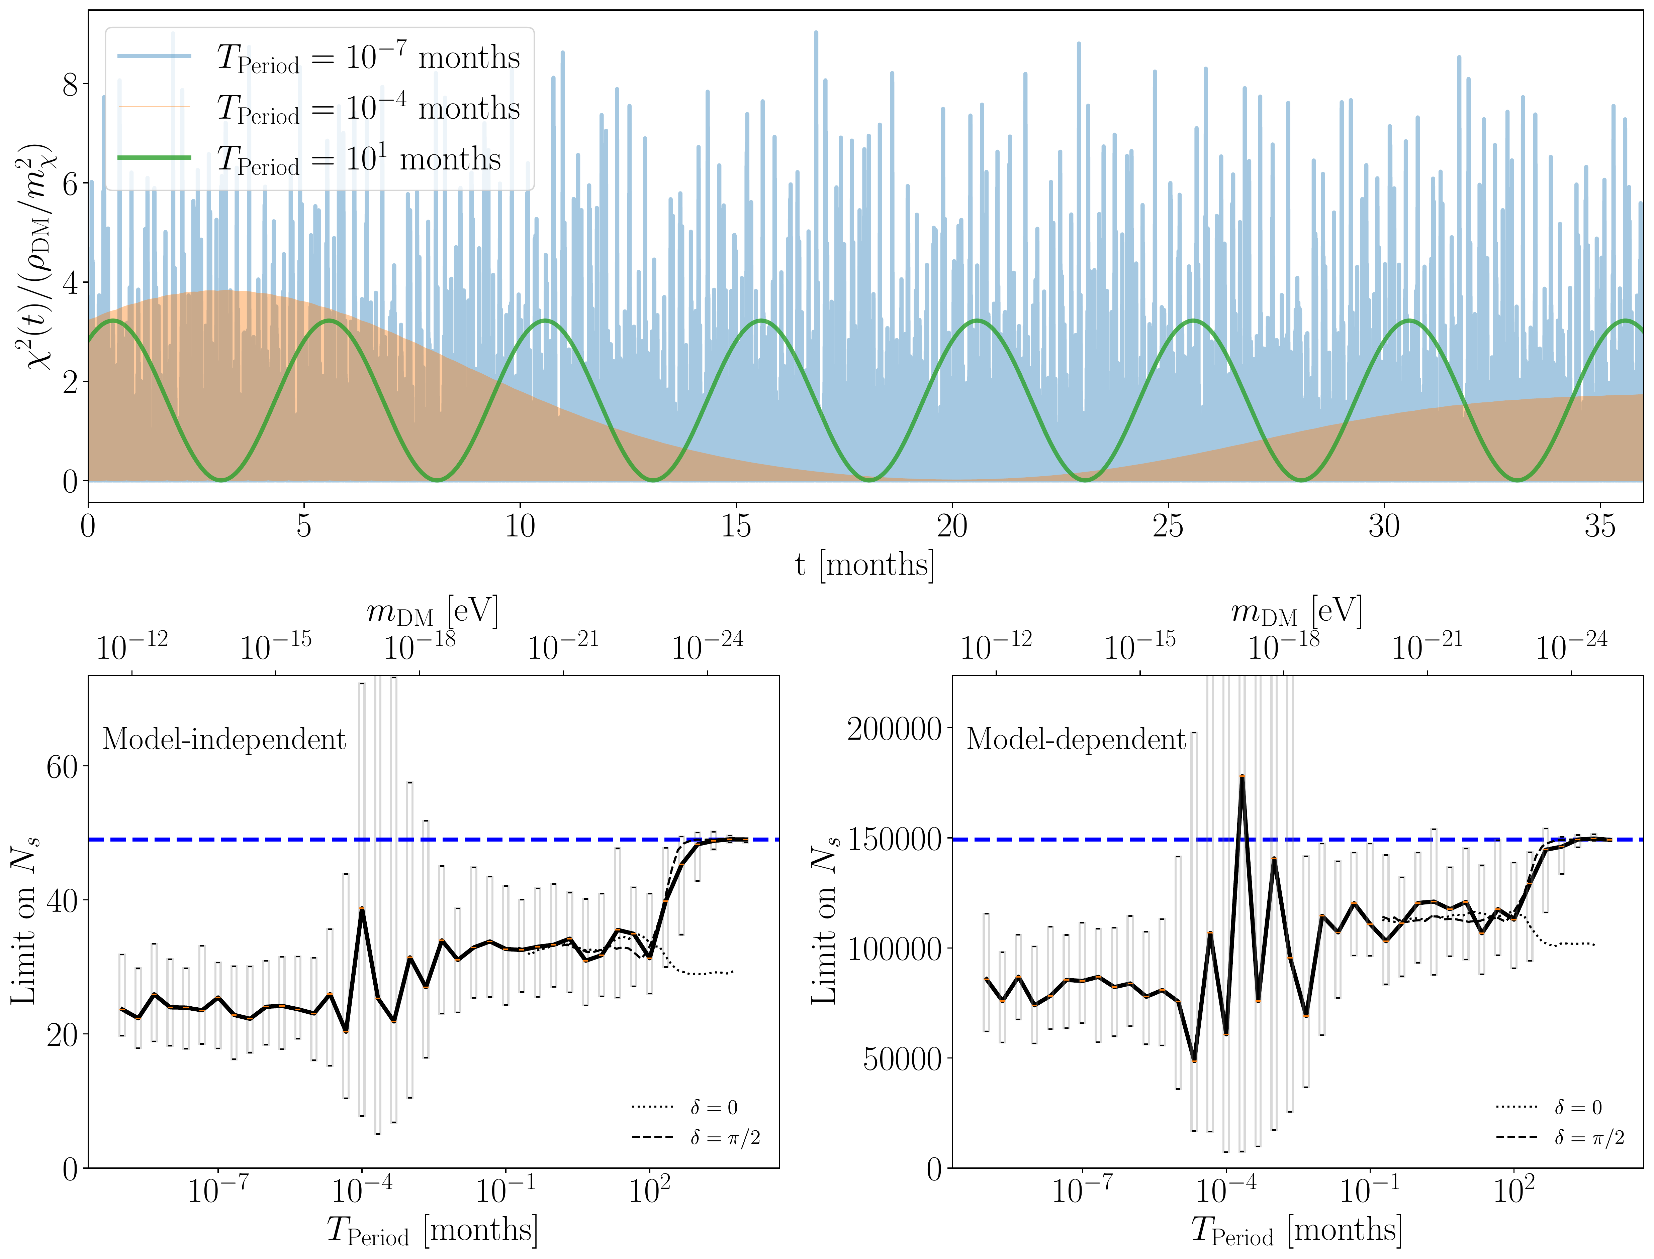

Time-dependent Signals of New Physics at the LHC
FERMILAB-PUB-26-0234-T
Max Fieg¹, Patrick J. Fox¹, Jinbo Zhang², Aishik Ghosh², and Daniel Whiteson²
¹Particle Theory Department, Fermilab, Batavia, IL 60510, USA
²Department of Physics & Astronomy, University of California, Irvine, CA 92697, USA
Motivation
Time-dependent Missing Momentum
Learned Oscillation (CATHODE)
Background
• The LHC searches for BSM physics via missing energy, resonance, and other channels. Current analyses assume signal cross sections are time-invariant.
• New physics coupled to ultralight dark matter (DM) can produce time-dependent signal rates — a powerful discriminator orthogonal to kinematics.
Ultralight Dark Matter
• Ultralight bosonic DM (mᵈᴹ ≲ 0.1 eV) has large phase-space occupancy and behaves as a classical oscillating background field.
• Oscillation period T = 2π/mᵈᴹ ≈ 4 s × (10⁻¹⁵ eV / mᵈᴹ).
• de Broglie wavelength is macroscopic: λ ≈ 10⁹ km × (10⁻¹⁵ eV / mᵈᴹ).
• Examples: QCD axion, axion-like particles, dark photon, dilaton.
Why the LHC?
• If SM couples to DM only via a TeV-scale mediator, low-energy experiments lose sensitivity → the energy frontier is the natural place to search.
• Timing information can improve sensitivity by up to ~2×.
ATLAS Mono-jet Reinterpretation
• ATLAS jet + E̸ᵀ search: 139 fb⁻¹, ~36 months, √s = 13 TeV.
• Highest E̸ᵀ bin (> 1200 GeV): Nᵇ = 223 ± 19 expected, 207 observed.
• Signal rate Pₛ(t) ∝ χ(t)²; background is uniform in time.
Extended Likelihood
• When the oscillation period is unknown, use CATHODE anomaly detection to learn time dependence directly from data.
• Auxiliary Fourier feature bank (100 periods × 4 harmonics):
• Motivated by sin⁴(x) = [3 − 4 cos(2x) + cos(4x)] / 4.
• CATHODE learns an LR-like score without pre-specifying target period or phase.
• Profiled over 100 random DM field realizations. Phase δ is critical for long Tₚₑₙᵢₒᵈ.
Figures 5: CATHODE Output & Limits
Time-dependent Resonances
Model & Signal Processes
Known Oscillation: Likelihood-Ratio Weighting
• Dijet resonance φ → jj at mφ = 750 GeV (MadGraph5 + Pythia + Delphes).
• Time component of the likelihood ratio factorizes:
• Consider ultralight DM (χ) and a dark sector scalar (φ) coupling to SM quarks via:
• The classical DM field oscillates as:
• Weighting events by LR(t) suppresses background relative to signal in the mass distribution.
Figures 3: Mass–Time & LR Distributions
• Left: Learned time score (blue) captures the true modulation (dashed orange).
• Right: Relative limit vs Tₚₑₙᵢₒᵈ — bounds are stronger than time-independent analysis.
Sidebands in Time
• ρᵈᴹ ≈ 0.4 GeV/cm³; velocity dispersion follows Maxwell–Boltzmann.
• Coherence time Tᶜₒₕ ≈ Tₚₑₙ / ⟨v⟩² = Tₚₑₙ × 10⁶.
• φ is a TeV-scale dark sector scalar; Λ ~ v′ (dark Higgs VEV).
• Mass sidebands fail when the background has non-trivial features (peaks, turn-ons) near the signal region.
• Key insight: low signal-to-background time intervals can constrain the background shape directly in the signal mass region.
Feynman Diagrams (Figure 1)
Figures 6 & 7: Toy Background & Time-Band Limits
• Left: Signal & background contours in (mⱼⱼ, t) plane.
• Right: LR distributions showing expected separation.
Figures 4: LR-Weighted Mass & Limits
• Left: Missing energy (qq̄ → φ + χ) with Pₛ(t) ∝ χ²(t).
• Right: Dijet resonance (qq̄ → φ → qq) with Pₛ(t) ∝ χ⁴(t).
• Time-independent channel (⟨χ⟩ → χ) is phase-space suppressed for small mχ.
DM Field Oscillation & Limits (Figure 2)
• Left: Mass distribution before (solid) and after (dashed) LR weighting.
• Right: ~50% improvement for Tₚₑₙᵢₒᵈ ∈ [0.01, 1] month.
• Top left (Fig. 6): Toy background with non-trivial peak at resonance mass.
• Top right (Fig. 7 top): Time sidebands maintain sensitivity even with large background uncertainty (α = 1): Nₛ from 290 → 125.
• Bottom (Fig. 7 bottom): Limit scan over background uncertainty α and signal fraction.
Discussion & Conclusions
Systematics
• Time-dependent systematics (luminosity decay, beam–beam effects, dust, ground motion) are generally non-periodic → distinguishable from signal in Fourier space.
Summary
• Time-dependent signals provide a discriminator orthogonal to kinematics.
• ATLAS mono-jet: limits improve up to ~2× with timing information.
• Dijet resonances + LR weighting: ~50% stronger limits.
• CATHODE learns oscillation from data using Fourier features.
• Time sidebands directly constrain background in the signal region.
• The LHC can function as a direct-detection experiment for ultralight DM.
• Top: DM field oscillation over 36 months of LHC Run 2.
• Middle: Expected 95% CL limit on Nₛ vs Tₚₑₙᵢₒᵈ.
• Bottom: Limits improve up to ~2× for short oscillation periods.
Acknowledgments: DW funded by DOE Office of Science. MF supported by NSF PHY-2210283 & GRFP DGE-1839285. MF & PF supported by Fermilab (DOE Contract 89243024CSC000002). Thanks to H. Frisch and D. Miller for useful discussions.

