Slide 1

UNLOCKE YOUR MIND
THE ENLIGHTENMENT IN EUROPE
1650-1800

Slide 2
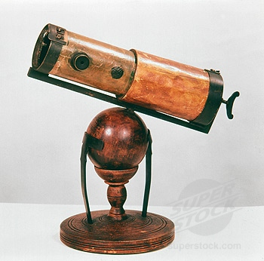
THE ENLIGHTENMENT IN EUROPE
Enlightenment: intellectual movement
Philosophes: Intellectual Thinkers
Inspired by the Scientific Revolution:
Apply the Scientific Method to discover natural laws of human
society

Slide 3
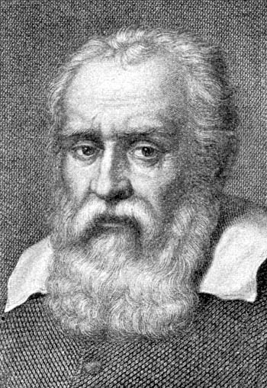
Galileo Galilei 1564-1642
Proves Heliocentric Theory: Sun centered Universe (Copernicus)
1633 The Inquisition: convicted him of heresy & forced to recant his findings
Sentenced to life imprison-spent under house arrest
Blinded by cataracts & glaucoma

Slide 4
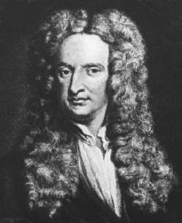
Sir Isaac Newton 1642-1727
Discoveries in math and astronomy show evidence that the physical universe followed natural laws
Described Universal Gravitation (apple tree)
3 Laws of Motion
Dies of bladder stones
Buried in Westminster Abbey

Slide 5
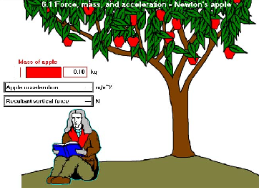
Laws of Gravity & Motion

Slide 6
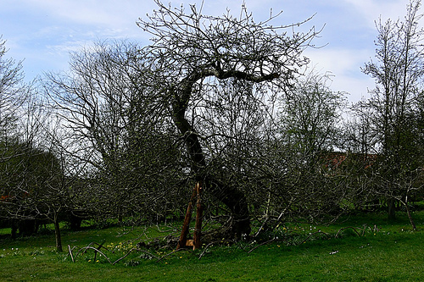
Could this be the tree?
Woolsthrope Manor, Lincolnshire

Slide 7
Philosophes Advocate Reason
1. Reason: discover truth through reason and logical thinking
2. Nature: what was natural was also good and reasonable
3. Happiness: reject medieval notion that people found joy in the here-after – urged
them to seek well-being on earth
4. Progress: stressed society & humankind could improve
5. Liberty: called for the liberties the English had won in the Glorious Revolution & Eng. Bill of Rights

Slide 8
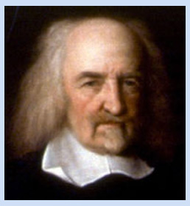
Thomas Hobbes 1588-1679
Humans are wicked & selfish – to escape a wretched life, people had to hand over their rights to strong ruler –in exchange, they gain law & order
Hobbes called this agreement
between people & government
the “Social Contract”
“Leviathan” (1651)

Slide 9
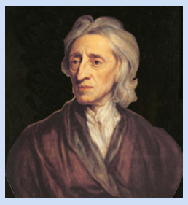
John Locke – 1632-1704
Tabula Rasa (Blank Slate) People could learn from experience and improve
People are born free and equal with 3 Natural Rights: life, liberty, and property
The purpose of Government is to protect our natural rights
If government fails to do so –
People have the right to
overthrow it.
*Government’s power comes from
the consent of the people!
“Two Treatises on Government”
(1690)

Slide 10
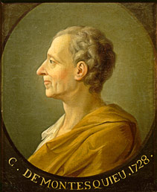
Baron de Montesquieu 1689-1755
SEPARATION OF POWER:
Executive – enforce the laws
Legislative – makes the laws
Judicial – interprets the law
SYSTEM OF CHECKS
and BALANCES
“Spirit of the Laws” (1748)

Slide 11
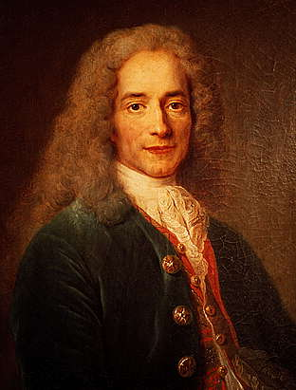
Voltaire 1694-1778
Tolerance, freedom of religion and speech
Societies worst enemies - intolerance, prejudice, and superstition
Used satire against opponents
Jailed twice – exiled to
England for 2 years.
*Deist

Slide 12
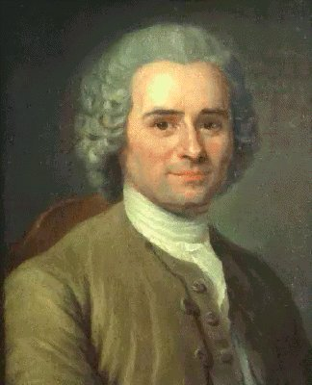
Rousseau 1712-1778
– “The Social Contract” (1762) – legitimate government comes from the consent of the people
People should vote for what
is best for the community
as a whole – govern by the
general will.
(Direct Democracy)

Slide 13
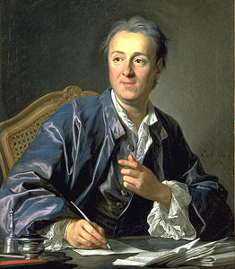
Denis Diderot 1713-1784
Published a 28-volume Encyclopedia
Encyc. Becomes weapon by attacking superstition & calling for political change
Many copies are sold – spreads Enlightenment ideas

Slide 14
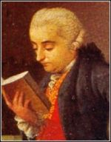
Cesare Beccaria 1738-1794
“On Crimes and Punishments” 1764
Laws exist to preserve social order – not to avenge crimes
Abolish torture, cruel and unusual punishments, lack of speedy trials
Degree of punishment should be based on the seriousness of the crime
Brutal punishments do not
stop crime

Slide 15
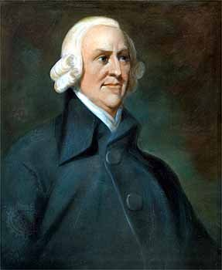
Adam Smith 1723-1790
1776 “Wealth of Nations”
Laissez-faire economics (let people do what they want)
The state should not interfere in economy
Law of Supply and Demand would regulate the economy naturally
Government has 3 basic roles:
Protect Society from invasion
Keep up public works
Defend citizens from injustice

Slide 16
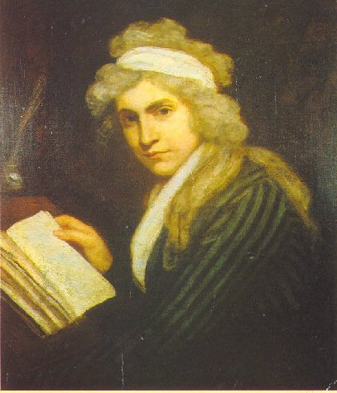
Mary Wollstonecraft 1759-1797
1792 “A Vindication of the Rights of Women”
Actively called for women’s rights in education, professions, and politics
Because women have reason, they too are entitled to natural rights
During this time in England,
women could not vote or hold
public office. They did not
have access to the court system
or lawyers. Women could not
hold jobs in government or medicine.

Slide 17
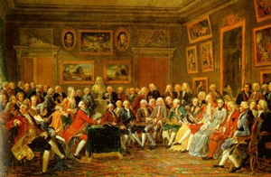
Enlightenment Ideas Spread
Salons – Wealthy women of Paris invite intellectuals to their parlors to share and discuss ideas
Marie-Therese Geoffrin – most influential – finances Diderot’s encyclopedia project

Slide 18

Communications
Denis Diderot compiles the first encyclopedia
Salons
Newspapers
Books
Letters
Journals

Slide 19
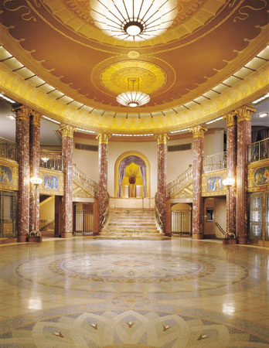
Art
  Neo Classical:
  Simple elegant style
  Borrowed from Greece
  And Rome
  “new classical”

Slide 20
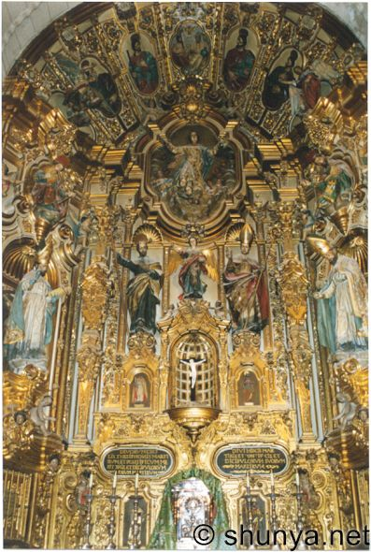
Baroque
Grand ornate design

Slide 21
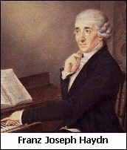
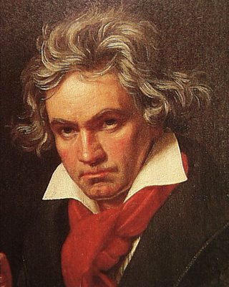
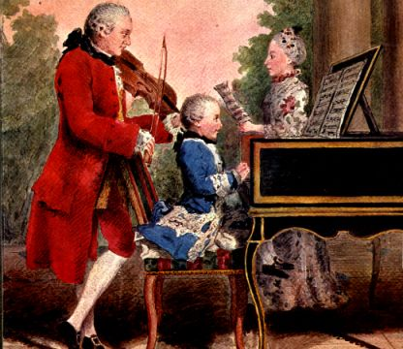
Music
Classical –light and elegant
Johann Haydn
Ludwig van Beethoven
Wolfgang Amadeas Mozart

Slide 22
Enlightened Despots
Use knowledge to benefit subjects

Slide 23
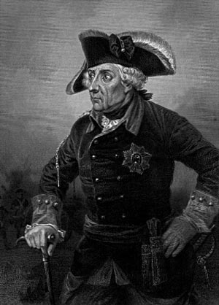
Frederick the Great
King of Prussia 1740-1786
Granted religious freedom
Improved education
Reduced censorship
Reformed justice system
Abolished torture

Slide 24
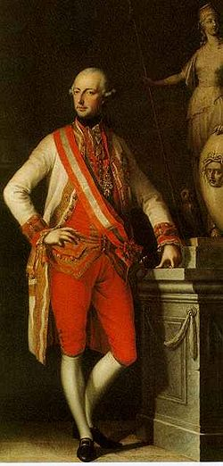
Joseph II
Rules Austria 1780-1790
Freedom of press
Freedom of religion
Abolished serfdom
Peasants paid in CASH
for labor

Slide 25
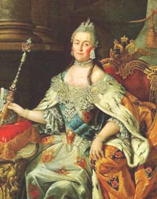
Catherine the Great 1729-1796
Becomes ruler of Russia 1762
Expands Russia and gains
Black Sea port
Works to abolish torture and capital
Intelligent and informed:
Reads and corresponds with
Voltaire...
“by chance your works fell into my hands; and since then I have never stopped reading them, have not wished to have anything to do with books which were not written as well and from which the same profit could not be derived.

Slide 26
LEGACY
Belief in Progress: Galileo and Newton unlock the door for scientific exploration and discovery
Importance of the Individual: People look to their own ability to use reason to judge between right and wrong (not the church, royalty, or government)
A More Secular Outlook: People question beliefs and teachings of the church. Rid religious faith of superstition and fear and promote religious tolerance

