Slide 1
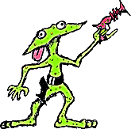
Let’s
Put an end to
sentences!
Language Arts
Notes:
This presentation was downloaded from: The Cyberexchange
http://208.183.128.3/ce/ppt/htm
It was modified by Don Fisher fisher_d@madera.k12.ca.us

Slide 2
What is an end mark?
An end mark is also known as punctuation, and comes at the end of a sentence. It lets you know
when to stop.
What are the different kinds of
end marks?

Slide 3
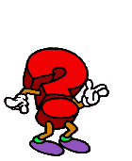

The period comes at the end of statements and commands.
It is raining today.
Do not interrupt me.
A question mark means something is being asked.
Are you going to lunch?
An exclamation mark shows excitement or feeling.
That is a huge dog!

Slide 4
The period is used for more than just an end mark.
It is used in abbreviations:
1290 College Rd.
J. K. Rollings
Ms. White
Dr. Watson

Slide 5
Where are we going
exclamation
mark
question
mark
period

Slide 6

Go Back
oops!
You’ve
been
zapped.
wrong answer

Slide 7
Correct
?
Where are we going
This sentence is a question, so it gets a question mark.

Slide 8
The phone is ringing
exclamation
mark
question
mark
period

Slide 9
Go Back
oops!
You’ve
been
zapped.
wrong answer

Slide 10
Correct
The phone is ringing.
This sentence is a statement, so it gets a period.

Slide 11
That car is going to crash
period
exclamation
mark
question
mark

Slide 12
Go Back
oops!
You’ve
been
zapped.
wrong answer

Slide 13
Correct
!
That car is going to crash
This sentence shows excitement, so it gets an exclamation mark.

Slide 14
That tree is going to
fall on the house
exclamation
mark
question
mark
period

Slide 15
Go Back
oops!
You’ve
been
zapped.
wrong answer

Slide 16
Correct
That tree is going to fall
on the house
!
This sentence is a exclamation, so it gets an exclamation mark.

Slide 17
Put those papers away
exclamation
mark
question
mark
period

Slide 18
Go Back
oops!
wrong answer
You’ve
been
zapped.
wrong answer
wrong answer
wrong answer

Slide 19
Correct
Put those papers away.
This sentence is a command, so it gets a period.

Slide 20

Remember,
An end mark comes at the END of a sentence, and lets you know when to
There are a few more members of the punctuation family…
Click here to meet them.

Slide 21

The colon is made with two periods.
11:35 pm
It is used for time.
It comes before a list.
I will need the following items from the store: bananas, grapes, watermelon, and lemons.

Slide 22
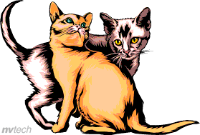
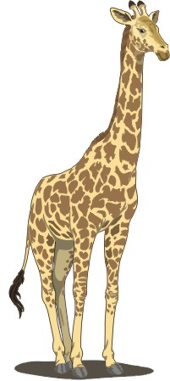
,
The comma
The comma is used to separate a list.
      My favorite animals are giraffes,
      dogs, cats, and birds.
It is also used between the date and the year.
      It was December 24, 2001.

Slide 23

Punctuation Rap
Punctuation rap is a game we play.
It’s fun to do, and we can learn that way.
Take the period, the period; he’s not hard to understand.
You’ll find him at the end of a sentence or command.
He marks abbreviations, shortens words that are long.
Don’t forget the period, he’s small but strong.
Question mark, question mark, what did you say?
He follows a question, that’s the only way.
Wow! Awesome! Rad! Hurray!
The exclamation point is next; he’s got something to say.
He follows something loud, he’s excited to play.
Don’t use him too much, he won’t be special that way.
The comma is next, he is used a lot
He can separate a list of some groceries you bought
You’ll find him in the middle of the year and the date,
Between two adjectives, or a city and state.
You can join two sentences with a “but” or an “and”
Just remember the comma, he will give you a hand.
There is one more place that our comma has been,
He comes after a clause that tells you when.
The dash-the dash-he’s here, then he’s gone.
If you need to make a pause, then you bring him along.
Quotation marks are nosey. They have no reservations
About hanging around in any conversation,
You must put quotes around a thing that is said,
And also a poem or a story you’ve read.
The colon likes to show a list that will come,
His brother, the “semi” will not be outdone.
The semicolon joins two sentences with no, and
If you have too many commas, he can take a stand.

Slide 24
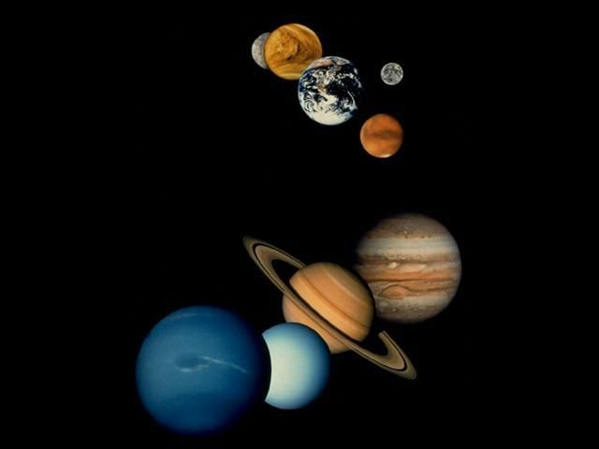


Mission Accomplished!!
We ended those pesky sentences.
You did great, earthlings!!

