Slide 1
© www.bankofbiology.com

Slide 2

Na
K
O
N
S
P
MINERAL NUTRITION
Ca
C
B
Fe
Mg
Mn
H
www.bankofbiology.com

Slide 3
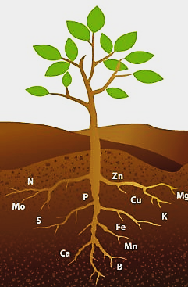

MINERAL NUTRITION
All organisms require macromolecules (carbohydrates, proteins, fats etc.), water & minerals for growth and development.
www.bankofbiology.com

Slide 4
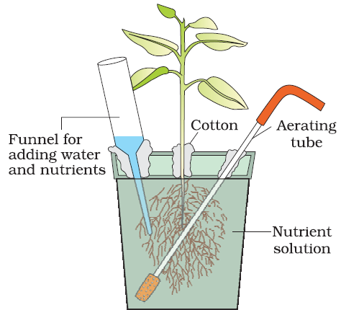
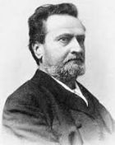

HYDROPONICS
It is the technique of growing plants in a defined nutrient solution (without soil).
It is demonstrated by Julius von Sachs (Germany, 1860).
The nutrient solution is aerated for optimum growth.
Diagram of a typical set-up for nutrient solution culture
Julius von Sachs
www.bankofbiology.com

Slide 5
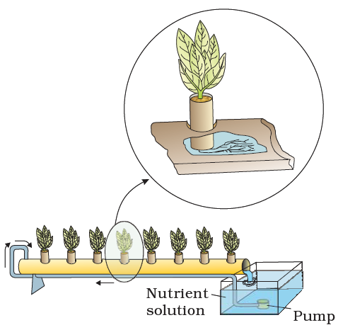
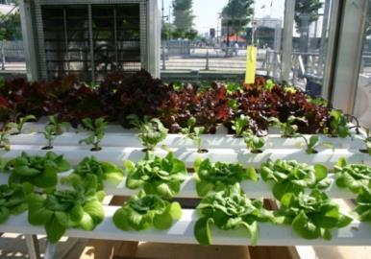

HYDROPONICS
Hydroponics was used to identify essential elements required for plants and their deficiency symptoms.
In this, plant roots were immersed in nutrient solutions and an element was added / removed or given in varied concentration.
Hydroponics is used for commercial production of vegetables (tomato, seedless cucumber, lettuce etc).
Hydroponic plant production
www.bankofbiology.com

Slide 6

ESSENTIAL MINERAL ELEMENTS
www.bankofbiology.com

Slide 7
ESSENTIAL MINERAL ELEMENTS
More than 60 elements are found in different plants.
Some plant species accumulate selenium, gold etc.
Some plants growing near nuclear test sites take up radioactive strontium.
There are techniques to detect minerals even at a very low concentration (10⁻⁸ g/mL).
www.bankofbiology.com

Slide 8
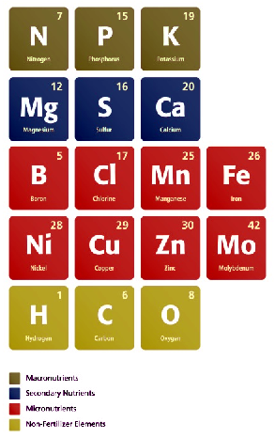

ESSENTIAL MINERAL ELEMENTS
An element must be needed for normal growth and reproduction. In the absence of the element, the plants do not complete their life cycle or set seeds.
The requirement of an element must be specific. i.e., deficiency of an element cannot be met by another element.
It must be directly involved in the plant metabolism.
Criteria for Essentiality of an element
Only 17 elements are absolutely essential for plant growth & metabolism.
www.bankofbiology.com

Slide 9
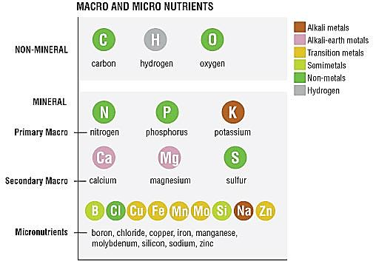

ESSENTIAL MINERAL ELEMENTS
Based on quantitative requirements, essential elements are 2 types:
Macronutrients
Micronutrients
www.bankofbiology.com

Slide 10

ESSENTIAL MINERAL ELEMENTS
MACRONUTRIENTS
Carbon
Potassium
Magnesium
Calcium
Hydrogen
Oxygen
Sulphur
Nitrogen
Phosphorous
They are present in plant tissues in large amounts (more than 10 mmole Kg^{–1} of dry matter).
They include carbon, hydrogen, oxygen, nitrogen, phosphorous, sulphur, potassium, calcium & magnesium.
Carbon, hydrogen & oxygen are mainly obtained from CO₂ & H₂O. Others are absorbed from the soil as mineral nutrition.
I. MACRONUTRIENTS
www.bankofbiology.com

Slide 11

ESSENTIAL MINERAL ELEMENTS
MICRONUTRIENTS
Iron
Chlorine
Nickel
Manganese
Copper
Boron
Molybdenum
Zinc
They are needed in very small amounts (less than 10 mmole Kg^{–1} of dry matter).
They include iron, manganese, copper, molybdenum, zinc, boron, chlorine & nickel.
II. MICRONUTRIENTS (TRACE ELEMENTS)
For higher plants, there are some other elements required such as sodium, silicon, cobalt & selenium.
www.bankofbiology.com

Slide 12
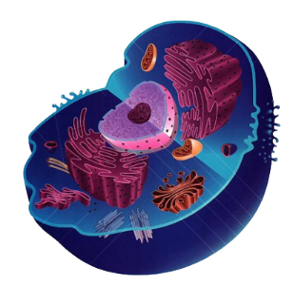
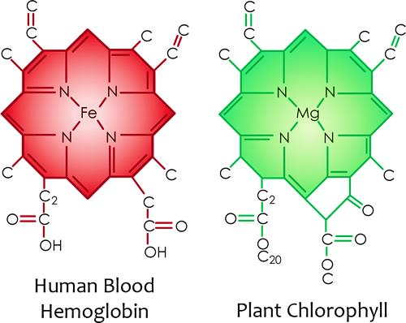
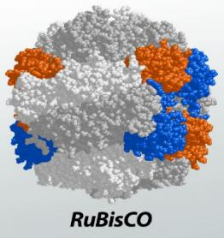
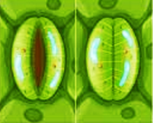
ESSENTIAL MINERAL ELEMENTS
Based on functions, essential elements are 4 categories:
  Components of biomolecules and structural elements of cells. E.g. C, H, O & N.
  Components of energy-related chemical compounds. E.g. Mg in chlorophyll and phosphorous in ATP.
  Elements that activate or inhibit enzymes.
  E.g. Mg²⁺ is an activator for RUBISCO & phosphoenol pyruvate carboxylase. They are critical enzymes in photosynthetic carbon fixation.
  Zn²⁺ is an activator of alcohol dehydrogenase and Mo of nitrogenase during nitrogen metabolism.
  Elements that alter the osmotic potential of a cell.
  E.g. Potassium helps in opening & closing of stomata.
www.bankofbiology.com

Slide 13
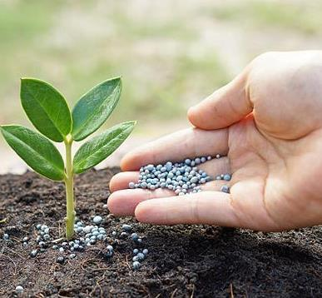
ESSENTIAL MINERAL ELEMENTS
Essential elements have role in metabolic processes such as
Permeability of cell membrane.
Maintenance of osmotic concentration of cell sap.
Electron transport systems.
Buffering action.
Enzymatic activity.
Constituents of macromolecules & co-enzymes.
Role of Macro- and Micro-nutrients
www.bankofbiology.com

Slide 14
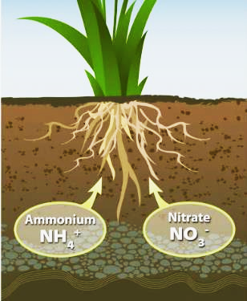
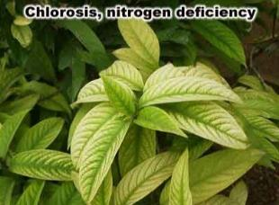
ESSENTIAL MINERAL ELEMENTS
This is required by plants in the greatest amount.
It is absorbed mainly as NO₃–. Some are also taken up as NO₂– or NH₄⁺.
Functions:
It is essential for all plant parts,
mainly meristematic tissues
and metabolically active cells.
It is the major constituents of
amino acids, proteins, nucleic
acids, chlorophyll, vitamins and hormones.
1. NITROGEN
www.bankofbiology.com

Slide 15
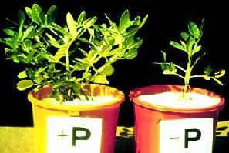
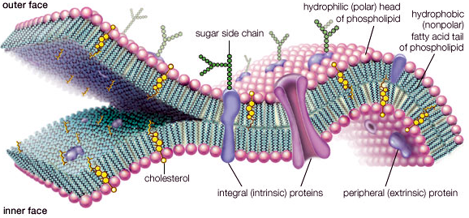
ESSENTIAL MINERAL ELEMENTS
It is absorbed by plants from soil as phosphate ions (as H₂PO₄⁻ or HPO₄²⁻).
Functions:
It is a constituent of cell membranes, certain proteins, all nucleic acids and nucleotides.
It is required for all phosphorylation reactions.
2. PHOSPHORUS
www.bankofbiology.com

Slide 16
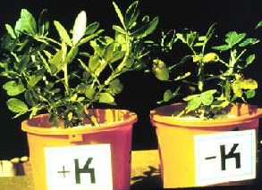
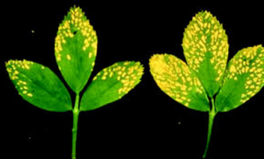
ESSENTIAL MINERAL ELEMENTS
It is absorbed as potassium ion (K⁺).
It is highly required in meristem, buds, leaves and root tips.
Functions:
It maintains an anion-cation balance in cells.
It is involved in protein synthesis, opening and closing of stomata, activation of enzymes and in the maintenance of the turgidity of cells.
3. POTASSIUM
www.bankofbiology.com

Slide 17

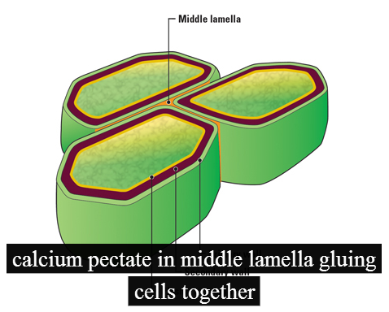
ESSENTIAL MINERAL ELEMENTS
It is absorbed from the soil as calcium ions (Ca²⁺).
It is required by meristematic & differentiating tissues.
It accumulates in older leaves.
Functions:
During cell division, it is used in the synthesis of cell wall, particularly as calcium pectate in middle lamella. It is also needed during the formation of mitotic spindle.
For normal functioning of the cell membranes.
It activates certain enzymes and plays an important role in regulating metabolic activities.
4. CALCIUM
www.bankofbiology.com

Slide 18

Need Full Version...?
WhatsApp: 89215 10476

