Slide 1
How to Build a Resume
Alex Xu, Jade Bisht, Katie Luangkote, and Martin Kong

Slide 2
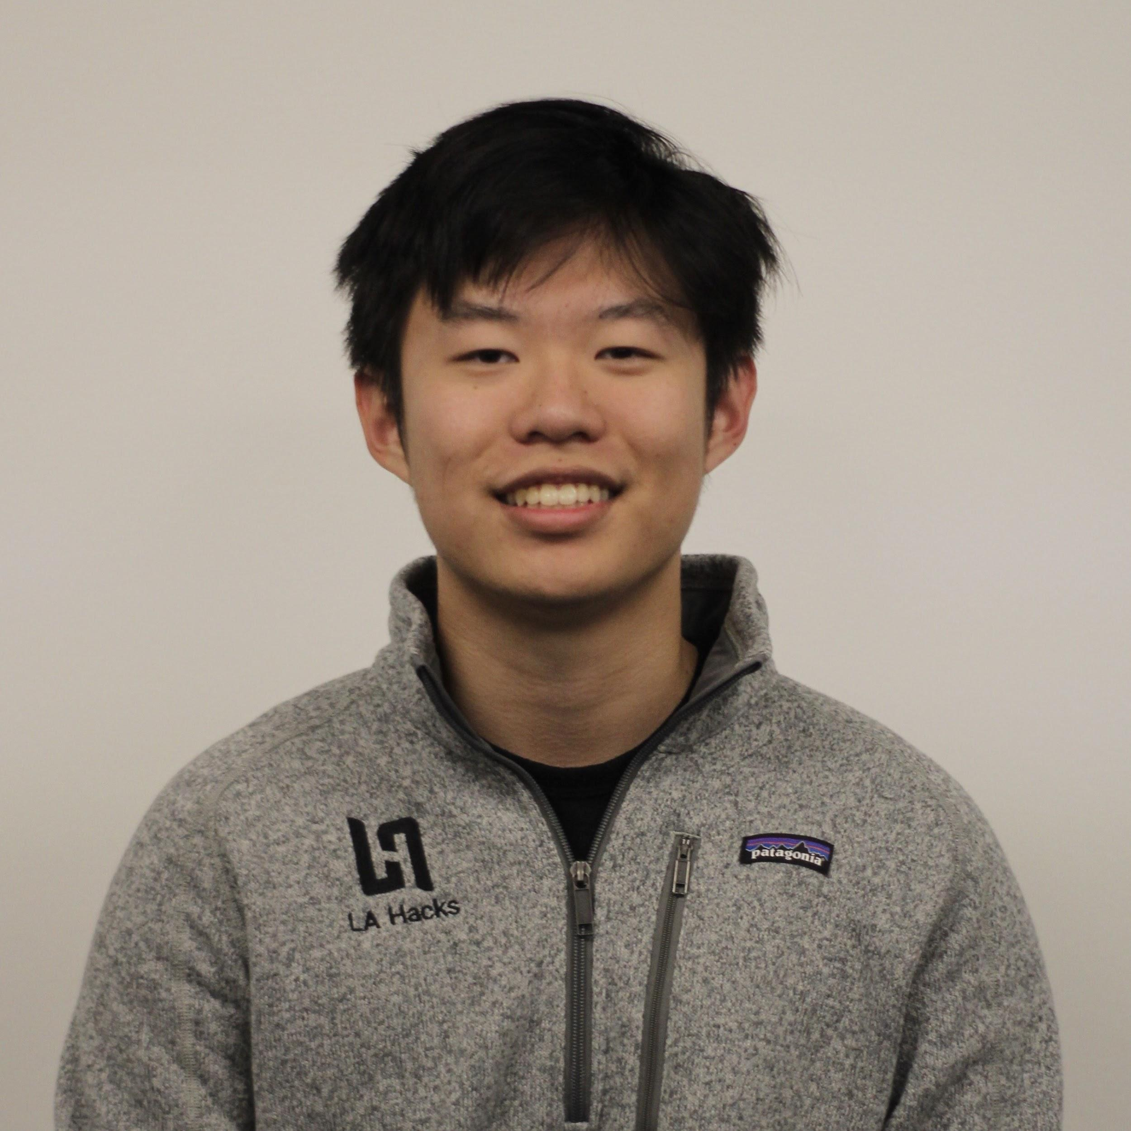



Who are we?
Alex Xu
Executive Director
Jade Bisht
Hacker Operations Director
Katie Luangkote
Hacker Operations Director
Martin Kong
Sponsorships Director

Slide 3
Overview - keeping it real
Why are resumes important
Common tips
Special tips
Life tips
Some examples
Q&A

Slide 4
Why are we doing this workshop?
Resumes are the first step to getting an internship/full-time at your dream company — they’re the first thing that recruiters see
We have applied to lots of (too many) jobs over our careers
We have read lots of (too many) resumes
There are common mistakes everyone makes!
We are here to help each other out. :)

Slide 5
Some common tips
ALWAYS KEEP YOUR RESUME TO 1 PAGE 🙏 (unless you have a PhD)
Focus on quality not quantity
Rule of thumb: Keep your GPA on your resume if its >= 3.0
Don’t lie
If you are ever caught with a lie on the resume then game over
Keep all information updated
By sophomore year of college, your high school achievements should no longer appear on your resume

Slide 6
Some special tips 😯
Use tech jargon responsibly
Make sure the skills come through descriptions of your past experience
Add elements that make your resume pop 🎉🎉🎉
Examples include - designed logo, some color (use in moderation)
Avoid clutter
By keeping it minimal, a quick skim of the resume becomes easy
List proficiency in technologies/languages

Slide 7
Some more special tips 🤫
If no tech work experience then projects else work experience followed by projects
Avoid objective statements - redundant, space-consuming
Focus mainly on tech, but also put in other soft skills
Use specific and definable metrics

Slide 8
The Black Hole of Online Applications
Show that you care! People like to feel special
Cover Letters are frustrating, but necessary!
Every company uses application scrapers
What is an application scraper?
Format with clear fonts with differentiated sizes and spacing
The simpler the more likely the scraper will pick it up
Tailor your resume like you would a cover letter
Have a couple options, really read the requirements

Slide 9
Career Fairs and Networking
Practice your pitch
Quick and concise, but also tailored
Friendly and interested go a long way in being memorable
This is where the general resume comes in handy
Show off your skills across the spectrum rather than just one or two
Do research
LinkedIn is your friend!

Slide 10
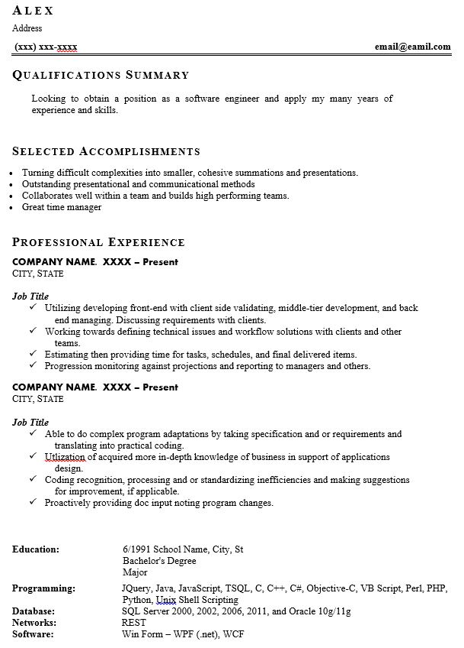
Not a good resume
Redundant summary section
Work experience doesn’t show any real skills
No skills listed
Spelling errors
Poor design and layout

Slide 11
Questions???

