Slide 1
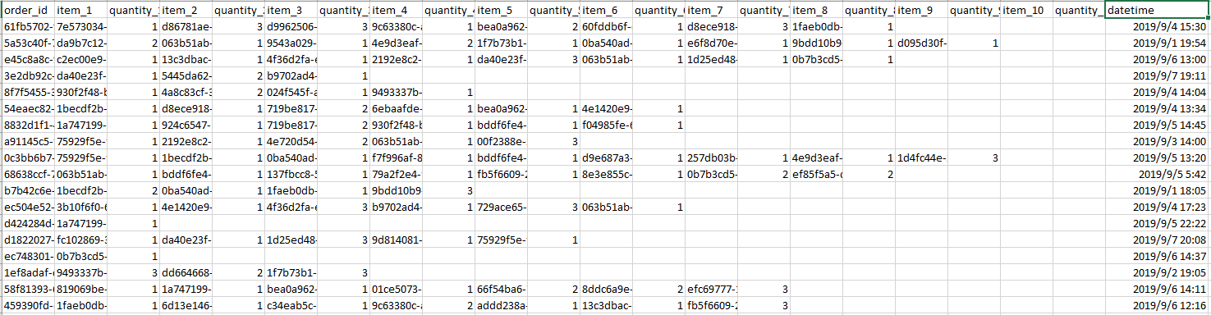
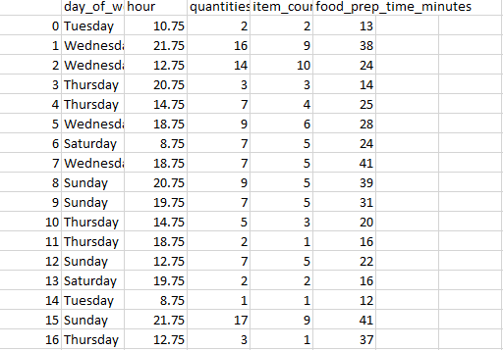
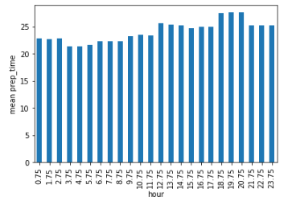
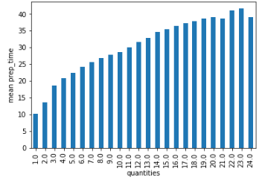
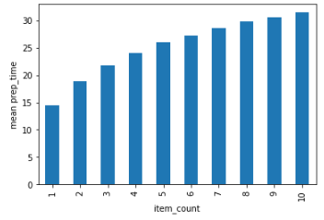
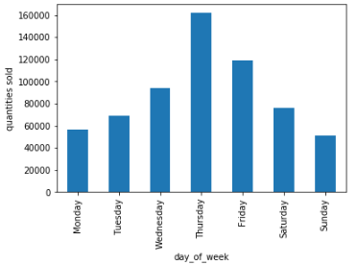
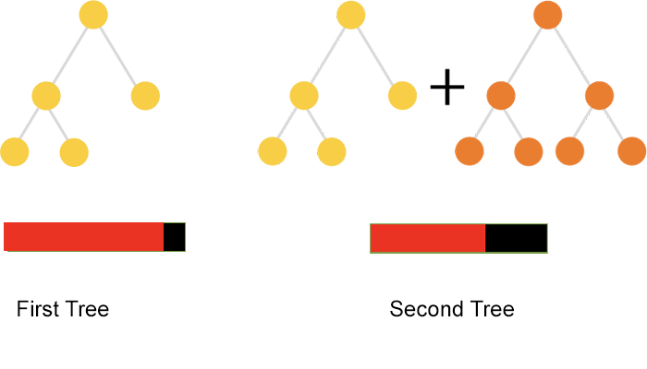

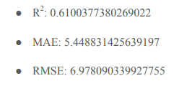
Skip the dishes food preparation time challenge
Luo Jiehao, Qu Shijun, Wei Yidong
Department of Computer Science, University of Manitoba
Raw data in a view
Data transformation and cleaning
Data visualization
Selected Model: catBoost
CatBoost is a state-of-the-art open-source gradient boosting on decision trees library.
Developed by Yandex researchers and engineers, it is the successor of the MatrixNet algorithm that is widely used within the company for ranking tasks, forecasting and making recommendations. It is universal and can be applied across a wide range of areas and to a variety of problems.
Image from https://avatars.mds.yandex.net/get-yablogs/47421/file_1548410151831/orig
10-fold cross validation
our model
Skip the dishes; base line
Acknowledgements

