Slide 1
WinGet
the Windows Package Manager
Demitrius Nelon

Slide 2

Many thanks to our sponsors:

Slide 3

Demitrius Nelon
I'm a product manager at Microsoft working on the Windows Package Manager. I've worked at a few other companies you might have heard of like Amazon, Verizon and VMWare, and a few you might not have heard of like FlashNet and Unbound Technologies. I love building products and digging into useless trivia.

Slide 4
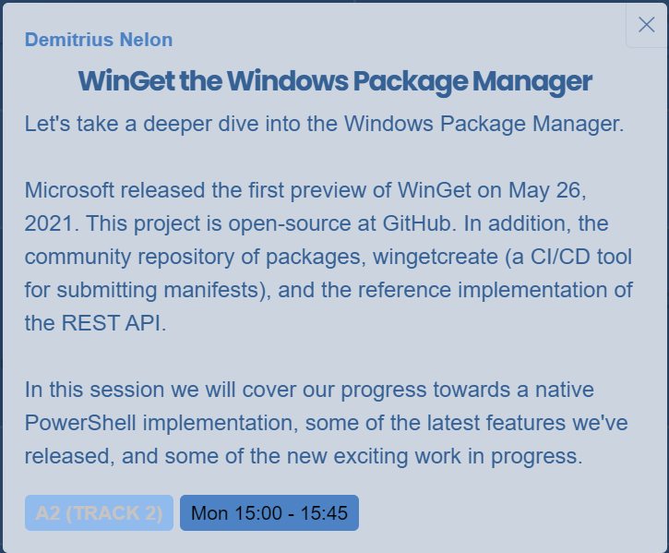
Imposter Syndrome

Slide 5
PowerShell
Why didn't we start with PowerShell?
Where are we now?
Where are we going?

Slide 6
Choose your own adventure
WinGet Client
WinGet Community Repository
Validation
Wingetcreate vs. YAML Create
PowerShell modules
WinGet configuration

Slide 7
Demos
We love Demos!

Slide 8
Resources
https://aka.ms/getwinget - https://aka.ms/getwingetpreview
Microsoft Learn - windows/package-manager/winget/
GitHub
microsoft/winget-cli
microsoft/winget-pkgs
microsoft/winget-create
microsoft/winget-cli-restsource
PowerShell Gallery
Microsoft.WinGet.Client
Microsoft.WinGet.DSC
Microsoft.WinGet.Create
Microsoft.WinGet.Source

Slide 9
Q&A
15 minutes

