Slide 1
What’s new with PowerShell Repositories
Sydney Smith

Slide 2

Many thanks to our sponsors:

Slide 3
Outline
PowerShellGet, PSResourceGet– what it all means, what the plan is to ship/get to GA
Depth of changes, why these changes needed to be made
How deeply we care
Getting off the nuget apis (local and remote)
Why we did this, education on scale needs
Why this took so long ect.
Maybe get into some technical details here
Local and PSGallery
Support for v3 feeds, get into some technical here challenges faced with nuget and demo if possible with beta 22, if not pin to 19 and demo
ADO feeds public and private
GH packages
Artifactory
Nuget gallery
Credential persistence– show this
PowerShell Gallery-– plans/work– high level ideas going forward, focus here is reliability and compliance
Question time

Slide 4
Defining terms
PowerShellGet v2/v1
PowerShellGet 3 == CompatPowerShellGet
Microsoft.PowerShell.PSResourceGet

Slide 5
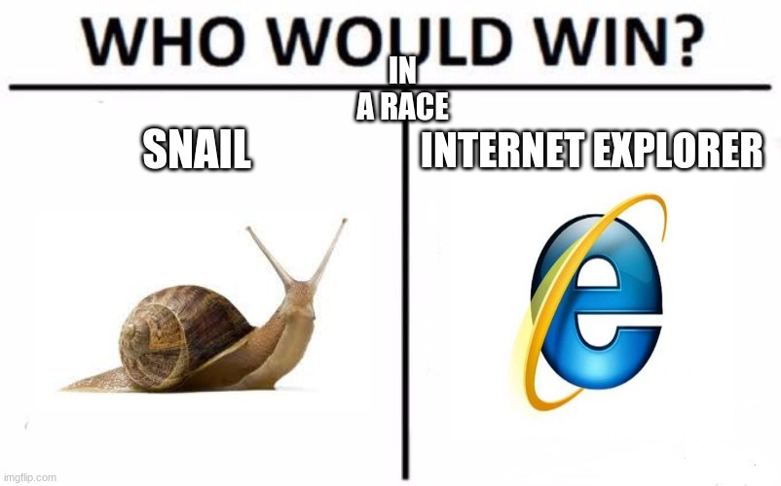

Slide 6
Path to GA
Shipping in PowerShell 7.4 previews
Shipping in PowerShell 7.4 (LTS)
Shipping in PowerShell 7.5
Notes:
Speak to the depth of changes

Slide 7


Slide 8
Getting off the nuget apis
Performance improvements
allow us to add streaming and parallelization in the future
allow us to add telemetry for calls made to PSGallery
cleaner code and easier to maintain PowerShell specific bug fixes/scenario support
Notes:
(since we control what the APIs do instead of having 1-2 APIs that attempt to do it all and then require us to do a lot of additional client-side filtering)

Slide 9
Challenges supporting v3 feeds
Tough feature decisions
Variation in response format
Some V3 responses also differ in metadata returned for Find
Dependency support
Being able to stand up tests for certain repositories so we can know if our support breaks.
Notes:
For certain repositories we had to choose not to support certain functionality that would return a very large result set or be very expensive cost wise.
For V3 server repositories, there was a bit of variation in the response format, so we had to account for and test against the wider set of repository types our users use to support V3 more generally.
i.e wildcard search for repositories that allow having upstream repositories (like ADO) will do a multi-repository search and may not return the desired package, unless the user is very specific, and result in an expensive search that we would need to keep paging through.
In the same vein, FindAll() is less reasonable for repositories like this as it would be very expensive and a very large set of results
This was the reason we broke GitHub Packages, JFrog and ADO in our last preview but have fixed it now
(i.e ADO does not return CompanyName property, but NuGet.org and GitHub Packages do)
We have not implemented support for V3 dependencies yet, so when you install a package you only get the parent package or if you search for it the Dependencies property returned is empty. This is because their dependency information in the response is tied to frameworks and we don't have that structure to account for or recommend dependencies based on the user's current framework yet.

Slide 10


Slide 11
Support for v3 feeds
ADO feeds (public and private)
NuGet gallery
Artifactory
GitHub packages
MyGet

Slide 12
Credential persistence
Specify credentials at Registration for find/install
Integration with SecretManagement

Slide 13
PowerShell Gallery
Focus is on security, availability, and reliability
Being an Azure service means we do (necessary) behind the scenes compliance work
Short term plans include bug fixes
Medium term plans include focusing on repository/package/author trust

Slide 14
We are going to have a public bug bash in July
Follow me on twitter for more information

Slide 15
How to track the project
https://github.com/powershell/psresourceget
https://devblogs.microsoft.com/powershell/

Slide 16
Q&A
15 minutes

Slide 17
Support Matrix
Server | Server Protocol Type | FindAll() | FindTag() | FindCommandOr DSCResource() | FindName() | FindName WithTag() | FindVersion() | FindVersion WithTag() | FindName Globbing() | FindName GlobbingWithTag() | FindVersion Globbing()
PowerShell Gallery | V2 server protocol | Yes | Yes | Yes | Yes | Yes | Yes | Yes | Yes | Yes | Yes
NuGet | V3 server protocol | No | Yes | No | Yes | Yes | Yes | Yes | Yes | Yes | Yes
Azure Devops | V3 server protocol | No | No (server side not consistent & v expensive as looks upstream) | No | Yes | Yes | Yes | Yes | No (expensive and not consistent if user is not specific) | No (expensive and not consistent if user is not specific) | Yes
GitHub Packages | V3 server protocol | No | No (server side broken) | No | Yes | Yes | Yes | Yes | Yes | Yes | Yes
Jfrog Artifactory | V3 server protocol | No | Yes | No | Yes | Yes | Yes | Yes | Yes | Yes | Yes
Local file share | File share | Yes | Yes | Yes | Yes | Yes | Yes | Yes | Yes | Yes | Yes

Slide 18
Breaking Changes
proxy support not supported yet at cmdlet level
New-ScriptFileInfo and Update-ScriptFileInfo had -PassThru, in v3 there's no passthru, but we write file contents to the console + possible solution is to do 'New-PSScriptFileInfo', then use 'Get-PSScriptFileInfo'
whatif and confirm not supported for update-psscriptfileinfo right now
Filter no longer exists for Find cmdlets
Remove 'SkipPublisherCheck' in v3 we now have 'AuthenticodeCheck'
For now v3 will always clobber
No more 'NoPathUpdate' parameter for Install-Script
Repository (register, set) no longer take 'Credential' because it no longer pings the uri
Register, set no longer accepts the following params: PublishLocation ScriptSourceLocation ScriptPublishLocation PackageManagementProvider
Wherever parameters are no longer accepted, the compat module will still bind them and then just delete them
Save will now by default accept license

