Slide 1
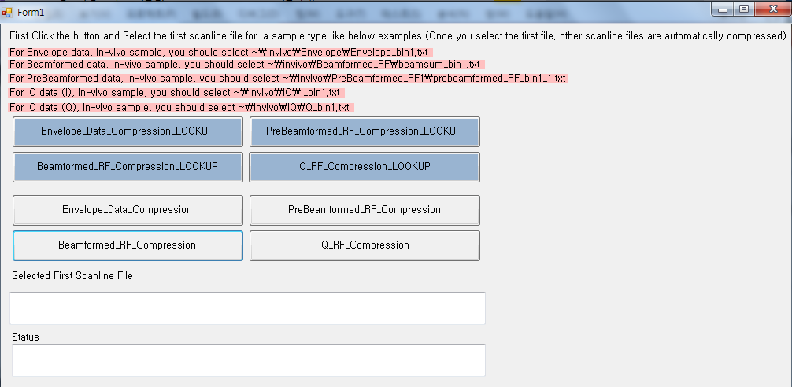
Install the Visual Studio 2017 Community (VS 2017)
Open UltraSound_Image_Compress.sln file with VS 2017
Run “Form1.cs”
You can see below form

Slide 2
If you want to compress “Envelope” data for a certain sample ultrasound with LUT method, click this
Or, If you want to compress Prebeamformed, IQ, Beamformed data for a certain sample ultrasound click another button.
Or, If you want to compress “Envelope” data for a certain sample ultrasound with Formula method(mathmatical method) , click this

Slide 3
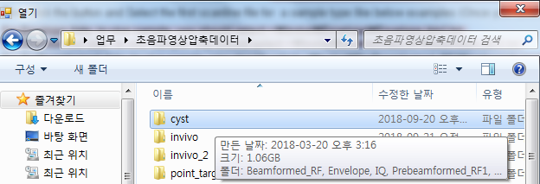
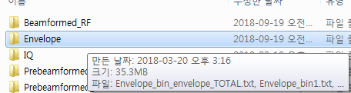
Then you can see this dialog box to select scanline data file
From dialog box, you select cyst folder and then select Envelope folder

Slide 4
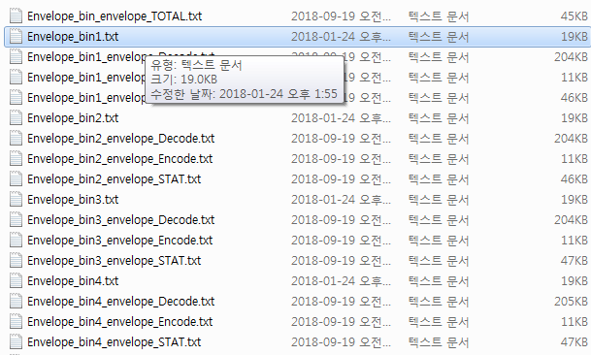
At first, You HAVE TO select Envelope_bin1.txt
Once you select this file, Other scanline (2~128) files are automatically handled by our demo program
If you do not select Envelope_bin1.txt then program issues error
.._TOTAL.txt, _Decode.txt, _Encode.txt, _STAT.txt files are temporarily produced files by program

Slide 5
After select file, then program start compressing ultrasound data
Then automatically _TOTAL, _Decode, _Encode, _STAT.txt files for each scanline files

Slide 6
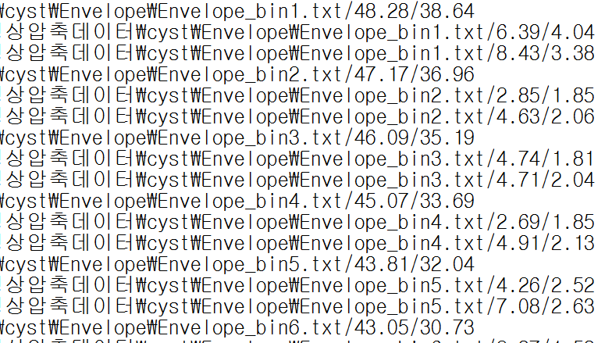
Compression ratio(%) for scanline 1
BL code / Exp-Golomb
Here is result files
…_TOTAL.txt : shows
Encoding time (ticks) for scanline 1
BL code / Exp-Golomb
Decoding time (ticks) for scanline 1
BL code / Exp-Golomb

Slide 7
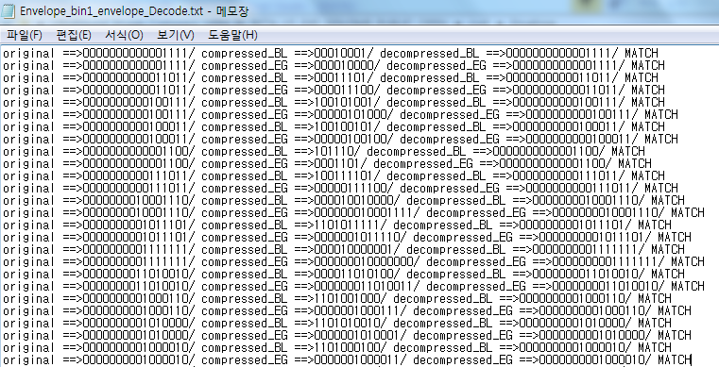
Here is result files
…_Decode.txt : shows original batches’ encoding, decoding test result for BL code and Exp-Golomb code

Slide 8
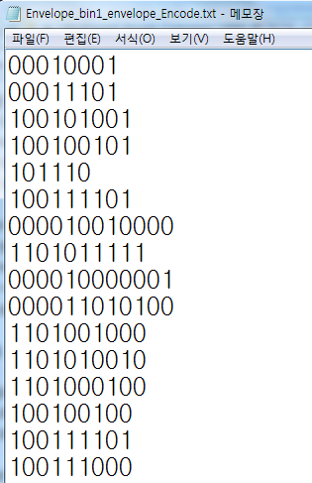
…_Encode.txt : shows BL code encoding result for each batch

Slide 9
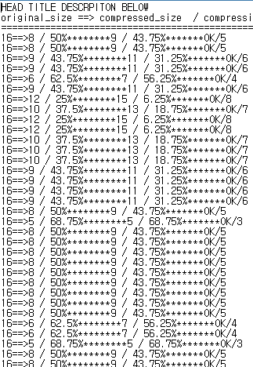
…_STAT.txt : shows Compression ratio percentage for BL code and Exp-Golomb code on every batch

Slide 10
Like explained above,
# Each button for data set type and algorithm implementation(LUT or Formular)
# Samples are selected by Folder’s name
(Cyst, Point-Target, Invio, Invivo-2, but in this github we only upload Cyst and Point-Target for personal healthcare record protection
LUT : look up table implementation
Implementation by formula

Slide 11
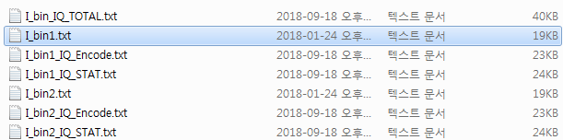
On thing are cautious – IQ data,
Our program uses same logic for I and Q data
So, for testing I data, you click IQ_RF_Compression_LOOKUP or IQ_RF_compression
Then you must
select “I_bin1.txt” not “Q_bin1.txt in IQ folder”

Slide 12
On the other hand, if you want to test Q data,
Then you must
select “Q_bin1.txt” not “I_bin1.txt at IQ folder”

Slide 13
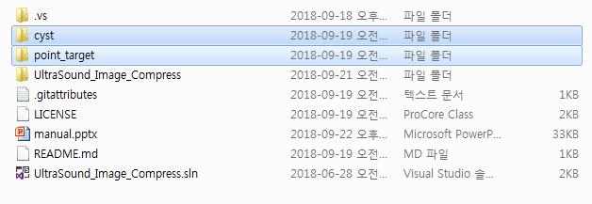
# APPENDIX : data folder information
UltraSound data (cyst, point target) folder

