Slide 1

Passtore

Slide 2
Problem And Motivation
There should be an easy way for users to centrally store and maintain passwords that are accessible across multiple platforms.
Too many password storing companies are being hacked and are having their customers’ data leaked
Secure sharing of passwords amongst users

Slide 3
Overview
Create a password management tool called Passtore
Web based user account creation
Encrypted password maintenance
Web based password retrieval
Mobile based password retrieval / reset
Command line password retrieval / reset
Download offline copy

Slide 4
Scope (Functional Requirements)
The user shall be able to maintain his / her account. This includes creating, updating, and deleting their account.
The user shall be able to log in and log out of his / her account.
The user shall be able to share and unshare his / her password with another user.
The user shall be able to retrieve and update his / her password through a command line interface.
The user shall be able to retrieve and update his / her password through a mobile interface.
The user shall be able to create, update, and delete his / her password through a web interface.
The user shall be able to download an offline copy of his / her password store that is viewable using a spreadsheet software.

Slide 5
Scope (Non-functional Requirements)
Product Requirements
Web interface is compatible with Internet Explorer 9, Firefox 36, Google Chrome 40 browsers.
Mobile interface is compatible with Android SDK 22.
There should be no more than 4 clicks to retrieve a password in a web or mobile interface.
Command line interface should be compatible with Windows 7 and Mac OSX 10.6.8.
The password return time should be no longer than 5 seconds.
Security Requirements
The security audit logs will be rotated every 24 hours.
All data stored should follow the Advanced Encryption Standard with key size 256.

Slide 6
Scope (Non-functional Requirements)
External Requirements
The system should not share the wrong password with any shared user.
A password that has been unshared from a user should no longer be accessible by that user.
Organizational Requirements
All source code should follow coding standards relative to the programing language.
The system should only be built upon licensed software.

Slide 7
Solution
Actors
User – Any person who signs up to use the application
Sharing user – A specialized user
Shared user – A specialized user

Slide 8
Use Cases
UC 1 User manages account
UC 2 User logs into account
UC 3 User logs out of account
UC 4 User shares password with another user
UC 5 User unshares password with another user
UC 6 User retrieves password through the command line
UC 7 User resets password through the command line
UC 8 User retrieves password through the mobile interface
UC 9 User resets password through the mobile interface
UC 10 User maintains password through the web interface
UC 11 System executes password maintenance
UC 12 User downloads an offline copy of the Passtore
UC 13 User accesses the offline copy of the Passtore

Slide 9
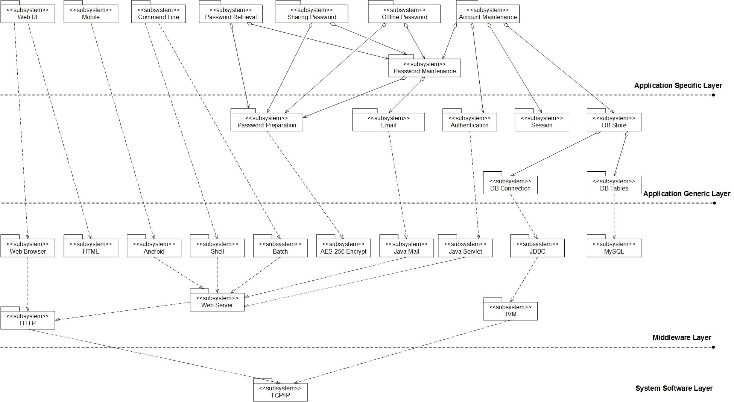
Architecture

Slide 10
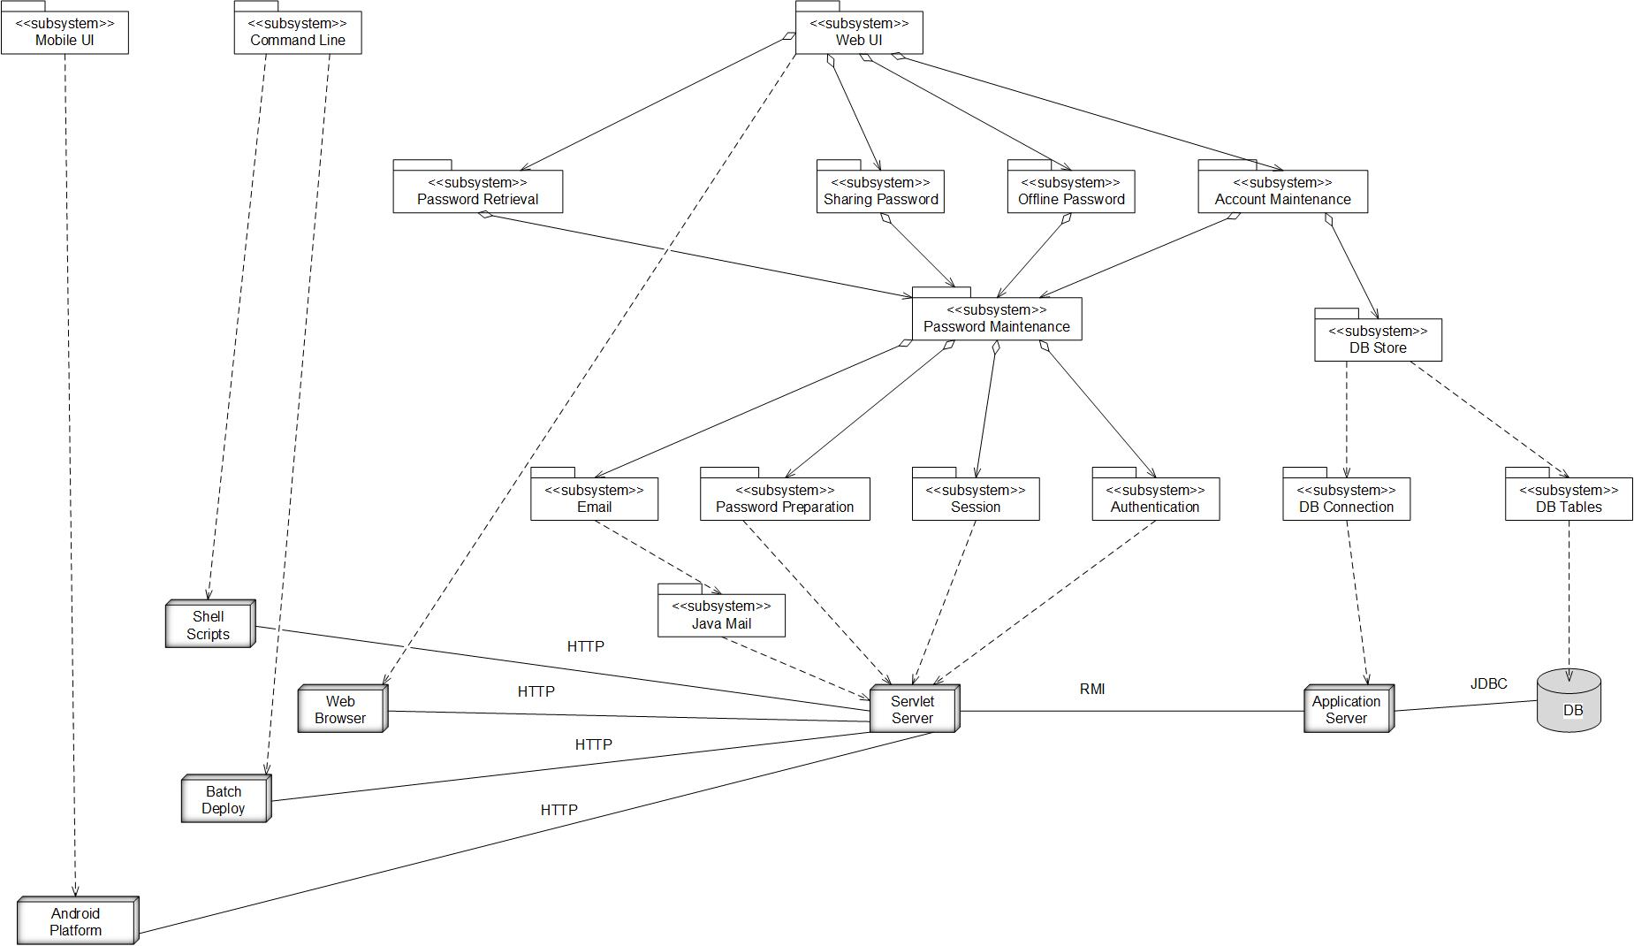
Deployment

Slide 11
Design Issues and Decisions
Issues
We cannot use unlicensed software to develop or host the software.
Command line implementation should be as compatible across platform as possible.
The retrieval and maintenance operations should be consistent across platforms.
Decisions
The programming language is Java
The database will run on MySQL (Version 5.7.8)
The web interface will be developed using JSP and hosted on Tomcat 7
The centralized web services will be hosted on Tomcat 7
The command line will be developed using bash shell and batch script
The mobile interface will be developed using Android SDK 22

Slide 12
Status, Problems Faced, Lessons Learned, Future Work
Currently 85% of the design is completed
Problems
Time and knowledge constraints
Time allocation
Variety of “hats”
Lessons Learned
Planning and designing is equally as important as implementation.
Attainable scope should be very clearly defined before any design phase.
Future Work
Organizational administrative interface for password maintenance
Improved secure hosting environment and data transmission
Broader Android operating system support

Slide 13
Questions
Notes:
What goes here?

