Slide 1
sEMG Signal Data

Slide 2
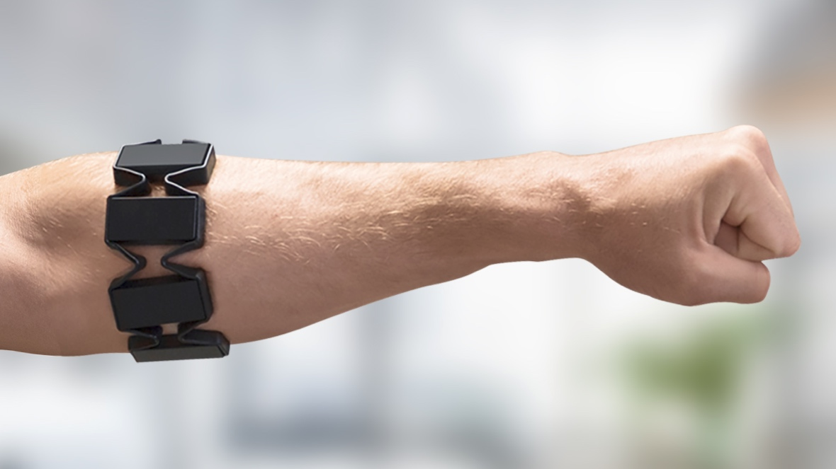
The MYO bracelet
8 channels

Slide 3
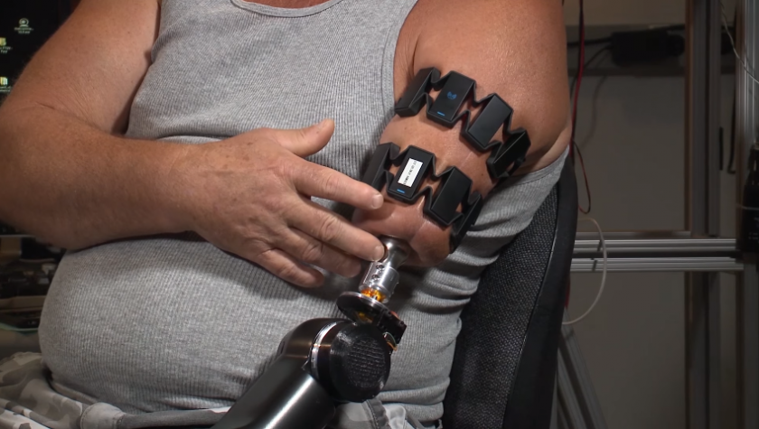
Each channel provides signal data, oscillating positive and negative values

Slide 4
36 participants
2 sessions each
Each gesture twice in a session for ~3s

Slide 5
6 Gestures
1: 'hand at rest',
2: 'hand clenched in a fist',
3: 'wrist flexion',
4: 'wrist extension',
5: 'radial deviations',
6: 'ulnar deviations'

Slide 6
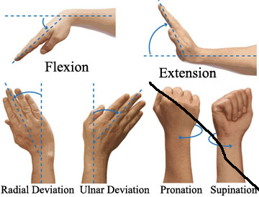

Slide 7
Looking at raw data

Slide 8
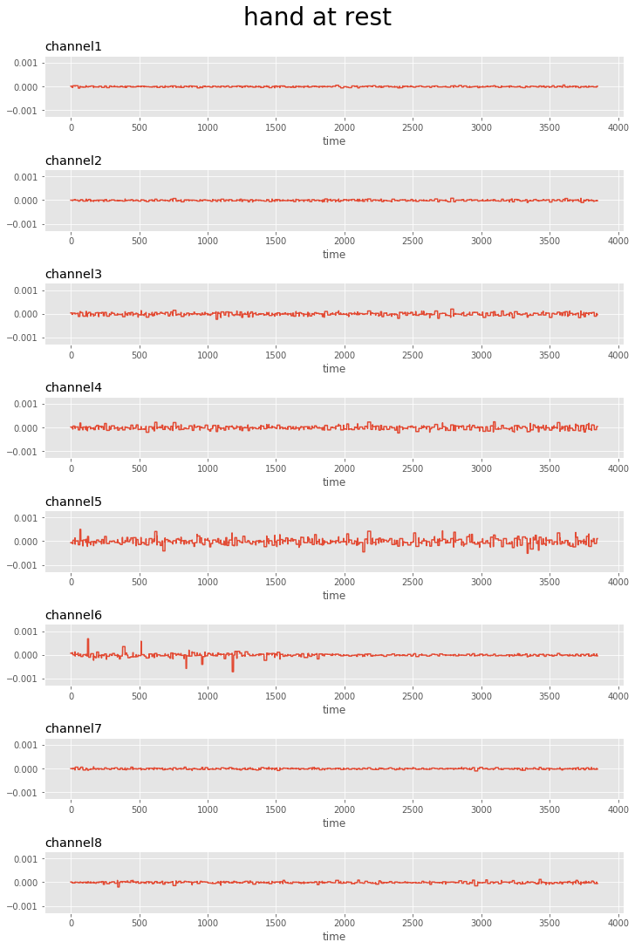
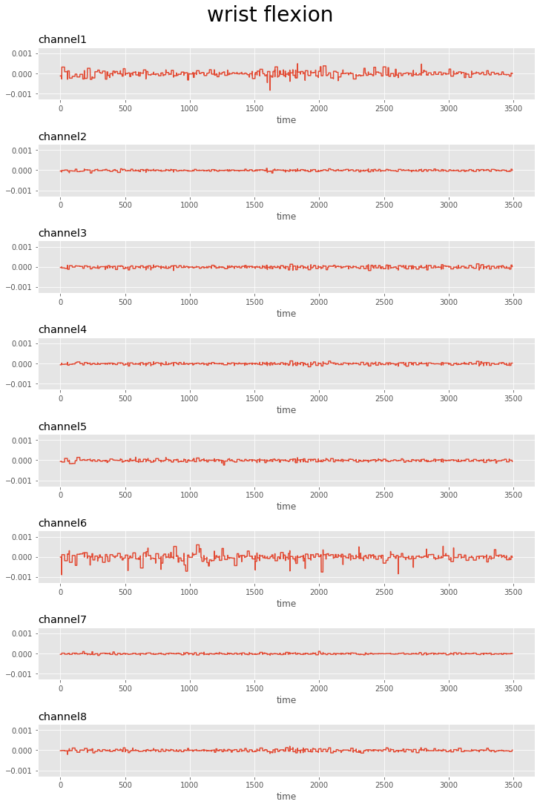
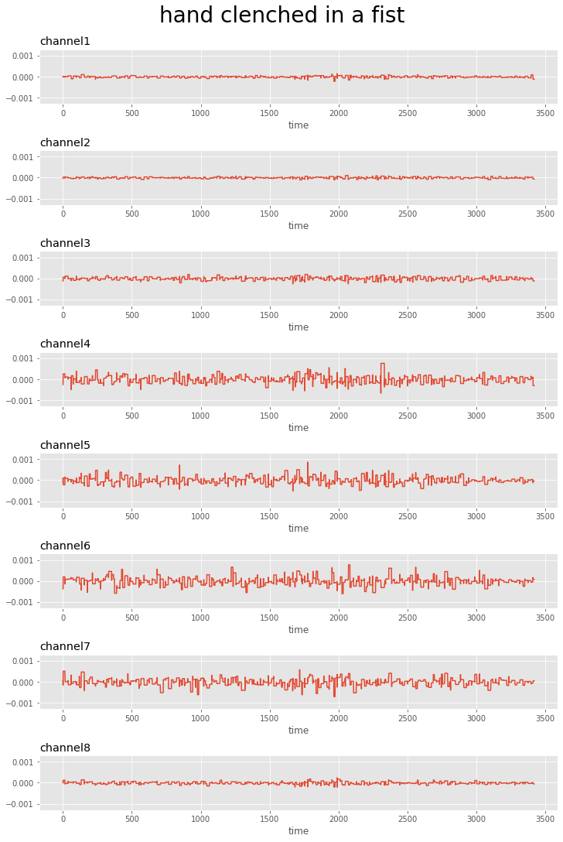

Slide 9
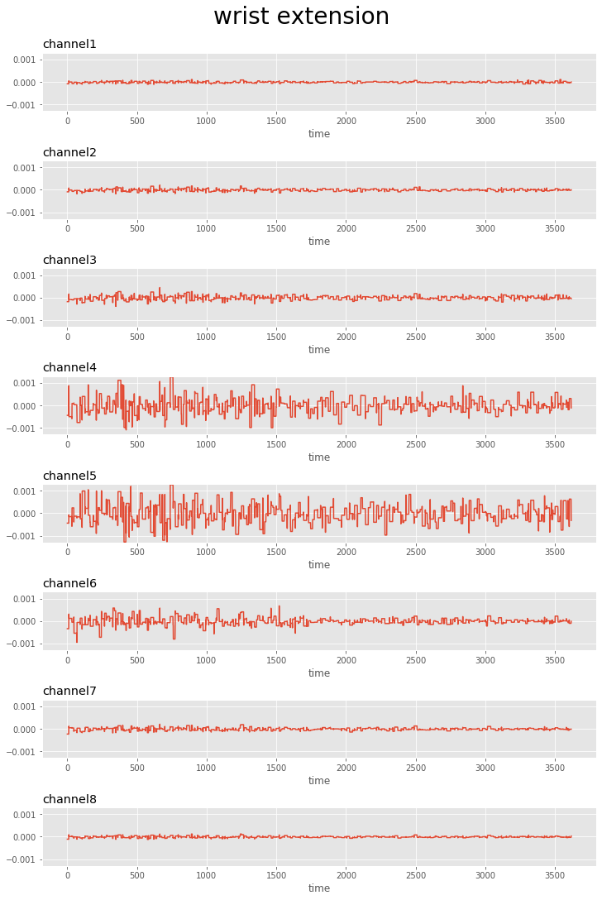
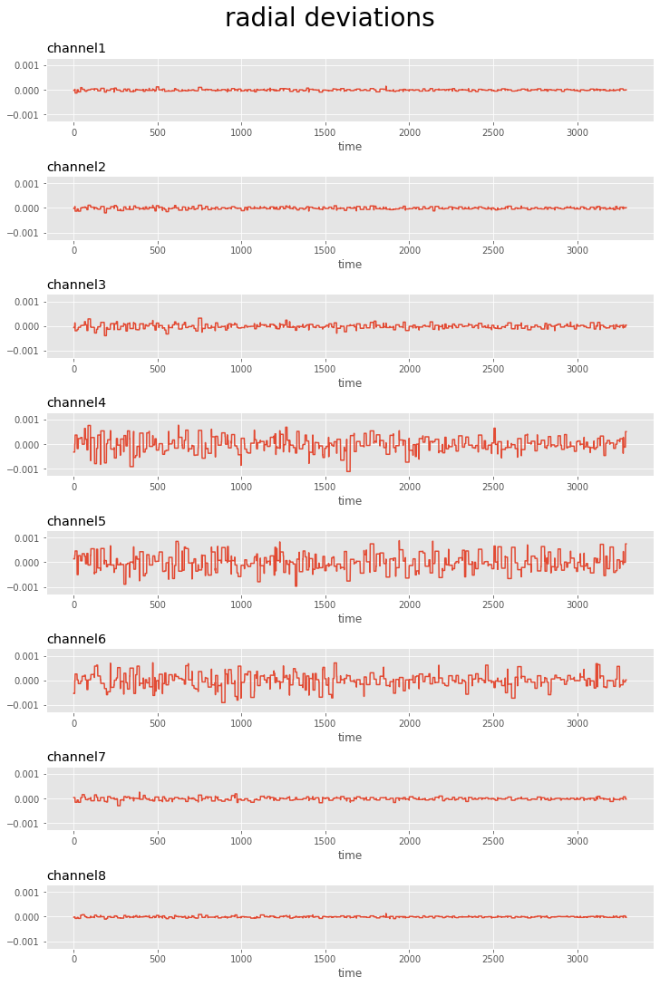
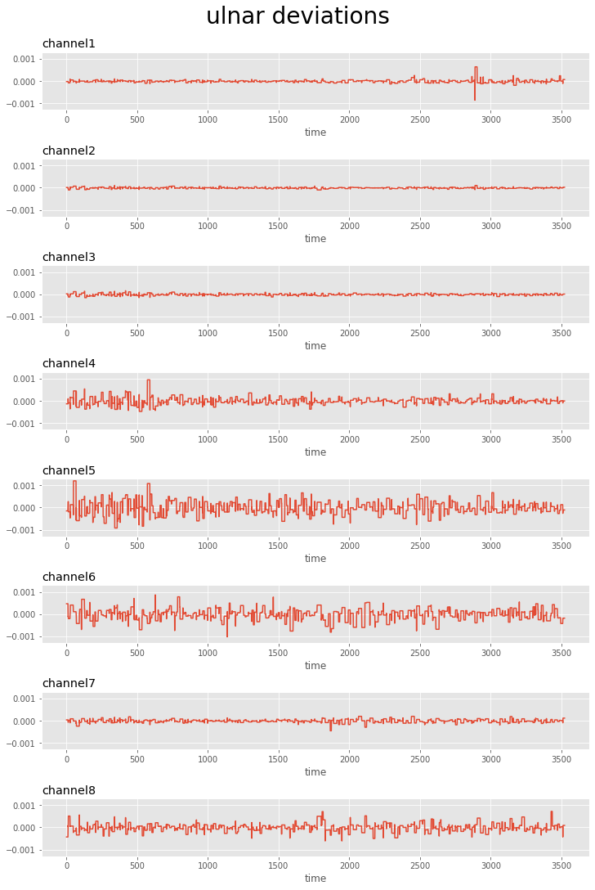

Slide 10
Comparing Gestures

Slide 11
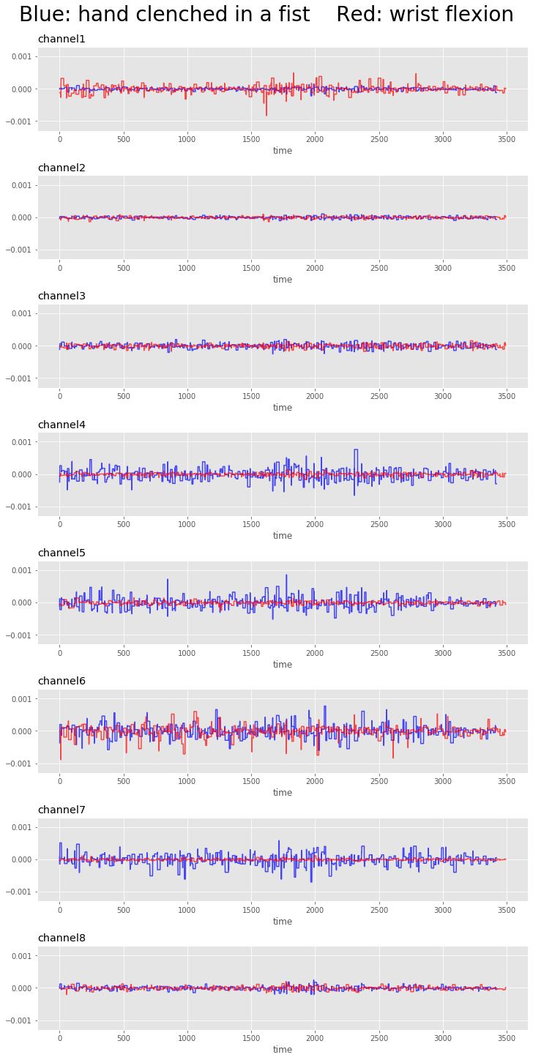
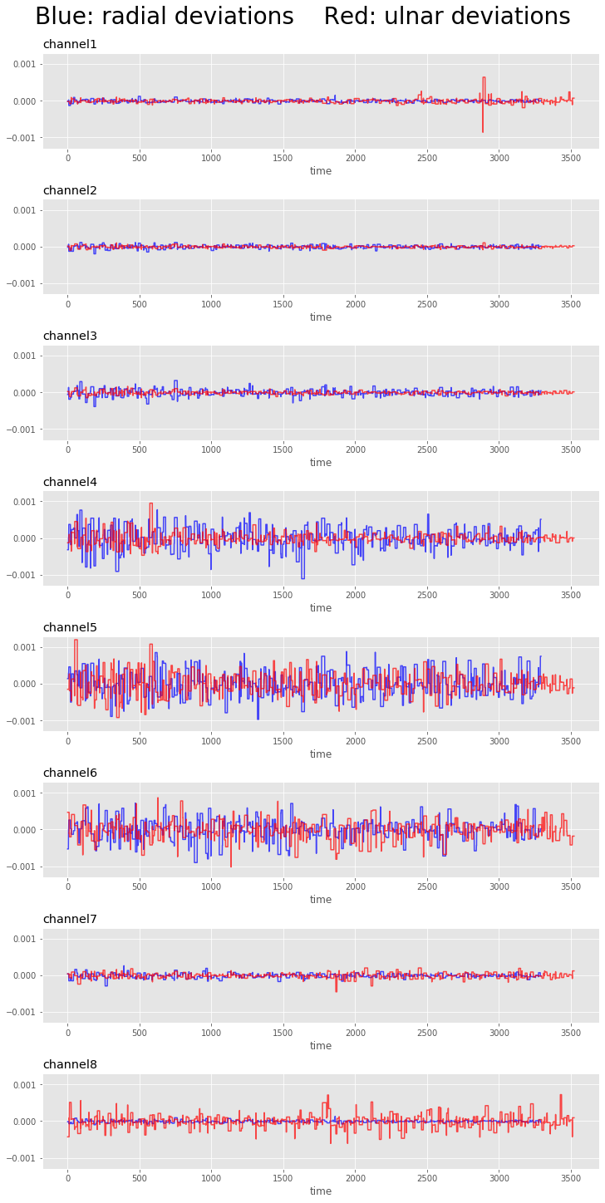
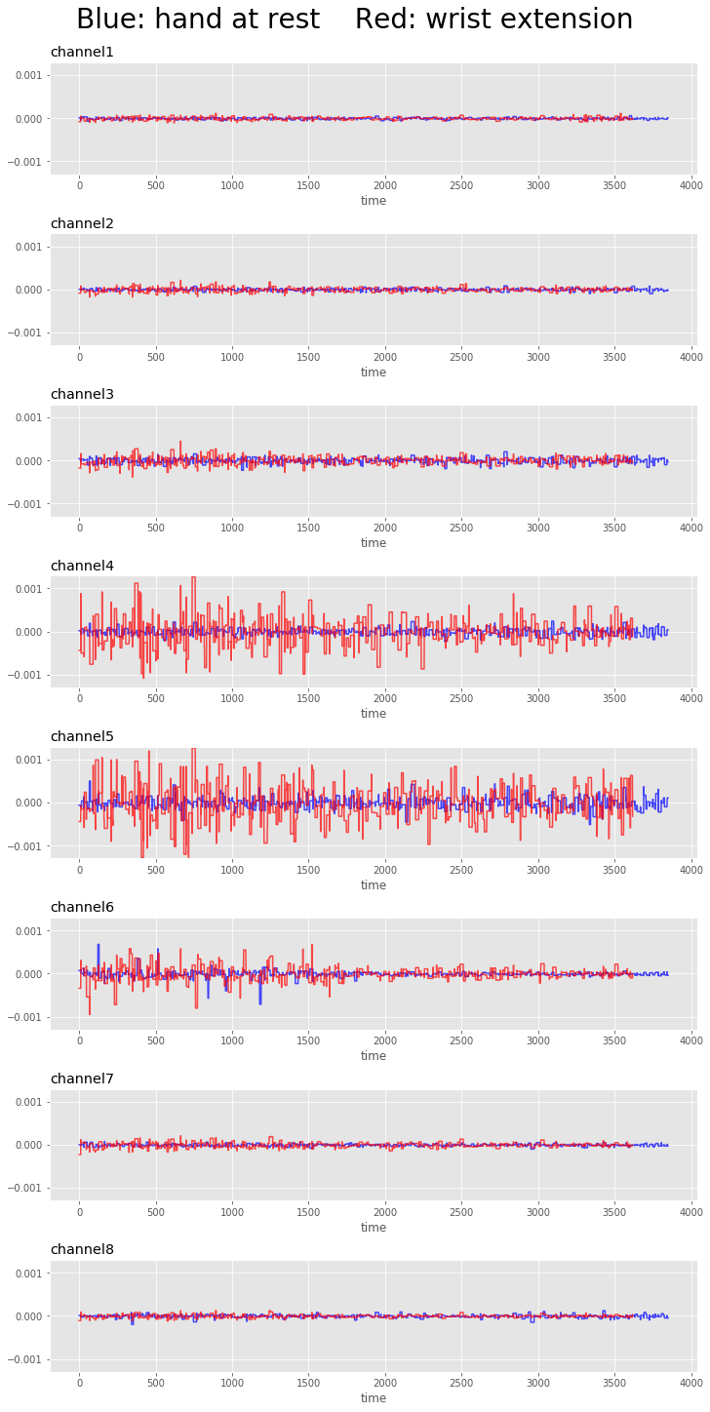

Slide 12
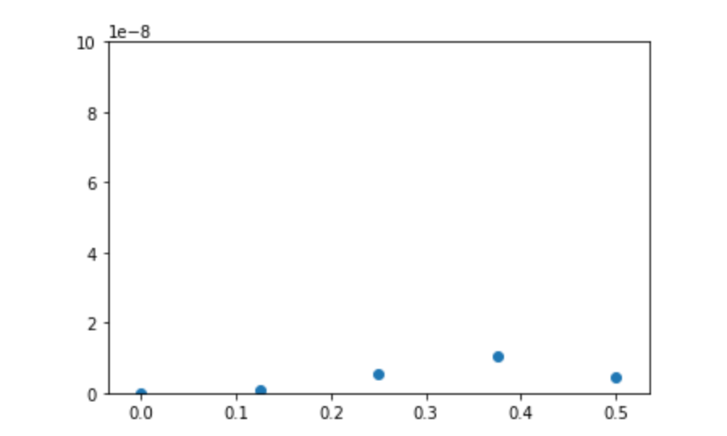
What Features to Extract?
Pseudo-Magnitude
Welch FFT
Bin-time

Slide 13
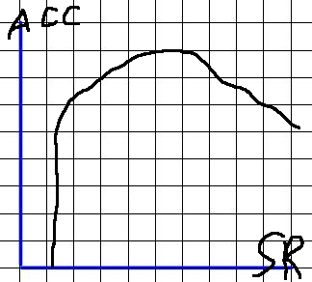
Tradeoff between device latency and retrospective analysis accuracy
~1ms sampling (1kHz)
Some loss
Expectation: →
Chosen SR: ~200ms

Slide 14
Extracted Feature Performance
Models attempted:
  RF, Gradientboost, NN
RF can achieve ~93-97%(with participant session normalization) accuracy on test data, GB and NN both ~%87

Slide 15
But is it fair to train on all participants?
Small training session is feasible for many applications
Still desirable to have a model that is both more universal and faster to implement

Slide 16
Features that could cause significant variance amongst participants
Bodyfat is the biggest factor
Total muscle amount
Particular muscle reactivity
Gender and age contribute to these significantly

Slide 17
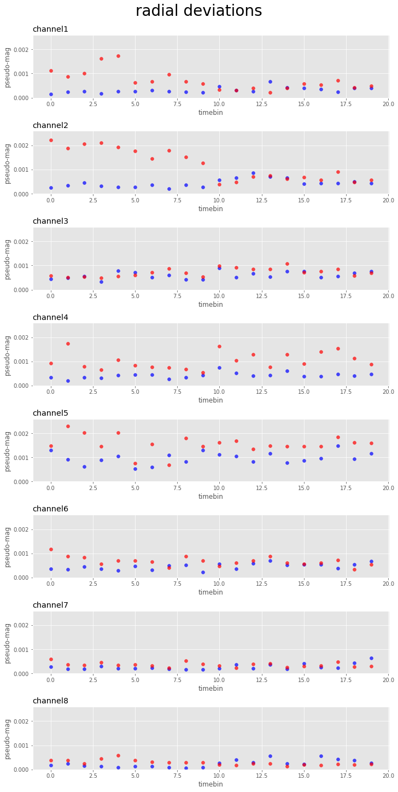
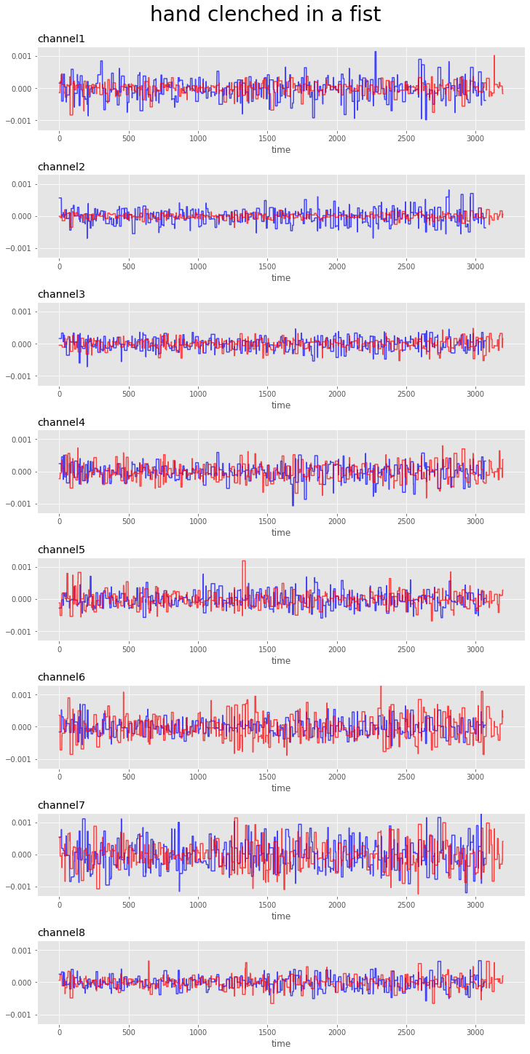

Slide 18
Normalization to participant
Significant gains on

Slide 19
Validating on a Withheld Participant
Significant reduction in performance
Cross-validating with defined test set

Slide 20
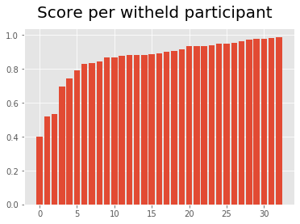
4/35 perticipants are
significantly
underperforming

Slide 21
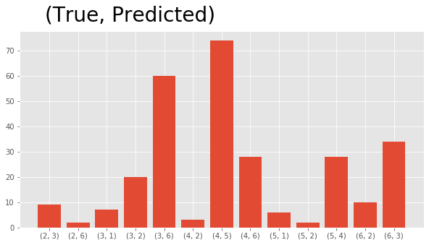
Totalling errors across witheld participants

Slide 22
Most Common:
True: Wrist extension
Pred: Radial deviation
True: Wrist felxion
Pred: Ulnar deviation
(consistent with common errors with no withheld participant)

Slide 23
Gesture conflicts
Gesture itself, bracelet, person?

Slide 24
Prev mentioned features not in dataset
Ex bodyfat, muscle, gender, age
Training with them is feasible for personalized use
Many cases where it would not be viable

Slide 25
Going forward
Optimal SR
Optimal NN
New Gestures
Train with other features

