Slide 1
2D Ising Model
Terri Poxon-pearson
Phy 905 Spring 2017

Slide 2
Outline
Introduction to Ferromagnetism and the Ising Model
Monte Carlo Methods and the Metropolis Algorithm
Implementation
Tests of Code
Results
Equilibrium time
Probability Distributions
Phase Transitions
Conclusions

Slide 3
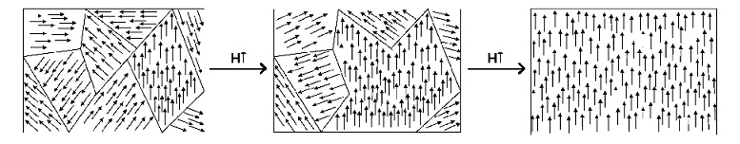
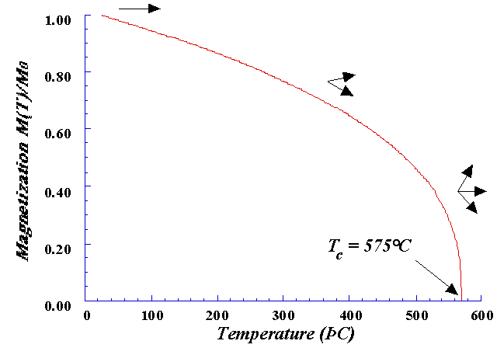
Ferromagnetic Materials
Materials that exhibit domains where the spins of unpaired electrons align
Domains grow with an applied B field and can be maintained after the B field is removed
http://pediaa.com/
This alignment competes with thermal excitations
At the Curie temperature, spins are forced out of alignment
Phase Transition
http://www.irm.umn.edu/hg2m/hg2m_b/hg2m_b.html

Slide 4
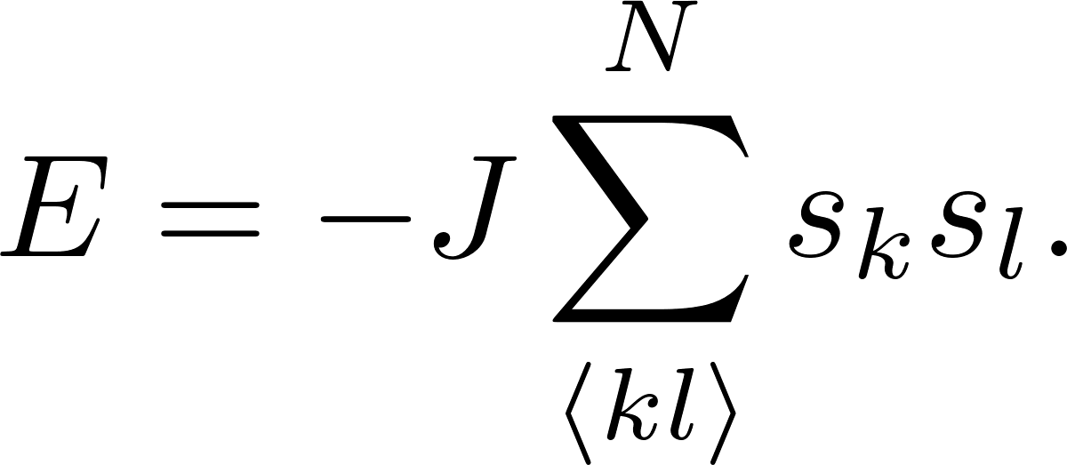
The 2D Ising Model
Models spins on two dimensional lattice where closest neighbors interact
Very simple model that allows us to study properties of phase transitions
Has been widely applied outside of ferromagnetism
Anti-ferromagnetism
Opinions on the economy
Urban segregation
Language evolution
Staugger, D. Applications of two-dimensional Ising Models. arXiv: 0706.3983

Slide 5
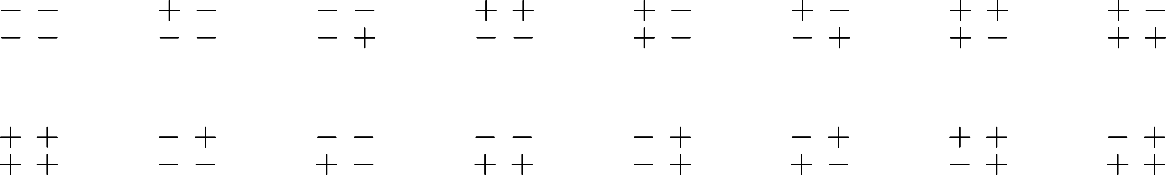
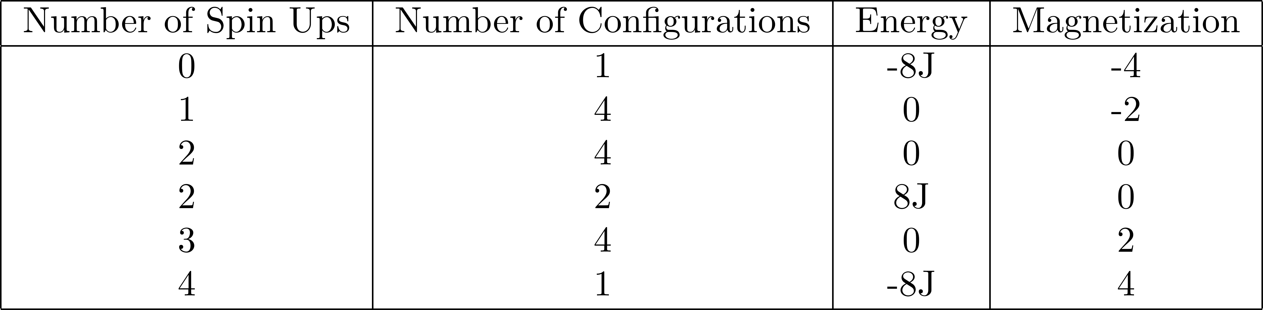
2 by 2 Lattice with Ising Model

Slide 6
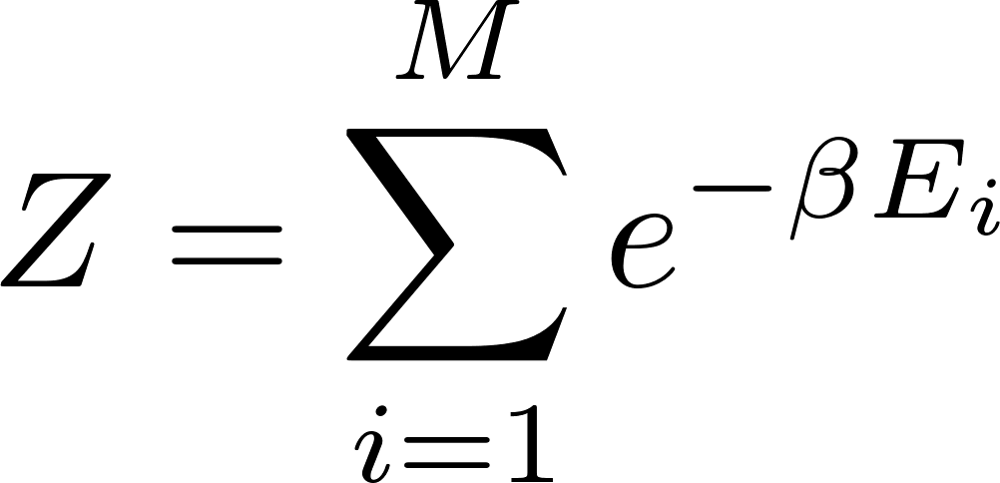
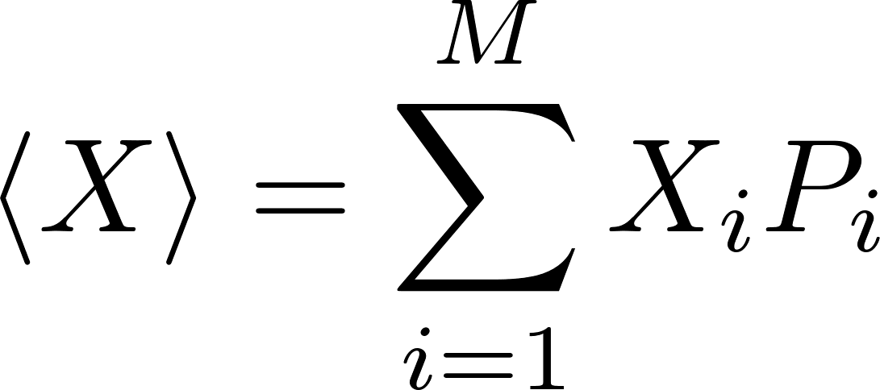
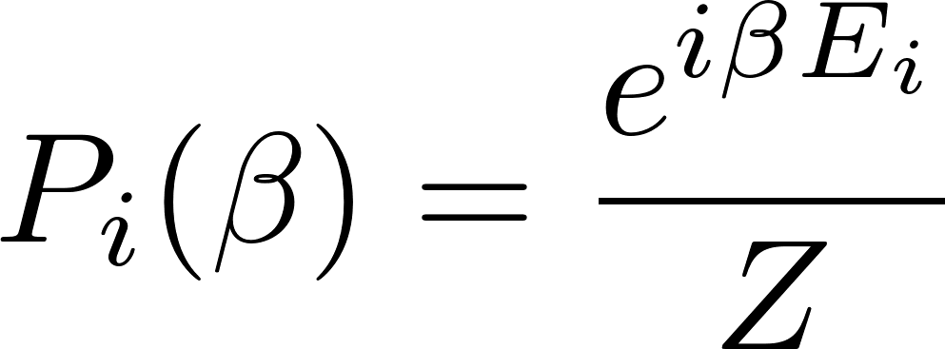
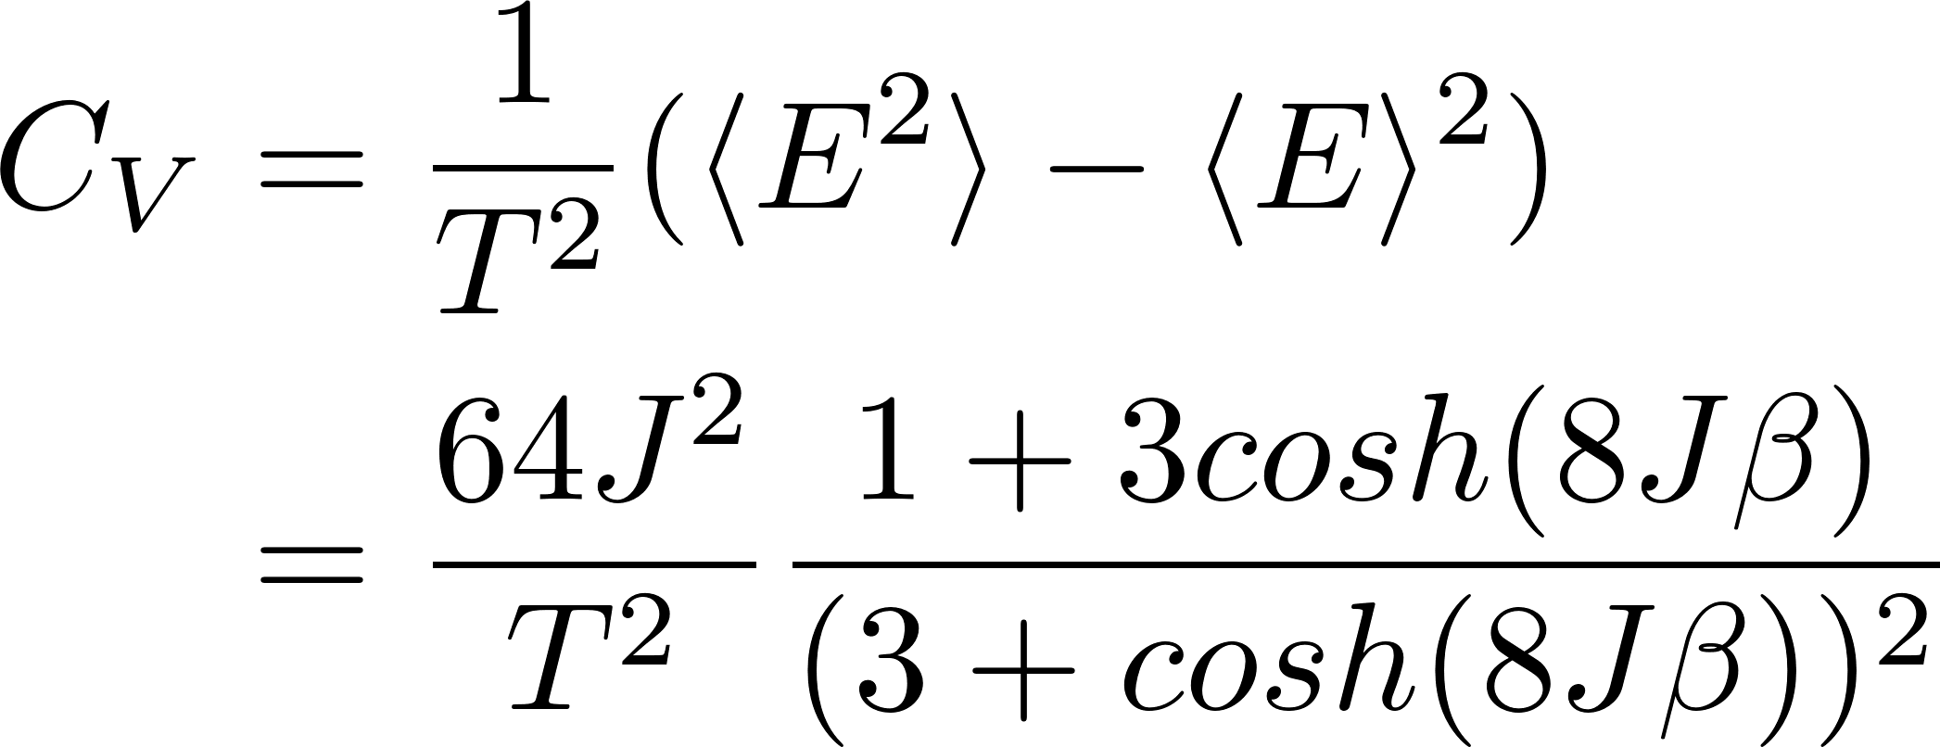
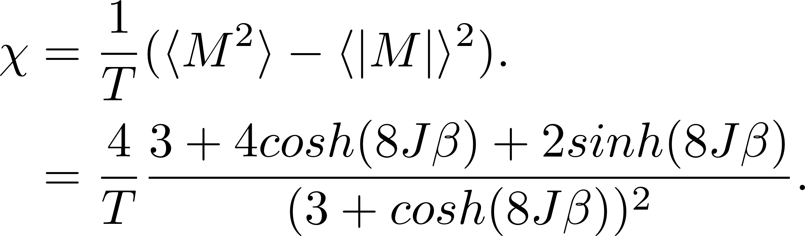
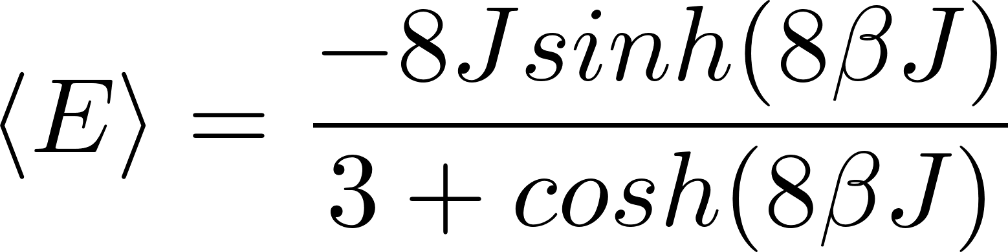
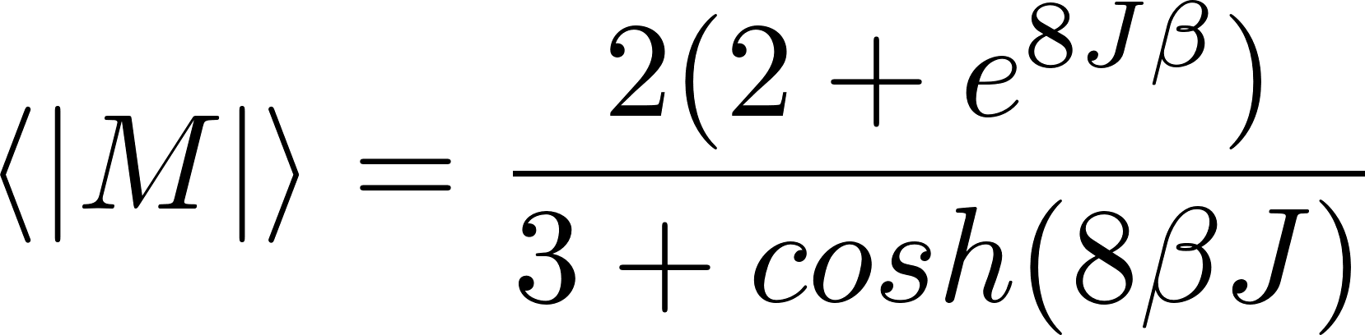
2 by 2 Lattice with Ising Model
Because of the limited number of energy states, we can calculation the partition function explicitly
Expectation values can be calculated using the formula
where
In this work we examined the behavior of 4 quantities

Slide 7
Introduction to Monte Carlo
Monte Carlo Methods are statistical simulation methods
Use random numbers to preform simulation
Useful in situations where the behavior of a system cannot be easily described analytically
The general components of a Monte Carlo method are
A PDF which characterizes a system
Calculation of random numbers to create proposed transition in the system
A sampling rule to decide whether or not to accept a proposed transition

Slide 8
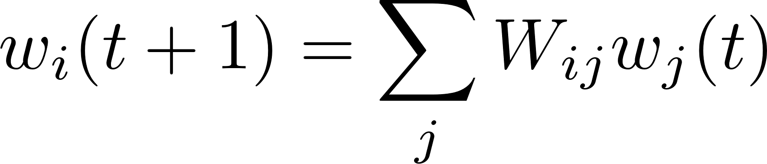
The Metropolis Algorithm
The PDF for large (physical) systems is intractable and we don’t know the transition probability analytically
Make a choice for the transition probability, W
Then we can write the full expression
Simplify using normalization of probabilities, equilibrium conditions, and detailed balance
Hjorth-Jensen, Morten. Computational Physics, Lecture Notes Fall 2015.

Slide 9
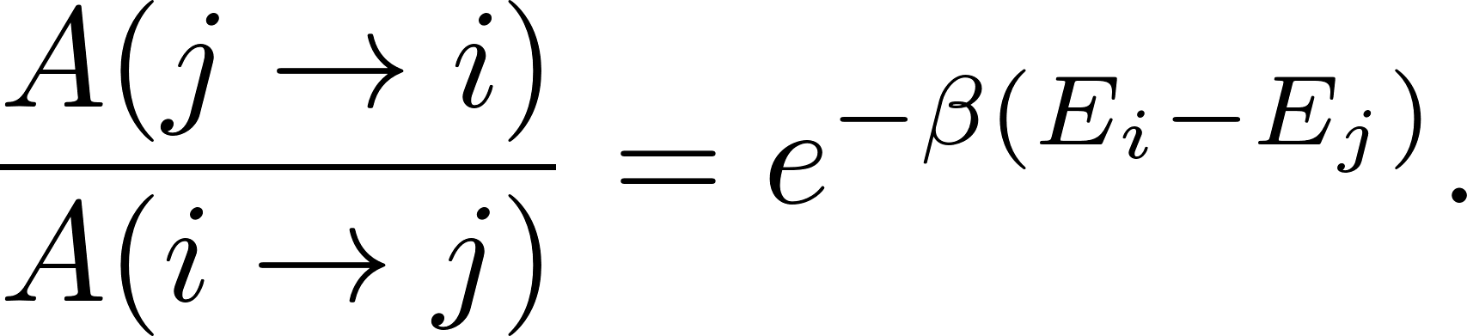
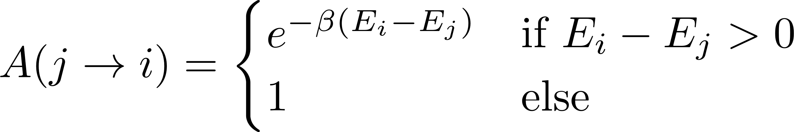
The Metropolis Algorithm
Then we are left with
The Metropolis Algorithm is the sampling rule that we get from this relation
Accept all transitions to a lower energy state. Transitions to higher energy states are accepted with some probability depending on change in energy
Preserves ergodicity
Hjorth-Jensen, Morten. Computational Physics, Lecture Notes Fall 2015.

Slide 10
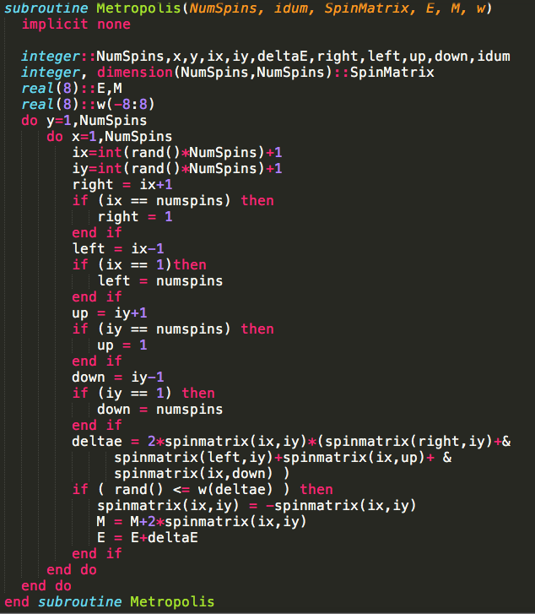
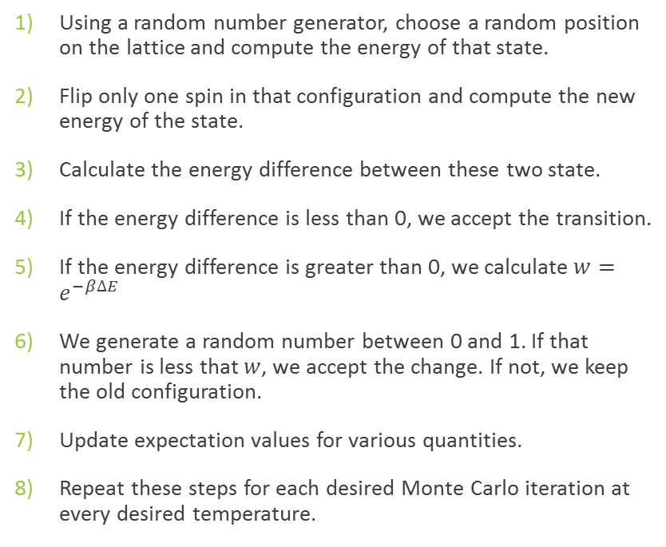
Implementation
Using a random number generator, choose a random position on the lattice and compute the energy of that state.
Flip only one spin in that configuration and compute the new energy of the state.
Calculate the energy difference between these two state.
If the energy difference is less than 0, we accept the transition.
If the energy difference is greater than 0, we calculate $w=e^{−β∆E}$
We generate a random number between 0 and 1. If that number is less that $w$, we accept the change. If not, we keep the old configuration.
Update expectation values for various quantities.
Repeat these steps for each desired Monte Carlo iteration at every desired temperature.

Slide 11
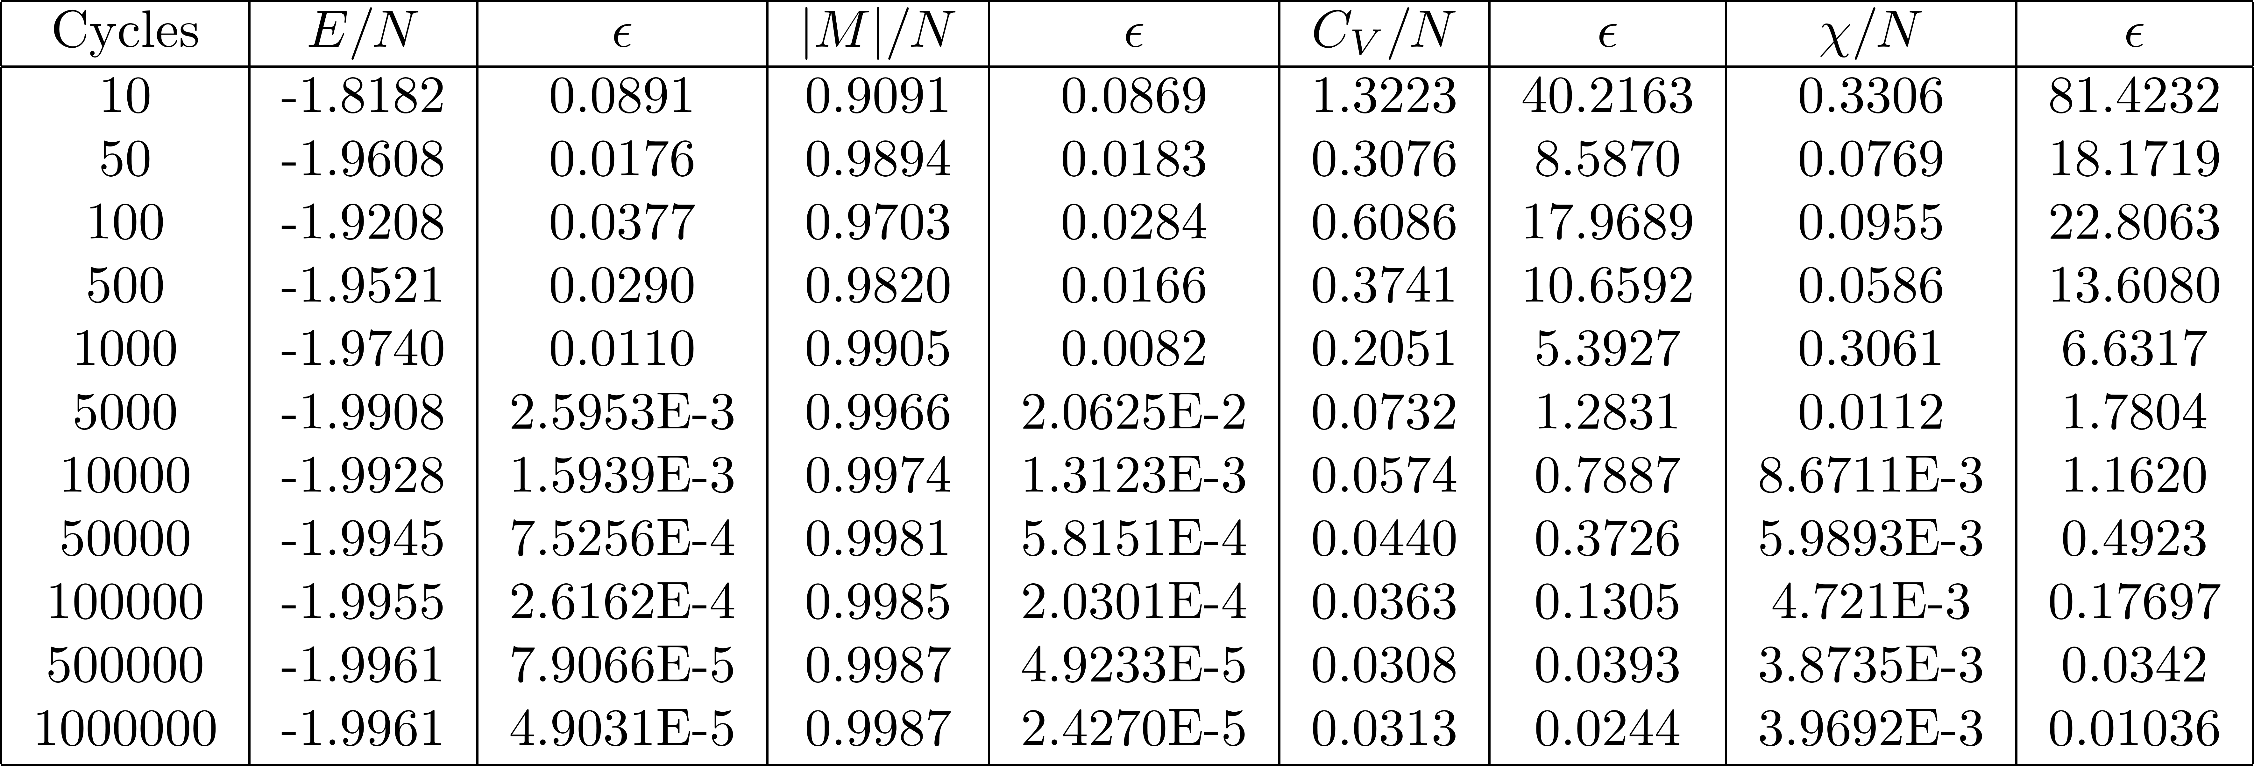
Verifying Code with 2 by 2 Lattice
Ran calculation with T=1.0 (units if kT/J) and compared to exact results
Exact:
-1.99598
0.998661
0.0320823
0.00401074

Slide 12
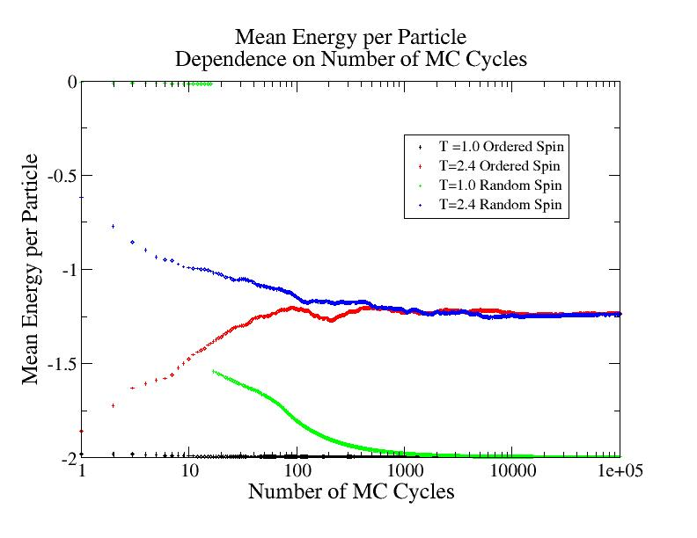
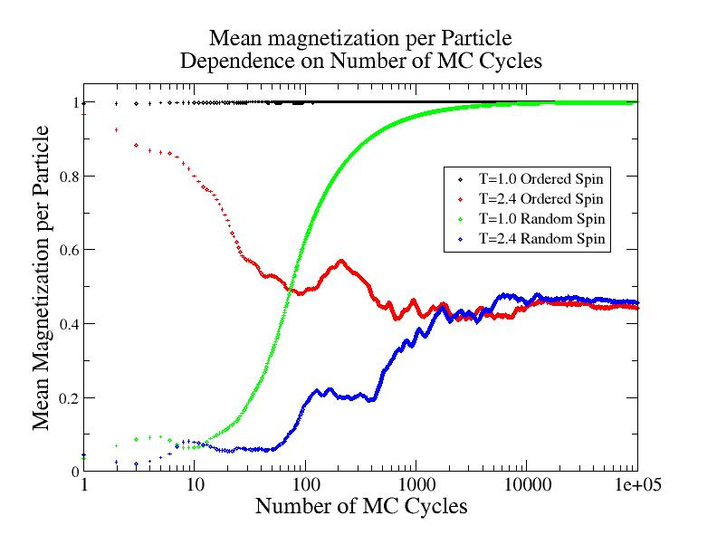
Results – Equilibrium Time
We can explore how long it takes to reach equilibrium, using MCS as a proxy for time
20 by 20 Lattice at T=1.0 and 2.4 (well below and above critical temperature)

Slide 13
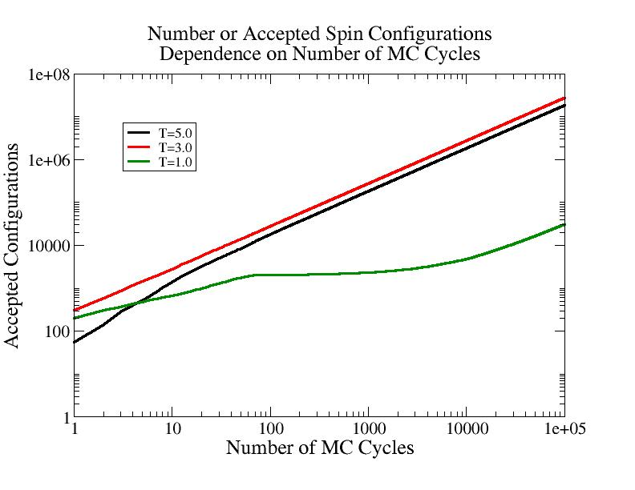
Results – Accepted Transitions
We can study the number of accepted spin configurations as a function of MCS at different temperatures
Log-log plot reveal linear relationship
Slope increases with temperature
As the temperature increases, more configurations are open to the system, allowing for a higher acceptance

Slide 14
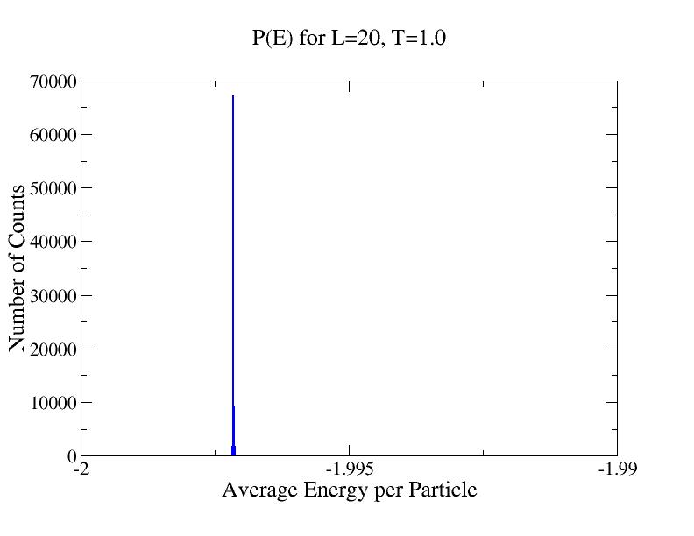
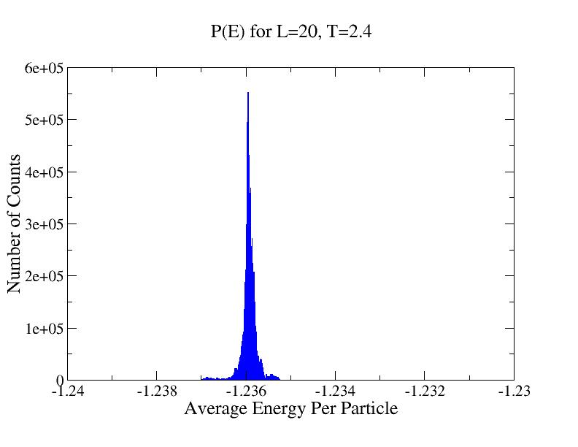
Results – Probability Distributions
Compare energy probability distribution at T=1.0 and T=2.4
Widening of distributions is related to the variance, which is captured by the heat capacity.

Slide 15
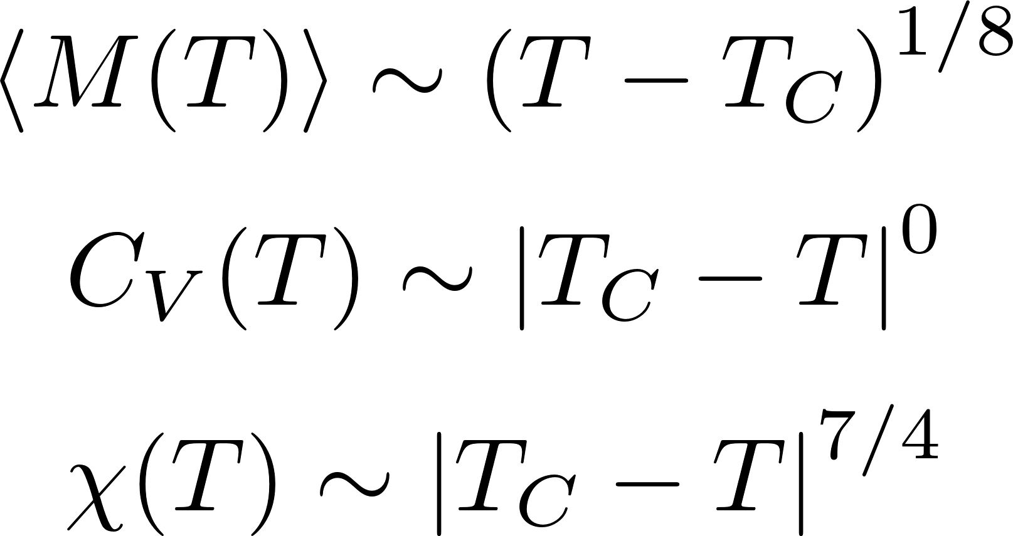
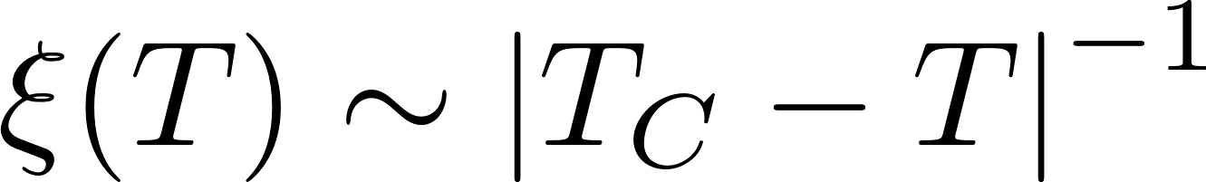
Introduction to Phase Transitions
Near the critical temperature, many physical properties are modeled using a power law
We can also model a correlation length by which is on the order of lattice spacing above the Curie Temperature
We can relate the behavior of finite lattices to the infinite lattice using

Slide 16
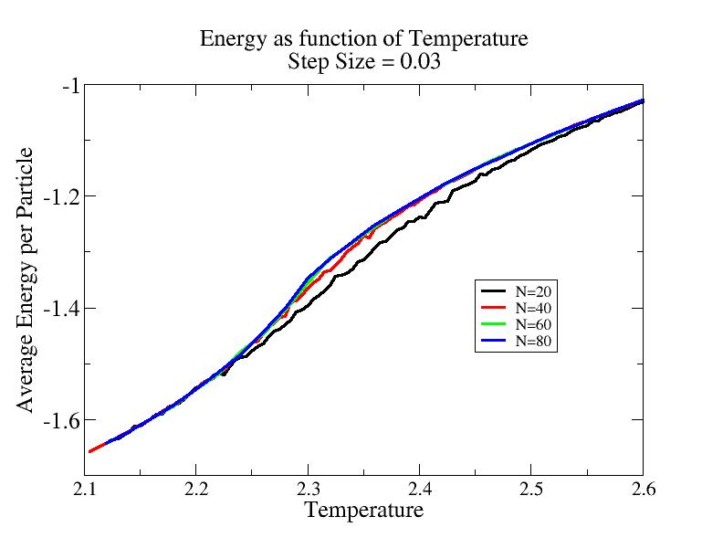
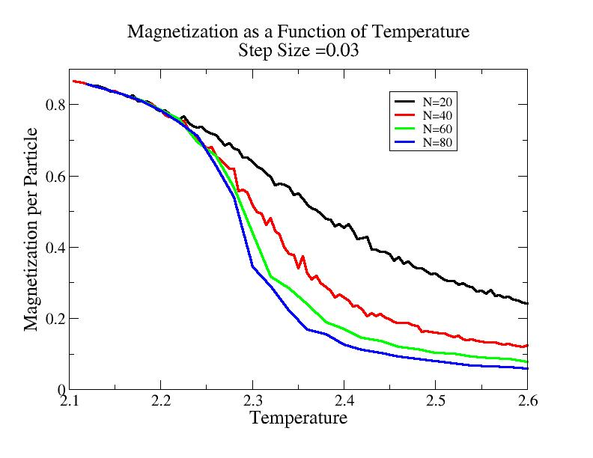
Results – Study of Phase Transition
100,000 cycles at step size of 0.03

Slide 17
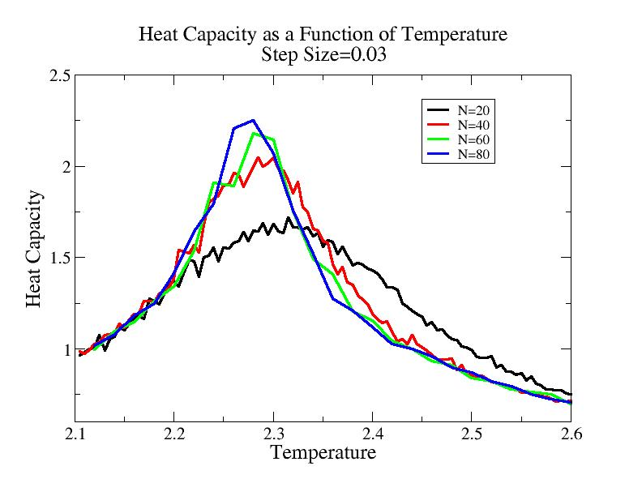
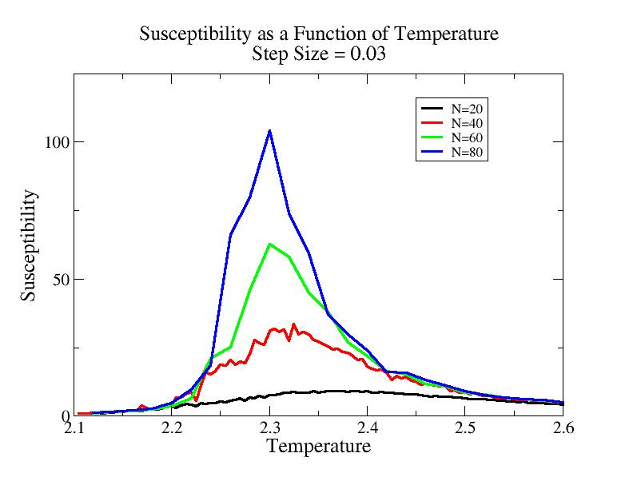
Results – Study of Phase Transition
100,000 cycles at step size of 0.03

Slide 18
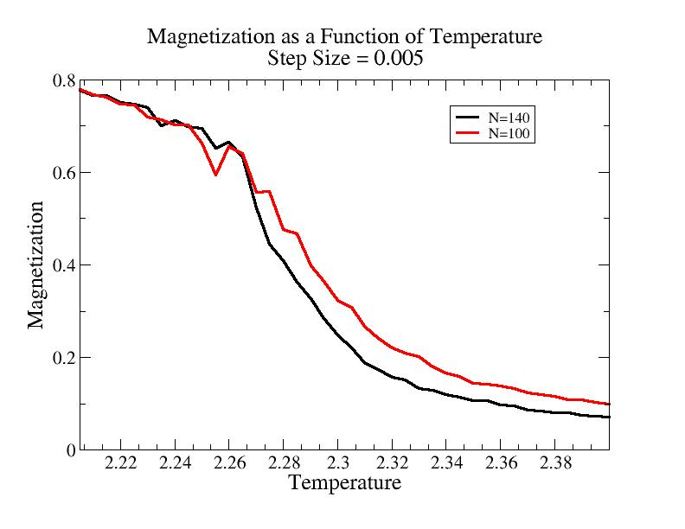
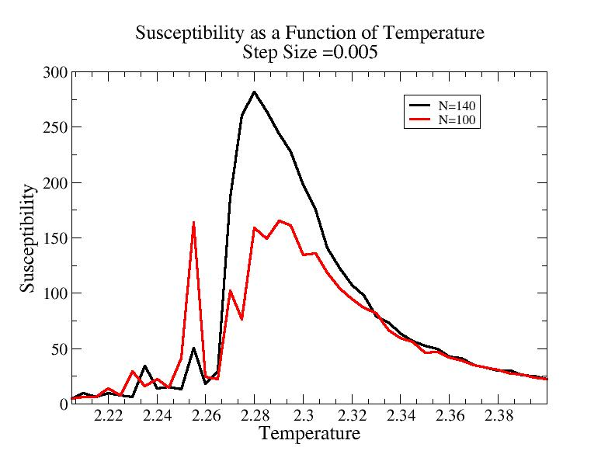
Results – Study of Phase Transition
1,000,000 cycles at step size of 0.005

Slide 19
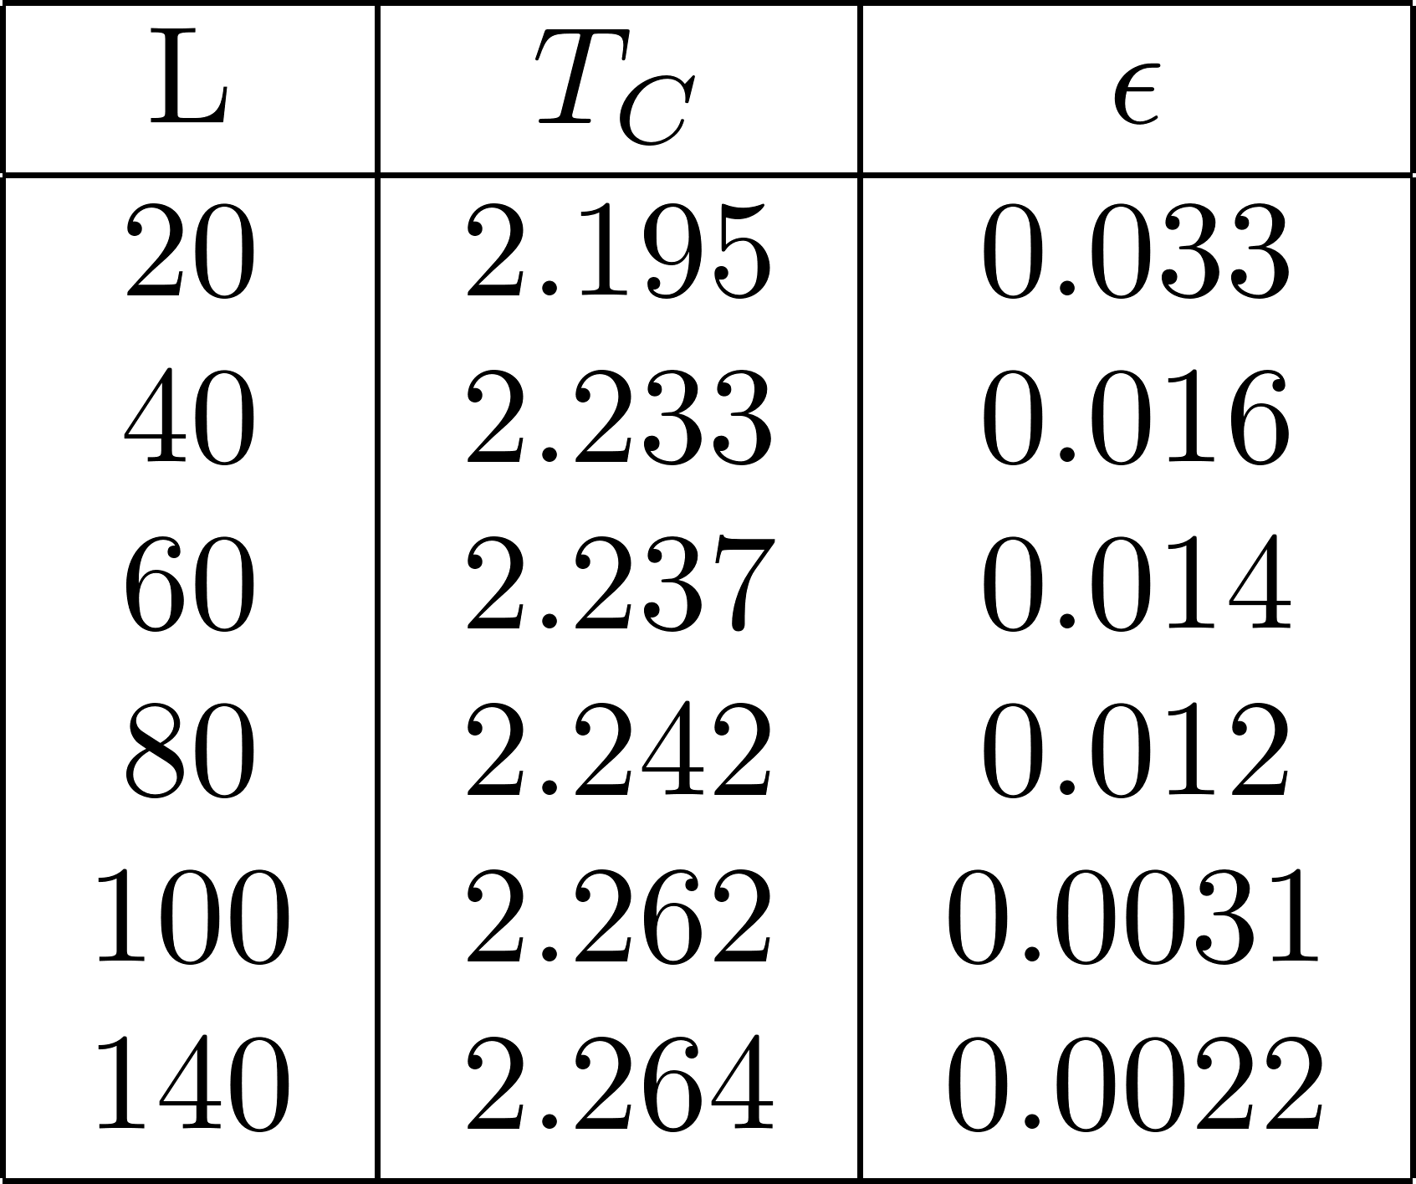
Results – Study of Phase Transition
We can use the relation we get
We see that as L gets larger, the curie temperature approaches the value in an infinite lattice.

Slide 20
Conclusions
I created a Monte Carlo Simulation which employed the Metropolis Algorithm to solve the 2D Ising Model and study magnetic phase transitions on a lattice
This code was verified using analytic results for the simple 2 by 2 lattice
I explored the energy probability distribution at different temperatures and connected this quantity to the heat capacity.
I saw evidence of a 2nd order phase transition in the magnetic material
I used finite size scaling relations to relate the Curie temperature on a finite lattice to the critical temperature for an infinite lattice

