Slide 1
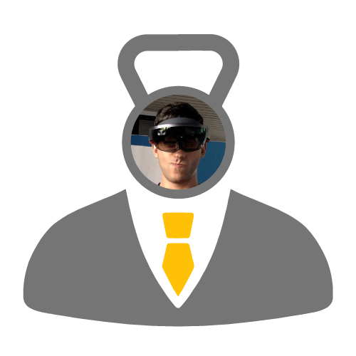
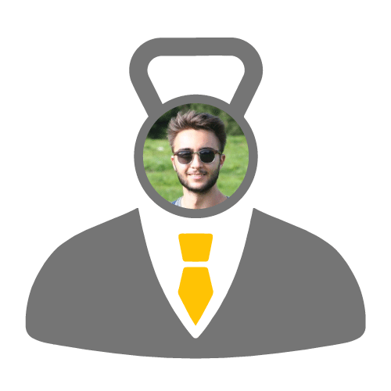
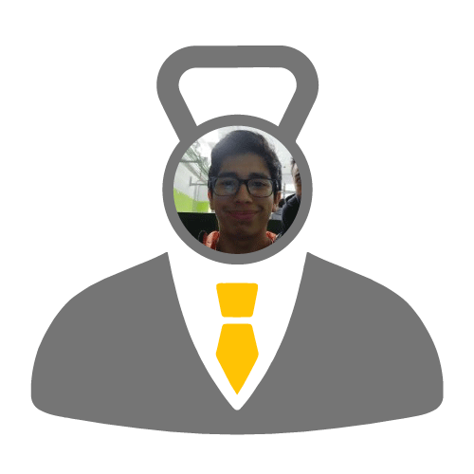
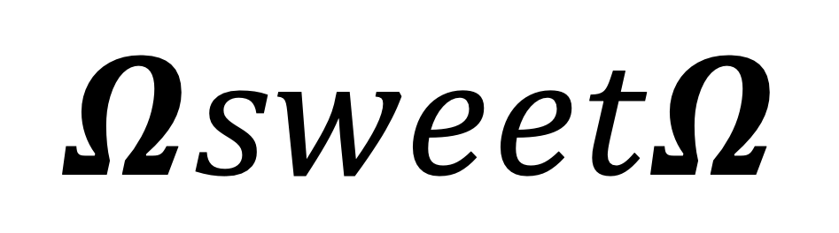
$$ΩsweetΩ$$
ALESSANDRO POZONE
THOMAS CARRASSI
BAYRON PALMA
Notes:
We are the hom sweet home team and for this hackathon we studied Crossfit. We found some problematic aspects like

Slide 2

CROSSFIT - THE PROBLEM
TIME WASTED demonstrating exercises
LAST MINUTE Workout of the Day
LOST FEEDBACK due to tiredness
INJURIES due to shyness
LOST TRAININGS not willingly
Notes:
time wasted ... like if there is someone new at the lesson..
as often we are too tired and just want to go home.
because people are afraid to ask to the trainer.
Lost Trainings for exampe if i am abroad
For these reasons we created Crossfit Manager

Slide 3

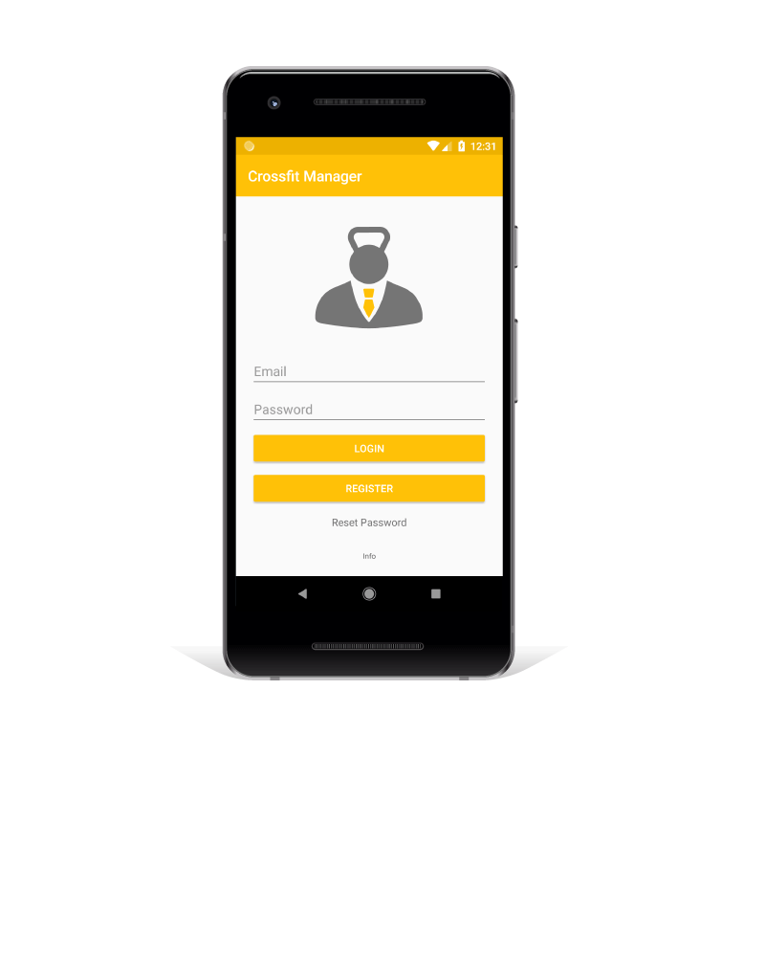
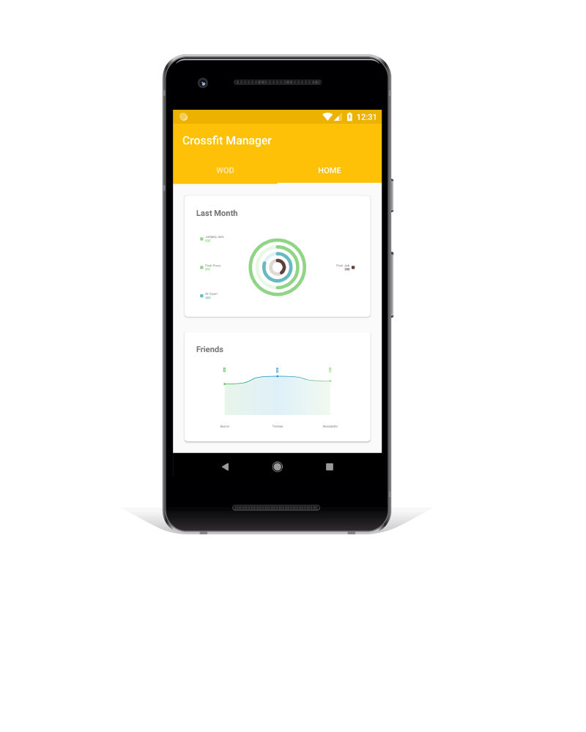
CROSSFIT
MANAGER
Notes:
CM is a mobile application designed for iOS and Android. It wants to solve the previous problems providing:

Slide 4
CROSSFIT - THE SOLUTION
FULLY CONTROLLABLE 3D MODEL demonstrating the exercises
PUSH NOTIFICATION of Workout of the Day
DELAYED FEEDBACK to the trainer through the application
EXERCISE in privacy
REMOTE training
STATISTICS of the group

Slide 5
DEMO

Slide 6


WHAT’S
POPULATE LIBRARY of 3D models with experts
IMPROVE THE WORKOUT creation flow
CHALLENGES AND REWARDS among members of a group
REVIEW AND IMPROVEMENT of mobile applications [iOS - Android]
SOCIAL SHARING of achievements
DATA MINING OF PAST DATA to improve the workout

Slide 7


INFRASTRUCTURE

