Slide 1






Linear regression
Martin Pozdílek

Slide 2
Dataset
Portland Housing Prices/Sales Jul 2020 - Jul 2021
https://www.kaggle.com/datasets/threnjen/portland-housing-prices-sales-jul-2020-jul-2021
348 columns
25681 records
Learning dataset
Data with correct results
m = number of examples = 100
x’s = input variables / features
y’s = output variable / target
(x, y) = single row of training dataset
x⁽²⁾ = (4, 5, 3374, 85)
y⁽²⁾ = 1 050 000
!!! Subset statistically not corresponding with original dataset
Bathrooms x | Bedrooms x | LivingArea (feet²) x | Age (years) x | Price ($) y
3 | 5 | 3470 | 7 | 1 165 000
4 | 5 | 3374 | 85 | 1 050 000
3 | 3 | 3265 | 20 | 442 500
3 | 3 | 3192 | 36 | 765 000
3 | 4 | 3157 | 73 | 815 000
4 | 5 | 2969 | 7 | 620 000

Slide 3
Linear regression with one variable
Objective
Find model / hypothesis / function that recommend selling price of house
Function f maps input x to output y
Problem
Regression
Supervisored learning
Input parameter
Living area in foot²
Output value
Selling price in $
Training dataset
Learning algorithm
x
Function f
x

Slide 4
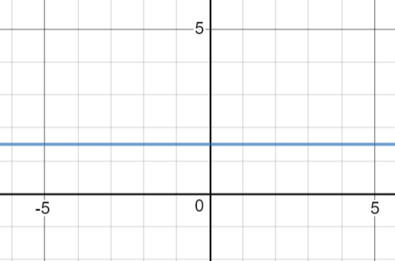
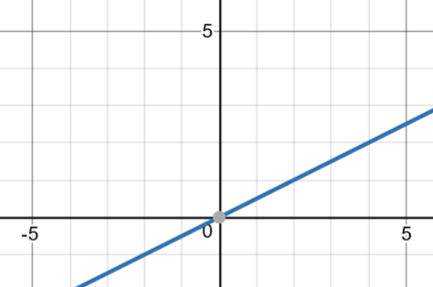
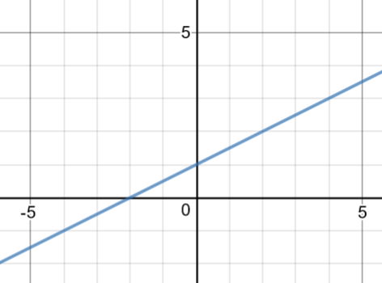
Linear regression with one variable
Function, model, hypothesis
f_{w,b}(x) = wx + b
w,b – parameters of function
b = 1.5
w = 0
b = 0
w = 0.5
b = 1.5
w = 0.5

Slide 5
Linear regression with one variable
Task: find parameters w and b that best fit the training dataset
y’=f_{w,b}(x) predicted value
y = true value from learning dataset
y’ should be maximally close to y

Slide 6
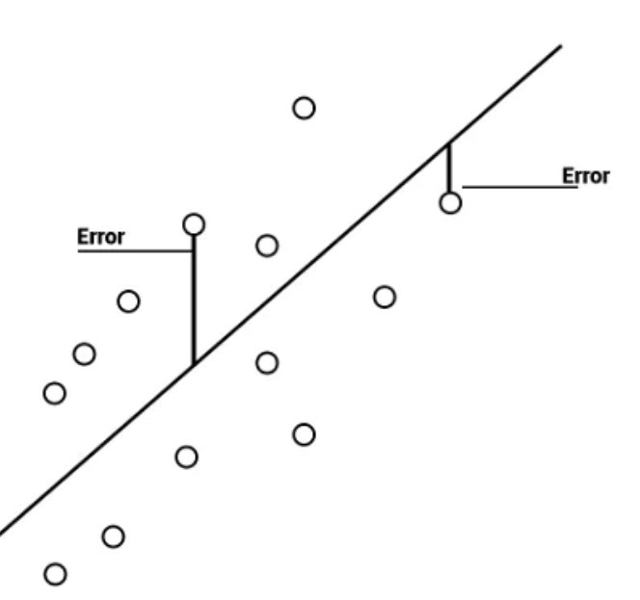

Linear regression with one variable
Cost / Loss / Objective function
Measure how close model fits the training data
Examples
MAE (Mean Absolute Error)
MSE (Mean Square Error)
$J\left(w, b\right)=\frac{1}{2m}\sum_{i=1}^{m}{{(f_{w,b}\left(x^{i}\right)−y^{i})}^{2}}$
Loss score
Value of cost function for specific w, b

Slide 7
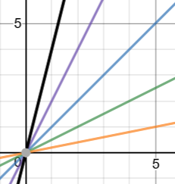

Model and cost function
Model Cost function
$f_{w, b}=wx+0$ $J\left(w\right)=\frac{1}{2m}\sum_{i=1}^{m}{{(f_{w, b}\left(x^{i}\right)−y^{i})}^{2}}$
Function of x Function of $Θ$
Dataset $w=1; J\left(w\right)= \frac{1}{2∙3} ({(1−1)}^{2}+$ ${(2−2)}^{2}$+ ${(3−3)}^{2})=0$
$w=0.5; J\left(w\right)= \frac{1}{2∙3} ({(0.5−1)}^{2}+$ ${(1−2)}^{2}$+ ${(1.5−3)}^{2})=0.58$
$w=0.2; J\left(w\right)= \frac{1}{2∙3} ({(0.2−1)}^{2}+$ ${(0.4−2)}^{2}$+ ${(0.6−3)}^{2})=1$.49
$w=1.5; J\left(w\right)= \frac{1}{2∙3} ({(1.5−1)}^{2}+$ ${(3−2)}^{2}$+ ${(4.5−3)}^{2})=0.58$
$w=1.8; J\left(w\right)= \frac{1}{2∙3} ({(1.8−1)}^{2}+$ ${(3.6−2)}^{2}$+ ${(5.4−3)}^{2})=1$.49
x | y
1 | 1
2 | 2
3 | 3

Slide 8
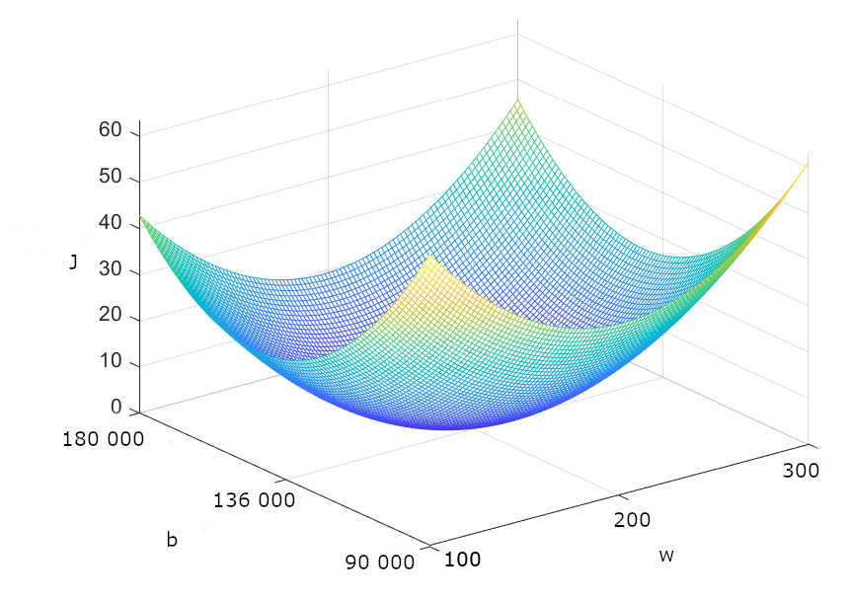

Model and cost function
Model Cost function
$f_{w,b}=wx+b$ $J\left(w, b\right)=\frac{1}{2m}\sum_{i=1}^{m}{{(f_{w, b}\left(x^{i}\right)−y^{i})}^{2}}$

Slide 9
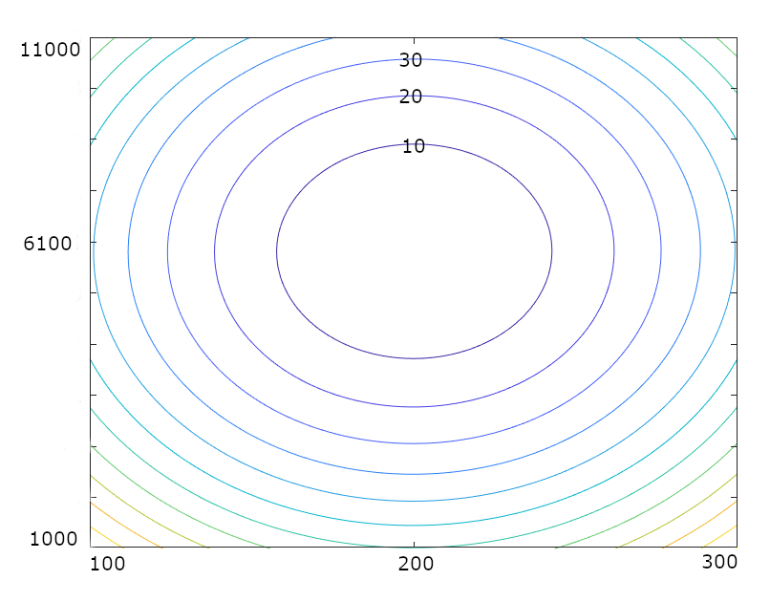

Contour plot
Points on contour line – different combinations of $w$ and $b$with same value of $J\left(w, b\right)$

Slide 10

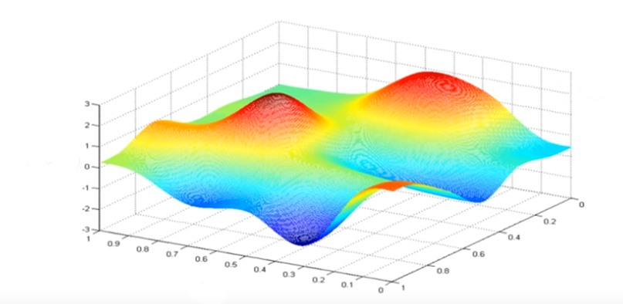
Gradient descent algorithm
Algorithm for finding minimum of J(w, b)
Set initial values of w, b, mostly (0, 0)
Finding the direction that leads most downward from a given point
Taking a small step in the found direction
If I can go down, repeat it again
Different starting point can lead to different minimums

Slide 11

Gradient descent algorithm
repeat until convergence
$step_0≔w−α\frac{∂}{∂w}J\left(w, b\right)$
step_1$≔b−α\frac{∂}{∂b}J\left(w, b\right)$
$w ≔step_0$
$b ≔step_1$
updates must be done simultaneously
$α$– learning rate, defines the size of step
$\frac{∂}{∂w}J\left(w, b\right)$ – partial derivative, tangent to the curve, direction of step

Slide 12
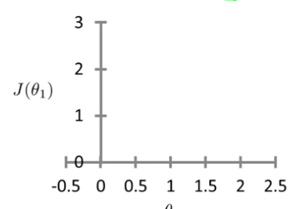

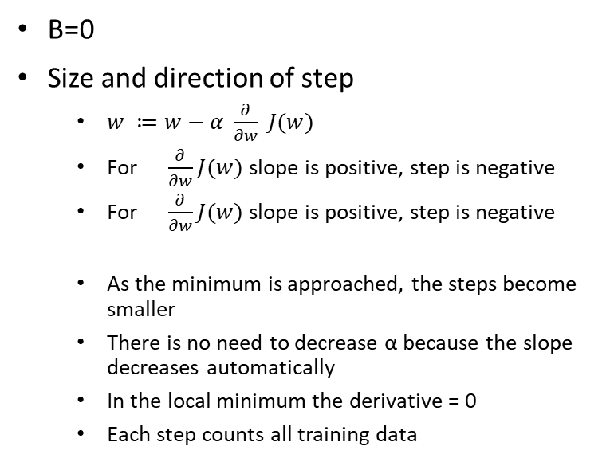
Simple derivative
B=0
Size and direction of step
$w ≔w−α \frac{∂}{∂w} J(w)$
For $\frac{∂}{∂w}J(w)$ slope is positive, step is negative
For $\frac{∂}{∂w}J(w)$ slope is positive, step is negative
As the minimum is approached, the steps become smaller
There is no need to decrease α because the slope decreases automatically
In the local minimum the derivative = 0
Each step counts all training data

Slide 13

Partial derivatives
Size of step
$w ≔w−α \frac{∂}{∂w} J(w,b)$
Cost function
$J\left(w, b\right)=\frac{1}{2m}\sum_{i=1}^{m}{{(f_{w, b}\left(x^{i}\right)−y^{i})}^{2}}$
Partial derivatives
$\frac{∂}{∂w}J\left(w, b\right)=$ $\frac{1}{m}\sum_{i=1}^{m}{(f_{w,b}\left(x^{i}\right)−y^{i})x^{i} }$
$\frac{∂}{∂b} J\left(w, b\right)=$ $\frac{1}{m}\sum_{i=1}^{m}{(f_{w,b}\left(x^{i}\right)−y^{i}) }$

Slide 14
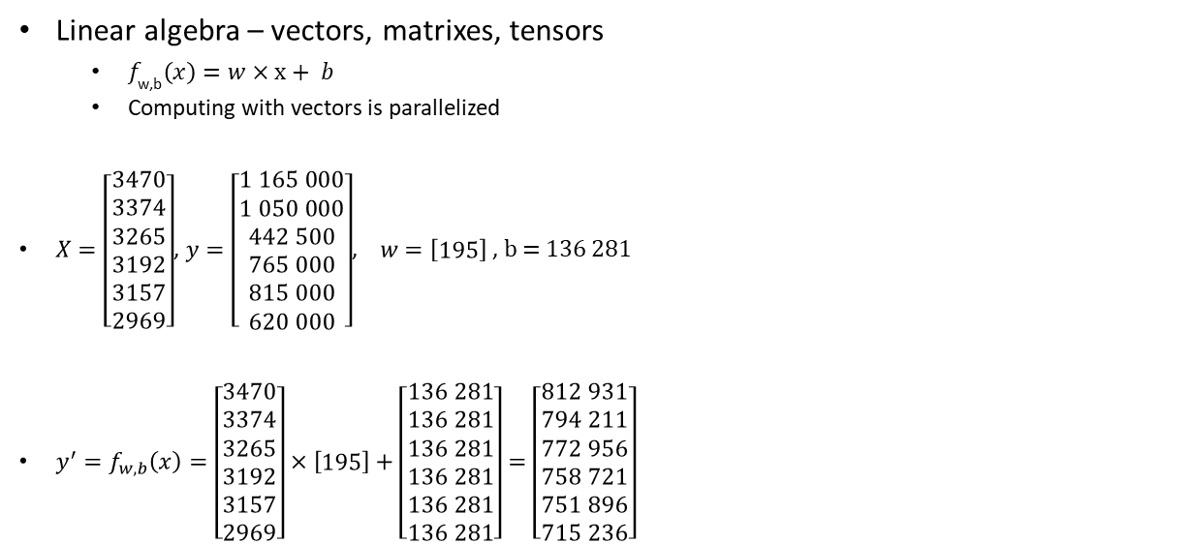
Linear regression with one variable
Linear algebra – vectors, matrixes, tensors
$f_{\text{w}\text{,}\text{b}}\left(x\right)=w×x+ b$
Computing with vectors is parallelized
$X=\left[\begin{matrix}3470 \\ 3374 \\ 3265 \\ 3192 \\ 3157 \\ 2969\end{matrix}\right]$, $y=\left[\begin{matrix}1 165 000 \\ 1 050 000 \\ 442 500 \\ 765 000 \\ 815 000 \\ 620 000\end{matrix}\right]$, $w=\left[\begin{matrix}195\end{matrix}\right]$ , b = 136 281
${y^{′}=f}_{w,b}\left(x\right)=\left[\begin{matrix}3470 \\ 3374 \\ 3265 \\ 3192 \\ 3157 \\ 2969\end{matrix}\right]×\left[\begin{matrix}195\end{matrix}\right]+\left[\begin{matrix}136 281 \\ 136 281 \\ 136 281 \\ 136 281 \\ 136 281 \\ 136 281\end{matrix}\right]=$ $\left[\begin{matrix}812 931 \\ 794 211 \\ 772 956 \\ 758 721 \\ 751 896 \\ 715 236\end{matrix}\right]$
LivingArea (feet²) x | Price ($) y
3470 | 1 165 000
3374 | 1 050 000
3265 | 442 500
3192 | 765 000
3157 | 815 000
2969 | 620 000

Slide 15
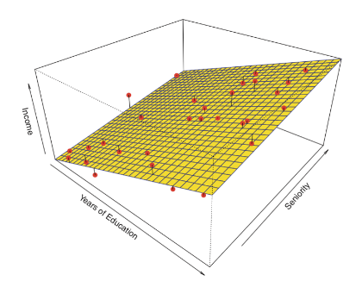
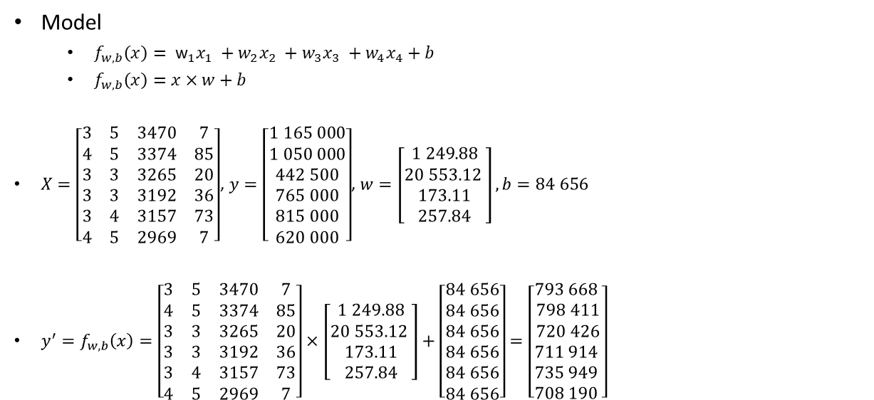
Linear regression with multiple variables
Bathrooms x₁ | Bedrooms x₂ | LivingArea (feet²) x₃ | Age (years) x₄ | Price ($) y
3 | 5 | 3470 | 7 | 1 165 000
4 | 5 | 3374 | 85 | 1 050 000
3 | 3 | 3265 | 20 | 442 500
3 | 3 | 3192 | 36 | 765 000
3 | 4 | 3157 | 73 | 815 000
4 | 5 | 2969 | 7 | 620 000
Model
$f_{w,b}\left(x\right)= {\text{w}}_{1}x_{1} +w_{2}x_{2} +w_{3}x_{3} +w_{4}x_{4}+b$
$f_{w,b}\left(x\right)=x×w+b$
$X=\left[\begin{matrix}3 & 5 & 3470 & 7 \\ 4 & 5 & 3374 & 85 \\ 3 & 3 & 3265 & 20 \\ 3 & 3 & 3192 & 36 \\ 3 & 4 & 3157 & 73 \\ 4 & 5 & 2969 & 7\end{matrix}\right]$, $y=\left[\begin{matrix}1 165 000 \\ 1 050 000 \\ 442 500 \\ 765 000 \\ 815 000 \\ 620 000\end{matrix}\right]$,$w=\left[\begin{matrix}1 249.88 \\ 20 553.12 \\ 173.11 \\ 257.84\end{matrix}\right], b=84 656$
$y^{′}=f_{w,b}\left(x\right)=\left[\begin{matrix}3 & 5 & 3470 & 7 \\ 4 & 5 & 3374 & 85 \\ 3 & 3 & 3265 & 20 \\ 3 & 3 & 3192 & 36 \\ 3 & 4 & 3157 & 73 \\ 4 & 5 & 2969 & 7\end{matrix}\right]×\left[\begin{matrix}1 249.88 \\ 20 553.12 \\ 173.11 \\ 257.84\end{matrix}\right]+\left[\begin{matrix}84 656 \\ 84 656 \\ 84 656 \\ 84 656 \\ 84 656 \\ 84 656\end{matrix}\right]=$ $\left[\begin{matrix}793 668 \\ 798 411 \\ 720 426 \\ 711 914 \\ 735 949 \\ 708 190 \end{matrix}\right]$

Slide 16

Linear regression with multiple variables
Cost function
$J\left(w, b\right)=\frac{1}{2m}\sum_{i=1}^{m}{{(f_{w, b}\left(x^{i}\right)−y^{i})}^{2}}$
Size of step
$w_{i}≔w_{i}−α \frac{∂}{∂w_{i}} J(w,b)$
$w_{1}≔w_{i}−α\frac{1}{m}\sum_{i=1}^{m}{(f_{w,b}\left(x^{i}\right)−y^{i})x_{1}^{i} }$
…
$w_{n}≔w_{i}−α\frac{1}{m}\sum_{i=1}^{m}{(f_{w,b}\left(x^{i}\right)−y^{i})x_{n}^{i} }$
$b≔b−α\frac{1}{m}\sum_{i=1}^{m}{(f_{w,b}\left(x^{i}\right)−y^{i}) }$

Slide 17
Size of learning rate α
α too small
The algorithm finds the minimum
It will take many steps and will be slow
α too big
The algorithm misses the minimum
Sometimes it cannot converge to a minimum
The steps increase due to moving away from the minimum

Slide 18
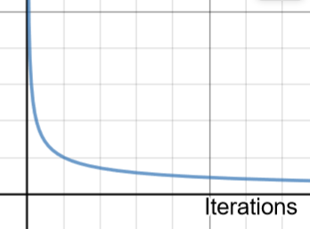

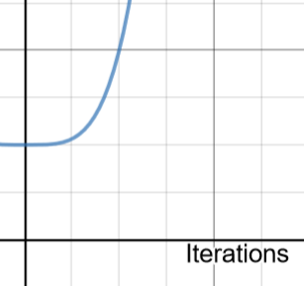
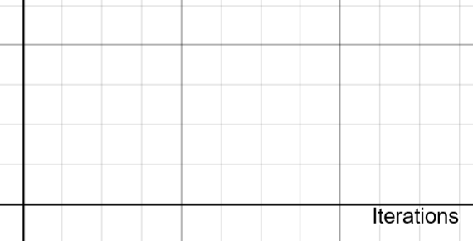
Size of learning rate α
Learning curve
Evaluate J(w,b) every iteration
Right α
J(w,b) should decrease with each iteration
Improvement is decreasing
After n iteration, the J curve is converged
Automatic learning stop - e.g., decreasing of J(w, b) < 10⁻³
Small α
Algorithm is too slow
High α
J(w, b) is increasing or fluctuating
Tune α
Try 0.001; 0.01; 0.3; 1 …

Slide 19
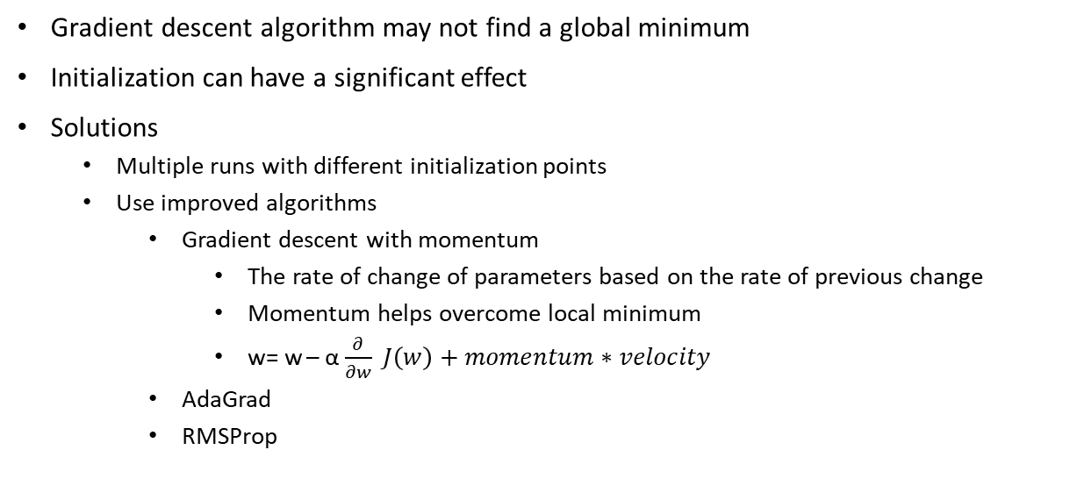
Local minimums
Gradient descent algorithm may not find a global minimum
Initialization can have a significant effect
Solutions
Multiple runs with different initialization points
Use improved algorithms
Gradient descent with momentum
The rate of change of parameters based on the rate of previous change
Momentum helps overcome local minimum
w= w – α $\frac{∂}{∂w} J\left(w\right)+momentum∗velocity$
AdaGrad
RMSProp

Slide 20
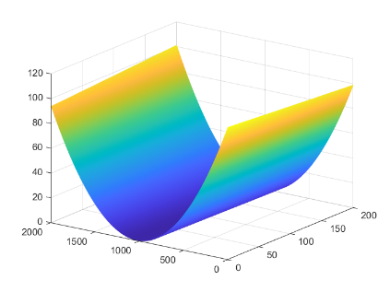
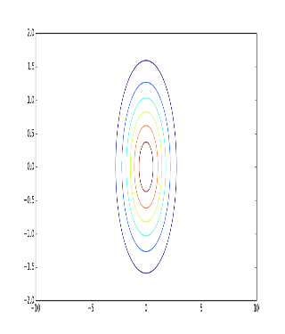
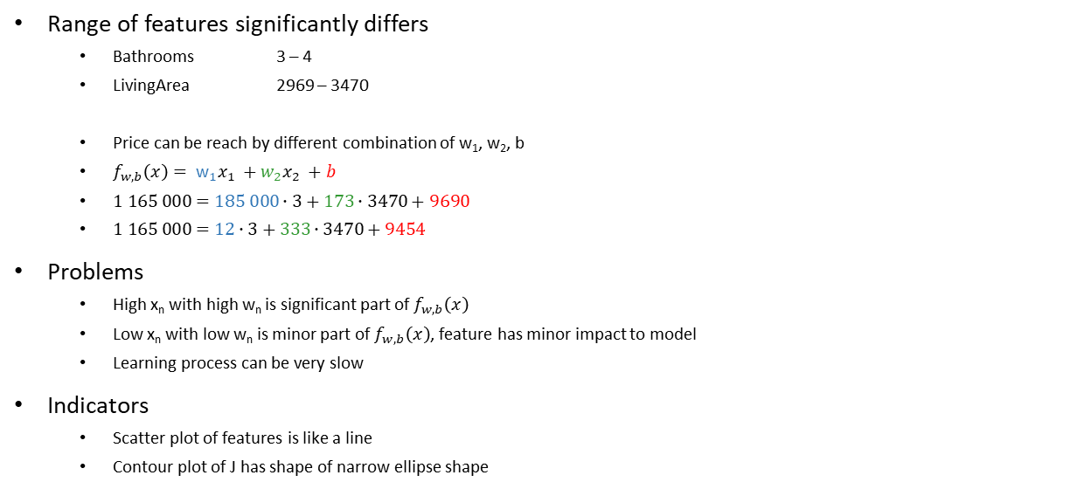
Feature scaling
Bathrooms x₁ | LivingArea (feet²) x₃ | Price ($) y
3 | 3470 | 1 165 000
4 | 3374 | 1 050 000
3 | 3265 | 442 500
3 | 3192 | 765 000
3 | 3157 | 815 000
4 | 2969 | 620 000
Range of features significantly differs
Bathrooms 3 – 4
LivingArea 2969 – 3470
Price can be reach by different combination of w₁, w₂, b
$f_{w,b}\left(x\right)= {\text{w}}_{1}x_{1} +w_{2}x_{2} +b$
$1 165 000=185 000∙3+173∙3470+9690$
$1 165 000=12∙3+333∙3470+9454$
Problems
High x_{n} with high w_{n} is significant part of $f_{w,b}\left(x\right)$
Low x_{n} with low w_{n} is minor part of $f_{w,b}\left(x\right)$, feature has minor impact to model
Learning process can be very slow
Indicators
Scatter plot of features is like a line
Contour plot of J has shape of narrow ellipse shape
bathrooms
Living Area

Slide 21
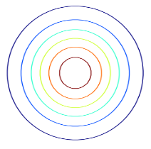
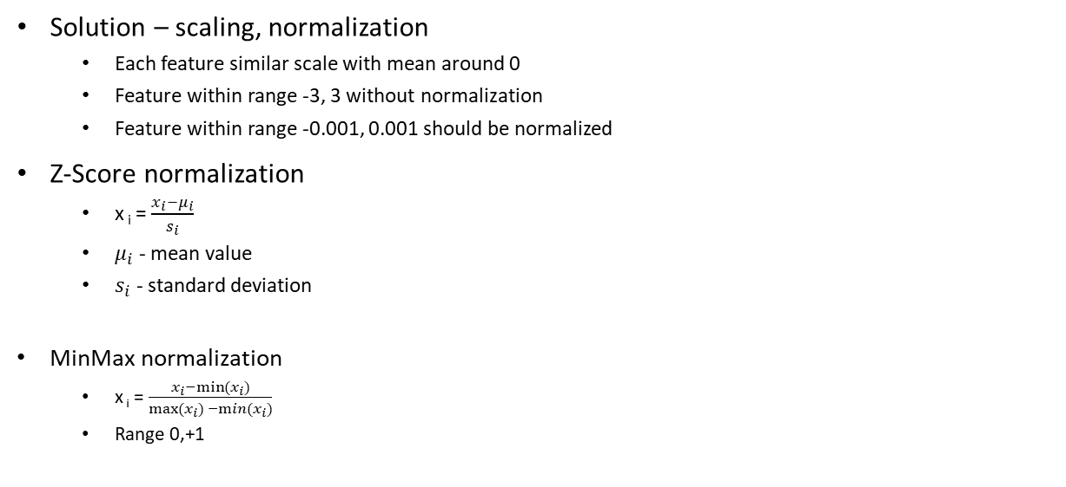
Feature scaling
Solution – scaling, normalization
Each feature similar scale with mean around 0
Feature within range -3, 3 without normalization
Feature within range -0.001, 0.001 should be normalized
Z-Score normalization
x _{i} = $\frac{x_{i}−μ_{i}}{s_{i}}$
$μ_{i}$ - mean value
$s_{i}$ - standard deviation
MinMax normalization
x _{i} = $\frac{x_{i}−{min⁡(x}_{i})}{{\max{(}x}_{i}) −min⁡(x_{i})}$
Range 0,+1
bathrooms
livingArea

