Slide 1

Constantin Shoot Vayevoda
Development of a Contextual Sensing Kit to Assess the Relationship Between Air Quality and Noise
Treball de Fi de Grau en Enginyeria Biomèdica
dirigit per Edgar Batista de Frutos i Antoni Martínez Ballesté
Tarragona
2025

Slide 2
Contents
Introduction & Motivation
Objectives & Theoretical Basis
Design & Implementation
Validation & Experiment Setup
Results & Discussion
Future Work
Conclusions

Slide 3
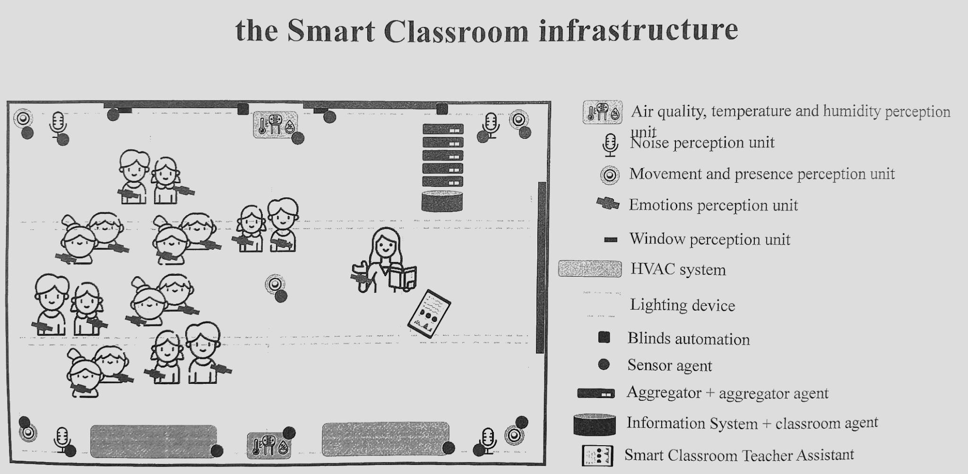
1: Motivation and problem
IEQ impacts comfort and learning
Current solutions are ad hoc, hard to compare
Issues: heterogeneity, manual setup, weak synchronisation
Need modular kits with accurate timestamping and privacy

Slide 4

2.1: Objectives
Build two modular kits: AirQ (air quality) & Noise (voice-band)
Accurate, timestamped on-device data retention; light IoT hooks
Compact 3D-printed enclosures for indoor use
Validate in real context; initial air–noise correlation analysis
Phase 1 groundwork boundary: networking & cloud deferred to Phase 2

Slide 5
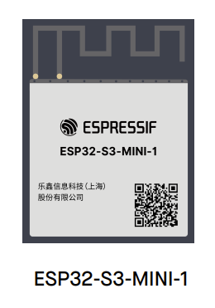
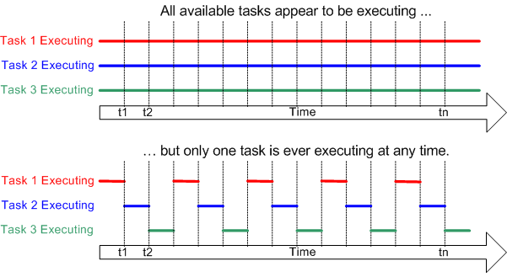
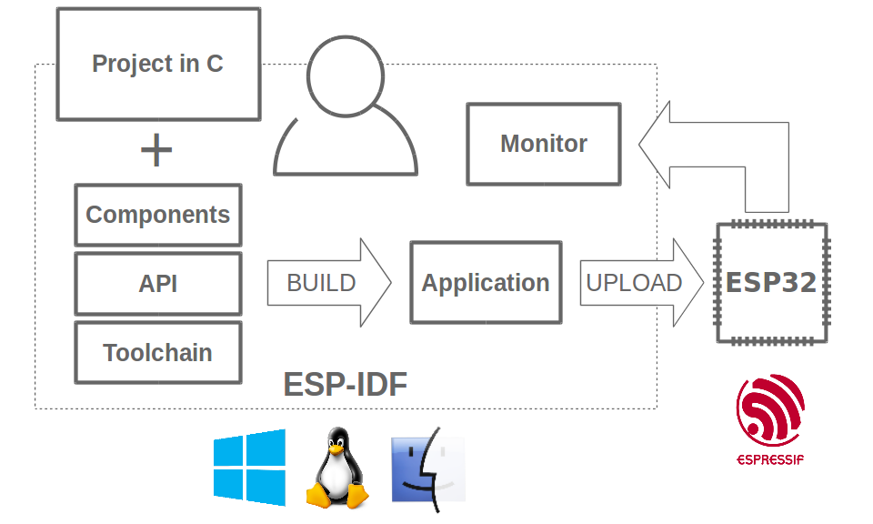
2.2: RTOS and ESP32
www.freertos.org
www.espressif.com

Slide 6
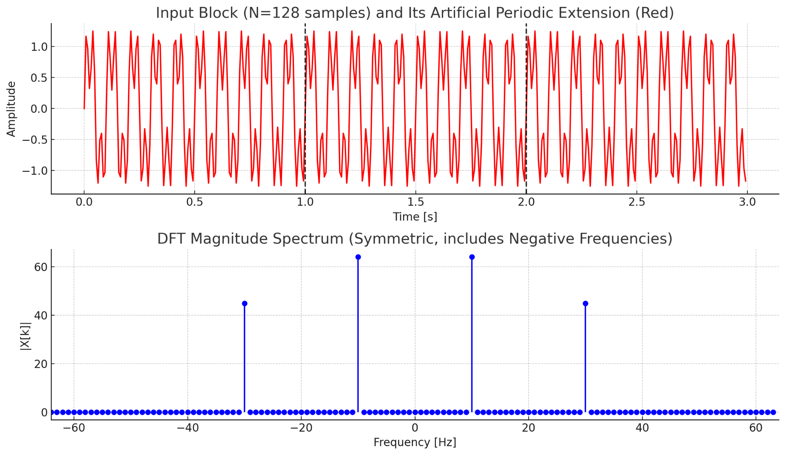
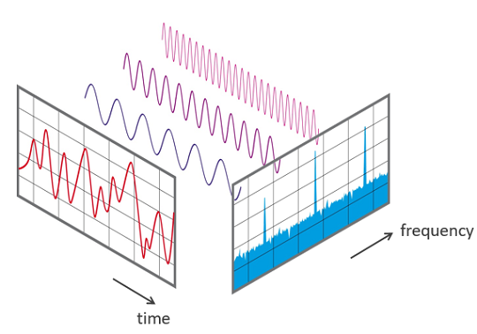
2.3: Discrete Fourier Transform and FFT
www.allaboutcircuits.com

Slide 7
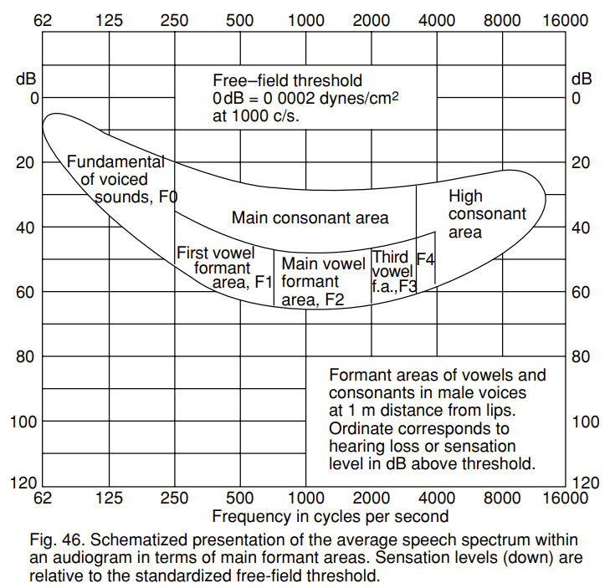
2.3: “Speech Banana”

Slide 8
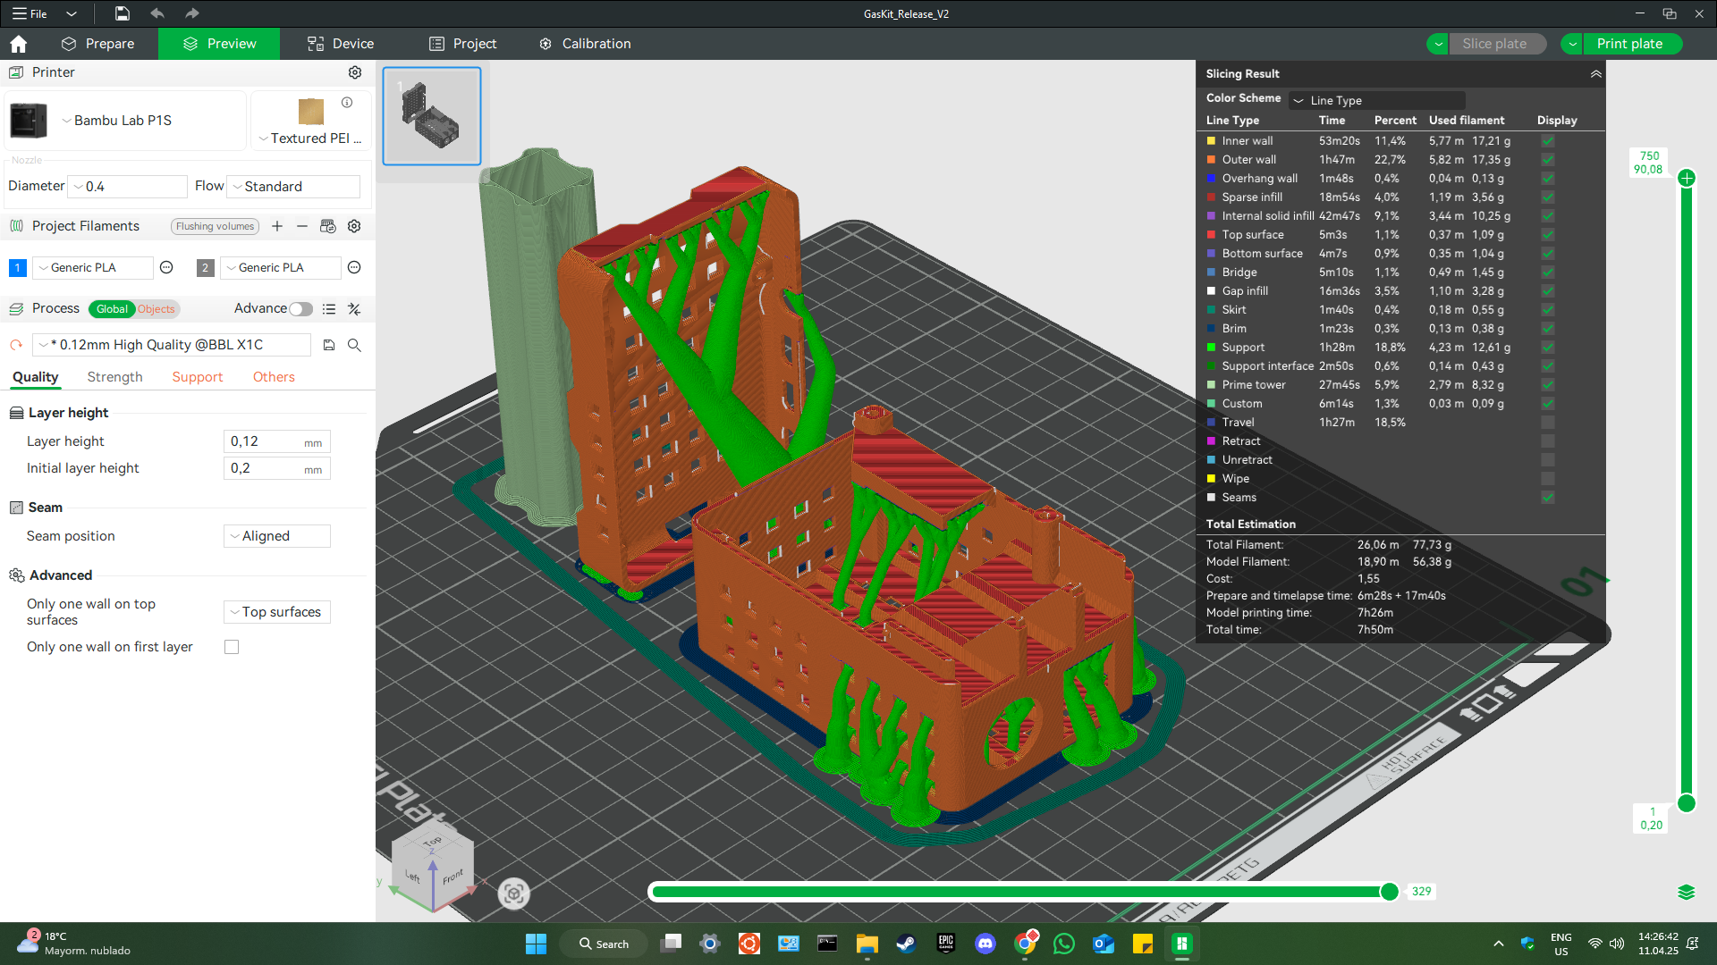
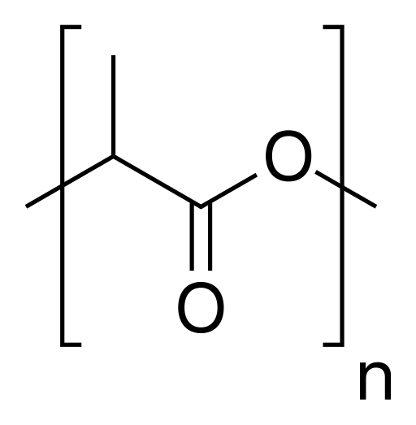
2.4: 3D printing and PLA

Slide 9
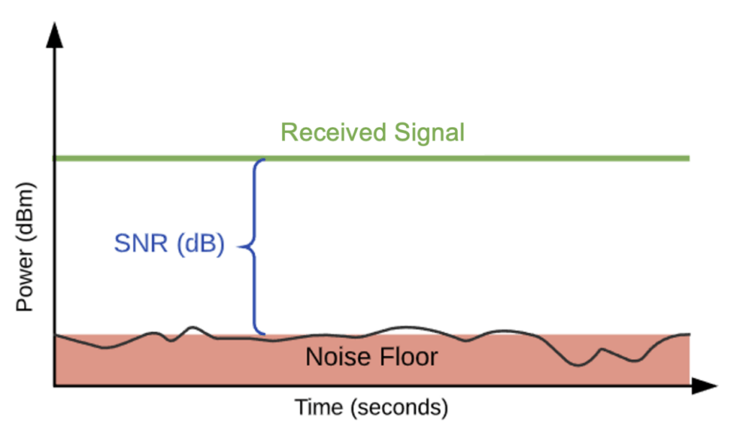
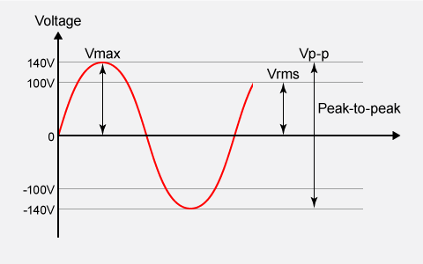
2.5: Data science
www.hollyland.com
www.matsusada.com

Slide 10
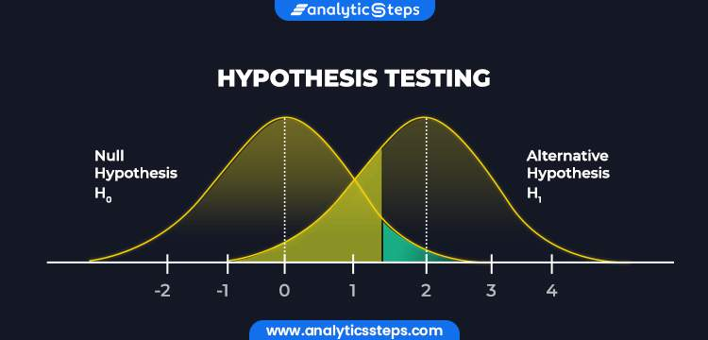
2.5: Data science
H₀/H₁ testing for Pearson r
Lagged alignment
Autocorrelation addressed
False discovery rate
Slow trends considered

Slide 11
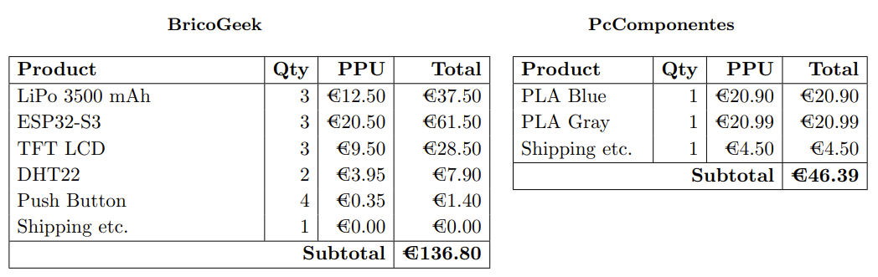
3.1: Budget

Slide 12
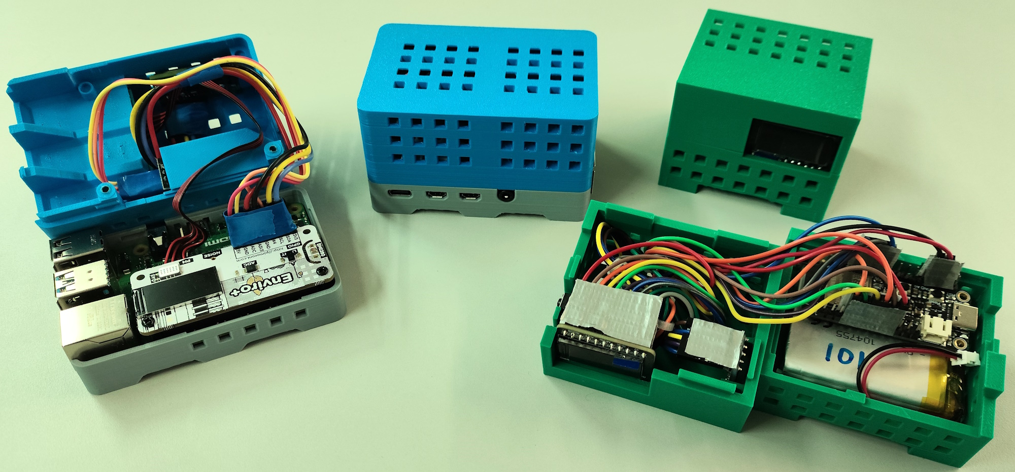
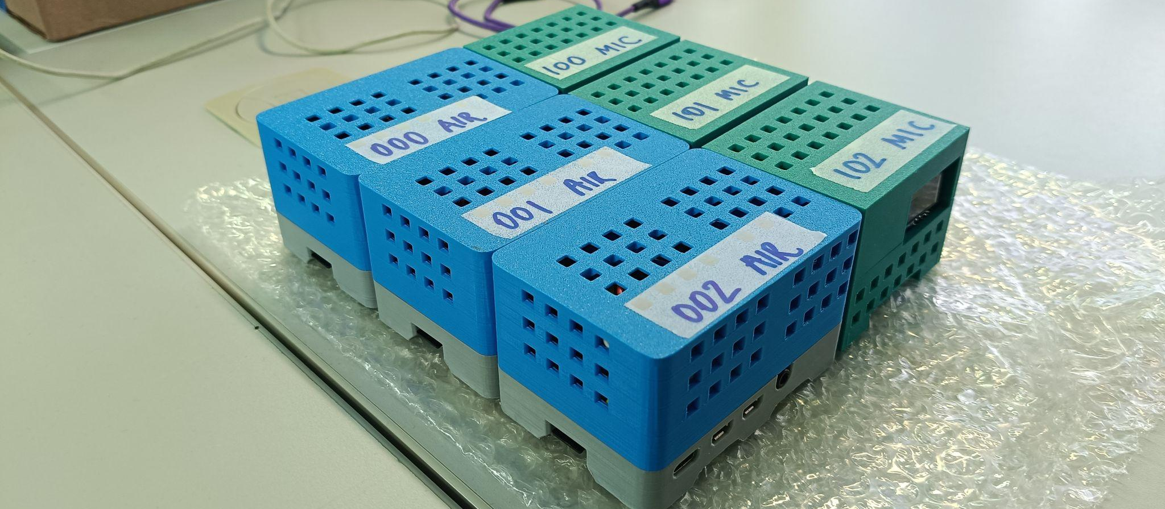
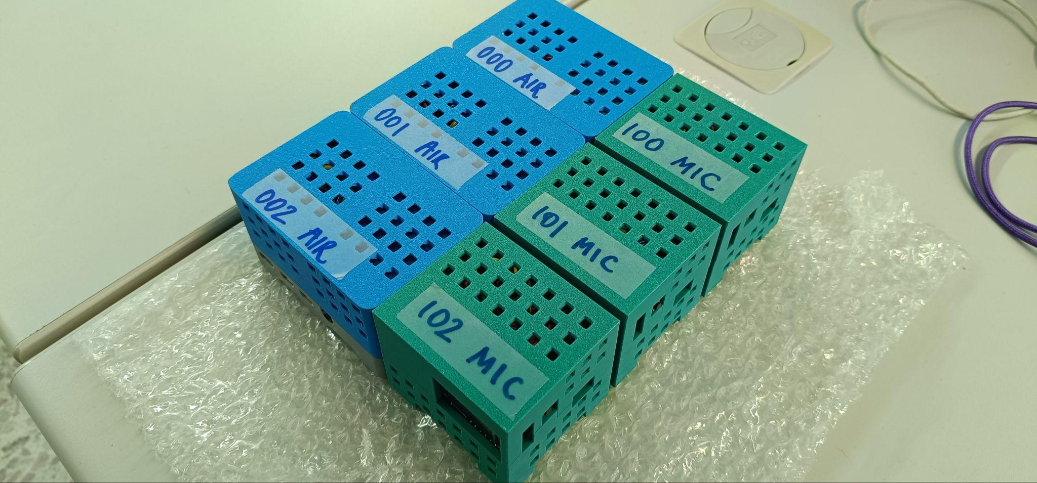
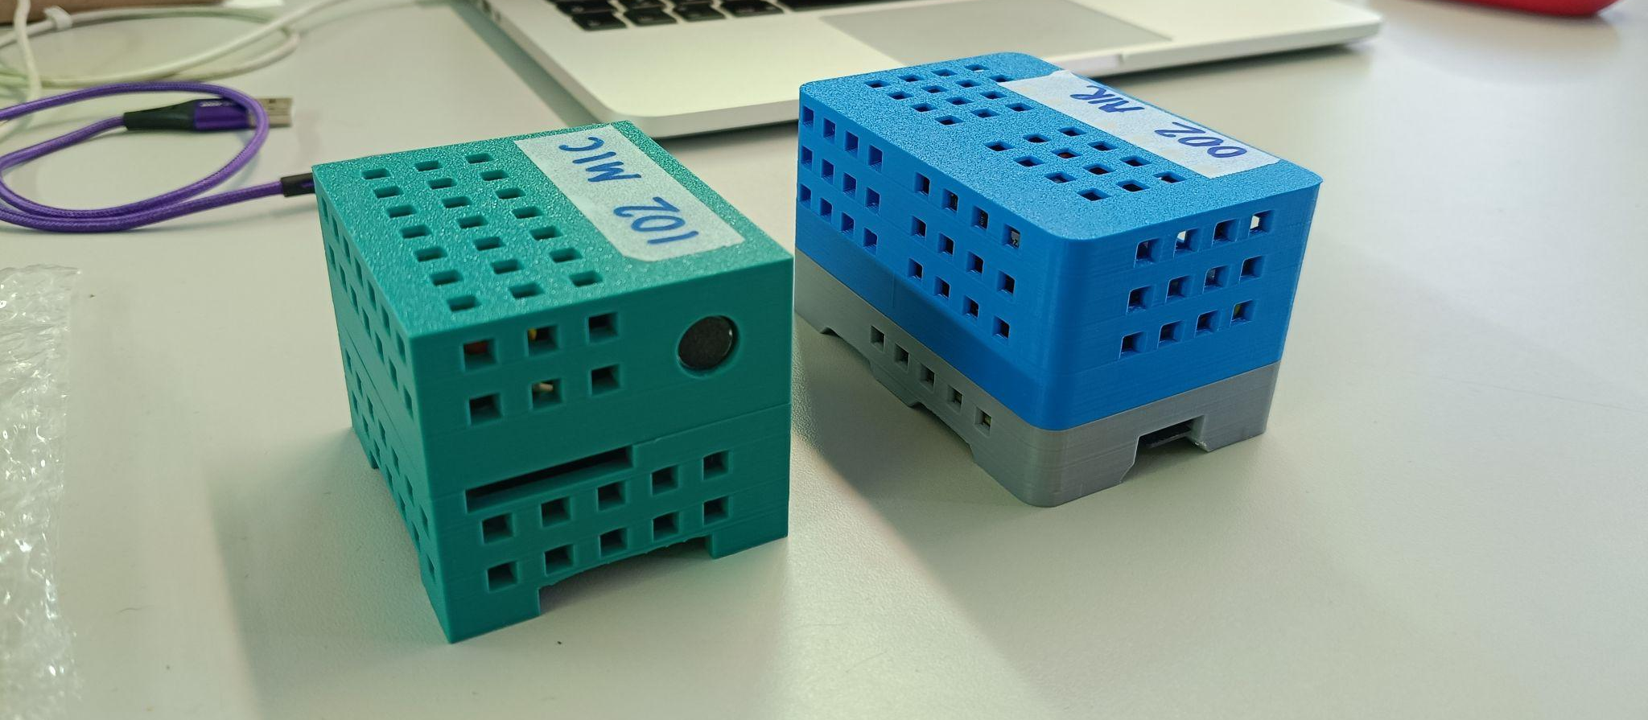
3.2: Kits produced

Slide 13
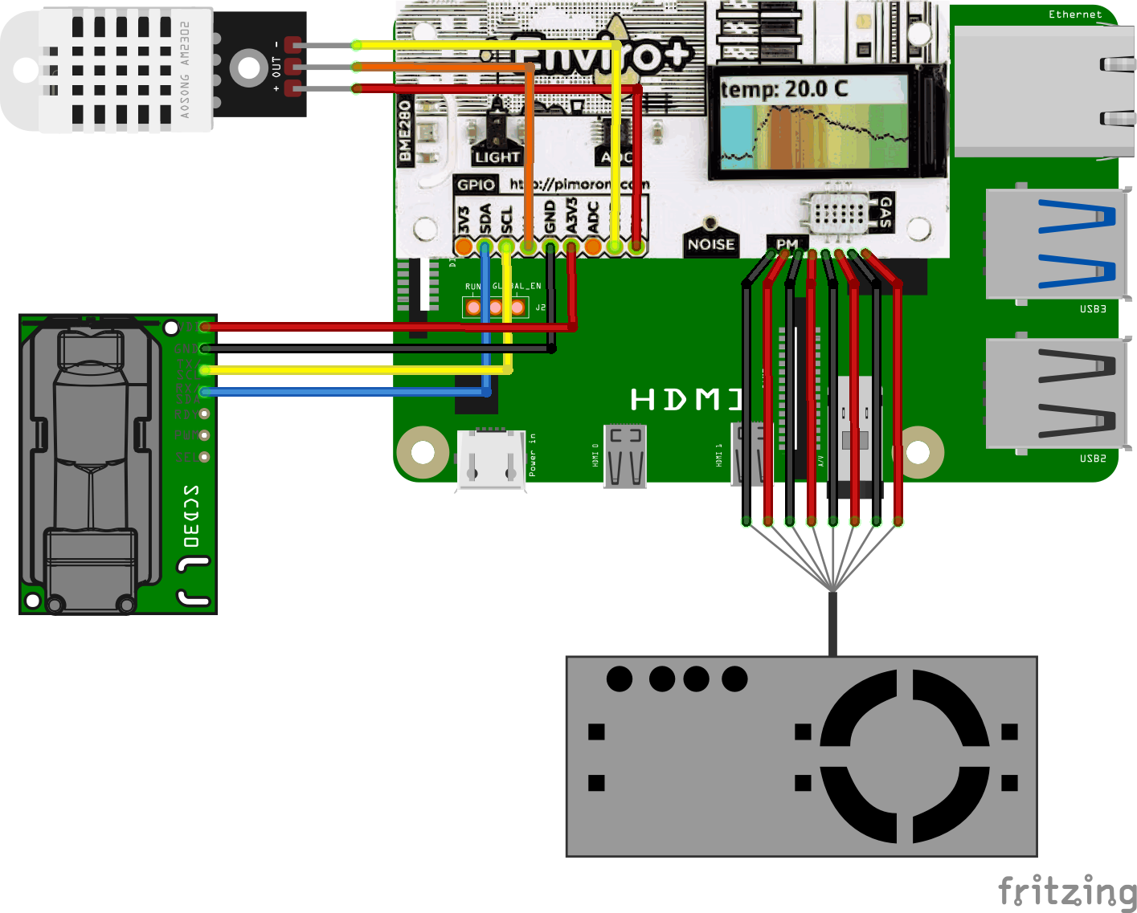
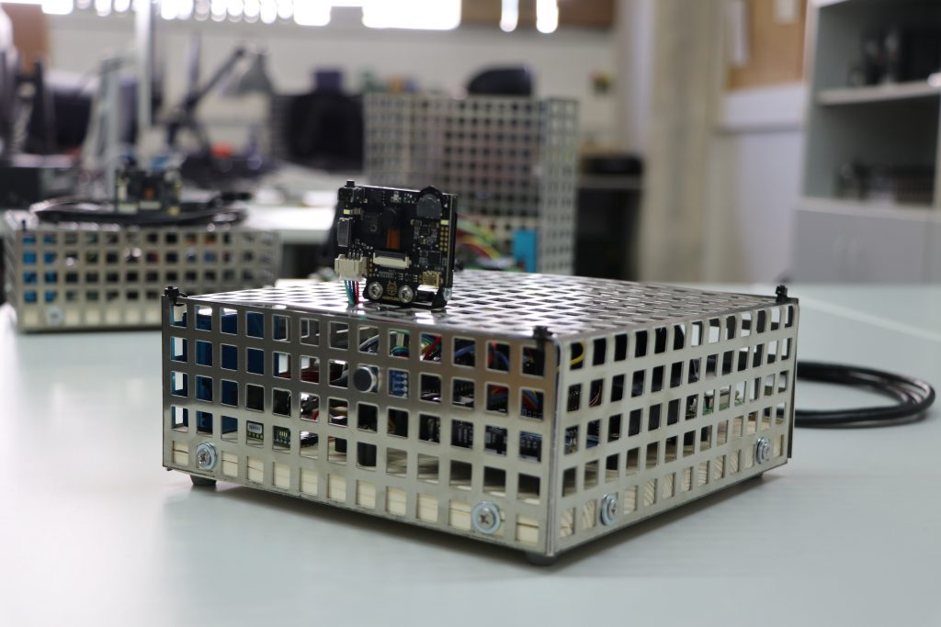
3.3: AirQ kit hardware

Slide 14
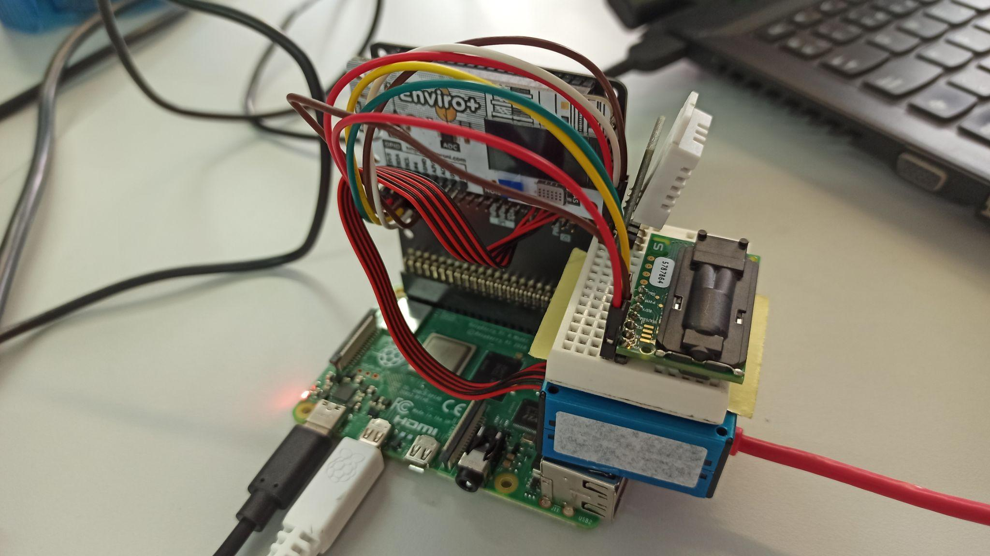
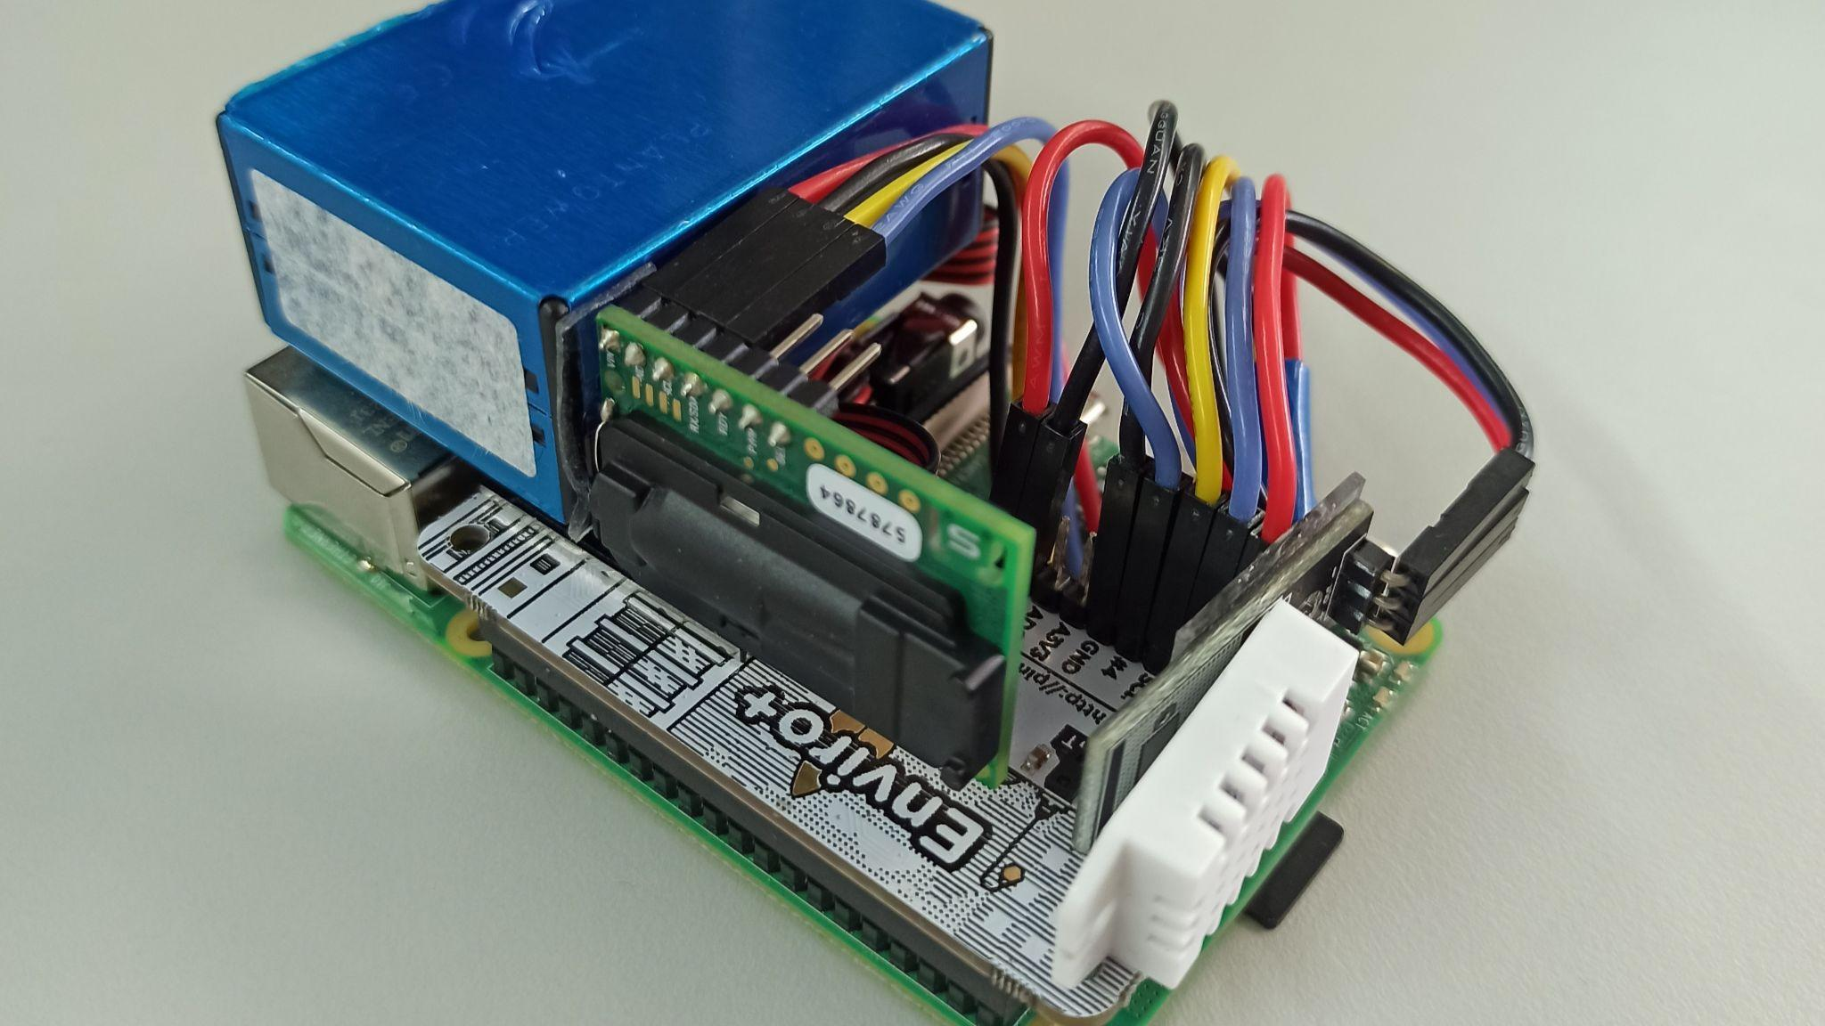
3.3: AirQ kit hardware

Slide 15
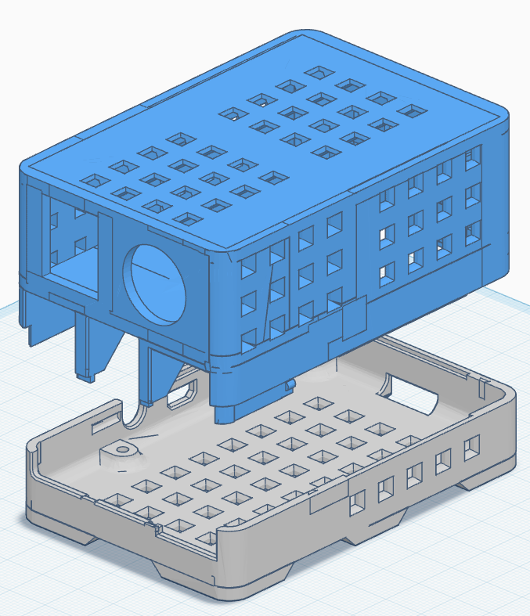
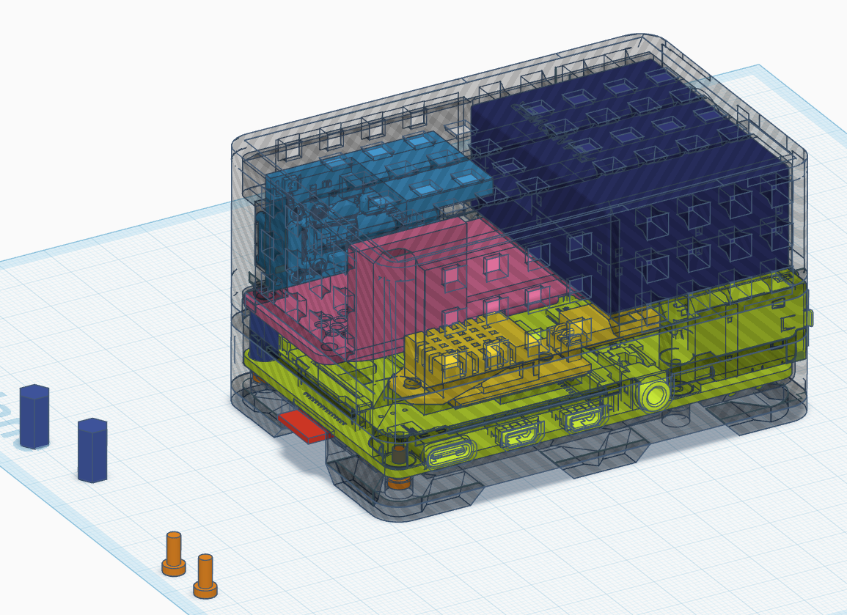
3.4: AirQ kit enclosure

Slide 16
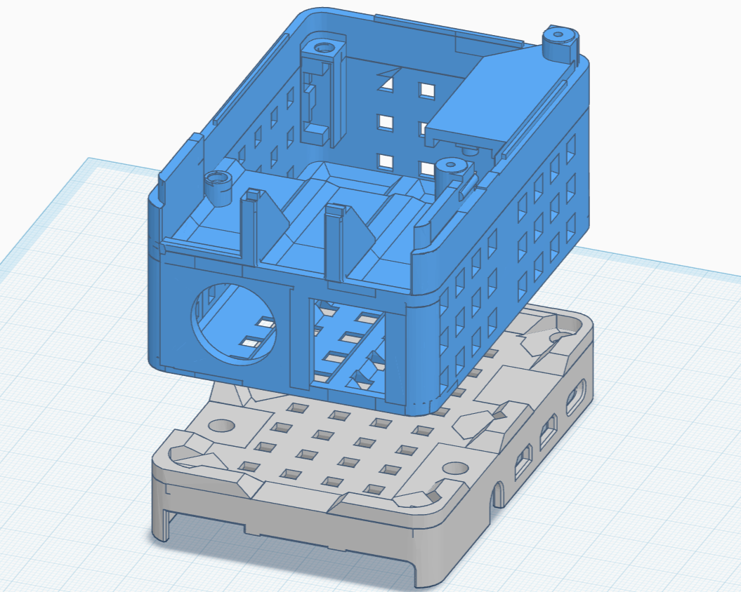
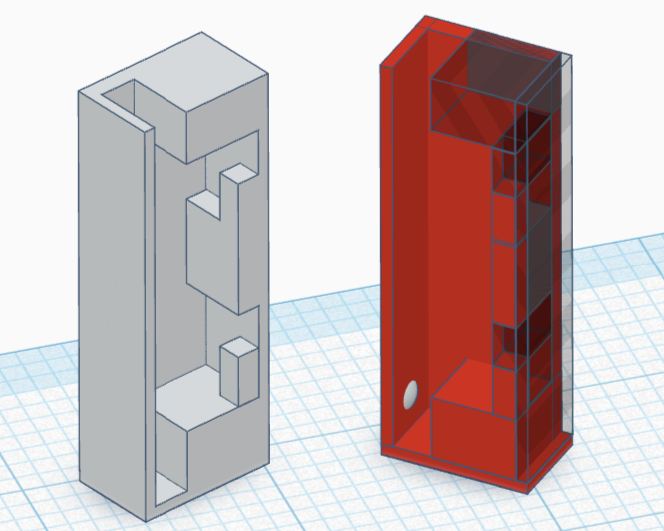
3.4: AirQ kit enclosure

Slide 17
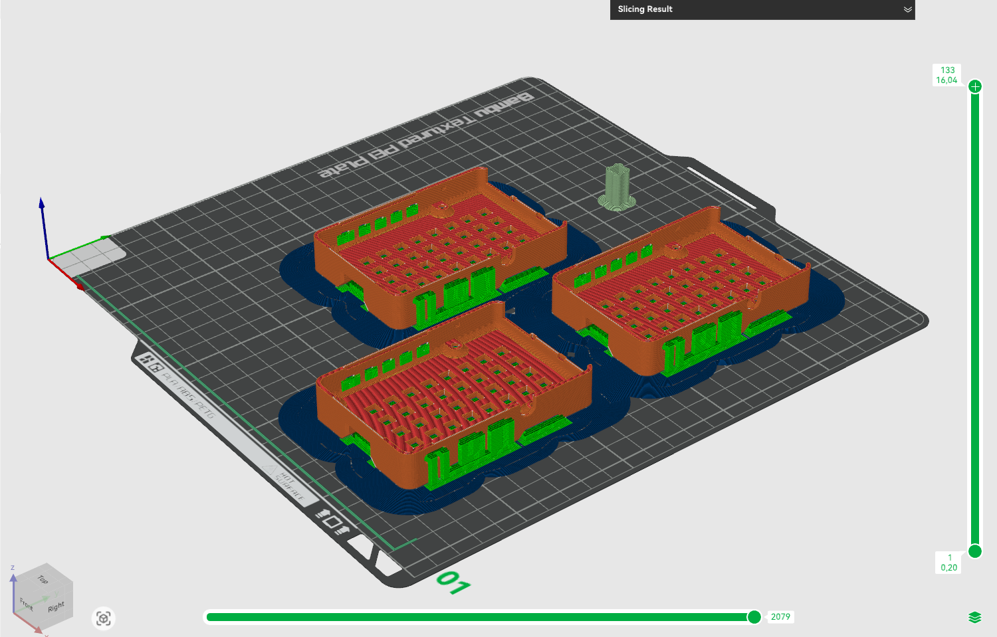
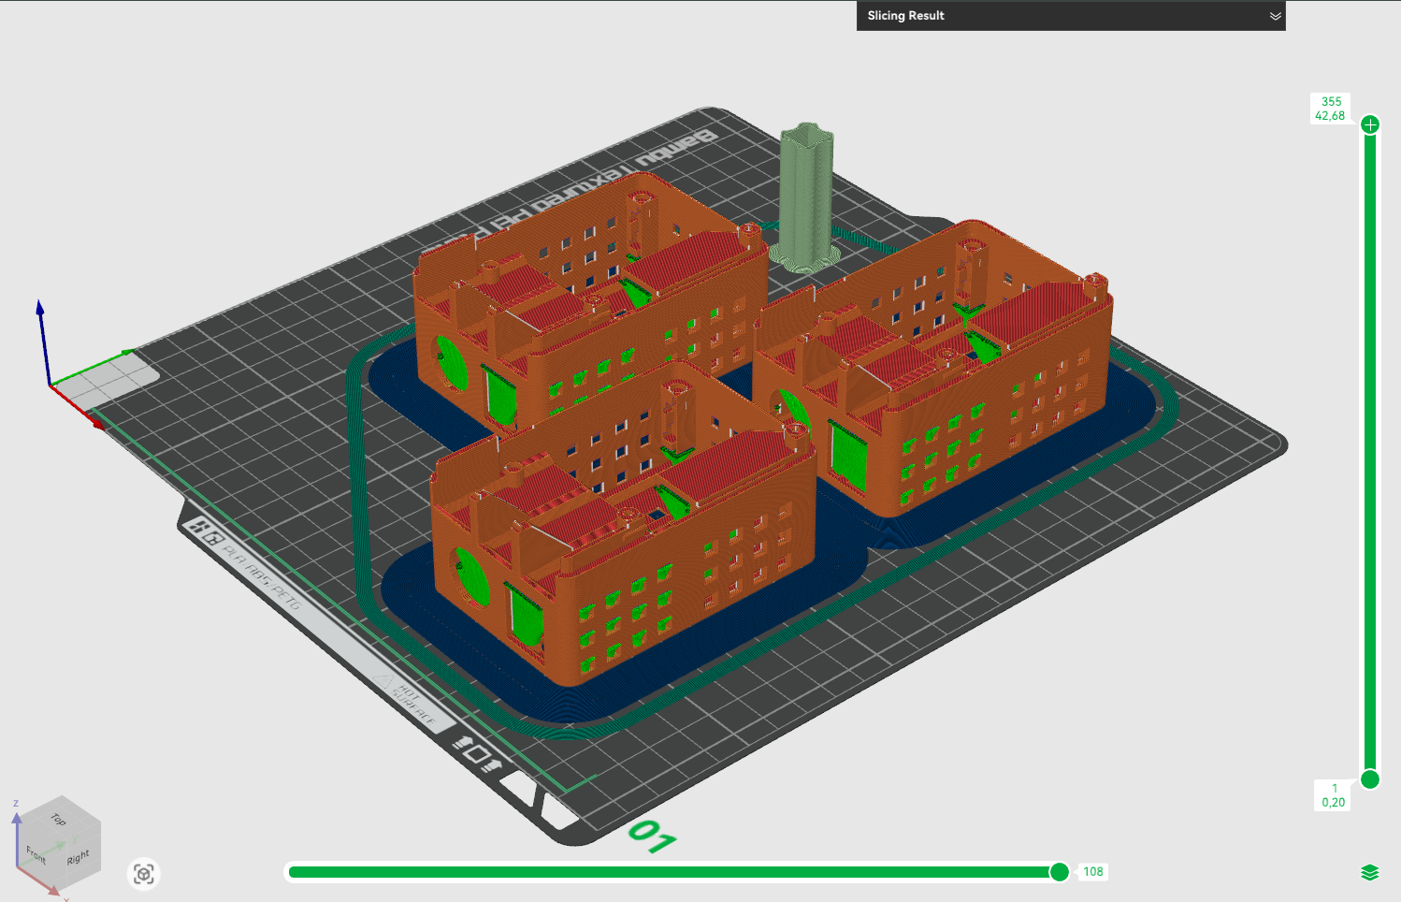
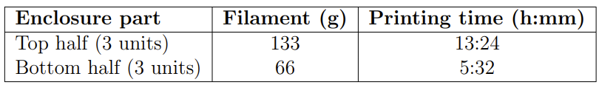
3.4: AirQ kit enclosure

Slide 18
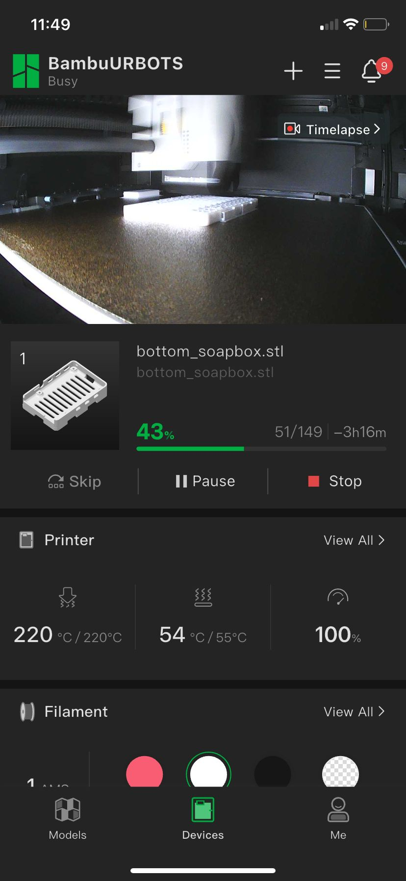
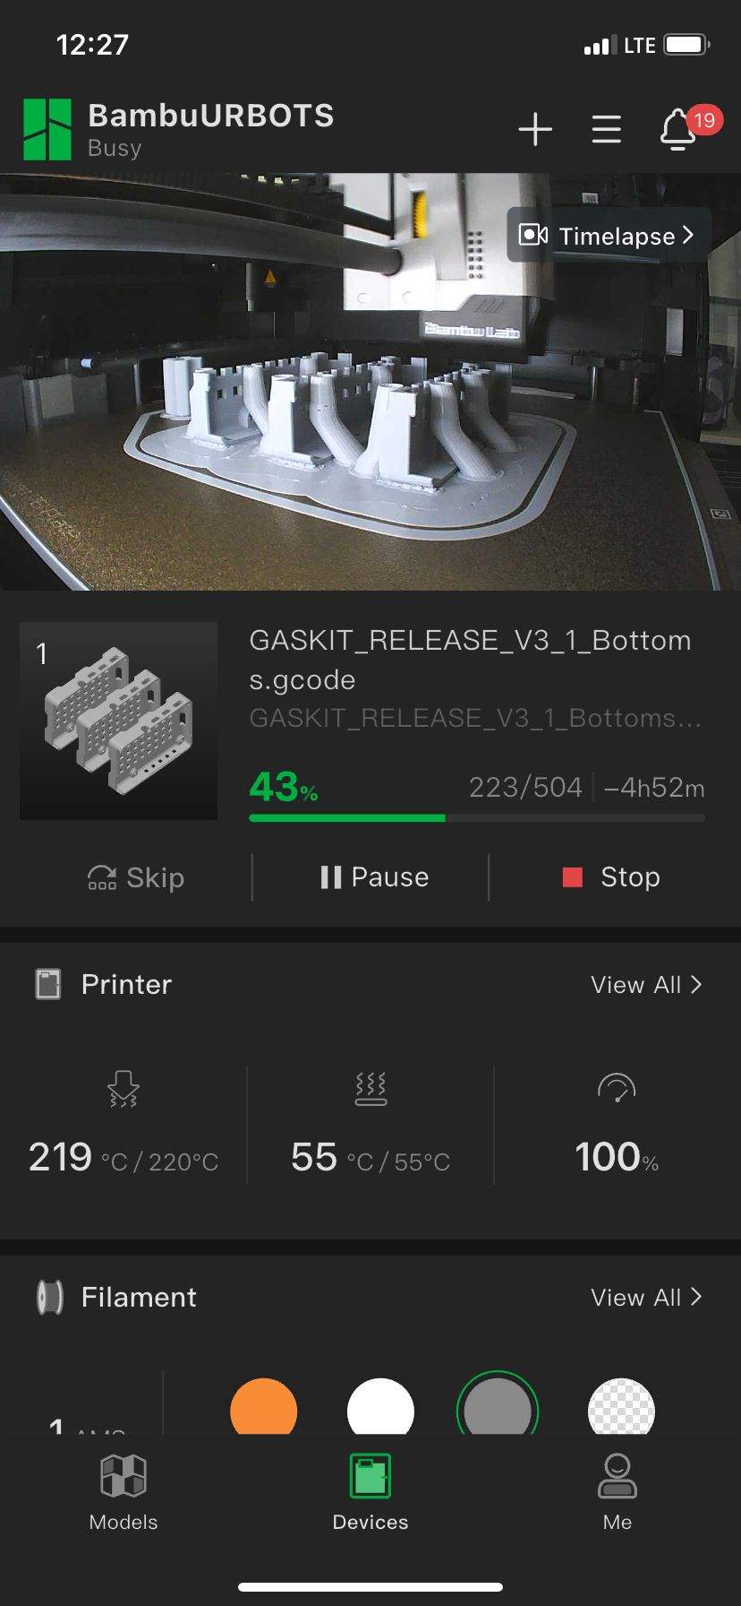
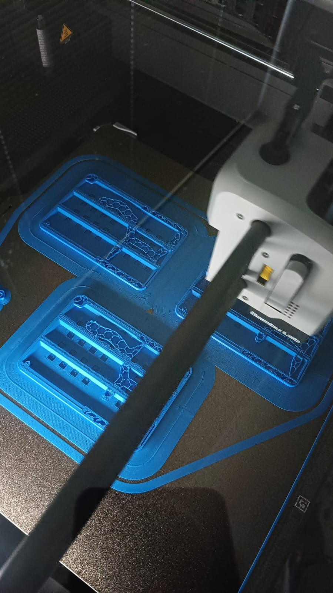
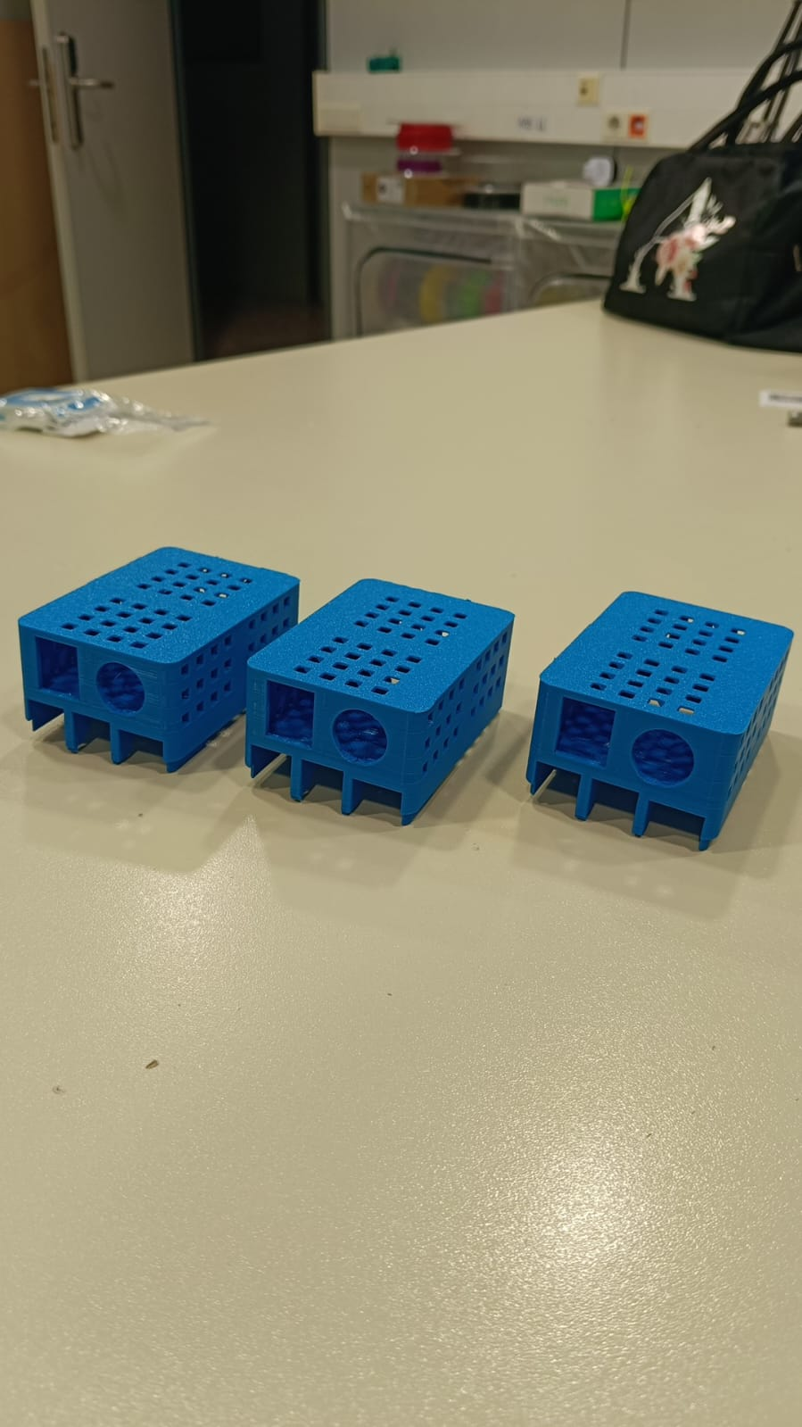
3.4: AirQ kit enclosure

Slide 19

3.4: AirQ kit enclosure

Slide 20
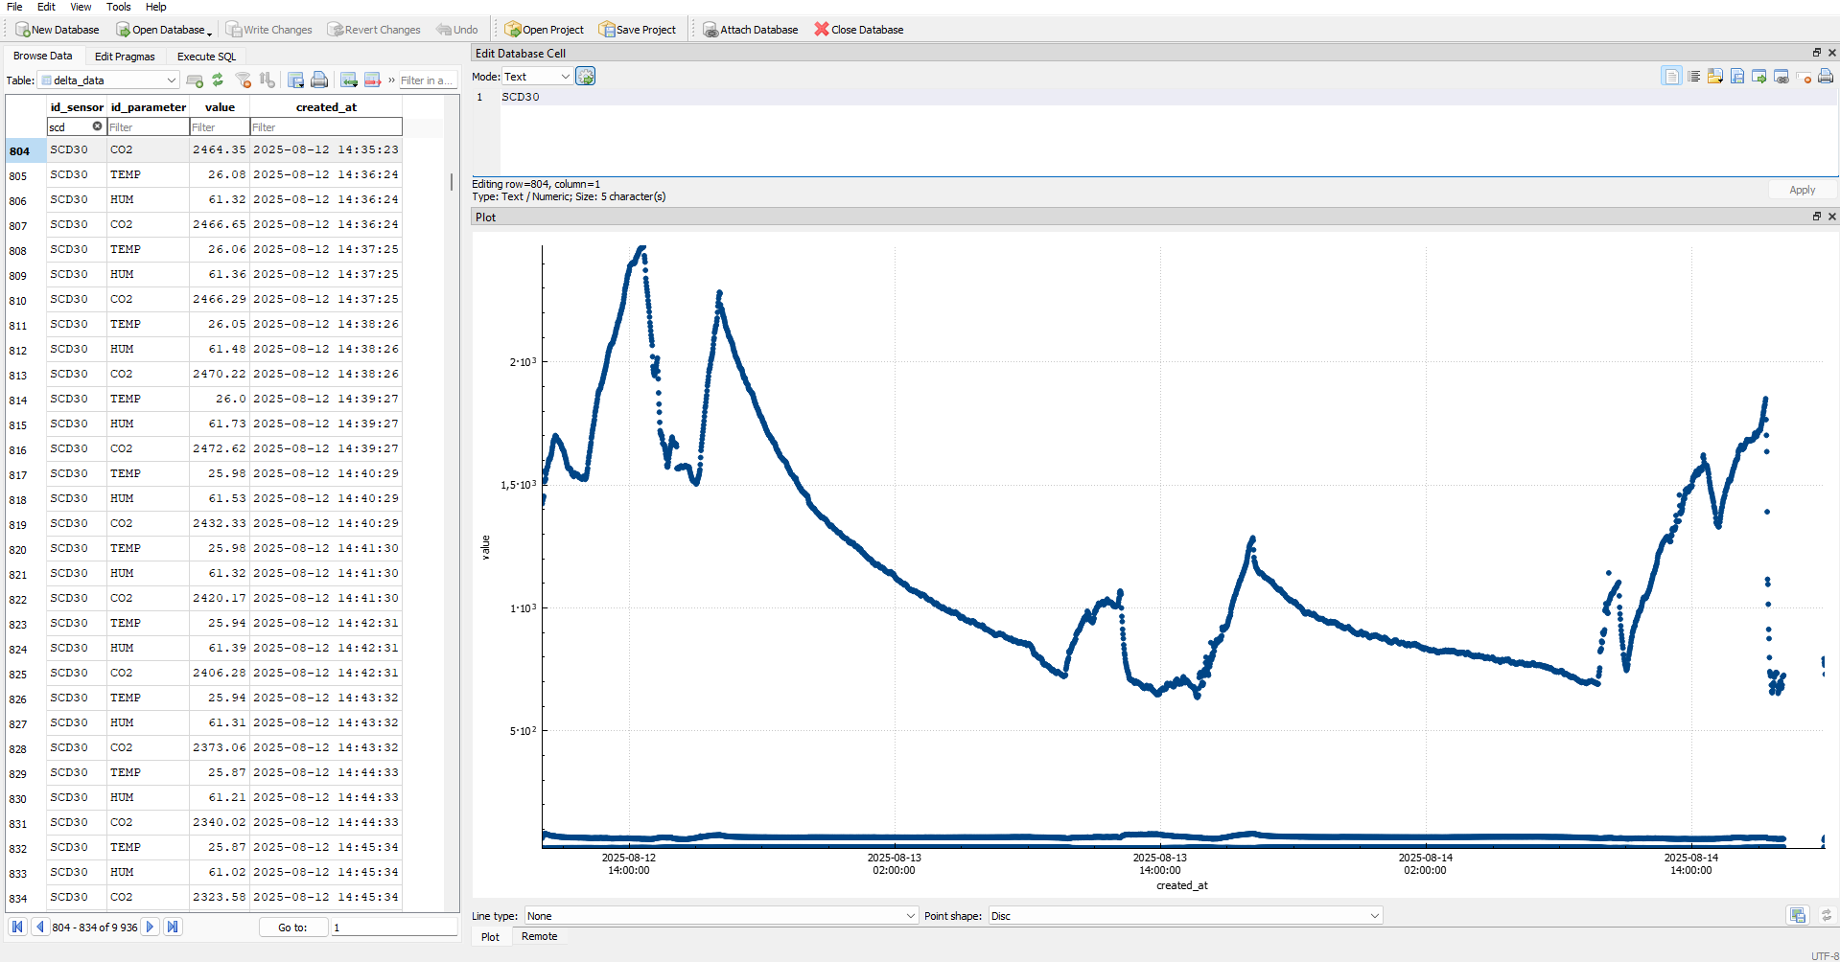
3.5: AirQ kit software
ACTUA legacy code modified
SQLite logging
Control scripts
Easy installation
Modular
Temp./Hum., pressure, PM, CO₂, Illuminance

Slide 21
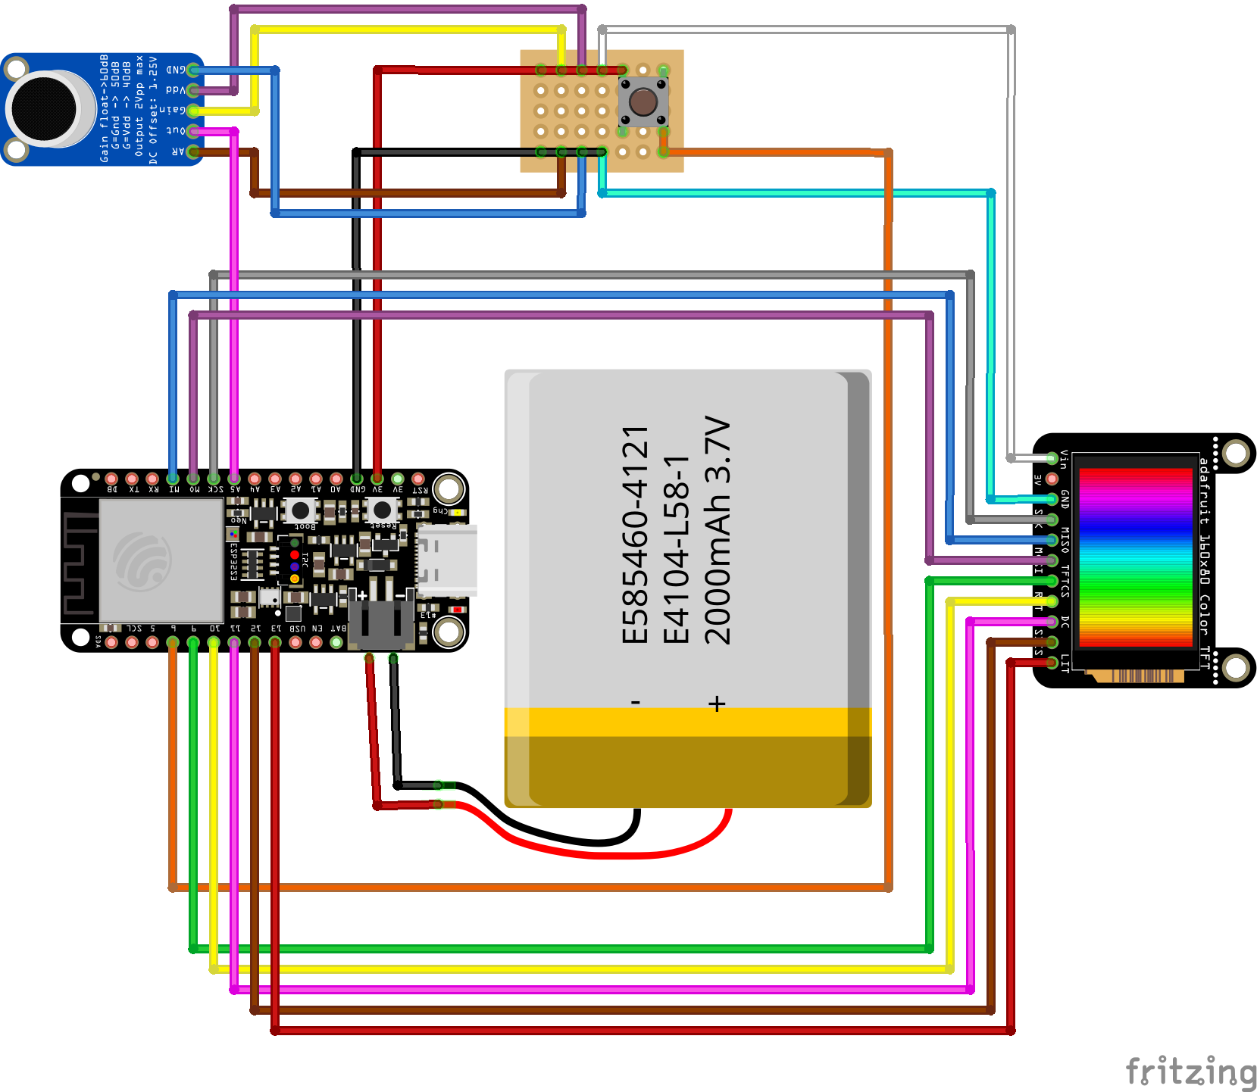
3.6: Noise kit hardware

Slide 22
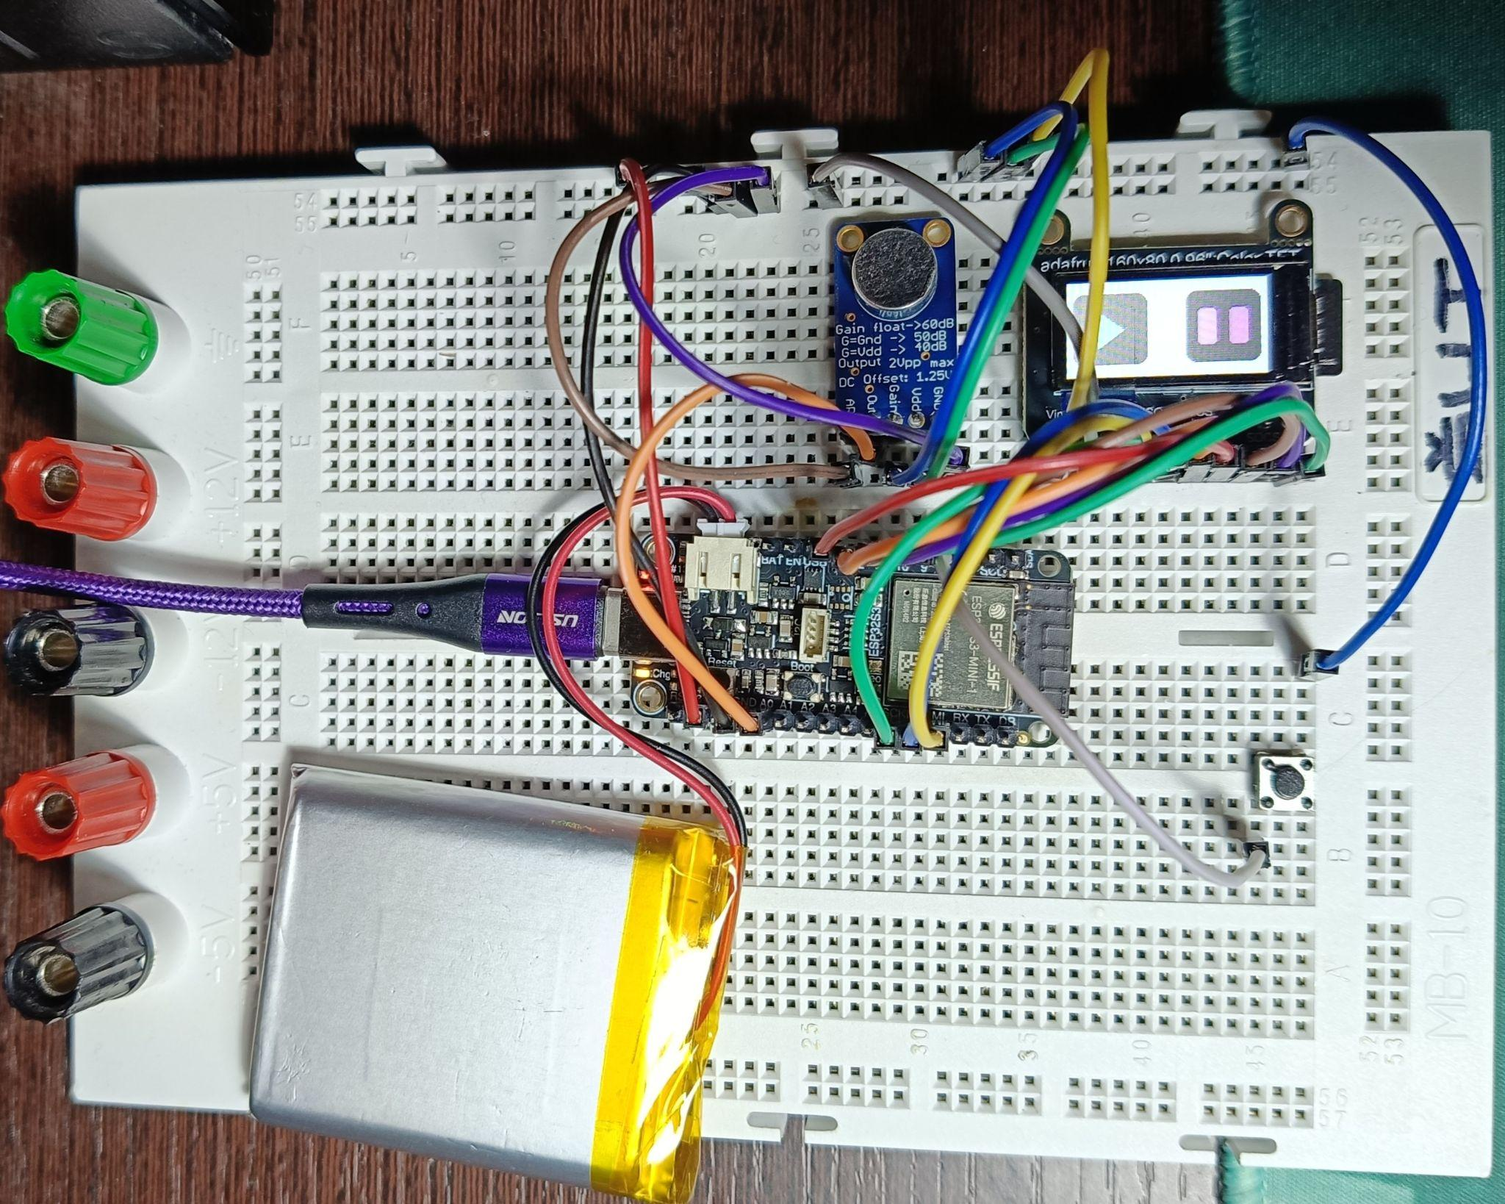
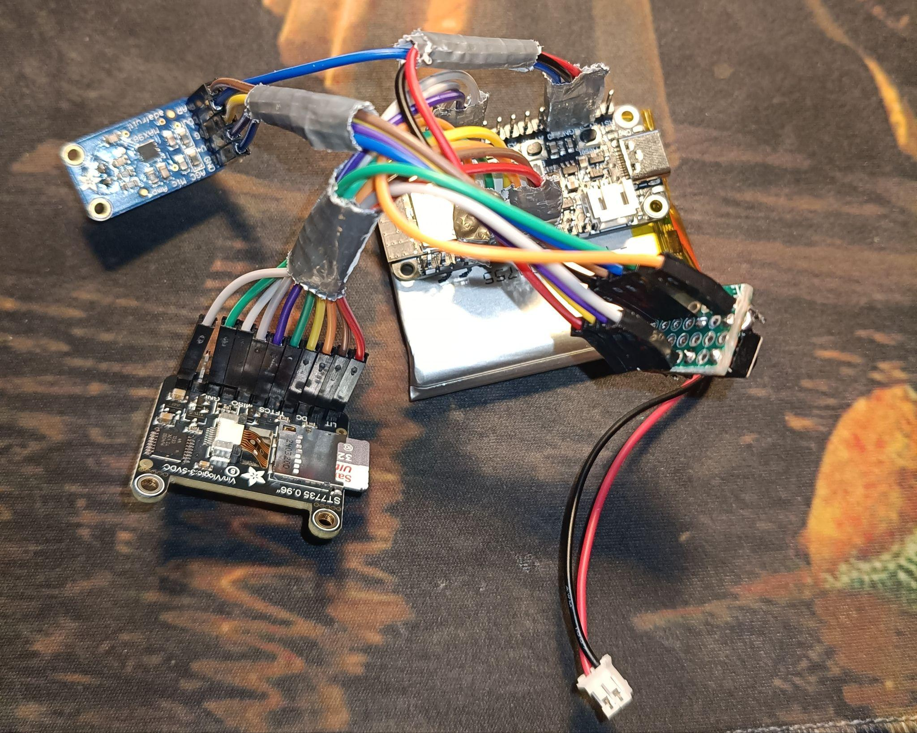
3.6: Noise kit hardware

Slide 23
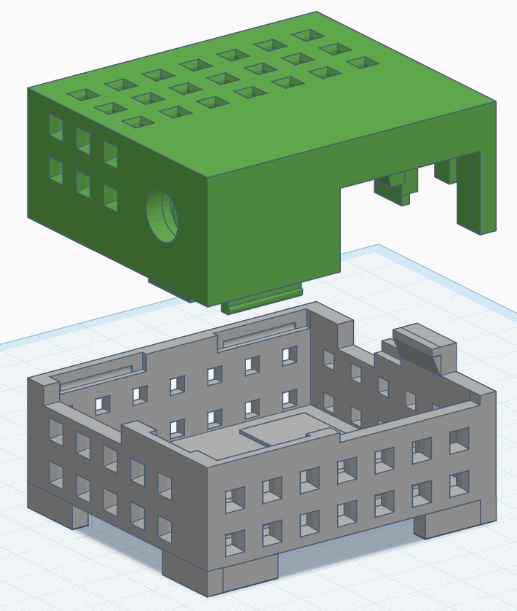
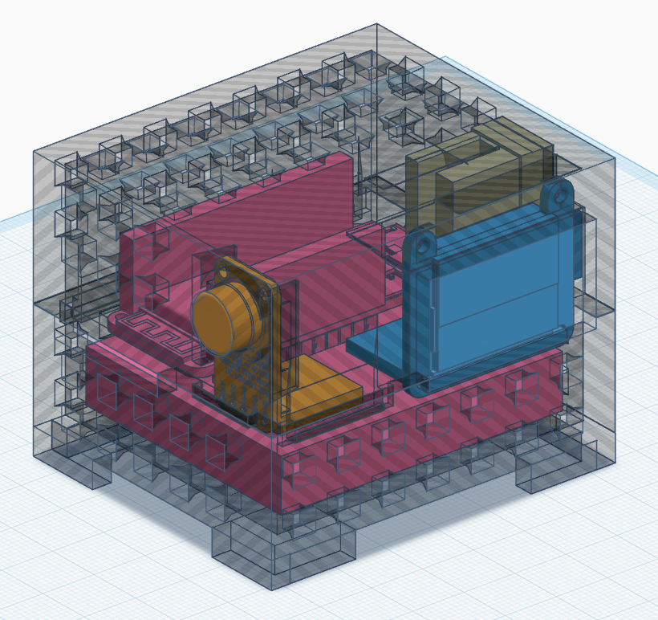
3.7: Noise kit 3D enclosure

Slide 24
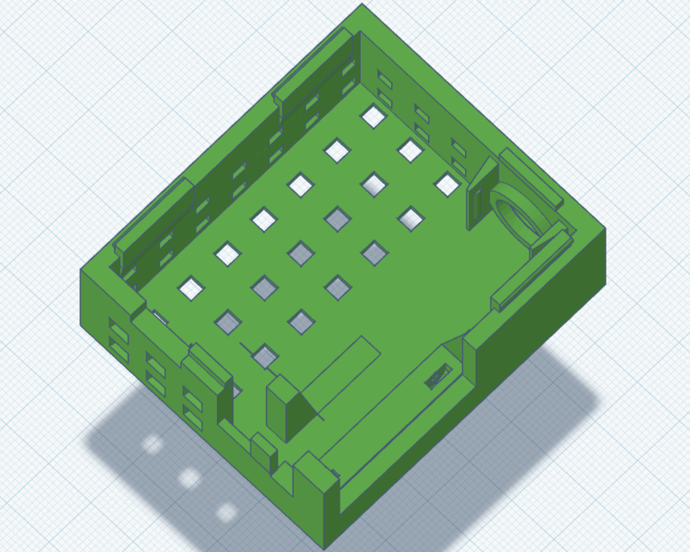
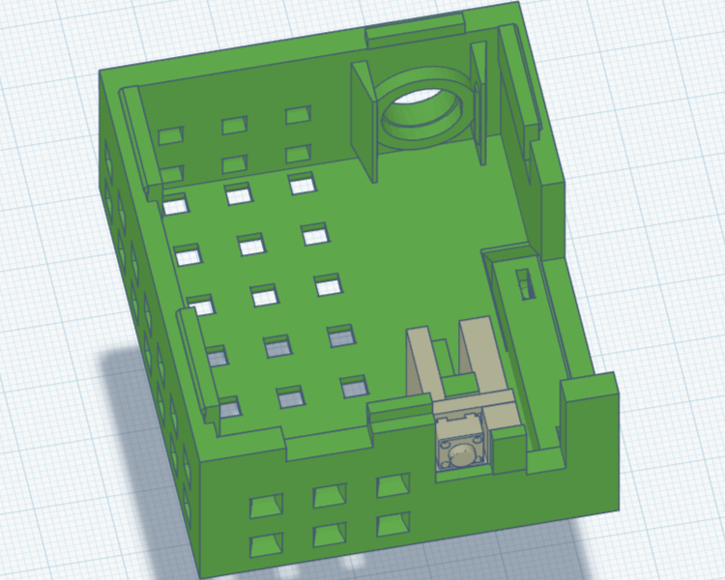
3.7: Noise kit 3D enclosure

Slide 25
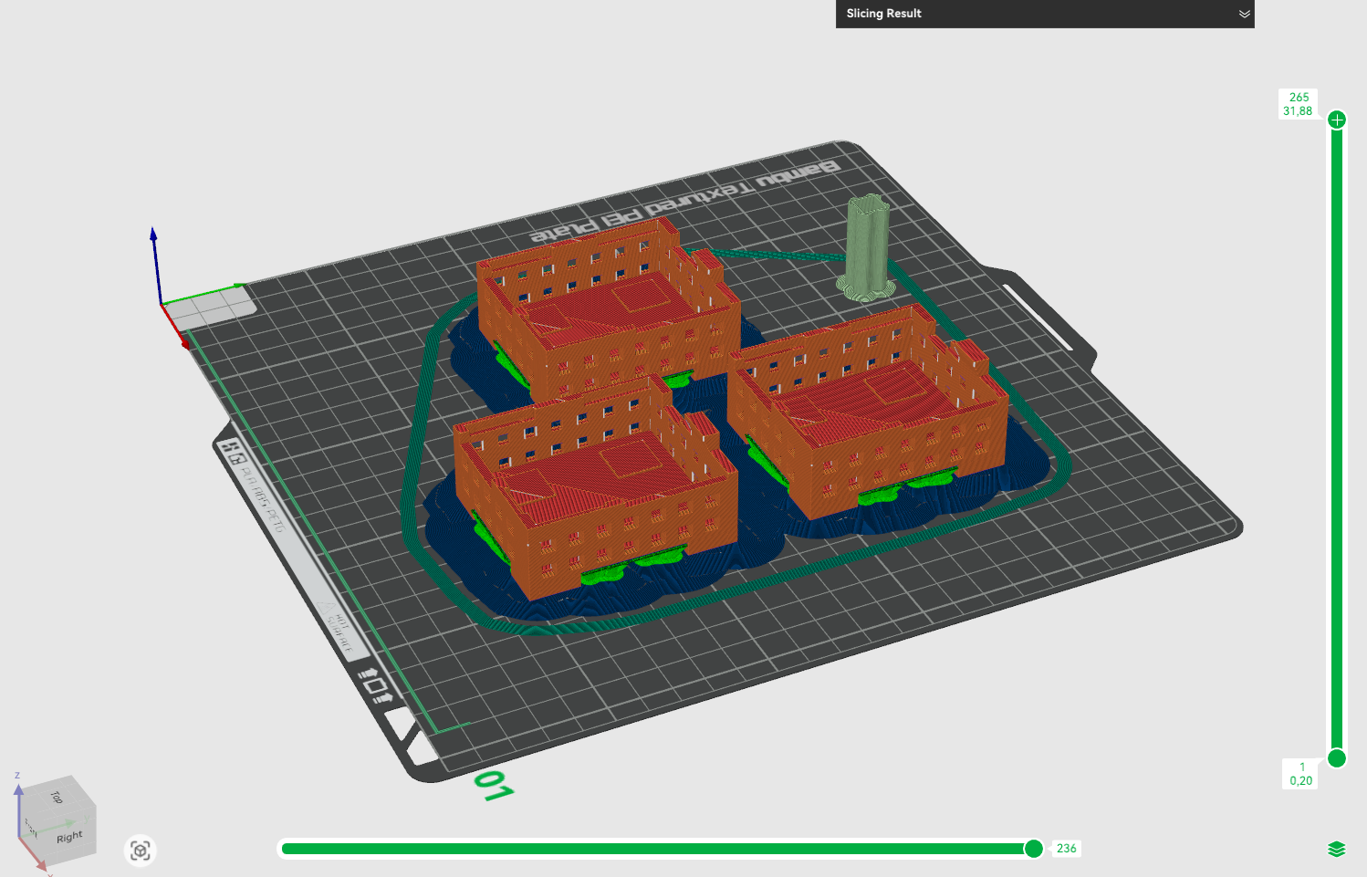
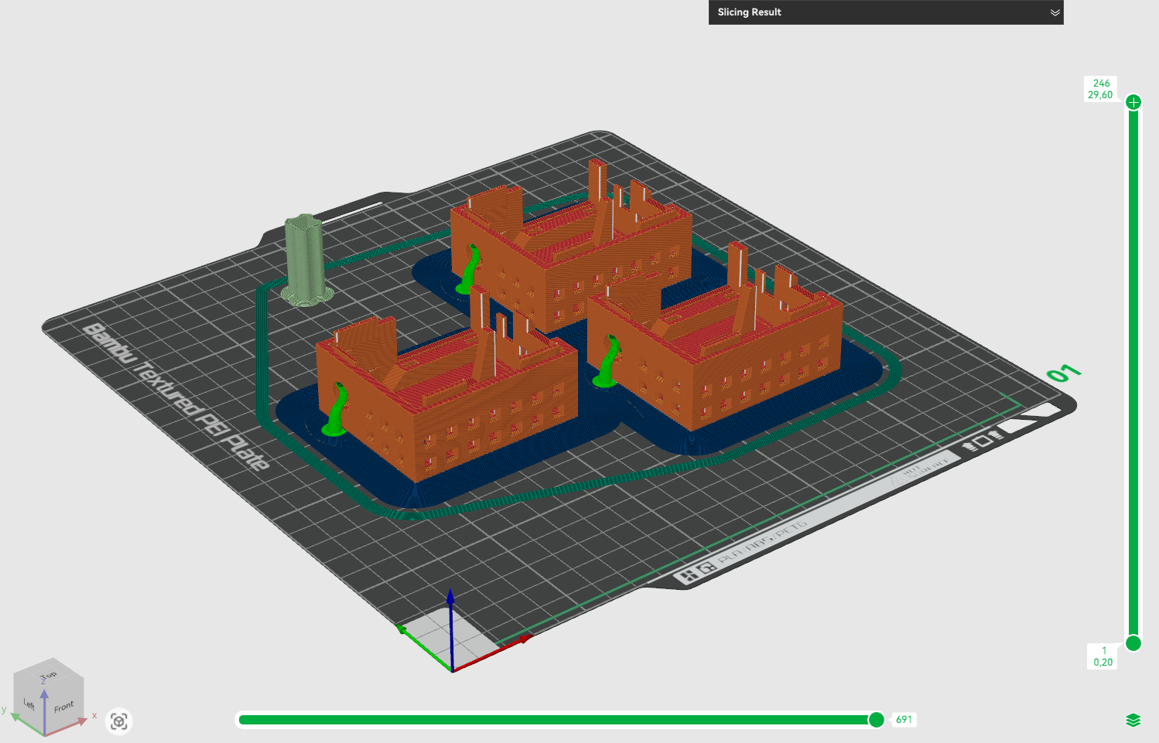
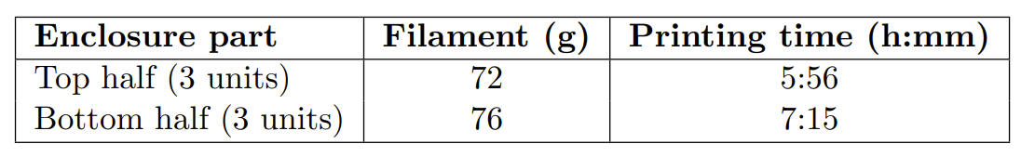
3.7: Noise kit 3D enclosure

Slide 26
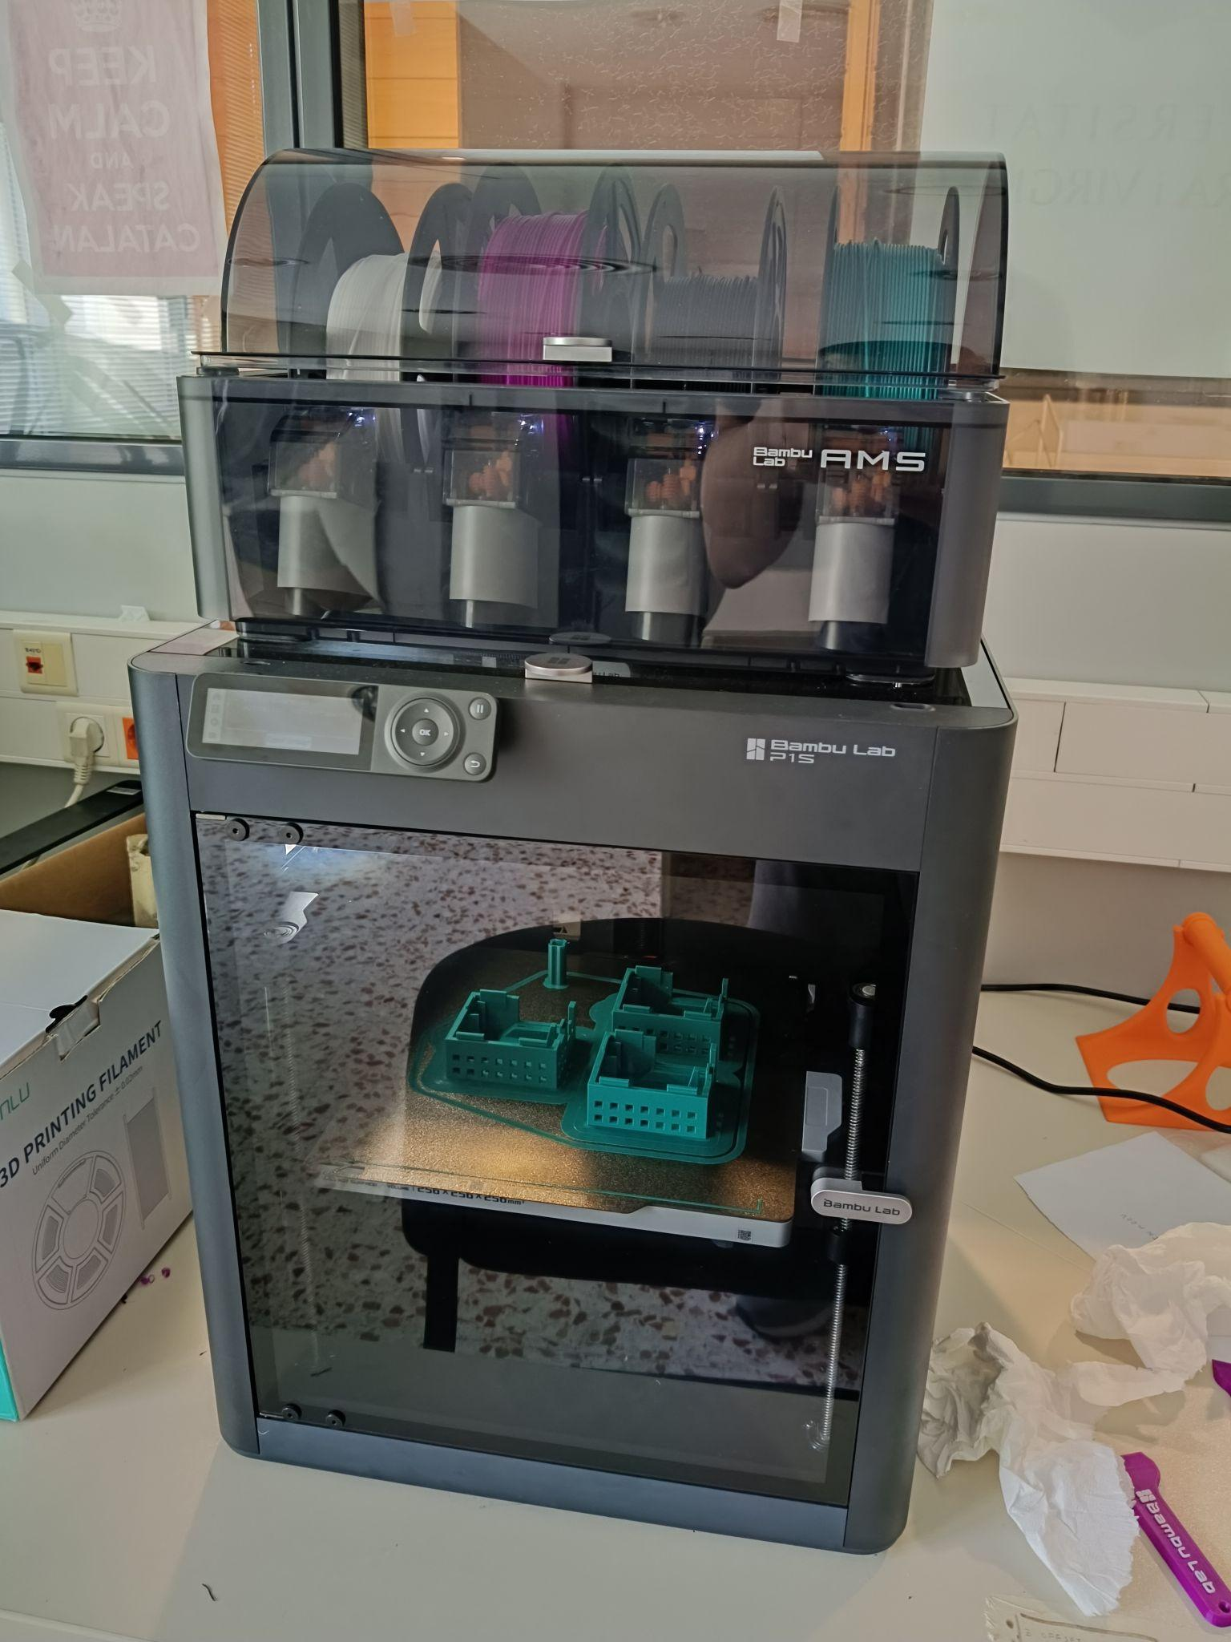
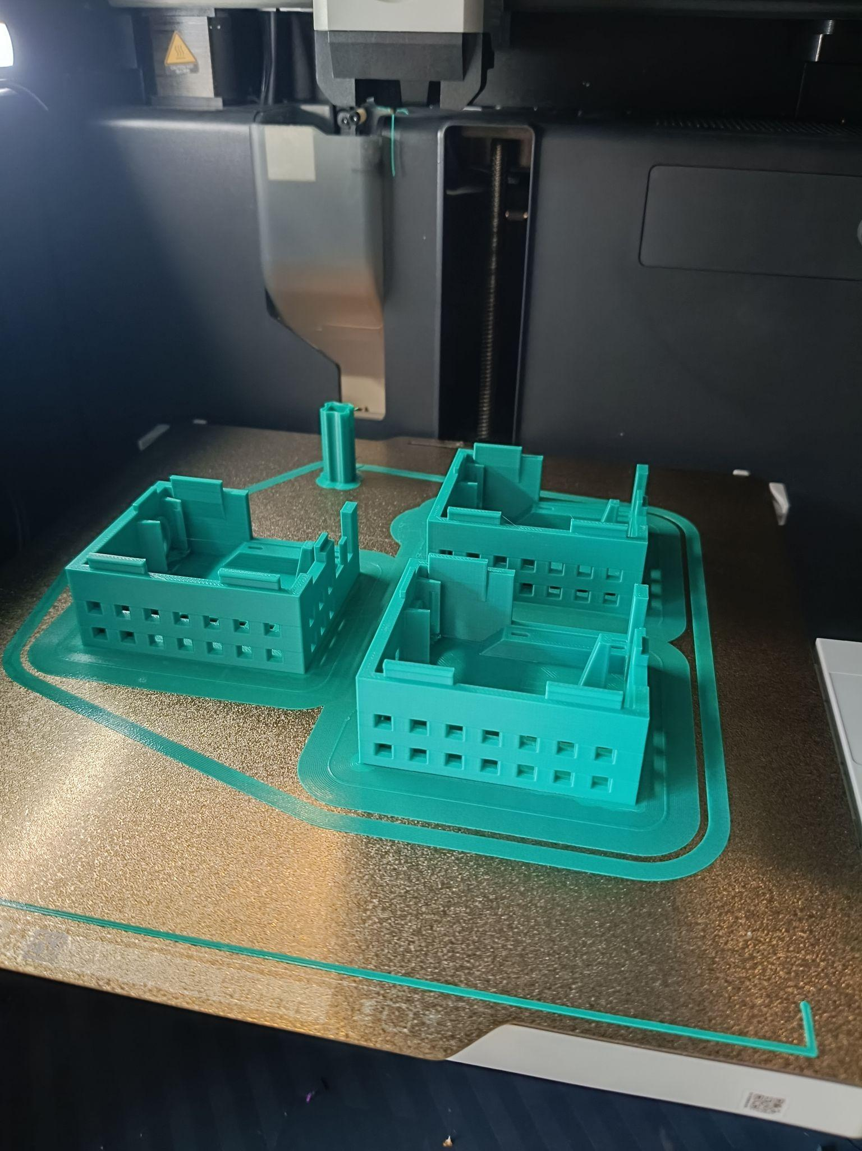
3.7: Noise kit 3D enclosure

Slide 27
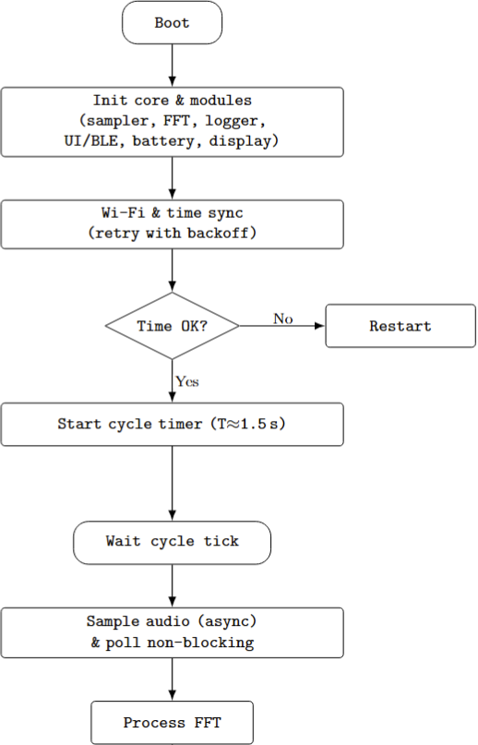
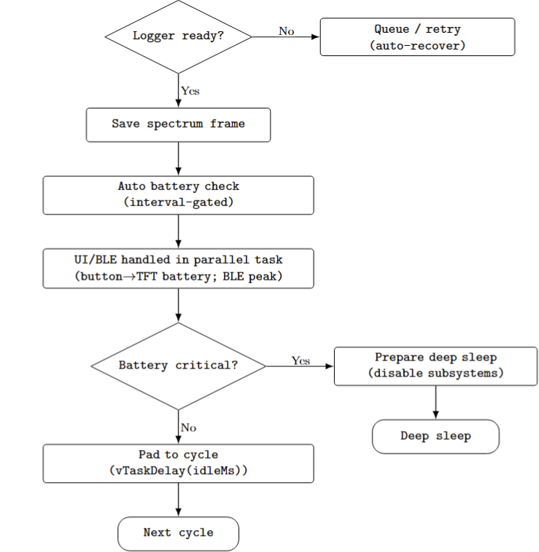
3.8: Noise kit firmware

Slide 28
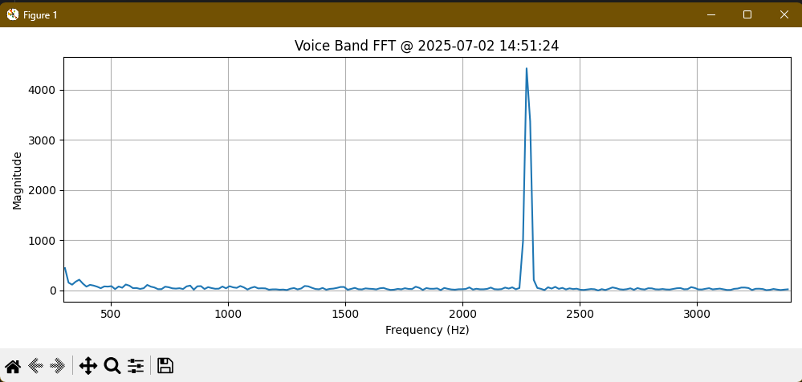
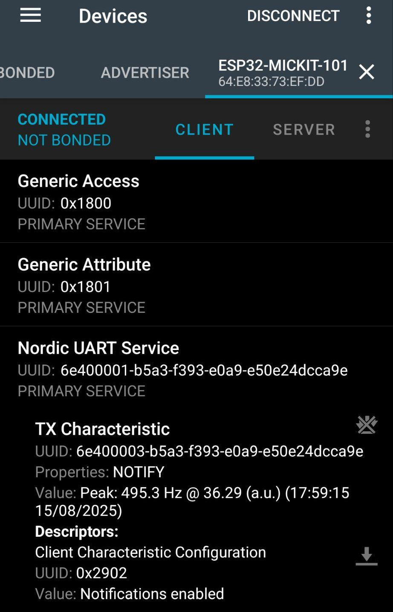
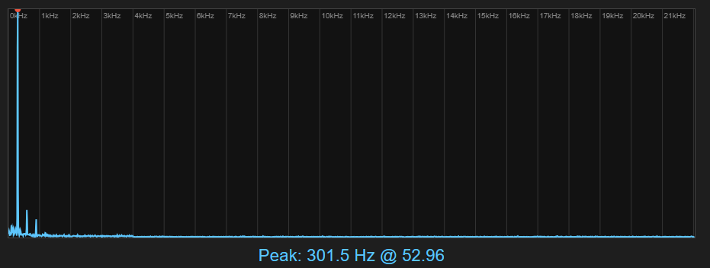
3.8: Noise kit firmware

Slide 29

3.9: Data analysis software
Python pipeline → columnar intermediates
Configuration YAMLs
Noise: decode binary logs → voice derivatives, per-minute aggregation
AirQ: pull DB → fuse redundant, per-minute aggregation
Align & analyse

Slide 30


4.1: Pre-deployment validation

Slide 31





4.2: Experimental setup

Slide 32


5: Results and discussion
Primary scope: presence-controlled (slow trends removed)
+4 min lag across locations for primary scope
Temp./Hum. likely HVAC driven
Correlational findings; causation not assured

Slide 33

6: Future work: Phase 1 → Phase 2
Self-organising, scalable fleet
Dynamic duty cycle, tuned settings
Embedded processing models, data privacy and security
Minimal on-device data storage, ephemeral buffers usage

Slide 34

7: Conclusions
Delivered: functional, reproducible contextual AirQ + Noise sensing kits
Legacy code and components recycled when possible
Modular structure across layers
ΔCO₂ correlation with human voice
Public repository available
Solid foundation for Phase 2 software improvement

Slide 35
Thank you for your attention!
Questions are welcome

Slide 36


