Slide 1
Lending Club
Case Study
01
GARV DAGA
PUSHPENDRA HIRWANI

Slide 2
Problem Statement
02
Understanding the driving factors (or driver variables) behind loan default, i.e. the variables which are strong indicators of default. These variables can be then utilized by the company for its portfolio and risk assessment.

Slide 3
Approach
03
Data Cleaning
1. Remove the columns and Rows based on Business Understanding.
2. Fix Column Values and Data Types .
Derived Metrics
1. Converting dates to Month and Year.
2. Finding ratios and percentage.
Univariate Analysis
Bivariate Analysis

Slide 4
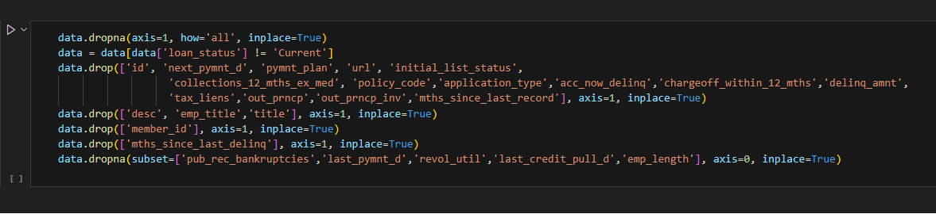
Data Cleaning
04
1. Remove the columns and Rows based on Business Understanding.
- Removed columns having all null values.
- Removed rows having loan_status as ‘Current’ as it is not required for this analysis.
- Removed columns having all same or, all unique values.
- Removed columns not relevant to the problem statement and requiring more data processing to give insights.
- Removed rows with null values as the number of such records were less.

Slide 5
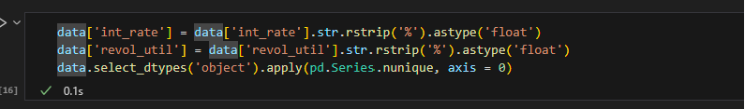
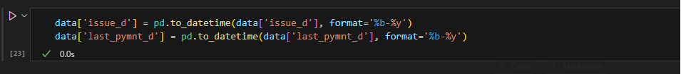
Data Cleaning
05
2. Fix Column Values and Data Types .
- Evaluate if the data type assigned to a property is correct.
- Numerical values should take int or float, whereas categorical can even take object.
- Convert column having % to float
- Convert Date fields from Object to DateTime.
- Note we are not converting term to numerical as the data has only two possible values and is categorical.

Slide 6
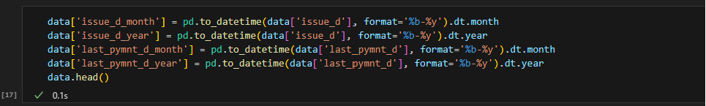
Derived Metrics
06
1. Converting dates to Month and Year will help in analysis
2. % of Amount funded by Investor to the Amount Asked by Borrower

Slide 7
Univariate Analysis
07

Slide 8
Univariate Analysis
08

Slide 9
Bivariate Analysis
09

Slide 10
Bivariate Analysis
10

Slide 11
Bivariate Analysis
11

Slide 12
Summary
12

