Slide 1
Three scenarios proposed to NURC for joint experiments in La Spezia in 2012
Folklore: no answer received, yet, despite the multiple pings ☺

Slide 2
Experiment 1: USR and fixed routes
USR: link error control protocol for underwater networks based on selective repeat

Slide 3
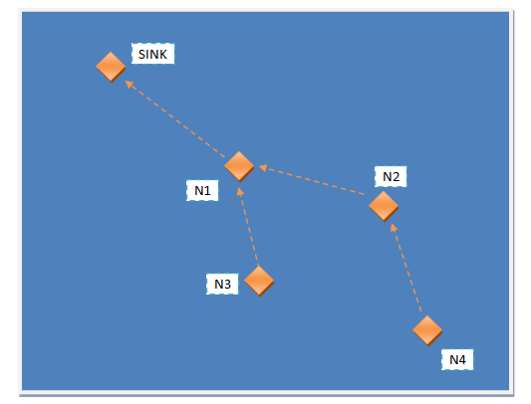
Experiment 1: USR and fixed routes

Slide 4
Experiment 1: USR and fixed routes
Objective
Measure the throughput, packet error rate and in-order delivery delay
Possibly compare against a protocol with simpler or no error control

Slide 5
Experiment 2: UW-DTN
UW-DTN
A protocol to exchange data between mobile assets in a store-and-forward fashion
Basics
4-way handshake to exchange “interests”
Ensuing packet exchange makes use of the USR protocol
Objective of UW-DTN
Provide a means for mobiles to forward data to a static sink in a network with erratic connectivity

Slide 6
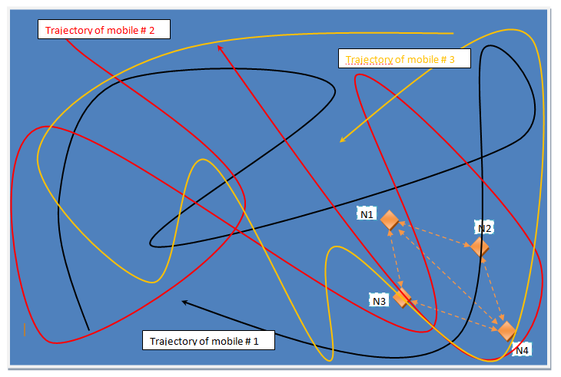
Experiment 2: UW-DTN in operation

Slide 7
Experiment 2: objectives
Measure how fast the data about the mobile assets reaches the sink
At any given time, measure old the sink’s data about any asset is
Measure the probability of losing packets (delivery timeout, full buffer at the transmitter)

Slide 8
Experiment 3: UW-Polling
UW-Polling
A protocol for allowing an AUV to coordinate a set of nodes and retrieve data using controlled access

Slide 9
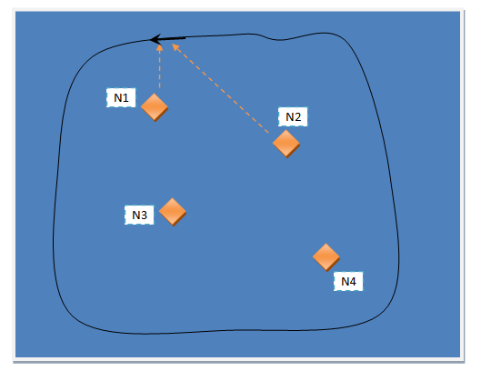
Experiment 3: UW-Polling

Slide 10
Experiment 3: UW-Polling
Objectives
Evaluate the performance of UW-Polling in terms of packet error rate
Possibly compare the performance of UW-Polling against the performance of other MAC protocols (e.g., DACAP)

