Slide 1
Information-based Learning, B
Shih Yu Chang

Slide 2
Today:
Alternative Feature Selection Metrics
Handling Continuous Descriptive Features
Predicting Continuous Targets
Noisy Data, Overfitting and Tree Pruning
Model Ensembles
Boosting
Bagging

Slide 3
Information gain problem
Some attributes for identification purpose will have high information gain, e.g., users ID, cusomer's credit card number.
This attribute has a high information gain, because it uniquely identifies each customer, but we do not want to include it in the decision tree.
Deciding how to treat a customer based on their ID or credit card number is unlikely to generalize to customers we haven't seen before.

Slide 4
Information gain ratio
In decision tree learning, Information gain ratio is a ratio of information gain to the intrinsic information.

Slide 5
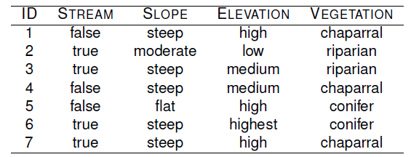

Slide 7
https://en.wikipedia.org/wiki/Information_gain_ratio
IG is biased for attributes with large number of values
(overfitting)

Slide 8
GINI Index
Other measures to Information Gain.
Most popular alternative: Gini index
used in e.g., in CART (Classification And Regression Trees)
impurity measure (instead of entropy) for a S, pi is the proportion for class i at S.
average Gini index (instead of average entropy / information)
Gini Gain
could be defined analogously to information gain
but typically avg. Gini index is minimized instead of maximizing Gini gain

Slide 9
Comparison among Splitting Measure

Slide 10
Gini Dtree Example Nadal Training, I
From Ehab Hassan, etl, Slides.

Slide 11
Gini Dtree Example Nadal Training, II
From Ehab Hassan, etl, Slides.

Slide 12
Gini Dtree Example Nadal Training, III
From Ehab Hassan, etl, Slides.

Slide 13
Gini Dtree Example Nadal Training, IV
From Ehab Hassan, etl, Slides.

Slide 14
Gini Dtree Example Nadal Training, V
From Ehab Hassan, etl, Slides.

Slide 15
Gini Dtree Example Nadal Training, VI
From Ehab Hassan, etl, Slides.

Slide 16
Today:
Alternative Feature Selection Metrics
Handling Continuous Descriptive Features
Predicting Continuous Targets
Noisy Data, Overfitting and Tree Pruning
Model Ensembles
Boosting
Bagging

Slide 17
Continuous Descriptive Features
The easiest way to handle continuous valued descriptive features is to turn them into boolean features by defining a threshold and using this threshold to partition the instances based their value of the continuous descriptive feature.
How do we set the threshold?

Slide 18
Threshold determination
The instances in the dataset are sorted according to the continuous feature values.
The adjacent instances in the ordering that have different classifications are then selected as possible threshold points.
The optimal threshold is found by computing the information gain for each of these classification transition boundaries and selecting the boundary with the highest information gain as the threshold.
Once a threshold has been set the dynamically created new boolean feature can compete with the other categorical features for selection as the splitting feature at that node.
This process can be repeated at each node as the tree grows.

Slide 24
Today:
Alternative Feature Selection Metrics
Handling Continuous Descriptive Features
Predicting Continuous Targets
Noisy Data, Overfitting and Tree Pruning
Model Ensembles
Boosting
Bagging

Slide 25
Regression tree
Regression trees are constructed so as to reduce the variance in the set of training examples at each of the leaf nodes in the tree
We can do this by adapting the ID3 algorithm to use a measure of variance rather than a measure of classification impurity (entropy) when selecting the best attribute

Slide 32
Today:
Alternative Feature Selection Metrics
Handling Continuous Descriptive Features
Predicting Continuous Targets
Noisy Data, Overfitting and Tree Pruning
Model Ensembles
Boosting
Bagging

Slide 33
Over-fitting
In the case of a decision tree, over-fitting involves splitting the data on an irrelevant feature.
The likelihood of over-fitting occurring increases as a tree gets deeper because the resulting classifications are based on smaller and smaller subsets as the dataset is partitioned after each feature test in the path.

Slide 34
Pruning
Pre-pruning: stop the recursive partitioning early. Pre-pruning is also known as forward pruning.
Pre-pruning:
early stopping
\chi^2 pruning
Post-pruning: allow the algorithm to grow the tree as much as it likes and then prune the tree of the branches that cause over-fitting.

Slide 39
Advantages of pruning
Smaller trees are easier to interpret
Increased generalization accuracy when there is noise in the training data (noise dampening).

Slide 40
Today:
Alternative Feature Selection Metrics
Handling Continuous Descriptive Features
Predicting Continuous Targets
Noisy Data, Overfitting and Tree Pruning
Model Ensembles
Boosting
Bagging

Slide 41
Model ensemble
Rather than creating a single model they generate a set of models and then make predictions by aggregating the outputs of these models.
A prediction model that is composed of a set of models is called a model ensemble.
In order for this approach to work the models that are in the ensemble must be different from each other.

Slide 42
Ensemble Intuition
Idea
Combine different classifiers to improve the performance
Ensembles of Classifiers
Combine the classification results from different classifiers to determine the final output
Unweighted voting
Weighted voting

Slide 43


Example: Mental Status Forecast
Reality
1
2
3
4
5
Combine
X
X
X
X
X
X
X
X
X
X
X
X
X

Slide 44
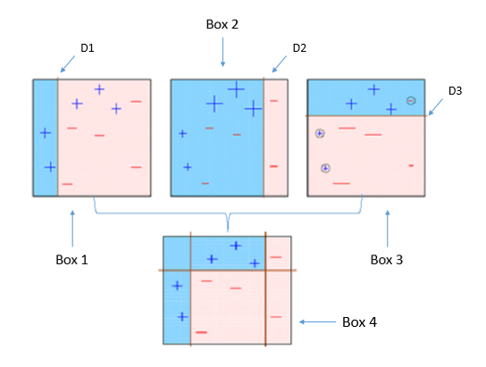
Boosting, 40

Slide 45
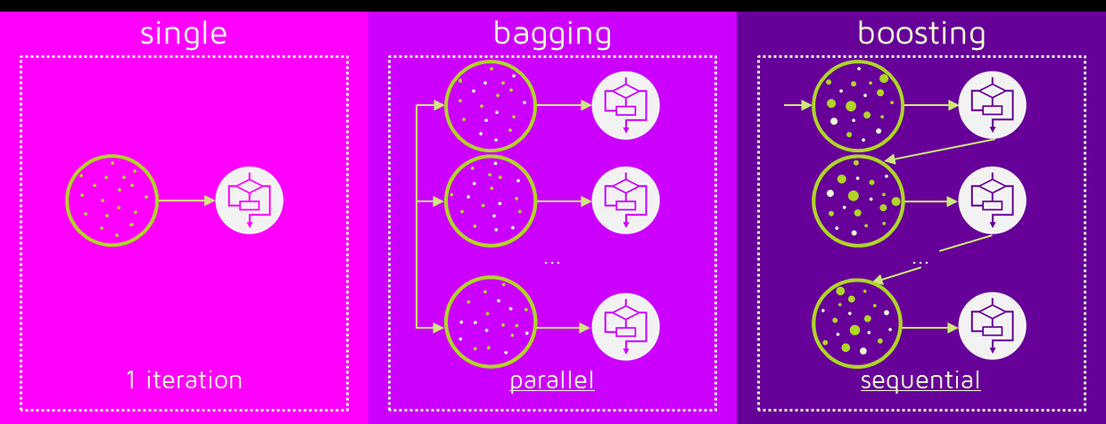
There are two standard approaches to creating ensembles
boosting
bagging.

Slide 46
Weighted dataset
Each instance has an associated weight wi greater or equal to 0
Initially set to 1/n where n is the number of instances in the dataset.
After each model is added to the ensemble it is tested on the training data and the weights of the instances the model gets correct are decreased and the weights of the instances the model gets incorrect are increased.
These weights are used as a distribution over which the dataset is sampled to created a replicated training set, where the replication of an instance is proportional to its weight.

Slide 47
How to update weight (The textbook is misleading)
See: https://en.wikipedia.org/wiki/AdaBoost

Slide 48
Bagging, I
When we use bagging (or bootstrap aggregating) each model in the ensemble is trained on a random sample of the dataset known as bootstrap samples.
Each random sample is the same size as the dataset and sampling with replacement is used.
Consequently, every bootstrap sample will be missing some of the instances from the dataset so each bootstrap sample will be different and this means that models trained on different bootstrap samples will also be different

Slide 49
Bagging, II
When bagging is used with decision trees each bootstrap sample only uses a randomly selected subset of the descriptive features in the dataset. This is known as subspace sampling.
The combination of bagging, subspace sampling, and decision trees is known as a random forest model.

Slide 50
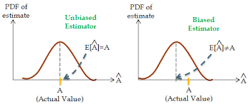
Bias VS Variance, Bias
The bias is an error between true value and its prediction.
High bias is induced by an algorithm to miss the relevant relations between features and target outputs (underfitting).

Slide 51
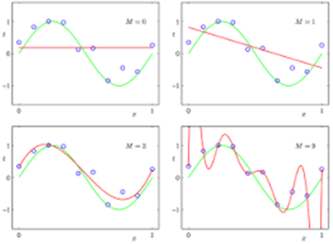
Bias VS Variance, Variance
The variance is an error from sensitivity to small fluctuations in the training set.
High variance can cause an algorithm to model the random noise into the model. (overfitting).

Slide 52
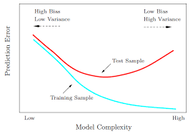
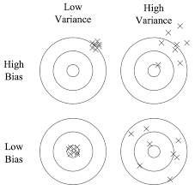
Bias VS Variance, tradeoff

Slide 53
Bagging VS Boosting, I
Bagging and random forests are "bagging" algorithms that aim to reduce the complexity of models that overfit the training data. In contrast, boosting is an approach to increase the complexity of models that suffer from high bias, that is, models that underfit the training data.

Slide 54
Bagging VS Boosting, II
Advantages of using Random Forest technique:
Handles higher dimensionality data very well.
Handles missing values and maintains accuracy for missing data.
Disadvantages of using Random Forest technique:
Since final prediction is based on the mean predictions from subset trees, it won’t give precise values for the regression model.
Advantages of using Gradient Boosting technique:
Supports different loss function.
Works well with adaptive environment.
Disadvantages of using Gradient Boosting technique:
Prone to over-fitting.
Requires careful tuning of different hyper-parameters

Slide 55
Bagging VS Boosting, III
error = bias + variance
Boosting is based on weak learners (high bias, low variance). In terms of decision trees, weak learners are shallow trees, sometimes even as small as decision stumps (trees with two leaves). Boosting reduces error mainly by reducing bias (and also to some extent variance, by aggregating the output from many models).
On the other hand, Random Forest uses as you said fully grown decision trees (low bias, high variance). It tackles the error reduction task in the opposite way: by reducing variance. The trees are made uncorrelated to maximize the decrease in variance, but the algorithm cannot reduce bias (which is slightly higher than the bias of an individual tree in the forest). Hence the need for large, unpruned trees, so that the bias is initially as low as possible.

Slide 56
Why Ensemble Works Well, I
The statistical problem arises when the amount of training data available is too small compared to the size of the hypothesis space.
By constructing an ensemble out of all of these accurate classifiers the algorithm can average their votes and reduce the risk of choosing the wrong classifier.

Slide 57
Why Ensemble Works Well, II
Many learning algorithms work by performing some form of local search that may get stuck in local optima
An ensemble constructed by running the local search from many different starting points may provide a better approximation to the true unknown function than any of the individual classifiers.

Slide 58
Why Ensemble Works Well, III
In most applications of machine learning the true function f cannot be represented by any of the hypotheses H.
By forming weighted sums of hypotheses drawn from H it may be possible to expand the space of representable functions.

Slide 59
Coding demo
Regression tree
Bagging
RF
GradientBoosting

Slide 60
Discussion
For regression tree, how you evaluate regression results?
Ensemble, adjust those ensemble parameters, e.g., n_estimators, max_leaf_nodes, learning_rate, compare your results.

Slide 61
Summary
The decision tree model makes predictions based on sequences of tests on the descriptive feature values of a query
The ID3 algorithm as a standard algorithm for inducing decision trees from a dataset.

Slide 62
Decision tree Pros and Cons
Advantages:
interpretable.
handle both categorical and continuous descriptive features.
has the ability to model the interactions between descriptive features (diminished if pre-pruning is employed)
relatively, robust to the curse of dimensionality.
Disadvantages:
trees become large when dealing with continuous features.
decision trees are very expressive and sensitive to the dataset, as a result they can overfit the data if there are a lot of features

