Slide 1
Data Insights and Project Topics
Shih Yu Chang

Slide 2
Today:
Data Story: Motor Insurance Fraud
Possible project topics

Slide 3
What to consider, 2
Converting business problem into data analysis problem
Assessing Feasibility
Design Analytics Base Table (ABT)
Designing and Implementing Features

Slide 4
Converting Business Problems into Analytics Solutions: asking key questions
What is current business problem?
What are goals?
What is our current status and what resources we have?
How to achieve goals?
Can be reached through DA?
What else…..?!

Slide 5
Motor insurance Fraud
In spite of having a fraud investigation team that investigates up to 30% of all claims made, a motor insurance company is still losing too much money due to fraudulent claims.
Can you ask yourself previous slide questions?

Slide 6
Possible DA questions:
Claim prediction
Member prediction
Application prediction
Payment prediction

Slide 7
Accessing feasibility
What data to have
Availability
Cost
Legal
Timing issue
Can solve our original problems

Slide 8
What are data requirements for claim predictions, 10
Related
Complete
Timing

Slide 9
Design ABT

Slide 11
Row at ABT, 14

Slide 12
Need domain knowledge to define feature

Slide 13


Domain knowledge examples

Slide 14
Common general domain concepts
Prediction Subject Details
Demographics
Usage
Changes in Usage
Special Usage
Lifecycle Phase
Objects links

Slide 15
Motor insurance fraud case:

Slide 16
Designing and implementing features, 20
Data availability
Timing
Duration
Effectiveness

Slide 17
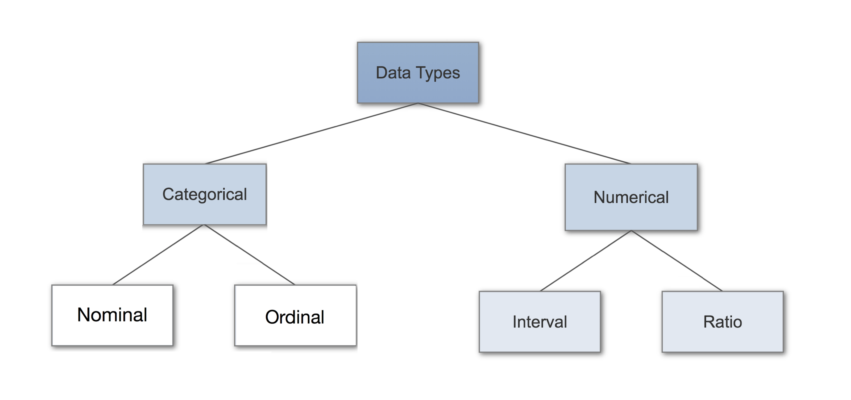
Data types
https://towardsdatascience.com/data-types-in-statistics-347e152e8bee

Slide 19
Derived features
The features in an ABT can be of two types:
raw features
derived features
There are a number of common derived feature types:
Aggregates
Flags
Ratios
Mappings

Slide 20
Propensity model
A propensity model is a statistical scorecard that is used to predict the behaviors of your customer or prospect base.
Propensity models are often used to identify those most likely to respond to an offer, or to focus retention activity on those most likely to churn.
Many of the predictive models that we build are propensity models, which inherently have a temporal element
For propensity modeling, there are two key periods:
the observation period
the outcome period

Slide 25
Legal issues, 28, 29
Anti-discrimination legislation
Data protection legislation
Data principles about ABT

Slide 26
Implementing features, 30
Data cleaning
SQL, joining and aggregating
joining data sources
filtering rows in a data source
filtering fields in a data source
deriving new features by combining or transforming existing
features
aggregating data sources
Python, PANDAS package
Review Data 225, 228

Slide 27
Discussions, 34
What are the observation period and outcome period for the motor insurance claim prediction scenario?

Slide 28
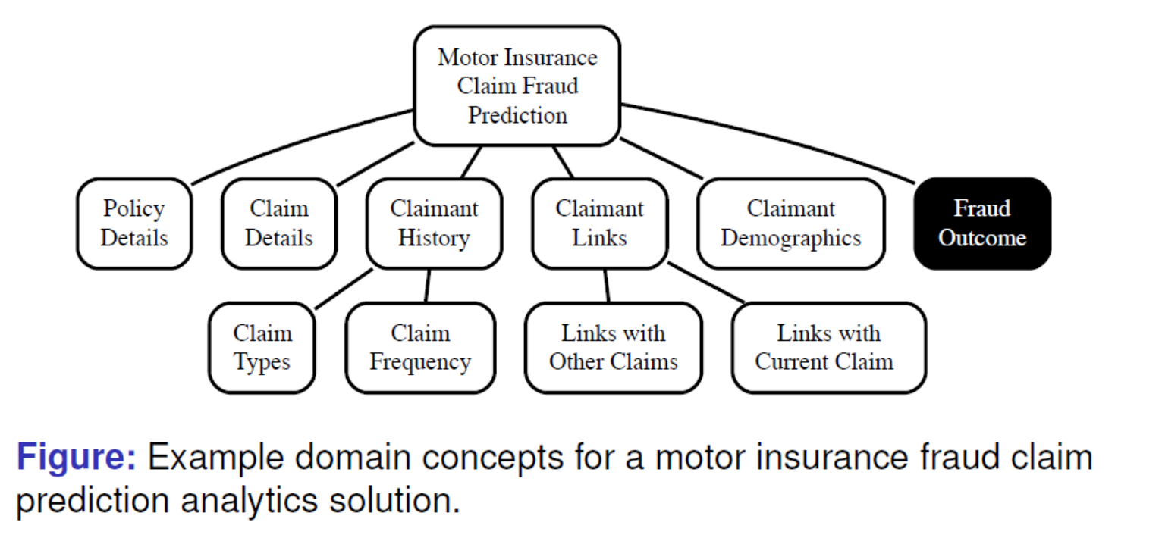
Discussions, 36
What features could you use to capture the Claim Frequency domain concept?

Slide 29
My analysis for period and frequency

Slide 30

Discussions, 38
What features could you use to capture the Claim Types domain concept?

Slide 32
Discussions, 40
What features could you use to capture the Claim Details domain concept?

Slide 33
My analysis for types and details

Slide 34
41

Slide 35
Chap 2 Summary, 44-46
ABT
Domain knowledge
Features
Raw features
Derived features

Slide 36
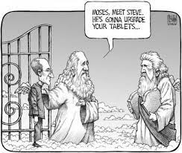
Data Joke
Technically, Moses was the first man in history to download data from the cloud to his tablet.

Slide 38
Group Discussions
What problems you even meet that require collect data?
How do you know what data to collect?
Besides those issues mentioned in section “Designing & Implementing Features”, what other factors are important to consider ?

Slide 39
Today:
Data Story: Motor Insurance Fraud
Possible project topics

Slide 40
Top 10 Applications of Machine Learning
https://www.youtube.com/watch?v=HKcO3-6TYr0

Slide 41
Group Discussions
How are those topics?
What problems you want to solve now need ML?
Which topics you are most interested in?

Slide 42
Today summary
Converting Business Problems into Analytics Solutions
Case Study: Motor Insurance Fraud
Assessing Feasibility
Case Study: Motor Insurance Fraud
Designing the Analytics Base Table
Case Study: Motor Insurance Fraud
Designing & Implementing Features
Different Types of Data
Different Types of Features
Handling Time
Legal Issues
Implementing Features
Case Study: Motor Insurance Fraud
Thinking deeply what to do at your team projects.

