Slide 1
Data Exploration, B
Shih Yu Chang

Slide 2
Today:
Advanced Data Exploration
Visualizing Relationships Between Features
Measuring Covariance & Correlation
Data Preparation
Normalization
Binning
Sampling

Slide 5
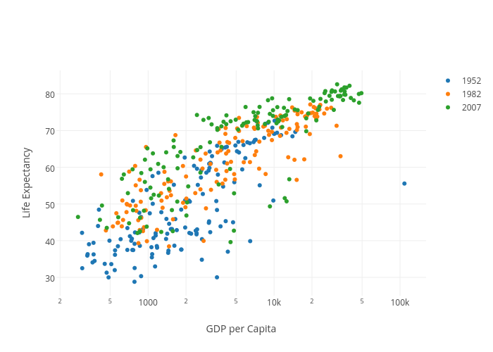
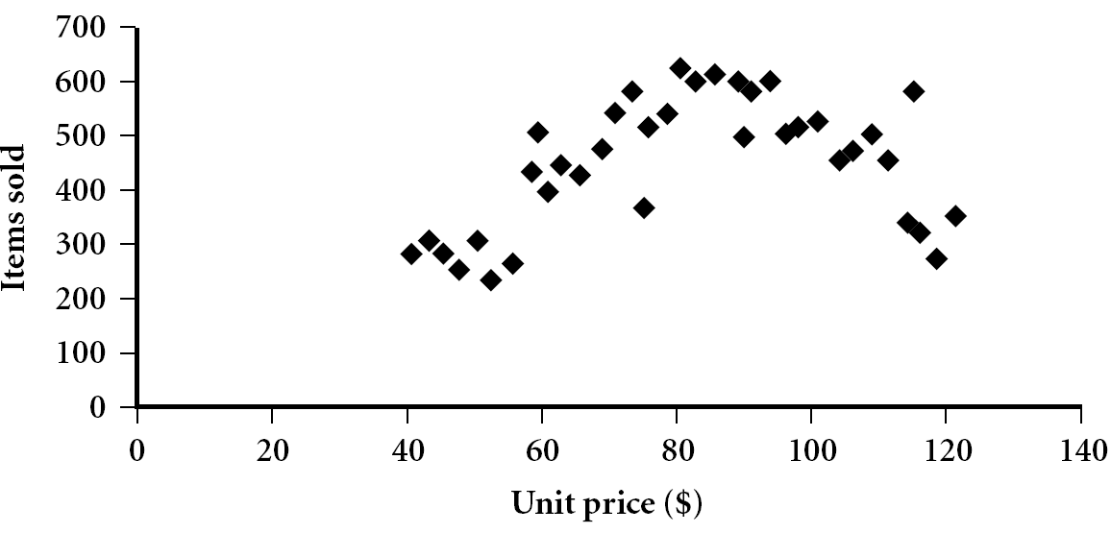
Scatter plot
Provides a first look at bivariate data to see clusters of points, outliers, etc.
Each pair of values is treated as a pair of coordinates and plotted as points in the plane
Notes:
Need a better and more MEANINGFUL scatter plot! -JH

Slide 6
Scatter plot, 5

Slide 7
Positively and Negatively Correlated Data
The left half fragment is positively correlated
The right half is negative correlated

Slide 9
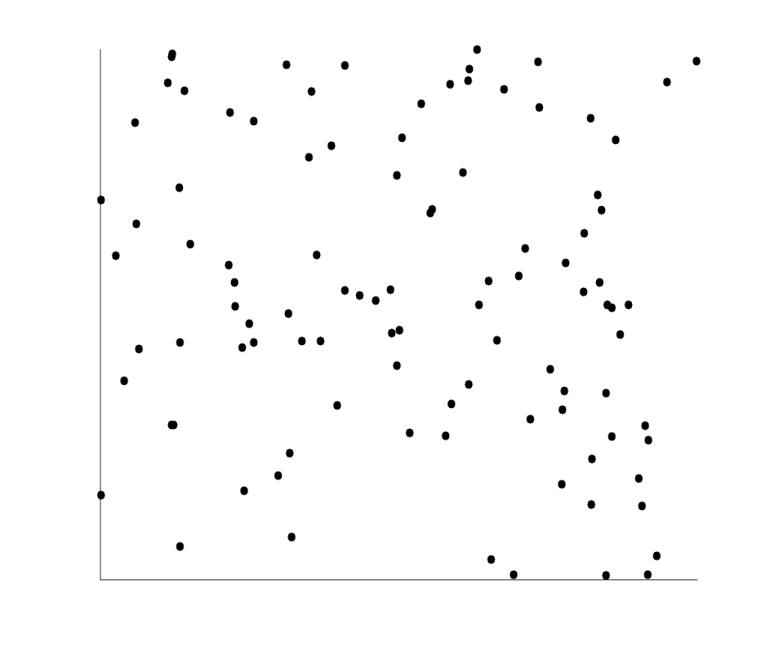
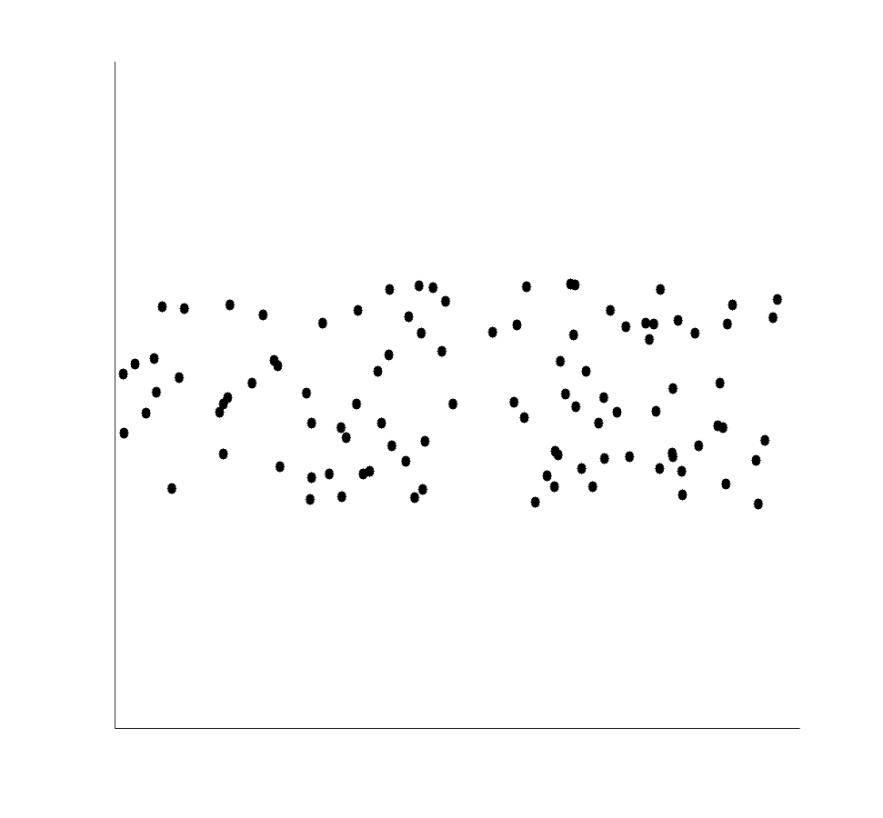
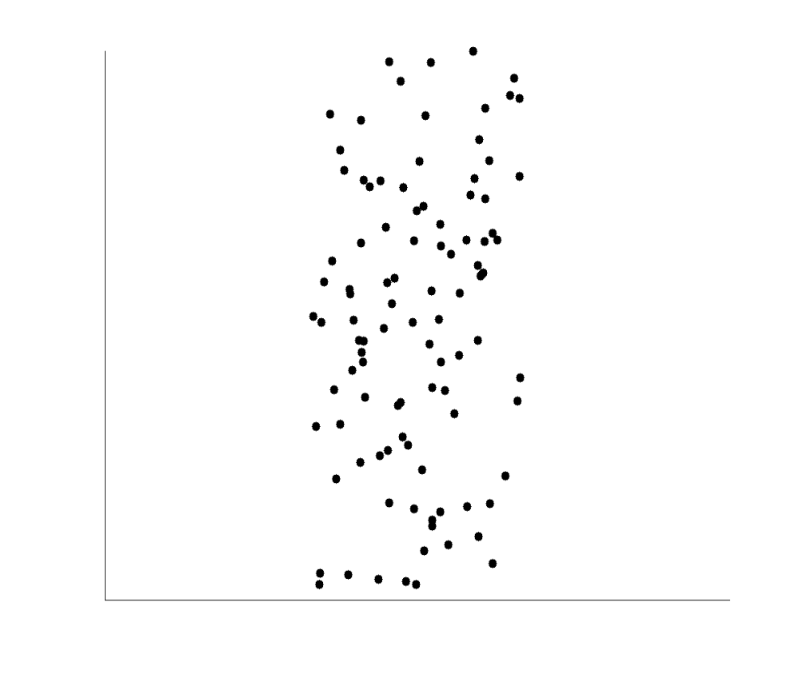
Uncorrelated Data

Slide 10
8

Slide 11
cat. vs cat.
The simplest way to visualize the relationship between two
categorical variables is to use a collection of small
multiple bar plots.

Slide 12
If the number of levels of one of the features being compared is no more than three we can use stacked bar plots as an alternative to the small multiples approach.

Slide 13
Cont. vs Cat.: multiple histograms
To visualize the relationship between a continuous feature and a categorical feature a small multiples histograms approach that draws a histogram of the values of the continuous feature for each level of the categorical feature is useful.

Slide 16
Cont. vs Cat.: collection of box plots
A second approach to visualizing the relationship between a categorical feature and a continuous feature is to use a collection of box plots.
For each level of the categorical feature a box plot of the corresponding values of the continuous feature is drawn.

Slide 19
Covariance and Correlation, 22

Slide 20
Calculating covariance between the HEIGHT feature and the WEIGHT and AGE features

Slide 21
Correlation, I

Slide 22
Correlation, II

Slide 23
Calculating correlation between the HEIGHT feature and the WEIGHT and AGE features

Slide 24
Higher dimensions: cov. matrix and cor. matrix
In the majority of ABTs there are multiple continuous features between which we would like to explore relationships.
Two tools that can be useful for this are the covariance matrix and the correlation matrix.

Slide 25
Covariance matrix

Slide 26
Correlation matrix

Slide 27
Your time to practice!, 31, 32
Calculating covariances matrix for the HEIGHT feature and the WEIGHT and AGE features from the basketball players dataset.
Calculating correlation matrix for the HEIGHT feature and the WEIGHT and AGE features from the basketball players dataset.

Slide 28
33

Slide 29
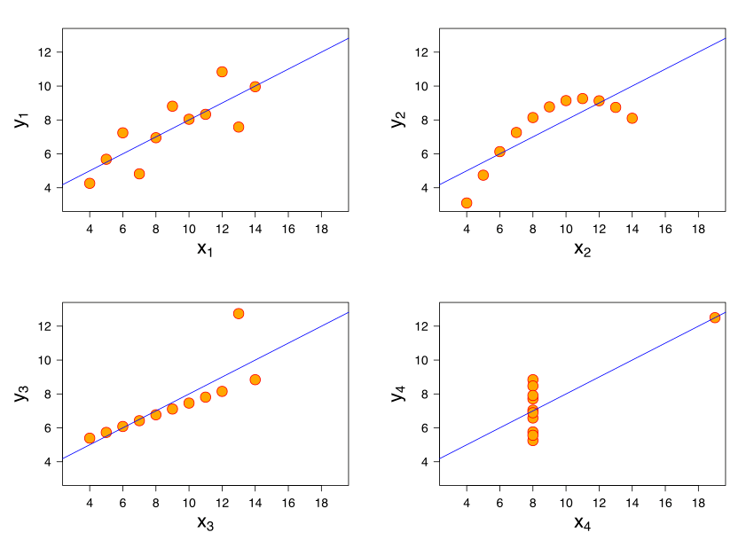
Correlation is a good measure of the relationship between two continuous features, but it is not by any means perfect.
Some of the limitations of measuring correlation are illustrated very clearly in the famous example of Anscombe’s quartet by Francis Anscombe.
https://en.wikipedia.org/wiki/Anscombe%27s_quartet

Slide 30
Careful!!
Perhaps the most important thing to remember in relation to correlation is that correlation does not necessarily imply causation.

Slide 31
Today:
Advanced Data Exploration
Visualizing Relationships Between Features
Measuring Covariance & Correlation
Data Preparation
Normalization
Binning
Sampling

Slide 32
Data preparation
Some data preparation techniques change the way data is represented just to make it more compatible with certain machine learning algorithms.
Normalization
Binning
Sampling

Slide 33
Normalization
Normalization techniques can be used to change a continuous feature to fall within a specified range while maintaining the relative differences between the values for the feature.

Slide 34
Range normalization

Slide 35
Standard normalization

Slide 36
Discussions: 43 (1) For Height (left column), what are their normalized value by range normalization and standard normalization (2) For Earnings (right column), what are their normalized value by range normalization and standard normalization (3) Why normalization matters in ML?

Slide 37
Binning
Binning involves converting a continuous feature into a categorical feature.
To perform binning, we define a series of ranges (called bins) for the continuous feature that correspond to the levels of the new categorical feature we are creating.
We will introduce two of the more popular ways of defining bins:
equal-width binning
equal-frequency binning

Slide 38
Bin size ?
Deciding on the number of bins can be difficult. The general trade-off is this:
If we set the number of bins to a very low number we may lose a lot of information
If we set the number of bins to a very high number then we might have very few instances in each bin or even end up with empty bins.

Slide 39
Equal-width binning
The equal-width binning algorithm splits the range of the feature values into b bins each of size range/b

Slide 40
Equal-frequency binning
Equal-frequency binning first sorts the continuous feature values into ascending order and then places an equal number of instances into each bin, starting with bin 1.
The number of instances placed in each bin is simply the total number of instances divided by the number of bins, b.

Slide 41
Sampling, 51
To reduce data processing complexity, we perform sampling
Careful bias
Common forms of sampling include:
top sampling
random sampling
stratified sampling
under-sampling
over-sampling

Slide 42
Sampling advantages
Cost is very less in conducting research on sample compared to cost on population for collecting data
Consumes less time
More accurate by minimizing errors due to dependence from large number of people
Suitable to limited resources man power and materials
However, selection of proper size of sampling from large number of population is difficult
Further reading: Sampling: Design and Analysis (Chapman & Hall/CRC Texts in Statistical Science) 2nd Edition by Sharon L. Lohr (Author)

Slide 43
Top sampling
Top sampling simply selects the top s% of instances from a dataset to create a sample.
Top sampling runs a serious risk of introducing bias, however, as the sample will be affected by any ordering of the original dataset.
Useful special group study, e.g., target marketing

Slide 44
Random sampling
Our recommended default, random sampling randomly selects a proportion of s% of the instances from a large dataset to create a smaller set.
Random sampling is a good choice in most cases as the random nature of the selection of instances should avoid introducing bias.

Slide 45
Stratified sampling
Stratified sampling is a sampling method that ensures that the relative frequencies of the levels of a specific stratification feature are maintained in the sampled dataset.
To perform stratified sampling:
the instances in a dataset are divided into groups (or strata), where each group contains only instances that have a particular level for the stratification feature
s% of the instances in each stratum are randomly selected
these selections are combined to give an overall sample of s% of the original dataset.

Slide 46
Under- and over- sampling
In contrast to stratified sampling, sometimes we would like a sample to contain different relative frequencies of the levels of a particular feature to the distribution in the original dataset.
To do this, we can use under-sampling or over-sampling.

Slide 47
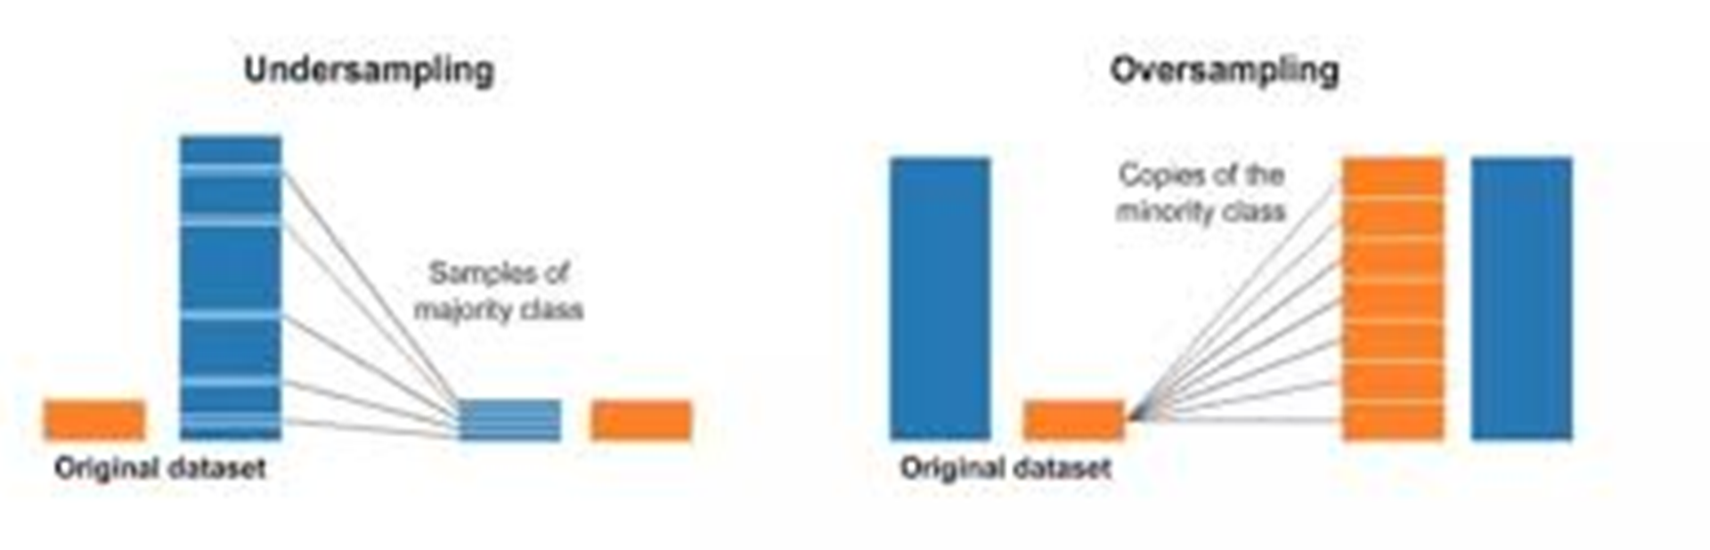
Under-sampling
Under-sampling is the process where you randomly delete some of the observations from the majority class in order to match the numbers with the minority class.

Slide 48
Over-sampling
Over-sampling is a little more complicated than under-sampling. It is the process of generating synthetic data that tries to randomly generate a sample of the attributes from observations in the minority class
https://rikunert.com/SMOTE_explained

Slide 49
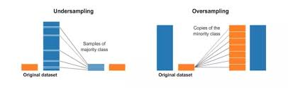
https://towardsdatascience.com/having-an-imbalanced-dataset-here-is-how-you-can-solve-it-1640568947eb

Slide 50
Coding demo

Slide 51
Discussions
Based on NBA data, do following
Prepare covariance and correlation matrices for Number, Age, Weight, and Salary
Apply under-sampling strategy for salary and compare distributions by histograms.

Slide 52
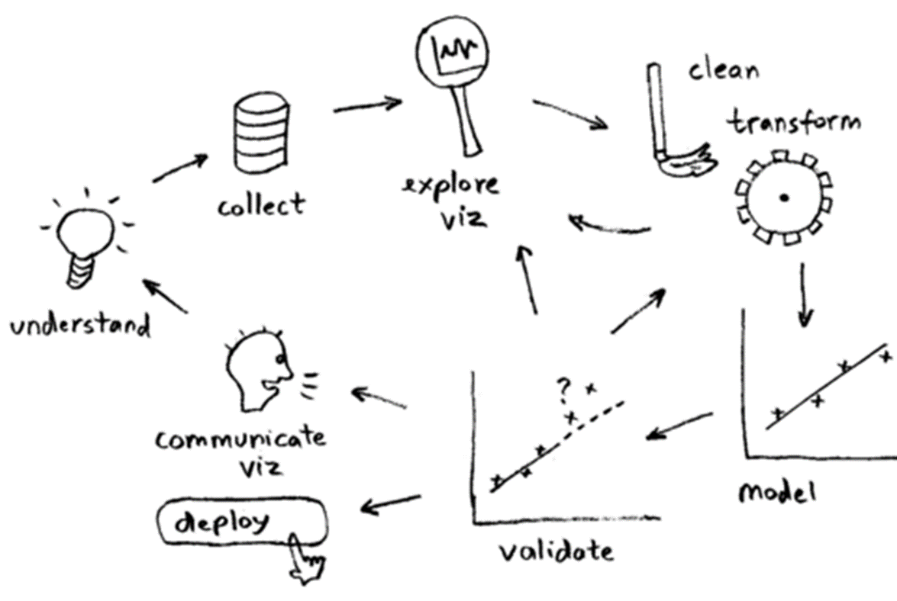
Summary
Data description
Handling data quality (Last time)
Advanced Data Exploration (Today)
Visualizing Relationships Between Features
Measuring Covariance & Correlation
Data Preparation
Normalization
Binning
Sampling

