Slide 1
Information-based Learning, A
Shih Yu Chang

Slide 2
Today:
Big Idea
Fundamentals
Decision Trees
Shannon’s Entropy Model
Information Gain
Standard Approach: The ID3 Algorithm
A Worked Example: Predicting Vegetation Distributions

Slide 3
Coverage at this chapter
In this chapter we are going to introduce a machine learning algorithm that tries to build predictive models using only the most informative features.
In this context an informative feature is a descriptive feature whose values split the instances in the dataset into homogeneous sets with respect to the target feature value.

Slide 5
What questions to ask first?
Q (1) Is it a man?
Q (2) Does the person wear glasses?

Slide 6
First question: Does the person wear glasses?

Slide 7
Average questions per game
In both of the diagrams:
one path is 1 question long,
one path is 2 questions long,
and two paths are 3 questions long.
Consequently, if you ask Question (2) first the average number of questions you have to ask per game is:
(1 + 2 + 3 + 3)/4 =2.25

Slide 8
First question: Is it man?

Slide 9
Average questions per game
All the paths in this diagram are two questions long.
So, on average if you ask Question (1) first the average number of questions you have to ask per game is:
(2 + 2 + 2 + 2)/4 = 2

Slide 10
Why difference?
On average getting an answer to Question (1) seems to give you more information than an answer to Question (2): less follow up questions.
It is to do with how the answer to each questions splits the domain into different sized sets based on the value of the descriptive feature the question is asked about and the likelihood of each possible answer to the question.

Slide 12
Today:
Big Idea
Fundamentals
Decision Trees
Shannon’s Entropy Model
Information Gain
Standard Approach: The ID3 Algorithm
A Worked Example: Predicting Vegetation Distributions

Slide 13
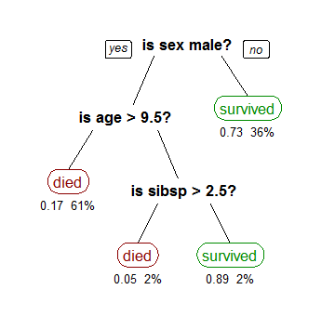
Decision Tree
A decision tree is composed by three parts:
Nodes: test for the value of a certain attribute.
Root note (starting)
Interior
Edges: correspond to the outcome of a test, used to connect to the next node or leaf.
Leaves: terminal nodes that predict the outcome

Slide 15


Slide 16
What tree to use?
Both of these trees will return identical predictions for all the examples in the dataset.
So, which tree should we use?

Slide 17
Occam’s Razor: Using simpler one!
Apply the same approach as we used in the Guess-Who game: prefer decision trees that use less tests (shallower trees).
This is an example of Occam’s Razor.

Slide 18
But how we create shallow tree, 19
Apply some metric to test each splitting results!
All we need to do that is a computational metric of the purity of a set: entropy

Slide 19
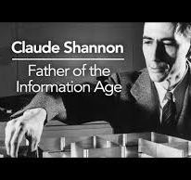

Shannon Entropy
How much surprising you get?
Tomorrow is Sat.
Today class is re-sheduled due to technical issue
USA attacked by

Slide 20
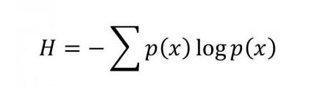
Shannon Entropy
Entropy is related to the probability of a outcome.
High probability -> Low entropy
Low probability -> High entropy
If we take the log of a probability and multiply it by -1 we get this mapping!
Review log definition

Slide 23
What is the entropy ? 25,27
Fair coin (H: 1/2, T: 1/2)
Dice with probability {1:1/16, 2:1/16, 3:1/16, 4:1/16, 5:3/8, 6:3/8}
What is the entropy of a set of 52 different playing cards?
What is the entropy of a set of 52 playing cards if we only distinguish between the cards based on their suit {clubs (♣), diamonds (♦), hearts (♥) and spades (♠)}

Slide 24
What do you find?

Slide 26
What are their entropy ? 31

Slide 27
Information gain
The information gain of a descriptive feature can be understood as a measure of the reduction in the overall entropy of a prediction task by testing on that feature.

Slide 38
Today:
Big Idea
Fundamentals
Decision Trees
Shannon’s Entropy Model
Information Gain
Standard Approach: The ID3 Algorithm
A Worked Example: Predicting Vegetation Distributions

Slide 39
ID3 algorithm
Attempts to create the shallowest tree that is consistent with the data that it is given.
The ID3 algorithm builds the tree in a recursive, depth-first manner, beginning at the root node and working down to the leaf nodes.

Slide 40
ID3 algorithm steps
The algorithm begins by choosing the best descriptive feature to test (i.e., the best question to ask first) using information gain.2
A root node is then added to the tree and labelled with the selected test feature.
The training dataset is then partitioned using the test.
For each partition a branch is grown from the node.
The process is then repeated for each of these branches using the relevant partition of the training set in place of the full training set and with the selected test feature excluded from further testing.

Slide 41
How to form a leaf node
The algorithm defines three situations where the recursion stops and a leaf node is constructed:
All of the instances in the dataset have the same classification (target feature value) then return a leaf node
tree with that classification as its label.
The set of features left to test is empty then return a leaf node tree with the majority class of the dataset as its classification.
The dataset is empty return a leaf node tree with the majority class of the dataset at the parent node that made the recursive call.

Slide 44
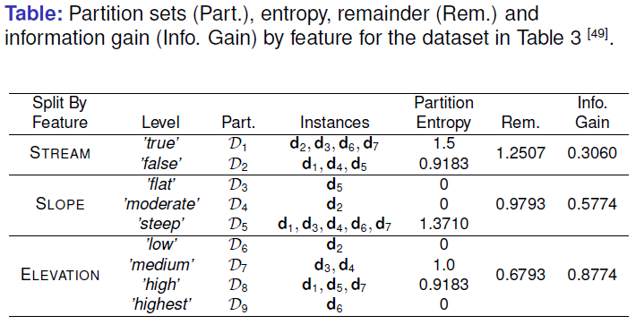

Slide 56
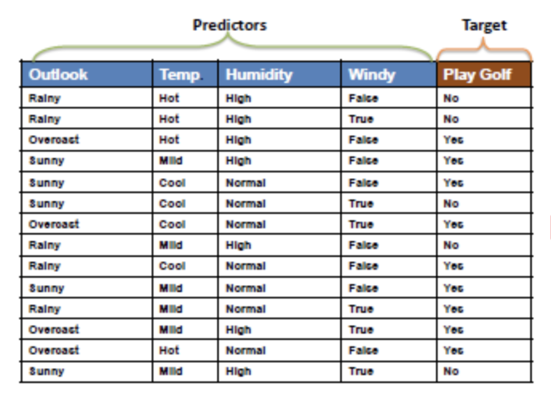
Discussion: Go though ID3 algorithm with following data to get a DTree, 62

Slide 57
Coding demo
Iris data set Dtree

Slide 58
Discussions
For Iris dataset at the jupyter notebook I provided, what difference of classification results can you find after removing remove the widest Iris-Versicolor from the iris training set ?

Slide 59
Summary
Using entropy to fine information gain
The ID3 algorithm works the same way for larger more complicated datasets.
There have been many extensions and variations proposed for the ID3 algorithm:
using different impurity measures (Gini, Gain Ratio)
handling continuous descriptive features
to handle continuous targets
pruning to guard against over-fitting
using decision trees as part of an ensemble (Random Forests)
We cover these extensions in Section 4:4.

