Slide 1
Probability-based Learning, A
Shih Yu Chang

Slide 2
Today
Big Idea
Fundamentals
Bayes’ Theorem
Bayesian Prediction
Conditional Independence and Factorization
Standard Approach: The Naive Bayes’ Classifier
A Worked Example

Slide 5
After observing dealer some time

Slide 8
Today
Big Idea
Fundamentals
Bayes’ Theorem
Bayesian Prediction
Conditional Independence and Factorization
Standard Approach: The Naive Bayes’ Classifier
A Worked Example

Slide 10
Probability review
A probability function, P(), returns the probability of a feature taking a specific value.
A joint probability refers to the probability of an assignment of specific values to multiple different features.
A conditional probability refers to the probability of one feature taking a specific value given that we already know the value of a different feature
A probability distribution is a data structure that describes the probability of each possible value a feature can take. The sum of a probability distribution must equal 1.

Slide 11
Joint probability distribution
A joint probability distribution is a probability distribution over more than one feature assignment and is written as a multi-dimensional matrix in which each cell lists the probability of a particular combination of feature values being assigned.
The sum of all the cells in a joint probability distribution must be 1.0.

Slide 13
Basic Concepts: Joint and Marginal Distributions
How about more than one RVs at your problem?

Slide 15
Bayes’ theorem application
After a yearly checkup, a doctor informs their patient that he has both bad news and good news. The bad news is that the patient has tested positive for a serious disease and that the test that the doctor has used is 99% accurate (i.e., the probability of testing positive when a patient has the disease is 0.99, as is the probability of testing negative when a patient does not have the disease). 1% positive testing result if the patient has no such disease. The good news, however, is that the disease is extremely rare, striking only 1 in 10,000 people.
What is the actual probability that the patient has the disease?
Why is the rarity of the disease good news given that the patient has tested positive for it?

Slide 30
False positive paradox
https://en.wikipedia.org/wiki/Base_rate_fallacy#False_positive_paradox

Slide 34
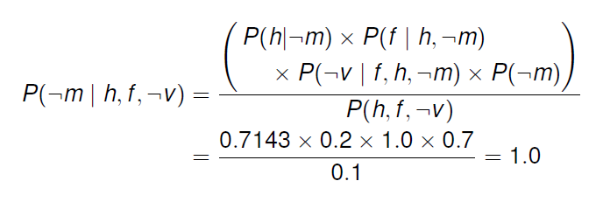
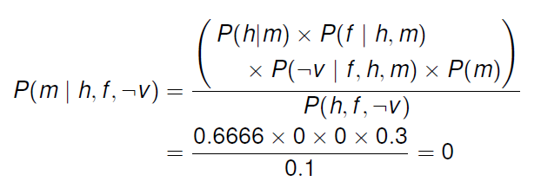

Slide 35
Overfitting
The probability of a patient who has a headache and a fever having meningitis should be greater than zero!
Our dataset is not large enough ! our model is over-fitting to the training data.
The concepts of conditional independence and factorization can help us overcome this flaw of our current approach.

Slide 37
Conditional Independence
Full independence between events is quite rare.
A more common phenomenon is that two, or more, events may be independent if we know that a third event has happened.
This is known as conditional independence.

Slide 39
Conditional independence example
https://math.stackexchange.com/questions/23093/could-someone-explain-conditional-independence

Slide 41
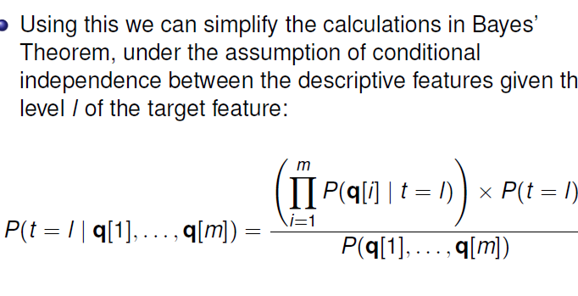

Slide 45
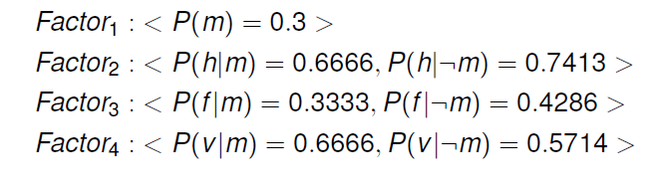

Slide 46
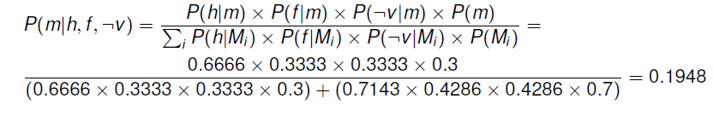

Slide 47
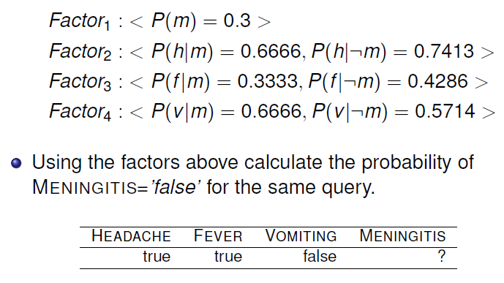

Slide 49
Today
Big Idea
Fundamentals
Bayes’ Theorem
Bayesian Prediction
Conditional Independence and Factorization
Standard Approach: The Naive Bayes’ Classifier
A Worked Example

Slide 50
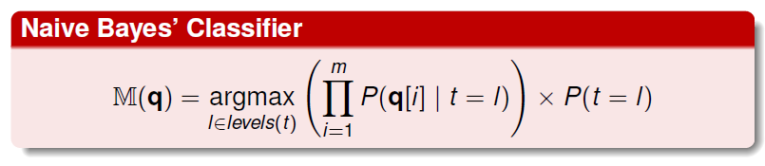
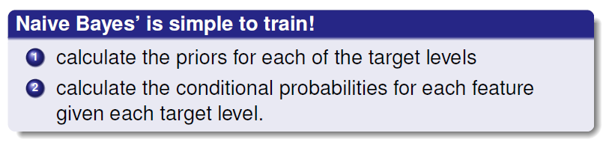

Slide 56
Coding Demo
GNB
MNB

Slide 57
Discussions
What parameters you can turn at GNB?
What parameters you can turn at MNB?
Let’s pick top three performance

Slide 58
Summary
A Naive Bayes’ classifier naively assumes that each of the descriptive features in a domain is conditionally independent of all of the other descriptive features, given the state of the target feature.
This assumption, although often wrong, enables the Naïve Bayes’ model to maximally factorize the representation that it uses of the domain.
The great thing about NB is that the naive assumption actually tends to help the classification. Think of it this way: if two features are actual dependent, say, hair length and gender, then assuming they are independent means you get to double-count evidence.

